Slide 1
Introduction to Software Exploitation in the Windows Environment
Corey K.
coreyxk at gmail

Slide 2
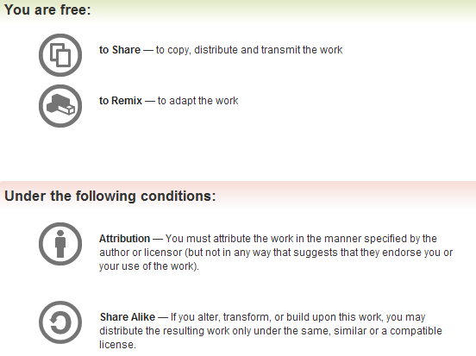
All materials is licensed under a Creative Commons “Share Alike” license.
http://creativecommons.org/licenses/by-sa/3.0/

Slide 3
Purpose of the course
Introduce you to the idiosyncrasies and complications associated with exploit development in an enterprise operating system environment.
Teach you the basics of finding and exploiting vulnerabilities in closed source applications.
Make you aware of the capabilities and limitations of exploit mitigation technologies deployed on the Windows environment.

Slide 4
Course Prerequisites
Strong understanding of x86 assembly
Solid understanding of buffer overflow basics
Familiarity with the inner workings of the Windows Operating System.
Have used a debugger before

Slide 5
Course Outline 1
Windows stack overflow basics
Windows shellcode

Slide 6
Course Outline 2
Windows exploit mitigation technologies
Defeating windows exploit migitation technologies

Slide 7
Course Outline 3
Fuzzing and crash dump analysis
From crash dump to working exploit lab

Slide 8
General Course Comments
Lab driven course
Learn by doing, not by reading/seeing. Please put effort into the labs/challenges. Ask questions, work together. This is how you will really understand the material.
I’ll stop covering new material and end class early each day. Students who need extra help can stay and I will help review the material. Students who understand the material well can leave, or stay and work on more challenging examples of the covered material.

Slide 9
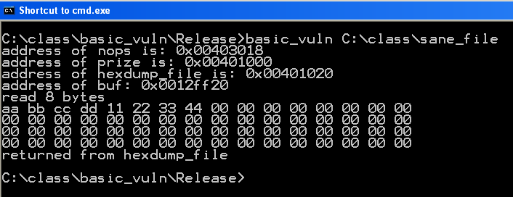
Starter example
Here is a very basic program to help us explore our exploit environment. The basic_vuln program reads in a binary file and displays the first 64 hexadecimal bytes from that file. The program prints various meta data such as the location of variables and functions in the process address space. This meta information will help simplify the exploitation process as we are learning.

Slide 10
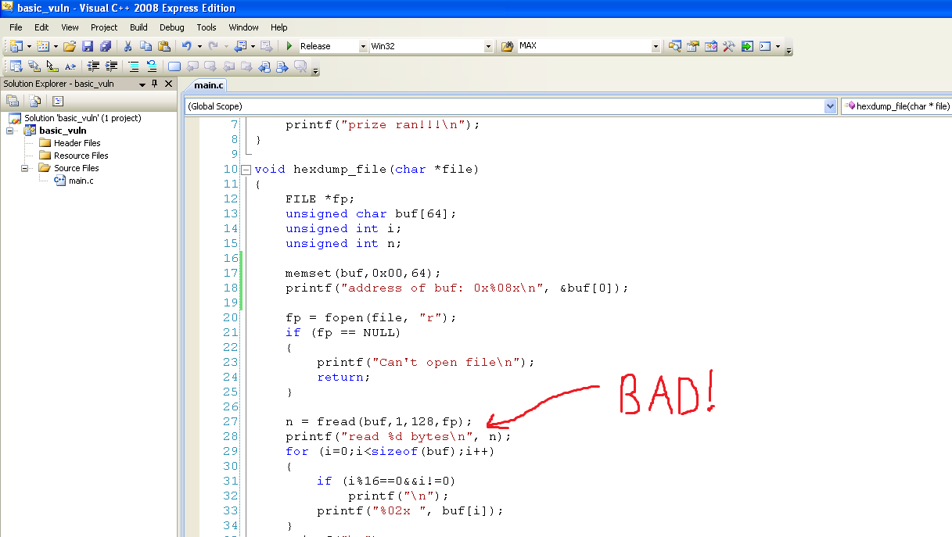
Starter example code
There is an obvious overflow in line 27 where the fread call reads 128 bytes into a 64 byte
Buffer. This leads to a traditional stack overflow, among other possibilities that we will later
explore.

Slide 11
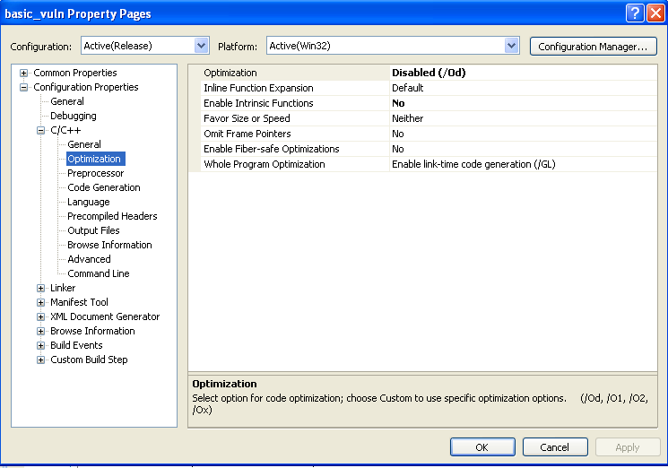
rose_colored_glasses = 1
For starters we disable all visual studio compiler optimizations. These don’t have anything to do with exploit mitigation, but they will often cause unexpected assembly to be generated for the given source code. For now, we are turning this off so the underlying assembly is as vanilla as possible.

Slide 12
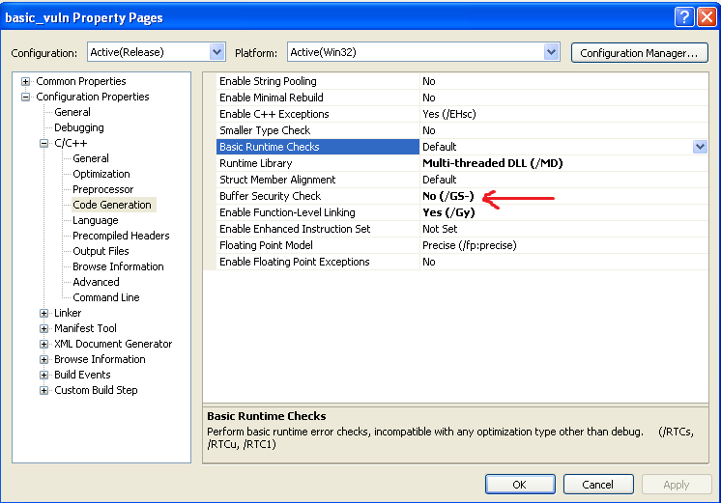
Rose_colored_glasses++
Here we are really helping ourselves by turning off visual studio stack protection. More about how this is implemented, and how to defeat it later.

Slide 13
First goal
An important concept in exploit development is, if you can exploit it, you can crash it
Let’s try to generate a crash in basic_vuln by creating a large test file, then analyzing the crashing process in windbg.

Slide 14
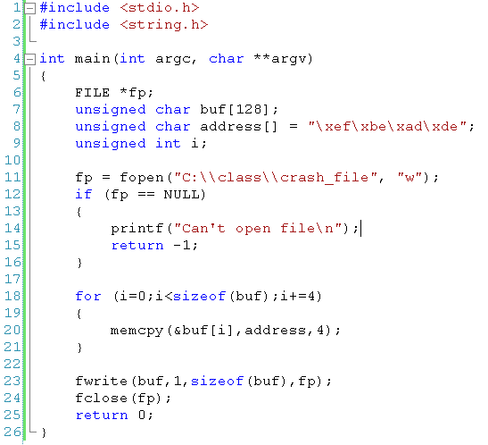
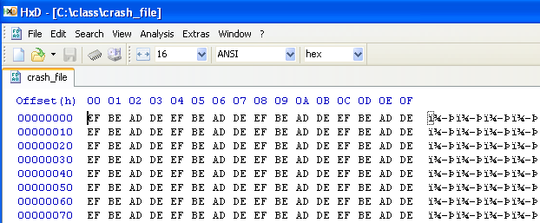
Byte writer
Byte writer is a generic visual studio project I’ve included for creating files of arbitrary binary bytes. You can modify this to generate your payloads. You are welcome to use cygwin and a scripting language of your choice instead.
In this case we create a file of 128 bytes of 0xdeadbeef. This will overflow the 64 byte buffer in the hexdump_file function, smashing the stack, and generating a crash. Let’s check it out.

Slide 15
First blood
Here we see a good ol’ fashion windows application crash. I’m sure you have seen this before. If you have seen it when you opened up a strange pdf from an unrecognized email address, you should be nervous….
However, this isn’t too informative. Let’s get comfortable with our windows debugger (windbg) so we can see what’s going on behind the scenes

Slide 16
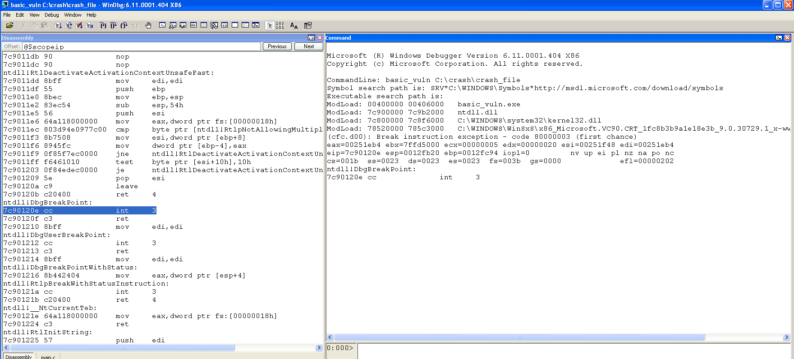
windbg
Windbg is our debugger of choice for this class. It takes some getting use to, but is quite powerful once you get the hang of it. In this case I initiate the debugger with the QY argument which basically tells it to save our settings. You can windbg to display whatever information is useful to you. Right now I have the command engine on the right, and the disassembly and corresponding source code displaying in the left window.

Slide 17
Useful windbg commands
Bp basic_vuln!main , set a break point for the main function in the basic_vuln process.
Dd ebp L2 , display 2 32bit values starting at the address pointing to by the ebp register.
K, display stack backtrace information
Using “run to cursor” icons in conjunction with source/binary mode.
p, step over
T, step
X basic_vuln!prize, tell me the location of the prize function in basic_vuln.
Poi(0xdeadbeef), returns *0xdeadbeef
? <expression>, masm evaluation mode
?? <expression>, c++ evaluation mode
U address, disassemble code at address
U poi(ebp+4), disassemble the code that the return address is pointing to
Dg fs, display segment information selected by the fs register
Dt nt!_peb, display structure information on the peb structure that is defined in the nt module

Slide 18
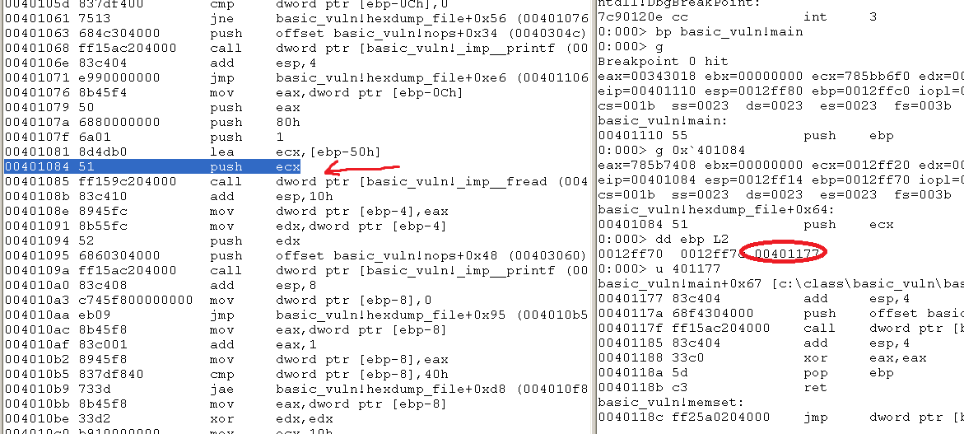
Basic_vuln crash 1
First we set a break point before the fread call in hexdump_file that will ultimately corrupt the stack, so we can check out the stack before its destroyed. In this case I switch to source mode, open up the disassembly window, put my cursor on the push ecx before the call to fread, then tell windbg to run to cursor. Once the break point before fread is hit, I can inspect the saved frame pointer and saved return address on the stack with dd ebp L2. Everything looks sane at this point since the stack hasn’t been smashed.

Slide 19
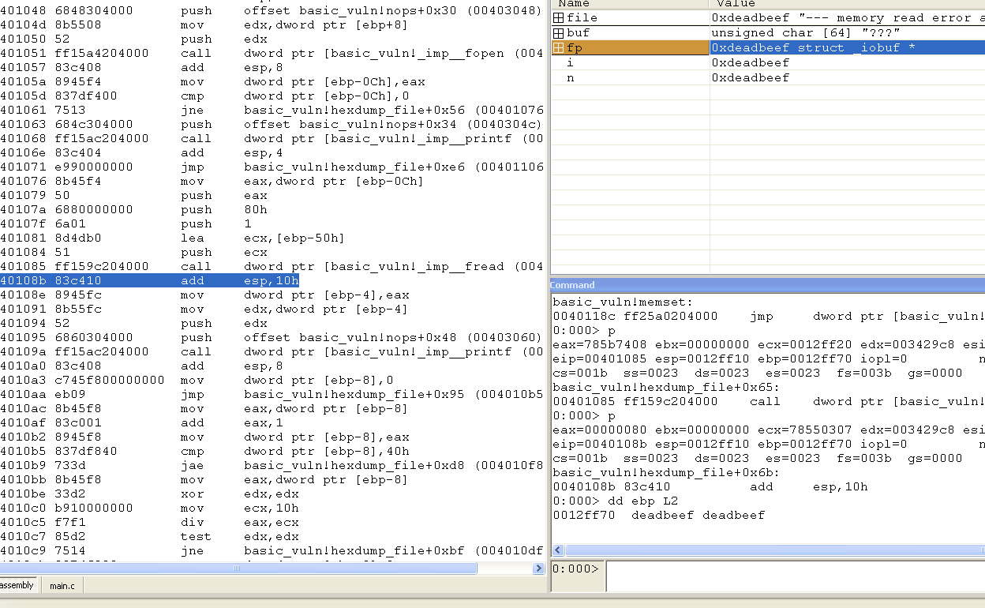
Basic_vuln crash 2
We do a couple “p” commands to step over the call to fread, then examine the stack again. Notice the return address, as well as all the over local variables have been obliterated.

Slide 20
Basic_vuln crash 3
One last ‘g’ to continue execution will send us into oblivion. You can see that our attacker controlled value, 0xdeadbeef, ends up controlling the execution flow.

Slide 21
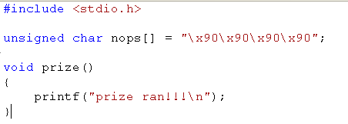
Basic_vuln lab
Your first lab will be to get basic_vuln to execute the prize function. Additionally make prize run once and only once. If you spam the entire stack the address of the prize function, it will execute multiple times. Use windbg to examine the stack and discover the precise number of bytes you will need to write to get to the return address.
After you have successfully executed the prize function, try to redirect execution to the nops buffer, which is just full of the nop instruction.
You can use the byte writer program to generate your payloads, or a scripting language of your choice. However, I’d suggest saving your payloads as we will use them later to explore exploit mitigation technologies.

Slide 22
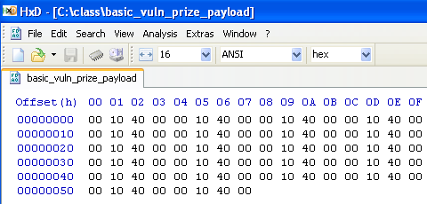
Basic vuln lab wrapup
How did you calculate the number of bytes to write?
What possible problems can you spot with this payload?

Slide 23
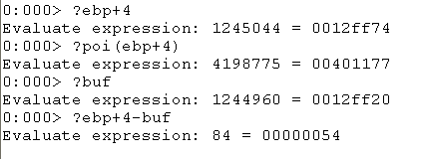
Basic vuln lab wrapup 2
I calculated the number of bytes to write by using windbg’s masm evaluation mode. Ebp+4 is the location of the return address. Buf is evaluated as the location of buf on the stack. The difference between them is the number of bytes you have to write to get to the return address.
A possible problem with our payload is all the null bytes. Many user input parsing functions will stop reading in input when they see the null byte. In our case, we are reading in the data like its binary data, so we don’t terminate upon seeing null bytes. This highlights a larger problem with windows exploitation, the addresses are often less friendly than in Linux because they often contain forbidden characters (0x00,0x0a, etc..)

Slide 24
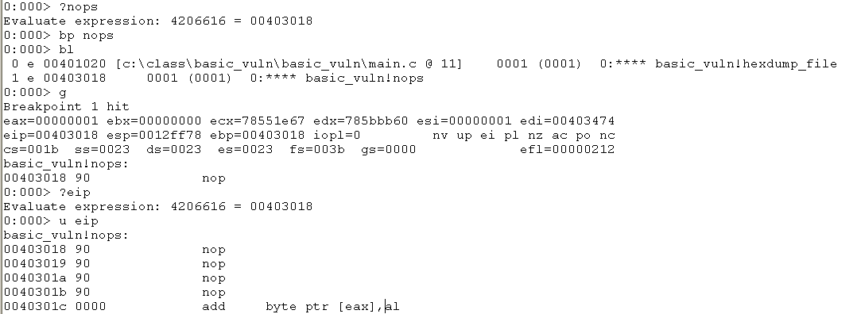
Basic vuln lab wrapup 3
Your payload to execute nops should look similar to the prize one. You can check whether
Or not nops actually ends up being executed by setting a breakpoint on it.

Slide 25
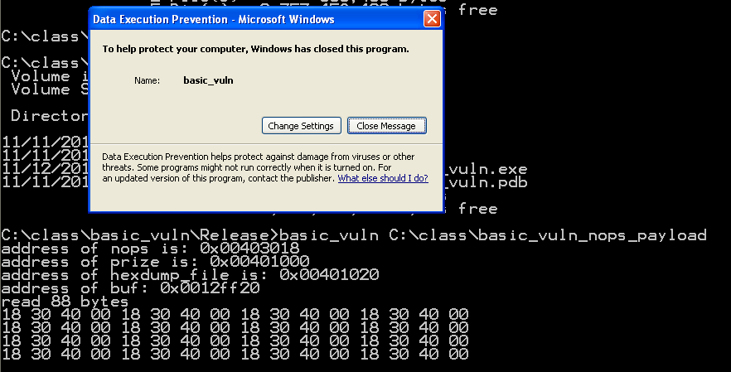
Basic vuln lab wrapup 4
If DEP was enabled on this computer, basic_vuln_nops_payload would not have worked
But basic_vuln_prize_payload would have. That’s because the nops is stored in a
Non-executable region of the processes memory. Obviously the prize function has to be
Stored in an executable region of the process since it is a function. More on this later…

Slide 26
The rabbit hole
This lab should have served as a gentle review of very basic exploit concepts and given you the opportunity to become familiar with our tools and environment.
Our goal in exploit development is always arbitrary code execution, so its time to talk about Windows shellcode development.
Windows shellcode is brutally complicated compared to Linux shellcode, so prepare for battle.

Slide 27
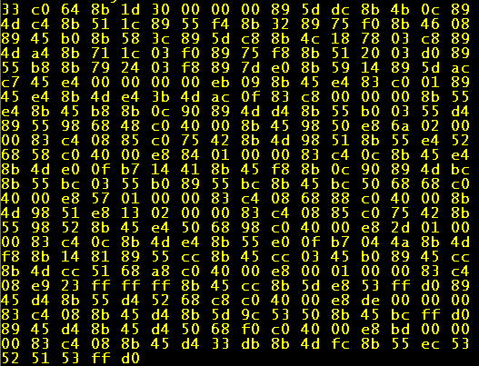
Linux vs Windows Shellcode
The top image is an example of Linux hello world style shellcode, the lower image is an equivalent example in Win32. Ouch.

Slide 28
Why?
In Linux we use the handy int 0x80 interface which allows us to directly access system calls.
Windows has something similar with int 0x2e, but it is not used by reliable shellcode.
The Linux int 0x80 interface is set in stone and will not change. The Windows int 0x2e interface changes from version to version, so can’t be used reliably in shellcode.
Also, the 0x2e interface lacks useful shellcode functionality like network socket creation code that is present in the Linux 0x2e.

Slide 29
The Way
Instead of using a system call interface, in Windows we will traverse a complicated and multilayered system of data structures to find important system DLLs loaded into the victim process address space.
Once we have located the system DLLs, we will parse their complicated and layered data structures to locate two important functions that allow us to load arbitrary DLLs into the victim process address space, then locate and call the functions those loaded DLLs provide.
We will use the functions contained in the DLLs we choose to load to accomplish arbitrary functionality.

Slide 30
Eyes on the prize
It’s easy to lose sight of our objective as we dive deep into the Quagmire that is the win32 API.
Remember, our first goal here is to find where important system DLLs are located in the processes address space.
Once we have located them, we can use their functions for shellcode functionality.
In particular, the DLL we are looking for is kernel32.dll, which hosts some important functions that we will make use of.

Slide 31
Repetition
We are looking for kernel32.dll’s location in the victim process address space.
We are looking for kernel32.dll’s location in the victim process address space.
We are looking for kernel32.dll’s location in the victim process address space.
We are looking for kernel32.dll’s location in the victim process address space.

Slide 32
Thread Execution Block (TEB)
In Windows, a process is composed of threads.
It’s the threads that are “executing,” not the process.
At logical address fs:0 Windows stores the Thread Execution Block (TEB) for the currently executing thread. (We all remember how segmentation works right…?)
The TEB stores all sorts of interesting data about the currently executing thread.
The TEB is the entrance to the complicated maze of data structures we will navigate.

Slide 33
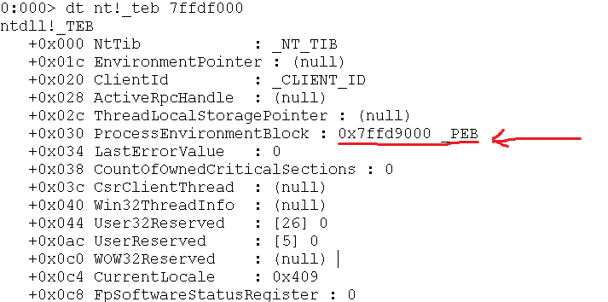
TEB 2
The TEB contains all sorts of interesting data in it.
However, we are really only interested in the pointer it contains to the Process Execution Block (PEB).

Slide 34
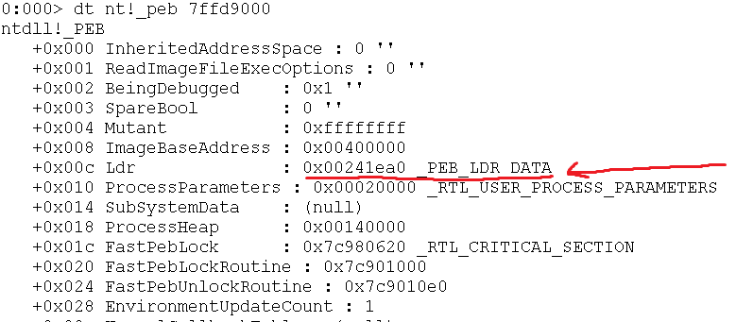
PEB
The Process Execution Block contains meta information about a process.
It contains a variety of useful data from an attacker’s perspective.
Right now we are interested in the “Ldr” member of the peb, which contains information about the DLLs loaded into the processes address space.

Slide 35
PEB_LDR_DATA
PEB_LDR_DATA stores the heads of a few linked lists that enumerate the DLLs currently loaded into the process.
As expected, InLoadOrderModule list gives a linked list of the DLLs used by the process, ordered by the order in which they were loaded by the process.
We are interested in the InInitializationOrderModuleList because it lists the process DLLs in an order where the system DLL we are looking for, “kernel32.dll” is always the second DLL in the list.

Slide 36
The unknown
Unfortunately once we hit the InInitializationOrderModuleList we have fallen off of the edge of the map as far as Windows is concerned.
The structure it is pointing too is mostly undocumented (or not documented accurately) and WinDBG won’t help us parse it because there are no publicly available debugging symbols for it.

Slide 37
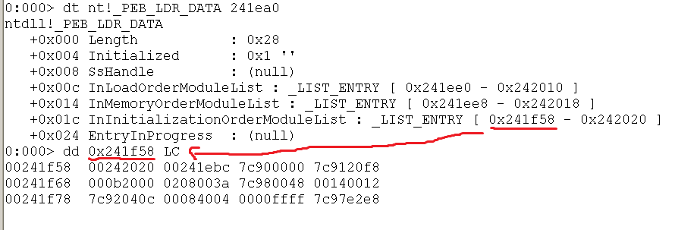
Manual Inspection
First we manually dump the bytes associated with the unknown structure.
When reverse engineering Windows structures, you can often make inferences about the data based on the values. For instance 0x7c900000 looks like a base address of something because of its alignment.

Slide 38
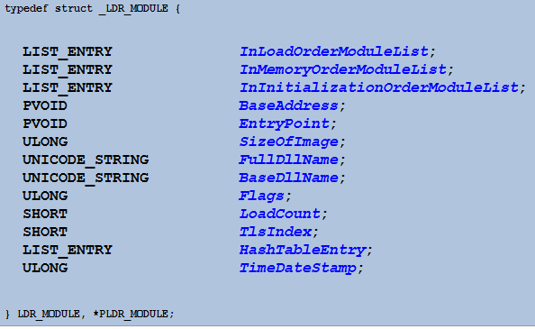
Spotty Documentation
Some developers/reverse engineering websites contain documentation of the reverse engineered structures.
However, they are not always 100% reliable. The above documentation gives us an idea of what we are looking at, but doesn’t completely match up with what we are seeing in the debugger.

Slide 39
Mini Lab
Spend some time using WinDbg to try to reverse engineer the contents of this structure.
Determine which look like pointers, and which look like data values. Inspect further anything that looks like a pointer.
Use the previous page as a guide for what you should “expect” to be seeing.
Reversing obscure data structures is a fundamental part of the Windows exploitation experience, so use this as an opportunity to familiarize yourself with the process.

Slide 40
Mini Lab Wrap Up
What inferences did you make about the data structure? What does each value represent?
What methodology and WinDbg commands did you use to help you figure out the structure?

Slide 41
My solution
First I notice that 242020 is similar to the address of the structure I am currently looking at (241f58), so they are close in locality and 242020 is probably also a pointer.
After inspecting that address, I see it contains similar looking data to the original data structure at 241f58. From this I deduce 242020 is a pointer to another data structure of the type we are inspecting.
Because I know I am dealing with a linked list structure, I know this is probably either the forwards or backwards pointer.
Further inference leads me to believe that 241ebc is also a similar linked list pointer.

Slide 42
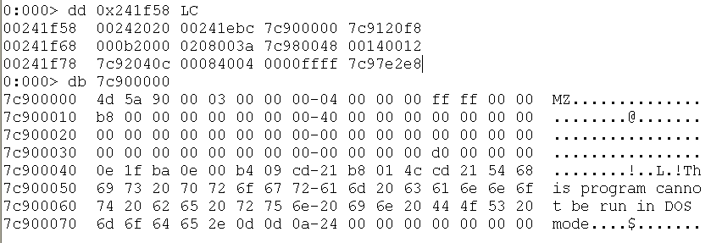
My solution 2
I originally guessed that 7c900000 was a base address because of its alignment. Inspecting it reveals it to point to the start of a win32 PE executable, so our assumption is confirmed.
All Win32 PE executable start with the bytes ‘MZ’. To help you remember, MZ are the initials of the inventor of the format: Mark Zbikowski.

Slide 43
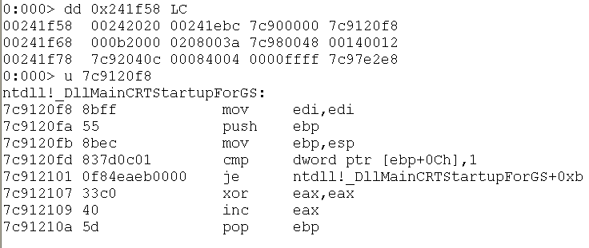
My solution 3
Since I know 7c900000 is the base address for the module that is currently being described, I see that 7c9120f8 is pointing into that module and take a wild stab in the dark that it might be the ‘entry point’ into that module.
Inspection with WinDbg shows the tell tale signs of a function prologue. Right again!

Slide 44
My solution 4
I continue this process until I discover where the module’s unicode name is located.
At this point we’ve located in the data structure where the module name is, it’s base address, entry point, and pointers to the next data structures in the linked list. For now, this is really all we care about.

Slide 45
Down the rabbit hole
Let’s use our new found understanding of this data structure to traverse its encapsulated linked list.
We are looking for “kernel32.dll” which contains the functions we need to call in our shellcode.

Slide 46
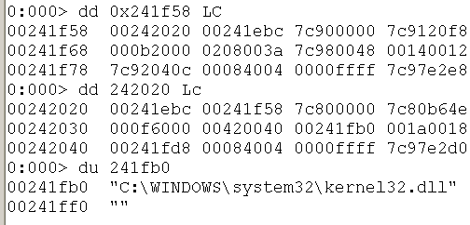
It turns out the very next entry in the linked list describes the kernel32.dll module we are looking for.
This isn’t a coincidence, kernel32.dll will always be the 2nd entry in the InInitializationOrderModuleList linked list.
Thus we have a reliable method to locate kernel32.dll and its base address.

Slide 47
Next Step
We have spent a lot of effort trying to find kernel32.dll, the reason is because kernel32.dll contains two very useful functions that will empower us to do whatever we want in shellcode.
These functions are LoadLibrary and GetProcAddress.

Slide 48
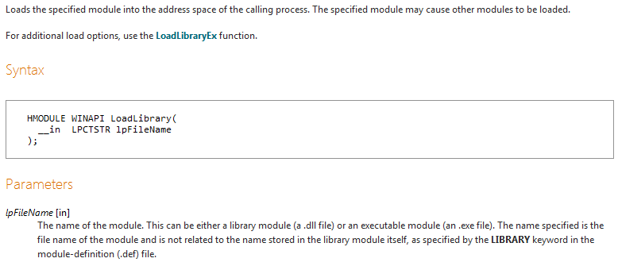
LoadLibrary
LoadLibrary allows us to load arbitrary DLLs into the victim address space.
It also automatically tells us the base address of the loaded module, thus once we have access to it we no longer have to jump through all the hoops previously described.

Slide 49
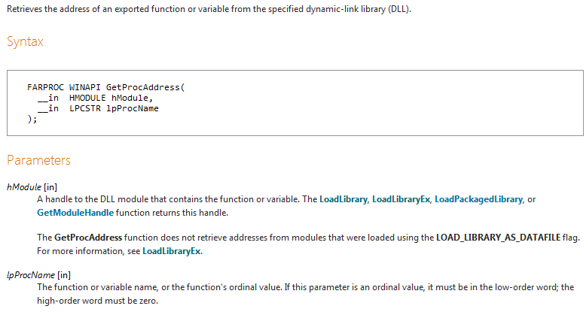
GetProcAddress
GetProcAddress tells us the address of any function in a DLL we previously loaded with LoadLibrary.
Unfortunately, we can’t use GetProcAddress to find GetProcAddress in kernel32.dll…

Slide 50
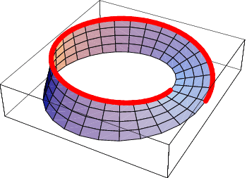
So LoadLibrary and GetProcAddress will allow us to load any DLL we want into the process we are exploiting, and then find out the location of the DLLs functions so we can use their exported functionality. But we can’t call GetProcAddress(“LoadLibrary”) or GetProcAddress(“GetProcAddress”) because we don’t yet know the address of either function in kernel32.dll!
Once again we will traverse a complicated and nested sequence of data structures embedded in kernel32.dll so we can find the location of the two functions we need.

Slide 51
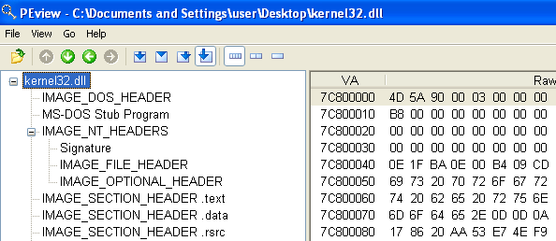
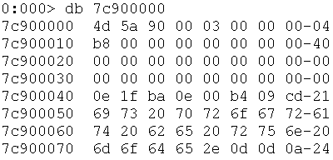
By now we know the address of kernel32.dll in the victim processes address space.
The kernel32.dll that appears in memory at the base address we discovered will closely resemble what is on disk.
Mostly important, the binary headers that contain meta information about the executable and allow the loader to run the executable, end up in the memory as well.
We will use the information in these headers to locate the address of GetProcAddress and LoadLibrary in kernel32.dll.

Slide 52
Repetition++
We are trying to locate GetProcAddress and LoadLibrary in kernel32.dll.
We are trying to locate GetProcAddress and LoadLibrary in kernel32.dll.
We are trying to locate GetProcAddress and LoadLibrary in kernel32.dll.
We are trying to locate GetProcAddress and LoadLibrary in kernel32.dll.

Slide 53
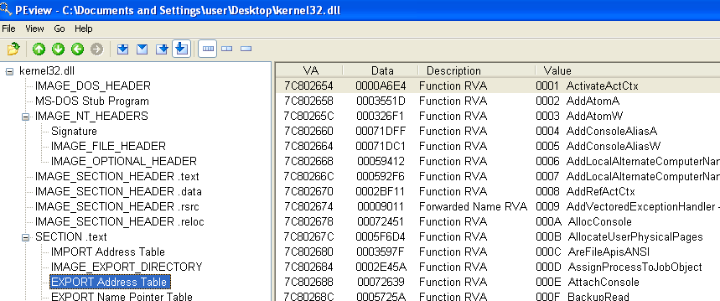
Export Address Table
DLL’s like kernel32.dll main purpose is to provide functions for other processes to use.
To meet this purpose, DLLs have a data structure known as the Export Address Table that advertises the locations of the functions the DLL provides.
Once we find the EAT we can use it to look up GetProcAddress and LoadLibrary.

Slide 54
But…
It’s not quite that easy.
There are actually several data structures associated with the Export Address Table. A table of the function names, a table of the function ordinals, and a table of the functions relative virtual addresses (RVAs) inside the DLL.
And…. The EAT isn’t immediately accessible, we first have to drill down on some of those headers located at the start of the executable in order to discover the EAT’s location.

Slide 55
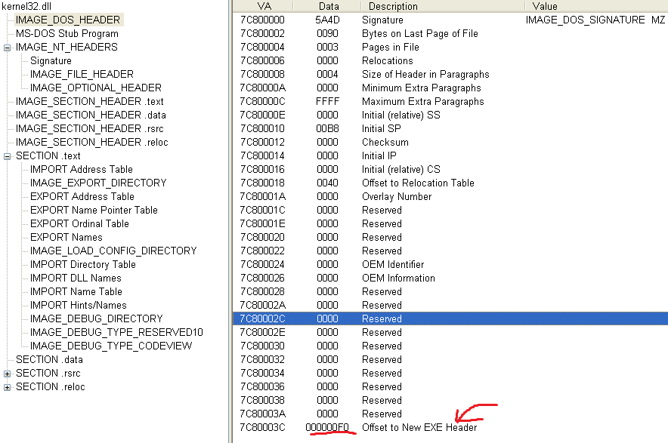
Located at the top of the executable file (and the base address of the DLL in memory) is the IMAGE_DOS_HEADER.
This contains a bunch of uninteresting stuff, the only thing useful to us is the offset to the NT_HEADER which contains all the useful data.

Slide 56
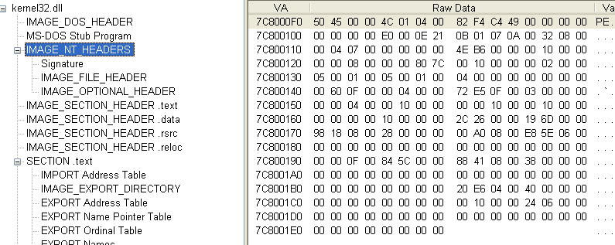
The NT Headers area contains 3 individual headers/sets of data.
The Signature which is just the bytes ‘PE’ for Portable Executable.
The IMAGE_FILE_HEADER which contains some moderately interesting data like the timestamp on the file, the type of executable it is (DLL, EXE, SYS, etc…) and so on
The IMAGE_OPTIONAL_HEADER which contains information about all of the stuff the attacker really cares about.

Slide 57
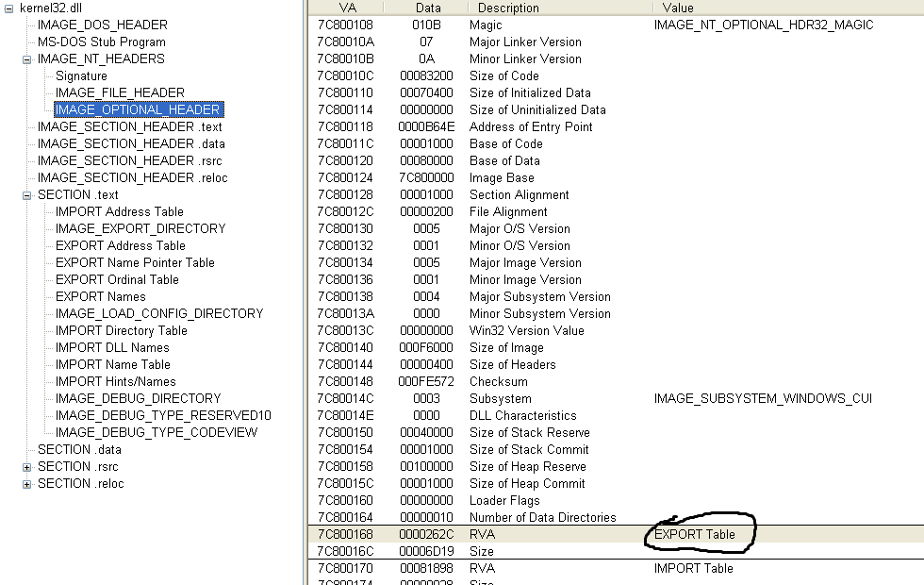
Inside the IMAGE_OPTIONAL_HEADER we find the RVA to the EAT.

Slide 58
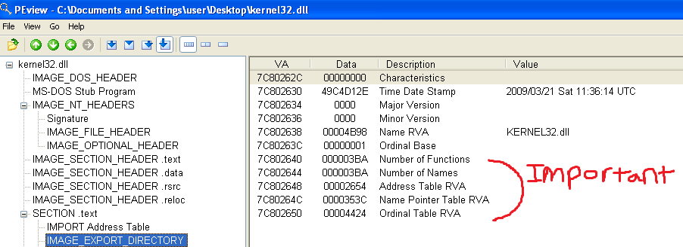
The RVA for the EAT we just received leads us to this data structure.
The names table contains an array of pointers to ASCII strings of the exported function names.
The address table contains an array of pointers to the actual functions that the DLL exports.
The ordinal table kind of links the names table and the address table.

Slide 59
Using the EAT
The locate a function named “function” using the EAT we do the following.
First, iterate through the names table comparing each one of the strings referenced in the table to “function.” Let’s say that the x’th entry in the names table is “function”, in other words namesTable[x] == “function.”
Then we get function’s ordinal in the x’th entry of the ordinal table. So functionOrdinal = ordinalTable[x].
Now we can retrieve function’s RVA inside the DLL by looking at the x’th entry of the addressTable. functionRVA = addressTable[functionOrdinal].
Finally, we can calculate where “function” actually exists in a processes address space by adding functionRVA to the base address of kernel32.dll in the victim process.
functionAddress = functionRVA + DLL base address
This allows us to call functionAddress!!!

Slide 60
Testing your understanding
If you really understand the process I just described, you should be able to use WinDbg to find the address of “AddAtomA” in basic_vuln’s address space.
AddAtomA is a function exported by kernel32.dll.

Slide 61
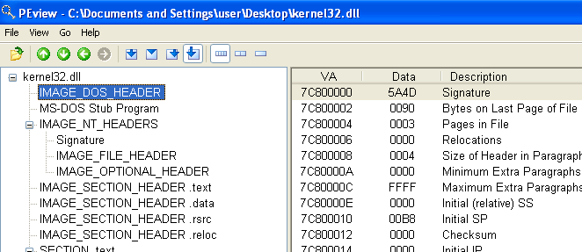
A little help
First start by using WinDbg to look at the bytes at the kernel32.dll base address.
Then open up kernel32.dll in PEView and use it to help you interpret the bytes you are looking at, and the datastructures they represent.

Slide 62
Room for improvement
When searching through the EAT name’s table, comparing each string to “GetProcAddress” or “LoadLibrary” is costly from an instruction count stand point, and from a shellcode size stand point because it requires that we hardcode the “GetProcAddrss” and “LoadLibrary” strings somewhere in our shellcode.

Slide 63
Waste not, want not
Instead of comparing string values, common practice is to hash each string in the EAT names table with a simple 32bit hash producing function and compare it to precalculated hashes for “LoadLibrary” and “GetProcAddress.”
This is simple to implement, and allows us to store hardcoded 32bit hashes instead of wastefully storing the entire ascii strings for “LoadLibrary” and “GetProcAddress.”
Comparing 32bit values on the x86 architecture is very simple and fast.

Slide 64
Hash function
For each character c in string: h=((h<<5)|(h>>27))+c
This simple hash function is fairly ubiquitous among win32 shellcode.
It produces hash values for GetProcAddress and LoadLibraryA that equal 0x7c0dfcaa and 0xec0e4e8e respectively.
*Hash function taken from: http://www.hick.org/code/skape/papers/win32-shellcode.pdf

Slide 65
Round up
The win32 shellcode process we have covered can be summarized as follows:
First locate kernel32.dll’s base address by walking from the TEB to the PEB to the loaded modules linked list. Kernel32.dll is always the second member of this linked list.
Locate kernel32.dll’s EAT by walking through the executable headers located at kernel32.dll’s base address. Then use the EAT’s names table, ordinal table, and address table to locate the addresses of GetProcAddress and LoadLibrary.
Use LoadLibrary to load arbitrary DLL’s into the victim processes address space.
Use GetProcAddress to locate the address of functions that those DLLs provide us.
Use LoadLibrary in conjunction with GetProcAddress to load and resolve functions to perform arbitrary functionality.

Slide 66
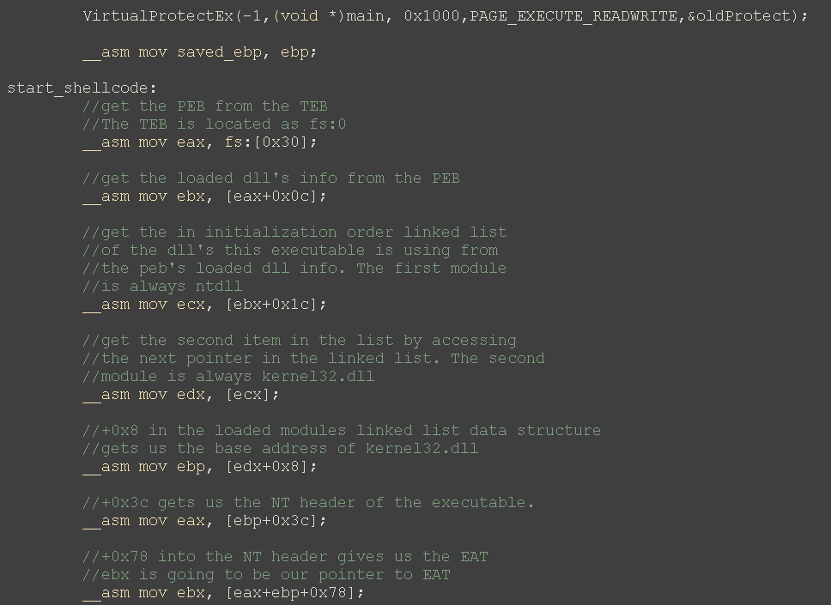
Hello World shellcode example
Tip: you can embed your shellcode into a standard C file using inline assembly as shown here. This can often make dumping/using your shellcode bytes to create a payload easier.
Also notice the call to VirtualProtectEx. I am setting the program’s code section to writeable (which it normally isn’t), that way the shellcode won’t crash when it modifies itself in this testbed.
When your exploit/shellcode is actually running after a successful exploit has taken place, this won’t be necessary because your shellcode will probably be running in a data region such as the stack which is already marked as writeable.

Slide 67
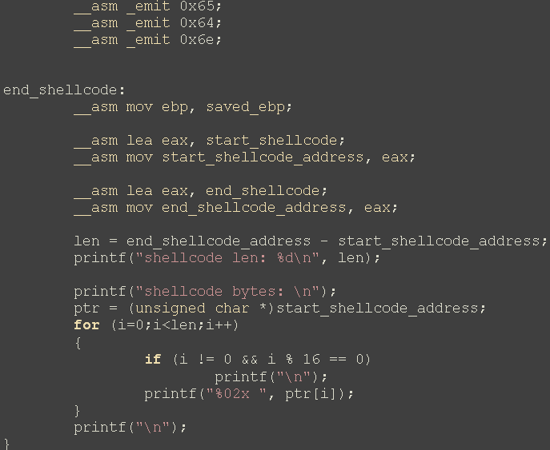
Shellcode example continued
Notice how embedding the shellcode in the C file allows us to easily parse out the relevant bytes, and how big the shellcode is.

Slide 68
More tips
You can compile your C programs, like the example shellcode with the cl compiler. Cl is actually what visual studio is using on the back end. This option is often convenient for smaller programs (like exploits) so you don’t have to deal with all the bloat associated with visual studio.
The /Zi flag tell’s cl to generate debugging symbols, this will make WinDbg much more informative when debugging.

Slide 69
Running shellcode example
For a protypical “hello world” style shellcode example, I’ve used LoadLibrary to load user32.dll into the process address space, then GetProcAddress to find the address of the MessageBox function.
The MessageBox function is what’s responsible for the lovely message you are now viewing.

Slide 70
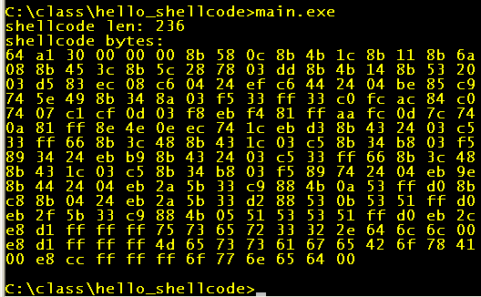
Running shellcode continued
The C program that contains the shellcode also prints out the shellcode bytes once the shellcode has run its course.
Notice all the bad bytes, like null and newline, in the shellcode payload. We aren’t going to worry about them.

Slide 71
Getting rid of the bad bytes is just an exercise in assembly manipulations, you should all know how to this this already.
Overflows that occur in binary data structures (as opposed to ascii strings) can have bad bytes in them. For instance, an overflow in a client side application will often be overflowing a binary data structure like the structure associated with an icon bitmap, embedded executable, or something of that sort.
Basically I am making things easier on you because I am a nice guy, but the scenario is still realistic.

Slide 72
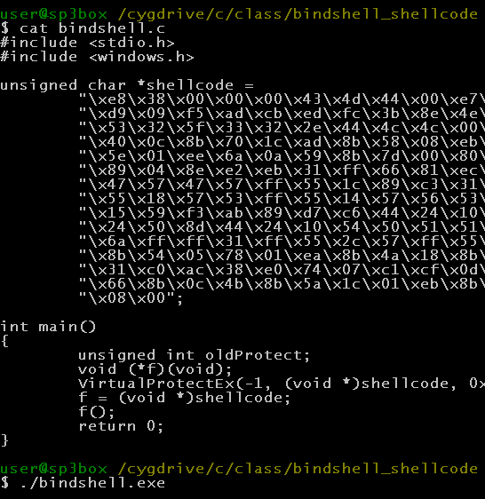
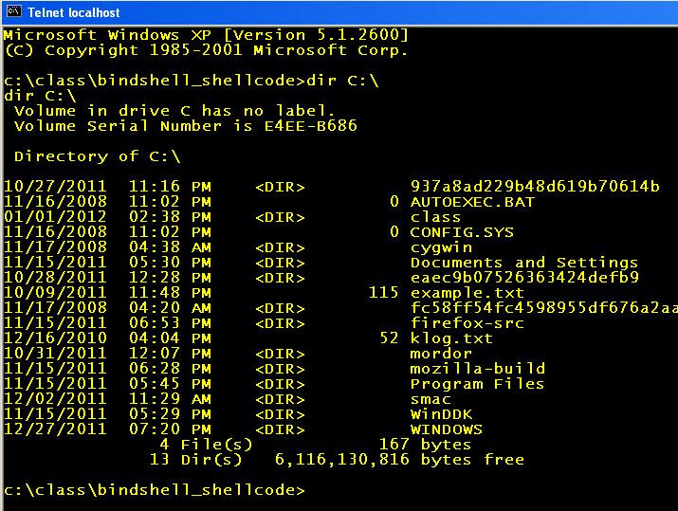
Other shellcode options
A more useful shellcode I’ve included is one that binds a cmd.exe shell to port 8721. This allows an attacker to connect to the exploited machine and accomplish whatever he pleases.

Slide 73
Real world shellcode
Cmd.exe port binding shellcode is still often not very useful since the victim machine is often behind a firewall, so you wouldn’t be able to connect to the port with the cmd.exe shell on it.
Instead, the attacker can develop shellcode that causes the victim machine to connect to a hardcoded server address/port and receive commands to execute from the server.
Another commonly used option is to have the shellcode download and execute a binary stored at a hardcoded http location. The binary that is downloaded/executed is typically a rootkit or something of that nature.

Slide 74
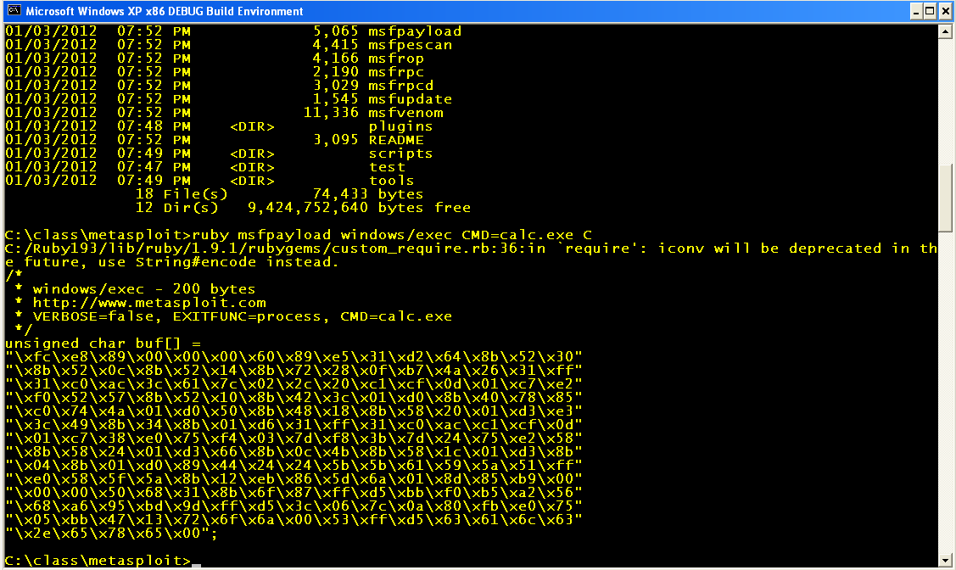
Easy shellcode generation
metasploit is very handy for is generating shellcode that fits your criteria.

Slide 75
Mystery Vuln Lab
Mystery.exe contains a vulnerability similar to the basic_vuln.exe we first looked at.
However, the functionality is slightly different and this time you don’t have source code.
You’ll have to use your trusty debugger to identify the vulnerability, trigger it, and use the shellcode from the previous slide to spawn calc.exe.
Hint: start set a breakpoint on the main function, so you can look at its disassembly to try to figure out what’s going on.

Slide 76
Abusing Windows Features
The Windows operating system provides us lots of useful “features” that are useful from an attacker stand point.
Often these features can be leveraged when performing an exploit to help gain control of EIP, defeat an exploit mitigation, etc…
One such important feature is Windows Structured Exception Handlers.

Slide 77
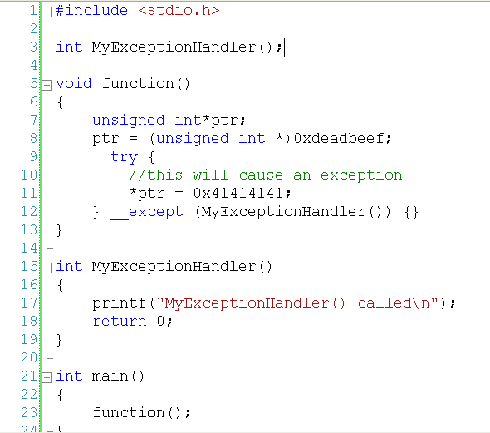
SEH
Exception Handlers provide us a means to detect an error condition in our program, and try to correct it.
In the above example, the dereferrence on line 7 will cause an exception and our exception handler will be called.

Slide 78
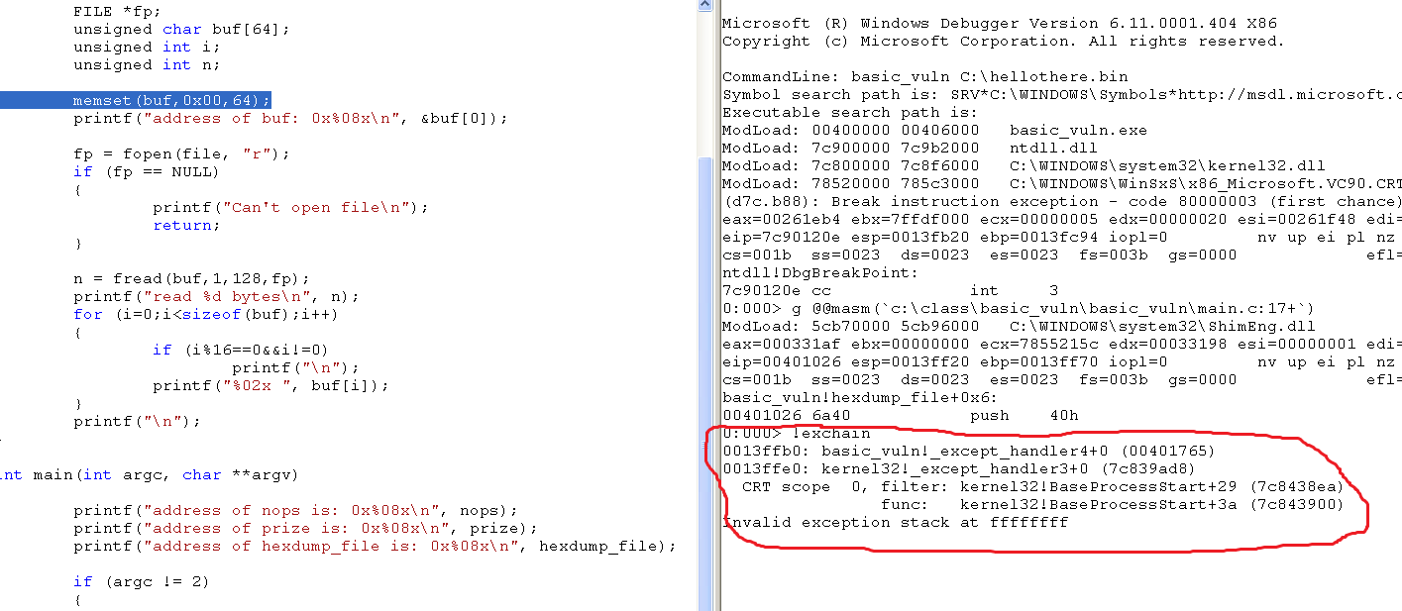
Even without the try/except clause, exception handlers are still in place and exception handling is still happening.
There is always at least one exception handler installed (there can be many) courtesy of Windows.
You can view the list of currently registered exception handlers with the WinDBG “!exchain” command.

Slide 79
SEH STRUCTURE
The Exception Handlers are stored in a linked list. The head of this list is stored in the TEB.
Each entry in the Exception Handler linked list contains 2 32 bit pointers. The first pointer is to the next entry in the Exception Handler linked list. The second pointer is to the actual exception handler code to be called in the event of an exception.
0xFFFFFFFF in the next entry position indicates the end of the linked list.

Slide 80
Important Points
The Exception Handler list is stored on the stack in a position that can be clobbered during a stack overflow. (In other words, the Exception Handler list is “above” local variables in memory).
The Exception Handler list contains function pointers that are called when an exception occurs.

Slide 81
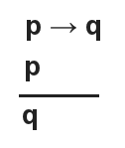
If we overwrite the exception handler list then cause an exception, we gain control of EIP.
Causing an exception during a buffer overflow is straight forward since we are corrupting all kinds of stuff. In fact, our stack overflow will cause an exception on its when we eventually write data off the end of the stack (if we can write a large enough amount of data).

Slide 82
Why Bother?
The return address resides in between the buffer we overflow and the exception handler list, so it is usually corrupted before we even get to the exception handler list. So why bother going all the way to the exception handler list?
That’s because the return address only allows us to gain control of EIP when the function returns. Thus execution has to continue gracefully until the function returns, so we actually get EIP. If our overflow causes an exception before the return instruction is reached, we lose.
Unless we overwrite the exception handler list!

Slide 83
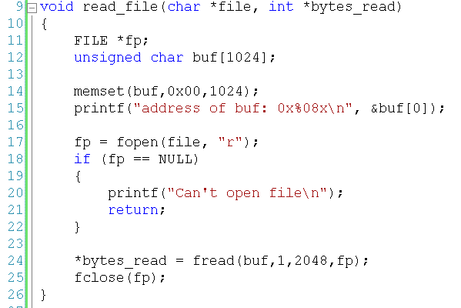
Consider the above example…

Slide 84
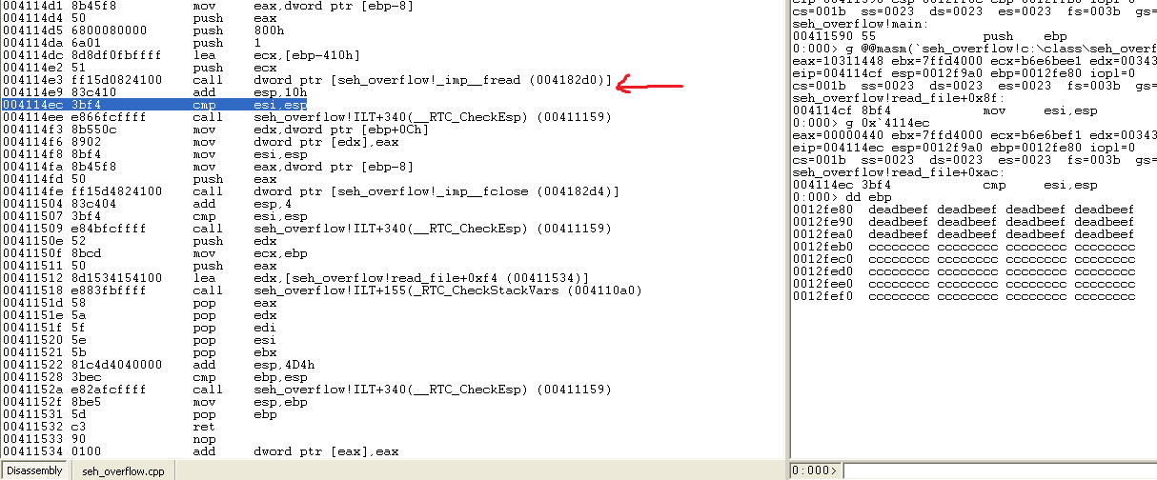
I have set and hit a break point directly after the vulnerable fread call.
At this point I have smashed the stack, overwritten the return address, and will soon achieve great glory.

Slide 85
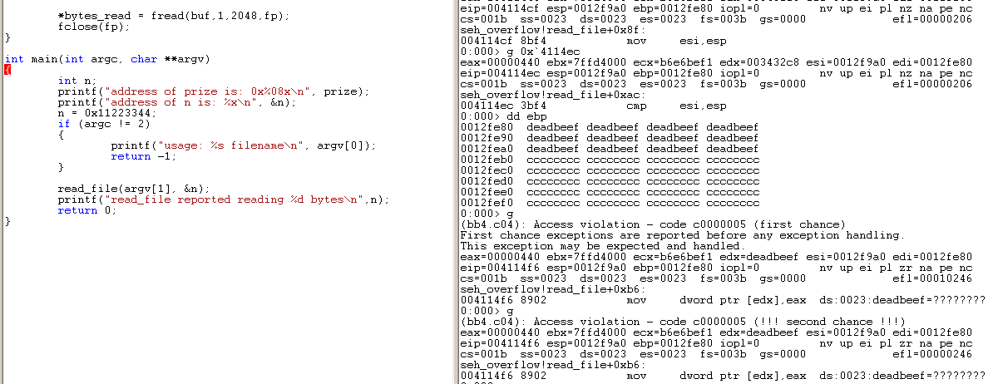
No 0xdeadbeef for me.
On my way to glory, I also destroyed some local variables, including the file pointer used by fread.
The call to fclose then crashed the application, and my corrupted return address was never used.

Slide 86
Once more…
Last time I only wrote enough data to smash the stack and overwrite the return address (plus a little bit extra because I was too lazy to calculate exact offsets).
This time I will write a lot more in an attempt to overwrite the exception handler list as well.

Slide 87
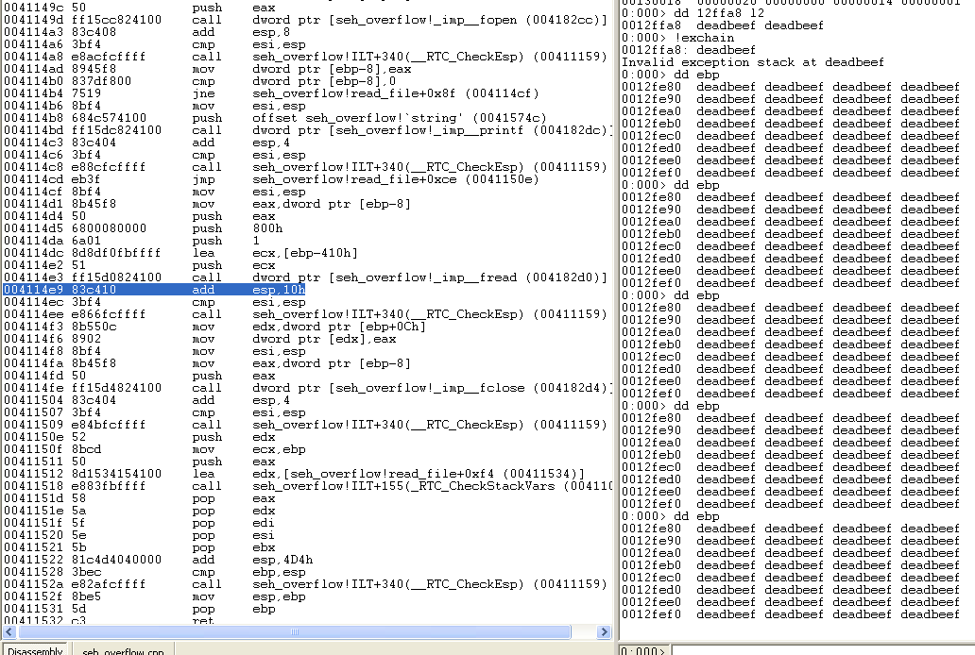
Same break point location, lot’s more deadbeefs.
Notice the exception handler linked list has also been corrupted.

Slide 88
Winner!
I continue from the break point, the same exception is generated during the fclose on the corrupted pointer.
But this time the exception handler points to 0xdeadbeef, so I gain control of EIP!

Slide 89
SEH Overflow Lab
Part 1: Exploit the SEH overflow application, overwrite the exception handler list, cause an exception, and cause the prize() function to be executed.
Part 2: Next, modify your payload to try to have the triggered exception execute some shellcode on the stack.
Note: you will have to press ‘g’ a couple times once windbg has encountered the exception so that Windbg will transfer handling of the exception to the actual application.
Note 2: Part 2 will be frustrating for you (and for good reason), try anyways.

Slide 90
Part 2 Futility
There is a reason you are having a hard time getting part 2 of the lab to work.
Due to prolific abuse of exception handler overwrites in “in-the-wild” windows exploits, Microsoft made the Windows Exception Handler “smarter.”
The code responsible for parsing the exception handler list now runs some heuristics on each exception record structure to decide if its acceptable or not.
If the address of the exception handler function pointer points to the stack, it’s not acceptable.

Slide 91
Return 2 libc continued
In Exploits 1 we discussed returning to a library function instead of returning directly to our shellcode, in that case it was because we couldn’t execute code on the stack.
In this case we can execute code on the stack (DEP is off), we just can’t use the exception handler to jump to the stack directly.
Instead, we will point the exception handler to something not on the stack, but that eventually transfers control to the stack.

Slide 92
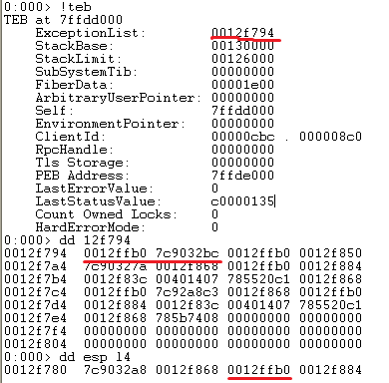
At the point when the exception handler we specify begins executing, ESP is 8 bytes away from the next exception handler pointer.

Slide 93
This means if we point the exception handler function pointer at a piece of code (not on the stack) that shifts the ESP register by 8 bytes and then does a return, we will be returning into the 4 bytes corresponding to the next exception handler pointer.
I’ll draw a diagram on the board to make things more clear…

Slide 94
Shift the stack by 8 and return
In order to point ESP at data we control (the next exception handler pointer), and then use that data, we need to shift the stack pointer by 8 bytes and then perform a return.
So we need to look for opcodes of the form:
Pop reg; pop reg; ret
OR
2) Add esp, 8; ret

Slide 95
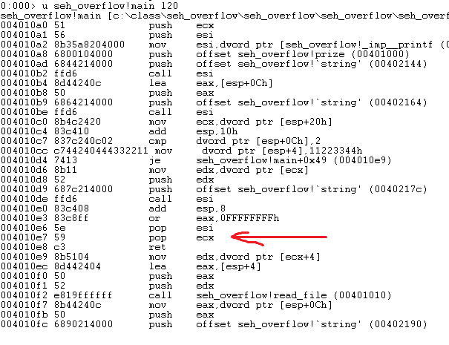
Lucky for us, pop reg; pop reg; ret is a common instruction sequence in Windows.
Since this code is not on the stack, the exception handler list parsing code will accept it as a valid function pointer to an exception handler.

Slide 96
What next?
The pop-pop-ret instruction executed when an exception occurs will load the address of the pointer to the next exception handler as the EIP. We control the bytes at this address, but we only have 4 bytes to work with before we overwrite the exception handler function pointer to pop-pop-ret (and we need that in tact).
What’s the best 4 byte shellcode in the world?

Slide 97
0xCC 0xCC 0xCC 0xCC
For now, use 4 bytes of 0xCC as your shellcode, which is just 4 software break points.
So modify your SEH exploiting payload to overwrite the exception handler function pointer with the pop-pop-ret sequence we found previously.
Also, overwrite the next_exception_handler pointer with 0xCCCCCCCC.
If you did it right, WinDBG should break like its hit a breakpoint when it starts executing your 4 byte shellcode.

Slide 98
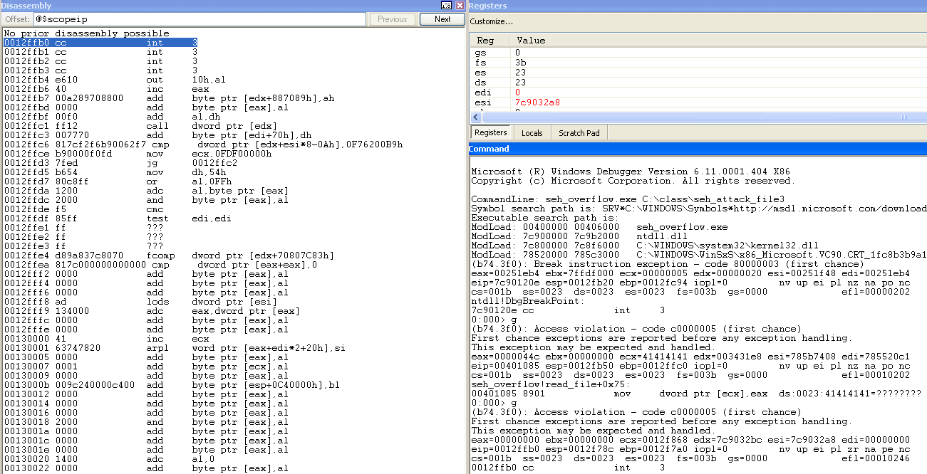
This is what you should see when you are successfully executing your 4 byte shellcode.

Slide 99
Weaponized 4 byte shellcode
In the real world you want your shellcode/exploit to do something beyond triggering a breakpoint.
The 4 byte shellcode you should actually be using is an x86 relative jump instruction to somewhere that contains your real shellcode.
The canonical example is to overwrite the next_exception_handler pointer with a jmp 6 instruction, and then place your shellcode directly after the overwritten exception handler function pointer. Then when the jmp 6 is executed, it will jmp directly to your shellcode.

Slide 100
Let’s try this relative jump trick to give us more than 4 bytes for shellcode.
Your exception handler should look similar to what you see in my debugger above.
Note the opcodes for relative jump forward 6 are 0xeb 0x06. I’ve used 2 NOP’s to pad out the additional 2 bytes we have in the next exception handler pointer.

Slide 101
Now we’ve moved out of our 4 byte boundary and have room for real shellcode.
I’ll leave executing “real” shellcode as an exercise for the bold. Note there are more unexpected challenges you will run into.

Slide 102
C++ Super Happy Fun Land
C++ Provides lots of super happy fun features, like classes and polymorphism etc.
These features are good for programmers, and good for exploit developers!
Behind the scenes what is really implementing all these features is liberal use of function pointers.
Thus, in a C++ application you usually have a lot of function pointers flying around that you can target for gaining control of EIP.

Slide 103
Consider the following class hierarchy.
Notice that it contains virtual functions, this is important.

Slide 104
With Virtual Functions you can implement polymorphic type functionality.
Even though “ptr” is of type person, it correctly calls the Student version of Action() thanks to polymorphism.
How is all this implemented under the hood?

Slide 105
Whenever you declare a class with virtual functions, what you are really ending up with in memory is basically a C structure in memory.
This structure contains all of your variables (like the name[64] buffer), as well as a pointer to a function pointer table.
This function pointer table stores pointers to all of the methods your C++ class implements.

Slide 106
Here I examine the function pointer table associated with p1 (which is of type Person).
Notice the first entry in the function pointer table is for the Person::Action method.

Slide 107
Target Acquired
The main point to realize is that whenever we declare a C++ class with virtual methods, the pool of memory where it exists (the heap, the stack, etc…) now contains a pointer to a function pointer table which will eventually be used to call the function.
In the event of an overflow, we can overwrite this pointer value so that our code will be called the next time a virtual method is called.
Let’s see this in action.

Slide 108
An overflow occurs during the SetName operation, corrupting the virtual table pointer for Person p1.
When one of p1’s virtual methods is called (Action() in this case), that corrupted virtual table pointer will be used to try to locate the correct Action() function. Since the table is corrupt, we should see a nice crash.

Slide 109
The exploitability of this is at first unclear because crashing on mov eax, [edx] doesn’t look very exciting. We should look closer.

Slide 110
Notice we control what data is read in eax, because we control edx.
Then, eax is used as the argument for call!
Thus if we point corrupt edx in a way that it points to attacker controlled data, we gain control of eip.

Slide 111
Notice if we had overwritten p1’s vtable pointer with 12fee0 (which points to attack controlled data), we would then gain control of EIP as well.

Slide 112
Day 2
Part 1: Exploits mitigations
Part 2: Exploit mitigation weaknesses

Slide 113
Justification
Why am I teaching you all of these exploitation techniques, many of whom overlap in their use cases?
Because they are all important tools for us to leverage once we start breaking Windows exploit mitigation technologies.

Slide 114
Exploit Mitigations
/GS stack protection
DEP
ASLR
SafeSEH
Variable reordering
Oh my!

Slide 115
/GS
Let’s enable GS for basic_vuln and see what happens when we try to exploit it again.

Slide 116
At this point you can see I’ve overwritten the stack and the return address with 0xdeadbeef.
Once the function returns, victory should be ours!

Slide 117
Let’s take a look under the hood to see what’s going on…

Slide 118
When the function begins executing it creates a stack cookie value and places it on the stack in front of the return address, saved ebp etc.
At the end of the function it checks to make sure that value is still in tact. If not, it immediately kill’s your program without ever using the return address you corrupted.

Slide 119
DEP
We should all be pretty familiar with this from exploits 1.
With DEP, the we cannot execute code in regions of memory that are not marked as executable.
Most data regions that we would overflow, like the stack and heap, are not marked as executable by default.

Slide 120
Without DEP
Here I am just using a function pointer to transfer EIP to my shellcode.
My shellcode is stored in a data region, but since DEP is currently off, the processor happily executes it.

Slide 121
Changing DEP options
Edit boot.ini to change your DEP options
OptOut means a process has to explicitly register to the OS that it does not want to have DEP turned on (usually for backwards compatibility issues).
OptIn means a process has to explicitly register to the OS that it DOES want DEP turned on.

Slide 122
Changing system wide DEP policy requires a reboot, this time I enable it to see how my shellcodes fair in the brave new world.

Slide 123
Try #2
These aren’t the calc.exe’s I’m looking for…

Slide 124
ASLR
We talked about this in Exploits 1 as well.
Executables and their associated DLL’s are loaded at random locations in the address space. This makes it harder for an attacker to guess where things will be located, ultimately making exploitation more difficult.

Slide 125
ASLR in Windows 7

Slide 126
ASLR in Windows XP
ASLR isn’t supported in Windows XP!

Slide 127
SafeSEH
Previously we abused the structured exception handler by pointing it to a piece of a code that was useful to us (a pop-pop-ret sequence).
We already had the constraint that the exception handler couldn’t point to the stack.
SafeSEH add’s further constraints: A SafeSEH enabled module registers a table of valid exception handlers. Before executing an exception handler routine, the operating system first verifies that the exception handler pointer points to an entry in this table.

Slide 128
Without SafeSEH
Here I’ve manually edited the Structured Exception Handler to point to the prize() function right before an exception is about to happen in the code. The exception handler isn’t pointing at the stack, so the exception handler parser should like it.

Slide 129
Without SafeSEH #2
Great Success

Slide 130
Enabling SafeSEH

Slide 131
SafeSEH Enabled
With SafeSEH enabled, I try the same trick as before…

Slide 132
Now no matter how hard I try, the exception handler parsing routine won’t execute the exception handler I hacked in because it doesn’t point to a registered exception handler routine.

Slide 133
Defeating mitigations
All the mitigations we’ve talked about can be defeated
Sometimes a mitigation will render a vulnerability impossible to exploit, but more often than not, the mitigation is just a nuisance that requires the attacker to work a little harder.
Let’s examine the weaknesses of each mitigation in detail.

Slide 134
GS Weaknesses
The main weakness of GS is that it only detects corruption at the point the function is preparing to return.
If the attacker can gain control of EIP before the vulnerable function returns, GS will never get the opportunity to detect the attack.
Let’s investigate

Slide 135
Let’s enable GS protection on the seh_overflow project we exploited previously.

Slide 136
I’ve pointed seh_overflow at a file containing a bunch of 0xdeadbeef. Let’s run it and see what happens…

Slide 137
Where my G’s at?
Great job GS
What happened?

Slide 138
GS failure analysis
What happened is we clobbered the whole stack with 0xdeadbeef, including the saved ebp, return address AND the exception handler list.
In fact, we wrote so much data we wrote off the end of the stack and caused an exception.
This caused the exception handler routine to kick in, and pick 0xdeadbeef as the exception handler to use.
Overwriting the exception handler list is always a good way to bypass GS.
GS will also fail you if you can overwrite c++ vtables on the stack or any other function pointer type data that get’s used before the function returns.

Slide 139
DEP
In exploits 1 we already saw some techniques to defeat DEP.
Instead of returning to shellcode, we returned to standard library functions that were useful to us. For instance, we returned to code to execute system(“/bin/sh”) instead of returning to shellcode on the stack.
We have also seen returning to pop-pop-ret as a means to accomplish our goals.
This general approach of calling other legitimate code, instead of shellcode, is often referred to as return oriented programming (ROP for short).

Slide 140
ROP principles
The key observation in using ROP is that if we control the stack (which we often do as the attacker) we can cause an arbitrary number of calls to existing code of our choosing.
This is because any code that ends with a return instruction (like all normal functions) will look to the stack for where they should go to continue execution after the function is complete.

Slide 141
Using ROP to Defeat DEP
There are two obvious paths we can take here
Option 1, we can use ROP to return to an existing function that does something useful from an attacker standpoint, like system(“/bin/sh”).
Option 2, we can use ROP to effectively disable DEP. Then we will be free to execute shellcode in the usual manner.

Slide 142
DEP implementation weaknesses
There exist several standard operating system functions that allow you to change the memory permissions on arbitrary ranges of memory.
Even with DEP enabled system wide, these functions can be freely called during a processes execution to change the memory permissions of pages of memory.
As an attacker, we can return to these functions and make the stack executable. Then we are free to return/call our shellcode and it will execute freely.

Slide 143
We saw this before, this is DEP keeping us safe.

Slide 144
This is DEP letting us down.
Notice the call to VirtualProtectEx. Even with DEP enabled, I am free to call this function to make the stack executable so that DEP won’t bother us when we execute shellcode on the stack.

Slide 145
SafeSEH and ASLR
SafeSEH and ASLR are really only useful to us if the target process and all of its DLL’s opt into them.
Let’s look at a typical 3rd party application’s SafeSEH/ASLR compliance on a Windows 7 64 bit machine…

Slide 146
Here I use a useful WinDBG extension called “narly” to automatically tell me the mitigation compatibility of each module loaded into a process address space.
These are narly’s results on a target process I randomly selected.
http://code.google.com/p/narly/

Slide 147
Non-compatability
Many 3rd party DLLs that are loaded in a process address space fail to opt into SafeSEH and ASLR.
If any one of these DLLs fail to opt into these mitigations, they can be leveraged to make our exploit successful.

Slide 148
ASLR Non-compatability
Having just one DLL in the process address space not be ASLR compatible severely weakens the security of the whole process.
This weak DLL gives the attacker a large body of code to work with that exists at a reliable location.

Slide 149
SafeSEH non-compatability
When a DLL fails to opt into SafeSEH, we can use any of its code in a exception handler overwrite scenario.
This means if we can find a pop-pop-ret sequence in the weak dll (which we usually can), we can exploit an exception handler overwrite in the victim process.

Slide 150
Mitigations bypass lab
To demonstrate the fragility of Windows exploit mitigation techniques, our next lab will exploit one of our previous targets with all exploit mitigations enabled.
The mitigations that we will enable and bypass are GS, DEP and SafeSEH. This is pretty much the worst case (from an attacker perspective) that you can expect to find in a vanilla Windows XP target.

Slide 151
Target
Our target will be the seh_overflow project we have previously exploited, with the aforementioned mitigations turned on.
Since seh_overflow is a simple project that doesn’t load many DLLs, I’ll force it to load some application DLLs that I’ve found on the system.
These application DLLs will be abused to help facilitate our attack.

Slide 152
A little help courtesy of Flash
Flash6 does not have SafeSEH enabled, which allows us to call any of its code during a SEH overflow. We will abuse this weak DLL to help us bypass other mitigations.

Slide 153
Game Plan
We will overwrite the Exception Handler and trigger an exception. This will bypass /GS protection because the Exception Handler will be called before the stack cookie is checked at the end of the function epilogue.
We will initially call code in a non-SafeSEH module (Flash6.ocx) which bypasses SafeSEH.
We will then call VirtualProtect to change the memory protections on the stack to include the executable bit. This bypasses DEP.
Finally, we will jump to our shellcode.

Slide 154
Stack Control
Because we will need to chain several blocks of code together to pull off our attack, we will need to control the stack pointer. More specifically we need esp to point to attack controlled data. This is because we need to:
Call the VirtualProtect function with the right arguments and the stack controls the arguments.
Control where executing flows during a return call and the stack controls the result of a return instruction.

Slide 155
We don’t have it
Whenever we gain control of EIP by corrupting something like a function pointer (like we do with a SEH overflow), we control EIP but not ESP.
We need to somehow force ESP to point to attacker controlled data so we can control return instructions, arguments to functions, and ultimately call multiple blocks of code to be executed in the order and with the parameters we desire.

Slide 156
Mini Lab 1
Force seh_overflow to crash by feeding it a file with a lot of 0xDEADBEEF.
Let the program continue a couple break points/exceptions until EIP=DEADBEEF.
What is the value of ESP?
What range of stack addresses point to attacker controlled data?
What is the difference between the current value of ESP and the range of stack addresses associated with attacker controlled data?
What registers point to attacker controlled data?

Slide 157
It looks like anywhere from esp+0x4ac to esp+0x8f0 points to attacker controlled data at the time we can control of EIP.

Slide 158
Stack pivot
If we can find a sequence of instructions of the form add esp, X; ret; for any 0x4ac < X < 0x8f0 we can use it to gain control of ESP while maintaining control of EIP.
If we can find this instruction sequence in Flash6.ocx we can point the exception handler to it and use it to gain control of the stack because Flash6.ocx does not have SafeSEH enabled.

Slide 159
Mini lab 2
Run the seh_overflow program again, setting a breakpoint after the point where Flash6.ocx gets loaded.
Search for a stack pivot that meets the criteria described previously.
The first bytes for add esp, imm32 ret are:
0x81 0xc4
So to perform the search you should execute:
“s flash6 L194000 81 c4”
From this list, try to pick out a suitable stack pivot.

Slide 160
What offset into the overflowed buffer will ESP point to after we execute the above stack pivot?

Slide 161
Target Stack Configuration
Esp points here after pivot
Overflowed Buffer Symbolic
VirtualProtectEx Address
Return address for Virtual Alloc
hProcess Argument
lpAddress Argument
dwSize Argument
flNewProtect Argument
lplOldProtect Argument
Fill Me Out
=?
=?
=-1
=?
=?
=?
=?
If we setup our buffer with the above layout, precisely at the point where esp will point after our stack pivot is used, we can call VirtualProtect with whatever arguments we choose.
Fill out the table for what these arguments should be to allow us to execute our shellcode on the stack.

Slide 162
Putting it all together
Modify your previous seh_overflow attack to overwrite the exception handler with the address of the stack pivot we discovered.
Setup your payload so that after the above stack pivot executes, esp is pointing precisely at the values you filled out on the previous page.
Set the return address for VirtualProtectEx to be the address of your nops/shellcode.

Slide 163
Victory!!!
Congratulations, you survived the thunderdome… This day…
http://www.blackhat.com/presentations/bh-usa-08/Sotirov_Dowd/bh08-sotirov-dowd.pdf offers a good summary of Windows mitigations and their weaknesses.

Slide 164
Day 3: Vulnerability Discovery

Slide 165
Game Plan
We are about to embark on a day long lab where we will fuzz an application to discover vulnerabilities, then develop exploits for those vulnerabilities.
Phase 1: Fuzz application to generate crashes
Phase 2: Analyze crashes for exploitability
Phase 3: Develop exploits for the crashes we deem vulnerable

Slide 166
No mitigations
For now we will turn off DEP and other mitigations. After we have working exploits in mitigation-less world, we can step it up to the big leagues.

Slide 167
Fuzzing
Fuzzing is the process of feeding an application malformed data in the hope of making it crash
The crashes that are generated may yield underlying vulnerabilities in the application.
Fuzzing is nice because it can be automated so you can use your brain cycles on other things.

Slide 168
Fuzzing pros/cons
Pro: you can program a computer to do it
Pro: easy and effective
Con: you can program a computer to do it
Con: lower quality bugs

Slide 169
Malformed data
Deciding how to generate the ‘malformed’ program data is a crucial step in the fuzzing process.
Two differing approaches are mutational vs generational.
The former involves taking known good existing data and warping them to some degree.
The latter involves generating data from scratch based on the constraints the program data is supposed to conform to.

Slide 170
Generational
Pro: generally produces better and more unique bugs
Con: requires that you understand the constraints on the program data. This is often difficult when dealing with proprietary data formats and applications, and requires time consuming reverse engineering.

Slide 171
Mutational
Pro: very easy to do
Pro: requires no knowledge of the data constraints
Con: not quite as good as generation fuzzing, but still works.

Slide 172
Our Fuzzer
We are going to take a mutation approach, because this class isn’t about reverse engineering.
Our first generation fuzzer will make the simplest mutation possible, it will change a random byte in a known good document to a random value.

Slide 173
I know what you’re thinking…
This is bogus bro…

Slide 174
Not exactly
This same method has been used to find vulnerabilities in many popular software packages (Microsoft Office, Adobe, etc…)
See Charlie Miller’s An analysis of Fuzzing 4 products with five lines of python. (http://www.youtube.com/watch?v=Xnwodi2CBws)

Slide 175
Crappy Document Reader
Crappy Document reader uses .cdf files (crappy document format) to render documents.
CDF reader supports drawing a background image, and displaying text on top of that background.

Slide 176
Well formed data sample
Our first step in the fuzzing process is to choose a set of well formed data to mutate.
The key is to choose a set of data that exercises all of the features offered by the target program.
In the case of CDF reader, any document that has text and a background is already utilizing all of the features available.

Slide 177
Target Data
This cdf file will serve us well since it is exercising all of cdf reader’s available features.

Slide 178
Reminder
Remember, our gameplan is to take this known good cdf file, mutate it a little bit by randomly changing data in it, throwing it at the cdf reader and seeing what happens.
Eventually we will have a set of crashes we can analyze to try to discover vulnerabilities.

Slide 179
The code
In the cdf_fuzzer python script, createFuzzyDocument is the function responsible for mutating known good cdf data.
I encourage you to adjust the functionality of this function.
Consider changing how many bytes are randomly changed, changing sequential bytes, etc…

Slide 180
Other code components
Some pydbg code that listens for cdf reader crashes and logs the context of the crash to file.
Code to start the cdf reader process with our mutated data, and then kill the reader process soon afterwards if a crash is not detected.

Slide 181
Start your engines
Now let’s raise the power bill up in here…

Slide 182
Crash analysis
Eventually you will end up with a large sample of crashes. Some will be exploitable, and some will not.
The trick is to examine program state at time of crash and get a general feel for how exploitable you think the crash is.

Slide 183
Crash Example
Exploitable/not exploitable?

Slide 184
Crash example
Exploitable/non exploitable?

Slide 185
Crash example
Exploitable/non exploitable?

Slide 186
Example continued
How about now?

Slide 187
Difficult crash dump
Sometimes the crashes you get provide no context because the process has been too far corrupted.

Slide 188
Rules of thumb
It is difficult to tell right away the implications of a bug just by looking at state during crash.
Often it is easy to determine exploitability, for instance, if EIP=41414141
Non-exploitability is harder.
In order to make stronger statement about the security implications of a crash, you really need to reproduce the crash and step through the crash in a debugger.

Slide 189
Example crash analysis
This crash looks interesting to me.
I’m crashing on a bad dereference, but esi is not null, ruling out the obvious null pointer deference case. Let’s be generous and assume ESI is completely attacker controlled.

Slide 190
Crash analysis continued
I note that this is crash 20, which means the offending file should be stored in crash_20.cdf
Let’s run that in the debugger to get a closer look.

Slide 191
Crash analysis continued
Even assuming we control ESI, which we aren’t really sure about, ESI isn’t being used in many interesting ways, so I’m not too excited about this crash.

Slide 192
Your Turn
Look at your crash log file, pick out a crash you think looks interesting.
Reproduce the crash in WinDBG so you can get a better feel for the state of the program at crash time.
Try to find one you feel confident is exploitable.
Also try to find a crash you feel is not exploitable.

Slide 193
Questions you should be asking yourself
What instruction did I crash on?
Is the EIP/exception chain corrupted?
What registers do I think I control at the time of the crash?
What function did I crash in?
Do I control the arguments to that function?
What is the state of the stack during the crash?

Slide 194
Automated crash analysis
Microsoft has developed a windbg module that will automatically attempt to classify a bug as exploitable/non-exploitable/unknown.
To use it, run “.load msec” to load the module, then “!exploitable” after the crash as occurred to attempt to automatically classify the crash.

Slide 195
!exploitable
!exploitable is using some pretty simple heuristics to attempt to classify a crash. For instance, if the crash occurs at a call instruction, it automatically classifies a bug as exploitable.
!exploitable is far from perfect, it will classify some bugs as not-exploitable that are exploitable and vice-versa.
However, it can be useful as a triaging tool to help you prioritize which bugs to investigate first, especially if you are a software engineer with limited security experience.

Slide 196
!exploitable experimentation
Revisit some of the cdf reader crashes you generated while fuzzing. Use !exploitable to automatically generate a crash classification. Do you agree/disagree with the classification?

Slide 197
Crash analysis lessons
As you probably noticed, not all of your crashes were unique. Many of the crashes were the same type (null pointer dereference), or crashed at the same EIP.
The more unique crashes you can cause your fuzzer to generate, the better.
To generate more unique crashes, you should make sure your fuzzer is exercising all features of the target application. In our case we were exercising all of cdf reader’s features: displaying a background, displaying a window title, drawing some text.

Slide 198
Crash analysis lessons 2
Determining crash exploitability is harder than you might think.
It’s easy to spot something very obviously exploitable (eip=41414141), but its hard to rule out a crash as not-exploitable.
There could be some technique you are unaware of that allows you to exploit what you deemed an unexploitable scenario.
Extensive research is being done to help automate the process of determining crash exploitability.
What you can do is rank the crashes in terms of how exploitable they seem, and start from the top of the list.

Slide 199
From Crash to Cash
In my fuzzing, crash 1 looks promising.
It it crashing in a memcpy (rep movsd) which is good
The source parameter of the memcpy (esi) also looks like its pointing at valid memory.

Slide 200
Let’s make a copy of the crash file and get to work building our exploit.
First step, recreate the crash in windbg.

Slide 201
First question: Do we control the data causing the overflow?

Slide 202
That looks promising, but how do we really know we control it and can manipulate it?

Slide 203
The origin of the data causing the overflow is our cdf file, so we can control the data used in the overflow. Good news so far…

Slide 204
The exception handler is being overwritten before its called. Also good.
But do we control the exception handler as well?

Slide 205
Looks promising. Let’s try changing the exception handler record and rerunning the program to see if we do in fact control the exchain by manipulating these bytes.

Slide 206
Bytes changed to place holder values for testing purposes…

Slide 207
Create, we have demonstrated control over the exception handler by modifying those bytes in the cdf file.
We also know parts of those bytes will be used as a function pointer.

Slide 208
Pop-pop-ret
We need the exception chain function pointer to point to a pop-pop-ret instruction as we encountered yesterday.
Furthermore, this pop-pop-ret construction must come from a non-safeseh module.

Slide 209
Unsurprisingly, the 3rd party graphics engine I’m using for CDF graphics rendering is not compatible with SafeSEH.
Thus if we can find a pop-pop-ret sequence in any of those modules, we can point our exception handler function pointer at it, and we’ll be in business.
Challenge: who can find a valid pop-pop-ret first? Don’t cheat and look at the next slide!

Slide 210
There are actually a bunch in those SDL modules, take your pick.
0x62e414fc will do.

Slide 211
I change the exception handler to the pop-pop-ret we discovered.
This will point EIP to the bytes just before the function pointer. Originally 11 22 33 44, I have changed them to eb 06 00 00, which are the opcodes for relative jump forward 6 bytes.
That jmp forward 6 bytes should put us at the 0xCC bytes I hacked in after the pop-pop-ret function pointer. These are software breakpoint bytes, and the debugger should cause a break to occur if our EIP gets there. Let’s see…

Slide 212
success
We caused the opcodes we inserted into the cdf file to be executed. We are very close to owning this thing… we just need to get some real shellcode to execute. Let’s replace those 0xCC’s with calc.exe spawning shellcode.
Hint: make a copy of the exploit file each time you make a change, this isnt going to be as easy as you might hope…

Slide 213
Here I’ve used the hex editor to hack in the calc.exe spawning shellcode where I had originally put 0xCC’s. I clobbered some other stuff too with all this shellcode, hopefully that doesn’t matter..
Let’s give this one a go and see what happens.

Slide 214
Hmm…
No calc.exe… Who can tell me (or at least speculate as to what happened?)

Slide 215
Not all of our shellcode got copied.
Why?

Slide 216
Plan B
Since we don’t have enough room on the stack to put our 200 byte calc shellcode AFTER the exception handler record. You need to relocate it.
Restore your exploit file with the 0xCC opcode bytes after the exception record.
Try to transplant your shellcode elsewhere in the file so that it ends up in one piece on the stack.
Then, change the 0xCC bytes after the exception handler record (the bytes that get executed) to get a relative call/jmp to your transplanted shellcode.

Slide 217
Some windbg investigation told me the location of the file being memcpy’d was where the “zero day haiku” ascii bytes were. Since I figure this will get copied on the stack, I’ll overwrite that message with my shellcode.
Next I’ll need to reload the file with cdf reader, and try to locate the address of where my new shellcode ends up.
Notice I gave myself some NOPs as well so I have some wiggle room.

Slide 218
Scanning for shellcode
Here I’ve recreated the crash with my work in progress exploit file, and scanned the stack space for my shellcode/nops.
They seem to be located at 12fd70.

Slide 219
Calculating jmp
At the time I get to my 0xCC opcodes, I am 0x248 bytes away from my transplanted shellcode. Therefore if I change my 0xCC opcodes to a relative jmp/call backwards ~0x248 bytes, I should start executing my shellcode.

Slide 220
-584 is 0xfffffdb8 in hexadecimal.
So if I change my 0xCC’s to e9 b8 fb ff ff, which tells the cpu jmp -584, I should hit my shellcode.

Slide 221
Victory!!!

Slide 222
Choose your path
At this point you should start trying to exploit other unique crashes you found in cdf reader.
If you want a much more difficult challenge, reboot with DEP turned on, and try to modify one of your cdf exploits to bypass DEP and launch a calc.exe

Slide 223
Recap: What you learned
Vanilla stack overflows in win32
Windows Shellcode Fundamentals
Exception Handler overwrites in Windows
Windows exploit mitigations including:
DEP
SafeSEH
GS Protection
ASLR

Slide 224
What you learned 2
Stack pivots and using VirtualProtect to bypass DEP.
Mutation based fuzzing
Crash analysis

