Slide 1
CISSP® Common Body of Knowledge Review
Information Security Governance & Risk Management Domain
Version: 5.10

Slide 2
Learning Objectives
Information Security & Risk Management Domain ...1/3
The Information Security Governance and Risk Management domain entails the identification of an organization’s information assets and the development, documentation, implementation, and updating of policies, standards, procedures, and guidelines that ensure confidentiality, integrity, and availability. Management tools such as data classification, risk assessment, and risk analysis are used to identify threats, classify assets, and to rate their vulnerabilities so that effective security measures and controls can be implemented.
Reference: CISSP CIB, January 2012 (4.17.14 Rev. 13)

Slide 3
Learning Objectives
Information Security & Risk Management Domain ...2/3
The candidate is expected to understand the planning, organization, roles, and responsibilities of individuals in identifying and securing organization’s information assets; the development and use of policies stating management’s views and position on particular topics and the use of guidelines, standards, and procedures to support the policies; security training to make employees aware of the importance of information security, its significance, and the specific security-related requirements relative to their position; the importance of confidentiality, proprietary, and private information; third party management and service level agreements related to information security; employment agreements, employee hiring and termination practices, and risk management practices, and tools to identify, rate, and reduce the risk to specific resources.
Reference: CISSP CIB, January 2012 (4.17.14 Rev. 13)

Slide 4
Learning Objectives
Information Security & Risk Management Domain ...3/3
New knowledge requirement for 2012 & 2013:
Management knowledge in budget, metrics, and resources for security programs.
Privacy requirements compliance. (Will this topic in the Legal, Regulations, Investigations and Compliance domain.)
Reference: CISSP CIB, January 2012 (4.17.14 Rev. 13)

Slide 5
Topics
Information Security & Risk Management Domain
Information Security Concept
Information Security Management
Information Security Governance
Information Classification
System Life Cycle (SLC) and System Development Life Cycle (SDLC)
Risk Management
Certification & Accreditation
Security Assessment
Configuration Management
Personnel Security
Security Education, Training, and Awareness
Project Management

Slide 6
Information Security Concept
Dimensions of Information Security Practice
Area of Specialty
  Securely Provision; Operate & Maintain; Protect & Defend; Investigate; Collect & Operate; Analyze; and Oversight & Development.
Breadth of Disciplines
  Families of security controls, security technologies, best-practices, etc. (e.g., CISSP, CISM, CISA)
Depth of Knowledge
  Systems/software/network engineering, cryptography, IT governance, vulnerability assessment, security certification & accreditation, etc.
Depth of Knowledge
(Proficiency)
InfoSec &
Risk
Management
Software
Dev.
Security
Breadth of Knowledge
Access
Control
Cryptography
BCP & DRP
Area of Specialty
Security
Architecture
&
Design
Telecom
&
Netowrk
System
Ops
Security
Physical
Security
Legal,
Investigation,
&
Ethics

Slide 7
Information Security Concept
Security Objectives
Confidentiality
  “Preserving authorized restriction on information access and disclosure, including means for protecting personal privacy and proprietary information.” (44 USC Sec. 3542)
Integrity
  “Guarding against improper information modification or destruction, and includes ensuring information non-repudiation and authenticity.” (44 USC Sec. 3542)
Availability
  “Ensuring timely and reliable access and use of information.” (44 USC Sec. 3542)

Slide 8
Information Security Concept
Security Implementation Principles
Confidentiality, Integrity, Availability
Need-to-know
  Users should only have access to information (or systems) that enable them to perform their assigned job functions.
Least privilege
  Users should only have sufficient access privilege that allow them to perform their assigned work.
Separation of duties
  No person should be responsible for completing a task involving sensitive, valuable or critical information from the beginning to end.
  No single person should be responsible for approving his/her own work.

Slide 9
Information Security Concept
Security Best Practices
Confidentiality
Integrity
Availability
Need-to-know
Least privilege
Separation of duties
Job rotation
  To reduce risk of collusion
  To ensure no single point of failure
Mandatory vacation
  To allow auditors to review records
http://youtu.be/b63hL4gq1Wg
Notes:
It should be noted that a well-rounded security management, it requires all 8 best practices.
For example:
- In 2008, Societe Generale-the second largest bank in France- had lost $7 billion (or 5 billion euro) in a security trading scandal by Jérôme Kerviel. Kerviel was allowed to by-pass six layers of controls.
- In 1994, Nick Leeson of Briton’s Barings Bank had lost $1.4 billion (or 827 million ponds) in the Singapore Stoke Exchange. Because nobody was reviewing his records.
On the government side:
- In 2001, Robert Hanssen, the FBI agent was able to access multiple compartmented information and spied for Russians over 20 years. In 2002, the Webster Commission had found that FBI had lacked in all security best practices.

Slide 10
Information Security Concept
Relationships between Threat, Risk, and Countermeasure
Threat Agent. An entity that may act on a vulnerability.
Threat. Any potential danger to information life cycle.
Vulnerability. A weakness or flaw that may provide an opportunity for a threat agent.
Risk. The likelihood of a threat agent exploits the discovered vulnerability.
Exposure. An instance of being compromised by a threat agent.
Countermeasure / safeguard. An administrative, operational, or logical mitigation against potential risk(s).
Reference: Information Assurance Technical Framework (IATF), Release 2.3

Slide 11
Information Security Concept
Security Controls
“Security controls are the management, operational, and technical safeguards or countermeasures employed within an organizational information system to protect the confidentiality, integrity, and availability of the system and its information.”
  What security controls are needed to adequately mitigate the risk incurred by the use of information and information systems in the execution of organizational missions and business functions?
  Have the selected controls or is there a realistic plan for their implementation?
  What is the desired or required level of assurance (i.e., grounds for confidence) that the selected security controls, as implemented are effective in their application?
Reference: NIST SP 800-53, Rev. 3, Recommended Security Controls for Federal Information Systems.

Slide 12
Information Security Concept
Categories of Security Controls …(1/4)
Management (Administrative) Controls.
  Policies, Standards, Processes, Procedures, & Guidelines
    Administrative Entities: Executive-Level, Mid.-Level Management
Operational (and Physical) Controls.
  Operational Security (Execution of Policies, Standards & Process, Education & Awareness)
    Service Providers: IA, Program Security, Personnel Security, Document Controls (or CM), HR, Finance, etc
  Physical Security (Facility or Infrastructure Protection)
    Locks, Doors, Walls, Fence, Curtain, etc.
    Service Providers: FSO, Guards, Dogs
Technical (Logical) Controls.
  Access Controls, Identification & Authorization, Confidentiality, Integrity, Availability, Non-Repudiation.
    Service Providers: Enterprise Architect, Security Engineer, CERT, NOSC, Helpdesk.

Slide 13
Information Security Concept
Categories of Security Controls …(2/4)
CLASS | FAMILY | IDENTIFIER
Management | Risk Assessment | RA
 | Planning | PL
 | System and Services Acquisition | SA
 | Security Assessment and Authorization | CA
 | Program Management | PM
Operational | Personnel Security | PS
 | Physical and Environmental Protection | PE
 | Contingency Planning | CP
 | Configuration Management | CM
 | Maintenance | MA
 | System and Information Integrity | SI
 | Media Protection | MP
 | Incident Response | IR
 | Awareness and Training | AT
Technical | Identification and Authentication | IA
 | Access Control | AC
 | Audit and Accountability | AU
 | System and Communications Protection | SC
Reference: NIST SP800-53, Rev 3, Recommended Security Controls for Federal Information Systems

Slide 14
Information Security Concept
Categories of Security Controls …(3/4)
Committee for National Security System (CNSS) Instruction No. 1253
  Harmonize definition of security controls by leveraging NIST SP 800-53, Rev. 4.
    Facilitate reciprocity of system certifications between National Security Community.
  Selection of security controls are based on risks in meeting security objectives, rather than FIPS 199 high-water mark (HWM) approach.
    Provides “control profiles” to facilitate selection of security controls.
SC (post-RA) _{NSS} = {(confidentiality, impact), (integrity, impact), (availability, impact)}, where the acceptable values for potential impact are low, moderate, or high.

Slide 15
Information Security Concept
Categories of Security Controls …(4/4)
ISO/IEC 27001:2005, Information Technology – Security Techniques – Security Management System – Requirements
CONTROL CATEGORY | SUB-CATEGORY OF CONTROLS
Security Policy | Information security policy
Organization of Information Security | Internal organization; External parties
Asset Management | Responsibility for assets; Information classification
Human Resource Security | Prior to employment; During employment; Termination or change of employment
Physical and Environmental Security | Secure areas; Equipment security
Communications and Operations Management | Operational procedures and responsibilities; Third party service delivery management; System planning and acceptance; Protection against malicious and mobile code; Back-up; Network security management; Media handling; Exchange of information; Electronic commerce services; Monitoring
Access Control | Business requirement for access control; User access management; User responsibilities; Network access control; Operating system access control; Application and information access control; Mobile computing and teleworking
Information Systems Acquisition, Development, and Maintenance | Security requirements of information systems; Correct processing in applications; Cryptographic controls; Security of system files; Security in development and support processes; Technical vulnerability management
Information Security Incident Management | Reporting information security events and weaknesses; Management of information security incidents and improvements
Business Continuity Management | Information security aspects of business continuity management
Compliance | Compliance with legal requirements; Compliance with security policies and standards, and technical compliance; Information system audit considerations

Slide 16
Information Security Concept
Concept of Security Requirements
Assurance requirements
  Example:
  SC-3: Security Function Isolation. The information system isolates security functions from non-security functions.
Functional requirements
  Example:
    VLAN technology shall be created to partition the network into multiple mission-specific security domains.
    The integrity of the internetworking architecture shall be preserved by the access control list (ACL).

Slide 17
Information Security Concept
Concept of Security Requirements & Common Criteria (ISO/IEC 15408)
The new draft NIST SP 800-53, Rev. 4 now maps its security controls to Common Criteria
Reference:
Draft NIST SP 800-53, Rev. 4, Security and Privacy Controls for Federal Information Systems and Organizations, February 2013.
ISO/IEC 15408, Common Criteria Evaluation & Validation Scheme (CCEVS), Version 2.3, August 2005.

Slide 18
Information Security Concept
Types of Security Controls
Directive Controls. Often called administrative controls, these are intended to advise employees of the behavior expected of them during their interfaces with or use the organization’s information systems.
Preventive Controls. Included in preventive controls are physical, administrative, and technical measures intended to preclude actions violating policy or increasing risk to system resources.
Detective Controls. Detective controls involve the use of practices, processes, and tools that identify and possibly react to security violations.
Corrective Controls. Corrective controls also involve physical, administrative, and technical measures designed to react to detection of an incident in order to reduce or eliminate the opportunity for the unwanted event to recur.
Recovery Controls. Once an incident occurs that results in the compromise of integrity or availability, the implementation of recovery controls is necessary to restore the system or operation to a normal operating state.
Reference: CISM Review Manual – 2007, ISACA.
Notes:
Ref. 5.3 Security Technology and Tools, Page 340.

Slide 19
Information Security Concept
Due Care vs. Due Diligence
Due Care
  Policies and implemented actions that an organization has taken to minimize risk to its tangible and intangible assets (i.e. information assets, customers, employees, resources and reputation.)
Due Diligence
  Continual actions that an organization are doing to protect and minimize risk to its tangible and intangible assets.

Slide 20
Information Security Concepts
Defense-in-Depth Model – Rings of Protection
Ring number determines the access level.
A program may access only data that resides on the same ring, or a less privileged ring.
A program may call services residing on the same, or a more privileged ring.
Ring 0 contains kernel functions of the OS.
Ring 1 contains the OS.
Ring 2 contains the OS utilities.
Ring 3 contains the applications.
Notes:
OS Security Kernel is at the center – highest privilege and most protected.
Reference Monitor is component of security kernel that enforces access control on objects.
Uses least privilege principle – processes have only the privileges they need to operate.
Only privileged instructions and programs are allowed to cross ring boundaries.

Slide 21
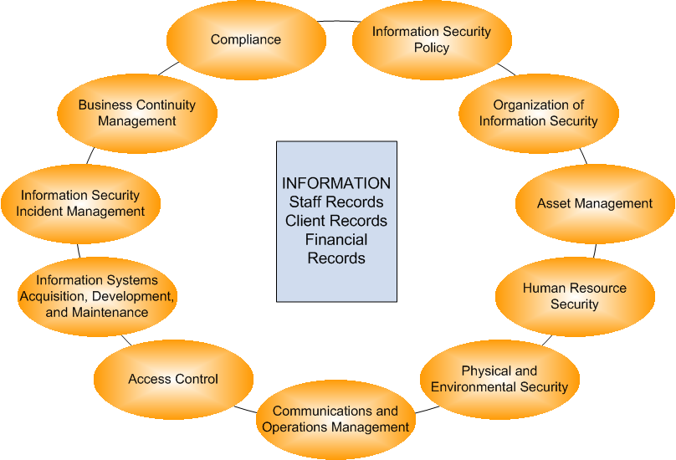
Information Security Concept
Defense-in-Depth Model – Information Security
Successful Organization Functions
Information Assurance
“Defense-In-Depth” Strategy
People
People
Executing Operations Supported by Technology
Operations
Technology
Information Assurance Technical Framework (IATF)
Overlapping Approaches & Layers of Protection
Defending the Network & Infrastructure
Defending the Enclave Boundary
Defending the Computing Environment
Supporting
the Infrastructure
References
NSA IA Solution Directions, Information Assurance Technical Framework, Release 3.1
ISO/IEC 27002:2005, Code of Practice for Information Security Management

Slide 22
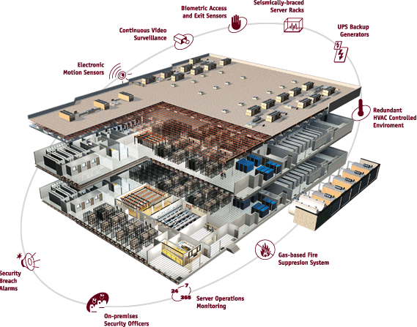
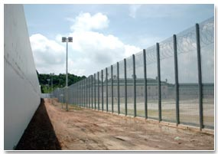

Information Security Concept
Defense-in-Depth Model – Physical Security
Source: Global Crossing website

Slide 23
Questions:
What are the three security objectives?
What are the six security implementation principles?

Slide 24
Answers:
What are the three security objectives?
  Confidentiality
  Integrity
  Availability
What are the six security implementation principles?
  Confidentiality
  Integrity
  Availability
  Need to know
  Least privilege
  Separation of duties

Slide 25
Questions:
What are the eight security “best practices”?
What are the three categories of security controls?

Slide 26
Answers:
What are the eight security “best practices”?
  Confidentiality
  Integrity
  Availability
  Need to know
  Least privilege
  Separation of duties
  Job rotation
  Mandatory vacation
What are the three categories of security controls?
  Management (Administrative)
  Operational (and Physical)
  Technical (Logical)

Slide 27
Learning Objectives
Information Security Management Domain
Information Security Concept
Information Security Management
Information Security Governance
Information Classification
System Life Cycle (SLC) and System Development Life Cycle (SDLC)
Risk Management
Certification & Accreditation
Security Assessment
Configuration Management
Personnel Security
Security Education, Training, and Awareness
Project Management

Slide 28
Information Security Management
Information Security Management Planning
Information Security Governance
Information Classification
Systems and Services Acquisition & Development
Risk Management
Certification & Accreditation
Security Assessment
Typical Outputs:
  Policies, Standards, and Procedures
  System Security Plan (SSP) or System Security Authorization Agreement (SSAA)
  ST&E Report, Risk Statement, and POA&M for Risk Mitigation

Slide 29
Information Security Management
DoD Information Assurance Program – Competencies
DoD takes risk management approach to define core competencies of any DoD IA Programs…
The ability to assess security needs and capabilities (Risk Management – Assess, Mitigate & Evaluate)
The ability to develop a purposeful security design or configuration that adheres to a common architecture and maximizes the use of common services (ISSE, IATF)
The ability to implement required controls and safeguards (ISSE Process)
The ability to test and verify (ST&E, CT&E)
The ability to manage changes to an established baseline in a secure manner (CM, Continuous Monitoring)
Reference: DoDI 8500.2, Information Assurance (IA) Implementation, February 6, 2003

Slide 30
Learning Objectives
Information Security Management Domain
Information Security Concept
Information Security Management
Information Security Governance
Information Classification
System Life Cycle (SLC) and System Development Life Cycle (SDLC)
Risk Management
Certification & Accreditation
Security Assessment
Configuration Management
Personnel Security
Security Education, Training, and Awareness
Project Management

Slide 31
Information Security Governance
Policy. Management directives that establish expectations (goals & objectives), and assign roles & responsibilities
Standards. Functional specific mandatory activities, actions, and rules
Process & Procedure. Step-by-step implementation instructions
Guideline. General statement, framework, or recommendations to augment process or procedure

Slide 32
Information Security Governance
Policies
Policies:
Explain laws, regulations, business/mission needs, and management expectations (goals & objectives).
Identify roles and delineate responsibilities.
Examples:
Executive Orders, Presidential Directives
  E.O. 13526, PDD-67, HSPD-7, etc.
Federal (/Civil)
  OMB Circulars: A-11, A-130, etc.
Military
  DoD Directives, Instructions, Manuals, etc.
Intelligence
  Director, Central Intelligence Directives (DCID).

Slide 33
Information Security Governance
Policies – Roles & Responsibilities
In order to have an effective security program, the roles, responsibilities and authority must be clearly communicated and understood by all.
  Information owner. Executive management are responsible for the protection of information assets. (Tangible and Intangible)
    C[X]Os
    Functional managers
    Solutions providers
    Configuration Management (CM) /CCB
  Information custodian. Information security professionals are delegated with responsibilities to provide security services that supports the execution of business processes within an organization.
    Security managers / officers
    Security administrators (network, systems, databases, etc.)
    Security analysts
    Network, system, database administrators
    Application owner (i.e.
  Information user. End users are responsible for safeguarding & handling of information. (i.e. marking & labeling, printing, transporting, NdA, etc.)
    Line managers
    Analyst
  Information (systems) auditor. The auditors provide independent assessment of the security of information and/or information systems.
    Military: White, Blue & Red Teams, IGs
    Commercial: Auditors, Black-hat Teams

Slide 34
Information Security Governance
Standards
Standards:
Mandatory activities, actions, and rules for the execution of management (or administrative) policies
Examples:
Federal (/ Civil)
  Federal Information Processing Standards (FIPS)
Military
  DoD Regulations, DoD Manuals, etc.
Intelligence
  Director, Central Intelligence Directives (DCID)
Commercial (/ Industry)
  ISO/IEC 27001, BS 7799, etc.

Slide 35
Information Security Governance
Standards
DoD 5200.28-STD Trusted Computer System Evaluation Criteria (TCSEC)
  Evaluates Confidentiality.
Information Technology Security Evaluation Criteria (ITSEC)
  Evaluates Confidentiality, Integrity and Availability.
Common Criteria (CC)
  Provided a common structure and language.
  It’s an International standard (ISO 15408).

Slide 36
Information Security Governance
Standards – ISO/IEC 27001:2005
ISO/IEC 27001 is an Information Security Management System Standard.
Commercially, the systems are certified based on meeting ISO/IEC 27001 (not ISO/IEC 27002!)
ISO/IEC 27002:2005 is a “Code of practice” for information security management
Reference:
ISO/IEC 27001:2005, Information Security Management Systems - Requirements, 2005.
ISO/IEC 27002:2005, Code of Practice for Information Security Management, 2005.

Slide 37
Information Security Governance
Process & Procedure
Process & Procedure:
Step-by-step explanation of how to implement or execute security instructions.
Examples:
System Development Life Cycle (SDLC) System & Services Acquisition Process
  Project Planning and Management Process
  Change Control Process
  Risk Management Process
  Certification & Accreditation Process
Standard Operations Procedure (SOP)
Incident Management Process
Contingency Planning Process
Security Assessment Process

Slide 38
Information Security Governance
Guidelines
Guidelines:
Frameworks or recommendations that facilitate implementation of policies, standards, processes, and procedures.
Examples:
Federal (/ Civil)
  NIST Special Publications (NIST SP 800 series).
Military
  NSA-IATF, NSA-IAM, NSA-IEM.
  NSA SNAC SCGs, DISA FSO STIGs.
Commercial
  ISO/IEC 17799: 2005.
  CIS Benchmarks.

Slide 39
Question:
What are the four types of documents that provide governance to IT security?

Slide 40
Answer:
What are the four types of documents that provide governance to IT security?
  Policy
  Standard
  Procedure (or Manual)
  Guideline

Slide 41
Learning Objectives
Information Security Management Domain
Information Security Concept
Information Security Management
Information Security Governance
Information Classification
System Life Cycle (SLC) and System Development Life Cycle (SDLC)
Risk Management
Certification & Accreditation
Security Assessment
Configuration Management
Personnel Security
Security Education, Training & Awareness

Slide 42
Information Classification
Identifies and characterizes the critical information assets (i.e. sensitivity)
Explains the level of safeguard (protection level) or how the information assets should be handled (sensitivity and confidentiality)
Commercial
Public
Private / Sensitive
Confidential / Proprietary
Military and Civil Gov.
Unclassified
Sensitive But Unclassified (SBU)
Confidential
Secret
Top Secret
Notes:
Commercial:
Public. Examples: Upcoming projects, personnel allocation, advertisements.
Private. Examples: HR, Medical, Salary information.
Sensitive. Example: Financial goals, profit margins.
Confidential / Proprietary. Example: Trade secrets, competitive advantage, processes.
U.S. Federal Government (Military + Civil)
E.O. 12958 “Classified National Security Information” as amended by E.O. 13292, then E.O. 13526.
Bonus: E.O. 12968 “Assess to Classified National Security Information”.
Bonus: What is DCID 6/1 for? “Security Policy for Sensitive Compartmented Information and Security Policy Manual”

Slide 43
Information Classification
Example: Executive Order 13526
Who can best determine the sensitivity of information?
  Information owner
Example: E.O. 13526, Classified National Security Information, Dec. 29, 2009
  President, VP, agency heads, official designated by the President, and delegated USG officials
  It specifically identifies what information shall be classified
    military plans, weapons systems, or operations;
    foreign government information;
    intelligence activities (including special activities), intelligence sources or methods, or cryptology;
    foreign relations or foreign activities of the United States, including confidential sources;
    scientific, technological, or economic matters relating to the national security;
    United States Government programs for safeguarding nuclear materials or facilities;
    vulnerabilities or capabilities of systems, installations, infrastructures, projects, plans, or protection services relating to the national security; or
    the development, production, or use of weapons of mass destruction.
Notes:
It all started with E.O. 12958, issued by President Clinton in 1995. The story behind it was Clinton’s interest in UFO and the assassination of Kennedy. (http://en.wikipedia.org/wiki/Executive_Order_12958)

Slide 44
Information Classification
Example: DoD Manual 5200.01 Vol. 1 to Vol. 4
DoDM 5200.01, DoD Information Security Program, February 24, 2012.
Volume 1: Overview, Classification, and Declassification
Volume 2: Marking of Classified Information
Volume 3: Protection of Classified Information
Volume 4: Controlled Unclassified Information (CUI) (for meeting the E.O. 13556, Controlled Unclassified Information, November 4, 2010.)

Slide 45
Questions:
What is the importance of information classification?
When should the sensitivity and the protection level should be determined in the system life cycle?
What is the importance of FIPS 199?

Slide 46
Answers:
What is the importance of information classification?
  Explains the sensitivity of the information, and the level of protection required to meet the security objectives
When should the sensitivity and the protection level should be determined in the system life cycle?
  At the Initial Phase. It is a part of system characterization activity
What is the importance of FIPS 199?
  Explains the sensitivity of the information in terms of impact in meeting the security objectives

Slide 47
Notes on NIST SP 800-59
The information classification concept is also implemented for information systems that store, process, and distribute national security information…
NIST SP 800-59, Guideline for Identifying an Information System as a National Security System, August 2003.
  It’s a guideline for identification only,
  It does not discuss how information should be managed, and
  Agencies have to establish their own policies

Slide 48
Learning Objectives
Information Security Management Domain
Information Security Concept
Information Security Management
Information Security Governance
Information Classification
System Life Cycle (SLC) and System Development Life Cycle (SDLC)
Risk Management
Certification & Accreditation
Security Assessment
Configuration Management
Personnel Security
Security Education, Training, and Awareness
Project Management

Slide 49
System Life Cycle (SLC) and System Development Life Cycle (SDLC)
System Development Life Cycle (SDLC) Models
Waterfall Development Models
  Waterfall: DoD-STD-2167A (replaced by MIL-STD-498 on 11/1994).
  Modified Waterfall: MIL-STD-498 (cancelled on 5/1998)
  ISO/IEC 12207, Software Life Cycle Processes (IEEE/EIA 12207 US implementation) (based on MIL-STD-499B)
  ISO/IEC 15288, Systems Engineering – System Life Cycle Processes (IEEE std 1220 – 2005, US implementation)
Iterative Development Models
  Boehm’s Spiral Model.
  Rapid Application Development (RAD) & Joint Application Development (JAD)

Slide 50
System Life Cycle (SLC) and System Development Life Cycle (SDLC)
Waterfall Development Models
Classic Waterfall:
DoD-STD-2167A
Modified Waterfall:
MIL-STD-498

Slide 51
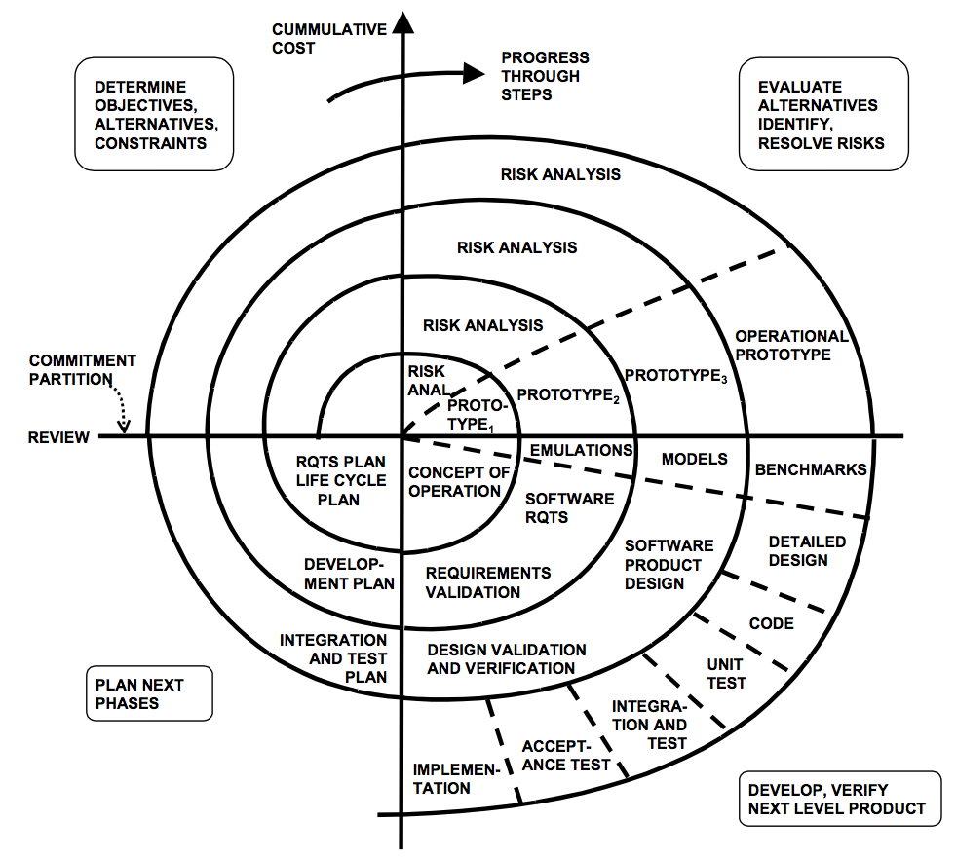
System Life Cycle (SLC) and System Development Life Cycle (SDLC)
Boehm’s Spiral Model
Reference: http://csse.usc.edu/people/barry.html

Slide 52
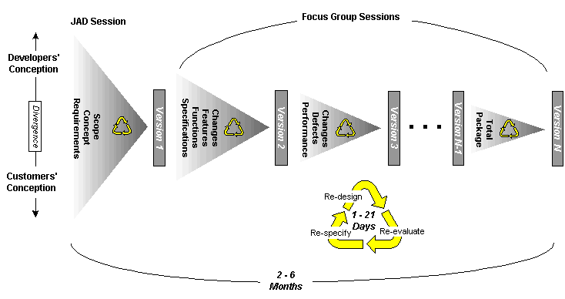
System Life Cycle (SLC) and System Development Life Cycle (SDLC)
Rapid Application Development (RAD) Model
Iterative, but spiral cycles are much smaller.
Risk-based approach, but focus on “good enough” outcome.
SDLC fundamentals still apply…
  Requirements, configuration, and quality management, design process, coding, test & integration, technical and project reviews etc.
Reference:
S. McConnell, Rapid Development: Taming Wild Software Schedules
http://www.cs.bgsu.edu/maner/domains/RAD.htm

Slide 53
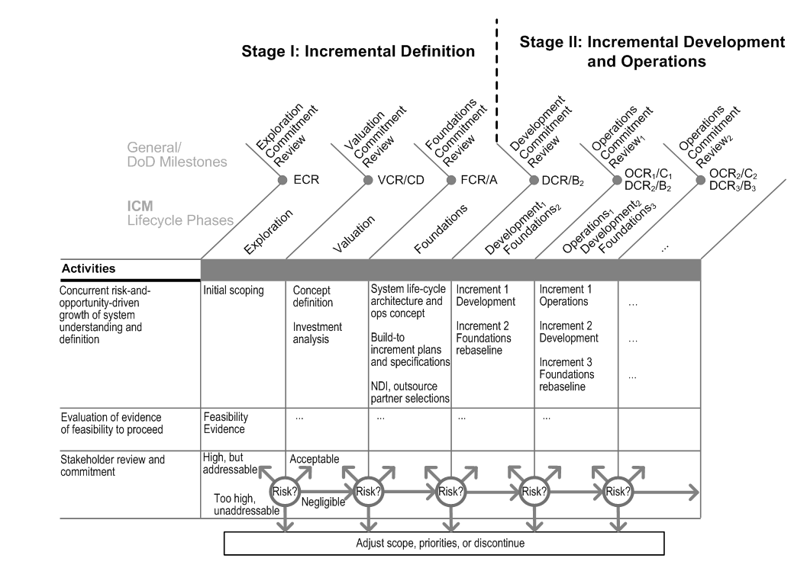

System Life Cycle (SLC) and System Development Life Cycle (SDLC)
Incremental Commitment Model
Reference: B. Boehm, J.A. Lane, Using the Incremental Commitment Model to Integrate System Acquisition, Systems Engineering, and Software Engineering, CrossTalk, October 2007.
Notes:
CJCSM 3170.01C,
CJCSI 3170.01F, Joint Capabilities Integration and Development System (JCIDS)

Slide 54
System Life Cycle (SLC) and System Development Life Cycle (SDLC)
Other SDLC Models – Modified Waterfall w/ Subprojects
Reference: Rapid Development: Taming Wild Software Schedules, Steve McConnell, Microsoft Press, 1996

Slide 55
System Life Cycle (SLC) and System Development Life Cycle (SDLC)
Other SDLC Models – Evolutionary Prototyping
The system concept is refined continuously…
  The focus is on “good enough” concept, requirements, and prototype.
  However, it is difficult to determine level of effort (LOE), cost, and schedule.
Reference: Rapid Development: Taming Wild Software Schedules, Steve McConnell, Microsoft Press, 1996

Slide 56
System Life Cycle (SLC) and System Development Life Cycle (SDLC)
Are there other SDLC models?
Have you heard of “Rugged DevOps”?
Rugged DevOps*
  Idea observed from cloud computing...
  2009, Flickr reported 10 deployments per day
  Amazon EC2 reported in May 2011:**
    Mean time between deployments: 11.6 seconds
    Maximum # of deployments in an hour: 1,079
    Mean # of hosts simultaneously receiving a deployment: 10k
    Maximum # of hosts simultaneously receiving a deployment: 30k
Reference:
  * J. Gorman, G. Kim, Security is Dead. Long Live Rugged DevOps: IT at Ludicrous Speed, RSA Conference 2012 (http://www.slideshare.net/realgenekim/security-is-dead-long-live-rugged-devops-it-at-ludicrous-speed)
  ** Jon Jenkins, Velocity Culture, O’Reilly Velocity 2011, (http://www.youtube.com/watch?v=dxk8b9rSKOo)

Slide 57
System Life Cycle (SLC) and System Development Life Cycle (SDLC)
Philosophy behind the Rugged DevOps
Seamless integration of software development and IT operations
Focus on the “big picture” rather than security controls
  Standard configuration
  Process discipline
  Controlled access to production systems
Results
  75% reduction in outages triggered by software deployment since 2006
  90% reduction in outage minutes triggered by software deployments
  Instantaneous automated rollback
  Reduction in complexity
Back to our study...
Reference:
Jon Jenkins, Velocity Culture, O’Reilly Velocity 2011, (http://www.youtube.com/watch?v=dxk8b9rSKOo)

Slide 58
System Life Cycle (SLC) and System Development Life Cycle (SDLC)
History of Systems/Software Engineering Process Standards

Slide 59
System Life Cycle (SLC) and System Development Life Cycle (SDLC)
Software & System Engineering Management Processes
There are more and more “software-intensive” systems…
  Systems are getting more complex. Hardware problems are often addressed through software;
  Operating environments are stochastic. Software are more flexible than hardware.
As SDLC models evolves, management processes are evolving too…
  DoD-STD-2167A: Waterfall SDLC + SE Process
  MIL-STD-498: Modified Waterfall SDLC + SE Process
  IEEE 1220: System Engineering Process
  ISO 12207: Software + System Engineering Mgmt Process
  ISO 15288: System Engineering Mgmt Process

Slide 60
System Life Cycle (SLC) and System Development Life Cycle (SDLC)
DoD-STD-2167A – System Engineering Process
Reference: DoD-STD-2167A, Defense System Software Development, February 29, 1988

Slide 61
System Life Cycle (SLC) and System Development Life Cycle (SDLC)
ISO/IEC 15288:2008, System Life Cycle Processes
ISO/IEC 15288* encompasses:
  Systems/software engineering processes (Technical Processes)
  Project management processes
  Project support infrastructure (Organizational Project-Enabling Processes)
  Contract/business management processes (Agreement Processes)
* Note: ISO/IEC 15288 is identical to IEEE Std 15288

Slide 62
System Life Cycle (SLC) and System Development Life Cycle (SDLC)
ISO/IEC 12207:2008, Software Life Cycle Processes
* Note: ISO/IEC 12207is identical to IEEE Std 12207
Reference: IEEE/IEC 12207:2008, Information Technology Software Life Cycle Processes

Slide 63
System Life Cycle (SLC) and System Development Life Cycle (SDLC)
IEEE std 1220, System Engineering Process

Slide 64
System Life Cycle (SLC) and System Development Life Cycle (SDLC)
System Life Cycle (SLC)
Initiation Phase (IEEE 1220: Concept Stage)
  Survey & understand the policies, standards, and guidelines.
  Identify information assets (tangible & intangible).
  Define information security categorization & protection level.
  Conduct business impact analysis (BIA) (a.k.a. risk assessment).
  Define rules of behavior & security CONOPS.
Acquisition / Development Phase (IEEE 1220: Development Stage)
  Define security requirements and select security controls.
  Assess system risk.
  Perform cost/benefit analysis (CBA).
  Security planning (based on risks & CBA).
  Practice Information Systems Security Engineering (ISSE) Process to develop security controls.
  Develop security test & evaluation (ST&E) plan.
Reference: NIST SP 800-64, Rev 2,Security Considerations in the Information System Development Life Cycle.

Slide 65
System Life Cycle (SLC) and System Development Life Cycle (SDLC)
Systems Life Cycle (SLC)
Implementation Phase (IEEE 1220: Production Stage)
  Implement security controls in accordance with baseline system design and update system security plan (SSP).
  Integrate system
  Perform Security Certification & Accreditation of target system.
Operations / Maintenance Phase (IEEE 1220: Support Stage)
  Review operational readiness.
  Configuration management & perform change control.
  Continuous monitoring of security posture
  Perform periodic security assessment.
Disposition Phase (IEEE 1220: Disposal Stage)
  Preserve information. archive and store electronic information
  Sanitize media. Ensure the electronic data stored in the disposed media are deleted, erased, and over-written
  Dispose hardware. Ensure all electronic data resident in hardware are deleted, erased, and over-written (i.e. EPROM, BIOS, etc.
Reference: NIST SP 800-64, Rev 2,Security Considerations in the Information System Development Life Cycle.

Slide 66
System Life Cycle (SLC) and System Development Life Cycle (SDLC)
Information System Security Engineering (ISSE) Process
Phase 1: Discover Information Protection Needs
  Ascertain the system purpose.
  Identify information asset needs protection.
Phase 2: Define System Security Requirements
  Define requirements based on the protection needs.
Phase 3: Design System Security Architecture
  Design system architecture to meet on
  security requirements.
Phase 4: Develop Detailed Security Design
  Based on security architecture, design
  security functions and features for the
  system.
Phase 5: Implement System Security
  Implement designed security functions
  and features into the system.
Phase 6: Assess Security Effectiveness
  Assess effectiveness of ISSE activities.
Reference: Information Assurance Technical Framework (IATF), Release 3.1

Slide 67
System Life Cycle (SLC) and System Development Life Cycle (SDLC)
Examples of SDLC and Systems Engineering Activities
IEEE 1220, Application and Management of the Systems Engineering Process
Concept Stage |  |  | Development Stage |  |  |  |  |  |  |  |  | Production Stage | Operations & Maintenance
Defense Acquisition Life Cycle (DoD 5000)
User needs & Technology Opportunities | Concept Refinement |  | Technology Development |  |  | System Development & Demonstration |  |  |  |  |  | Production and Deployment | Operations & Support
IRS Enterprise Life Cycle (ELC)
Vision & Strategy | Project Initiation |  | Domain Architecture |  | Preliminary Design |  |  |  | Detailed Design |  | System Development | System Deployment | Operations & Maintenance
FBI Information Technology Life Cycle Management Directive (IT LCMD)
Concept Exploration |  | Requirements Development |  | Acq. Planning |  |  | Source Select’n. | Design |  |  | Develop & Test | Implementation & Integration | Operations & Maintenance
Systems Engineering (SE) Tasks
Discover Mission/Business Needs |  |  | Define System Requirements |  |  | Design System Architecture |  |  |  | Develop Detailed System Design |  | Implement System Design | Sustainment
Information Systems Security Engineering (ISSE) Tasks
Discover Information Protection Needs |  |  | Define Security Requirements |  |  | Design System Security Architecture |  |  |  | Develop Detailed System Security Controls |  | Implement Security Controls | Continuous Monitoring
We need to do more on understanding the mission/business needs and align to EA

Slide 68
It starts at the beginning of a SDLC…
IEEE 1220 | DoD Acquisition SDLC | Key System Engineering Tasks | Key Security Engineering Tasks*
Concept Stage | User Needs & Technology Opportunities | Task 1: Discover Mission/Business Needs | Task 1: Discover Information Protection Needs
 |  | Understand customer’s mission/business goals (i.e., initial capability, project risk assessment) | Understand customer’s information protection needs (i.e., infosec. risk assessment)
 | Concept Refinement | Understand system concept of operations (CONOPS) | Understand operating environment (i.e., sensitivity of information assets, mode of operations)
 |  | Create high-level entity-data relations model (i.e., system context diagram) | Create information management model (IMM)
 |  | Define engineering project strategy and integrate into the overall project strategy | Define information protection policy (IPP) and integrate into the project strategy
 |  | Create system engineering management plan (SEMP) | Create system security plan (SSP) and integrate into SEMP
 | Milestone A | Task 6: Assess project performance in meeting mission/business needs
* Reference: Information Assurance Technical Framework (IATF), Release 3.1
Key Deliverables
  Mission Needs Statement / Project Goal(s) and Objectives
  System Capabilities
  Preliminary CONOPS
  Preliminary System Context Descriptions
  Project Risk Assessment
  Draft System Engineering Management Plan (SEMP)

Slide 69
IEEE 1220 | DoD Acquisition SDLC | Key System Engineering Tasks | Key Security Engineering Tasks
Development Stage | Technology Development | Task 2: Define System Requirements | Task 2: Define Security Requirements
 |  | Refine system context (e.g., functional components)
 |  | Define system requirements (e.g., functional, performance, operational, support, etc.) | Select assurance requirements and define security functional requirements
 |  | Refine CONOPS | Refine IMM and SSP
 |  | Baseline system requirements
 | Milestone B | Task 6: Assess project performance in meeting mission/business needs
 | System Development & Demonstration | Task 3: Design System Architecture | Task 3: Design System Security Architecture
 |  | Determine & select architecture framework
 |  | Design system architecture and allocate system requirements to subsystems and components (i.e., RTM) | Allocate system security requirements to subsystems and service components (i.e., RTM)
 |  | Analyze gaps (i.e., risk assessment)
 |  | Task 4: Develop Detailed System Design (Logical & Physical) | Task 4: Develop Detailed System Security Design (Logical & Physical)
 |  | Refine entity-data relations model (i.e., UML diagrams, data-flow, network, etc.) | Refine IMM, embed security controls into system design products (i.e., UML, data-flow, network, etc.)
 |  | Perform system synthesis analysis to assure system integration (i.e., system design, system architecture, system requirements, and project mission/business needs)
 | Milestone C | Task 6: Assess project performance in meeting mission/business needs
Key Deliverables
  System Requirements
  Functional Definitions (+ allocation of system requirements)
  System Architecture (Contextual + Logical)
  Detailed System Design (Logical + Physical)
  Requirements Traceability Matrix (RTM)

Slide 70
IEEE 1220 | DoD Acquisition SDLC | Key System Engineering Tasks | Key Security Engineering Tasks
Production Stage | Production and Deployment | Task 5: Implement System Design | Task 5: Implement Security Controls
 |  | Procure system components / construct system
 |  | Code/ customize/ configure system functional components
 |  | Conduct code inspection/ walk-through/ unit test
 |  | Perform system integration
 |  | Conduct system test | Conduct security test & evaluation (ST&E)
 |  | Task 6: Assess project performance in meeting mission/business needs
 |  | Generate system operations procedure (SOP) and users guide/ manual | Generate SOP (a.k.a. trusted facility manual (TFM)), Incident response plan, business continuity plan (BCP)
 |  | Conduct system readiness review | Obtain system certification
 |  | Deploy system
 |  | Conduct system acceptance test | Assess security effectiveness
 |  | Obtain approval to operate (ATO)
Key Deliverables
  Implement detailed system design
  Perform test & evaluations (unit, system, security tests)
  Test reports
  Standard Operating Procedure (SOP) + User Manuals
  Deploy system
  Conduct acceptance tests

Slide 71
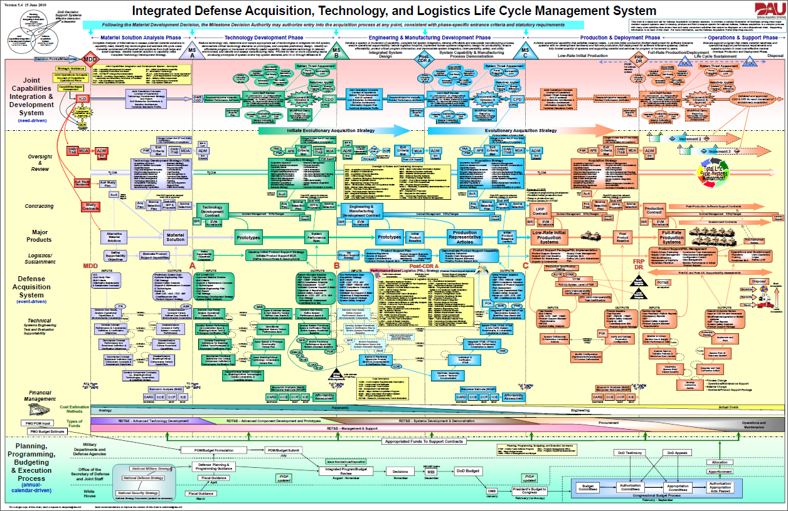
System Life Cycle (SLC) and System Development Life Cycle (SDLC)
Example of SDLC in a Defense Acquisition Lifecycle
* Source: Integrated Life Cycle Chart (https://ilc.dau.mil/)

Slide 72
System Life Cycle (SLC) and System Development Life Cycle (SDLC)
Example: SDLC in a Defense Acquisition Lifecycle
Security engineering is ubiquitously in…
  Planning, Programming, Budget & Execution (PPBE) Process
  Joint Capabilities Integration & Development System (JCIDS) process
  Management & Oversight process(Project/Program Management), and
  Systems engineering process

Slide 73
Questions:
What classic system development life cycle (SDLC) model allows system engineers go back to the previous step?
What iterative SDLC model allows system engineers to evaluate, refine, plan and construct an information system utilizing a series of prototypes ?
Which SDLC model requires formal verification and validation of requirements at the unit-level, system-level, and operational-level?

Slide 74
Questions:
What classic system development life cycle (SDLC) model allows system engineers go back to the previous step?
  Modified Waterfall
What iterative SDLC model allows system engineers to evaluate, refine, plan and construct an information system utilizing a series of prototypes ?
  Spiral Model
Which SDLC model requires formal verification and validation of requirements at the unit-level, system-level, and operational-level?
  The V-Model, IEEE 12207 or ISO/IEC 12207

Slide 75
Learning Objectives
Information Security Management Domain
Information Security Concepts
Information Security Management
Information Security Governance
Information Classification
System Life Cycle (SLC) and System Development Life Cycle (SDLC)
Risk Management
Certification & Accreditation
Security Assessment
Configuration Management
Personnel Security
Security Education, Training, and Awareness
Project Management

Slide 76
Risk Management
What is a Risk?
Risk is the relationship between the likelihood of a loss and the potential impact to the business (/ mission).
For information security, risk is defined as:
  The likelihood of a threat agent (a threat) exploiting vulnerabilities in a “system” (/ system of systems), where “system” = people + process + technology; and
  The potential impact of a successful attack to an organization’s information operations.

Slide 77
Risk Management
Relationship between Threat, Risk, and Countermeasure
Threat Agent. An entity that may act on a vulnerability.
Threat. Any potential danger to information life cycle.
Vulnerability. A weakness or flaw that may provide an opportunity for a threat agent.
Risk. The likelihood of a threat agent exploits a discovered vulnerability.
Exposure. An instance of being compromised by a threat agent.
Countermeasure / safeguard. An administrative, operational, or logical mitigation against potential risk(s).

Slide 78
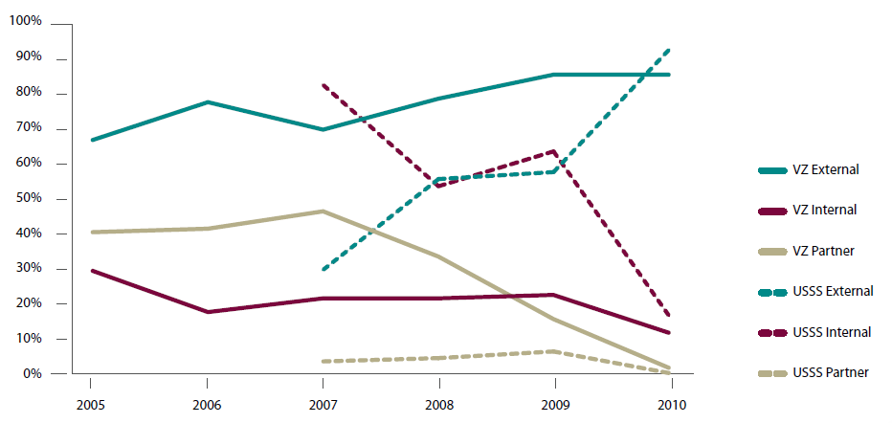
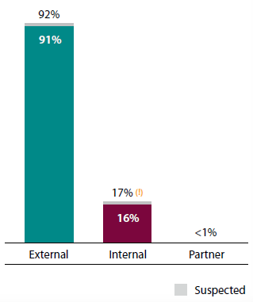
Risk Management
Threat to Information Operations
Operations are getting better at addressing insider threats
        VZ (Verizon)
        USSS (United States Secret Service)
Most of threats are from external threat
agents
Reference: 2011 Data Breach Investigations Report, Verizon, January 2012 (http://www.verizonbusiness.com/resources/reports/rp_data-breach-investigations-report-2011_en_xg.pdf)

Slide 79
Information Security Management
Risk Management Practice
Risk management practice is composed of:
  Risk assessment activities: risk identification, risk analysis, and risk prioritization
  Risk control activities: risk management planning, risk resolution, and risk monitoring
Reference: Software Risk Management, B. Boehm, IEEE Computer Society Press , 1989.

Slide 80


Information Security Management
“All Security Involves Trade-offs”
Step 1: What assets are you trying to
protect?
Step 2: What are the risks to these assets?
Step 3: How well does the security solution
mitigate those risks?
Step 4: What other risks does the security solution cause?
Step 5: What cost and trade-offs does the security solution impose?
And looking out for the “black swan”...
Reference:
Beyond Fear: Thinking Sensibly About Security in an Uncertain World, Bruce Schneier, Springer, 2003.
The Black Swan: The Impact of the Highly Improbable, Nassim Nicholas Taleb, Random House, 2007.

Slide 81
Risk Management
Current State of Insecurity in Federal Agencies
“The 25 major agencies of Federal government continue to improve information security performance relative to C&A rate and testing of contingency plans and security controls.” – OMB FY 2008 Report to Congress on Implementation of FISMA.
# of security incidents keeps growing*…
% of System with a: | FY 2005 | FY 2006 | FY 2007 | FY 2008 | FY 2009
Certification and Accreditation (C&A) | 85% | 88% | 92% | 96% | 95%
Tested Contingency Plan | 61% | 77% | 86% | 92% | 86%
Tested Security Controls | 72% | 88% | 95% | 93% | 90%
Total Systems Reported | 10,289 | 10,595 | 10,304 | 10,679 | 12,930
Incident Categories | FY 2005 | FY 2006 | FY 2007 | FY2008 | FY2009
1. Unauthorized Access | 304 | 706 | 2,321 | 3,214 | 4,848
2. Denial of Service | 31 | 37 | 36 | 26 | 48
3. Malicious Code | 1,806 | 1,465 | 1,607 | 2,274 | 6,977
4. Improper Usage | 370 | 638 | 3,305 | 3,762 | 6,148
5. Scans/Probes/Attempted Access | 976 | 1,388 | 1,661 | 1,272 | 1,152
6. Under Investigation | 82 | 912 | 4,056 | 7,502 | 10,826
Total Incidents Reported | 3,569 | 5,146 | 12,986 | 18,050 | 29,999
* Source: OMB and US-CERT
Notes:
Unauthorized Access: identification and authentication of users are not consistently enforced… a systems engineering problem.
Improper Usage: Information assets are not always identified and inventoried… another security engineering problem. We don’t always know the level of protection necessary. One thing that DoD does pretty well is having a security classification guide for each project.
Under investigation: Those are the incidents that nobody knows exactly the cause and impact. During May of ‘08, MITRE’s Bill Neugent had presented a talk to my sponsor – IRS on the fact that cyber threats are getting more “sophisticated” – no longer just hackers, we now have insiders, organized crime, terrorists, criminals perpetrating fraud. Security engineers needs to understand the MISSION, BUSINESS OBJECTIVES, and OPERATIONAL PROCESSES.

Slide 82
Risk Management
C&A ≠ Risk Management
“… seven years after the passage of FISMA and approximately $40 billion later, I am troubled to learn that the Office of Management and Budget does not track how much agencies spend on cyber security or measure whether those expenditures actually resulted in improved security.” * – Senator Tom Carper
  For FY08, OMB reported 93% of federal information systems had their security controls tested.
  Yet, between FY05 and FY09, the total number of reported security incidents had increased by over 740%.**
Source:
* Congressional hearing: More Security, Less What Makes Sense for our Federal Cyber Defense, October 29, 2009.
** US-CERT

Slide 83

Information Security Management
Fundamental revisited
Risk assessment activities: risk identification, risk analysis, and risk prioritization
Risk control activities: risk management planning, risk resolution, and risk monitoring
Reference: Software Risk Management, B. Boehm, IEEE Computer Society Press , 1989.

Slide 84
Risk Management
Risk Assessment Process
Reference:
NIST SP 800-30, Rev. 1, Guide for Conducting Risk Assessments, Sept. 2011

Slide 85
Risk Management
Risk Assessment Methods
Quantitative
ALE = SLE x ARO
SLE = AV x EF
Annualized Lost Expectance (ALE).
Single Loss Expectance (SLE). Monetary loss (impact) for each occurrence of a threatened event
Annualized Rate of Occurrence (ARO). The frequency which a threat is expected to occur on an annualized basis
Asset Value (AV). Monetary value of the information asset
Exposure Factor (EF). Percentage of loss from a specific threat.
Qualitative
Likelihood Determination
  Threat agent motivation & capability
  Nature of the vulnerability
  Existence and effectiveness of current controls.
Impact Analysis (Confidentiality, Integrity & Availability)
  System mission (e.g., the processes performed by the IT system)
  System and data criticality (e.g., the system’s value or importance to an organization)
  System and data sensitivity.
 |  | Likelihood Level
 |  | Low | Medium | High
 | Significant (High) | 2 | 3 | 3
 | Serious (Moderate) | 1 | 2 | 3
 | Mild (Low) | 1 | 1 | 2
Magnitude of Impact
SC _{information type} = {(confidentiality, impact), (integrity, impact), (availability, impact)}, where the acceptable values for potential impact are low, medium, or high.
Notes:
Ref. NIST SP 800-30 “Risk Management Guide for Information Technology Systems”.
Ref. NIST SP 800-53 “Recommended Security Controls for Federal Information Systems”.

Slide 86
Risk Management
Risk Assessment Methods: Quantitative vs. Qualitative
Quantitative
Pros
  Assessment & results are based substantially on independently objective processes & metrics. Thus, meaningful statistical analysis is supported.
  The value of information are expressed in monetary terms with supporting rationale, is better understood. Thus, the basis for expected loss is better understood.
  A credible basis for cost/benefit assessment of risk mitigation measures is provided. Thus, information security budget decision-making is supported.
Cons
  Calculations are complex. If they are not understood or effectively explained, management may mistrust the results.
  A substantial amount of information about the target information & its IT environment must be gathered
  There is not yet a standard, independently developed & maintained threat population & frequency knowledge base.
Qualitative
Pros
  Calculations are simple and readily understood and executed.
  Not necessary to determine quantitative threat frequency & impact data.
  Not necessary to estimate the cost of recommended risk mitigation measures & calculate cost/benefit.
  A general indication of significant areas of risk that should be addressed is provided.
Cons
  Risk assessment & results are essentially subjective in both process & metrics. Use of independently objective metrics is eschewed.
  No effort is made to develop an objective monetary basis for the value of targeted information assets.
  No basis is provided for cost/benefit analysis of risk mitigation measures. Only subjective indication of a problem.
  It is not possible to track risk management performance objectively when all measures are subjective.

Slide 87
Risk Management
Risk Control – Determine Information Protection Needs
Mode of Operations: System-High
Data Sensitivity: SBU/FOUO
SC (Budget & Finance) =
{Conf.(M), Integ.(M), Avail.(L)}
Threat agent (Likelihood):
  Hackers (Moderate)
  Organized Crime (Moderate)
  International Press (Moderate)
  Careless/Poorly Trained Employees (High)
 | PHE (Threat Likelihood)
Severity of HTI (Impact) | Low | Moderate | High
Significant (High) | 2 | 3 | 3
Serious (Moderate) | 1 | 2 | 3
Mild (Low) | 1 | 1 | 2

Slide 88
Risk Management
Risk Control – Risk Management Actions
Risk Acceptance
  Establish risk acceptance criteria to determine what is acceptable.
Risk Mitigation
  Establish plan of action & milestone (POA&M) for implementing safeguards and countermeasures.
Risk Transfer
  Transfer the potential liability to another entity (e.g., insurance company.)
Total Risk = ∑ (Threats x Vulnerability x Asset value)
Residual Risk = (Total Risk) – (Countermeasures and Safeguards)

Slide 89
Questions
What are the two types of risk analysis methods?
What type of risk analysis requires the potential impact be measured in financial terms?
What type of risk analysis requires the potential impact be adjudicated in terms of “severity of loss”?

Slide 90
Answers
What are the two types of risk analysis methods?
  Qualitative
  Quantitative
What type of risk analysis requires the potential impact be measured in financial terms?
  Quantitative
What type of risk analysis requires the potential impact be adjudicated in terms of “severity of loss”?
  Qualitative

Slide 91
Learning Objectives
Information Security Management Domain
Information Security Concepts
Information Security Management
Policies, Standards, Procedures, and Guidelines
Information Classification
System Life Cycle (SLC) and System Development Life Cycle (SDLC)
Risk Management
Certification & Accreditation
Security Assessment
Configuration Management
Personnel Security
Security Education, Training & Awareness

Slide 92
Certification & Accreditation (C&A)
Concept
Certification is a disciplined approach to evaluate level of conformance to the prescribed security requirements and the implemented security controls to a security enclave.
Accreditation is the official management decision to operate the certified system(s). It is also a formal acceptance of the responsibility to the security of the certified system(s).
C&A does not guarantee the system(s) free of vulnerability and risks… hence, the need for periodic security (or vulnerability) assessments.

Slide 93
Certification & Accreditation (C&A)
We are in a “Transition Period”
The concept of C&A is still around...
  It’s a cultural thing.
  Most of IG security auditors, and many agency information assurance (IA) professionals are sorting out RMF & ongoing security authorization
C&A has a long history...
  Computer Security Act of 1987 → FISMA 2002
  The Rainbow Series/DoD 5200.28-STD (TCSEC) → NIST SP 800-37/DoDI 8500.2 → NIST 800-37, Rev. 1/CNSSP-22
For CISSP, we just need to learn the broad concept of C&A

Slide 94
Certification & Accreditation (C&A)
Process & Guideline
Standard C&A / Security Authorization Processes:
For Federal Information Systems
  Civil: NIST SP 800-37, Rev. 1, Guide for Applying the Risk Management Framework to Federal Information Systems: A Security Life Cycle Approach, February 2010
For National Security Systems (NSS)
  Civil: CNSSP-22, Information Assurance Risk Management Policy for National Security Systems, January 2012
  Military: DoDI 8510.01, Department of Defense Information Assurance Certification and Accreditation Process (DIACAP) → Risk Management Framework (RMF) DoD Information Technology (IT), March 12, 2014.

Slide 95
Information Security Management
Risk Management Framework – Management Process
Objectives:
  To ensure that managing information system-related security risks is consistent with the organization’s mission/business objectives and overall risk strategy established by the senior leadership through the risk executive (function);
  To ensure that information security requirements, including necessary security controls, are integrated into the organization’s enterprise architecture and system development life cycle processes;
  To support consistent, well-informed, and ongoing security authorization decisions (through continuous monitoring), transparency of security and risk management-related information, and reciprocity; and
  To achieve more secure information and information systems within the federal government through the implementation of appropriate risk mitigation strategies.
Reference: NIST SP 800-37, Rev. 1, Guide for Applying the Risk Management Framework to Federal Information Systems – A Security Life Cycle Approach, Joint Task Force Transformation Initiative, February 2010.

Slide 96
Certification & Accreditation (C&A)
Risk Management Framework & System Life Cycle

Slide 97
Certification & Accreditation (C&A)
Risk Management Framework and Ongoing Security Authorization

Slide 98
Certification & Accreditation (C&A)
DIACAP
Reference: DoDI 8510.1 Department of Defense Information Assurance Certification and Accreditation Process (DIACAP)

Slide 99
Learning Objectives
Information Security Management Domain
Information Security Concepts
Information Security Management
Information Security Governance
Information Classification
System Life Cycle (SLC) and System Development Life Cycle (SDLC)
Risk Management
Certification & Accreditation
Security Assessment
Configuration Management
Personnel Security
Security Education, Training, and Awareness
Project Management

Slide 100
Security Assessment
NSA Defined Security Assessment Methodology
ASSESSMENTS
(Level I)
INFOSEC Enhancements
EVALUATIONS
(Level II)
INFOSEC Enhancements
RED TEAM
(Level III)
Cooperative High Level Overview
Information / Mission Critical Analysis (Compliance Audit)
Inventory Audit of Assets
Information / Data Flow Analysis
Security Process Audit / Analysis
Detailed Inventory Audit of Assets
Cooperative Security Testing / Audit
  Non-Intrusive Tests
  Penetration Tests
Non-cooperative Security Testing
  External Penetration Tests
Simulation of Appropriate Adversary

Slide 101
Security Assessment
The “Current State” of Cyber Defense Operating Model
Cyber adversary attacks and cyber defense operation reacts...
Not very effective...*
Reference:
* US-CERT.

Slide 102
Security Asssessment
The “Future State” of Cyber Defense Operating Model – Information Security Continuous Monitoring (ISCM)
Knowing and fixing problems before our adversaries discover them – proactive...
Reference:
T. Sanger, Keynote Address, 7th Annual IT Security Automation Conference, Oct. 31, 2011.
T. Keanini, Boyd’s OODA Loop and Continuous Monitoring, 7th Annual IT Security Automation Conference, Oct. 31, 2011.

Slide 103
Questions:
When should risk assessment be performed in a typical system life cycle?
What are the three actions, a designated approving authority may take to address risk?

Slide 104
Answers:
When should risk assessment be performed in a typical system life cycle?
  Risk management is a life cycle activity. Risk assessment should be performed periodically throughout the system life cycle
What are the three actions, a designated approving authority may take to address risk?
  Accept Risk
  Mitigate Risk
  Transfer Risk

Slide 105
Questions:
In qualitative risk assessment method, what are the two variables for determining risks?
In quantitative risk assessment method, what are the variables that determines the annual lost expectance (ALE)?
  Hint: What is the term used to describe the monetary lost for each occurrence of a threatened event?
  Hint: What is the term used to describe the frequency which a threat is expected to occur on an annualized basis?

Slide 106
Answers:
In qualitative risk assessment method, what are the two variables for determining risks?
  Likelihood and Impact.
In quantitative risk assessment method, what are the variables that determines the annual lost expectance (ALE)?
  ALE = SLE X ARO.
  Hint: What is the term used to describe the monetary lost for each occurrence of a threatened event?
  Hint: What is the term used to describe the frequency which a threat is expected to occur on an annualized basis?

Slide 107
Learning Objectives
Information Security Management Domain
Information Security Concepts
Information Security Management
Information Security Governance
Information Classification
System Life Cycle (SLC) and System Development Life Cycle (SDLC)
Risk Management
Certification & Accreditation
Security Assessment
Configuration Management
Personnel Security
Security Education, Training, and Awareness
Project Management

Slide 108
Configuration Management
Change Control & Configuration Management
Change control (or Change Management) is a organizational business process.
Configuration Management (CM) is a organizational practice that manages and maintains records of system baseline, configuration changes, and supports the change control process.
Note: Example of change control process according to ITIL

Slide 109
Configuration Management
Configuration Management and Security Posture Baseline

Slide 110
Configuration Management
Configuration Management and Information Security
We know that 80-90% of known vulnerabilities can be attributed to misconfigurations and missing patches, so ...
  Asset inventory data (to know what agencies have?)
  Configuration (to know how are they configured?)

Slide 111
Configuration Management
Configuration Management and Information Security
The effort started with Federal Desktop Core Configuration (FDCC, OMB M-07-18)
Provided implementation guidance on FDCC (OMB M-08-22)
Attempted using FISMA to drive change (OMB M-09-29, M-10-15 to CyberScope, then M-11-33)

Slide 112
Learning Objectives
Information Security Management Domain
Information Security Concepts
Information Security Management
Information Security Governance
Information Classification
System Life Cycle (SLC) and System Development Life Cycle (SDLC)
Risk Management
Certification & Accreditation
Security Assessment
Configuration Management
Personnel Security
Security Education, Training, and Awareness
Project Management

Slide 113
Personnel Security
Personnel Security Best Practice
Hiring…
  Personnel security interviews.
  Background investigation.
  Adjudication.
  Non-disclosure agreement.
Operating…
  Separation of duties.
  Rotation of jobs.
  Security awareness briefing.
Exiting…
  Debriefing / exit interview.
  Inventory & close accounts.
  Escort.
Soap box:
Personnel security is critical to information security.
DIA reported 80% of security incidents are originated from internal threat agents.
  Navy, the Walkers.
  FBI, the Hanssen.
Security Awareness
  Protect against social engineering, dumpster diving, transmission of virus.
  Kevin Mitnick
References:
E.O. 13467, Reforming Process to Suitability for Government Employment, Fitness for Contractor Employees, and Eligibility for Access to Classified National Security Information, June 30, 2008.
DCID 6/4, Personnel Security Standards and Procedure Governing Eligibility for Access to Sensitive Compartmented Information
DoD 5200.2-R, Personnel Security Program

Slide 114
Personnel Security
Insider Threats… (1/2)
Employees, former employees, and business partners may be the biggest information security threat to an enterprise...
Source of Incidents* | 2007 | 2008
Unknown | N/A | 42%
Employees | 48% | 34%
Hackers | 41% | 28%
Former employees | 21% | 16%
Business partners | 19% | 15%
Customer | 9% | 8%
Other | 20% | 8%
Terrorist/ foreign government | 6% | 4%
References:
* The Global State of Information Security 2008, CSO Online (http://www.csoonline.com/article/print/454939)

Slide 115
Personnel Security
Insider Threats… (2/2)
Software Engineering Institute (SEI) CERT Program’s insider threat studies also found that…
  68% of the insider attack occurred at the workplace
  73% of crimes were committed during working hours
  Over three-quarters of the insider had authorized access to information assets
  None of the insider had privileged access (i.e. system/database administrator.)
  20% involved in theft of physical properties (e.g., document, laptops, PC, etc.)
References: Insider Theft of Intellectual Property for Business Advantage: A Preliminary Model, CERT Program, Software Engineering Institute and CyLab at Carnegie Mellon University, June 2009.

Slide 116
Learning Objectives
Information Security Management Domain
Information Security Concepts
Information Security Management
Information Security Governance
Information Classification
System Life Cycle (SLC) and System Development Life Cycle (SDLC)
Risk Management
Certification & Accreditation
Security Assessment
Configuration Management
Personnel Security
Security Education, Training, and Awareness
Project Management

Slide 117
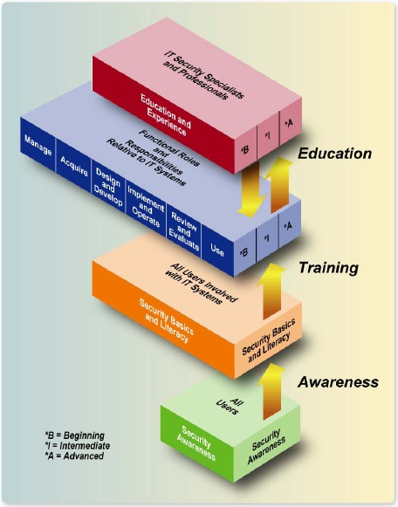
Security Education, Training and Awareness (SETA)
Awareness
  Orientation briefs and materials to inform and remind employees of their security responsibilities and management’s expectation.
Training
  Course and materials to provide employees the necessary skills to perform their job functions.
Education
  Course and materials to provide employees the necessary decision-making and management skills to improve their promotional ability and mobility.
Reference: NIST SP800-50, Building an IT Security Awareness and Training Program.

Slide 118
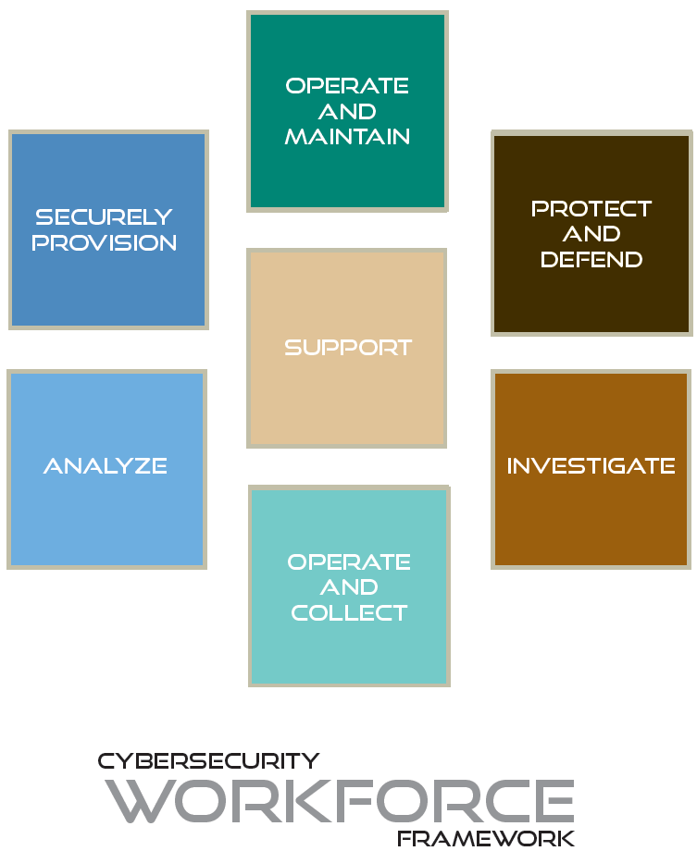
Security Education, Training, and Awareness
National Initiative for Cybersecurity Education (NICE) (1/2)
NICE is a part of Comprehensive National Cybersecurity Initiative (CNCI) where government and industry collaborated to create a training & educational framework for cybersecurity workforce.
Reference: http://csrc.nist.gov/nice/

Slide 119
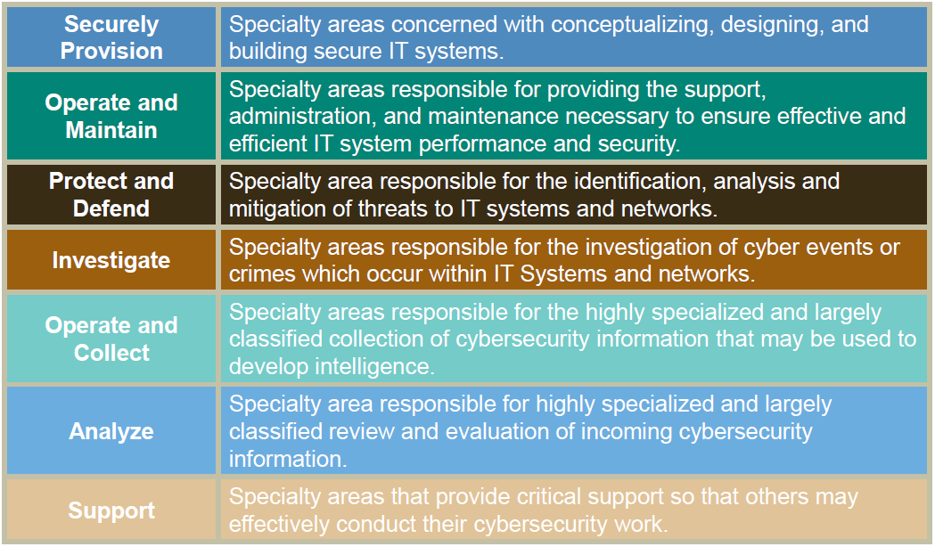
Security Education, Training, and Awareness
National Initiative for Cybersecurity Education (NICE) (2/2)
Reference: http://csrc.nist.gov/nice/

Slide 120
Learning Objectives
Information Security Management Domain
Information Security Concepts
Information Security Management
Information Security Governance
Information Classification
System Life Cycle (SLC) and System Development Life Cycle (SDLC)
Risk Management
Certification & Accreditation
Security Assessment
Configuration Management
Personnel Security
Security Education, Training, and Awareness
Project Management

Slide 121
Project Management
Terms & Definitions... 1/2
Project: A planned undertaking to accomplish a specific business goal/objectives.
Program: A collection of integrated, networked projects to accomplish a set of business/mission goals/objectives.
Integrated Master Plan (IMP): An “event-based” plan consists of a hierarchical program events (/tasks) supported by specific accomplishments.
Integrated Master Schedule (IMS): An integrated, networked schedule that contains the detailed discrete tasks or activities (defined in IMP).
Notes:
Program Management Terminologies:
Project is a planned undertaking to accomplish a specific business goal or objectives.
Program is a collection of projects.
All programs should have an Integrated Master (/ Management) Plan (IMP). This is to explain the series of tasks and resources that are required to accomplish projects.
Of course, all programs should also have an Integrated Master Schedule (IMS). This specifies the period of performance for each tasks within each projects and thus the program.

Slide 122
Project Management
Terms & Definitions... 2/3
Task (/ Activity): An element of work performed during the course of a project.
Resources: Budget, people, time, material and tools, etc.
Notes:
Task or activities defines the work performed during the course of a project.
For a large group of tasks, the sequence of tasks can be grouped into a work package.
There are two types of projects: Level-of-Effort (LOE), and Discrete Effort.
Level-of-Effort (LOE) projects, the activities are flat, the work effort is generally flat and the cost is measured through time. (as shown in the picture on the right. 4 x Full Time Effort (FTE)). For example: Project Management Support, this is a general support function.
Discrete Effort is also known as “Activities-based Costing (ABC)”. In this type of projects, the efforts or the tasks are based on project needs. For example, to perform the development of a system interface may starts with one system engineer, but in the software coding phase may require 4 software programmers, and in the testing phase may need 2 testers. Thus, the effort is based on the activities.

Slide 123
Project Management
Terms & Definitions... 3/3
Types of Projects:
Level-of-Effort (LOE): General / supportive
activities typically measured through time
(e.g. PM, CM, Operations, etc.)
Discrete Effort (a.k.a. Activities-based
Costing (ABC)): Purposeful activities
related to completion of a specific
product or service that can be
measured in Cost/Schedule
(e.g. development of a functional
module, software code, etc.)

Slide 124
Project Management
Project Management Methodologies & Framework
Project Management Methodologies
  Critical Path Method (CPM).
  Program Evaluation & Review Technique (PERT).
  Earned-Value Management System (EVMS) / Earned-Value Technique (EVT).
Project Management Framework
  Project Management Institute’s (PMI) Project Management Body of Knowledge (ANSI/PMI 99-001-2004).
Notes:
This is a list of project management concepts we will be delve in depth during this domain…
1959: PERT (for Polaris Project).
1963: Earned-Value Concept (for Minuteman Project).
1964: Cost Accomplishment Concept (Titan III Project).
1967: Cost/Schedule Control System Criteria (C/SCSC) (DoDI 7000.2).
1972: Cost/Schedule Performance Criteria (C/SPC) (NASA-MSFC).
1975: Performance Management System (PMS) (DOE).
1983-1985: PMS (NASA-GSFC, LRC, JSFC).
1996: DoD adopted Earned-Value Management (EVMS) industry standard – ANSI/EIA-748… issued DoD 5000.2-R and DFARS.
1998: DoD issued MIL-HDBK-881.
2002: Defense Acquisition Guide officially replaced DoD 5000.2-R.
2005: DoD issued revised MIL-HDBK-881A.

Slide 125
Project Management
“Scientific” Project Management Methodologies
The concept of “Scientific Management” started by Frederick Winslow Taylor in 1911.
Critical Path Method (CPM):
  Started by DuPont Corporation as a scientific management method standard for managing projects/product production.
Program Evaluation & Review Technique (PERT):
  Started by USN in 1958, as a scientific management method for the Polaris Missile Program.
  In 1958, USA also used PERT for their Minuteman Missile Program.
Reference:
The Principle of Scientific Management, by Frederick Winslow Taylor, 1911.
http://en.wikipedia.org/wiki/Critical_path_method
http://en.wikipedia.org/wiki/PERT
Notes:
The concept of “Scientific Management” started around 1911. The book – The Principle of Scientific Management by Frederick Winslow Taylor is a good historic read, this book provide you a historical perspective on the importance of project management.
Critical Path Method (CPM), it originated by the DuPont Corporation in 1950s. CPM is used for managing industrial/chemical plant.
Program Evaluation & Review Technique (PERT). Is the scientific management method for U.S. Navy on their Polaris Missile Program and U.S. Army for their Minuteman Missile Program.
Question: Does anybody remember the Polaris missile?
Answer: It was a submarine-launched ballistic missile (SLBM), and Minuteman missile is a land-based intercontinental ballistic missile (ICBM).

Slide 126
Project Management
“Scientific” Project Management Methodologies
Earned-Value Management System (EVMS):
  A systematic integration and measurement of cost, schedule, and accomplishments of an investment that enables organizations to evaluate project performance during execution.
  Incorporate CPM, PERT and EVT.
The use of EVMS is required by the Clinger-Cohen Act of 1996.
  Section 5113 Performance-based and Result-based Management.
  (a) IN GENERAL – The Director shall encourage the use of performance-based and results-based management in fulfilling the responsibilities assigned under section 3504(h), of title 44, United States Code.
  (b)(1) REQUIREMENT – The Director shall evaluate the information resources to the performance and results of the investment made by the executive agencies in information technology.
Notes:
Earned-Value Management System (EVMS) is a systematic integration of cost, schedule, and accomplishments project management methodology. EVMS is now the official project management methodology for USG – U.S. Government.

Slide 127
Project Management
Critical Paths Method (CPM)
Critical Path Method (CPM) provides you insights to sequence of project tasks/activities.
Statement of Work (SOW)
  + Work Breakdown Structure (WBS)
  + Critical Path Method (CPM)
  = Integrated Master Plan (IMP)
However, CPM does not show you: Time, Entry/Exit Criteria and Resources required.
Notes:
So, I have just show the secret to the universe ☺
The Critical Path Method (CPM) provides you insights to the sequence and interdependencies of project activities.
So, with Statement of Work, WBS, and Critical Paths you have the basic components of a Integrated Master Plan.
However… <Click> For a plan to be a PLAN, you need to define: Performance period, Entry Criteria, Success Criteria, and Resources!

Slide 128
Project Management
Program Evaluation & Review Technique (PERT)
PERT is CPM with “time vector.”
Time vector contains: Start time and Finish time.
  Earliest Start time (ES), Latest Start time (LS).
  Earliest Finish time (EF), Latest Finish time (LF).
Notes:
PERT – Program Evaluation & Review Technique provides the schedule element to the critical paths.
The “time vector”: A, B, C, D, … show the start and finish time.
Question: How does one estimate those time vectors?
Answer: By knowing how much effort and resources needed to complete a task. You either learn it by doing it, or watching somebody doing the work. This is where experience becomes valuable, so speak up when you have question. Nobody knows everything.

Slide 129
Management Methodologies
Program Evaluation & Review Technique (PERT)
PERT provides you insights to sequence of tasks/ activities in terms of schedule.
Work Breakdown Structure (WBS)
+ Program Evaluation & Review Technique (PERT)
= Integrated Master Schedule (IMS)
However, PERT does not show you: Entry/exit criteria and resources required.
Notes:
So PERT provides you insights to sequence of tasks in a project schedule.
Therefore, with WBS and PERT, you have an Integrated Master Schedule (IMS). <Click>
However, the problem with PERT is that it does not show you the entry/exit criteria and it does not explain anything about the resource usage or cost.
Hence for large program with complex matrix organization structure you need to use EVMS.
<Continue, next slide>

Slide 130
Management Methodologies
Program Evaluation & Review Technique (PERT)
This is an actual example!
What is wrong with this project?
This PM has never build an system architecture.
Notes:
This is an actual example! I am not going to name names, nor the project… <Click>
Question: What is wrong with this project? <Click>
Answer: It appears that this project manager needs help. And your are the person to do it! Because you are that “Senior IA Engineer”! ☺

Slide 131
Some serious facts about the current state of federal IT projects
Government Accountability Office (GAO) reported:
  “… for fiscal year 2006, nearly 25% of the funds (IT budget) requested, totaling about $15 billion, were considered by OMB to be at risk.”
  “In the case of risk assessment, supporting documentation for about 75% of the investments did not address OMB’s required risk categories.”
Government Computer News (GCN) reported a survey from 104 Federal IT executives:
  Reasons for program over-run are…
    65+%: Poor program management.
    54%: Scope creep.
  Key to reduce number of failed agency IT projects is…
    Training.
Resource:
GAO-06-250 Information Technology: Agencies Need to Improve the Accuracy and Reliability of Investment Information.
http://www.gcn.com/online/vol1_no1/42733-1.html

Slide 132
Project Management
Earned-Value Management System (EVMS)
DoD EVMS is based on ANSI/EIA-748-A-1998, Earned Value Management Systems Standard.
Implementation of EVMS (i.e. DoD EVMIG) consists of 32 Guidelines in 5 Categories:
  Organization.
  Planning, Scheduling & Budgeting.
  Accounting Considerations.
  Analysis and Management Reports.
  Revisions and Data Maintenance.
Reference:
http://www.acq.osd.mil/pm/historical/ansi/ansi_announce.html
http://www.ndia.org/Content/ContentGroups/Divisions1/Procurement/NDIA_PMSC_EVMS_IntentGuide_Jan2006U1.pdf
Notes:
DoD’s earned value management system is based on the ANSI-748-A standard.
DoD’s Earned Value Management Implementation Guide (DoD EVMIG) had specified 32 guidelines in the following 5 categories:
Organization
Planning, Scheduling and Budgeting
Accounting Considerations
Analysis and Management Reports
Revisions and Data Maintenance
Note: C/SCSC had 35 criteria.

Slide 133
Project Management
Earned-Value Management System (EVMS)
Key attributes in EVMS:
  Statement of Work (SOW).
  Work Breakdown Structure (WBS).
  Entry Criteria (i.e. task dependencies, work authorization, etc.)
  Exit Criteria (i.e. deliverables, PMR, closure, etc.)
  Resources: Time, costs & budget.
Notes:
There are 5 key attributes in any EVMS system:
Statement of Work that describes what you are planning to do.
Work Breakdown Structure that delineates all the tasks and work packages.
Entry Criteria are the prerequisites to tasks, things like work authorization, resources, and dependent tasks.
Exit Criteria, also known as the Success Criteria, are the deliverables, program management reviews, and project closures.
Resources. Time, budget and costs.
Question: What is the difference between a budget and a cost?
Answer: A budget is an allocated plan expenditure. And cost is the acquisition value for an effort or product.

Slide 134
Project Management
Earned-Value Management System (EVMS)
Project performance value is “earned” through:
  Work performed.
  Product delivery (i.e. milestones).
Project performance can be analyzed and projected using Earned-Value Technique (EVT) (a.k.a. Performance Measurement Analysis).
Notes:
In an EVMS system, the program performance is “earned” through work performed and product delivery.
Using the EVMS system, project performance can be measured, analyzed and projected by using Earned-Value Technique.

Slide 135
Project Management
EVMS – Earned-Value Technique (EVT)
Earned Value (EV): Actual work performed.
Planned Value (PV): Budgeted cost for work scheduled at a given time.
Actual Cost (AC): Costs incurred in actual work performed.
BCWP: Budgeted cost for work performed.
BCWS: Budgeted cost for work scheduled.
ACWP: Actual cost for work performed.
Reference: PMI Project Management Body of Knowledge (ANSI/PMI 99-001-2004)
Notes:
Earned-Value Technique terminology and definitions.
Earned Value (EV) is the actual work performed
Planned Value (PV) is the budgeted cost for work scheduled at a given time.
Actual Cost (AC) is the costs incurred from performing actual work.
BCWP is Budgeted Cost for Work Performed.
BCWS is Budgeted Cost for Work Scheduled.
ACWP is Actual Cost for Work Performed.
<Continue, next slide>

Slide 136
Project Management
EVMS – Earned-Value Technique (EVT)
Cost Variance: CV = BCWP – ACWP
Schedule Variance: SV = BCWP – BCWS
Cost Performance Index: CPI = BCWP ÷ ACWP
Schedule Performance Index: SPI = BCWP ÷ BCWS
Reference: PMI Project Management Body of Knowledge (ANSI/PMI 99-001-2004)
Notes:
Now here is the math part…
Cost Variance (CV) is the Budgeted Cost for Work Performed (BCWP) minus the Actual Cost for Work Performed (ACWP).
Schedule Variance (SV) is the Budged Cost for Work Performed (BCWP) minus the Actual Cost for Work Scheduled (ACWP).
Cost Performance Index (CPI) is the Budgeted Cost for Work Performed (BCWP) divided by the Actual Cost for Work Performed (ACWP).
Schedule Performance Index (SPI) is the Budgeted Cost for Work Performed (BCWP) divided by the Budgeted Cost for Work Scheduled (BCWS).
Let me decode this graphically…
<Continue, next slide>

Slide 137
Project Management
EVMS – Earned-Value Technique (EVT)
Calculating the Cost Variance…
BCWP ($400k)
– ACWP ($450k)
= CV (-$50k)
Notes:
As the diagram on the right have shown…
Cost Variance is the earned-value minus the actual cost at a specific date. (It can be a milestone date, or end-of-week, month, or year).
Question: So if your cost variance is negative, then how is this project doing? <Click>
Answer: The project is costing more than it had budgeted. We call this event – a “budget over-run”.

Slide 138
Project Management
EVMS – Earned-Value Technique (EVT)
Calculating the Cost Performance Index (CPI)…
BCWP ($400k)
÷ ACWP ($450k)
= CPI (.89)
Question:
If CPI < 1 then how
is this project doing?
Answer:
Project is not as productive as planned.
Notes:
As the diagram on the right have shown…
Cost Performance Index (CPI) is an indicator of how project is doing?
Question: So if your CPI is less than 1, then how is this project doing? <Click>
Answer: The project is costing more than it had budgeted. We call this event – a “budget over-run”. This project spends $1.13 for every $1.00 budgeted work accomplished!

Slide 139
Project Management
EVMS – Earned-Value Technique (EVT)
Calculating the Schedule Variance…
BCWP ($400k)
– BCWS ($500k)
= SV (- $100k)
Notes:
Now take look at the diagram on the right…
Schedule variance is the earned-value (BCWP) minus the planned value (BCWS) at a specific time. (It can be a ceiling, or end-of-week, month, or year).

Slide 140
Project Management
EVMS – Earned-Value Technique (EVT)
Calculating the Cost Performance Index (CPI)…
BCWP ($400k)
÷ BCWS ($500k)
= SPI (.80)
Question:
If SPI < 1 then how
is this project doing?
Answer:
It’s is behind schedule.
Notes:
Now take look at the diagram on the right…
Schedule variance is the earned-value minus the planned value at a specific cost. (It can be a ceiling, or end-of-week, month, or year).
Question: So if your schedule variance is positive, then how is this project doing? <Click>
Answer: The project is behind schedule.

Slide 141
Project Management
Project Recovery
So, project is not doing well… What do you do?
Notes:
So, your project is not doing well…
You are a budget over-run, and likely you are behind schedule.
This means that you’ll have to do a project recovery. <Click>
Increase resources? De-scope? Or point fingers and start a re-org.?

Slide 142
Project Management
Project Recovery
Use CPM to find task dependencies.
Use PERT to locate effect(s) on schedule.
Use Cause-Effect (Fishbone) to locate problem.
Re-negotiate project goals or
milestone (via change-order).
Increase resources, but watch for:
  Impact of resource re-allocation
  to other dependent tasks.
  The “Mythical Man-Month” problem.
De-scope tasks, but watch for:
  Effects on quality & program dependencies.
Notes:
Find out what task or project is behind schedule or eating up all the resources?
Use critical path – CPM to locate task dependencies. <Click>
Use PERT to locate effects on schedule of other tasks. <Click>
Many time, during the course of a project, you may find out that the project is more complex than originally planned. So you:
Renegotiate project goals or milestones through Change Order or change request.
Increase resources to catch-up, but watch for impact of resource re-allocation to other dependent task.
Question: What is the “mythical man-month” problem?
Answer: Mr. Frederick Brooks, in his book: The Mythical Man-Month, had observed the fact that there is no “silver bullet” in software engineering. This is the fact that we are human, and we can only handle so many communication interfaces or tasks. When you add more resources to an already complex project, then you will have more people to communicate – (n -1)*n/2.
So, the right thing to do may be de-scope the tasks, but watch for its effects on quality and program dependencies.

Slide 143
Validation Time… ☺
Classroom Exercise
Review Answers

Slide 144
Exercise #1: Build Security In
A civilian agency is planning an acquisition of an information system…
  Please identify key security engineering tasks required.

Slide 145
Exercise #2: Risk Management Process
A civilian agency is planning an acquisition of an information system that will assess the security configuration settings of IT assets in a Secret-System High operating enclave.
  Please identify the attributes required to enable you to determine the information protection needs.
Google is planning to offer its Google Apps service to biotech research company.
  What is the annual loss expectancy from a service outage?
    Estimated asset value: $14.6B (total revenues in 2009)
    Exposure factor: 0.01%
    Google’s annual rate of service outage occurrence: 1.2%

