Slide 1
Hacking Techniques & Intrusion Detection
Ali Al-Shemery
arabnix [at] gmail

Slide 2
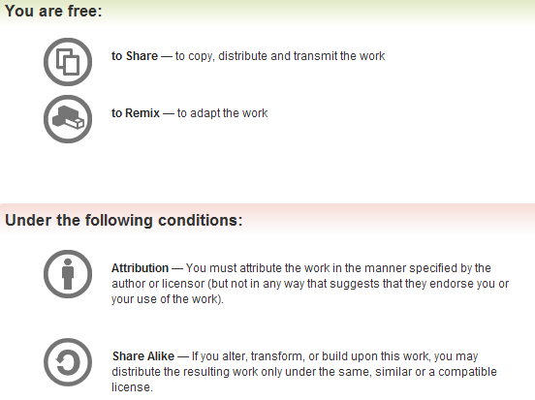
All materials is licensed under a Creative Commons “Share Alike” license.
http://creativecommons.org/licenses/by-sa/3.0/

Slide 3
# whoami
Ali Al-Shemery
Ph.D., MS.c., and BS.c., Jordan
More than 14 years of Technical Background (mainly Linux/Unix and Infosec)
Technical Instructor for more than 10 years (Infosec, and Linux Courses)
Hold more than 15 well known Technical Certificates
Infosec & Linux are my main Interests

Slide 4
Welcome
Please introduce yourself:
Name:
Work:
Why Infosec degree?
Any Technical Background?

Slide 5
Social Engineering

Slide 6
Kickstarting Notes
The course will cover different topics from an offensive point of view,
Mitigation and remediation steps will be provided for each subject of the course,
Backtrack Linux is used to perform the attacks,
Don’t depend on the course’s slide notes!

Slide 7
Outline - Social Engineering
Intro.
Information Gathering
Elicitation
Pretexting: How to Become Anyone!
Mind Tricks: Psychological Principles Used in Social Engineering
Tools Used

Slide 8
Why Start the course with Social Engineering
?

Slide 9
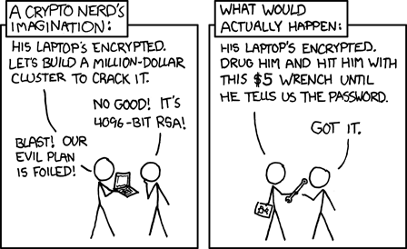
Social Engineering
“You could spend a fortune purchasing technology and services from every exhibitor, speaker and sponsor at the RSA Conference, and your network infrastructure could still remain vulnerable to old-fashioned manipulation.”
Kevin Mitnick

Slide 10
Definition SE
“The act of manipulating a person to take an action that may or may not be in the “target’s” best interest. This may include obtaining information, gaining access, or getting the target to take certain action.”
– Christopher Hadnagy

Slide 11
Why Attackers Might Use Social Engineering?
No technology in the world can prevent social engineering!
Because there is no patch for human stupidity!
People are the largest vulnerability in any network or security chain!
Path of Least Resistance
Why spend hours, days, weeks to crack a password when you can just ask for it?
On The Rise
Phishing attacks are rising 26% per month!

Slide 12
Categories of Social Engineers
Hackers
Penetration Testers
Spies or Espionage
Identity Thieves
Disgruntled Employees
Information Brokers
Scam Artists
Executive Recruiters
Sales People
Governments
Everyday People

Slide 13
Typical Goals of a Social Engineer
Dr. Max Kilger (Honeynet Project) identified six motivations for non-ethical computer activity:
Money, Entertainment, Ego, Cause, Entrance into a social group, and Status within that social group
Other key motivations:
knowledge, revenge and curiosity.
Social Engineering as a Protection

Slide 14
Classic Social Engineering Attacks
Username / Password Information
Credit Information
Name & Address Information
Procedures
PIN Codes
Impersonation
In Person
Dumpster Diving
Shoulder Surfing
Websites

Slide 15
Real World Social Engineering Examples
Playing the Part
Opposite Sex
Confidence Men (Con Men)
Phishing (more on this coming)
Politicians

Slide 16
Phishing
In the field of computer security:
“Phishing is the criminally fraudulent process of attempting to acquire sensitive information such as usernames, passwords and credit card details by masquerading as a trustworthy entity in an electronic communication".
Examples:
URL and Email Manipulation
A URL like (http://www.company.com) looks almost identical to (http://www.cornpany.com)
Spear Phishing
Penetration Testers and Social Engineers

Slide 17
Information Gathering
Human Intelligence (HUMINT)
Signals Intelligence (SIGINT)
Open Source Intelligence (OSINT)
Imagery Intelligence (IMINT)
– Will be discussed next week.

Slide 18
ELICITATION
“Elicitation is the process of extracting information from something or someone.”
– NASA

Slide 19
Elicitation Goals
Elicitation is used to get to know people better.
Used to make mental judgments of IF and HOW to develop a relationship with a person.
In the case of an individual or group of people, this is something we do everyday by talking, listening, and asking questions.

Slide 20
Elicitation Preloading
Preloading is influencing subjects before the event.
Think about a movie's pre-release trailers.
They use desired outcome words such as “The best film you have ever seen!”
This technique works great when introducing anything.

Slide 21
Becoming a Successful Elicitor
Understand how to communicate with people.
Must learn to be adaptive (communication must be made to fit the environment and situation).
Build a bond or relationship with the potential "target".
Communications should match your pretext, otherwise you might seem out of place to the people your communicating with. If your pretext is a member of the IT staff then you need to know, understand, and be able to effectively communicate enough technical information to appear convincing.
You must know how to ask intelligent questions that will force a response. Questions that can be answered with a simple "Yes" or "No" are not good questions at all.

Slide 22
Types of Questions
Open Ended
Close Ended
Neutral
Leading
Assumptive

Slide 23
Key Points
Important key points in mind:
Too many questions can shut down the interaction
Too little may make the person uncomfortable
Ask only one question at a time, too many will cloud the answer you get
Use a narrowing approach to questions to gain the most information
i.e. Neutral Questions -----> Open Ended -----> Closed Ended -----> Highly Directed

Slide 24
PRETEXTING: How to Become Anyone!
“True social engineering is not just believing you are playing a part, but for that moment you are that person, you are that role, it is what your life is.”
– Chris Nickerson

Slide 25
Definition
Pretexting is a social engineering technique wherein a hacker uses false pretenses to engage with his/her intended victim in order to get information from that target.
Basically it’s a lie with a made-up story to go along with it. Pretexting is often used to gain trust, and when trust is gained by the pretexter, data and privacy are in danger.
“Honesty is the key to a relationship. If you can fake that, you’re in.”
—Richard Jeni

Slide 26
Importance of Pretexting
One of the most important aspects of social engineering is trust. If you cannot build trust you will most likely fail.
A solid pretext is an essential part of building trust.
If your alias, story, or identity has holes or lacks credibility or even the perception of credibility the target will most likely catch on.

Slide 27
Pretexting Principles and Planning
A crucial aspect of using pretexting as a social engineering tactic is proper planning.
If proper planning is not taken, the percentage of your social engineering attempts that will succeed will be few to none.
Basic Principles
Planning and Using Pretexts
Character Creation
Trust Relationships

Slide 28
Basic Principles
The more research that is done the better chance of success
Careful planning is required for success
Practicing dialects or expressions that will be familiar to your target is essential
Just because the pretext is over the phone does not minimize the research effort
The simpler the pretext the better chance of success
Your pretext should appear spontaneous
Your pretext should seem accurate or have aspects that are not susceptible to verification
You must know the intelligence and type of person you will be contacting

Slide 29
Planning and Using Pretexts
Pretexting has been hailed as one of the quickest ways to obtain information.
Utilized by federal and local law enforcement, private detectives, reporters, interrogators and many other types of people.
While selecting your pretext it is imperative to consider a few key questions:
What problem am I trying to solve?
What questions am I trying to answer?
What information do I seek?
The nature of the person whom we will be contacting

Slide 30
Character Creation
When you're developing a pretext you are essentially creating a character.
The complexity of that character is determined by the planned depth of interaction with people at the target site.
A pretext can be as simple as just being friendly to someone during a conversation or as complicated as a full blown fake identity complete with ID’s, public records, and all the trappings of a normal person’s life (social networking pages, blog postings, and other things searchable via the Internet).
The process of character development is well documented and practiced by the acting community.

Slide 31
Mind Tricks
Psychological Principles Used in Social Engineering

Slide 32
PSYCHOLOGICAL PRINCIPLES
“Simply confirming your nonverbal behavior to the client, using language from the client’s preferred representational system and matching speech volume, tone and area of speech often overcomes client reluctance to communicate.”
Subtle Skills for Building Rapport, FBI

Slide 33
Modes of Thinking
To alter someone’s way of thinking you must understand the way people think and in what modes they think.
A basic question will come in mind “How do I figure out a target’s dominant mode of thinking?”
The Senses
Micro-Expressions
Neurolinguistic Programming (NLP)

Slide 34
The Three Main Modes of Thinking
Although we have five senses, the modes of thinking are associated with only three of them:
Sight, or a visual thinker
Hearing, or an auditory thinker
Feeling, or a kinesthetic thinker

Slide 35
Micro-Expressions
Anger
Disgust
Fear
Joy
Sadness
Surprise

Slide 36
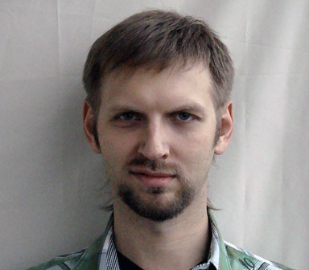
Anger
Disgust
Fear
Happiness
Contempt
Sadness

Slide 37
Training Yourself to See Microexpressions
Replay expression videos to see how each part of the face is involved.
Perform the ME yourself using a mirror.

Slide 38
Benefits of ME Training
Combine the skill with:
interrogation tactics,
body language skills,
and elicitation skills to not only figure out what targets are thinking, but also to lead them down the path you want.

Slide 39
You’re not a Mind Reader!
The expression is linked to an emotion, but the expression doesn’t tell you why the emotion is being displayed.

Slide 40
How to Use ME as a Social Engineer
Eliciting or causing an emotion
Detecting deception
Contradictions
Hesitation
Changes in behavior
Hand gestures

Slide 41
Neurolinguistic Programming (NLP)
“a model of interpersonal communication chiefly concerned with the relationship between successful patterns of behavior and the subjective experiences (esp. patterns of thought) underlying them,”
and “a system of alternative therapy based on this which seeks to educate people in self-awareness and effective communication, and to change their patterns of mental and emotional behavior.”
Oxford English Dictionary

Slide 42
How to Use NLP as a Social Engineer
Many of the scripts and principles of NLP tend to lean toward hypnosis and similar avenues.
Even though you will not use hypnosis to social engineer a target, you can use many of the principles of NLP as a social engineer.
For example, NLP can teach you how to use your voice, language, and choice of words to guide people down the path you want.

Slide 43
SOCIAL ENGINEERING TOOLS

Slide 44
Physical Tools
Lock Picking and Shims
(Shove Knife,
Bump Keys,
Shims)
Snap Gun.

Slide 45
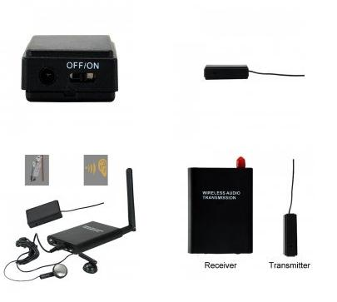
Physical Tools – Cont.
Cameras (Small/Compact, Cell Phones, Covert, Qik)
GPS Tracker (SpyHawk, SuperTrack)
Pen Recorder
RF Bug Kits

Slide 46
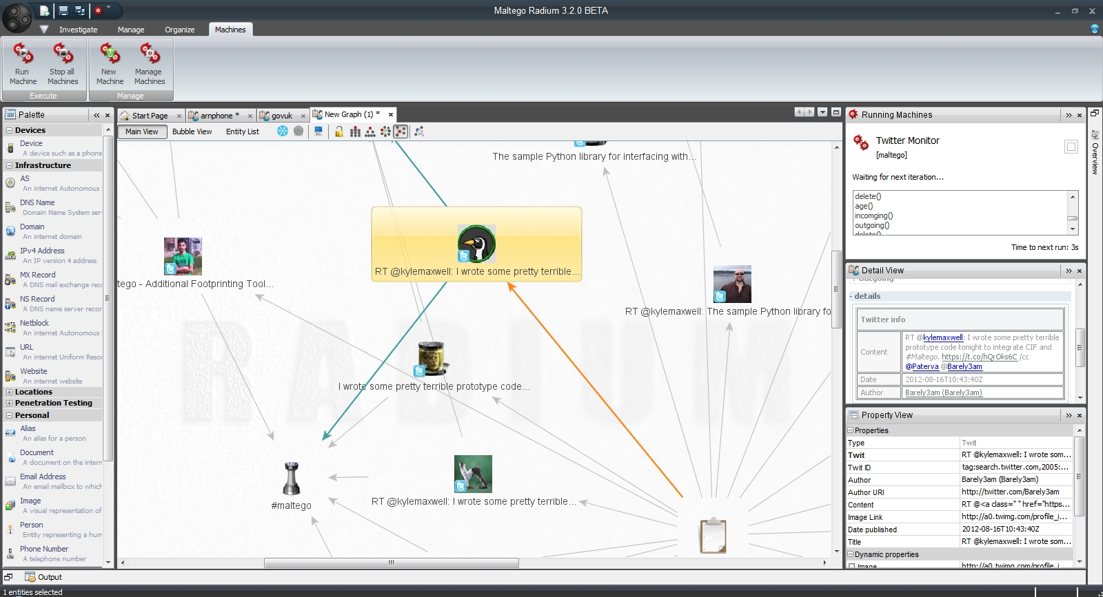
Computer Based Tools
Maltego

Slide 47
Computer Based Tools – Cont.
Social Engineer Toolkit (SET)
Common User Passwords Profiler (CUPP)
Who's Your Daddy Password Profiler (WYD)
Dradis, BaskKet – Information Gathering

Slide 48
Phone Based Tools
Caller ID Spoofing
SpoofCard
Asterisk
SpoofApp
Voicemail

Slide 49
Social Engineering
Countermeasure
Mitigation
Remediation
?

Slide 50
SUMMARY
How hackers manipulate people to reach information using Social Engineering techniques,
Who are Social Engineers,
The Tools used by Social Engineers,
Countermeasures, Mitigation, and Remediation for Social Engineering.

Slide 51
References
[-] Social Engineering Framework, http://www.social-engineer.org/framework/
[-] Chris Nickerson, a well-known social engineer from the TV series Tiger Team
[-] Dr. Max Kilger, motivations, http://www.social-engineer.org/wiki/archives/TypicalGoals/TypicalGoals-rdodge.pdf
[-] Social Engineering: The Art of Human Hacking, Chris Hadnagy
[-] NASA SE definition, http://social-engineer.org/wiki/archives/Elicitation/Definition_of_Elicitation.htm

