Slide 1
Introduction to Intel x86-64 Assembly, Architecture, Applications, & Alliteration
Xeno Kovah – 2014
xkovah at gmail

Slide 2
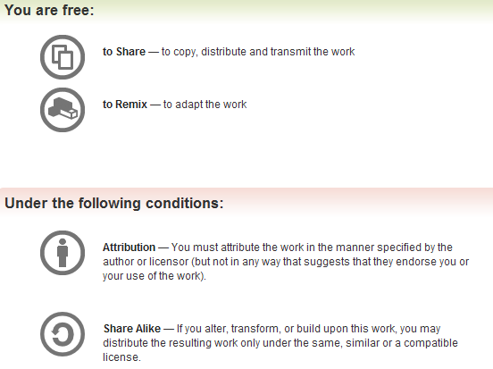
All materials is licensed under a Creative Commons “Share Alike” license.
http://creativecommons.org/licenses/by-sa/3.0/
Attribution condition: You must indicate that derivative work
"Is derived from Xeno Kovah's 'Intro x86-64’ class, available at http://OpenSecurityTraining.info/IntroX86-64.html”
Notes:
Attribution condition: You must indicate that derivative work
"Is derived from Xeno Kovah's ‘Intro x86-64’ class, available at http://OpenSecurityTraining.info/IntroX86-64.html"

Slide 3
Pass1Parameter.c
Adding a single argument
//Pass1Parameter.c:
int func(int a){
int i = a;
return i;
}
int main(){
return func(0x11);
}
func:
0000000140001000 mov dword ptr [rsp+8],ecx
0000000140001004 sub rsp,18h
0000000140001008 mov eax,dword ptr [rsp+20h]
000000014000100C mov dword ptr [rsp],eax
000000014000100F mov eax,dword ptr [rsp]
0000000140001012 add rsp,18h
0000000140001016 ret
main:
0000000140001020 sub rsp,28h
0000000140001024 mov ecx,11h
0000000140001029 call func (0140001000h)
000000014000102E add rsp,28h
0000000140001032 ret

Slide 4
The stack looks like this at line 000000014000100F in func():
00000000`0012FEB8 | return address = 00000001400012FD
00000000`0012FEB0 | undef
00000000`0012FEA8 | undef
00000000`0012FEA0 | undef
00000000`0012FE98 | undef
00000000`0012FE90 | arg1 = ecx = 0x11
00000000`0012FE88 | return address = 000000014000102E
… | undef
00000000`0012FE78 | undef
00000000`0012FE70 | undef`0000BEEF
0x28 bytes
Huh? func() wrote the register-passed argument above the return address?
Because the asm only wrote a “dword ptr” (4 bytes) worth of memory at this location, so the top 4 bytes are undefined
0x18 bytes
RSP

Slide 5
Pass1Parameter.c takeaways
Something very interesting is going on with the stack!
The value which is passed in a register is then still being stored on the stack…doesn’t that kind of defeat the speed benefit of passing in registers?
//Pass1Parameter.c:
int func(int a){
int i = a;
return i;
}
int main(){
return func(0x11);
}
func:
0000000140001000 mov dword ptr [rsp+8],ecx
0000000140001004 sub rsp,18h
0000000140001008 mov eax,dword ptr [rsp+20h]
000000014000100C mov dword ptr [rsp],eax
000000014000100F mov eax,dword ptr [rsp]
0000000140001012 add rsp,18h
0000000140001016 ret
main:
0000000140001020 sub rsp,28h
0000000140001024 mov ecx,11h
0000000140001029 call func (0140001000h)
000000014000102E add rsp,28h
0000000140001032 ret

Slide 6
SpecialMaths.c
With command line arguments, 2 function parameters, and special maths known to generate particular asm as a teachable moment :)
#include <stdlib.h>
int main(int argc, char ** argv){
int a;
//reminder: atoi() converts an ASCII string to an integer
a = atoi(argv[1]);
return 2*argc + a;
}
main:
0000000140001000 mov qword ptr [rsp+10h],rdx
0000000140001005 mov dword ptr [rsp+8],ecx
0000000140001009 sub rsp,38h
000000014000100D mov eax,8
0000000140001012 imul rax,rax,1
0000000140001016 mov rcx,qword ptr [rsp+48h]
000000014000101B mov rcx,qword ptr [rcx+rax]
000000014000101F call qword ptr [400020F8h]
0000000140001025 mov dword ptr [rsp+20h],eax
0000000140001029 mov eax,dword ptr [rsp+20h]
000000014000102D mov ecx,dword ptr [rsp+40h]
0000000140001031 lea eax,[rax+rcx*2]
0000000140001034 add rsp,38h
0000000140001038 ret

Slide 7
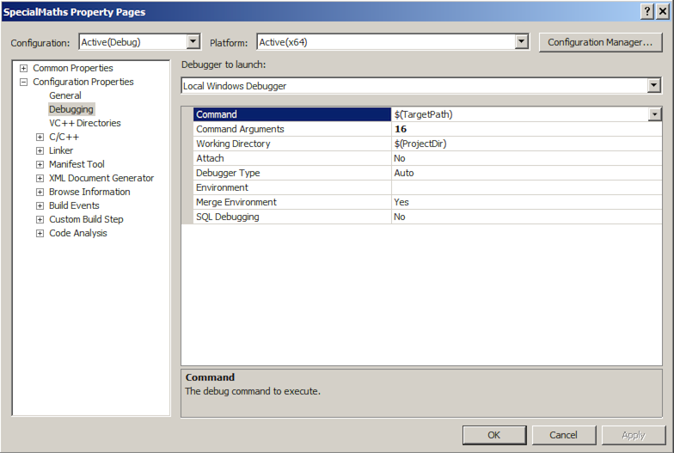
Setting command line arguments

Slide 8
“r/mX” Addressing Forms Reminder
Anywhere you see an r/mX it means it could be taking a value either from a register, or a memory address.
I’m just calling these “r/mX forms” because anywhere you see “r/mX” in the manual, the instruction can be a variation of the below forms.
In Intel syntax, most of the time square brackets [] means to treat the value within as a memory address, and fetch the value at that address (like dereferencing a pointer)
mov rax, rbx
mov rax, [rbx]
mov rax, [rbx+rcx*X] (X=1, 2, 4, 8)
mov rax, [rbx+rcx*X+Y] (Y= one byte, 0-255 or 4 bytes, 0-2^32-1)
Most complicated form is: [base + index*scale + disp]
More info: Intel v2a, Section 2.1.5 page 2-4
in particular Tables 2-2 and 2-3

Slide 9
12
LEA - Load Effective Address
Frequently used with pointer arithmetic, sometimes for just arithmetic in general
Uses the r/mX form but is the exception to the rule that the square brackets [ ] syntax means dereference (“value at”)
Example: rbx = 0x2, rdx = 0x1000
lea rax, [rdx+rbx*8+5]
rax = 0x1015, not the value at 0x1015
Not covered in book!? It’s kind of important!

Slide 10
SpecialMaths.c takeaways
When a compiler sees “special math” that can be computed in the form “a + b*X + Y” (derived from the “r/mX” form, where X = {1, 2, 4, 8}, and Y = {0-2^32-1}), then it can compute the result faster if it uses the LEA instruction, rather than a IMUL instruction for instance.
More evidence that pass-by-register function arguments are being stored onto the stack at some point (this time both ecx and rdx)
main:
0000000140001000 mov qword ptr [rsp+10h],rdx
0000000140001005 mov dword ptr [rsp+8],ecx
0000000140001009 sub rsp,38h
000000014000100D mov eax,8
0000000140001012 imul rax,rax,1
0000000140001016 mov rcx,qword ptr [rsp+48h]
000000014000101B mov rcx,qword ptr [rcx+rax]
000000014000101F call qword ptr [400020F8h]
0000000140001025 mov dword ptr [rsp+20h],eax
0000000140001029 mov eax,dword ptr [rsp+20h]
000000014000102D mov ecx,dword ptr [rsp+40h]
0000000140001031 lea eax,[rax+rcx*2]
0000000140001034 add rsp,38h
0000000140001038 ret
#include <stdlib.h>
int main(int argc, char ** argv){
int a;
a = atoi(argv[1]);
return 2*argc + a;
}

Slide 11
func:
0000000140001000 mov dword ptr [rsp+20h],r9d
0000000140001005 mov dword ptr [rsp+18h],r8d
000000014000100A mov dword ptr [rsp+10h],edx
000000014000100E mov dword ptr [rsp+8],ecx
0000000140001012 sub rsp,18h
0000000140001016 mov eax,dword ptr [rsp+28h]
000000014000101A mov ecx,dword ptr [rsp+20h]
000000014000101E add ecx,eax
0000000140001020 mov eax,ecx
0000000140001022 sub eax,dword ptr [rsp+30h]
0000000140001026 add eax,dword ptr [rsp+38h]
000000014000102A sub eax,dword ptr [rsp+40h]
000000014000102E mov dword ptr [rsp],eax
0000000140001031 mov eax,dword ptr [rsp]
0000000140001034 add rsp,18h
0000000140001038 ret
main:
0000000140001040 sub rsp,38h
0000000140001044 mov dword ptr [rsp+20h],55h
000000014000104C mov r9d,44h
0000000140001052 mov r8d,33h
0000000140001058 mov edx,22h
000000014000105D mov ecx,11h
0000000140001062 call 0000000140001000
0000000140001067 add rsp,38h
000000014000106B ret
TooManyParameters.c
Using more than 4 arguments, to force it to pass the extra parameters via the stack
//TooManyParameters:
int func(int a, int b, int c, int d, int e){
int i = a+b-c+d-e;
return i;
}
int main(){
return func(0x11,0x22,0x33,0x44, 0x55);
}
Notes:
http://www.youtube.com/watch?v=Nr8r09c8ogg

Slide 12
The stack looks like this at line 0000000140001031 in func():
00000000`0012FEB8 | return address = 000000014000132D
… | undef
00000000`0012FEA8 | undef
00000000`0012FEA0 | arg5 = 0x55
00000000`0012FE98 | arg4 = r9 = 0x44
00000000`0012FE90 | arg3 = r8 = 0x33
00000000`0012FE88 | arg2 = edx = 0x22
00000000`0012FE80 | arg1 = ecx = 0x11
00000000`0012FE78 | return address = 0000000140001067
… | undef
00000000`0012FE78 | undef
00000000`0012FE70 | undef`ffffffef
0x38 bytes
A pattern emerges! Say hello to the Microsoft stack “Shadow Space”!
Because the asm only wrote a “dword ptr” (4 bytes) worth of memory at this location, so the top 4 bytes are undefined
0x18 bytes
RSP

Slide 13
Who knows what the first 4 parameters passed in registers were when you’re trying to backtrace the stack calls?
“Shadow space” reference http://msdn.microsoft.com/en-us/library/zthk2dkh.aspx
Notes:
http://ifanboy.com/wp-content/uploads/2011/10/The-Shadow-Alex-Ross-Cover-1.jpg

Slide 14
TooManyParameters.c takeaways
Microsoft compiler specifically augments the calling convention by not only passing the first 4 arguments through registers, but also still reserving “shadow space” for them on the stack.
“The callee has the responsibility of dumping the register parameters into their shadow space if needed.”
Compiler reserves this space even if no function parameters are passed to another function
func:
mov dword ptr [rsp+20h],r9d
mov dword ptr [rsp+18h],r8d
mov dword ptr [rsp+10h],edx
mov dword ptr [rsp+8],ecx
sub rsp,18h
mov eax,dword ptr [rsp+28h]
mov ecx,dword ptr [rsp+20h]
add ecx,eax
mov eax,ecx
sub eax,dword ptr [rsp+30h]
add eax,dword ptr [rsp+38h]
sub eax,dword ptr [rsp+40h]
mov dword ptr [rsp],eax
mov eax,dword ptr [rsp]
add rsp,18h
ret
main:
sub rsp,38h
mov dword ptr [rsp+20h],55h
mov r9d,44h
mov r8d,33h
mov edx,22h
mov ecx,11h
call 0000000140001000
add rsp,38h
ret
//ExampleSubroutine4:
int func(int a, int b, int c, int d, int e){
int i = a+b-c+d-e;
return i;
}
int main(){
return func(0x11,0x22,0x33,0x44, 0x55);
}
Notes:
You can confirm that the typical sub rsp, 0x28 that you see is due to shadow space reservation by just changing func() to only take 4 parameters instead of 5, and seeing that it only reserves 0x28 again instead of 0x38 like seen here. But if you then add a local variable, which should technically fit in the reserved stack space (just like this 5th parameter should have), it will again bump it up to 0x38. Still not sure what’s up with the over-allocation of stack space in general (possibly just 0x10 alignment)…

Slide 15
Instructions we now know (12)
NOP
PUSH/POP
CALL/RET
MOV
ADD/SUB
IMUL
MOVZX/MOVSX
LEA

Slide 16
Back to Hello World
.text:0000000140001000 main
.text:0000000140001000
.text:0000000140001000 sub rsp, 28h
.text:0000000140001004 lea rcx, Format ; "Hello World!\n"
.text:000000014000100B call cs:__imp_printf
.text:0000000140001011 mov eax, 1234h
.text:0000000140001016 add rsp, 28h
.text:000000014000101A retn
Are we all comfortable with this now?
(other than the fact that IDA hides the address of the string which is being calculated and replaces it with “Format” for the format string being passed to printf?)
Windows Visual C++ 2012, /GS (buffer overflow protection) option turned off
Optimize for minimum size (/O1) turned on
Disassembled with IDA Pro 6.6 (with some omissions for fitting on screen)

