Slide 1
Introduction to Intel x86-64 Assembly, Architecture, Applications, & Alliteration
Xeno Kovah – 2014
xkovah at gmail

Slide 2
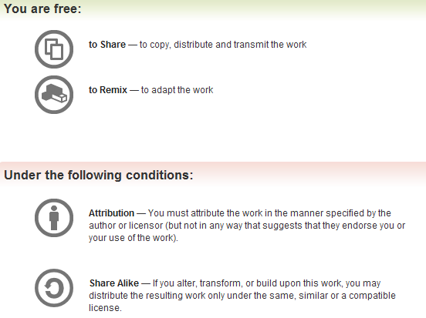
All materials is licensed under a Creative Commons “Share Alike” license.
http://creativecommons.org/licenses/by-sa/3.0/
Attribution condition: You must indicate that derivative work
"Is derived from Xeno Kovah's 'Intro x86-64’ class, available at http://OpenSecurityTraining.info/IntroX86-64.html”
Notes:
Attribution condition: You must indicate that derivative work
"Is derived from Xeno Kovah's ‘Intro x86-64’ class, available at http://OpenSecurityTraining.info/IntroX86-64.html"

Slide 3
Bomb lab
From CMU architecture class - http://csapp.cs.cmu.edu/public/labs.html
Thanks to Randal E. Bryant & David R. O’Hallaron for providing the source code so it could be ported to x86-64 (and Windows in the Intro RE class)
The textbook for the class which the bomb lab is a part of is “Computer Systems: A Programmer's Perspective, 2nd Edition, Prentice Hall, 2011; Bryant and O'Hallaron”

Slide 4
Bomb lab 2
Goal is to reverse engineer multiple phases to determine the program’s desired input
Create a text file with answers, one per line, named “answers”
gdb -x myCmds bomb
run with “r < answers”
Should add/remove breakpoints on the different phases as you go along

Slide 5
Bomb lab - EXPERT MODE!
If you already know a thing or two about asm (and were just here for the 64 bit update), let’s see how far you can get how fast if you play it on expert mode, without symbol information. Execute the following command in the directory where the bomb resides:
strip bomb
This is more like what you will actually see with malware. You’re not going to get symbols in that case.
Now go ahead and see how fast you can go through the rounds ;)

Slide 6
Phase_2 hint
sscanf() is defined as follows:
int sscanf(const char *str, const char *format, ...);
So if it was e.g. “sscanf(foo, “%d %d”, &a, &b)”
It would take whatever string was pointed to by the first argument, parse it according to the second format string argument, and then store the parsed out values in the variables which were given by the subsequent n arguments (for n = 2 in this case)
“On success, the function returns the number of variables filled"

Slide 7
Phase_2 hint
sscanf() is defined as follows:
int sscanf(const char *str, const char *format, ...);
So if it was e.g. “sscanf(guess, “%d %d %d %d %d %d”, &var1, &var2, &var3, &var4, &var5, &var6,)”

Slide 8
GDB/Bomb Lab Cheat Sheet
Christian Arllen found this, and it has many more example of gdb syntax, as well as some help for if you get stuck on the lab
http://condor.depaul.edu/~jriely/csc373fall2010/extras/mygdbnotes.txt
(get it on google cache while you can, because it's gone now)

