Slide 1
The Adventures of a KeyStroke
An in-depth look into Keyloggers on Windows

Slide 2
What you will learn?
Completing this training, you will be able to:
Use a kernel debugger for malware analysis,
Understand the threats posed by keyloggers,
Detect / Remove all kinds of keyloggers,
Understand how a keylogger works in greatest detail,
Be prepared to Advanced Persistent Threats!
We will cover a lot of OS Internal structures.
Without dealing with OS Internals, you can’t be sure that your system is clean.

Slide 3
Who am I?
Emre TINAZTEPE
Ex military:
Maltepe Military High School (21 / 421)
Turkish War Academy (8 / 838)
Passed half of his life in the army (First Lieutenant)
Resigned 3 years ago.
Low level guy who likes to deal with OS Internals
Currently leading Comodo Malware Analysis Team
Responsible of malware analysis and mobile av dev.

Slide 4
Methodology
Hard to easy because it all starts at hardware ☹
If you have question, just interrupt me.
Hands on labs combined with theory.

Slide 5
Why keyloggers?
Because keyboard is the device you command your computers.
Logging keys from a PC provides the malware authors with great power.
Best way to gather intelligence.
Russia is said to be switching to “typing machines” in critical institutions.
Best way to get rich ☺
Notes:
Let’s talk about the criticalness of Keyloggers.

Slide 6
Before we begin
Please download these files:
Materials: http://bit.ly/1aLVnOI (pass: infected)
Labs: http://bit.ly/16FZ73t
Please turn your AV/Windows Defender OFF!

Slide 7
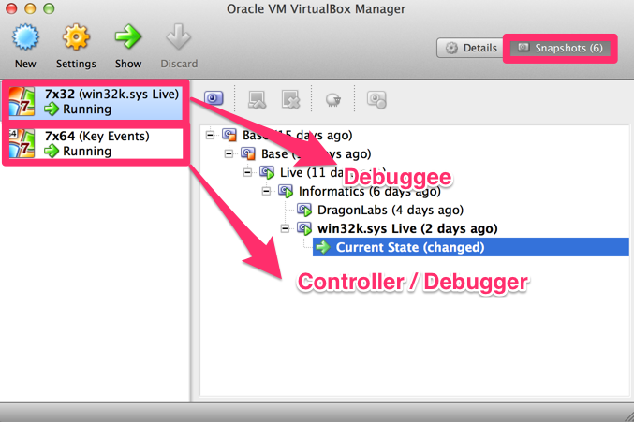
VirtualBox
Notes:
Best free virtualization software!
Supports snapshots
We will be debugging a Windows 7 x32 machine (debuggee) using a Win 7 x64 machine (debugger).
32 bit should not be turned on alone. Turn on x64 then x32.
2 modes => Normal / Kernel Debugging
Labs:
Click snapshots button
Select the last one
Click “Restore” button
Untick “Create a snapshot of current state”
Run x64 machine
Run x32 machine, beware the RED walpaper of the victim machine

Slide 8
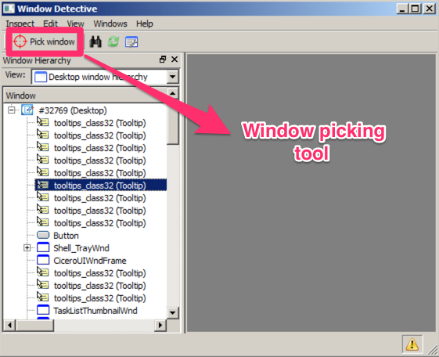
Window Detective
Notes:
A window inspector.
Supports displaying window messages processed by a window.
Right click into the selected window entry for messages.
Lab:
Run Notepad.exe
Align Window Detective and the Notepad side by side.
Click the picker tool and select Notepad’s window.
Select “Notepad” from the Window Pane
Right click on it and select “Messages”
Hover your mouse over Notepad.exe
See what happens…

Slide 9
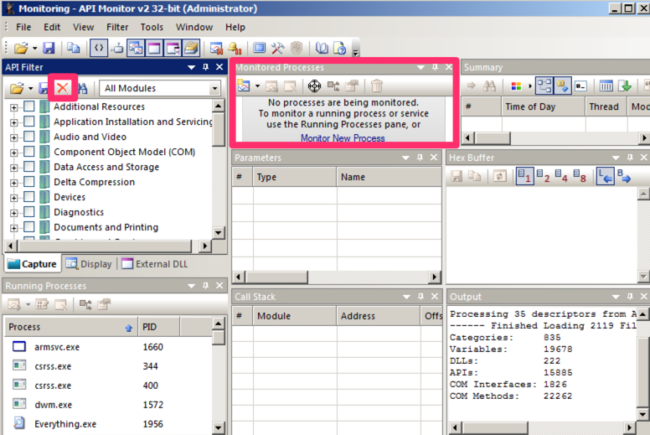
API Monitor
Notes:
Powerful tool for dynamic analysis, one of my favorite tools.
A lot of useful features with ability to display API parameters
Easy to use with process tracking feature.
Lab:
Fire up “API Monitor”
Wait for it to load API definitions
Click on “Clear Capture Filter” for removing old filters
Click on “Find” button and write “GetMessageA”, check it.
Do the same for “GetMessageW”
Dismiss any other process if one pops up and run “Notepad.exe”
Click “Monitor” button
Take a look at the “Summary” window
Remove the cursor from Notepad by clicking Taskbar.
Watch the idleness.
Move your mouse over the notepad and observe how it gets the messages.
Now press “A” a few times and take a look at the “Parameters” window (MSG parameter)

Slide 10
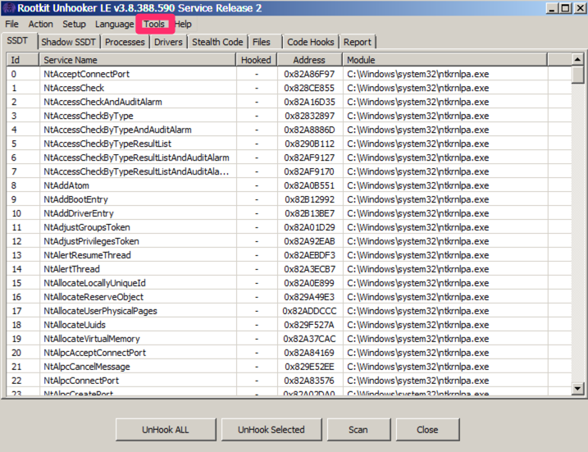
Rootkit Unhooker
Notes:
Great anti rootkit tool.
Detects even the lowest level malware modifications
Also able to fix them!!!
Only supports 32bit and it is discontinued ☹
Labs:
Click on each tab, see what is inside.
Click on “Tools” menu and select “Windows Hooks”
It’s currently empty, but wait :)

Slide 11
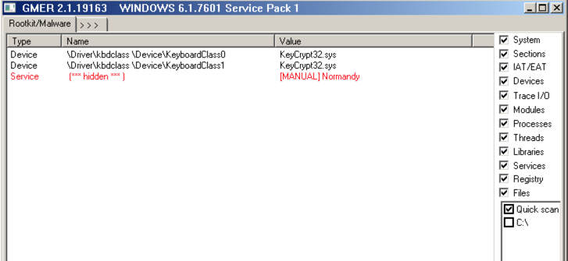
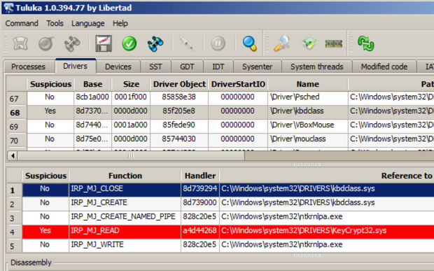
GMER / Tuluka
Notes:
Great anti rootkits also.
Labs:
Click on each tab, see what is inside.

Slide 12
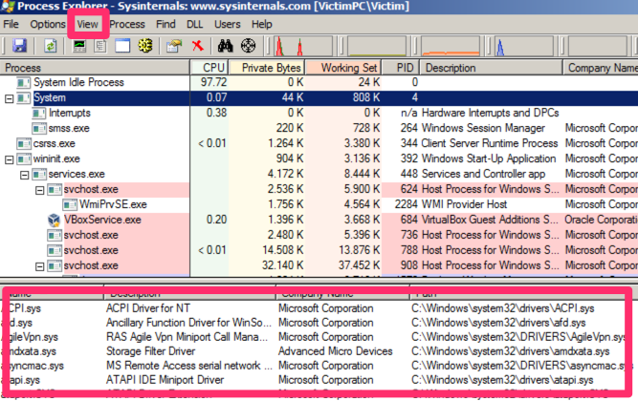
Process Explorer
Notes:
One of the best tools for malware analysis
Superior features when compared to “Task Manager”
Used by nearly every malware analyst!
Labs:
Click on “View” menu
Select “Lower Pane View” -> DLLs
Select the “System” process (the process in which most of the OS code runs
Find the i8042prt.sys driver
It displays the DLLs loaded by processes but also Drivers.
Click on “Options” menu and select “Difference Highlight Duration”
Click ın “View” select “Scroll to new Processes”
Align it to the right side
Run notepad.exe see how it’s highlighted on the Process Explorer (GREEN)
Select notepad.exe from the list and make the lower pane a little wider.
Go to “Materials/Keyloggers” folder
Execute “KeyCap_orginal.exe” and align it left-bottom with Notepad on left-top.
Re-select “Notepad” from the Process Explorer list
Click “Install Hook” and observe “KeyCap_DLL.dll” being loaded into the Notepad.exe address space

Slide 13
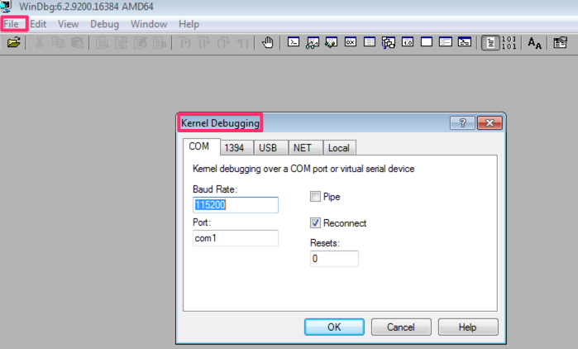
Windbg
Notes:
Provided by Microsoft itself.
Most powerful debugger for malware analysis and kernel debugging.
Supports both user mode and kernel mode
FREEZES the Operating System when you click Debug -> Break.
Labs:
Switch to the controller machine with the blue background
Double click “Windbg” on the desktop
Click on “File” menu -> Select “Kernel Debugging”
Click “Reconnect” and make sure “Baud Rate” is 115200 and “com1” as port
Before clicking on the “OK” button, make sure the RED VM is responsive (mouse your mouse and see it is)
Click the “OK” button and click “NO” on workspace menu
** Describe what is KERNEL DEBUGGING on the board
Click “Debug” -> “Break” several times until you see something gets printed (10+ times ☹☹)
Click “Yes” to workspace question
Click “File” -> “Symbol File Path…”
Write “﻿srv*C:\Symbols*”
Click OK.
Write “.reload” ENTER, wait for symbols to load (could take some time ☹)

Slide 14
Windbg Cheat Sheet
lm : Lists loaded modules (drivers , dlls)
﻿!process -1 0 : Displays current process
﻿!process 0 0 winlogon.exe : Displays info for the process
.process EPROCESS : Switches to the process (implicit)
bp ADDRESS : Puts a breakpoint at the address
g,p,t : Go, Step, Trace
bl : Lists the breakpoints
bc INDEX : Clears the BP indicated by the index
bd INDEX : Disables BP temporarily
.echo : Outputs a string
Notes:
UP / DOWN keys brings the History
TAB auto completes
Labs:
Write “bp nt!NtCreateFile” + ENTER
Write “bl” + ENTER
Press F5 until you see “Break point 0 hit”
Write “bd *” + ENTER
Write “bp nt!NtCreateFile “.echo CREATE FILE CALLED;g;”
Press F5 and do something in the RED VM and see what happens.
Let’s clear all the break points by issuing “bc *” command + ENTER + F5

Slide 15
Windbg Cheat Sheet
.cls : Clears the screen
u ADDRESS / SYMBOL : Unassembles the address
uf ADRESS OF FUNCTION : Unassembles the whole func.
db ADDRESS : Dumps the address.
? poi(ADDRESS) : Displays the address pointed by.
!pic / !ioapic : Displays information about interrupt controllers.
!drvobj \Driver\kbdclass 0x7: Display the specified driver.
!devobj OBJECT : Display information about device obj.
Notes:
Labs:
BREAK the RED Machine by Debug->Break
Write “u nt!NtCreateFile” + ENTER
This unassembles a small portion of the address
Write “.cls” + ENTER
Press up arrow two times and modify the previous “u nt!NtCreateFile” to “uf nt!NtCreateFile” + ENTER
Write “db nt!NtCreateFile” + ENTER
Write “? poi(nt!NtCreateFile)” + ENTER
DO NOT GET CONFUSED, THEY ARE SIMPLY DATA STRUCTURES ☺ NOTHING MORE THAN THAT.
Write “!pic” + ENTER
Write “!ioapic” + ENTER
These two commands will help us understand how first keylogging method works.
Write “!drvobj \Driver\kbdclass 0x7” + ENTER
Copy the second object address from the previous command an write “!devobj OBJECT ADDRESS” + ENTER

Slide 16
Let’s infect ourselves
Restart RED VM, make sure it is not in “KERNEL DEBUG” mode.
Go to Materials/Keyloggers directory
Double click “Elite Keylogger.exe”
Install with default settings (Click NEXT multiple times)
Choose “Allow” in case Windows Defender consents.
Restart the VM in non debug mode.
Write “unhide” on start menu and provide a password at least 3 chars long.
Fire up a “Notepad” and write your name in it.
Please also provide your Credit Card number ☺☺☺
Do not save it please, it is safer ???
Notes:
Elite Keylogger detects that a Kernel Debugger is in place and messes with the boot process.

Slide 17
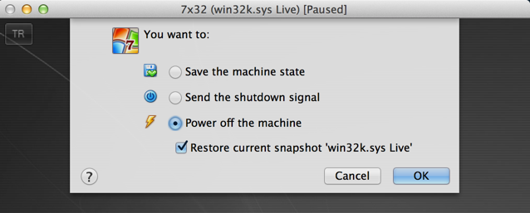
You are infected now ☹
We will see how to detect keyloggers in the following ours.
For the moment, please restore your VM to snapshot “Informatics” and start your VM in “Kernel Debugging” Mode.

Slide 18
Ready to dive?
Notes:
Intentionally chosen this photo because it really looks like diving.
You dive into the OS which looks a lot like an ocean (at least in my opinion)
The more you dive and spend your time, you more you see and respect the NT team ☺

Slide 19
An overview of a mother board
CPU
Front Side Bus (FSB)
North Bridge
Internal Bus (IB)
South Bridge
Peripherals

Slide 20
An overview of a mother board
Bus is a communication system that transfers data between components inside a computer,
FSB is the CPU's connection to the North Bridge and through it to rest of the system,
North Bridge is a high-speed hub that in most systems connects the CPU to the graphics card and to RAM,
South Bridge is a slower-speed hub that connects the CPU to the rest of the system.

Slide 21
South Bridge (SB)
It is also named as “Input/Output Controller Hub”.
Responsible from the peripheral device connections such as USB, PCI, PS/2, Sound and etc.
Why two bridges?
Same as the idea of having RAM, Cache, Register
Simpler design which is easy to modify in terms of IO capabilities.
It is what you actually connect your keyboard to.

Slide 22
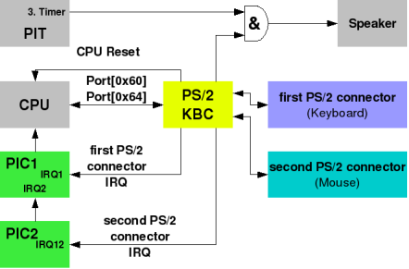
PS/2 Keyboard Controller
A component of a mainboard which handles the connection between a motherboard and a PS/2 keyboard.

Slide 23
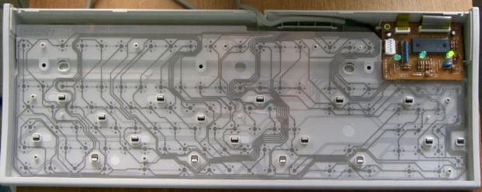
PS/2 Keyboard
Just a limited computer system which scans a wireframe continuously for finding a closed/opened circuit.

Slide 24
PS/2 Keyboard
The PS/2 Keyboard is a device that talks to a PS/2 controller using serial communication.
The PS/2 Keyboard accepts commands and sends responses to those commands, and also sends scancodes indicating when a key was pressed or released.
The keyboards processor includes its own timer, 33 instruction set, and can even access 128K of external memory.
16 Byte Buffer

Slide 25
Talking to a Keyboard?
A PS/2 Keyboard accepts many types of commands,
Each command is one byte,
Some commands have data byte/s which must be sent after the command byte,
The keyboard typically responds to a command by sending either an "ACK" (to acknowledge the command) or a "Resend" (to say something was wrong with the previous command) back.

Slide 26
Talking to a Keyboard?
COMMAND
DATA
ACK RESEND
Commands must be sent one at a time (IN/OUT),
Some commands have data byte/s which must be sent after the command byte,
0xFE (resend) expects a command to be sent again,
while 0xFA (ACK) means command is successfully processed.

Slide 27
PS/2 Keyboard Controller/Encoder Ports
IO Port | Access Type | Purpose
Keyboard Encoder
0x60 | Read | Read Input Buffer
0x60 | Write | Send Command
Keyboard Controller
0x64 | Read | Status Register
0x64 | Write | Send Command
Port 0x60 is what we use for reading and writing data to/from the keyboard device,
The Status Register contains various flags that indicate the state of the PS/2 controller such as the state of input/output buffers,
The Command Port (0x64) is used for sending commands to the PS/2 Controller (not to PS/2 Devices).

Slide 28
Some of the PS/2 Keyboard Encoder Commands
Command | Description | Data
0xED | Set LEDs | Bit0: ScrollLock Bit1: NumberLock Bit2: CapsLock
0xEE | Echo | For diagnostic purposes.
0xF0 | Get/set current scan code set | 0: Get current scan code set 1: Set scan code set 1 2: Set scan code set 2 3: Set scan code set 3
0xF4 | Enable scanning | -
0xF5 | Disable scanning | Discard key presses or mouse movements. Used especially while identifying the attached PS/2 device in order to prevent messing up the identification process.

Slide 29
Scancodes and Code Sets
A scan code set is a set of codes that determine when a key is pressed or repeated, or released.
Scancode
Make Code
Release Code

Slide 30
Scancodes and Code Sets
There are 3 scan code sets, normally on PC compatible systems the keyboard itself uses scan code set 2 and the keyboard controller translates this into scan code set 1 for compatibility.
Microsoft Keyboard Scan Code Specification Document

Slide 31
How to read scancodes?
Poll the Bit 0 of status register and then read the data from port 0x60
To much CPU time!
Multiple PS/2 devices lead to problems for differentiating the data.
Wait for an interrupt to occur
Much better!
Wait for an IRQ 1 / IRQ 12 (wait for the next slide☺)

Slide 32
What is an interrupt?
Interrupt is a signal to the processor emitted by hardware or software indicating an event that needs immediate attention.
Do this and let me know when it’s done!
I am a little bit busy ☺
CPU
Device
(Harddisk, Keyboard)
It’s done!
Let’s see what you have.

Slide 33
Why called as “IRQ”?
Each peripheral device requests to “Interrupt the CPU” this is why it is a “Request” which may or may not be handled by the CPU.
Question: What happens when multiple devices send an IRQ at the same time?
Answer: The one with a higher IRQL gets processed while the others keep waiting.

Slide 34
Interrupt Handling
One of the best advantages of an interrupt driven device is the ability to overlap device’s processing time with the CPU’s activity.
Process a lengthy operation
Device
CPU
t1
t2
Issue an operation

Slide 35
Where do I connect my device?
Question: If we have 2 or more devices attached to our mainboard, how will we differentiate one device’s interrupt from the other?
Answer: Each motherboard has an at least one Programmable Interrupt Controller (PIC / APIC) into which your external devices get connected. You do not have to anything, all is done seamlessly by this electronic circuit.

Slide 36
Programmable Interrupt Controller
OMG! What is an interrupt controller?
One of the most important chips making up the x86 architecture,
Without it, the x86 architecture would not be an interrupt driven architecture,
The function of the PIC is to manage hardware interrupts and send them to the appropriate system interrupt.
This way, no polling needed ☺
Notes:
Labs:
Fire up Windbg and BREAK the VM
Write “!pic” + ENTER
See that there are 16 interrupts (0x0 – 0xF)
For hex values, you can use “Calc.exe”

Slide 37
APIC
More sophisticated interrupt handling and the ability to send interrupts between processors.
In an APIC-based system, each CPU is made of a "core" and a "local APIC".
Core
Local APIC
CPU
Notes:
Labs:
Write “!apic” + ENTER
Pay attention to the address it’s mapped to. ﻿”0xfffe0000”
The next slide will make it easier to understand the relation of this to the other components.

Slide 38
I/O APIC
The external I/O APIC is part of Intel’s system chip set. Its primary function is to receive external interrupt events from the system and its associated I/O devices and relay them to the local APIC as interrupt messages.
Local APIC
Local APIC
I/O APIC
External
Devices
Local APIC
Interrupt Messages

Slide 39
What magic CPU does to handle IRQs?
There is no magic, we tell it what to do.
We create a table of function pointers and tell the CPU where it resides.
This table is called as “Interrupt Descriptor Table” and the address for this table is hold by a register called IDTR (IDT register).
IDTR
Handler 0
Handler 1
Keyboard Interrupt Handler
Handler 2
Handler 3
Handler 4
IDT
RAM
Notes:
Labs:
Write “!idt –a” + ENTER
Much of the OS code resides in memory and some of it on disk
This table is the glue between the hardware and the Operating System.
Pay attention to the one used by “i8042prt.sys” driver for keyboard handling

Slide 40
Intel x86 CPU Modes
3 + 1 Modes of operation is supported by CPU.
Real Mode
Virtual 8086 Mode
Protected Mode
System Management Mode

Slide 41
Real Mode
Also called real address mode.
Real mode is characterized by a 20-bit segmented memory address space and unlimited direct software access to all memory, I/O addresses and peripheral hardware.
Real mode provides no support for memory protection, multitasking, or code privilege levels.
Before the release of the 80286, which introduced Protected mode, real mode was the only available mode for x86 CPUs.
In the interests of backwards compatibility, all x86 CPUs start in real mode when reset.

Slide 42
Protected Mode
Also called protected virtual address mode.
It allows system software to use features such as virtual memory, paging and safe multi-tasking designed to increase an operating system's control over application software.
Power ON
Real Mode
Protected Mode
Create some
tables for
Virtual Memory
and set PE bit in
CR0 register

Slide 43
Virtual 8086 Mode
Also called virtual real mode.
Allows the execution of real mode applications that are incapable of running directly in protected mode while the processor is running a protected mode operating.

Slide 44
System Management Mode
Is an operating mode in which all normal execution (including the operating system) is suspended, and special separate software (usually firmware or a hardware-assisted debugger) is executed in high-privilege mode.
SMM is a special-purpose operating mode provided for handling system-wide functions like:
Handle system events like memory or chipset errors,
Manage system safety functions, such as shutdown on high CPU temperature and turning the fans on and off,
Emulate motherboard hardware that is unimplemented or buggy.

Slide 45
More on SMM
A powerful mode of CPU which can even preempt the whole OS!!!
SMM is entered via the SMI (system management interrupt)
SMM is a really good place to execute malicious software without modifying the structures created by OS.
Here comes the karate kick!

Slide 46
#1 SMM Rootkits

Slide 47
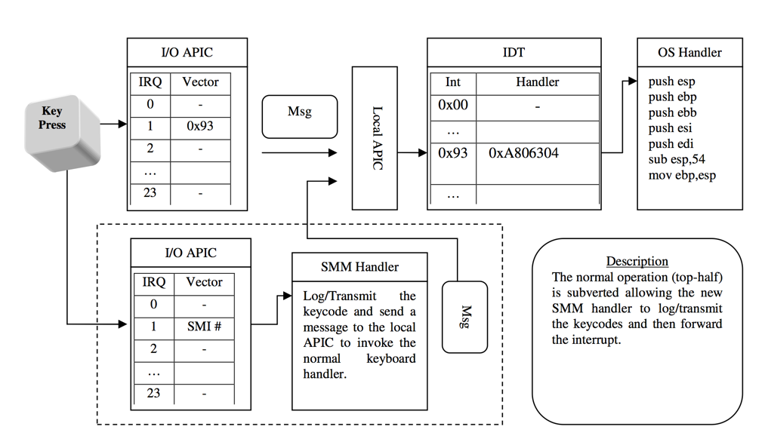
An overview of SMM Rootkits
Did you know that you can see the keystrokes even before they are handled by “Interrupt Handler”?
Normal Path
Infected Path

Slide 48
The implementation
Use SM RAM Control Register (SMRAMC)
Check bit D_OPEN (is SMRAM visible to outside code)
Check bit D_LCK (is SMRAMC is read-only, if yes a reset is needed)
If D_LCK bit is clear:
Set D_OPEN bit to make SMRAM visible to protected mode code,
Copy the SMM Handler code to the handler portion of SMRAM defined by Intel Docs,
Clear D_OPEN bit and set D_LCK bit to protect our evil code ☺
We are invisible!

Slide 49
Routing IRQ 1 to Malicious SMM Handler
Modify the I/O APIC in such a way that when ever a user presses a key, our SMM code is executed,
SMM Handler reads the scan code, logs it and sends a special command to keyboard for overcoming the problem of a popped up scancode.
This in turn makes the next data written into the keyboard buffer available for OS Keyboard Interrupt handler,
Send an IPI to ourself for handling an emulated IRQ 1!
Let the OS think it is a real scancode generated by the keyboard encoder ☺

Slide 50
Pros & Cons
Pros
Totally invisible to the OS!
No need to change any OS created structures.
Very hard to detect.
Cons
Works only with PS/2
Limited to single processor system
D_LCK bit is already set on modern systems ☹

Slide 51
#2 IDT Hooking

Slide 52
Structure of an Interrupt Descriptor Table
Protected Mode counterpart of Real Mode Interrupt Vector Table (IVT),
Contains at most 256 entries.
Each entry is 8 bytes long and they are structured as defined below:
nt!_KIDTENTRY
+0x000 Offset : Uint2B
+0x002 Selector : Uint2B
+0x004 Access : Uint2B
+0x006 ExtendedOffset : Uint2B
Notes:
It’s the GLUE between the OS and the hardware
Provides entry points for hardware
Keyboard interrupt is supposed to be NUMBER 1
Labs:
Break the VM
Write “dt nt!_KIDTENTRY” + ENTER
If you modify the “Offset” and “ExtendedOffset” values appropriately, you can make it call your keylogger routine.

Slide 53
Keyboard Interrupt is not mapped to IDT#1???
Where is IRQ 1 mapped? Which IDT Entry???
“IOAPIC makes IRQ and remaps IRQ to IDT.”
Methods for retrieving the vector address:
Use APIC
Scan kernel memory
Use the kernel API function
﻿kd> !ioapic
IoApic @ FEC00000 ID:1 (11) Arb:0
Inti00.: 00000000`000100ff Vec:FF FixedDel Ph:00000000 edg high m
Inti01.: 01000000`00000991 Vec:91 LowestDl Lg:01000000 edg high
Inti02.: 00000000`000100ff Vec:FF FixedDel Ph:00000000 edg high m
Inti03.: 00000000`000100ff Vec:FF FixedDel Ph:00000000 edg high m
kd> !idt –a
31: 84866058 i8042prt!I8042KeyboardInterruptService (KINTERRUPT 84866000) NO I/O APIC
﻿91: 84864058 i8042prt!I8042KeyboardInterruptService (KINTERRUPT 84864000)
Notes:
Let’s inspect the relation between IOAPIC and IDT
Labs:
Write “!ioapic” + ENTER
Note the INT01 Vector Number
Write “!idt 0x91” + ENTER
You should see something like the one shown in slide.

Slide 54
How to read scancode?
It’s as easy as executing an “in al,60h” instruction ☺
IN instruction empties the data, we need to put it back into its place for system’s use.
Here is an excerpt from the Keyboard Controller command set:
Command 0xd2: Write keyboard output buffer
Write the keyboard controllers output buffer with the byte next written to port 0x60, and act as if this is a keyboard generated data.
Notes:
Reading the scan code will empty the buffer.
We should put it back into its place

Slide 55
Here is the method
IDT
Record the keystroke into a buffer and execute the special keyboard controller command for putting it back into place
Entry
Keylogger Interrupt Handler
Original Interrupt Handler
Notes:
Labs:
!idt 0x91 (or what ever your PC shows as the interrupt index)
If it’s pointing to i8042prt.sys, then we should check “!chkimg i8042prt” for possible modifications.
Let’s talk about the logic behind !chkimg” command ( DISK IMAGE vs MEMORY IMAGE)

Slide 56
#3 Hacking KINTERRUPT

Slide 57
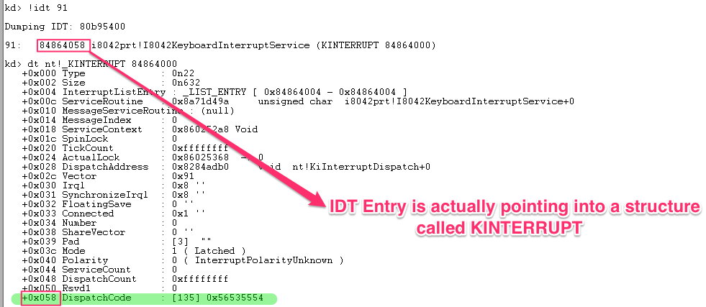
Structure of a KINTERRUPT
Notes:
Labs:
Write “!idt 0x91” + ENTER
Copy the address of the Interrupt starting with “Dumping IDT:”
Write “dt nt!_KINTERRUPT ADDRESS” + ENTER
Pay attention to the DispatchCode field.
Write “uf DISPATCH_CODE + 0x0” see the code.
Next slide.

Slide 58
Where does this code come from?
KINTERRUPT->DispatchCode is actually a modified version of KiInterruptTemplate.
Can be easily modified for different kinds of interrupts such as KiChainedDispatch, KiFloatingDispatch.
Notes:
Talk about “Chained Dispatching”
Multiple drivers handling a single device, until some one returns.
Labs:
CTRL + F and search for ”BADB0D0”
Pay attention to EDI.
What address does it contain?
﻿dt nt!_KINTERRUPT ADDRESS

Slide 59
What does a DispatchCode do?
Acquire the SpinLock of ServiceRoutine
Raise the IRQL to DEVICE_IRQL
Call the ServiceRoutine
Lower IRQL
Release the SpinLock of ServiceRoutine
This is the point where “Interrupt Servicing” takes place!
i8042KeyboardInterruptService
Notes:
Spinlocks are mechanisms for syncronizing two different procedures
IRQL is a term we have seen before.
Spinlock + IRQL combination provides support for symmetric multi processor systems.

Slide 60
How to intercept
Put an inline hook into DispatchCode’s prolog,
Create a new KINTERRUPT object and make EDI point to it,
Replace the ServiceRoutine field of KINTERRUPT,
Inline hook the ServiceRoutine.

Slide 61
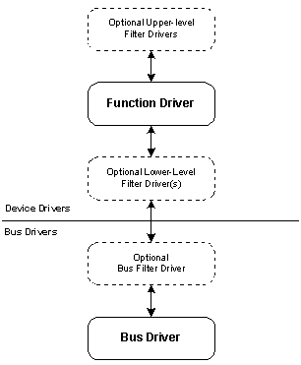
Windows Driver Model
A layered design with support for adding drivers into the stack dynamically.
Great design for management.
Allows another driver to filter some other driver’s packets.
Notes:
Relation between a DEVICE and a DRIVER
Talk about the differences of Devices.
BUS / FUNCTION / FILTER Drivers.

Slide 62
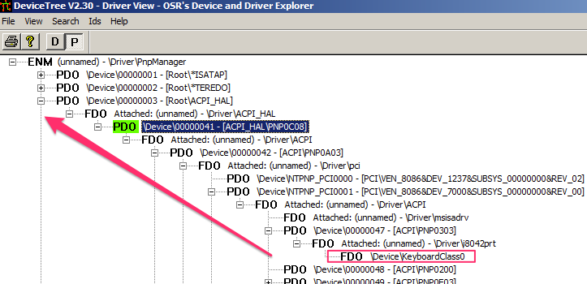
Keyboard Device Stack
Notes:
Labs:
Run “DeviceTree”
Click “P” button on left wait for it to load it’s tree
Click “Search” menu -> “Find Device”
Write “KeyboardClass0” + ENTER
Take a look at the way it’s structured.

Slide 63
What is an IRP?
A structure which is used by the I/O manager for defining a request targeted to a device.
Reading a file, writing to a file and much more operation is handled with IRPs.
Each IRP has a Major code which makes it possible to call appropriate handler for that IRP.
Upper Driver
Keylogger
Class Driver
Lower Driver
Notes:
Labs:
Go to “Materials/Applications”
Install “Zemana AntiLogger Free.exe”
DO NOT RESTART THE MACHINE
Run GMER, take a look at the “Rootkit/Malware” tab
Close GMER and run “Tuluka” and click on “Drivers” tab
Switch down until you see the \Driver\kbdclass which should be RED
Click on it and see which IRP handler is hooked.

Slide 64
i8042prt.sys
Port driver for 8042 compatible keyboard and mouse devices.
Handles the interrupt for a keyboard device and delivers it to the system.
Contains good candidates for a keylogger.
Notes:
Labs:
Go to C:\Windows\System32\drivers\ directory.
Find the i8042prt.sys
Right click and select “Open with CFF Explorer”
See what it says in “FileDescription”

Slide 65
i8042prt.sys
I8042prt.sys
I8042KeyboardInterruptService
I8xGetByteAsynchronous
GLOBALS Globals;
I8042KeyboardIsrDpc
I8xWriteDataToKeyboardQueue
Notes:
These functions are not exported
We can scan for them and find their addresses easily.
ONE OF THE BEST ways, it is not scanned by PATCHGUARD

Slide 66
i8042prt.sys Overview
I8xGetByteAsynchronous
Call IsrHookCallback if one is registered
I8xQueueCurrentKeyboardInput
I8xWriteDataToKeyboardQueue
May also terminate the
ISR by modifying
ContinueProcessing param
Adds the INPUT data into
keyboard input data queue
Uses Globals.Read method
internally
Queues a DPC for giving a
chance to class driver for processing
the input data at DISPATCH_LEVEL
(I8042KeyboardIsrDpc)
Notes:
Here are the steps performed by 8042 port driver.
Go over them one by one.
Talk about DPC.

Slide 67
#4 i8042prt!Globals Hack

Slide 68
i8042prt.sys GLOBALS structure
Notes:
An internal structure for reading a 8042 port.
Labs:
Write “﻿uf i8042prt!I8042KeyboardInterruptService” + ENTER

Slide 69
A look into i8042prt!Globals
﻿8d94c601 ffb0a0000000 push dword ptr [eax+0A0h]
8d94c607 ff15cc40958d call dword ptr [i8042prt!Globals+0xc (8d9540cc)]
8d94c60d 8807 mov byte ptr [edi],al
8d94c60f 0fb6c0 movzx eax,al
kd> dps i8042prt!Globals
8d9540c0 85799cd8
8d9540c4 8594cab8
8d9540c8 85a52c88
8d9540cc 8281a094 hal!READ_PORT_UCHAR
8d9540d0 8281a0fc hal!WRITE_PORT_UCHAR
8d9540d4 00720070
8d9540d8 859b3c80
Replace it with your own ☺
Notes:
Labs:
Write “dps i8042prt!Globals” + ENTER
Take a look at READ_PORT_UCHAR / WRITE_PORT_UCHAR
Why putting them there?

Slide 70
Globals Read Data Hook
kd> bl *
0 d 8d94c57c 0001 (0001) i8042prt!I8xGetByteAsynchronous+0x81 "r al;g;"
1 d 8d94c599 0001 (0001) i8042prt!I8xGetByteAsynchronous+0x9e "r al;g;"
2 e 8d94c60d 0001 (0001) i8042prt!I8xGetByteAsynchronous+0x112 "r al;g;"
﻿0 3d 0 3d 0 3d 9 1d 1e 1d 9e 1d 1f 1d 9f 1d 20 1d a0 1d 21 1d a1 1d 22 1d a2 1d 23 1d
Here we have the keystrokes, also little noisy but can be parsed with a simple
script.
Notes:
This GLOBALS structure is being used in I8xGetByteAsynchronous function
Putting break points into this function, we are able to retrieve the keystrokes.

Slide 71
#5 I8xGetByteAsynchronous

Slide 72
I8xGetByteAsynchronous
Defined as
I8xGetByteAsynchronous(CCHAR KeyboardType,UCHAR*ScanCode)
Pretty good place to hook.
Internally uses Global.Read
Notes:
Can be inline hooked easily

Slide 73
#6 Hacking IsrHookCallback

Slide 74
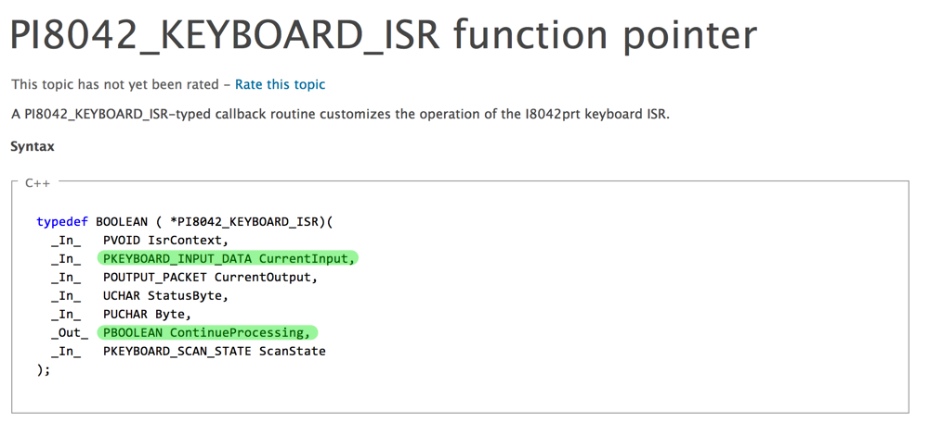
IsrHookCallback
Used by upper level drivers to modify the scancode in the ISR routine.
Gets called right after scan code is retrieved from the keyboard controller.
Notes:
Talk about when ISR gets called.

Slide 75
Hack IsrHookCallback
As easy as setting DeviceExtension->IsrHookCallback
Right after that, keys will start flowing into our callback!
Callback can even stop the ISR’s processing.

Slide 76
#7 Hacking ClassService

Slide 77
What does I8xQueueCurrentKeyboardInput do?
Queues a DPC for further processing.
DPC calls DeviceExtension->ConnectData.ClassService function for delivering the scan code information to the class driver.
Question: Can’t we hook that?
Answer: Definitely yes!
How: Replace the ClassService function with your own ☺

Slide 78
I8xQueueCurrentKeyboardInput
Queues a DPC object for further processing the input data.
This gives class drivers or any upper level drivers a chance to process the input data structure, even modify it!
As soon as IRQL drops to DISPATCH_LEVEL, DPC gets executed and calls the callback supplied by Class Driver.
I8042KeyboardIsrDpc
Class Service Callback

Slide 79
DPC – Deferred Procedure Call
Time is a precious thing!
Do what ever you can to make hardware feel better and queue a procedure to be called when everything is OK.
This prevents keeping a CPU at a high IRQL level for a long time.
Notes:
Talk about DPC Processing and CPU time.
Re-cover IRQL and its use combined with Spinlocks.

Slide 80
#8 I8xWriteDataToKeyboardQueue

Slide 81
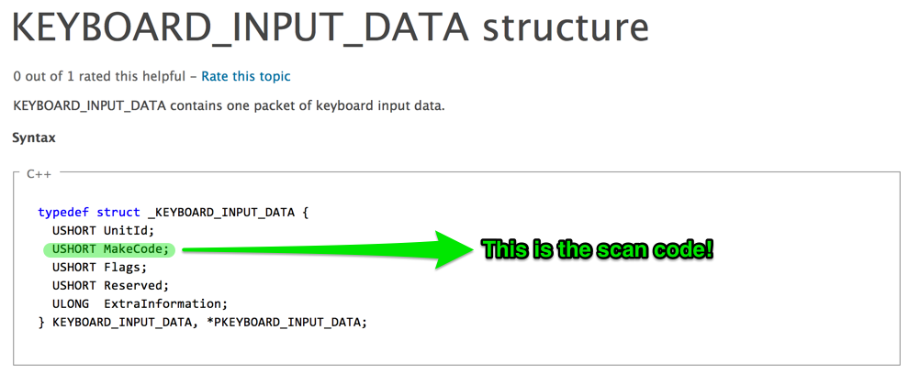
I8xWriteDataToKeyboardQueue
A great candidate for hooking!
Gets the INPUT data as it’s second parameter and writes that into it’s internal data queue.
Flags describe whether the key is down or up.

Slide 82
#9 Filter Drivers

Slide 83
How to filter?
Meaning of layer in malware authors slang:
“A point for injecting evil”
Two methods:
IoAttachDevice API: The IoAttachDevice routine attaches the caller's device object to a named target device object, so that I/O requests bound for the target device are routed first to the caller.
Registry hacks for devices. Set UpperFilter and LowerFilters. Upper filter drivers go between the operating system and the main driver, and lower filter drivers go between the main driver and the hardware.
NTSTATUS IoAttachDevice(
_In_ PDEVICE_OBJECT SourceDevice,
_In_ PUNICODE_STRING TargetDevice,
_Out_ PDEVICE_OBJECT *AttachedDevice
);
Notes:
Describe the filter driver logic.

Slide 84
Let’s check for Keyboard Filters
Go to Materials/Applications copy RegShot directory to your Desktop.
Execute “regshot.exe”
Set output path to “Desktop”
Click on “1st Shot” -> “Shot”
Install “Zemana AntiLogger Free.exe”
Go to regshot again and click “2nd Shot” -> “Shot”
Click “compare”
Search for “﻿UpperFilters” (Upper filters for keyboard device)
Copy the GUID and google it. Guess what does it define?
Restart the machine in DEBUG MODE and execute:
!drvobj \Device\kbdclass
!devstack SECOND OBJECT ADDRESS

Slide 85
#10 IRP Handler Hooking

Slide 86
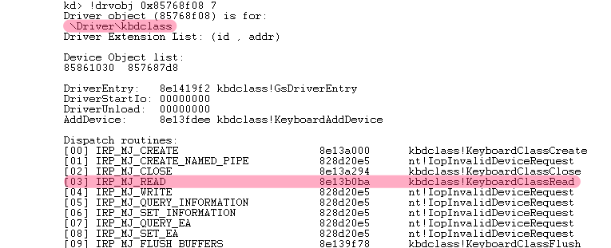
Keyboard Class Driver
\Driver\kbdclass
Represents a Keyboard Device either USB or PS/2.
Used exclusively by the Raw Input Thread (RIT) (coming next).
Notes:
Labs:
Write “.cls” + ENTER
Write “!drvobj \Driver\kbdclass 0x7” + ENTER
Inspect the driver object, pay attention to IRP_MJ_READ

Slide 87
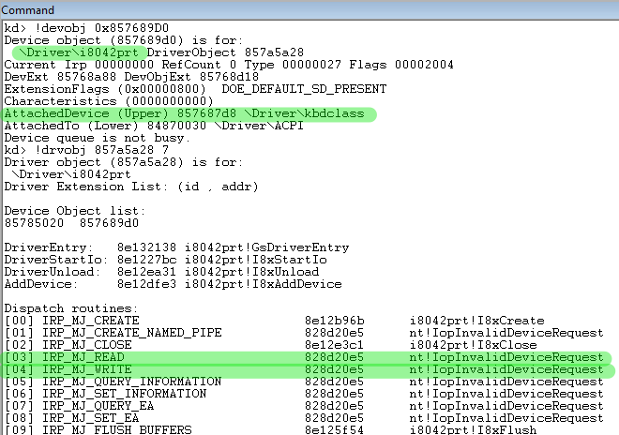
Look at the difference
KbdClass has a READ routine while the Port Driver doesn’t! Why?
Notes:
Labs:
Write “.cls” + ENTER
﻿Write “!drvobj \Driver\i8042prt 0x7” + ENTER
Comparison is made in the next slide.

Slide 88
Here is why
Because it doesn’t need!
It handles the requests from the RIT and waits for it’s KeyboardClassServiceCallback to get called by the keyboard port driver’s ISR.
This callback is registered by sending an IRP carrying a structure called as CONNECT_DATA with an IOCTL_INTERNAL_KEYBOARD_CONNECT code.
This in turn makes the port driver record this callback routine for calling whenever an interrupt occurs.
Notes:
Talk about IO Control Codes. Why they are useful.

Slide 89
KeyboardClassServiceCallback
Routine which dequeues an IRP each time it gets called by the port driver.
As soon as data is copied to the IRP, it completes the IRP with STATUS_SUCCESS.

Slide 90
#12 Inline hooking for ClassCallback

Slide 91
Hook the class callback
We have already hacked this callback routine but in a different way. It was just a replacement of a pointer in ConnectData structure residing in port driver’s DeviceExtension.
This time, another approach.
Put an inline hook into KeyboardClassServiceCallback which will make us the king of scancodes ☺
As easy as putting a 5 byte prolog into the routine.

Slide 92
Let’s talk about “Raw Input Thread”
A thread of csrss.exe which continuously makes a read request to keyboard class device.
It is the guy who retrieves keystrokes from the class driver and posts them to appropriate queues.
It’s mainly a loop which makes a request and waits for that request to complete which in turn makes another request and so forth…
Key method here is ﻿﻿StartDeviceRead which sends a read request to class driver asynchronously with an APC object.
Notes:
Draw the drivers on right and RIT on left, describe the relationship between them.
Next slide will also cover the steps.

Slide 93
How it functions?
Make an async read request
StartDeviceRead
Wait for it to complete
Process the keyboard data in APC routine
Go to step one
Calls ProcessKeyboardInput
Notes:
Talk about Asyncronous Procedure Calls.
Describe its importance.

Slide 94
#13 Hacking Device Templates

Slide 95
What is a Device Template?
A structure for keeping device specific attributes such as keyboard and mouse.
This is where the word “KbdClass” comes from ☺
Also contains a function pointer which is responsible for processing the Keyboard or Mouse input hence the name : “ProcessKeyboardInput”
Notes:
A structure for making the management easier.
Lets take a look at it.
(Next slide)

Slide 96
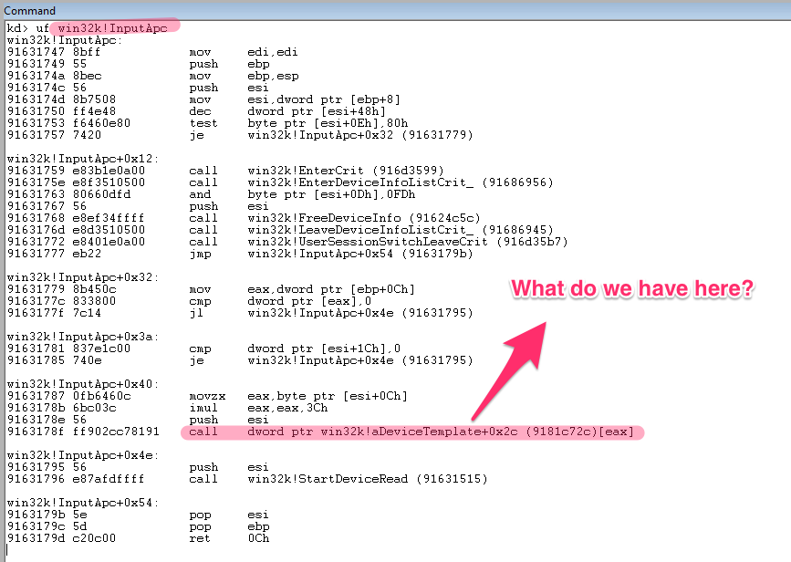
Device Template
Notes:
Labs:
Write “.cls” + ENTER
Write “﻿uf win32k!InputAPC” + ENTER
Scroll to the end and pay attention to the CALL instruction.
(Next slide)

Slide 97
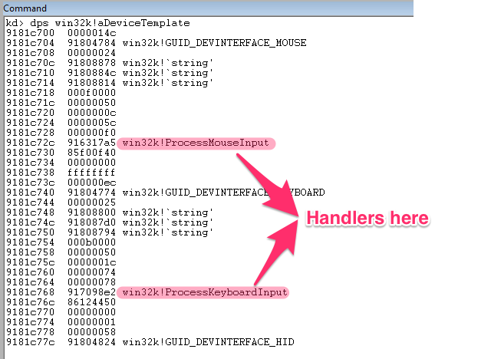
It’s dump time
Notes:
Labs:
Let’s dump it with “﻿dps win32k!aDeviceTemplate”
Pay attention to 3 sequential strings and the handlers.
Write “du STRINGADDRESS” for EACH string and see what they have?

Slide 98
#14 Hook ProcessKeyboardInput

Slide 99
ProcessKeyboardInput
ProcessKeyboardInput
﻿ProcessKeyboardInputWorker
Notes:
Real job is done by Worker.
We don’t care, each one is a target.

Slide 100
Inside ProcessKeyboardInput
Find the first call to worker function.
EBX points to scancode,
Worker function is also a good target.
﻿
Notes:
Labs:
Write “uf win32k!ProcessKeyboardInput” + ENTER
Scroll to end
Copy the address with which worker is called
﻿ba e1 ADDRESS "? poi(@ebx);g;”
Now switch to RED VM and click start menu, hit “A” once
Pay attention to the number of times it gets called. Why at least two times?

Slide 101
#15 Hook ProcessKeyboardInputWorker

Slide 102
Inline Hook ProcessKeyboardInputWorker
Pretty obvious ☺
You can easily see that it is a 3 parameter function with the 3rd parameter as ScanCode.

Slide 103
#16 Hacking xxxProcessKeyEvent

Slide 104
xxxProcessKeyEvent
Called by ProcessKeyboardInputWorker until each input event gets consumed.
Lets take a look at the parameters:
Pointer to a Keyboard Event structure,
An ULONG_PTR value carrying extra information,
A flag indicating if key is from hardware or not.
Performs some language specific operations.

Slide 105
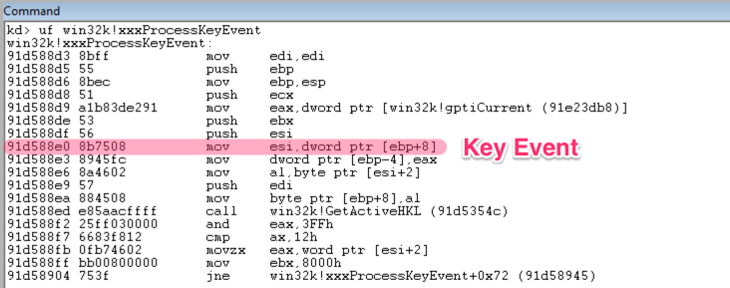
Break on xxxProcessKeyEvent
Notes:
Labs:
Write “﻿uf win32k!xxxProcessKeyEvent” + ENTER
Find the line with “﻿mov esi,dword ptr [ebp+8]”
Copy the following address
Issue command: ba e1 ADDRESS ".echo KEYLOGGER;db @esi;.echo ---------;g;”
Press F5 and write something into RED VM.
Pay attention to the buffer (VKEY + ScanCode)
(Next slide)

Slide 106
Virtual Key vs. Scan Code
Scancode
Virtual Key
Hardware Dependent
Independent

Slide 107
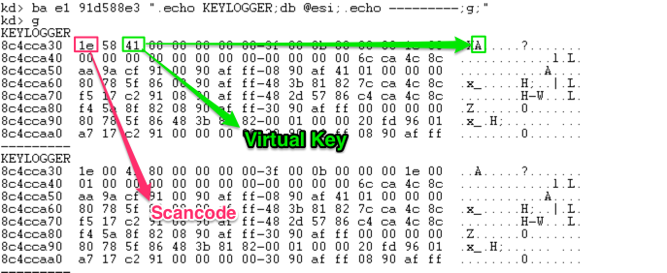
Virtual Key vs. Scan Code

Slide 108
xxxProcessKeyEvent
xxxProcessKeyEvent
﻿UpdateRawKeyState
﻿xxxKeyEvent

Slide 109
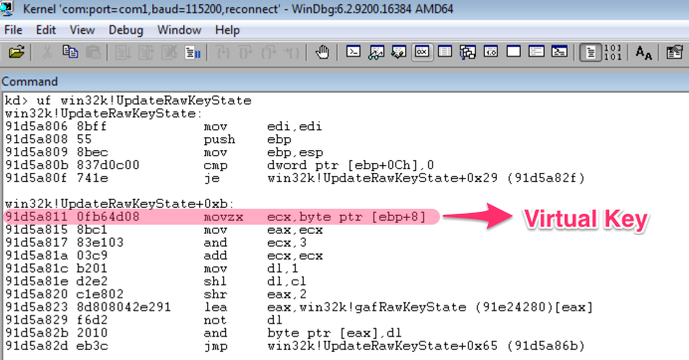
Raw Key State Table
Just a simple array holding UP / DOWN states of keys.
Represents the physical state of keyboard.
Let’s put a BP on it.
Notes:
Labs:
Write “bc *” + ENTER
Write “uf win32k!UpdateRawKeyState” + ENTER
Find the first line starting with “movz”
Put a breakpoint right after it by issuing: ﻿ba e1 ADDRESS "r ecx;g;”
Press F5 and write some keys into the RED machine.

Slide 110
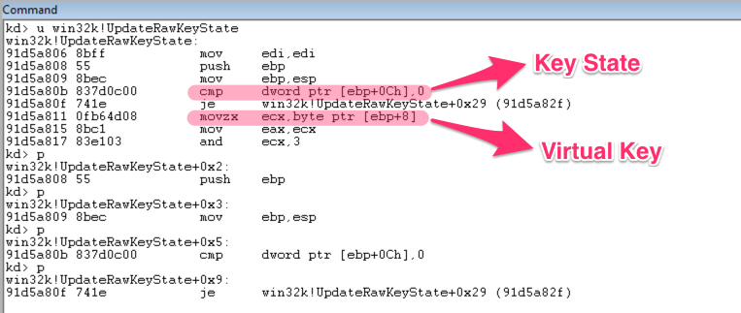
Hook UpdateRawKeyState
Two params:
VirtualKey
Key State (Make / Break)

Slide 111
#17 RawKeyState Sniffer

Slide 112
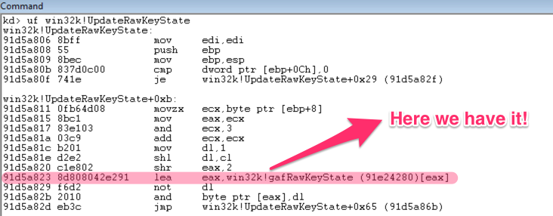
Sniffing Raw Key State Table
Can be easily retrieved by disassembling UpdateRawKeyState.
First LEA instruction points to it,
AV buster ☺

Slide 113
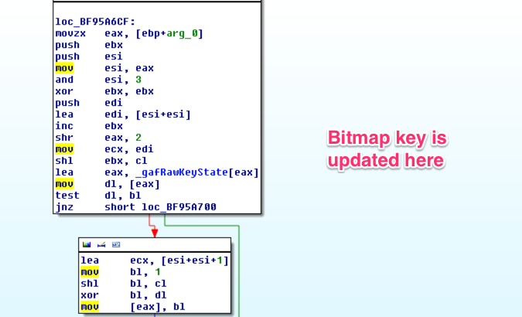
Raw Key State Sniffer
Put a BP on UpdateRawKeyState
2 bits for each VKEY (Down/Up – Toggled)

Slide 114
Raw Key State Sniffer Demo
Put a BP on UpdateRawKeyState end address.
gafRawKeyState
Offset: gafRawKeyState + (VK * 2 bits)

Slide 115
#18 Hacking xxxKeyEvent

Slide 116
xxxKeyEvent
Very critical function!
Performs the POST operation of key into input queue.
Called by xxxProcessKeyEvent for every input event.
Responsible of calling window hooks (wait for next slides)
Params:
Virtual Key with flags,
ScanCode

Slide 117
xxxKeyEvent
Call Low Level Keyboard Hook
Update Async Key State Table
Post Input Message

Slide 118
xxxKeyEvent
Very critical function!
Performs the POST operation of key into input queue.
Called by xxxProcessKeyEvent for every input event.
Responsible of calling window hooks (wait for next slides)
Params:
Virtual Key with flags,
ScanCode

Slide 119
#19 Hacking UpdateAsyncKeyState

Slide 120
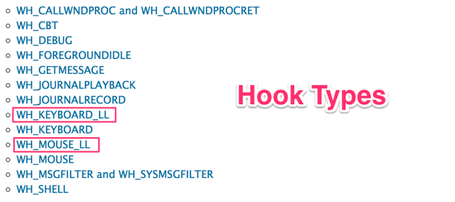
Low Level Hooks
What is a Hook Function?
Only low level hooks are allowed in Raw Input Thread.
Ability to block some input events using these hooks.
Will be described seperately.

Slide 121
UpdateAsyncKeyState
Looks same as the method for UpdateRawKeyState
Async keystate table could also be sniffed.

Slide 122
#20 Hacking PostInputMessage

Slide 123
PostInputMessage
What it does? Calls
Calls ﻿StoreQMessage for saving the message into queue. Another target for hooking ☺
Foreground thread queue receives the input event.
Thread
Input Event
Input Queue

Slide 124
PostInputMessage
Put a BP on PostInputMessage.

Slide 125
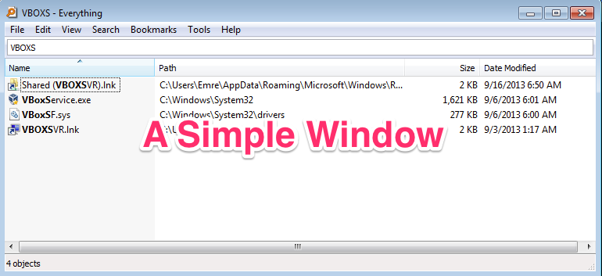
Here comes the second part ☺
Thread now has an input event in it’s queue.
What’s next?

Slide 126
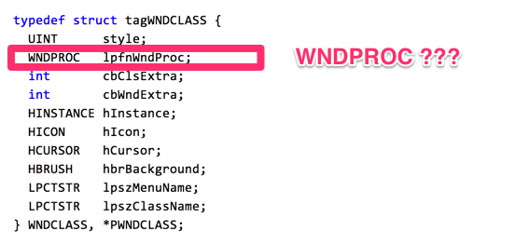
Create Window API
Creates a window with a Window Class.
What is a window class?

Slide 127
Classes vs. Windows
Window Class
Window 1
Window 2
Window 3
Window Procedure

Slide 128
WNDPROC Function
Function defined as:
Every window has one WNDPROC. This is the entry point for window messages.
LRESULT CALLBACK WindowProc(
_In_ HWND hwnd,
_In_ UINT uMsg,
_In_ WPARAM wParam,
_In_ LPARAM lParam
);

Slide 129
#21 Hacking Window Procedures

Slide 130
WNDPROC Function
We can either inline hook the WndProc or we can set a new WndProc by using GetWindowLong / SetWindowLong APIs.

Slide 131
#22 Subclassing a Window

Slide 132
Subclassing
MSDN Blog: When you subclass a window, you set the window procedure to a function of your choosing, and you remember the original window procedure so you can pass it to the CallWindowProc function when your subclass function wants to pass the message to the original window procedure.
Window Class
Window Subclass Procedure
(Log The Keystroke)
Call The Original Window Procedure

Slide 133
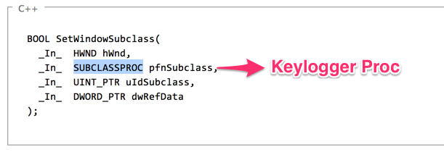
Subclassing
SetWindowSubclass API is pretty good for that.
CallWndProc could be used for retrieving keys from subclassed windows.

Slide 134
Classes vs. Windows
Window Class
Window 1
Window 2
Window 3

Slide 135
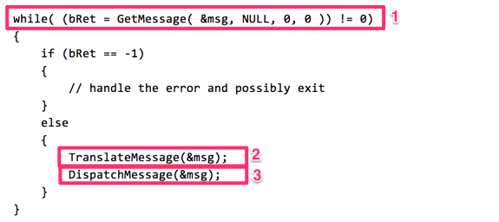
Message Loops
Each UI Thread has one message loop for processing window messages.
http://msdn.microsoft.com/en-us/library/windows/desktop/ms644928(v=vs.85).aspx

Slide 136
#23 Hacking GetMessage / PeekMessage

Slide 137
GetMessage / PeekMessage
Used for getting a message from the thread’s message queue.
BOOL WINAPI GetMessage(
_Out_ LPMSG lpMsg,
_In_opt_ HWND hWnd,
_In_ UINT wMsgFilterMin,
_In_ UINT wMsgFilterMax
);
BOOL WINAPI PeekMessage(
_Out_ LPMSG lpMsg,
_In_opt_ HWND hWnd,
_In_ UINT wMsgFilterMin,
_In_ UINT wMsgFilterMax,
_In_ UINT wRemoveMsg
);
Blocking
Non-Blocking

Slide 138
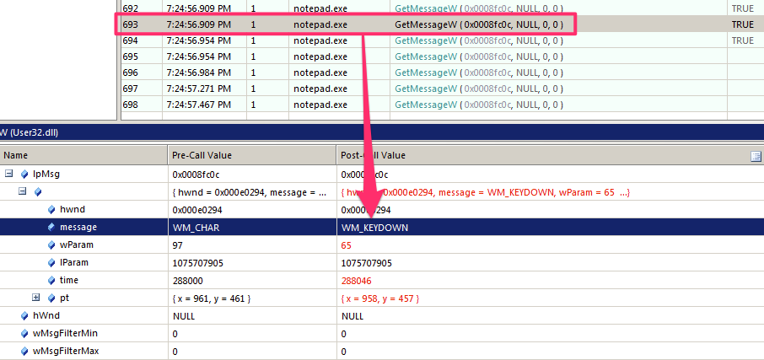
GetMessage / PeekMessage
Sniff GetMessage API call.

Slide 139
#24 Hacking Translate and Dispatch

Slide 140
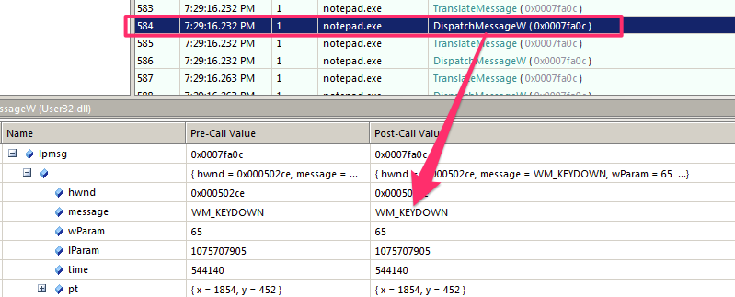
TranslateMessage / DispatchMessage
Sniff TranslateMessage / DispatchMessage API calls.

Slide 141
TranslateMessage
Translate to what?
GetMessage
WM_CHAR
WM_KEYDOWN
TranslateMessage

Slide 142
DispatchMessage
Calls the Window Procedure of a Window Class.
Hooking it will definitely give you a lot power.

Slide 143
#25 Hacking Counterparts

Slide 144
Kernel Mode Counterparts
The APIs which are used for message handling and delivering such as DispatchMessage,GetMessage, PeekMessage.
All of them have their kernel mode counterparts starting with NtUser*. NtUserGetMessage, NtUserPeekMessage, NtUserTranslateMessage.
These could be inline hooked by kernel mode keyloggers.
Best example for this is “Elite Keylogger” (newest versions)
Pretty effective!

Slide 145
Inspecting Kernel Mode Counterparts
Anti-rootkits such as GMER, KernelDetective or Tuluka could be used for detecting these kind of modifications.

Slide 146
#26 SSDT Shadow Hooking

Slide 147
What is SSDT Shadow?
Just a simple table residing in win32k.sys module.
Holds the addresses of system services.
This table is the glue between user mode APIs and the kernel mode counterparts.
Hooking this table is so easy, and also effective.

Slide 148
How it is used?
SSDT Shadow
NtUserGetMessage
NtUserGetMessage
sysenter
W32pServiceTable
User Mode
Kernel Mode

Slide 149
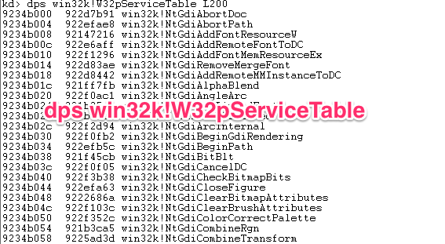
How to check?
We can use anti-rootkits
Windbg can also be used for displaying SSDT Shadow Table.
Notes:
Labs:
Switch to winlogon.exe by issuing “!process 0 0 winlogon.exe”
Copy the address of EPROCESS and write “.process ADDRESS” + ENTER
Write “dps win32k!W32pServiceTable L200”

Slide 150
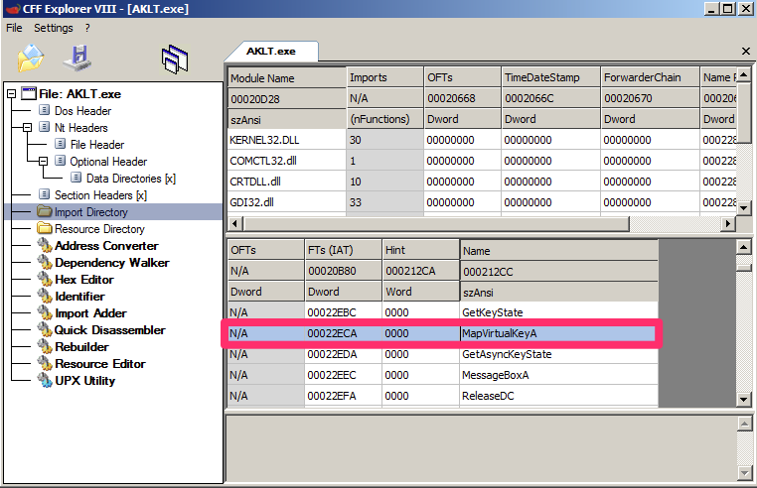
Conversion Functions
MapVirtualKey / MapVirtualKeyEx
ToAscii / ToAsciiEx
VkKeyScan / VkKeyScanEx
Notes:
Labs:
Go to Materials/Keyloggers/
Right click on “AKLT_3.0.new”
Select “CFF Explorer”
Go to “Import Directory”
Select “User32.dll” and see what APIs are residing there.

Slide 151
#27 GetKeyState / GetAsyncKeyState

Slide 152
GetKeyState / GetAsyncKeyState
APIs for determining the state of a key at some point time.
Difference is:
GetKeyState is more spesific and doesn’t reflect the interrupt-level state information,
GetAsyncKeyState reflects the interrupt-level state of keys.
One of the most widely used technique by keyloggers.
Notes:
Labs:
Go to Materials/Keyloggers/
Run GetAsyncKeySate.exe
Run GetKeyState.exe

Slide 153
#28 GetKeyboardState

Slide 154
GetKeyboardState
API for determining the state of a keyboard.
Fills an array of virtual keys.
One of the most widely used method used by keyloggers.

Slide 155
#29 Text Output APIs

Slide 156
Text Output APIs
APIs used by applications to output text.
Examples:
TextOut
ExtTextOut
DrawText / DrawTextEx
Notes:
Labs:
Run “API monitor”
Set “ExtTextOutW” as filter
Run notepad.exe and click monitor button.

Slide 157
#30 GetWindowText

Slide 158
GetWindowText
Can be used within an injected thread.
Copies the text of the specified window's title bar (if it has one) into a buffer. If the specified window is a control, the text of the control is copied. However, GetWindowText cannot retrieve the text of a control in another application.

Slide 159
#31 WM_GETTEXT Message

Slide 160
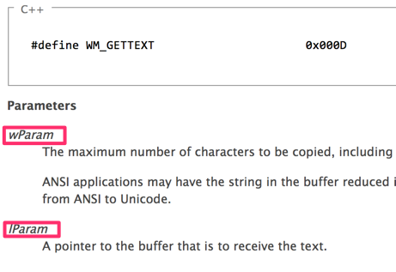
WM_GETTEXT Message
Can be used for retrieving another applications window content.

Slide 161
#32 SetWindowsHookEx

Slide 162
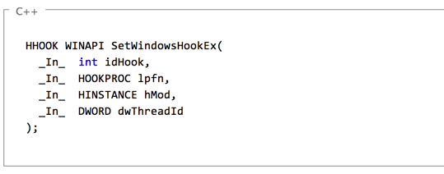
SetWindowHookEx
Another term for saying “Keylogger” ☺
Definitely the MOST WIDELY USED technique for keylogging!!!
Nearly %95 of keyloggers use it ☺
Notes:
Best way to analyze is RkUnhooker

Slide 163
Why?
It is a way for providing callbacks to developers but widely used by malware authors.
Have pretty much variations such as “Low Level Hook”, “Get Message Hook” and etc.

Slide 164
Hook Types
WH_CALLWNDPROC : Installs a hook procedure that monitors messages before the system sends them to the destination window procedure.
WH_CALLWNDPROCRET : Installs a hook procedure that monitors messages after they have been processed by the destination window procedure.
WH_CBT : Installs a hook procedure that receives notifications useful to a CBT application.
WH_DEBUG : Installs a hook procedure useful for debugging other hook procedures.

Slide 165
Hook Types
WH_GETMESSAGE : Installs a hook procedure that monitors messages posted to a message queue.
WH_JOURNALRECORD : Installs a hook procedure that records input messages posted to the system message queue.
WH_KEYBOARD : Installs a hook procedure that monitors keystroke messages.
WH_KEYBOARD_LL : Installs a hook procedure that monitors low-level keyboard input events.
Notes:
Labs:
Go to Materials/Keyloggers/SetWindowsHookEx
Run keylog.exe and SSM_KeyLog from command line
Analyze them using RkUnhooker.

Slide 166
#33 DirectX Keylogger

Slide 167
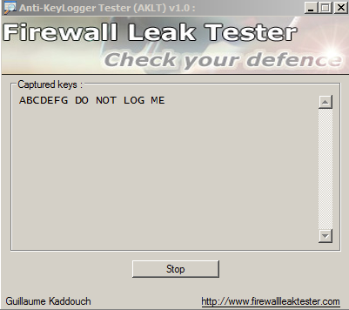
DirectX
Not widely used but a good way for logging keystrokes.
Notes:
Labs:
Run AKLT_3.0.exe
Click DirectX
See how it works.

Slide 168
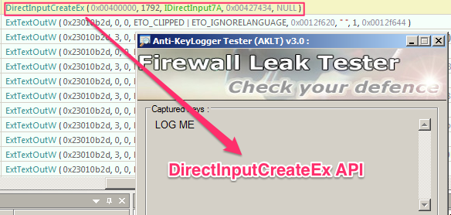
How?
Pretty easy to implement with DirectInputCreateEx API.
CreateDevice API is used for keyboard device creation.

Slide 169
#34 Browser Extensions

Slide 170
Browser Extensions
Sneaky creatures!
Not widely used but a great for bypassing security measures.
Notes:
Pretty easy to create
A place where most people do not expect.
Labs:
Fire up “firefox.exe”
Go to Materials/Keyloggers
Select firefox_keylogger.xpi
Drag and drop it into “Firefox”
Install it and provide “1” for password
Now go to “facebook.com”
Send CTRL + SHIFT + \ combination or do it with OSK.exe (pay attention to language EN)

Slide 171
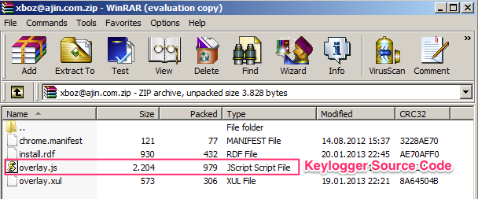
Inspecting
XPI files are just zip files.
Unzip it and analyze what it does.
Notes:
Labs:
Change the extension name to zip
Unzip it
Select overlay.js and edit it.
See what’s inside.

Slide 172
Demos
Go to Materials/Keyloggers folder:
Analyze martin.exe
Analyze AKLT_3.0.exe
Analyze refog_personal_manager.exe”
Analyze Elite Keylogger
Analyze java keylogger
Analyze Free Keylogger

Slide 173
Thanks

Slide 174
Questions?

