Slide 1
Malware Dynamic Analysis Part 1
Veronica Kovah
vkovah.ost at gmail
http://opensecuritytraining.info/MalwareDynamicAnalysis.html

Slide 2
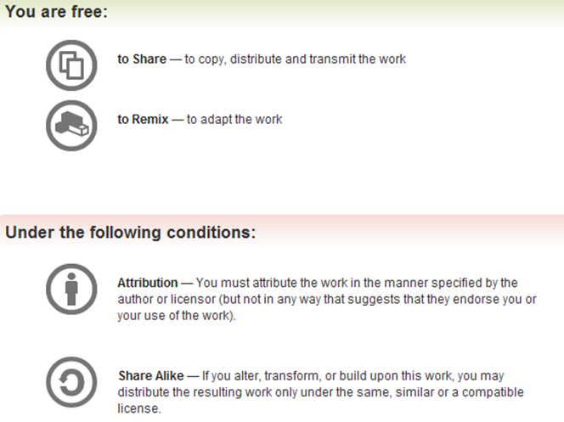
All materials is licensed under a Creative Commons “Share Alike” license
http://creativecommons.org/licenses/by-sa/3.0/

Slide 3
Where are we at?
Part 1: Introduction
Observing an isolated malware analysis lab setup
Malware terminology
RAT exploration - Poison IVY
Behavioral analysis
Part 2: Persistence techniques
Using registry keys
Using file systems
Using Windows services

Slide 4
Isolated Lab Settings
It is very important to have an isolated lab machine ready to avoid accidental malware escape
It should be easy to restore the old state, which is not infected by malware
Lab with physical machines
Use Deep Freeze (restore), FOG (clone/restore), etc.
Lab with virtual machines
Use virtualization solution such as VMware, VirtualBox, KVM, Xen, etc.
Notes:
[References]
Deep Freeze, http://www.faronics.com/products/deep-freeze/standard/
FOG, http://sourceforge.net/projects/freeghost/
Vmware, http://www.vmware.com/
VirtualBox, https://www.virtualbox.org/
KVM, http://www.linux-kvm.org/page/Main_Page
Xen, http://www.xen.org/

Slide 5
VirtualBox
Oracle VM VirtualBox is freely available open source software
6 network modes are available
Not attached, NAT, Bridged Adapter, Internal Network, Host-only Adapter, Generic Driver
Can use VMware or Microsoft Virtual PC generated formats
Notes:
[References]
VirtualBox, https://www.virtualbox.org/
Chapter 6. Virtual networking, Oracle VM VirtualBox User Manual, http://www.virtualbox.org/manual/ch06.html
[Image Sources]
https://www.virtualbox.org/graphics/vbox_logo2_gradient.png

Slide 6
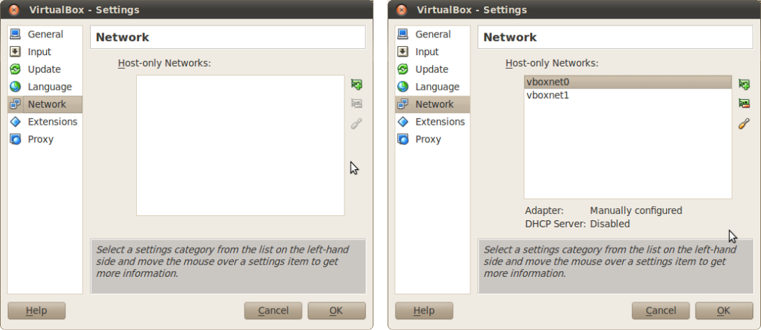
2 Host-only Networks
File->Preferences…->Network
Notes:
[References]
Oracle VM VirtualBox User Manual, http://www.virtualbox.org/manual/UserManual.html

Slide 7
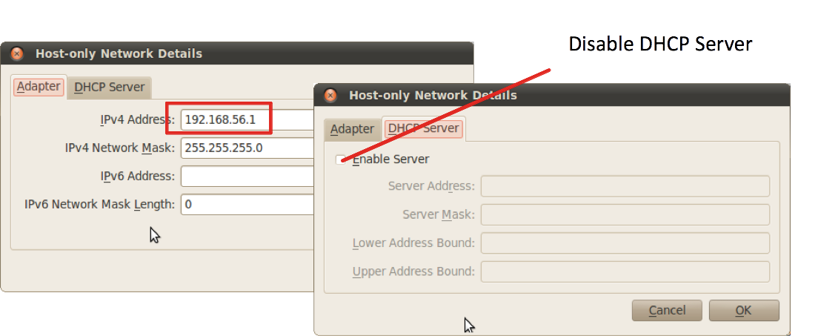
Network Details
Same for vboxnet1 except IPv4 address, 192.168.57.1
On host machine, check if you see new network interfaces
$ ifconfig

Slide 8
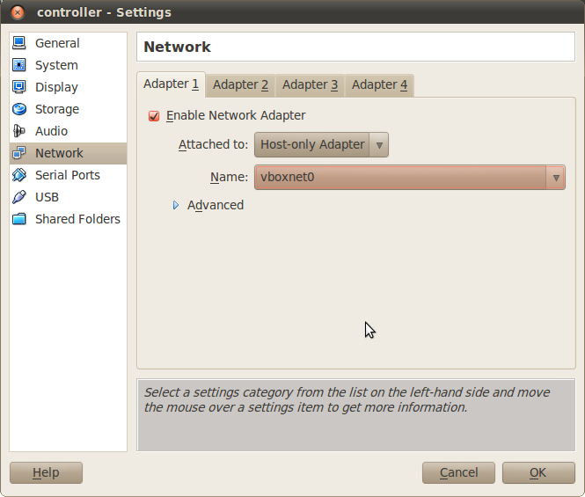
VM’s network setting (1)
Start controller VM first
C:\> ipconfig
Open controller VM’s Settings, change Network->Adapter 1

Slide 9
VM’s network setting (2)
Open victim VM’s Settings → Network → Adapter 1
Attached to = ‘Host-only Adapter’
Name = ‘vboxnet1’
Start VMs and change network setting
VM name | controller | victim
IP address | 192.168.56.20 | 192.168.57.100
Subnet mask | 255.255.255.0 | 255.255.255.0
Default Gateway | 192.168.56.1 | 192.168.57.1
Preferred DNS Server | 192.168.56.1 | 192.168.57.1

Slide 10
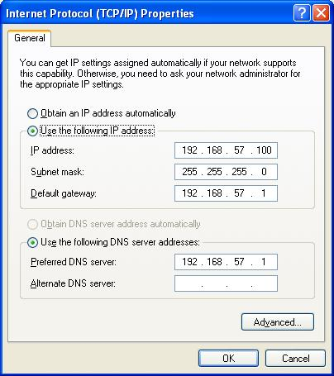
Change IP on Windows
Start → Control Panel → Network Connections → Local Area Connection → Properties → Internet Protocols (TCP/IP) → Properties

Slide 11
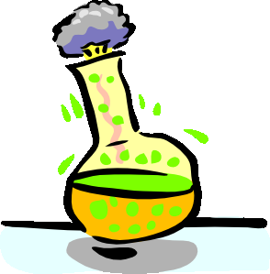
IP Forwarding
IP Forwarding is disabled by default on Ubuntu
$ sudo su
# echo 1 > /proc/sys/net/ipv4/ip_forward
Enable packet forwarding in firewall
# iptables –P FORWARD ACCEPT
Can you ping from victim to controller VM?

Slide 12
Network Sniffing
Try to capture network traffic
$ wireshark&
From the menu bar, Capture->Options…
Do you see any interface?
Running Wireshark as root is not safe
Malformed network traffic can exploit a Wireshark vulnerability
But you cannot access to any interface without root privilege
Choice 1: use a simple dumper (wireshark uses this) and then open up the file as a non-root user
$ sudo dumpcap -i vboxnet0 -w /tmp/pi.pcap
Shortcoming: you cannot see network traffic in real time

Slide 13
Wireshark with User Privilege (1)
This lab will setup sniffing with Wireshark as a non-root user
Install setcap
$ sudo apt-get install libcap2-bin
Add wireshark group
$ sudo groupadd wireshark
$ sudo usermod -a -G wireshark student
Close all open windows and terminals
$ gnome-session-quit
Notes:
[References]
Jeremy Stretch, Sniffing with Wireshark as a Non-Root User, http://packetlife.net/blog/2010/mar/19/sniffing-wireshark-non-root-user/

Slide 14
Wireshark with User Privilege (2)
$ sudo chgrp wireshark /usr/bin/dumpcap
$ sudo chmod 750 /usr/bin/dumpcap
Grant capabilities
$ sudo setcap cap_net_raw,cap_net_admin=eip /usr/bin/dumpcap
Verify
$ getcap /usr/bin/dumpcap

Slide 15
Network Connectivity Test
Can you ping from the victim VM to the host machine?
C:\> ping 192.168.57.1
Start the controller VM
Can you ping from the victim VM to the controller VM?
On the victim VM
C:\> ping 192.168.56.20

Slide 16
Capturing Network Packets
Ping from victim VM to controller VM.
Capture the traffic using Wireshark with non-root privilege.
Which network interface did you choose?

Slide 17
INetSim
Software suite for simulating common internet services in a lab environment
HTTP/HTTPS, DNS, SMTP, etc. servers
IRC channel with basic command sets
Open source, written in Perl
v1.2.4 can be installed on Ubuntu 12.04 via the package manager
Notes:
[References]
Thomas Hungenberg and Matthias Eckert, INetSim, http://www.inetsim.org/

Slide 18
inetsim setup
On the host machine
$ gedit /etc/inetsim/inetsim.conf
$ sudo inetsim
$ wireshark &
listen on vboxnet1
On the victim VM
c:> ping www.google.com

Slide 19
Where are we at?
Part 1: Introduction
Observing an isolated malware analysis lab setup
Malware terminology
RAT exploration - Poison IVY
Behavioral analysis
Part 2: Persistence techniques
Using registry keys
Using file systems
Using Windows services

Slide 20
Malware Terminology (1) (Just so we can be on the same page throughout the class)
Virus: “Malware that replicates, commonly by infecting other files in the computer, thus allowing the execution of the malware code and its propagation when those files are activated. Other forms of viruses include boot sector viruses and replicating worms.”
Worm: “A worm is a self-propagating program that can automatically distribute itself from one computer to another. Worms may propagate themselves using one or more of the following methods”

Slide 21
Malware Terminology (2)
Trojan: “A malicious application that is unable to spread of its own accord. Historically, the term has been used to refer to applications that appear legitimate and useful, but perform malicious and illicit activity on an affected computer.”
Backdoor: “A backdoor is a piece of software which, once running on a system, opens a communication vector to the outside so that the computer can be accessed remotely by an attacker.”

Slide 22
Malware Terminology (3)
Bot: “A malicious program installed on a computer that is part of a bot network (botnet). Bots are generally backdoor trojans that allow unauthorized access and control of an affected computer. They are often controlled via IRC from a centralized location (although other models of command and control exist).”
Remote Administration Tool (RAT): “A piece of software that allows a remote "operator" to control a system as if he has physical access to that system.”

Slide 23
Malware Terminology (4)
Downloader: “A type of trojan that downloads other files, which are usually detected as other malware, onto the computer. The Downloader needs to connect to a remote host to download files”
Dropper: “A type of trojan that drops other files, which are usually detected as other malware, onto the computer. The file to be dropped is included as part of the dropper package”

Slide 24
Malware Terminology (5)
Spyware: “The term 'spyware' essentially covers any software that gathers information and passes it to a third party without adequate permission from the owner of the data.”
Adware: “Adware is essentially any software that is funded by advertising.”
Ransomware: “A type of malware that encrypts files on a victim's system, demanding payment of a ransom in return for the access codes required to unlock the files.”

Slide 25
Vendor Naming Convention
Conventions derived from Computer Antivirus Research Organization (CARO) Malware Naming Scheme
Microsoft, F-Secure
Vendor | Name Convention | Example
Symantec | Prefix.Name.Suffix | Infostealer.Banker.C
Avira | Prefix:Name [Type] | Win32:Zbot-BS [Trj]
Kaspersky | [Prefix:]Behaviour.Platform.Name[.Variant] | Trojan.Win32.Genome.taql
Notes:
[References]
Microsoft Malware Protection Center Naming Standards, http://www.microsoft.com/security/portal/Shared/MalwareNaming.aspx
Virus Naming Conventions, http://www.symantec.com/security_response/virusnaming.jsp
Michal Krejdl, What to imagine behind Win32:MalOb [Cryp], https://blog.avast.com/2009/07/29/what-to-imagine-behind-win32malob-cryp/
Rules for naming detected objects, http://www.securelist.com/en/threats/detect?chapter=136

Slide 26
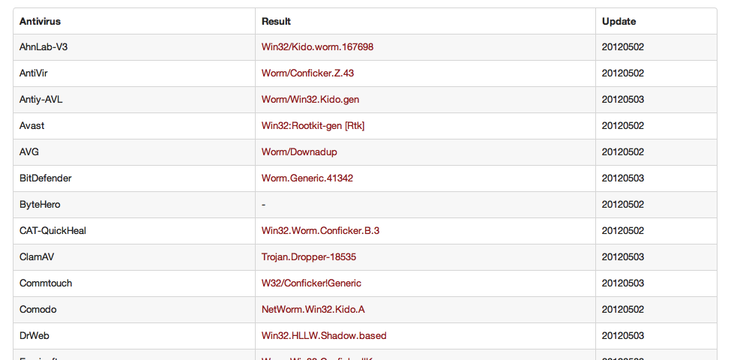
Non-standardized Naming Scheme

Slide 27
Where are we at?
Part 1: Introduction
Observing an isolated malware analysis lab setup
Malware terminology
RAT exploration - Poison IVY
Behavioral analysis
Part 2: Persistence techniques
Using registry keys
Using file systems
Using Windows services

Slide 28
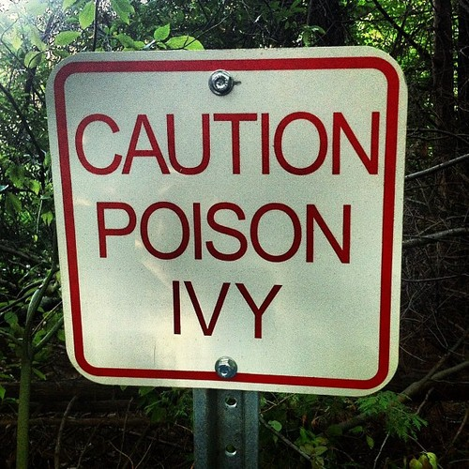
Poison Ivy
Freely available RAT, the latest version is v2.3.2
Implant (Server)
Customizable features: Encrypted communications, registry and file manager, screen capture, key logger, NTLM hash captures, etc.
No need to update for new features
Support 3rd party plugins
E.g. port scanner, wifi enumerator (“stumbler”), etc
Controller (Client)
Once an implant is deployed, the implant connects to a controller, whose information is built into the implant.
Notes:
[References]
Poison Ivy – Remote Administration Tool, http://www.poisonivy-rat.com/
[Image Sources]
http://25.media.tumblr.com/tumblr_m83rfveJWO1r6dcg4o1_500.jpg

Slide 29
Simple PI Server Creation
On the controller VM
Start Poison Ivy
MalwareClass/samples/PoisonIvy/Poison Ivy 2.3.2.exe
File→New Server
Create Profile with name “pi_agent”
Connection: set DNS/Port to the controller VM’s IP and set port to 3460
192.168.56.20:3460:0,

Slide 30
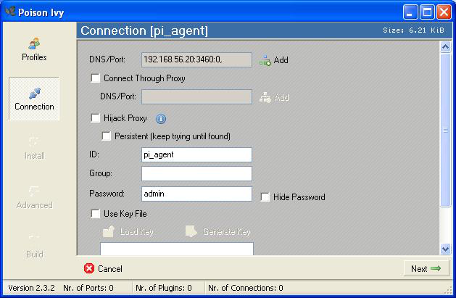
Connection

Slide 31
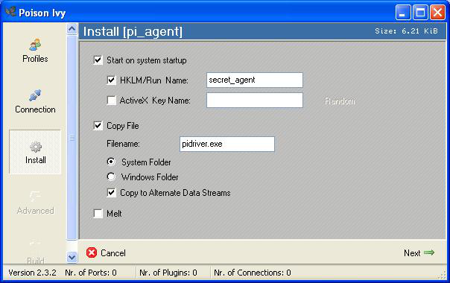
Install

Slide 32
Creating pitest.exe
Advanced: Leave as it is
Build:
Click ‘Generate’ and save as “pitest.exe”
Then click ‘OK =>’
We need to copy pitest.exe to the victim VM but will skip the step to save time

Slide 33
Client Creation
On the controller VM
File→New Client
Verify ‘Listen on Port’ is set to 3460
Click ‘Start’ button

Slide 34
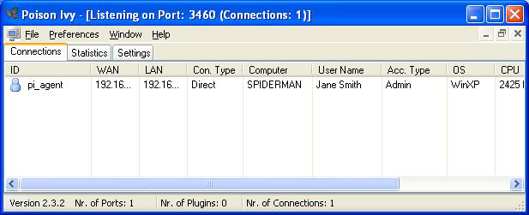
Executing Poison Ivy Implant
On the victim VM
Execute the already prepared PI server (MalwareClass/samples/PoisonIvy/pi_agent.exe)
Once a server connects to the client, you will see the following entry on the controller VM

Slide 35
Think Evil!
On the controller VM, double click on the ‘pi_agent’ line
Q1. Select ‘Remote Shell’ on the left panel, then on the right panel, click the right mouse button and select ‘Activate’, Can you start a calculator to surprise the victim? Hint: “cmd.exe /c ...”
Q2. Can you kill the calculator on the victim VM?
Q3. What’s in the registry value ‘secret_agent’ under HKLM\SOFTWARE\Microsoft\Windows\CurrentVersion\Run? Anything special about it?

Slide 36
Answers for PI Lab (1)
A1. C:\> cmd.exe /c c:\Windows\system32\calc.exe
A2. You can kill the calculator process using Managers→Processes left-side bar

Slide 37
Answers for PI Lab (2)
A3. Alternate Data Stream (ADS) is attached to C:\WINDOWS\System32
If you go to C:\WINDOWS\System32, you won't see anything named “pidriver.exe”. Let's find it with gmer
Malware occasionally stores data in Alternate Data Stream (ADS). ADS is a mechanism for attaching metadata to files.
If you use a colon in a filename, the part after the colon will be the metadata name/file, and the part before the colon will be the file it's being attached to
Explorer doesn't show ADS files, but functions like CreateFile() can access them just fine, so the file still runs.
Notes:
[References]
GMER, http://www.gmer.net/
AlternateStreamView, http://www.nirsoft.net/utils/alternate_data_streams.html

Slide 38
Where are we at?
Part 1: Introduction
Observing an isolated malware analysis lab setup
Malware terminology
RAT exploration - Poison IVY
Behavioral analysis
Part 2: Persistence techniques
Using registry keys
Using file systems
Using Windows services

Slide 39
Diffing
Take a snapshot of a clean system state and a snapshot of a compromised system state
Compare before and after
Pros: Artifacts can be observed easily
Cons: Can miss evidence that is created during malware activities and erased purposely by malware
Tools: regshot, autoruns
Notes:
[References]
Regshot, http://code.google.com/p/regshot/
Mark Russinovich et al., Autoruns, http://technet.microsoft.com/en-us/sysinternals/bb963902.aspx
[Image Sources]
http://familyfun.go.com/assets/cms/printables/0707c_findthedifference.jpg

Slide 40
System Monitoring
From a clean system state, record every individual change on system and network traffic that appear after execution of made by the suspicious file
Pro: Can collect all manifested changes
Cons: Often too much information and need to weed out irrelevant data
Tools: procmon, Wireshark
Notes:
[Image Sources]
http://i1.kym-cdn.com/entries/icons/original/000/007/195/im%20watching%20you%20-%20copia.jpg

Slide 41
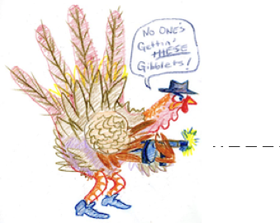
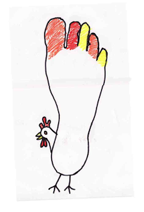
API Tracing
Hook and record important API calls made by the suspicious process
Pro: Can provide visibility into activity beyond the typical file/process/registry/network shown by other tools. Gets you a little closer to the type of interpretation that is required when doing static analysis.
Cons: Often too much of information and need to weed out irrelevant data. API-specific interpretation can take a lot of time (but still less than static analysis ;))
Tools: WinApiOverride, Rohitab API Monitor
Notes:
[References]
WinAPIOverride, http://jacquelin.potier.free.fr/winapioverride32/
API Monitor, http://www.rohitab.com/apimonitor
[Image Sources]
Left, http://fc03.deviantart.net/fs39/f/2008/332/c/d/HAND_TURKEY_by_Bilious.jpg
Right, http://dorpahdoo.files.wordpress.com/2010/11/foot-turkey.jpg

Slide 42
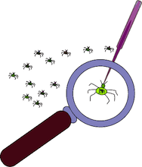
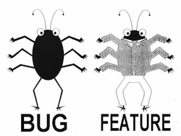
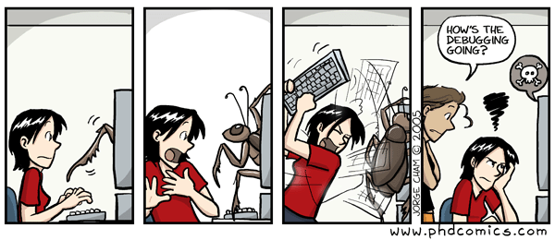
Debugging
Set breakpoints inside the suspicious file to stop its execution at a given location and inspect its state. Can break when it calls to important APIs.
Pro: Provides a superset of the functionality of an API monitor
Cons: Typically must be be done in conjunction with some basic static analysis and assembly reading. Malware will often change its behavior or refuse to run when being debugged, which requires a work-around.
Tools: IDA Pro Debugger, OllyDbg, Immunity Debugger, WinDbg
We will NOT cover this in this class, because x86 assembly is not a prerequisite. See the Intro x86 and Intro Reverse Engineering classes to start working with debuggers.
Notes:
[Image Sources]
Top left, http://www.wpclipart.com/computer/humour/debugging.png
Top right, http://www.phdcomics.com/comics/archive/phd011406s.gif
Bottom, http://www.oraclealchemist.com/wp-content/uploads/2008/07/bug-feature.jpg

Slide 43
Behavioral Analysis Techniques “Always use the easiest tool for the job” :)
AWESOMA POWA!
Diffing
Ease-of-use/ Abstraction level
File,
Registry,
Process,
Network Monitoring
API
Tracing
Debugging

