Slide 1
Advanced x86:
Virtualization with VT-x
Part 1
David Weinstein
dweinst@insitusec.com

Slide 2
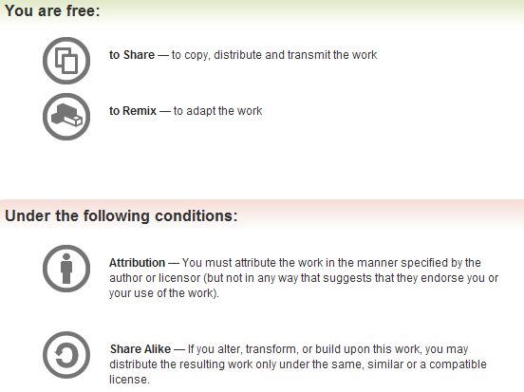
All materials are licensed under a Creative Commons “Share Alike” license.
http://creativecommons.org/licenses/by-sa/3.0/

Slide 3
Acknowledgements
<Could be you!> : Tell me something that I didn’t know that ends up in the course material
Thanks to Xeno Kovah for pushing me to create this material and for reviewing it periodically as it was created.
Thanks to Corey Kallenberg for device driver signing info for Windows 7

Slide 4
Introductions
Name
Department
Work interests
  Projects, sponsor, etc.

Slide 5
Prerequisites
Intro/Intermediate x86 (or equivalent) required
Rootkits class will probably help

Slide 6
Agenda
Introduction
Lightning x86_64 review
VT-x
  VMM detection
  Relevant hypervisor projects
Time permitting
  Discussion: writing “undetectable” bot for SC2/Diablo 3?

Slide 7
Questions
Stolen from Xeno…
Questions: Ask ‘em if you got ‘em
  If you fall behind and get lost and try to tough it out until you understand, it’s more likely that you will stay lost, so ask questions ASAP.
Browsing the web and/or checking email during class is a great way to get lost ;)
2 hours, 10 min break, 2 hours, 1 hour lunch, 2 hours 10 min break, 1.5 hours, done
Adjusted depending on whether I’m running fast or slow (or whether people are napping after lunch :P)

Slide 8
Scope
While advanced, still introductory
Fundamentals, challenges, techniques
Open source virtualization technologies and implementations
Primarily Intel® specific discussions, 64 bit host/guests
All indications to sections in Intel® manual correspond to December 2011 edition (Order Number: 325384-041US) which should be provided with these slides

Slide 9
Goals
Identify/understand/implement various hypervisor concepts, integrate by parts
Blue Pill/Hyperjack
  post-boot (hosted) hypervisor shim technique
Highly curated tour of Intel Manual with labs

Slide 10
Introduction
The goal is to get the core virtualization concepts out of the way and clear up the semantics first.
We’ll cover some 64-bit concepts
Then move into specifics for Intel VT-x;
  We will be covering the architecture, instructions, and specifics needed to write real code
    With Windows focus
    Series of labs to guide the way
Notes:
Let’s talk about VMX baby

Slide 11
Sqr0…
Each instance of an OS is called a Virtual Machine (VM), guest, or domU.
Hypervisor ≡ Virtual Machine Monitor (VMM)
There are fundamentally different approaches to virtualization; important to understand the differences

Slide 12
Terminology Bootstrap
Virtual Machine Extensions (VMX)
Virtual Machine Monitor (VMM)
VMX Root operation
  VMM, host VM
Management VM
  dom0
VMX Non-root operation
  domU, guest VM
Others we’ll pick up along the way

Slide 13
Virtualization is
Resource Abstraction yo!
“The process of hiding the underlying physical hardware in a way that makes it transparently usable and shareable by multiple operating systems.” [IBM]
  Most hardware can be virtualized to the point that a guest doesn’t know/care
  Underlying physical hardware supporting VM may not be dedicated to it
[IBM] http://www.ibm.com/developerworks/linux/library/l-hypervisor/

Slide 14
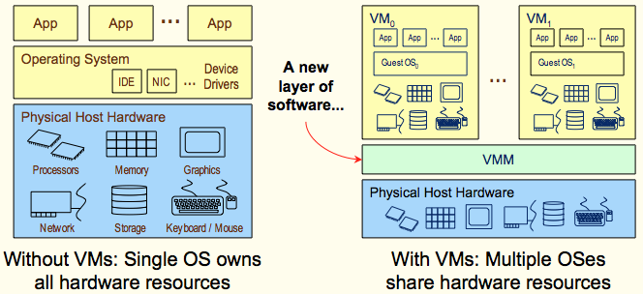
Abstraction
Grey for effect… 2005 seems so long ago…
Ref: August 2005 System Virtual Machines, HotChips 17 Tutorial

Slide 15
Vendor technologies
 | Intel | AMD
CPU Flag | Virtual Machine Extensions (VMX) | Secure Virtual Machine (SVM)
Processor emulation | VT-x | AMD-v
Extended page tables | Extended page tables (EPT) | Rapid Virtualization Indexing (RVI)
MMU emulation | VT-d | AMD-Vi
Network emulation | VT-c
PCI emulation | PCI-SIG I/O Virtualization | PCI-SIG I/O Virtualization
We will be focused on Intel VT-x
Notes:
We will primarily be covering VT-x, but most of it maps to AMD-v as well.

Slide 16
VMM Types
Type 1. “bare metal” hypervisors run directly on the host hardware
  guest OS runs at level above the hypervisor
Type 2. “hosted” hypervisors run on top of an OS
  The hypervisor layer exists as distinct second software level
  Guest operating systems run at the third level above the hardware
Notes:
In the 1960s, IBM2 had created something of a Type 1 hypervisor.

Slide 17
x86-64 Quick Review
No more inline assembly (MS compilers)
New instructions
New General Purpose (GP) registers
Changes to Segmentation
Paging, now more fun
RIP relative addressing
REX prefixes
x64 (fastcall) calling convention

Slide 18
Checking The 64-bit feature
Use CPUID input-value 0x80000001 for obtaining extended feature bits
Returned in the ECX and EDX registers
.data
ext_features DB 8 DUP(0) # 8 bytes (zeroed) for extended features bits
.code
mov eax, 80000001h # setup input-value in EAX
cpuid # then execute CPUID
mov [ext_features+0], edx # save feature-bits from EDX
mov [ext_features+4], ecx # save feature-bits from ECX

Slide 19
Extended features bits
31 30 29 28 27 26 25 24 23 22 21 20 19 18 17 16 15 14 13 12 11 10 9 8 7 6 5 4 3 2 1 0
R
R
R
R
R
R
R
R
R
R
R
R
R
R
R
R
R
R
R
R
R
R
R
R
R
R
R
R
R
R
R
L
S
F
ECX =
31 30 29 28 27 26 25 24 23 22 21 20 19 18 17 16 15 14 13 12 11 10 9 8 7 6 5 4 3 2 1 0
R
R
IA-32e
R
R
R
R
R
R
R
R
X
D
R
R
R
R
R
R
R
R
S
Y
S
C
A
L
L
R
R
R
R
R
R
R
R
R
R
R
EDX =
Modified from http://cs.usfca.edu/~cruse/cs630f06/lesson05.ppt
IA32e = Intel 64-bit Technology
XD = eXecute Disable paging-bit implemented
SYSCALL = Fast SYSCALL / SYSRET (64-bit mode)
LSF = LAHF / SAHF implemented in 64-bit mode
R = reserved bit

Slide 20
New instructions (x64)
CDQE | Convert doubleword to quadword
CMPSQ | Compare string operands
CMPXCHG16B | Compare RDX:RAX with m128
LODSQ | Load qword at address (R)SI into RAX
MOVSQ | Move qword from address (R)SI to (R)DI
MOVZX (64-bits) | Move doubleword to quadword, zero-extension
STOSQ | Store RAX at address RDI
SWAPGS | Exchanges current GS base register value with value in MSR address C0000102H
SYSCALL | Fast call to privilege level 0 system procedures
SYSRET | Return from fast system call
Notes:
No need to memorize these, just something to keep in mind.

Slide 21
New GP Registers
“In 64-bit mode, there are 16 general purpose (GP) registers and the default operand size is 32 bits. However, general-purpose registers are able to work with either 32-bit or 64-bit operands.”
R8-R15 represent eight new general-purpose registers. All of these registers can be accessed at the byte (B), word (2 B), dword (4 B), and qword (8 B) level.
Notes:
byte, word = 2 bytes, dword = 4 bytes, qword = 8 bytes

Slide 22
Registers
typedef struct _GUEST_REGS
{
ULONG64 rax;
ULONG64 rcx;
ULONG64 rdx;
ULONG64 rbx;
ULONG64 rsp;
ULONG64 rbp;
ULONG64 rsi;
ULONG64 rdi;
ULONG64 r8;
ULONG64 r9;
ULONG64 r10;
ULONG64 r11;
ULONG64 r12;
ULONG64 r13;
ULONG64 r14;
ULONG64 r15;
} GUEST_REGS, *PGUEST_REGS;

Slide 23
x86-64 Segmentation
“Segmentation is generally (but not completely) disabled, creating a flat 64-bit linear-address space.”
“Specifically, the processor treats the segment base of CS, DS, ES, and SS as zero in 64-bit mode (this makes a linear address equal an effective address). Segmented and real address modes are not available in 64-bit mode.”
Intel Vol 3 (Section 3.2.4)

Slide 24
x86-64 Segmentation (2)
“Even though segmentation is generally disabled, segment register loads may cause the processor to perform segment access assists.”
“During these activities, enabled processors will still perform most of the legacy checks on loaded values (even if the checks are not applicable in 64-bit mode).”
Notes:
By not completely we really mean the segment checks are still in place:

Slide 25
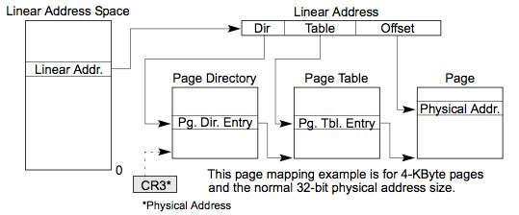
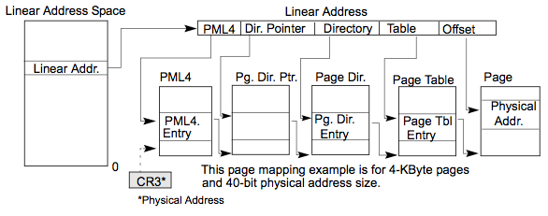
Paging structures
32-bit
64-bit

Slide 26
4-Levels of mapping (4KB pages)
64-bit ‘canonical’ virtual address *
63 48 47 39 38 30 29 21 20 12 11 0
sign-extension
PML4
PDPT
PDIR
PTBL
offset
Page
Frame
(4KB)
* AMD/Intel did not extend virtual addresses to the full 64 bits in order to keep 4 instead of 6 levels of page tables…
Page
Table
PDE
Table 4-18
Page
Directory
PDPTE
Table 4-16
Page
Directory
Pointer
Table
Page
Map
Level-4
Table
PML4E
Table 4-14.
Each mapping-table contains up to 512 quadword-size entries
CR3
Modified from http://cs.usfca.edu/~cruse/cs630f06/lesson27.ppt

Slide 27
Page-Table entry format (4KB pages)
63 62 52 51 M M-1 32
XD
available
Reserved
[51 : M] must be 0
Base
Address
[(M-1) : 32]
31 12 11 9 8 0
Base Address [31 : 12]
avail
G
P
A
T
D
A
P
C
D
P
W
T
S
/
U
R
/
W
P
Legend:
P = present (0=no, 1=yes) PWT = Page Write-Through (0=no, 1=yes)
R/W (0=read-only, 1=writable) PCD = Page Caching Disable (0=no, 1=yes)
S/U (0=supervisor-only, 1=user) PAT = Page-Attribute Table-Index
A = accessed (0=no, 1=yes) G = Global page (1=yes, 0=no)
D = dirty (0=no, 1=yes) M = 12+MAXPHYADDR
XD = e(X)ecute (D)isable
Modified from http://cs.usfca.edu/~cruse/cs630f06/lesson27.ppt

Slide 28
MAXPHYADDR (1)
CPUID.80000008H:EAX[7:0] reports the physical-address width supported by the processor.
  Ours will probably be 36-bits (64 GB)
For processors that do not support CPUID function 80000008H, the width is generally 36 bits if CPUID.01H:EDX.PAE [bit 6] = 1 and 32 bits otherwise.
This width is referred to as MAXPHYADDR and is at most 52 bits.

Slide 29
RIP-relative addressing
In 64-bit mode, the RIP register is the instruction pointer.
  This register holds the 64-bit offset of the next instruction to be executed.
64-bit mode also supports a technique called RIP-relative addressing.
  Using this technique, the effective address is determined by adding a displacement to the RIP of the next instruction.
Some assemblers handle RIP-relative stuff differently ☹
  http://codegurus.be/codegurus/Programming/riprelativeaddressing_en.htm

Slide 30
RIP relative addressing example
; New method
mov ah, [rip] ; since RIP points to the next instruction aka NOP, ah now holds 0x90
nop
; Alternative new method
lea rbx, [rip] ; RBX now points to the next instruction
nop
cmp byte ptr [rbx], 90h ; Should be equal!
; Old method (using 64-bit addressing!)
call $ + 5 ; A 64-bit call instruction is still 5 bytes wide!
pop rbx
add rbx, 5 ; RBX now points to the next instruction aka NOP
nop
mov al, [rbx]
; AH and AL should now be equal :)
cmp ah, al
; Ref: http://codegurus.be/codegurus/Programming/riprelativeaddressing_en.htm#Mode64

Slide 31

REX Prefix
REX (byte) prefixes are used to generate 64-bit operand sizes or to reference registers R8-R15.
If REX.w = 1, a 64-bit operand size is used.
See Intel Vol. 2 Section 2.2.1.2 for details
REX
REX.w bitflag

Slide 32
Windows x64 calling convention (1)
Argument passing (use registers)
4 register “fast-call” calling convention, with stack-backing for those registers
The arguments are passed in registers RCX, RDX, R8, and R9.
RAX, R10, R11 are volatile (caller saved)

Slide 33
Windows x64 calling convention (2)
All other registers are non-volatile (callee saved)
  must be preserved
Caller responsible for allocating space for parameter
  must always allocate sufficient space for the 4 register parameters,
  even if the callee doesn’t have that many (or any) parameters

Slide 34
Getting the Brand String with CPUID
CPUID.EAX = 0x80000002
  Characters [0:15] in EAX, EBX, ECX, EDX
CPUID.EAX = 0x80000003
  Characters [16:31] in EAX, EBX, ECX, EDX
CPUID.EAX = 0x80000004
  Characters [32:47] in EAX, EBX, ECX, EDX

Slide 35
VMX Cpuid.S skeleton (for Linux)
  .section .rodata
  S0:
  .string “VMX available!”
  S1:
  .string “No VMX!”
  .text
  .global main
  .type main, @function
  main:
  pushq %rbp
  movq %rsp, %rbp
  <<set appropriate eax value>>
  cpuid
  <<look at VMX bit in appropriate register>>
  jz <<no_vmx>>
  leaq S0(%rip), %rdi
  call puts
  leave
  ret
You can lookup appropriate values in the Intel manual:
Vol 2a 3-212, Figure 3-6 (pg 269)
Notes:
Need to convert this to Windows masm
check_vmx:
xorl %eax, %eax
inc %eax
cpuid
# look at bit 5 for vmx
test $16, %ecx
jnz has_vmx

Slide 36
Our general cpuid.asm skeleton
(for Windows)
_CpuId PROC
push rbp
mov rbp, rsp
push rbx
push rsi
mov [rbp+18h], rdx
mov eax, ecx
cpuid
mov rsi, [rbp+18h]
mov [rsi], eax
mov [r8], ebx
mov [r9], ecx
mov rsi, [rbp+30h]
mov [rsi], edx
pop rsi
pop rbx
mov rsp, rbp
pop rbp
ret
_CpuId ENDP
Function prototype:
VOID _CpuId (
ULONG32 leaf,
OUT PULONG32 ret_eax,
OUT PULONG32 ret_ebx,
OUT PULONG32 ret_ecx,
OUT PULONG32 ret_edx
);
Notes:
Need to convert this to Windows masm
check_vmx:
xorl %eax, %eax
inc %eax
cpuid
# look at bit 5 for vmx
test $16, %ecx
jnz has_vmx

Slide 37
Example:
Check for 64-bit using intrinsic cpuid
typedef union _CpuId {
int i[4];
struct {
int eax;
int ebx;
int ecx;
int edx;
};
} CpuId_t;
int CheckFor64Bit() {
int eax;
CpuId_t regs; // eax, ebx, ecx, edx
char bitres;
eax = 0x80000001;
__cpuid(regs.i, eax);
bitres = _bittest((long*) &regs.edx, 29);
return bitres ? 1 : 0;
}
Intrinsic = Visual Studio supplied C macro (i.e. built in)

Slide 38
Lab: CPUID + VMX
Purpose
  x86 Assembly refresher
Note
  No more inline assembly on 64-bit Windows
Steps
  Setup your coding environment
  Implement code in assembly to determine whether your CPU supports VMX, and for fun AESNI if you like
  You can lookup appropriate values in the Intel manual Vol 2a 3-212, Figure 3-6. (Learn to search the manual!)
  Implement grabbing the brand string—we’ll be playing with that later

Slide 39
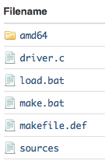

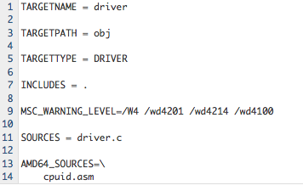
64-bit driver notes (1)
You will implement here:
You will implement here:

Slide 40
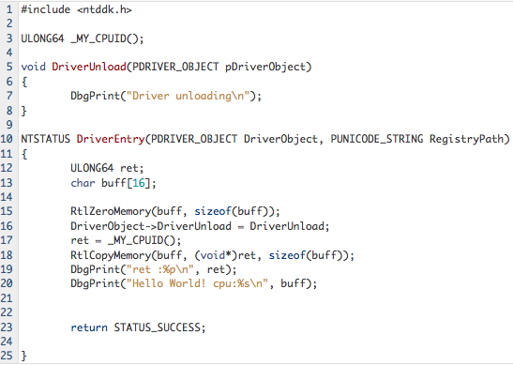
64-bit driver notes (2)

Slide 41
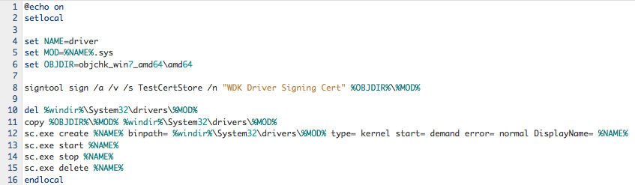
64-bit driver notes (3)

Slide 42
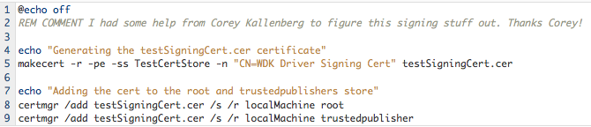
Generating a certificate
Windows 7 requires signed drivers
  We can self-sign if we boot into “Test signing mode”
  In Admin command prompt:
    bcdedit /set testsigning on
Self signed drivers:

Slide 43
Back to virtualization…
Why is virtualization useful?
How complex is it to implement?
What inherent challenges can be expected?
What techniques have proven successful?

Slide 44
Popek and Goldberg
Virtualization Criterion
POPEK, G. J., GOLDBERG, R. P., “Formal requirements for virtualizable third generation architectures,” ACM Communications, July 1974
Equivalence / Fidelity
  A program running under the VMM should exhibit a behavior essentially identical to that demonstrated when running on an equivalent machine directly.
Resource control / Safety
  The VMM must be in complete control of the virtualized resources.
Efficiency / Performance
  A statistically dominant fraction of machine instructions must be executed without VMM intervention.

Slide 45
Different strokes for different folks…
CPU Simulation
Binary translation
Para-virtualization
Hardware assist +/- some software emulation
  Emulation required for supporting some x86 guests (i.e., real-mode) even with hardware virtualization
Notes:
http://www.usingenglish.com/reference/idioms/different+strokes+for+different+folks.html

Slide 46
Who is what?
Full virtualization (aka emulation)
  Bochs and QEMU
Paravirtualization
  Xen, VMware
Binary Translation
  VMware, VirtualPC, VirtualBox, QEMU
Hardware Virtualization
  Xen, VMware, VirtualPC, VirtualBox, KVM, …
Notes:
Virtualisation security and the Intel privilege model Tavis Ormandy, Julien Tinnes Google Inc.

Slide 47
Software Virtualization Challenges
CPUID instruction
Ring Aliasing
Ring Compression
Memory addressing
Non-faulting guest access to privileged state
17 instructions don't meet Popek and Goldberg criteria [Lawton and Robin] (citation)

Slide 48
CPUID instruction
Returns processor identification and feature information
Thought: When employing virtualization, are there certain undesirable features not to be exposed to the guest?
  Some of these features could make the guest believe it can do things it can’t
  Might want to mask off some features from guest (virtualization)

Slide 49
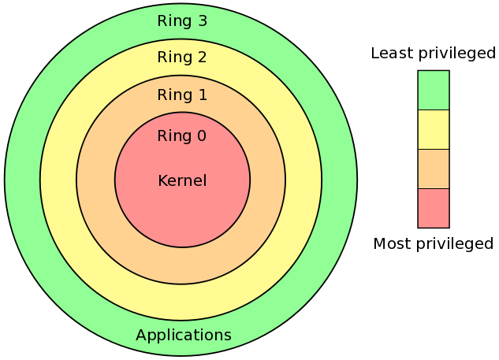
Ring Aliasing
Ring 0 is most privileged
OS kernels assume to be running at ring 0
  Our guest VM is no different
VMM and guest cannot share ring 0
  If guest isn’t in ring 0, could use PUSH CS to figure that out (CPL is in the last two bits of CS register)
See Figure 5-3. Protection Rings for Intel’s version

Slide 50
Ring Compression
IA32 supplies two isolation mechanisms, Segmentation and Paging
Segmentation isn’t available in 64-bit
So paging is only choice for isolating a guest
But paging doesn’t distinguish between rings 0 – 2
  See Section 5.11.2 “If the processor is currently operating at a CPL of 0, 1, or 2, it is in supervisor mode; if it is operating at a CPL of 3, it is in user mode.”
And our host kernel is in ring 0 and guest software is in ring 3. No more rings = we’re compressed.
  Therefore, our guest cannot be isolated from user-space applications and cannot be reasonably protected from each other.

Slide 51
Faulting instructions
CLI (clear interrupt flag) and STI (set interrupt flag
A ring 3 guest that calls CLI or STI raises CPU exception
Different choices about how to architect your virtualization environment
  options: turn these interrupts into virtual interrupts, trap to VMM, binary translation.

Slide 52
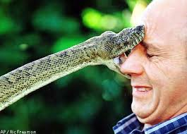
Non-faulting instructions (1)
If you wanted to construct a VMM and use fault-then-emulate to virtualize the guest, x86 would turn around and bite you
  Some things just don’t fault, and silently fail instead (i.e., POPF, LAR)
  The POPF instruction is an example of a sensitive instruction which is non-privileged.
Notes:
What does LAR do again? LAR -- Load Access Rights Byte

Slide 53
Non-faulting instructions (2)
Software can also execute the instructions that read (store) from GDT, IDT, LDT, TR using SGDT, SIDT, SLDT, and STR
  at any privilege level
If the VMM maintains these registers with unexpected values then clearly the guest can figure that out and violate one of our virtualization criteria

Slide 54
Inline assembly refresh
__asm {
}

Slide 55

Lab: Non-faulting instruction
Go run POPF and confirm that it is bad for virtualization (should be able to do it in ring 3)
Remember, POPF pops stack into the FLAGS or EFLAGS register
Use popfd/pushfd
Get current flags
Write your own
Check them
“all will be revealed…”

Slide 56
Memory addressing
OS kernel expects full (linear) virtual address space. VMM could be in guest address space or mostly in separate address space.
Why “mostly?”
  Because there are some data structures to manage transitions from guest to VMM (these structures need to be protected).
Reminder
  only protection in 64-bit mode is paging (there is no segmentation)

Slide 57
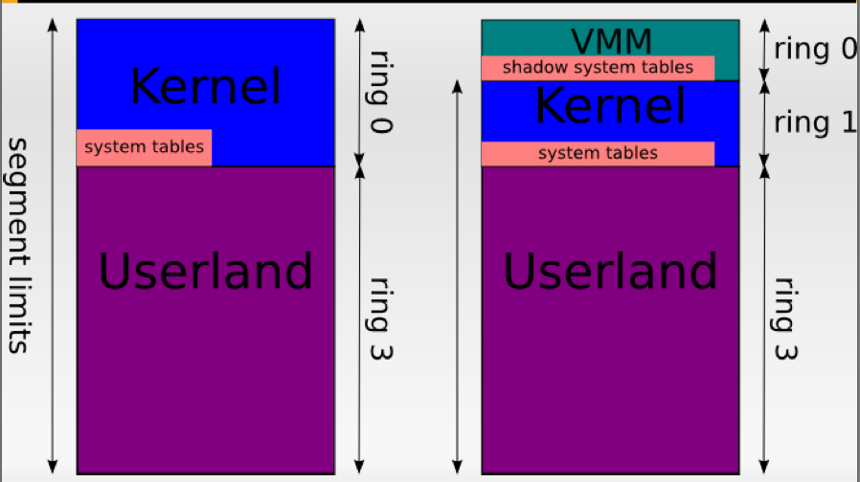
VMWare-style Virtualization, (pre x64)
PanSec 2009, Tavis Ormandy, Julien Tinnes
Notes:
Tavis Ormandy, Julien Tinnes Google Inc., Virtualisation security and the Intel privilege model

Slide 58
Address-space compression
Refers to the challenges of protecting these portions of the virtual-address space and supporting guest accesses to them
VMware’s older approach could no longer be used on x64 guests because they required segment limits
  “The virtual machine monitor’s trap handler must reside in the guest’s address space, because an exception cannot switch address spaces.”
  In theory a task gate in the IDT pointing to a TSS with appropriate CR3 could help, but the performance overhead might have been prohibitive.
  See http://www.pagetable.com/?p=25 (How retiring segmentation in AMD64 long mode broke VMware)

Slide 59
Access to privileged state
privileged instructions in the x86 instruction like LGDT, LIDT
MOV to CR3, CR0, CR4
For example, contention for IDT between guest and host would result in a crash most likely…

Slide 60
Software based techniques
Binary translation
  Emulation of one instruction set by another for same CPU.
  When source and target instruction set are the same, it’s called instruction set simulation
  can be done “just in time” (JIT)
    can do some caching to be more efficient (i.e., hot spot detection)
Para-virtualization
  modification of guest kernel to support being virtualized
  Can be pretty efficient

Slide 61

Binary Translation
Can ``defang” privileged instructions such as POPF
Instruction streams are modified on the fly (think interpreter) to trap offending instruction sequences.
Two kinds
  static and dynamic translation

Slide 62
Static Binary Translation
May not be able to have full code coverage
  Hidden code in data sections could be reached through an indirect jump or jump into the middle of an instruction
  A problem if code is specifically trying to thwart the binary translation mechanism

Slide 63
Dynamic Binary Translation
What do you think?
Fill it in…

Slide 64
How VMWare done it?
Early versions of the VMware VMM scanned the instruction stream being executed in the VM and detected the presence of sensitive instructions.
It then substituted the sensitive instruction with a target instruction and then emulated the action of the original instruction.
Binary Translation introduced into VMware circa 1999
Notes:
http://www.h2hc.org.br/repositorio/2008/Edgar.pdf

Slide 65
If interested… read up
PAYER, M., AND GROSS, T. Requirements for fast binary translation. In 2nd Workshop on Architectural and Microarchitectural Support for Binary Translation (2009).
PAYER, M., AND GROSS, T. R. Generating low-overhead dynamic binary translators. In SYSTOR’10 (2010).
Notes:
Still a pretty active area of research

Slide 66
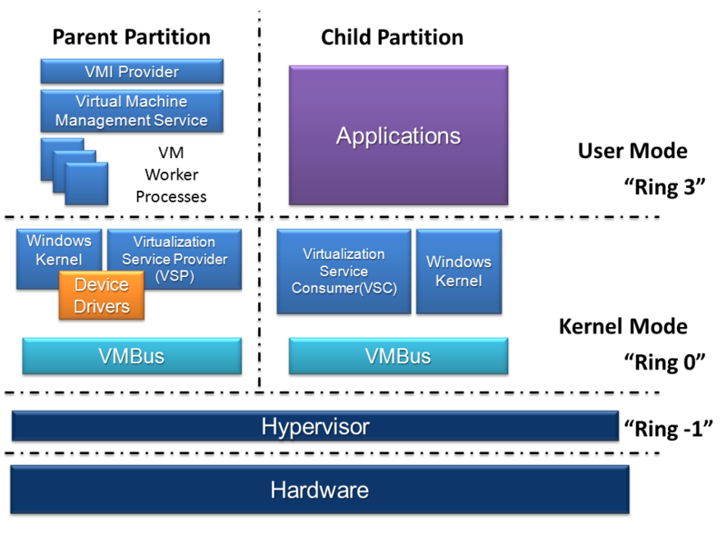
Microsoft Hyper-V
https://en.wikipedia.org/wiki/File:Hyper-V.png

Slide 67
Microsoft Hyper-V
A hypervisor instance has to have at least one “parent partition”
The virtualization stack runs in the parent partition and has direct access to the hardware devices.
The parent partition then creates the child partitions which host the guest OSs.
Xen is pretty similar

Slide 68
Lab: Which is it?
Play with JSLinux (http://bellard.org/jslinux/)
Run Linux in your web browser…
  So is it a binary translator or an emulator?
Read technical notes
  http://bellard.org/jslinux/tech.html

Slide 69
Review

