Slide 1
Advanced x86:
Virtualization with VT-x
Part 2
David Weinstein
dweinst@insitusec.com

Slide 2
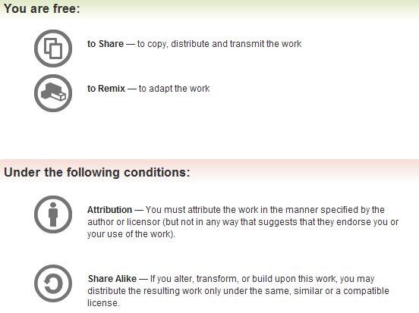
All materials are licensed under a Creative Commons “Share Alike” license.
http://creativecommons.org/licenses/by-sa/3.0/

Slide 3
Hardware Assisted Virtualization
Hardware provides the heavy lifting to deal with all these issues
Host (dom0 or VMM) – whoever is there “first”
  in charge of creating VM “control structures” (VMCSs)
Before a guest runs, specify a number of events/state that cause VM exits
  Think “bitmask” of interrupts to jump out to VMM land

Slide 4
Hardware Assisted Virtualization (2)
Guest runs until
  It does something that has been registered in data structures (i.e., VMCS) to exit out to VMM,
  It explicitly calls the VMCALL instruction
VMM can preempt guest regularly with on a timer
VMM can virtualize access to guest’s memory
  “guest-physical” addresses
Instructions can cause trap to the VMM

Slide 5
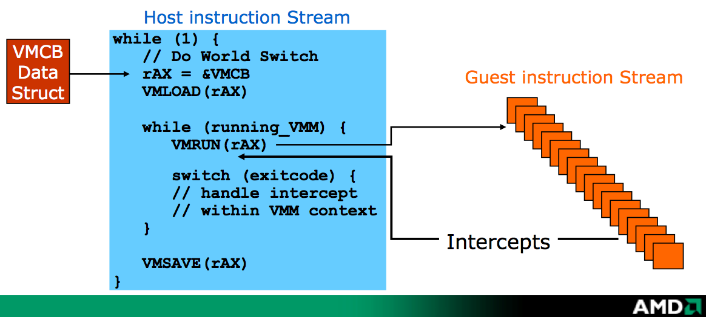
Basic Idea…
VMCS (intel)
VMXON
AMD India Developer’s Conference Bangalore, 10-May-2006

Slide 6
BluePill/HyperJacking Techniques
Does not virtualize hardware
  BP’d systems see same hardware before/after
Early PoCs, BlackHat 2006
  BluePill (Rutkowska/Tereshkin @ COSEINC) , AMD-v, Windows
  Vitriol (Dino Dai Zovi @ Matasano), Intel VT-x, Mac OS X
Early academic PoC
  SubVirt, Samuel T. King et al

Slide 7
General Hardware VM Based Rootkit
Virtual Machine Based Rootkit (VMBR)
Start with CPL=0
Allocate some unpaged physical memory
  Ensure no linear mappings to VMM after guest entry
Move running OS into VMCS
Intercept access to hardware (IO ports, …)
Communicate to hardware VM rootkit via sentinel instructions

Slide 8
VMX introduces new x86 instructions
Intel instruction | purpose
VMXON | Enable VMX
VMXOFF | Disable VMX
VMLAUNCH | Start/enter VM
VMRESUME | Re-enter VM
VMCLEAR | Null out/reinitialize VMCS
VMPTRLD | Load the current VMCS
VMPTRST | Store the current VMCS
VMREAD | Read values from VMCS
VMWRITE | Write values to VMCS
VMCALL | Exit virtual machine to VMM
VMFUNC | Invoke a VM function in VMM without exiting guest operation

Slide 9
High level VMX flow
VMM will take these actions
  Initially enter VMX mode using VMXON
  Clear guest’s VMCS using VMCLEAR
  Load guest pointer using VMPTRLD
  Write VMCS parameters using VMWRITE
  Launch guest using VMLAUNCH
  Guest exit (VMCALL or instruction, …)
  Read guest-exit info using VMREAD
  Maybe reenter guest using VMRESUME
  Eventually leave VMX mode using VMXOFF

Slide 10
Introducing Chicken Syrup
Your toy VMM, pieced together from various bits
Frankenchicken?
Windows 7 x64 Driver
Based on Virtdbg
  We’re building up to virtdbg’s feature set

Slide 11
MSRs and VMX capabilities
MSRs used to identify capabilities of the hardware
We’ll refresh on how to access MSRs and talk about how each plays a role in implementing a VMM
Appendix A goes into detail on each.
These slides should have what you need, though.

Slide 12
Relevant VMX MSRs (1)
IA32_VMX_BASIC (0x480)
  Basic VMX information including revision, VMXON/VMCS region size, memory types and others.
IA32_VMX_PINBASED_CTLS (0x481)
  Allowed settings for pin-based VM execution controls.
  When you see Pin, think asynchronous events/interrupts
IA32_VMX_PROCBASED_CTLS (0x482)
  Allowed settings for primary processor based VM execution controls. Things like exiting on specific instruction execution
IA32_VMX_PROCBASED_CTLS2 (0x48B)
  Allowed settings for secondary processor based VM execution controls.
IA32_ naming convention just means it’s an architectural MSR, nothing to do with 32-bit specifically

Slide 13
Relevant VMX MSRs (2)
IA32_VMX_EXIT_CTLS (0x483)
  Allowed settings for VM Exit controls.
IA32_VMX_ENTRY_CTLS (0x484)
  Allowed settings for VM Entry controls.
IA32_VMX_MISC (0x485)
  Allowed settings for miscellaneous data, such as RDTSC options, unrestricted guest availability, activity state and others.

Slide 14
Relevant VMX MSRs (3)
IA32_VMX_CR0_FIXED{0,1} 0x486, 0x487
  Indicate the bits that are allowed to be 0 or to 1 in CR0 during VMX operation.
IA32_VMX_CR4_FIXED{0,1} 0x488, 0x489
  Same for CR4.
IA32_VMX_VMCS_ENUM 0x48A
  Enumeration helper for VMCS.
IA32_VMX_EPT_VPID_CAP 0x48C
  Provides information for VPIDs/EPT capabilities.

Slide 15
#define MSRs
#define MSR_IA32_FEATURE_CONTROL 0x03a
#define MSR_IA32_VMX_BASIC 0x480
#define MSR_IA32_VMX_PINBASED_CTLS 0x481
#define MSR_IA32_VMX_PROCBASED_CTLS 0x482
#define MSR_IA32_VMX_EXIT_CTLS 0x483
#define MSR_IA32_VMX_ENTRY_CTLS 0x484
#define MSR_IA32_VMX_CR0_FIXED0 0x486
#define MSR_IA32_VMX_CR0_FIXED1 0x487
#define MSR_IA32_VMX_CR4_FIXED0 0x488
#define MSR_IA32_VMX_CR4_FIXED1 0x489

Slide 16
MSR: IA32_FEATURE_CONTROL
(index 0x03a)
Controls the ability to turn VMX “on”
    Usually controlled by the BIOS to enable/disable virtualization
Gets set to 0 on CPU reset
If not configured appropriately our VMX instructions will generate invalid opcode exceptions
Bit 0 is the lock bit. If 0, BIOS has locked us out of VMX
Bit 1 enables VMX in SMX operation.
  Outside scope of this class
Bit 2 enables VMX outside SMX, which we need
In our case virtualization should already be turned “on” in system BIOS, but please verify this for yourself.

Slide 17
IA32_FEATURE_CONTROL in C
typedef struct
_IA32_FEATURE_CONTROL_MSR
{
unsigned Lock :1;
unsigned VmxonInSmx :1;
unsigned VmxonOutSmx :1;
unsigned Reserved2 :29;
unsigned Reserved3 :32;
} IA32_FEATURE_CONTROL_MSR;

Slide 18
MSR: IA32_VMX_CR0_FIXED0/1
(index: 0x486, 0x487)
Bit X in CR0 is either fixed to 0 (with value 0 in both MSRs), fixed to 1 (1 in both MSRs), or flexible (0 in CR0_FIXED0 and 1 in CR0_FIXED1).
If bit X is 1 in CR0_FIXED0, then that bit is also 1 in CR0_FIXED1

Slide 19
MSR: IA32_VMX_CR4_FIXED0/1
(index: 0x488, 0x489)
Bit X in CR4 is either fixed to 0 (with value 0 in both MSRs), fixed to 1 (1 in both MSRs), or flexible (0 in CR4_FIXED0 and 1 in CR4_FIXED1).
If bit X is 1 in CR0_FIXED0, then that bit is also 1 in CR4_FIXED1

Slide 20
CR4 Typedef
typedef struct _CR4_REG {
unsigned VME :1; // Virtual Mode Extensions
unsigned PVI :1; // Protected-Mode Virtual Interrupts
unsigned TSD :1; // Time Stamp Disable
unsigned DE :1; // Debugging Extensions
unsigned PSE :1; // Page Size Extensions
unsigned PAE :1; // Physical Address Extension
unsigned MCE :1; // Machine-Check Enable
unsigned PGE :1; // Page Global Enable
unsigned PCE :1; // Performance-Monitoring Counter Enable
unsigned OSFXSR :1; // OS Support for FXSAVE/FXRSTOR
unsigned OSXMMEXCPT :1; // OS Support for Unmasked SIMD Floating-Point Exceptions
unsigned Reserved1 :2; //
unsigned VMXE :1; // Virtual Machine Extensions Enabled
unsigned Reserved2 :18; //
} CR4_REG, *PCR4_REG;

Slide 21
Enabling and Entering the Matrix
In addition to IA32_FEATURE_CONTROL…
Before entering VMX operation, enable VMX by setting CR4.VMXE[bit 13] = 1
  Or VMX instructions will also generate invalid-opcode exceptions
VMX operation is then entered by executing the VMXON instruction
; Enable VMX by setting CR4.VMXE
MOV eax, cr4
BTS eax, 13
MOV cr4, eax

Slide 22
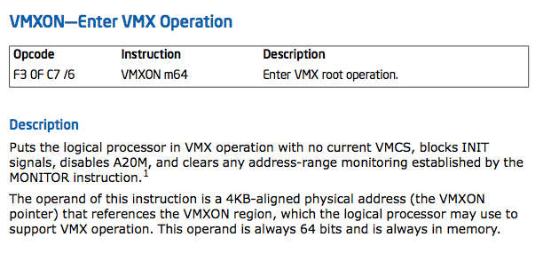
VMXON
4. If IA32_VMX_BASIC[48] is read as 1, VMfailInvalid occurs if addr sets any bits in the range 63:32; see Appendix G.1.

Slide 23
VMXON vs VMCS region
We will talk about a VMXON region and a VMCS
The VMXON region is created per logical processor and used by it for VMX operations
The VMCS region is created per guest virtual cpu and used both by the hypervisor and the processor.

Slide 24
4KB-aligned Address stated different ways
Means 0x*****000 or 0x*************000
  i.e., ends in hex 000
  ADDR % 4096 = 0
  remainder when dividing by 4096 is 0
Some of our data structures will require this 4KB alignment condition.

Slide 25
MSR: IA32_VMX_BASIC (index 0x480)
Bits 31:0 contain the 32-bit VMCS revision identifier
Bits 44:32 report the # of bytes to allocate for the VMXON/VMCS regions
Bit 48 indicates the width of the physical addresses that may be used for the VMXON region, each VMCS, and data structures referenced by pointers in a VMCS (I/O bitmaps, virtual-APIC page, MSR areas for VMX transitions). If the bit is 0, these addresses are limited to the processor’s physical-address width. If the bit is 1, these addresses are limited to 32 bits.
  This bit is always 0 for processors that support Intel 64 architecture.
XOR ecx, ecx
MOV ecx, 0480h
RDMSR
; result is now in edx:eax (i.e., 64 bits across two 32 bit registers)

Slide 26
IA32_VMX_BASIC as C struct
typedef struct _VMX_BASIC_MSR {
unsigned RevId:32;
unsigned szVmxOnRegion:12;
unsigned ClearBit:1;
unsigned Reserved:3;
unsigned PhysicalWidth:1;
unsigned DualMonitor:1;
unsigned MemoryType:4;
unsigned VmExitInformation:1;
unsigned Reserved2:9;
} VMX_BASIC_MSR, *PVMX_BASIC_MSR;
0 – Uncacheable (UC)
6 – Write Back (WB)

Slide 27
Reading MSRs
In our amd64/amd64.asm:
_ReadMsr PROC
xor rax, rax
rdmsr ; MSR[ecx] --> edx:eax
shl rdx, 32
or rax, rdx
ret ; don’t forget to ret or you will mess up your stack
_ReadMsr ENDP
In our src/amd64.h:
ULONG64 _ReadMsr(ULONG32 reg);
In our src/vmx.c :
PVMX_BASIC_MSR pvmx;
ULONG64 msr;
msr = _ReadMsr(MSR_IA32_VMX_BASIC);
pvmx = (PVMX_BASIC_MSR)&msr;

Slide 28
Lab: VMXMSR driver
Write a Windows driver to check the value of MSR index 0x480 – 0x48A, + FEATURE_CONTROL (0x03a)
Use the C structs provided for MSR_IA32_VMX_BASIC/CR4 to dump a detailed description
Also grab and dump the CR4 value and for convenience whether CR4.VMXE is set to 1
Use DbgPrint’s to print the values and Sysinternals DbgView to view the results.

Slide 29
Allocating VMXON Region in Windows Driver
In our src/vmx.c :
typedef LARGE_INTEGER PHYSICAL_ADDRESS, *PPHYSICAL_ADDRESS;
PVMX_BASIC_MSR pvmx;
PHYSICAL_ADDRESS pa;
PVOID va;
/* Read VMX_BASIC MSR into pvmx */
/* determine size from bits 44:32 of IA32_VMX_BASIC MSR or assume 4K … */
va = AllocateContiguousMemory(size);
/* check for null va, set VMX revision ID */
*(ULONG32 *)va = pvmx->RevId;
pa = MmGetPhysicalAddress(va)
…
/* set CR4.VMXE bit => */
_VmxOn(…)

Slide 30
Allocating VMXON Region in Windows Driver
; pure assembly implementation
.data
vmxon_ptr dq ; initialized elsewhere
…
.code
MOV ecx, 0x480 ; IA32_VMX_BASIC MSR
RDMSR ;
MOV edx, [vmxon-ptr] ; load VMXON region
MOV [edx], eax ; VMX revision id into offset 0 of VMXON region

Slide 31
PHYSICAL_ADDRESS
typedef LARGE_INTEGER PHYSICAL_ADDRESS, *PPHYSICAL_ADDRESS;
(LARGE_INTEGER is declared in ntddk.h)

Slide 32
AllocateContiguousMemory
PVOID AllocateContiguousMemory(ULONG size)
{
PVOID Address;
PHYSICAL_ADDRESS l1, l2, l3;
l1.QuadPart = 0;
l2.QuadPart = -1;
l3.QuadPart = 0x200000;
Address = MmAllocateContiguousMemorySpecifyCache(size, l1, l2, l3, MmCached);
if (Address == NULL) {
return NULL;
}
RtlZeroMemory(Address, size);
return Address;
}

Slide 33
NTKERNELAPI PVOID
MmAllocateContiguousMemorySpecifyCache(
IN SIZE_T NumberOfBytes,
IN PHYSICAL_ADDRESS LowestAcceptableAddress,
IN PHYSICAL_ADDRESS HighestAcceptableAddress,
IN PHYSICAL_ADDRESS BoundaryAddressMultiple OPTIONAL,
IN MEMORY_CACHING_TYPE CacheType
);
/* declared in ntddk.h */

Slide 34
MEMORY_CACHING_TYPE
MmNonCached
  The requested memory should not be cached by the processor.
MmCached
  The processor should cache the requested memory.
MmWriteCombined
  The requested memory should not be cached by the processor, but writes to the memory can be combined by the processor.
/* declared in ntddk.h */
typedef enum _MEMORY_CACHING_TYPE {
MmNonCached,
MmCached,
MmWriteCombined
} MEMORY_CACHING_TYPE;

Slide 35
Lab: VMXON!
Expand on VMXMSR lab to allocate VMXON region, initialize it, and turn VMX on!
Allocate contiguous regions for VMXON region based on appropriate size (hint IA32_VMX_BASIC)
You’ll need to make another assembly function with C prototype:
  VOID _VmxOn(PHYSICAL_ADDRESS PA);

Slide 36
CPUID check for VMX support
; Check VMX support
MOV eax,1
CPUID
BT ecx,5
JC VMX_Supported
JMP VMX_NotSupported

Slide 37
Lab Review
CheckIfVMXIsSupported()
  CPUID leaf 1, bit 5 in ecx = 1 ?
CheckIfVMXIsEnabled()
  Check CR4 bit 13 = 1 ? Set it if not.
  Check IA32_FEATURE_CONTROL bit 2 = 1?
SetupVMX()
  ReadMsr IA32_VMX_BASIC for VMXON region size
  And VMX revision ID
  AllocateContiguousMemory(size)
  Set Revision ID in VMXON region
  Call VMXON with 64-bit Physical Address
Download sample solution to VMXMSR and VMXON labs

Slide 38
Possible mistakes/gotchas
Forget to RET in your assembly PROC
Forget to set VMX Revision ID in VMXON region
Make sure you use the right MSR index numbers
x64 calling convention
Multiple logical processors (have to loop on them and perform these steps on each to be kosher)
  KeSetSystemAffinityThreadEx

Slide 39
Multi-processor virtualization
Symmetric VMM is most common
  Same effective VMM on all logical processors
  It’s what we’ve been talking about thus far
Asymmetric configuration is possible though
  i.e., VMMs with different VMX revision id, exit controls
  The benefits might be to allow for migration of VMs across a cluster
  Out of scope for this class. Perhaps a topic for an advanced class

Slide 40
VMM Design Considerations (1)
Multi-processor
  symmetric vs. asymmetric
  Locking mechanisms to protect shared VMM data
    Meta information about multiple VMCSs for example and state tracking
    If your VMM is for debugging, info about task, etc…
    Don’t forget we’re virtualizing on multiple logical cores

Slide 41
VMM Design Considerations (2)
Also depends on your design goals
  Are you Hyper-jacking? (i.e., for debug, bluepill)
  Or hosting multiple guest OS types? Like VMware
  Do you want to fully support guest VM self-debug?
    Is your goal to do debugging on malware?
    Does speed matter?
  Are you going to migrate VMs to other hardware platforms? Are you an IaaS provider?

Slide 42
Multi-processor initialization
for (i = 0; i < KeNumberProcessors; i++)
{
OldAffinity = KeSetSystemAffinityThreadEx((KAFFINITY) (1 << i));
OldIrql = KeRaiseIrqlToDpcLevel();
_StartVirtualization();
KeLowerIrql(OldIrql);
KeRevertToUserAffinityThreadEx(OldAffinity);
}

Slide 43
KeNumberProcessors
It’s bound to the total number of logical processors
Obsolete and shouldn’t be used anymore… but it still works
“In Windows Server 2008, code that can determine the number of processors must use KeQueryActiveProcessors”
Read the MSDN reference below on alternative
http://msdn.microsoft.com/en-us/library/windows/hardware/ff552975%28v=vs.85%29.aspx

Slide 44
KeSetSystemAffinityThreadEx
Sets the system affinity of the current thread
  Parameter is actually a set of possible processors
  In our case we pick a specific one (i.e., 1 << i)
Returns either the previous system affinity of the current thread, or zero to indicate that there was no previous system affinity
Callers should save the return value and later pass this value to the KeRevertToUserAffinityThreadEx routine to restore the previous affinity mask.

Slide 45
KeRaiseIrqlToDpcLevel
Raises the hardware priority to IRQL = DISPATCH_LEVEL, thereby masking off interrupts of equivalent or lower IRQL on the current processor.
Caller should save the returned IRQL value and restore the original IRQL as quickly as possible by passing this returned IRQL in a subsequent call to KeLowerIrql

Slide 46
Managing Multiple VMXON regions
typedef struct _VIRT_CPU {
  PVOID Self,
  PVOID VMXON_va;
  PHYSICAL_ADDRESS VMXON_pa;
  PVOID VMCS_va;
  PHYSICAL_ADDRESS VMCS_pa;
  …
} VIRT_CPU, *PVIRT_CPU;

Slide 47
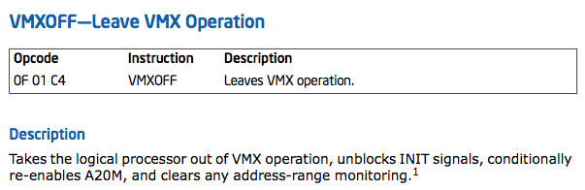
VMXOFF

Slide 48
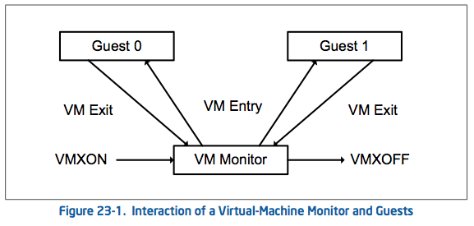
Wax on, wax off…

Slide 49
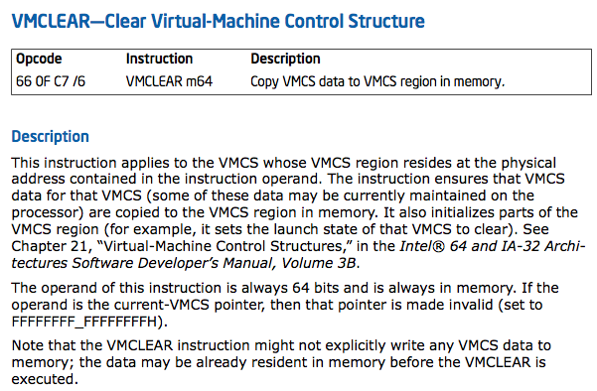
VMCLEAR

Slide 50
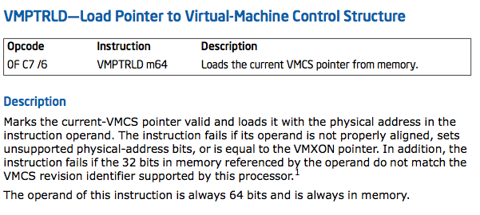
VMPTRLD

Slide 51
VMControlStructure
Offset 0: VMCS revision ID
  Same as VMXON region
Offset 4: VMX abort indicator
Offset 8: VMCS data (later)
Size determined by IA32_VMX_BASIC MSR
  Same as VMXON region
Once allocated, not to be directly accessed (except for putting the revision ID)
Instead, use VMREAD/VMWRITE with desired field encodings.

Slide 52
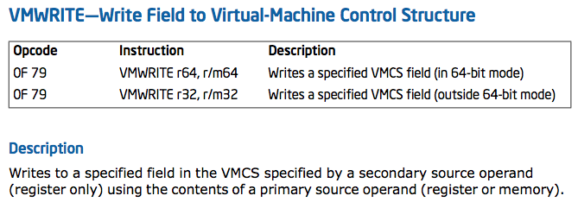
VMWRITE

Slide 53
VMX Field Encodings
Bit position | Contents
0 | Access type (0 = full; 1 = high); must be full for 16-bit, 32-bit, and natural- width fields
9:1 | Index
11:10 | Type: 0: control 1: read-only data 2: guest state 3: host state
12 | Reserved to 0
14:13 | Width 0: 16-bit 1: 64-bit 2: 32-bit 3: natural width
31:15 | Reserved to 0
Every field of the VMCS is encoded by a 32-bit value
APPENDIX B for complete description
For 64-bit fields using the “high” access type
  A VMREAD returns the value of bits 63:32 of the field in bits 31:0 of the destination operand
  in 64-bit mode, bits 63:32 of the destination operand are zeroed out

Slide 54
Sample VMCS Field Encodings in C
/* VMCS Encodings */
enum {
GUEST_ES_SELECTOR = 0x00000800,
GUEST_CS_SELECTOR = 0x00000802,
GUEST_SS_SELECTOR = 0x00000804,
GUEST_DS_SELECTOR = 0x00000806,
GUEST_FS_SELECTOR = 0x00000808,
GUEST_GS_SELECTOR = 0x0000080a,
GUEST_LDTR_SELECTOR = 0x0000080c,
GUEST_TR_SELECTOR = 0x0000080e,
HOST_ES_SELECTOR = 0x00000c00,
HOST_CS_SELECTOR = 0x00000c02,
HOST_SS_SELECTOR = 0x00000c04,
HOST_DS_SELECTOR = 0x00000c06,
HOST_FS_SELECTOR = 0x00000c08,
HOST_GS_SELECTOR = 0x00000c0a,
HOST_TR_SELECTOR = 0x00000c0c,
IO_BITMAP_A = 0x00002000,
IO_BITMAP_A_HIGH = 0x00002001,
IO_BITMAP_B = 0x00002002,
IO_BITMAP_B_HIGH = 0x00002003,
MSR_BITMAP = 0x00002004,
MSR_BITMAP_HIGH = 0x00002005,
VM_EXIT_MSR_STORE_ADDR = 0x00002006,
VM_EXIT_MSR_STORE_ADDR_HIGH = 0x00002007,
VM_EXIT_MSR_LOAD_ADDR = 0x00002008,
VM_EXIT_MSR_LOAD_ADDR_HIGH = 0x00002009,
...
};

Slide 55
Example VMWRITE
VMREAD/VMWRITE operate on the current VMCS
  Only one current VMCS at a time
# set guest RIP to 0x12345678 (pure assembly)
mov rax, 0681Eh /* GUEST_RIP VMCS field*/
mov rbx, 12345678h
vmwrite rax, rbx

Slide 56
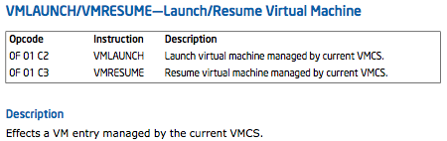
VMLAUNCH/VMRESUME
The VMLAUNCH instruction requires a VMCS whose launch state is “clear”
The VMRESUME instruction requires a VMCS whose launch state is “launched”

Slide 57
VM “Launch” State
The launch state of a VMCS determines which VM-entry instruction should be used with that VMCS: the VMLAUNCH instruction requires a VMCS whose launch state is “clear”; the VMRESUME instruction requires a VMCS whose launch state is “launched”.
In other words, if the launch state of the current VMCS is “clear,” VMLAUNCH changes the launch state to “launched.”

Slide 58
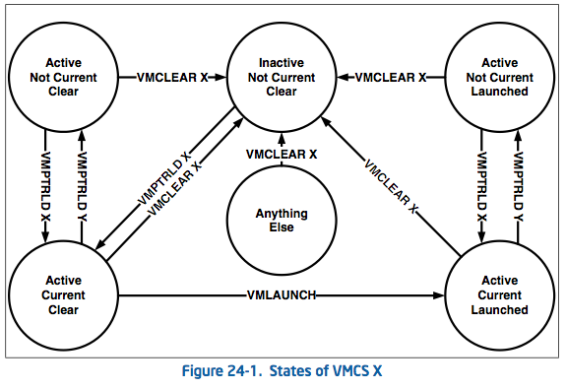
VM “Launch” State (2)

Slide 59
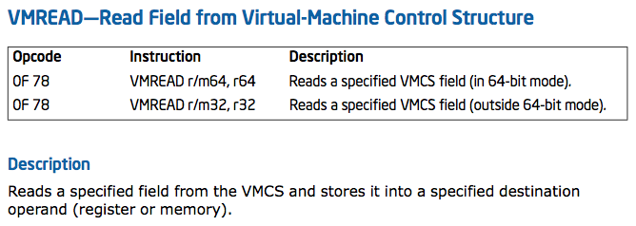
VMREAD

Slide 60
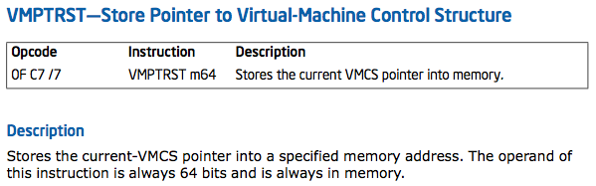
VMPTRST

Slide 61
VM Read/Write in our VMM
In our amd64/amd64.asm:
_ReadVMCS PROC
vmread rdx, rcx
mov rax, rdx
ret
_ReadVMCS ENDP
_WriteVMCS PROC
vmwrite rcx, rdx
ret
_WriteVMCS ENDP

Slide 62
And Back in C
Our prototype functions for binding assembly functions
ULONG64 _ReadVMCS(ULONG32 Encoding);
VOID _WriteVMCS(ULONG32 Encoding, ULONG64 Value);

Slide 63
Lab: Introducing Virtdbg
Purpose
  Familiarize yourself with the code base
  Prepare to make some edits to the code
Steps
  Read control flow RTF document
  Navigate the functions in Visual Studio
  Optional: Fill in any missing control flow notes in the RTF document

Slide 64
VMCS Data Organization
Organized into 6 categories
  Guest state
  Host state
  Execution control fields
  Exit control fields
  Entry control
  VM exit info
Notes:
Section 24.5

Slide 65
VMCS Data Organization
Organized into 6 categories
  Guest state
  Host state
  Execution control fields
  Exit control fields
  Entry control
  VM exit info
Notes:
Section 24.5

Slide 66
VMCS Guest State
Describes the values of the registers the CPU will have after next VMEntry
Divided into Register and Non-register state
Use of certain fields depends on the “1-setting” of various VM controls
  E.g., 1-setting of EPT control →PDPTE0 – PDPTE3
VMCS link pointer is unused and reserved to FFFFFFFF_FFFFFFFFh

Slide 67
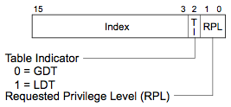
VMCS: Guest Register State
64-bits each
LDTR
TR
CR{0,3,4}
Selector
Selector
CR{0,3,4}
DR7
RFLAGS
CR{0,3,4}
Base addr
Base addr
RSP
RIP
MSRs
IA32_DEBUGCTL
IA32_SYSENTER_CS (32b)
IA32_SYSENTER_ESP
IA32_SYSENTER_EIP
IA32_PERF_GLOBAL_CTRL*
IA32_PAT*
IA32_EFER*
Segment limit
Segment limit
32-bits each
Access rights
Access rights
SMBASE
{C,S,D,E,F,G}S
{C,S,D,E,F,G}S
{C,S,D,E,F,G}S
Selector
{C,S,D,E,F,G}S
Selector
{C,S,D,E,F,G}S
Selector
{C,S,D,E,F,G}S
Selector
Base addr
Selector
Base addr
Selector
Base addr
Base addr
Segment limit
Base addr
Segment limit
Base addr
Segment limit
Segment limit
Access rights
Segment limit
Access rights
Segment limit
Access rights
Table 24-2. Format of Access Rights
* - based on 1-setting of respective VM control
Access rights
Access rights
Access rights

Slide 68
SMBASE
Contains the base address of the logical processor’s SMRAM image
SMM mode related
  Out of scope of this class
Should be able to basically ignore it as far as initialization

Slide 69
VMCS Guest Segments
Access rights come from the segment descriptor. Base addr + Segment Limit + Access rights form the “descriptor cache” of each segment register.
These data are included in the VMCS because it is possible for a segment register’s descriptor cache to be inconsistent with the segment descriptor in memory (in the GDT or the LDT) referenced by the segment register’s selector.

Slide 70
Grabbing/Setting the Guest segments
In practice for our toy VMM we will grab the host’s existing values and insert them into our VMCS data structure with VMWRITEs
We will call some functions (written in our assembly file) from our C code to grab the current values
  i.e. CR0, CR3, CR4 and {C,S,D,E,F,G}S

Slide 71
Segment access rights format
Bit Position(s) | Field
3:0 | Segment type
4 | S – Descriptor type (0=system, 1=code or data)
6:5 | DPL – descriptor priv. level
7 | P – Segment present
11:8 | Reserved
12 | AVL – Available for use by system software
13 | Reserved (except for CS) L – 64-bit mode active (for CS only)
14 | D/B – Default operation size (0=16-bit segment, 1=32-bit segment)
15 | G – Granularity
16 | Segment unusable (0=usable, 1=unusable)
31:17 | Reserved

Slide 72
Once again in C … with feeling!
typedef union
{
USHORT UCHARs;
struct
{
USHORT type:4; /* 0; Bit 40-43 */
USHORT s:1; /* 4; Bit 44 */
USHORT dpl:2; /* 5; Bit 45-46 */
USHORT p:1; /* 7; Bit 47 */
// gap! (this will be explained later)
USHORT avl:1; /* 8; Bit 52 */
USHORT l:1; /* 9; Bit 53 */
USHORT db:1; /* 10; Bit 54 */
USHORT g:1; /* 11; Bit 55 */
USHORT Gap:4;
} fields;
} SEGMENT_ATTRIBUTES;
This is a copy of bit 40:47 & 52:55 of the segment descriptor

Slide 73
Lab: Guest segments in Virtdbg
Locate in virtdbg the guest segment initialization code
Create high-level write-up on what you think is happening
Everyone compare notes
  Learn from each other

Slide 74
VMCS: Guest Non-register State
Value | Definition
0 | Active
1 | HLT
2 | Shutdown
3 | Wait-for-SIPI
… | …
64 bits
32 bits
Pending debug exceptions
Activity State*
VMCS link pointer
Interruptibility State
See Table 24-3
PDPTE0*
PDPTE1*
VMX preemption timer value*
PDPTE2*
value that the VMX-preemption timer will use following the next VM entry
PDPTE3*
* - based on 1-setting of respective VM control

Slide 75
VMCS Data Organization
Organized into 6 categories
  Guest state
  Host state
  Execution control fields
  Exit control fields
  Entry control
  VM exit info
Notes:
Section 24.5

Slide 76
VMCS Host State Area
Tells the CPU how to return to the VMM after a VMExit
Consists of register states and MSRs
  Again some of the MSRs depend on “1-setting” of VM controls

Slide 77
VMCS: Host State Area
64 bits each
CR{0,3,4}
MSRs
IA32_SYSENTER_CS (32)
IA32_SYSENTER_ESP
IA32_SYSENTER_EIP
IA32_PERF_GLOBAL_CTRL*
IA32_PAT*
IA32_EFER*
CR{0,3,4}
RSP
CR{0,3,4}
RIP
GDTR
FS
IDTR
GS
Selector
Base addr
TR
Selector
Base addr
Selector
Base addr
Base addr
Selector
Selector
{C,S,D,E}S
Selector
Selector
* - based on 1-setting of respective VM control
Notes:
Access rights come from the segment descriptor. Base addr + Segment Limit + Access rights form the “descriptor cache” of each segment register.
“These data are included in the VMCS because it is possible for a segment register’s descriptor cache to be incon- sistent with the segment descriptor in memory (in the GDT or the LDT) referenced by the segment register’s selector.”
VMCS Link Pointer should be set to all F’s, current unused

Slide 78
VMCS Data Organization
Organized into 6 categories
  Guest state
  Host state
  Execution control fields
  Exit control fields
  Entry control
  VM exit info
Notes:
Section 24.5

Slide 79
Reserved controls/default settings
Certain VMX controls are reserved and must be set to a specific value
  The specific value to which a reserved control must be set is its default setting
Discover the default setting of a reserved control by consulting the appropriate VMX capability MSR
Partitioned into 3 sets
  Always-flexible, Default0, Default1
Bit 55 of the IA32_VMX_BASIC MSR is used to indicate whether any of the default1 controls may be 0

Slide 80
Memory virtualization
Volume 3 Section 31.3 in the manual
Can get complex to implement.
Choices
  Brute Force
  Extended Page Table (EPT) + VPID = Virtual TLB

Slide 81
Memory Virtualization: Brute Force
Intercept all CR3 load/store
Use shadow page tables
  You tell me… what do you think a shadow page table is?
Ensure all guest manipulation of guest-page hierarchy remains consistent
Poor performance, doesn’t leverage hardware mechanisms (EPT/VPID)

Slide 82
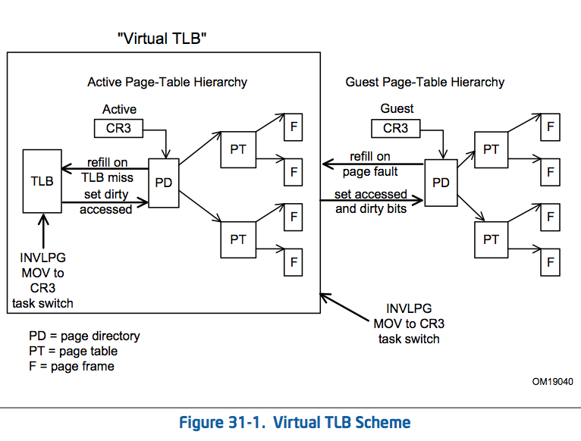
Memory Virtualization: Virtual TLB

Slide 83
VMCS: Execution Control
Controls what is not allowed to execute in the VM (VMX non-root) without a VMExit, i.e.:
  Load/store MSRs
  I/O access in/out
  Load/store of CR3
  Read shadows for CR0/CR4
  Interrupts (i.e., INT3)
  {RDTSC, TSC MSR} offsetting
  More…

Slide 84
VMCS: Execution Control Fields
Pin-based (asynchronous) controls
Processor-based (synchronous) controls
Exception bitmap
I/O bitmap addresses
Timestamp Counter offset
CR0/CR4 guest/host masks
CR3 targets
MSR Bitmaps

Slide 85
Execution controls not discussed
APIC access
  Plays a role in power management
  Allow guest to be alerted to AC->battery?
Executive VMCS pointer
  Plays a role with SMM
  We don’t know enough about SMM, save for another class.
PAUSE-loop exiting
  Deals with guest using PAUSE instruction in a loop

Slide 86
VMCS: Execution Control Fields
Pin-based (asynchronous) controls
Processor-based (synchronous) controls
Exception bitmap
I/O bitmap addresses
Timestamp Counter offset
CR0/CR4 guest/host masks
CR3 targets
MSR Bitmaps

Slide 87
Pin-based Execution Controls
One 32-bit value that controls asynchronous events in VMX non-root
  External-interrupt exiting (bit 0)
  Non maskable interrupt (NMI) exiting (bit 3)
  Virtual NMIs (bit 5)
  VMX preemption timer (bit 6)
Supported settings governed by IA32_VMX_PINBASED_CTLS MSR
Notes:
24.6.1 Pin-Based VM-Execution Controls

Slide 88
MSR: IA32_VMX_PINBASED_CTLS
(index 0x481)
64-bits
63 32 31 0
Allowed 1-settings
Allowed 0-settings
Reports on the allowed settings of most of the pin-based VM-execution controls
Bits 31:0 indicate the allowed 0-settings of these controls.
  VM entry allows control X (i.e. bit X of the pin-based VM-execution controls) to be 0 if bit X in the MSR is cleared to 0;
  If bit X in the MSR is set to 1, VM entry fails if control X is 0.
Bits 63:32 indicate the allowed 1-settings of these controls.
  VM entry allows control X to be 1 if bit 32+X in the MSR is set to 1;
  If bit 32+X in the MSR is cleared to 0, VM entry fails if control X is 1.

Slide 89
Non Maskable Interrupts
“NMI is meant to communicate a ‘panic’ status from the hardware to the CPU in a way that the CPU cannot ignore. It is typically used to signal memory errors.”
“The second reason is a "watchdog timer", which can be used to detect when the kernel itself locks up (and is sometimes also used for more accurate profiling as it allows EIP to be sampled even when IRQs are disabled).”
http://wiki.osdev.org/NMI

Slide 90
VMCS: Execution Control Fields
Pin-based (asynchronous) controls
Processor-based (synchronous) controls
Exception bitmap
I/O bitmap addresses
Timestamp Counter offset
CR0/CR4 guest/host masks
CR3 targets
MSR Bitmaps

Slide 91
Processor-based Execution Controls
Two 32-bit values
  Primary and Secondary controls
Controls handling of synchronous events
  i.e., events caused by execution of specific instructions
See Table 24-6, 24-7 for full description (partial description follows)

Slide 92
MSR: IA32_VMX_PROCBASED_CTLS
(index 0x482)
64-bits
63 32 31 0
Allowed 1-settings
Allowed 0-settings
Reports on the allowed (based on h/w support) settings of most of the primary processor-based VM-execution controls
Bits 31:0 indicate the allowed 0-settings of these controls.
  VM entry allows control X (i.e. bit X of the pin-based VM-execution controls) to be 0 if bit X in the MSR is cleared to 0;
  If bit X in the MSR is set to 1, VM entry fails if control X is 0.
Bits 63:32 indicate the allowed 1-settings of these controls.
  VM entry allows control X to be 1 if bit 32+X in the MSR is set to 1;
  If bit 32+X in the MSR is cleared to 0, VM entry fails if control X is 1.

Slide 93
Processor-based Execution Controls
Primary (partial description)
  1-setting of ‘use time stamp counter offsetting’ (bit 3)
  RDTSC exiting control (bit 12)
  CR3 load exiting (bit 15), CR3 store (bit 16)
  Activate secondary controls (bit 31)
  1-setting of ‘use I/O bitmaps’ (bit 25)
  1-setting of ‘use MSR bitmaps’ (bit 28)
  Activate secondary controls (bit 31)
Secondary (partial description)
  Enable EPT (bit 1)
  Enable VPID (bit 5)
  Enable VM functions (bit 13)

Slide 94
VMCS: Execution Control Fields
Pin-based (asynchronous) controls
Processor-based (synchronous) controls
Exception bitmap
I/O bitmap addresses
Timestamp Counter offset
CR0/CR4 guest/host masks
CR3 targets
MSR Bitmaps

Slide 95
Exception Bitmap
32-bit field
  One bit for each exception
When an exception occurs (in guest)
  If the bit is 0 in bitmask
    Exception delivered through guest IDT normally
  Otherwise
    Causes VMExit
E.g., INT3 exiting
  Set bit 3 in Exception Bitmap
Notes:
Note there is some special case for page faults. See Section 25.3

Slide 96
Exception Bitmap: Page faults
Special case for page faults (vector 14)
If software desires VM exits on all page faults, it can set bit 14 in the exception bitmap to 1 and set the page-fault error-code mask and match fields each to 0x00000000.
If software desires VM exits on no page faults, it can set bit 14 in the exception bitmap to 1, the page-fault error-code mask field to 0x00000000, and the page-fault error-code match field to 0xFFFFFFFF.

Slide 97
page-fault error-code mask/match fields
VMRead/VMWrite VMCS field 0x4006 to get Page-fault error-code mask value
VMRead/VMWrite VMCS field 0x4008 to get Page-fault error-code match value

Slide 98
VMCS: Execution Control Fields
Pin-based (asynchronous) controls
Processor-based (synchronous) controls
Exception bitmap
I/O bitmap addresses
Timestamp Counter offset
CR0/CR4 guest/host masks
CR3 targets
MSR Bitmaps

Slide 99
I/O Bitmap Addresses
Two 4K bitmaps (A and B)
A contains one bit for each I/O port in range 0000h through 7FFFh
B contains one bit for each I/O port in range 8000h through FFFFh
Used only with “1-setting” of “use I/O bitmaps” control
  If bitmaps corresponding to a port is 1, execution of an I/O instruction causes a VM exit

Slide 100
VMCS: Execution Control Fields
Pin-based (asynchronous) controls
Processor-based (synchronous) controls
Exception bitmap
I/O bitmap addresses
Timestamp Counter offset
CR0/CR4 guest/host masks
CR3 targets
MSR Bitmaps

Slide 101
Time-Stamp Counter Offset
Controlled by “1-setting” of “use TSC offsetting” option in Primary Processor base control (bit 3)
Additionally controls RDMSR of IA32_TIME_STAMP_COUNTER
Signed addition of signed TSC offset and TSC
Possibly eliminates need for 1-setting of RDTSC-exiting:
  potential performance optimization
TSC Offsetting is page 1337 of my Intel manual. Yeah, it’s pretty leet.
Notes:
Note, TSC Offsetting is page 1337 of the intel manual. Yeah, it’s pretty leet.

Slide 102
The Time-Stamp Counter
64-bit MSR first introduced in the Pentium
It increments once every CPU clock-cycle, starting from 0 when power is turned on
“It won’t overflow for at least ten years” (2006*)
Unprivileged programs (ring3) normally can access, it via the RDTSC instruction
* http://cs.usfca.edu/~cruse/cs630f06/lesson27.ppt

Slide 103
Using the TSC
64-bits
63 32 31 0
EDX
EAX
time0 dq 0 ; saves starting value from the TSC
time1 dq 0 ; saves concluding value from TSC
; how you can measure CPU clock-cycles in a code-fragment
rdtsc ; read the Time-Stamp Counter
mov time0+0, eax ; save least-significant longword
mov time0+4, edx ; save most-significant longword
; <Your code-fragment to be measured goes here>
rdtsc ; read the Time-Stamp Counter
movl time1+0, eax ; save least-significant longword
movl time1+4, edx ; save most-significant longword
; now subtract starting-value ‘time0’ from ending value ‘time1’
Modified to masm from: http://cs.usfca.edu/~cruse/cs630f06/lesson27.ppt

Slide 104
The TSC as an MSR
The Time-Stamp Counter is MSR number 0x10
To write a new 64-bit value into the TSC, you load the desired 64-bit value into the EDX:EAX register-pair, you put the MSR ID-number 0x10 into register ECX, then you execute wrmsr
  To modify a guest TSC use the appropriate VMCS field with VMWRITE

Slide 105
Lab: cpuid hooking
Purpose:
  Show that specific VM exit conditions are observed by the VMM
  Hook cpuid and return our own CPU string
Steps
  Modify virtdbg to hook cpuid leaf 0 (eax=0) and return something other than GenuineIntel in appropriate registers
  Run CPUID either in ring 0 or ring 3 to get the cpuid eax=0 brand string

Slide 106
sc stop virtdbg

Slide 107
Lab: TSC Offsetting
Modify Virtdbg to perform TSC offsetting
  Check your work by running RDTSC in userspace or kernel space
  Does it work as you expected?

Slide 108
VMCS: Execution Control Fields
Pin-based (asynchronous) controls
Processor-based (synchronous) controls
Exception bitmap
I/O bitmap addresses
Timestamp Counter offset
CR0/CR4 guest/host masks
CR3 targets
MSR Bitmaps

Slide 109
Read Shadows
Reads of CR0 and CR4 don’t cause exits.
Instead, these use “shadows” configured by the VMM in the respective guest’s VMCS with the guest-expected values.
  Why? (poll class)
Notes:
Volume 3 Section 30.12
Why read shadows??? For performance reasons.

Slide 110
CR0/CR4 Refresher
CR0 (64 bits)
  Controls things like paging, memory cache (and write-back), page write protection, protected mode
CR4 (64 bits)
  Controls things like Virtual-8086 mode, enabling SSE, enabling performance counters, PAE paging, page size

Slide 111
Masks and Shadows for CR0/CR4
Controls execution of instructions that read or modify CR4/CR0
  i.e., CLTS, LMSW, MOV to/from CR, and SMSW
Host/guest mask determines who “owns” that bit (guest or host) in CR0/CR4
For bits set to 1 in the mask, these are owned by host
  Guest bit-setting events
    Bits set in the mask that differ from respective shadow value will cause VMExit
  Guest bit-read event for bit in bitmask will read from corresponding shadow register
For bits set to 0 in the mask, these are owned by guest
  Load/store are unhindered
Notes:
Will probably want to jump to the board for this. It’s not complicated but looks to be.
Might want to pull up the meaning of the CR0 and CR4 registers as a quick reference. Could help motivate why this special treatment of these two registers.

Slide 112
Cloak and Dagger
Where a bit is masked, the shadow bit appears
Where a bit is not masked, the actual bit appears
actual:
mask:
shadow:
apparent:
1
0
1
0
0
1
0
1
1
0
1
0
0
1
0
1
1
1
1
1
0
0
0
0
1
1
1
1
0
0
0
0
1
1
0
0
1
1
0
0
1
1
0
0
1
1
0
0
1
1
0
0
0
1
0
1
1
1
0
0
0
1
0
1

Slide 113
VMCS: Execution Control Fields
Pin-based (asynchronous) controls
Processor-based (synchronous) controls
Exception bitmap
I/O bitmap addresses
Timestamp Counter offset
CR0/CR4 guest/host masks
CR3 targets
MSR Bitmaps

Slide 114
Memory Virtualization (1)
Provides guest software with contiguous “guest physical” address space starting at zero and extending to the maximum address supported by the guest virtual processor’s physical address width
The VMM utilizes guest-physical-to-host-physical address mapping to locate all or portions of the guest physical address space in host memory
The VMM requires the guest-to-host memory mapping to be at page granularity

Slide 115
Memory Virtualization (2)
Memory virtualization is accomplished using a combination of setting VM exit conditions on specific instructions (i.e. mov to/from cr3) and/or with an Extended Page Table (EPT) mechanism possibly assisted by a translation caching mechanism called Virtual Processor Identifier (VPID)
For Bluepill we don’t need to use some of these mechanisms… though it may make sense to employ some mechanisms to protect the VMM memory from the guest
More details on memory virtualization will be discussed later. (Part 3)

Slide 116
CR3 Target Controls
CR3-target values
  Allows for an exception to the rule of exiting for all MOV to/from CR3. Obviously for performance.
  Does not cause a VM exit if its source operand matches one of these values.
IA32_VMX_MISC bits 24:16 indicate the # of CR3-target values supported by the processor
    In practice most processors only support 4 targets
    Intel manual is confusing here because they assume 4, but recommend using the IA32_VMX_MISC MSR later.

Slide 117
VMCS: Execution Control Fields
Pin-based (asynchronous) controls
Processor-based (synchronous) controls
Exception bitmap
I/O bitmap addresses
Timestamp Counter offset
CR0/CR4 guest/host masks
CR3 targets
MSR Bitmaps

Slide 118
MSR Bitmaps
Processor must support 1-setting of the “use MSR bitmaps” VM-execution control
Partitioned into four 1KB contiguous blocks
  Read bitmap for low MSRs
  Read bitmap for high MSRs
  Write bitmap for low MSRs
  Write bitmap for high MSRs
If the bitmaps are used, an execution of RDMSR or WRMSR causes a VM exit if the value of RCX is in neither of the ranges covered by the bitmaps
Or if the appropriate bit in the MSR bitmaps (corresponding to the instruction and the RCX value) is 1
VMCS field 0x2004 stores the base address of the MSR bitmaps

Slide 119
VMCS: Execution Control Fields
Pin-based (asynchronous) controls
Processor-based (synchronous) controls
Exception bitmap
I/O bitmap addresses
Timestamp Counter offset
CR0/CR4 guest/host masks
CR3 targets
MSR Bitmaps
EPTP

Slide 120
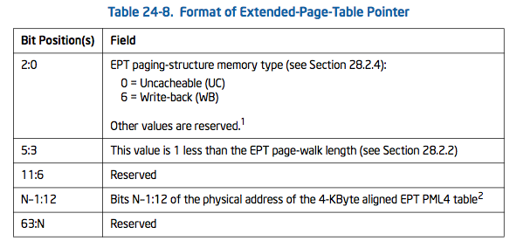
Extended Page Table Pointer (EPTP)
Contains the base address of the EPT PML4 table
VMCS field encoding 0x201A

Slide 121
Do you EPT?
The EPT paging structures are similar to those used to translate linear addresses for 64-bit paging
When the “enable EPT” VM-execution control is 1, the identity of guest-physical addresses depends on whether paging in the guest is enabled
  If CR0.PG = 0, each linear address is treated as a guest-physical address.
  If CR0.PG = 1, guest-physical addresses are those derived from the contents of control register CR3 and the guest paging structures.
A logical processor uses EPT to translate guest-physical addresses only when those addresses are used to access memory.

Slide 122
EPT Translation (1)
If CR0.PG = 1, the translation of a linear address to a physical address requires multiple translations of guest-physical addresses using EPT

Slide 123
EPT Translation (2)
Bits 31:22 of the linear address select an entry in the guest page directory located at the guest-physical address in CR3. The guest-physical address of the guest page-directory entry (PDE) is translated through EPT to determine the guest PDE’s physical address.

Slide 124
EPT Translation (3)
Bits 21:12 of the linear address select an entry in the guest page table located at the guest-physical address in the guest PDE. The guest-physical address of the guest page-table entry (PTE) is translated through EPT to determine the guest PTE’s physical address.

Slide 125
EPT Translation (4)
Bits 11:0 of the linear address is the offset in the page frame located at the guest-physical address in the guest PTE. The guest-physical address determined by this offset is translated through EPT to determine the physical address to which the original linear address translates.

Slide 126
VMCS: Execution Control Fields
Pin-based (asynchronous) controls
Processor-based (synchronous) controls
Exception bitmap
I/O bitmap addresses
Timestamp Counter offset
CR0/CR4 guest/host masks
CR3 targets
MSR Bitmaps
EPTP
VPID

Slide 127
Virtual Processor Identifier (VPID)
Used to cache information for multiple linear-address spaces
  “translations, which are mappings from linear page numbers to physical page frames,
  and paging-structure caches, which map the upper bits of a linear page number to information from the paging-structure entries used to translate linear addresses…”
Ref: 28.3.1 Information That May Be Cached

Slide 128
Translations
Linear mappings
  “Each of these is a mapping from a linear page number to the physical page frame to which it translates, along with information about access privileges and memory typing.”
Guest-physical mappings
  Guest-physical translations
  Guest-physical paging-structure-cache entries

Slide 129
More VPID
The current VPID is 0000H in the following situations:
  Outside VMX operation. (This includes operation in system-management mode under the default treatment of SMIs and SMM with VMX operation; see Section 29.14.)
  In VMX root operation.
  In VMX non-root operation when the “enable VPID” VM-execution control is 0.

Slide 130
VMCS Data Organization
Organized into 6 categories
  Guest state
  Host state
  Execution control fields
  Exit control fields
  Entry control
  VM exit info
Notes:
Section 24.5

Slide 131
VM Exits (preface)
VM exits have significant overhead
  Begin by recording information about the nature of and reason for the VM exit in the VM-exit information fields (details on this later)
  Each field in the guest-state area of the VMCS is written with the corresponding component of current processor state.
  Save guest MSR values
  Load host state
  Load host MSRs
A problem encountered during a VM exit leads to a VMX abort

Slide 132
VMCS: Exit Control Fields
VM Exits
  Occur in response to certain instructions and events in VMX non-root operation
  i.e., what to load and discard in the case of a VM Exit
Control fields consist of 2 groups
  VM Exit controls
  VM Exit controls for MSRs

Slide 133
VM Exit Controls
32-bit vector
  Save debug controls (bit 2)
    Whether DR7/IA32_DEBUGCTL are saved on VM exit
  Host addr-space size (bit 9)
    Whether VM exits occur into 64-bit mode host
  Load IA32_PERF_GLOBAL_CTRL (bit 12)
    Whether IA32_PERF_GLOBAL_CTRL is loaded on VM exit
  Save VMX-preemption timer value (bit 22)
    Whether pre-emption timer is saved on exit

Slide 134
VM Exit Controls
Bit Position | Name | Description
2 | Save debug controls | DR7 and IA32_DEBUGCTL_MSR are saved on VM exit?
9 | Host addr space size | 64-bit or 32-bit on VM exit (in VMX root mode)
12 | Load IA32_PERF_GLOBAL_CTR | IA32_PERF_GLOBAL_CTRL MSR saved on VM exit?
15 | Ack. Interrupt on exit | affects VM exits due to external interrupts (see Table 24-10)
18 | Save IA32_PAT | IA32_PAT MSR saved on VM exit?
19 | Load IA32_PAT | IA32_PAT MSR loaded on VM exit?
20 | Save IA32_EFER | IA32_EFER MSR saved on VM exit?
21 | Load IA32_EFER | IA32_EFER MSR loaded on VM exit?
22 | Save VMX-preemption timer value | VMX-preemption timer saved on VM exit?
  *All other bits are reserved, some to 0 and some to 1. Consult the VMX capability MSRs IA32_VMX_EXIT_CTLS and IA32_VMX_TRUE_EXIT_CTLS

Slide 135
VM Exit Controls for MSRs (1)
Guest and Host will make use of MSRs
  Business as usual
And we can register with the VMM that some MSR reads need not perform VM exits
But assuming there is a VM exit, i.e., in the case that we want to intercept that MSR read event
  Then there needs to be a mechanism to store the guest’s current MSRs (before exit) and re-load the host’s MSRs (so that the VMM can do its job)
  And later when there is a VM entry we will have shelved the guest’s MSRs and it will “do the right thing…”

Slide 136
VM Exit Controls for MSRs (2)
A VMM may specify lists of MSRs to be stored and loaded on VM exits/entry
Uses the VM-exit MSR-store-address and the VM-exit MSR-store-count exit control fields
Each data entry is 16 bytes and expressed by
  Bits 31:0 store the MSR index
  Bits 63:32 are reserved (unclear whether to 0 or 1)
  Bits 127:64 store the MSR data
127 64 63 32 31 0
MSR data | Reserved | MSR index

Slide 137
VM Exit Controls for MSRs
VM-exit MSR-store count (32-bit)
  Specifies the # of MSRs to be stored on VM exit
VM-exit MSR-store address (64-bit)
  Physical address of the VM-exit MSR-store area
VM-exit MSR-load count (32-bit)
  Contains the # of MSRs to be loaded on VM exit
VM-exit MSR-load address (64-bit)
  Physical address of the VM-exit MSR-load area

Slide 138
VMCS Data Organization
Organized into 6 categories
  Guest state
  Host state
  Execution control fields
  Exit control fields
  Entry control fields
  VM exit info
Notes:
Section 24.5

Slide 139
VMCS: Entry Control Fields
32-bit vector that controls the basic operation of VM entries
VMCS field 0x4012
3 groups
  Entry controls
  Entry controls for MSRS
  Entry controls for Event Injection

Slide 140
Entry controls
Bit Position | Name | Description
2 | Load debug controls | DR7 and IA32_DEBUGCTL_MSR are saved on VM exit?
9 | IA-32e mode guest | 64-bit mode guest? (0=no, 1=yes)
10 | Entry to SMM | Put into SMM mode on entry? (0=no, 1=yes)
11 | Deactivate dual-monitor treatment | See Section 29.15.7. Set to 0 for VM entry outside SMM (for our purpose)
13 | Load IA32_PERF_GLOBAL_CTRL | IA32_PERF_GLOBAL_CTRL MSR is loaded on VM entry?
14 | Load IA32_PAT | IA32_PAT MSR loaded on VM entry?
15 | Save IA32_EFER | IA32_EFER MSR saved on VM entry?

Slide 141
Entry controls for MSRs
Similar to exit controls for VM Exit.
  Except use the VM entry load count and address
  VM-entry MSR load count: 0x4014 (VMCS field)

Slide 142
VM Event Injection (1)
VMX operation allows injecting interruptions to a guest virtual machine through the use of VM-entry interrupt-information field in VMCS.
  Generate event on next VMEnter
  Happens after all guest state is loaded
Allows injection of
  External interrupts
  Non-maskable interrupts
  Exceptions (e.g., page faults)
  Traps

Slide 143
VM Event Injection (2)
If the interrupt-information field indicates a valid interrupt, exception or trap event upon the next VM entry; the processor will use the information in the field to vector a virtual interruption through the guest IDT after all guest state and MSRs are loaded.

Slide 144
Entry controls for Event Injection
VM entry can be configured to conclude by delivering an event through the IDT
  after all guest state and MSRs have been loaded
Use the VM-entry interruption-information field (VMREAD/VMWRITE 0x4016)

Slide 145
VM Function Controls

Slide 146
VMCS Data Organization
Organized into 6 categories
  Guest state
  Host state
  Execution control fields
  Exit control fields
  Entry control
  VM exit info
Notes:
Section 24.5

Slide 147
VM Exit (1)
All VM exits load processor state from the host-state area of the VMCS that was the controlling VMCS before the VM exit.
  This state is checked for consistency while being loaded. Because the host-state is checked on VM entry, these checks will generally succeed.
  Failure is possible only if host software is incorrect or if VMCS data in the VMCS region in memory has been written by guest software (or by I/O DMA) since the last VM entry.

Slide 148
VM Exit info
The VM-exit information fields provide details on VM exits due to exceptions and interrupts. This information is provided through the exit- qualification, VM-exit-interruption-information, instruction-length and inter- ruption-error-code fields.

Slide 149
VM Exit info field encodings
enum {
…
VM_EXIT_REASON = 0x00004402,
VM_EXIT_INTR_INFO = 0x00004404, VM_EXIT_INTR_ERROR_CODE = 0x00004406,
VM_EXIT_INSTRUCTION_LEN = 0x0000440c,
EXIT_QUALIFICATION = 0x00006400,
…
}

Slide 150
VMCS: Exit Information fields
Basic info
  Exit reason (32-bits)
  Exit qualification (64-bits)
  Guest Linear Address (64-bits)
  Guest Physical Address (64-bits)
Vectored exit info
Event delivery exits
Instruction execution exits
Error field

Slide 151
VM Exit Error Handling
Examples
  There was a failure on storing guest MSRs.
  There was failure in loading a PDPTR.
  The controlling VMCS has been corrupted
  There was a failure on loading host MSRs
  Machine-check event

Slide 152
VMM Error Handling
Error conditions may occur during VM entries and VM exits and a few other situations
Two basic strategies for error handling in VMM
  Basic error handling: in this approach the guest VM is treated as any other thread of execution. If the error recovery action does not support restarting the thread after handling the error, the guest VM should be terminated.
  Machine Check Architecture virtualization. In this approach, the VMM virtualizes the MCA events and hardware. This enables the VMM to intercept MCA events and inject an MCA into the guest VM. The guest VM then has the opportunity to attempt error recovery actions, rather than being terminated by the VMM.
MCA virtualization is out of scope of this class

Slide 153
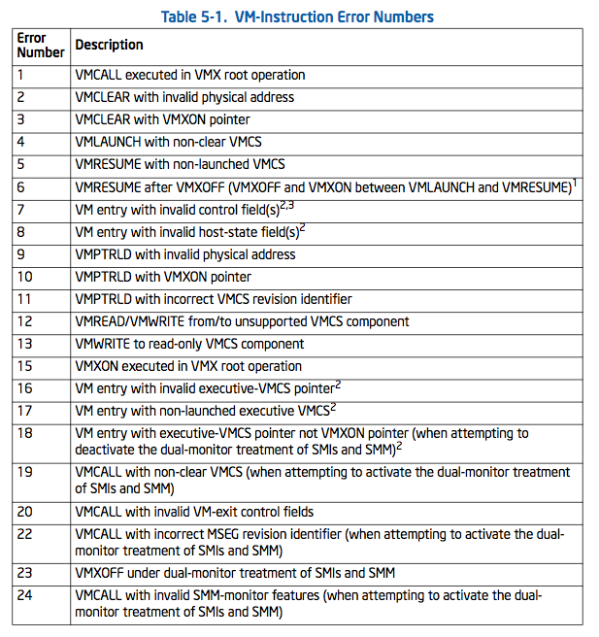
VMX Errors
Intel Reference Volume 2B
Section 5.4
Defines 28 error codes
(not all shown here)

Slide 154
VM Entry
MOV rax,0681eh # RIP VMCS identifier
MOV rbx,0 #
VMWRITE rax,rbx # after next successful VM entry, guest will start with RIP=0

Slide 155
Lightning review of Debugging
Registers hold addresses of memory and I/O of BPs/state
  8 registers, 4 for BPs (DR0-3), Debug Status (DR6), Debug Status (DR7)
MSRs monitor branches, interrupts, and exceptions

Slide 156
Debug Registers Review
Most debuggers also have support for something called a “hardware breakpoint”, and these breakpoints are more flexible than software breakpoints in that they can be set to trigger when memory is read or written, not just when it’s executed. However only 4 hardware breakpoints can be set.
There are 8 debug registers DR0-DR7
  DR0-3 = breakpoint linear address registers
  DR4-5 = reserved (unused)
  DR6 = Debug Status Register
  DR7 = Debug Control Register
Accessing the registers requires CPL == 0
  MOV DR, r32
  MOV r32, DR
Ref: http://opensecuritytraining.info/IntermediateX86.html (Part 4)

Slide 157
DR6 typedef
typedef union _DR6 {
ULONG Value;
struct {
unsigned B0:1;
unsigned B1:1;
unsigned B2:1;
unsigned B3:1;
unsigned Reserved1:10;
unsigned BD:1;
unsigned BS:1;
unsigned BT:1;
unsigned Reserved2:16;
};
} DR6, *PDR6;

Slide 158
DR7 typedef
typedef union _DR7 {
ULONG Value;
struct {
unsigned L0:1;
unsigned G0:1;
unsigned L1:1;
unsigned G1:1;
unsigned L2:1;
unsigned G2:1;
unsigned L3:1;
unsigned G3:1;
unsigned LE:1;
unsigned GE:1;
unsigned Reserved1:3;
unsigned GD:1;
unsigned Reserved2:2;
unsigned RW0:2;
unsigned LEN0:2;
unsigned RW1:2;
unsigned LEN1:2;
unsigned RW2:2;
unsigned LEN2:2;
unsigned RW3:2;
unsigned LEN3:2;
};
} DR7, *PDR7;

Slide 159
Virt + Debugging: play nice? (1)
Volume 3 section 31.2
The VMM can program the exception-bitmap to ensure it gets control on debug functions
  like breakpoint exceptions occurring while executing guest code such as INT3 instructions
The VMM may utilize the VM-entry event injection facilities described to inject debug or breakpoint exceptions to the guest.

Slide 160
Virt + Debugging: play nice? (2)
The MOV-DR exiting control bit in the processor-based VM-execution control field can be enabled by the VMM to cause VM exits on explicit guest access of processor debug registers
Guest software access to debug-related model-specific registers (such as IA32_DEBUGCTL MSR) can be trapped by the VMM through MSR access control features

Slide 161
Virt + Debugging: play nice? (3)
Debug registers such as DR7 and the IA32_DEBUGCTL MSR may be explicitly modified by the guest (through MOV-DR or WRMSR instructions)
Or modified implicitly by the processor as part of generating debug exceptions.
The current values of DR7 and the IA32_DEBUGCTL MSR are saved to guest-state area of VMCS on every VM exit.

Slide 162
Virt + Debugging: play nice? (4)
DR7 and the IA32-DEBUGCTL MSR are loaded from values in the guest-state area of the VMCS on every VM entry.
This allows the VMM to properly virtualize debug registers when injecting debug exceptions to guest.
Similarly, the RFLAGS register is loaded on every VM entry (or pushed to stack if injecting a virtual event) from guest-state area of the VMCS.

Slide 163
Lab: Virtdbg exceptions

Slide 164
End of Section

