Slide 1
Advanced x86:
Virtualization with VT-x
Part 3
David Weinstein
dweinst@insitusec.com

Slide 2
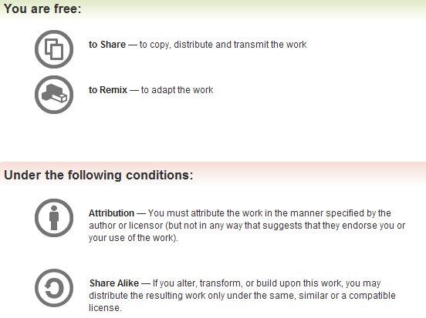
All materials are licensed under a Creative Commons “Share Alike” license.
http://creativecommons.org/licenses/by-sa/3.0/

Slide 3
VMX Setup Refresher (in assembly)
; 1. Check VMX support
mov eax,1
cpuid
bt ecx,5
jc VMX_Supported
jmp VMX_NotSupported
; 2. Enable VMXE
mov eax, cr4
bts eax, 13
mov cr4, eax
; 3. Init. VMXON/VMCS regions
mov ecx, 0x480
rdmsr
mov edx, [vmxon-ptr]
mov [edx], eax
mov edx, [guestvmcs-ptr]
mov [edx], eax
; 4. Initialize VMX
; *vmxon-ptr = (PA*) Alloc()
VMXON [vmxon-ptr]
jbe fail
VMCLEAR [guest-ptr]
jbe fail
VMPTRLD [guest-ptr]
jbe fail
; 5. Init VMCS and VM execution controls …
; 50. set guest RIP to 0x1234
mov rax, 0681Eh
mov rbx, 1234h
vmwrite rax, rbx
…
vmlaunch

Slide 4
Real mode guest VM
What if we wanted to run some real mode code as a guest VM.
  Maybe because support for Virtual-8086 emulation is unsupported by the CPU’s compatibility mode in 64-bit mode
Allan Cruse (Prof. Emeritus @ University of San Francisco) shows us how to do this with a guest VM
  http://www.cs.usfca.edu/~cruse/cs686s07/lesson24.ppt
So I fixed the code to work with recent Linux 3.* kernels
We’ll get to experience the fun of calling a BIOS interrupt in a guest VM container ☺
  In the comfort of our Linux environment

Slide 5
The Real Mode Address Space
Code that uses real-mod addresses is limited to the bottom megabyte of memory:
0xFFFFF
ROM
Read-Only Memory (BIOS)
Read-Only Memory (Video)
ROM
VRAM
Video display memory
one-megabyte
address-space
EBDA
Extended BIOS Data Area
ROM-BIOS Data Area
RBDA
IVT
Interrupt-Vector Table
0x00000
Ref: http://www.cs.usfca.edu/~cruse/cs686s07/lesson24.ppt

Slide 6
Real mode guests… for reals
To support guest real-mode execution, the VMM may establish a simple flat page table for guest linear to host physical address mapping.

Slide 7
BIOS Services
int 0x10: video display services
int 0x11: equipment-list service
int 0x12: memory-size service
int 0x13: disk input/output services
int 0x14: serial communications services
int 0x15: system software services
More on BIOS stuff
http://wiki.osdev.org/BIOS

Slide 8
Int 0x11: Equipment List result
14 13 12 11 10 9 8 7 6 5 4 3 2 1 0
ax
Internal modem
(1=yes, 0=no)
Number of printer-ports
Number of serial-ports
Number of diskette drives (if bit 0 is set)
(00=1 drive, 01=2 drives, etc)
Initial video-display mode (11=80x25 monochrome,
10=80x25 color, 01=40x25 color, 00=EGA/VGA/SVGA)
PS/2-type pointing-device is installed (1=yes, 0=no)
External math-coprocessor installed (1=yes, 0=no)
Diskette available for booting (1=yes, 0=no)

Slide 9
linuxvmm.c
Character-mode Linux device-driver
  Loaded as a kernel module at runtime
Accessed via a /dev/vmm
Can use standard functions like fopen, mmap, and ioctl to interact with the device
Compile with included mmake.cpp
  g++ -o mmake mmake.cpp
Read the README file in the linuxvmm directory

Slide 10
tryoutpc.cpp
Uses an ioctl on the /dev/vmm
  Ask the host VMM to continue to execute the kernel’s code in 64-bit mode, and to launch a Guest VM that will execute the real-mode procedure in Virtual-8086 mode
  We’ll supply the register values to be placed in the guest VM as part of the ioctl.
  And we’ll see the result when the guest exits and returns the resulting register values.

Slide 11
dram.c
Another kernel module to allow us to browse the physical memory of the system
  Exposed via /dev/dram
  Best viewed with fileview (in linuxvmm dir)
    g++ -o fileview fileview.cpp
    sudo ./fileview /dev/dram

Slide 12
Lab: ‘real-mode’ guest VM container
Purpose
  Demonstrate execution of a real-mode guest
  Execute BIOS interrupt 0x11 to obtain the available system device hardware
Steps
  README in directory

Slide 13
Lab: Reverse engineer a VMM
Purpose
  Familiarize ourselves with VMM from assembler-only perspective
Steps
  You’ll be provided with some assembly files in a zip file (transfer folder?)
  Look through them and locate VMX initialization
Question
  What is this system doing?
  Is this a bluepill?

Slide 14
VMCS Setup Algorithms
Setting up a VMCS is the hardest part
We’ve seen a couple of implementations that take shortcuts by making assumptions
A VMWare/Xen, however, would need to be more robust and configure appropriately based on features the hardware actually supports and features the user of the VMM wants
Intel manual discusses a couple of algorithms for discovering hardware features and configuring the VMCS appropriately

Slide 15
Memory virtualization
Volume 3 Section 31.3
Pretty complex implementation
Choices
  Brute Force
  Extended Page Table (EPT) + VPID = Virtual TLB

Slide 16
Memory Virtualization: Brute Force
Intercept all CR3 load/store
Use shadow page tables
  You tell me… what’s a shadow page table?
Ensure all guest manipulation of guest-page hierarchy remains consistent
Poor performance, doesn’t leverage hardware mechanisms (EPT/VPID)

Slide 17
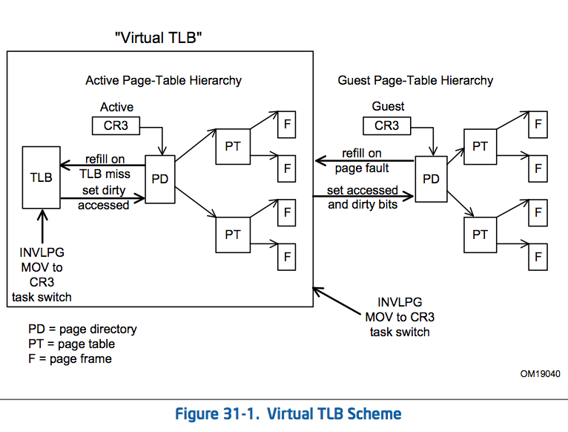
Memory Virtualization: Virtual TLB

Slide 18
VM “Introspection” (1)
By registering with the VMCS events that cause VMExits, the transition from VMX non-root to root mode allows the inspection of guest state and memory, thus allowing the external inspection of the guest.
We’ve discussed a number of events that can trigger a VM exit and allow for inspection of the guest system’s state
We’ve also shown how we can essentially create callbacks that get hit when the VM exit conditions match an event of interest

Slide 19
VM “Introspection” (2)
Since the CR3 register contains the page directory pointer during a context switch (and thus VM Exit), this can be used to identify the upcoming process before it executes.
At the end of the day, this is a tool that can be used for malware analysis, system integrity checking, code isolation, etc.

Slide 20
BluePill/HyperJacking Techniques
Does not virtualize hardware
  BP’d systems see same hardware before/after
Early PoCs, BlackHat 2006
  BluePill (Rutkowska/Tereshkin @ COSEINC) , AMD-v, Windows
  Vitriol (Dino Dai Zovi @ Matasano), Intel VT-x, Mac OS X
Early academic PoC
  SubVirt, Samuel T. King et al

Slide 21
General Hardware VM Based Rootkit
Virtual Machine Based Rootkit (VMBR)
Start with CPL=0
Allocate some unpaged physical memory
  Ensure no linear mappings to VMM after guest entry
Move running OS into VMCS
Intercept access to hardware (IO ports, …)
Communicate to hardware VM rootkit via sentinel instructions

Slide 22
Keylogging in VMBR
Setup VMCS appropriately
  Determine the keyboard’s IO ports
  Intercept IO port access and handle/reinject the event to the guest VM.
Look up the lab Xeno made for talking to the keyboard controller
  http://opensecuritytraining.info/IntermediateX86.html
Another example, see Hyperdbg
  https://code.google.com/p/hyperdbg/source/browse/trunk/hyperdbg/keyboard.c

Slide 23
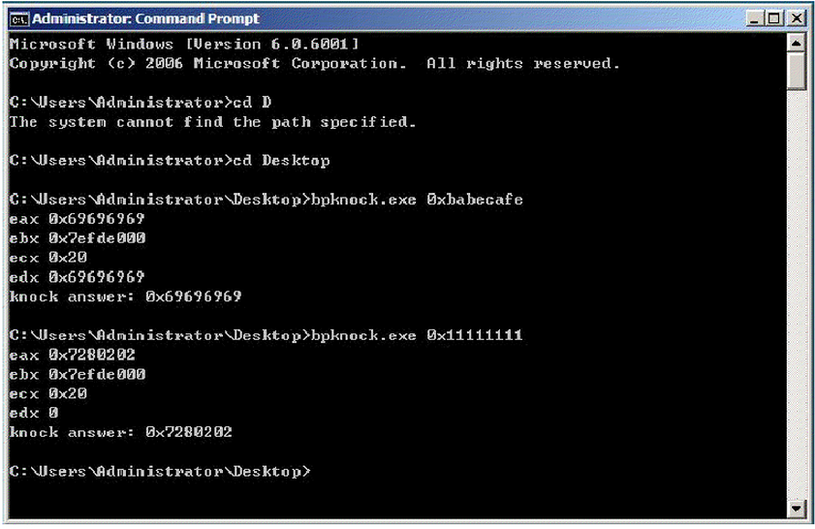
bpknock

Slide 24
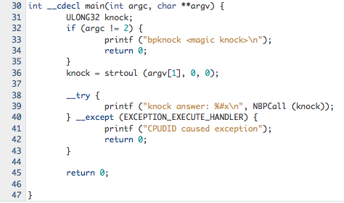
bpknock

Slide 25
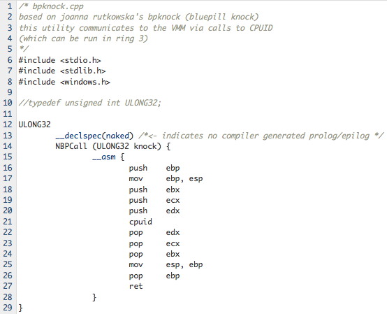
bpknock

Slide 26
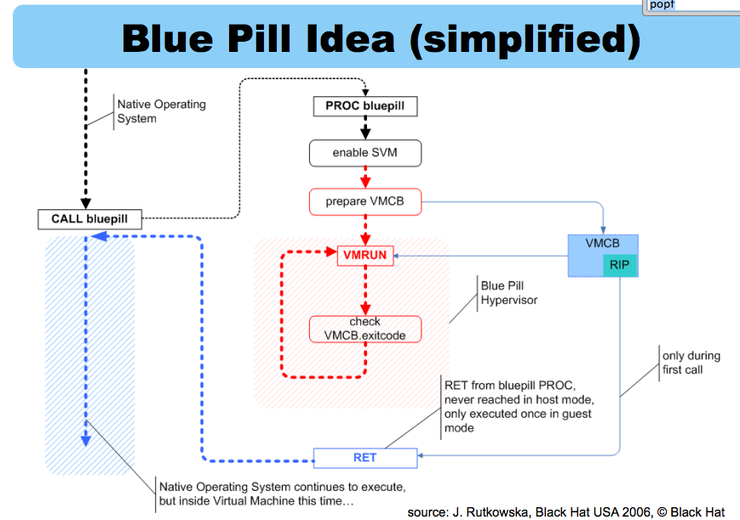
Blue Pill Idea (Simplified)

Slide 27
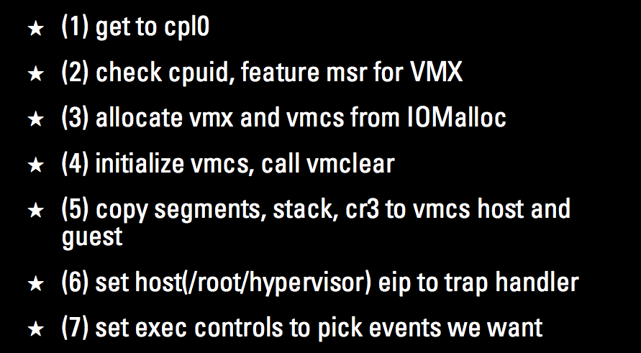
Vitriol
BH USA 2007. Goldsmith and Lawson

Slide 28
Virtualization projects
Lguest, Xen, QEMU/KVM
Vitriol (Matasano), BluePill/NewBluePill (ITL)
Debugging
  Hyperdbg, virtdbg
Academic
  SubVirt (Microsoft Research), V3vee Palacios (NWU), SecVisor (CMU), BitVisor (University of Tsukuba)

Slide 29
NewBluePill
Created for a Black Hat training session
Copyright terms are limiting (reproduced below)
https://bluepillstudy.googlecode.com/svn/trunk/nbp-0.32-public/
; Copyright holder: Invisible Things Lab
;
; This software is protected by domestic and International
; copyright laws. Any use (including publishing and
; distribution) of this software requires a valid license
; from the copyright holder.
;
; This software is provided for the educational use only
; during the Black Hat training. This software should not
; be used on production systems.

Slide 30
Lguest
Simple x86 hypervisor for hosting other Linux kernels
Load kernel module which you will load into running kernel
Simple I/O for communication

Slide 31
Detecting Virtualization/VMBRs
Godsmith, Lawson proposed detection heuristics [1]
  Functional (behavior or state changes)
  Side-channel (timing variations)
Point methods
  Processor errata
  VMCall functions/CPUID results
  Look for artifacts in processes, file system, and/or registry, memory.
  Look for specific virtual hardware
  Look for specific processor instructions and capabilities
See RedPill, NoPill, and ScoopyNG
  ScoopyNG = Scoopy Doo + Jerry
[1] http://www.matasano.com/research/bh-usa-07-ptacek_goldsmith_and_lawson.pdf

Slide 32
Instructions That Cause VM Exits Unconditionally
CPUID, GETSEC, INVD, and XSETBV. This is also true of instructions
introduced with VMX, which include: INVEPT, INVVPID, VMCALL,5 VMCLEAR, VMLAUNCH, VMPTRLD, VMPTRST, VMREAD, VMRESUME, VMWRITE, VMXOFF, and VMXON.
Meaning there should be a timing difference caused by a VM exit

Slide 33
Instructions That Cause VM Exits Conditionally
If you can figure out whether the software trying to escape detection will be forced to exit to support a particular pre-existing feature
Section 25.1.3

Slide 34
RedPill
Joanna Rutkowska, 2004 - “Red Pill... or how to detect VMM using (almost) one CPU instruction”
  http://www.invisiblethings.org/papers/redpill.html
Using SIDT (Store Interrupt Descriptor Table Register) instruction to profile the current value in the IDTR
She had found that the most significant byte of the IDTR had a predictable value in VMWare 4 and VirtualPC, which was different from what it was in an non-virtualized system
Ref: http://opensecuritytraining.info/IntermediateX86.html

Slide 35
Lab: RedPill
Grab the VerboseRedPill.c lab from Xeno’s Intermediate x86 course
  http://opensecuritytraining.info/IntermediateX86_files/IntermediateX86CodeOnly.zip
Try RedPill after installing Virtdbg
  Results? Discussion?
Notes:
Results: This works OK for binary translators or VMMs using shadow tables. Not so good for VMM using EPT/VPIDs

Slide 36
Measuring time (1)
CPU Tick Counter
  RDTSC instruction
  resolution: number of processor cycles (super high!)
  very accurate, but trivial to cheat!
    TSC offsetting/RDTSC VMExit
High Precision Event Timer (HPET) and other local timers
  Might have a high resolution
  But we can cheat them
  e.g. interrupt interception
http://invisiblethingslab.com/resources/bh07/IsGameOver.pdf (Slide 54)
Notes:
HPET – High precision event timer

Slide 37
Measuring time (2)
Real Time Clock (RTC)
  I/O with RTC device
  resolution: milliseconds (poor)
  relatively easy to cheat (I/O interceptions)
External clock
  e.g. NTP protocol
  resolution: 10 milliseconds (very poor)
  can not be cheated using generic approach – only attacks against specific implementation
http://invisiblethingslab.com/resources/bh07/IsGameOver.pdf (Slide 54)

Slide 38
TLB Profiling
Based on the belief that a VMM puts the hardware TLB entries to 0 if it is intercepting an instruction.
Technique
  Detector can watch timing access of a page, calling a possibly intercepted instruction, and then once again timing access to the same page
  Comparing both results should indicate a longer access time (from an external reference) if there has been an interception.

Slide 39
Volatile Memory Capture over DMA
Access all of physical memory over external peripheral interface (e.g. Firewire)
It should then be possible to detect a VMBR by searching for its signature.
  What signatures would you look for having learned what we know about the various data structures?

Slide 40
BlueChicken/TOCTOU
“It's a funny feature that allows Blue Pill to defeat timing-based virtualization detectors, so they can't find out that they're inside a VM. Obviously we do not need Blue Chicken in case there is Virtual PC in the system or any other application that makes use of hardware virtualization already.” - Joanna Rutkowska
Blue Chicken puts Blue Pill into a mode where it doesn’t interfere or cause VM exits. This sleep mode means it doesn’t hook anything and could remain in memory encrypted to avoid detection.
This is an example of a Time of Check Time of Use attack designed to protect Blue Pill from detection.

Slide 41
Nested Virtualization
Ben-Yehuda et al. The Turtles Project: Design and Implementation of Nested Virtualization
  Talk: http://www.youtube.com/watch?v=FbH63kVGTek
  “… our approach multiplexes multiple levels of virtualization … on the single level of architectural support available”
Alexander Tereshkin (ITL), Bluepilling the Xen Hypervisor
Other uses
  IaaS providers
  Live Migration
  Debugging hypervisors
“Nested virtualization is needed in case we have some other applications in the target system that also want to make use of virtualization (e.g. Virtual PC 2007) or we have a system with built-in hypervisor. In both cases Blue Pill must run those applications and/or OS' own hypervisor as nested ones.” - Rutkowska

Slide 42
Cheat Engine
“Cheat Engine is an open source tool designed to help you with modifying single player games running under window so you can make them harder or easier depending on your preference(e.g: Find that 100hp is too easy, try playing a game with a max of 1 HP), but also contains other usefull tools to help debugging games and even normal applications.”
Implements a VMM along the way ☺ (DBVM)
  SC2/D3 hax?
http://cheatengine.org/aboutce.php
https://code.google.com/p/cheat-engine/

Slide 43
SubVirt Rootkit
Wang et al. SubVirt: Implementing malware with virtual machines
  Microsoft research
  Proof of concept against Windows XP and Gentoo Linux
    On Windows it implants itself during system shutdown event (using LastChanceShutdownNotification event handler) so that it will load on next boot.
    On Linux they modify init.d (rc.d?) scripts to load their VMBR on next boot.

Slide 44
Azure
“Named after the rootkit that relies on similar principles for its operation, Azure is a proof-of-concept malware analysis tool for Windows XP-based guests that functions externally through the use of Intel VT. It was implemented using KVM (a Linux-based virtualization solution) as a base.”
“Azure uses virtual machine introspection to identify a target process and fine-grained tracing to monitor its behavior; coarse-grained tracing is left as future work.”
  https://code.google.com/p/azurema/

Slide 45
Some old and new VMM Bugs
VMMs are non-trivial to write
  Microsoft Virtual Server 2005 R2, CVE-2007-0948
  CVE-2006-5379, Nvidia vulnerability
    Webpage visit -> Guest to Host Ring0
  VMWare ESX 3.0.1, CVE-2007-4496
  Xen 3.0.3, CVE-2007-4993
  CVE-2012-1516, VMWare ESXi 4.1 RPC events, arbitrary code execution.
  Intel SYSRET privilege escalation, CVE-2012-0217
    http://blog.xen.org/index.php/2012/06/13/the-intel-sysret-privilege-escalation/

Slide 46
End

