Slide 1
CISSP® Common Body of Knowledge Review:
Legal, Regulations, Compliance & Investigations Domain
Version: 5.9.2

Slide 2
Learning Objective
Legal, Regulations, Compliance and Investigations Domain
The Legal, Regulations, Investigations and Compliance domain addresses ethical behavior and compliance with regulatory frameworks. It includes the investigative measures and techniques that can be used to determine if a crime has been committed and methods used to gather evidence (e.g., forensics). A computer crime is any illegal action where the data on a computer is assessed without permission. This includes unauthorized access or alteration of data, or unlawful use of computers and services. This domain also includes understanding the computer incident forensic response capability to identify the Advanced Persistent Threat (APT) that many organizations face today.
Reference: CISSP CIB, January 2012 (Rev. 5)

Slide 3
Topics
Legal, Regulations, Compliance and Investigations Domain
Laws & Regulatory Compliance
Investigations & Digital Forensics
Ethics

Slide 4
Concept
Laws & Regulations– Information Security Requirements
Laws and regulations are the source of directive requirements (e.g. organizational policies)
Directive requirements interpret the laws for:
  Management to institute policy and procedure to keep the organization and its employees from violating the law.
  Security engineering and design to keep
  the organization and its employees
  from violating the law.

Slide 5
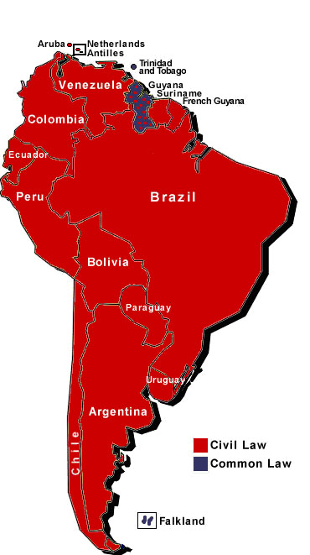
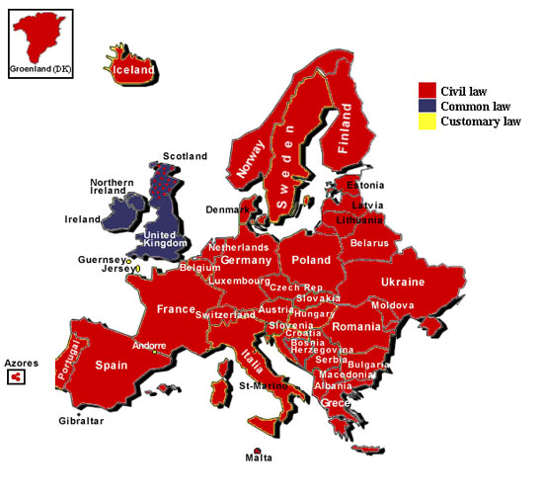
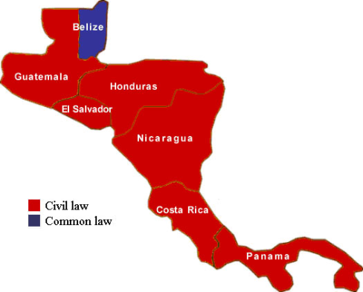
Laws & Regulations
Categories of Law …(1/4)
Civil law: Rule-based, not based on precedence. (ex. United States Code (U.S.C.))
  Codification: Written rules. (e.g., Roman Law, Napoleonic Code of France, French Civil Code of 1804.)
  Administrative law: Regulations that sets the standards of performance and conduct . (e.g. Banking regulations, SEC regulations, Insurance, FAR, EAR, ITAR.)
Reference:
CISSP® All-in-One Exam Guide, S. Harris
http://www.juriglobe.ca/eng/rep-geo/cartes/amer-nord.php
Notes:
Page 856

Slide 6
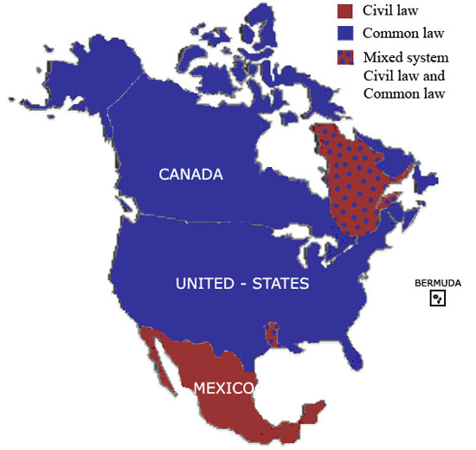
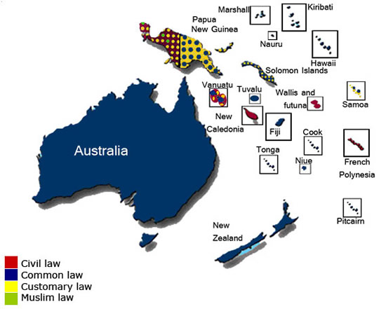
Laws & Regulations
Categories of Law …(2/4)
Common law: Based on precedence.
  Criminal law (imprisonment, $ penalty, etc.)
  Civil/tort law (compensatory damage, $ restitution, no prison time.)
Reference:
CISSP® All-in-One Exam Guide, S. Harris
http://www.juriglobe.ca/eng/rep-geo/cartes/amer-nord.php

Slide 7
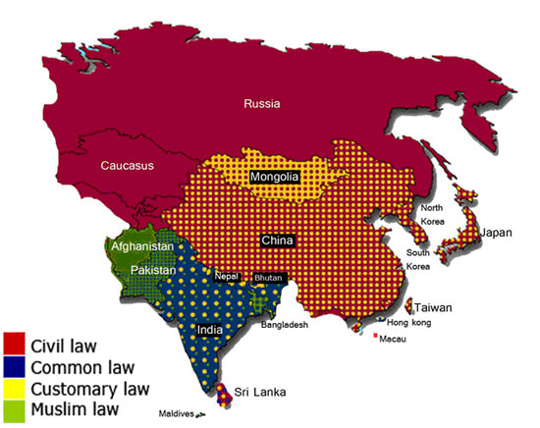
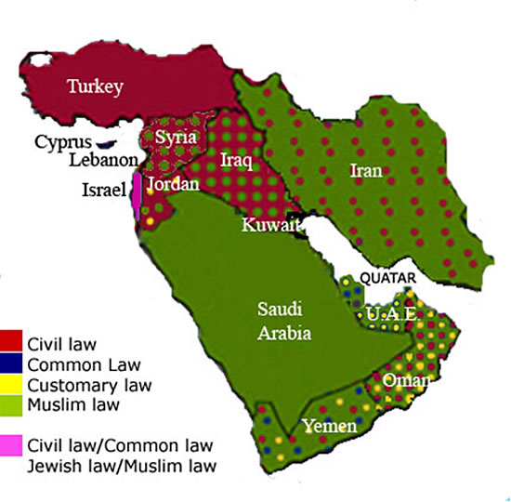
Laws & Regulations
Categories of Law …(3/4)
Customary law: Based on cultural customs, traditions, common believes. (ex. China, India, Muslim nations, etc.)
Religious law: Based on religions (e.g. Islamic law)
Reference: CISSP® All-in-One Exam Guide, S. Harris

Slide 8
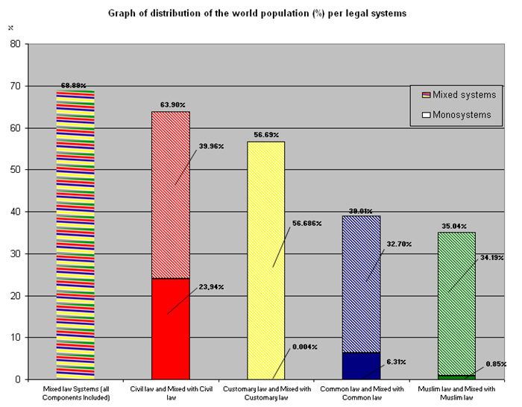
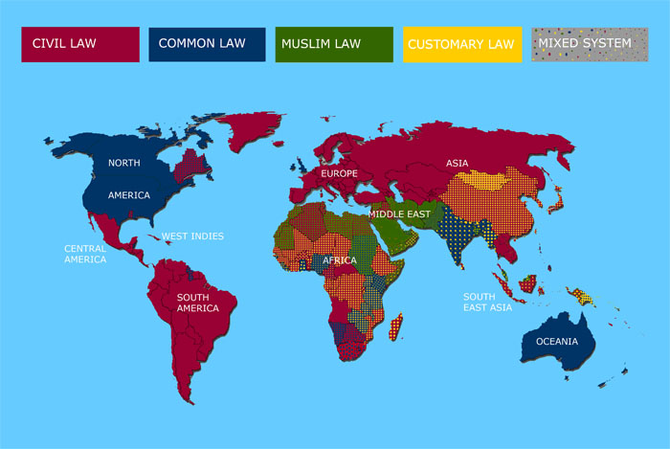
Laws & Regulations
Categories of Law …(4/4)
Mixed law system: Based on culture, religion, & customs.
  Civil law: Rule-based.
  Common law: Precedence-based.
  Customary law: Based on cultural customs, traditions, & common believes.
  Religious law: Based on religions.
Reference:
CISSP® All-in-One Exam Guide, S. Harris
http://www.juriglobe.ca/eng/index.php

Slide 9
Laws & Regulations
Example of Civil Laws
Privacy Act of 1974
  Covers U.S. citizens and legal permanent residents.
  The Government agencies must restrict disclosure of personal system of records.
  The Government agencies must provide individuals the ability to modify their system of records.
  Therefore, the Government agencies must establish a “code of fair information practice” policy on the collection, maintenance, disseminate and sharing of personal system of records.
Health Insurance Portability and Accountability Act of 1996 (HIPAA)
  Privacy of personal medical records.
Electronic Communications Privacy Act of 1986 (ECPA)
  Privacy of electronic communications. (Title I for data-in-transit, Title II for data-at-rest.)

Slide 10
Laws & Regulations
Privacy Act of 1974
Individual means a citizen of the United States or an alien lawfully admitted for permanent residence.
Record means any item, collection, or grouping of information about an individual that is maintained by an agency.
System of records means a group of any records under the control of any agency from which information is retrieved by the name of the individual or by some identifying number, symbol, or other identifying particular assigned to the individual.
Source: http://frwebgate.access.gpo.gov/cgi-bin/getdoc.cgi?dbname=browse_usc&docid=Cite:%2B5USC552a
Notes:
Privacy Act of 1974
Covers U.S. citizen and permanent resident (i.e. individual).
It defines record as “any item, collection or grouping of information associated to an individual” maintained by a Government agency.
It defines system of records as a group of records associated with an individual controlled by a Government agency.
Note: In privacy practice, it is important to:
Know the definition of individual.
What constitutes a record?
Understand that system of records is not information system. It is a set of data items that are associated to an individual.

Slide 11
Laws & Regulations
What is Privacy?
Information security is a definitive concept
  Security Objectives: Confidentiality, Integrity, and Availability (44 USC Sec. 3542)
  Security Implementation Principles: Need-to-know, Least Privilege, Separation-of-Duties
“Privacy is a concept in disarray.” – Daniel J. Solove, J.D.
  No formal definition for “privacy”, just jurisprudence
    Bill of Rights
    Federal privacy statues
    State privacy statues
  Sociological Concept: “The need for privacy is a socially created need. Without society there would be no need for privacy.” – Barrington Moore, Jr.

Slide 12
Laws & Regulations
Classes of Privacy
Information privacy
  Collection and handling of personal information (medical records, credit information.)
Bodily privacy
  A person’s physical being and any invasion thereof (drug test, cavity search, genetic testing)
Territorial privacy
  Individual environment (private property, workspace, public space)
Communications privacy
  Correspondence between entities (e-mail, postal mail, phone conversation)
Ref: Information Privacy – Official Reference for the CIPP, 2007

Slide 13
Laws & Regulations
Privacy: Understanding of Harmful Activities – Information Collection
Surveillance (Fourth Amendment)
  Wiretapping
    Need a court order (Katz vs. United States)
  Monitoring
    Not within a private property (Kyllo vs. United States)
    Ok, if lack of protection (Florida vs. Riley)
    Ok, if in public place (United States vs. Karo)
Interrogation (Fifth and First Amendments)
  Self Incrimination
  Mandated Questioning
    Not on personal affiliation to organization(s) (Shelton vs. Tucker)
    Not on political views or associations (Baird vs. State Bar of Arizona)
    Not on disabilities (American with Disabilities Act of 1990)
    Not on medical / health information (CA, CT, DE, NY, WI, etc.)
Notes:
Katz vs. US.

Slide 14
Laws & Regulations
Privacy: Understanding of Harmful Activities – Information Processing
Aggregation
  Not ok for “rap sheet” (DOJ vs. Reporters Committee for Freedom of the Press)
  But ok for convicted sex-offenders (Megan’s Law)
Identification
  President Roosevelt and Congress promised SS card would be kept confidential and not for identification purposes (Social Security Act of 1935)
  Standard universal identifier (SUI) is not ok
Insecurity
  Need ways to handle and protect personal information (Fair Information Practice, Privacy Act, GLB, HIPAA, etc.)
Secondary Use
  Need ways to limit the secondary use (Fair Information Practice, Privacy Act, GLB, HIPAA, etc.)
Exclusion
  Failure to provide individuals with notice and input about their records.
Notes:
DOJ vs. Reporters Committee for Freedom of the Press. Supreme Court concluded that while “rap sheets” are public records but aggregation of these records

Slide 15
Laws & Regulations
Privacy: Understanding of Harmful Activities – Information Dissemination
Breach of Confidentiality
  Ok, if it related to public interest (i.e., infectious disease) (Simonsen vs. Swenson)
  Ok, if it is shared with a 3rd party (United States vs. Miller and Smith vs. Maryland)
Disclosure
Exposure
Increased Accessibility
Blackmail
Appropriation
Distortion
Notes:
Simonsen vs. Swenson. Simonsen is a patient of Dr. Swenson. Simonsen has syphilis. Supreme Court concluded that protecting public health outweighed any privacy interest.
US vs. Miller. Customer lacked a reasonable expectation of privacy in the financial records maintained by his bank – a 3rd Party.
Smith vs. Maryland. People lack a reasonable expectation of privacy in the phone numbers they dialed. Because they must convey phone numbers to the phone company.

Slide 16
Laws & Regulations
Example of Criminal Law
Computer Fraud and Abuse Act of 1984 …(1/2)
  Amended in 1994, 1996, Broadened in 2001 by the USA PATRIOT Act (P.L. 99-474, 18 U.S.C. 1030)
  List of criminal offenses:
    Knowingly accessing a computer without authorization to obtain national security data.
    Intentionally accessing a computer without authorization to obtain:
      Information contained in a financial record of a financial institution, or contained in a file of a consumer reporting agency on a consumer.
      Information from any department or agency of the United States.
      Information from any protected computer if the conduct involves an interstate or foreign communication.
    Intentionally accessing without authorization a government computer and affecting the use of the government’s operation of the computer.
Reference: http://frwebgate.access.gpo.gov/cgi-bin/getdoc.cgi?dbname=browse_usc&docid=Cite:+18USC1030
Notes:
Crime laws, page 847

Slide 17
Laws & Regulations
Example of Criminal Law
Computer Fraud and Abuse Act of 1984 …(2/2)
  List of criminal offenses:
    Knowingly accessing a computer with the intent to defraud and there by obtaining anything of value.
    Knowingly and with the intent to defraud, trafficking in a password or similar information through which a computer may be accessed without authorization.
    Knowingly cause the transmission of a program, information, code, or command that causes damage that result in:
      Loss to one or more persons during any one-year period aggregating at least $5,000 in value.
      The modification or impairment, or potential modification or impairment, of the medical examination, diagnosis, treatment, or care of one or more individuals.
      Physical injury to any person.
      A threat to public health or safety.
      Damage affecting a government computer system.

Slide 18
Laws & Regulations
Example of Administrative Laws
U.S. Export Administration Regulations (EAR)
  Administered by Bureau of Industry and Security, Dep. Of Commerce (http://www.access.gpo.gov/bis/ear/ear_data.html).
  EAR, Part 774, Category 5 (Part 2) – Information Security: mass market & retail cryptography can be exported without a license.
European Union Council (EC) Regulation No. 1334/2000 (22 June 2000): Setting up a Community Regime for the Control of Exports of Dual-use Items and Technology
  Member states can issue General Intra-Community Licenses to export crypto products within EU.
  Export to non-EU countries require a Community General Export License (CGEA) or General National License.
Reference: Official (ISC)^{2®} Guide to the CISSP® Exam

Slide 19
Laws & Regulations
Intellectual Property Laws
Intellectual property is divided into two categories:
Industrial property
  Inventions (patents),
  Trademarks,
  Industrial designs, and
  Geographic indications of source.
Copyright
  Literary works (e.g. books, articles, architecture designs, engineering designs, plays, poems, etc.)
  Artistic works (e.g. musical works, songs, films, paintings, photographs, sculptures, etc.)
Reference: World Intellectual Property Organization (http://www.wipo.int/portal/index.html.en)
Notes:
Intellectual property laws, page 860

Slide 20
Laws & Regulations
Intellectual Property Laws – Industrial Property
Patent
  A patent grants the owner a legally enforceable right to exclude others from practicing the invention covered.
  Usually 20 years from the filing date.
Trademark
  Word, name, symbol, color, sound, product shape or combination of these used to identified goods & distinguish them from those made or sold by others.
  When a trademark is used in relation to services rather than products, it may sometimes be called a “service mark”.
Reference:
Official (ISC)^{2®} Guide to the CISSP® CBK
General Information Concerning Patents, USPTO (http://www.uspto.gov/patents/resources/general_info_concerning_patents.jsp#heading-3)

Slide 21
Laws & Regulations
Intellectual Property Laws - Copyright
Copyright
  Is a set of exclusive rights regulating the use of a particular expression of ideas (i.e. “original works of authorship”).
  Copyright law covers only the form or manner in which ideas or information have been manifested, the "form of material expression".
  It is not designed or intended to cover the actual idea, concepts, facts, styles, or techniques which may be embodied in or represented by the copyright work
Trade Secrets
  Proprietary business or technical information which is confidential and protected as long as its owner takes “reasonable” security precautions.
  Not a formal protection; a third party is not prevented from independently duplicating and using the secret information once it is discovered.
  It does not expire as would a patent.
Reference: Official (ISC)^{2®} Guide to the CISSP® CBK

Slide 22
Laws & Regulations
Information Security Related Legal Issues
Three types of harm addressed in computer crime laws:
Unauthorized access.
Unauthorized alteration, destruction or disclosure of information.
Insertion of malicious programming code.
Three categories of computer crime:
Computer assisted crime (computer as a tool).
Computer targeted crime (crime directed at computer).
Computer is incidental (computer data from criminal activities).
Reference: Official (ISC)^{2®} Guide to the CISSP® Exam

Slide 23
Laws & Regulations
Computer Crime Law Issues
Defining electronic information or data.
Defining intellectual property.
Complex legal definitions of technical issues.
Unlawful destruction of data or denial of service.
Using a computer to commit, aid, or abet crime.
Private sector lack of reporting.
Sentencing guidelines (for “white-collar” crimes).
Reference: Official (ISC)^{2®} Guide to the CISSP® Exam

Slide 24
Laws & Regulations
International Computer Crime Law Issues
Some countries have no or poorly defined computer crime laws.
Law enforcement technical capabilities vary.
Government may not wish to assist each other in international cases.
Trans-national criminal activities.
Jurisdictional legal disputes.
Reference: Official (ISC)^{2®} Guide to the CISSP® Exam

Slide 25
Laws & Regulations
International Groups addressing Computer Crimes
The G8 Nations: International agreements on computer crime.
Mutual Legal Assistance Treaties (MLAT): U.S. law enforcement agents (i.e. FBI, Department of State) working with law enforcement of other nations.
European Union Border Controls (Interpol): International police organization.
United Nations (U.N.): U.N. Agreements.
Reference: Official (ISC)^{2®} Guide to the CISSP® Exam

Slide 26
Laws & Regulations
Example of International Treaties – Export Control
Coordinating Committee for Multilateral Export Controls (COCOM)
  17 member nations, dissolved in March 1994.
  Maintained International Industrial List & International Munitions List. To prevent export of cryptography to “dangerous” countries.
Wassenaar Arrangement on Export Controls for Conventional Arms and Dual-Use Goods and Technologies (1995)
  December 1998, 33 nations has agree to restrict export of crypto products based on key length. (56-bit for symmetric, 512-bit for asymmetric)
  Products that use encryption to protect intellectual property (e.g. DVDs) is relaxed.
  Export of all other crypto require license.
Reference: Official (ISC)^{2®} Guide to the CISSP® Exam

Slide 27
Laws & Regulations
Example of International Treaties – Export Control
Export control of cryptosystems:
  EAR, Part 774, Category 5 (Part 2) – Information Security: mass market & retail cryptography can be exported without a license.
    Parity bits are not included in the key length
    Key length of 56-bit for symmetric (DES)
    Key length of 512-bit for asymmetric (RSA, Diffie-Hellman)
    Key length of 112-bit for ECC-DH
  European Union Council (EC) Regulation No. 1334/2000 (22 June 2000): Setting up a Community Regime for the Control of Exports of Dual-use Items and Technology
    Parity bits are not included in the key length
    Key length of 56-bit for symmetric (DES)
    Key length of 512-bit for asymmetric (RSA, Diffie-Hellman)
    Key length of 112-bit for ECC-DH

Slide 28
Laws & Regulations
Example of International Treaties – Cybercrime Definition
On August 3, 2006, U.S. Senate signed the first international treaty on computer crime – Council of Europe Convention on Cybercrime.
  Negotiations on the treaty began in 1997.
  Final document ratified by 15 European nations and the United States.
  U.S. Senate did not consider the optional: Additional Protocol to the Convention on cybercrime, concerning the criminalization of acts of a racist and xenophobic nature committed through computer systems due to our First Amendment – Freedom of Speech.
Reference:
http://conventions.coe.int/Treaty/en/Treaties/Html/185.htm
http://www.cybercrime.gov/

Slide 29
Laws & Regulations
International Issues on Intellectual Property (IP) …(1/2)
On patents… (http://www.wipo.int/treaties/en/registration/pct/summary_pct.html)
  Covered by Patent Cooperation Treaty (PCT) of 1978.
  Not for “all” nations. (141 nations as of March 7, 2009.)
  Not implemented in uniform manner:
    China has never signed PCT. However, China has signed Washington Treaty in May 1990. An only applies to Hong Kong and Macao Special Administrative Regions.
    Taiwan enforces PCT, but is not a recognized state, so it can’t sign treaties.
On copyright…
  “There is no such thing as an ‘international copyright’ that will automatically protect an author’s writing throughout the world.” – U.S. Copyright Office (http://www.copyright.gov/fls/fl100.html).
  Covered by Berne Convention, enforced by 164 nations.
  Not implemented in uniform manner:
    Paris Convention of 1992 only applies to Hong Kong and Macao Special Administrative Regions.

Slide 30
Laws & Regulations
International Issues on Intellectual Property (IP) …(2/2)
In 2005, U.S. intellectual property is estimated worth between $5 – $5.5 trillion, which accounts for 45% of GDP. – Intellectual Property Book, GIPC, U.S. Chamber of Commerce, 2010.
“Software piracy costs U.S. software companies billions of dollars each year.” – R. Holley, Business Software Alliance testified before House Foreign Affairs Committee on March 10, 2010.
On October 2009, China issued its own “exclusive right” laws on patents and trademarks.
  Foreign companies must provide their trade secrets in order to sell any products developed overseas to Chinese government.
  Foreign companies are challenged by Chinese companies based on their Chinese issued patents
      – D. Roberts, China: Closing for Business?, Bloomberg Businessweek, March 25, 2010.

Slide 31
Questions:
What are the three categories of computer crime?
Why international computer crime law do not apply to “all nations”?
What is the difference between copyright and trade secret?

Slide 32
Answers:
What are the three categories of computer crime?
  Computer assisted (i.e., computer as a tool)
  Computer targeted (i.e., computer is the target)
  Computer is incidental (i.e., data in a criminal activities)
Why international computer crime law do not apply to “all nations”?
  Nation is a sovereign entity, law of one nation does not apply to another nation unless there is a treaty that acknowledges the computer crime law.
What is the difference between copyright and trade secret?
  Copyright is a set of exclusive rights.
  Trade secret has no formal protection, it is a “proprietary” information.

Slide 33
Topics
Legal, Regulations, Compliance and Investigations Domain
Laws & Regulatory Compliance
Investigations & Digital Forensics
Ethics

Slide 34
Investigations
Investigative Process vs. Evidence Life Cycle
Investigative Process encompasses
  Identification of an incident
  Preservation of “scene”
  Collection of evidence
  Examination of evidence
  Analysis of the incident
  Presentation of evidence
  Decision to act
Evidence Life Cycle
  Acquisition collection and identification
  Storage, preservation, and transportation
  Analysis
  Presented in court
  Returned to victim
Reference: Official (ISC)^{2®} Guide to the CISSP® Exam

Slide 35
Investigations
Data Acquisition – Preservation of Forensic Evidence
Make 2 copies of the original media (Primary Image / Working Image).
Bit for Bit copying capture all the data on the copied media including hidden and residual data (e.g. slack space, swap, residual, unused space, deleted files, etc.)
Preserve integrity of source and image (e.g. hash functions)
  MD-5 sum provides a 128-bit signature that is sensitive to bit changes.
  The reported digest should match.
Reference: Official (ISC)^{2®} Guide to the CISSP® Exam

Slide 36
Investigations
Rule of Evidence
Type of evidence
  Evidence is any species of proof or probative matter, legally presented at the trial of an issue, by act of parties and through the medium of witness, records, documents, objects, etc.
Admissibility of evidence
  Evidence must be admissible in court.
Preservation of electronic evidence (Chain-of-custody)
  Electronic evidence is fragile.
  Integrity of the “scene” must be preserved.
  Only one chance to do it correctly.
Reference: Official (ISC)^{2®} Guide to the CISSP® Exam

Slide 37
Investigations
Rule of Evidence – Common Types of Evidence
Direct evidence is oral testimony by witness.
Real is physical evidence made up by tangible objects that prove or disprove guilt.
Documentary is in form of business records, manuals, or print outs, etc.
Demonstrative evidence is evidence used to aid the jury. In a form of model, illustration, chart or experiment offered as proof.
Reference: Official (ISC)^{2®} Guide to the CISSP® Exam

Slide 38
Investigations
Rule of Evidence – Hearsay Rule
Hearsay is second-hand evidence; normally NOT admissible in court.
Value depends on veracity and competence of source.
Depending on the circumstance, business records may be considered hearsay.
  No first-hand proof of accuracy, reliability, trustworthiness
Business records exemption:
  Information relates to regular business activities.
  Automatically computer generated data.
    No human intervention.
    Prove system was operating correctly.
    Prove no one changed the data.
Reference: Official (ISC)^{2®} Guide to the CISSP® Exam

Slide 39
Investigations
Rules of Evidence – Admissibility of Evidence
Relevancy of evidence
  Proof a crime occurred.
  Document of events & time frame.
  Identification of acts / methods.
  Sources of evidence: Oral (witnesses), Written Document, Computer generated, Visual/audio (during & after events).
Reliability of evidence
  Evidence is Trustworthy.
  Evidence is legally obtained.
Durability of evidence
  Evidence identification & preservation
  Preservation, collection and documentation (Chain-of-custody)
  Can be reconstructed
Reference: Official (ISC)^{2®} Guide to the CISSP® Exam

Slide 40
Investigations
Rule of Evidence – Handling of Computer Evidence
Minimize handling/corruption of original data.
Account for any changes and keep detailed logs of your actions.
Comply with the rules of evidence.
Do not exceed you knowledge, seek legal advise.
Follow you local security policy and obtain written permission.
Capture as accurate an image of the system as possible.
Be prepared to testify.
Ensure you actions are repeatable.
Proceed from volatile to persistent evidence.
Don’t run any programs on the affected system.
Reference: Official (ISC)^{2®} Guide to the CISSP® Exam

Slide 41
Investigations
Rule of Evidence – Chain of Custody
Helps protect the integrity and reliability of the evidence.
Effective process of documenting the complete journey of the evidence during the life of the case.
To answer the following questions:
  Who collected it?
  How & where?
  Who took possession of it?
  How was it stored & protected in storage?
  Who took it out of storage & why?
Reference: Official (ISC)^{2®} Guide to the CISSP® Exam

Slide 42
Investigations
IOCE-G8
In March 1998, the International Organization on Computer Evidence (IOCE) was appointed by U.N.: (http://www.ioce.org)
  To define international principles for the procedures relating to digital evidence,
  To ensure the harmonization of methods and practices among nations and guarantee the ability to use digital evidence collected by one state in the courts of another state.
IOCE principals are governed by the following objectives: (i.e., by-laws)
  To identify and discuss issues of common interest
  To facilitate the international dissemination of information
  To develop recommendations for consideration by the member agencies
Reference: Official (ISC)^{2®} Guide to the CISSP® Exam

Slide 43
Investigations
IOCE-G8 – Principles of Computer Evidence
When dealing with digital evidence, all of the general forensic and procedural principles must be applied
Upon seizing digital evidence, actions taken should not change that evidence
When it is necessary for a person to access original digital evidence, that person should be trained for the purpose.
All activity relating to the seizure, access, storage or transfer of digital evidence must be fully documented, preserved and available for review
An Individual is responsible for all actions taken with respect to digital evidence whilst the digital evidence is in their possession
Any agency, which is responsible for seizing, accessing, storing or transferring digital evidence is responsible for compliance with these principles
Reference: Official (ISC)^{2®} Guide to the CISSP® Exam

Slide 44
Investigation
Digital Forensics
While digital forensics has been around for a while; they are still a bit of “CSI black art”. For CISSP, it consists of:
  Media analysis
  Network analysis
  Software analysis
  Hardware/embedded device analysis
There are much more…
  Cryptographic analysis
  Steganography analysis
  Audit trails analysis
  Digital watermarks

Slide 45
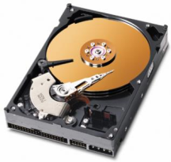
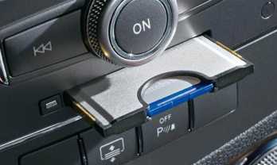

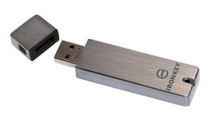



Investigation
Digital Forensics – Media Analysis
There are all types of storage media…
They all use some type of standard digital format
  Do the “bit-for-bit” copy and hash it.
  Maintain “chain-of-custody” and preserve the original evidence
Most of time, forensic analysts look for incriminating data:
  Web browsing history, cookies, user id, passwords
  Data files: document, spreadsheet, pictures, etc.
  Log files: system, application
  Hidden, temporary, and deleted files
  E-mails, contact information
If encrypted, then do the cryptographic analysis

Slide 46
Investigation
Digital Forensics – Software Analysis
Software applications can write data just about everywhere…
  Web browser: browsing history, cookies, and temporary files
  OS: log, swap files, deleted files, print spool files
  Applications: temporary files, e-mail (.pst files), encrypted, steganography, etc.
  Malware: Trojan-horse executable, logs, unallocated space (hidden blocks), boot sectors, slack space, etc.
Forensic toolkits such as: Forensic Toolkit and EnCase helps, but still requires experience and analytical mind.

Slide 47
Investigation
Digital Forensics – Network Analysis
Capture of network data:
  Full packet capture
  Data flow
  Security alert data and logs
Capture of network data is done using tools such as:
  PCAP
  Netwitness, NetFlow, IPFIX, etc.
  Log files from firewall, IPS/IDS, routers, switches, etc.
Analysis of captured network data is done using:
  Wireshark, TCPDump
  Netwitness, SiLK, Argus, etc.
  SIEM tools: Arcsight, RSA enVision, Splunk, etc.

Slide 48
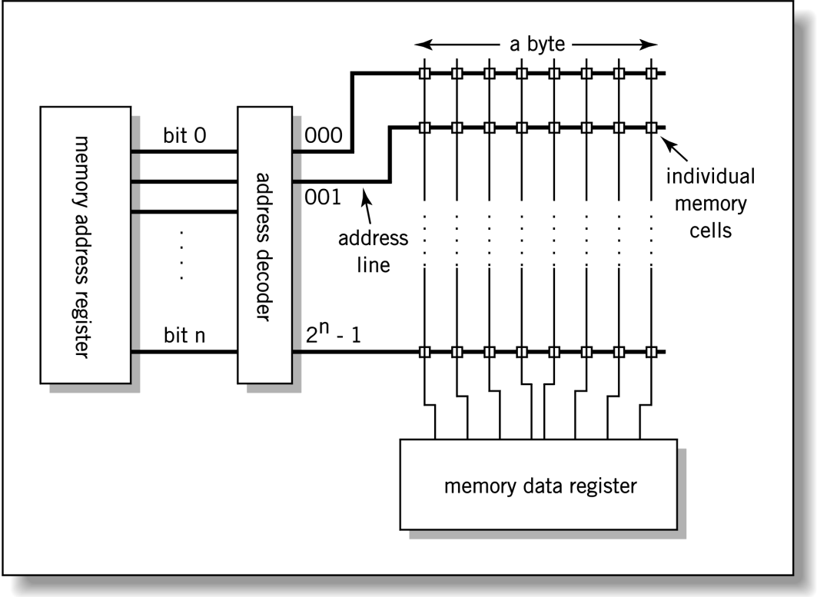
Investigation
Digital Forensics – Hardware/Embedded Device Analysis
Hardware/embedded device analysis is most challenging and requires:
  Deep knowledge of how computer works (i.e., von Neuman computer architecture, memory registry, IO drivers.)
  Requires deep knowledge of assembly language and assembler.
  Typically “platform-specific, system-on-chip”: Intel x86, AMD, ARM, Intel Atom, etc.
  ICS/SCADA are mostly “purpose-build” platforms using proprietary architecture.

Slide 49





Investigation
Digital Forensic Analysis @ MITRE
Xeno Kovah (G029) & friends have
several training courses on digital forensics:
Online at http://opensecuritytraining.info/Welcome.html
    Introductory & Intermediate Intel x86: Architecture, Assembly, Applications, and Alteration
    The Life of Binaries
    Malware Dynamic Analysis
    Introduction to Network Forensics
    Android Forensics & Security Testing
    Rootkits: What they are, and how to find them
    Reverse Engineering Malware
MITRE Institute:
    TSV108: Introduction to Computer Forensics:
    Hard Disk Media Analysis (Rick Murad [G027])
    TSV049: Identifying, Obfuscated and Forensic
    Techniques for Web User Identification
    (Zak Zebrowsk [G122])

Slide 50
Investigations
Incident Response – CSIRT
Computer Security Incident Response Team (CSIRT) a.k.a.:
  Computer Emergency Response Team (CERT)
  Security Operations Center (SOC)
CERT® started as a DARPA program in November of 1988, after the Morris worm incident.
  Similar to MITRE, CERT Coordination Center (CERT/CC) is a FFRDC managed by the Software Engineering Institute of Carnegie Mellon University (CMU/SEI)
  Areas of Work:
    Software Assurance
    Secure Systems
    Organizational Security
    Coordinated Response (e.g., CSIRTs)
    Education and Training
Reference: http://www.cert.org/meet_cert

Slide 51
Investigations
Incident Response – Categories of CSIRT Services
Reference: Handbook for Computer Security Incident Response Teams (CSIRTs), CMU-SEI

Slide 52
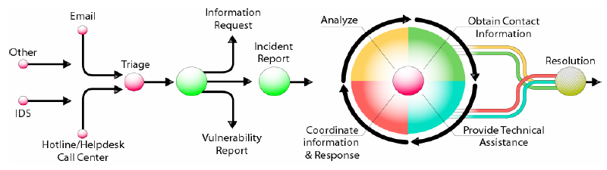
Investigations
Incident Response
Observe event(s) → Identify incident.
Triage:
  Contain damage and Preserve & Collect evidence .
  Document incident and escalate to CSIRT.
CSIRT examine evidence and conduct analysis on incident.
Generate mitigation steps and coordinate response measures.
Reference: Handbook for Computer Security Incident Response Teams (CSIRTs), CMU-SEI

Slide 53
Questions:
What type of evidence is the oral testimony by a witness?
What type of evidence is where it is presented to jury in a form of model, illustration, chart or experiment outcome?
What type of business record is exempt from the hearsay rule?

Slide 54
Answers:
What type of evidence is the oral testimony by a witness?
  Direct
What type of evidence is where it is presented to jury in a form of model, illustration, chart or experiment outcome?
  Demonstrative
What type of business record is exempt from the hearsay rule?
  Auto-generated computer data related to regular day-to-day business activities.

Slide 55
Questions:
What is the best practice for preserving electronic evidence?
What are the three criteria of an admissible evidence?

Slide 56
Answers:
What is the best practice for preserving electronic evidence?
  Bit-for-bit copy with an associated digest.
What are the three criteria of an admissible evidence?
  Relevancy
  Reliability
  Durability

Slide 57
Topics
Legal, Regulations, Compliance and Investigations Domain
Laws & Regulatory Compliance
Investigations & Digital Forensics
Ethics

Slide 58
Concept
Ethics vs. Law
Ethics is “Should”,
Law is “Must”.

Slide 59
RFC 1087, Ethics and the Internet
Internet Activities Board (IAB) characterized the following activities as unethical and unacceptable on the Internet:
  Seeks to gain unauthorized access to the resources of the Internet,
  Disrupts the intended use of the Internet,
  Wastes resources (people, capacity, computer) through such actions,
  Destroys the integrity of computer-based information, and/or
  Compromises the privacy of users.
Notes:
IAB is a part of DARPA

Slide 60
(ISC)² Code of Ethics
Code of Ethics Preamble:
Safety of the commonwealth, duty to our principals, and to each other requires that we adhere, and be seen to adhere, to the highest ethical standards of behavior.
Therefore, strict adherence to this code is condition of certification.
Reference: (ISC)^{2®} Code of Ethics

Slide 61
(ISC)² Code of Ethics
Code of Ethics Canons:
Protect society, the commonwealth, and the infrastructure.
Act honorably, honestly, justly, responsibly, and legally.
Provide diligent and competent service to principals.
Advance and protect the profession.

Slide 62
(ISC)² Code of Ethics – Canons
Protect society, the commonwealth, and the infrastructure.
Promote and preserve public trust and confidence in information and systems.
Promote the understanding and acceptance of prudent information security measures.
Preserve and strengthen the integrity of the public infrastructure.
Discourage unsafe practice.
Reference: (ISC)^{2®} Code of Ethics

Slide 63
(ISC)² Code of Ethics – Canons
Act honorably, honestly, justly, responsibly, and legally.
Tell the truth; make all stakeholders aware of your actions on a timely basis.
Observe all contracts and agreements, express or implied.
Treat all constituents fairly. In resolving conflicts, consider public safety and duties to principals, individuals, and the profession in that order.
Given prudent advice; avoid raising unnecessary alarm or giving unwarranted comfort. Take care to be truthful, objective, cautious, and within your competence.
When resolving differing laws in different jurisdictions, give preference to the laws of the jurisdiction in which you render your service.
Reference: (ISC)^{2®} Code of Ethics

Slide 64
(ISC)² Code of Ethics – Canons
Provide diligent and competent service to principals.
Preserve the value of their systems, applications, and information.
Respect their trust and the privileges that they grant you.
Avoid conflicts of interest or the appearance thereof.
Render only those services for which you are fully competent and qualified.
Reference: (ISC)^{2®} Code of Ethics

Slide 65
(ISC)² Code of Ethics – Canons
Advance and protect the profession.
Sponsor for professional advancement those best qualified. All other things equal, prefer those who are certified and who adhere to these cannons. Avoid professional association with those whose practices or reputation might diminish the profession.
Take care not to injure the reputation of other professionals through malice or indifference.
Maintain your competence; keep your skills and knowledge current. Give generously of your time and knowledge in training others.
Reference: (ISC)^{2®} Code of Ethics

Slide 66
Ethics Plan of Action
Develop a corporate guide to computer ethics for the organization
Develop a computer ethics policy to supplement the computer security policy
Add information about computer ethics to the employee handbook.
Find out whether the organization has a business ethics policy, and expand it to include computer ethics.
Learn more about computer ethics and spread what is learned.
Reference: Official (ISC)^{2®} Guide to the CISSP® Exam

