Slide 1
CISSP® Common Body of Knowledge:
Operations Security Domain
Version: 5.9.2

Slide 2
Learning Objective
Operations Security Domain
Security Operations domain is used to identify critical information and the execution of selected measures that eliminate or reduce adversary exploitation of critical information. It includes the definition of the controls over hardware, media, and the operators with access privileges to any of these resources. Auditing and monitoring are the mechanisms, tools and facilities that permit the identification of security events and subsequent actions to identify the key elements and report the pertinent information to the appropriate individual, group, or process.
The candidate is expected to know the resources that must be protected, the privileges that must be restricted, the control mechanisms available, the potential for abuse of access, the appropriate controls, and the principles of good practice.
Reference: CISSP CIB, January 2012 (Rev. 5)

Slide 3
Topics
Operations Security Domain
Concept & Definition
Identification of Resource Protection Needs
Threats to Information Operations
Security Controls & Countermeasures

Slide 4
Concept & Definition
CISSP “Operations Security”
CISSP Operations Security Domain focuses on information security operations.
CISSP operations security objectives are:
  Reduce the operational vulnerability and threats to confidentiality, integrity and availability.
  Protect organization’s computing resources and information assets.
  Balance:
    Ease-of-use and system controls;
    Value of data and business/mission needs.
  Compliance with laws, regulations and organizational policies.

Slide 5
Concept & Definition
Security Best Practices
Need-to-know
  Subjects should only have access to objects that enables them to perform their assigned job functions.
Least privilege
  Subjects should only have sufficient access privilege that allows them to perform their assigned work.
Separation of duties
  No single person should be responsible for approving his/her own work.
Job rotation
  To reduce risk of collusion and to ensure no single point of failure.
Mandatory vacation
  To allow auditors to review records.

Slide 6
Concept & Definition
Categories of Security Controls
Management (Administrative) Controls
  Policies, Standards, Processes, Procedures, & Guidelines.
    Administrative Entities: Executive-Level, Mid.-Level Management.
Operational (and Physical) Controls
  Operational Security (Execution of Policies, Standards & Process, Education & Awareness).
    Service Providers: InfoSec/IA Department, Program Security, Personnel Security, Document Controls (or CM), HR, Finance, etc.
  Physical Security (Facility or Infrastructure Protection)
    Locks, Doors, Walls, Fence, Curtain, etc.
    Service Providers: Facility Security Department, Guards, Dogs.
Technical (Logical) Controls
  Access Controls , Identification & Authentication, Authorization, Confidentiality, Integrity, Availability, Non-Repudiation.
    Service Providers: Enterprise Architect, Security Engineer, CERT, SOC, NOSC, Helpdesk.

Slide 7
Concept & Definition
Types of Security Controls
Directive controls: Often called administrative controls, these are intended to advise employees of the behavior expected of them during their interfaces with or use the organization’s information systems.
Preventive controls: Included in preventive controls are physical, administrative, and technical measures intended to preclude actions violating policy or increasing risk to system resources.
Deterrent controls: Deterrent controls involve the use of warnings of consequences to security violations.
Detective controls: Detective controls involve the use of practices, processes, and tools that identify and possibly react to security violations.
Corrective controls: Corrective controls also involve physical, administrative, and technical measures designed to react to detection of an incident in order to reduce or eliminate the opportunity for the unwanted event to recur.
Recovery controls: Once an incident occurs that results in the compromise of integrity or availability, the implementation of recovery controls is necessary to restore the system or operation to a normal operating state.
Notes:
Ref. 5.3 Security Technology and Tools, Page 340.

Slide 8
Concept & Definition
Due Care vs. Due Diligence
Due Care:
  Policies and implemented actions that an organization has taken to minimize risk to its tangible and intangible assets (e.g. information assets, customers, employees, and resources.)
  Example: Installation of anti-virus (AV) system
Due Diligence:
  Continual actions that an organization are doing to protect and minimize risk to its tangible and intangible assets.
  Example: Keeping virus signatures up to date

Slide 9
Questions:
Personnel security policy, procedure, and guidelines are what type of operational security control?
Communicating security policy, conducting annual security awareness training, and exercise business continuity planning (BCP) are what type of operational security control?
Performing periodic background re-investigation is what type of operational security control?

Slide 10
Answers:
Personnel security policy, procedure, and guidelines are what type of operational security control?
  Directive (or Administrative)
Communicating security policy, conducting annual security awareness training, and exercise business continuity planning (BCP) are what type of operational security control?
  Preventive
Performing periodic background re-investigation is what type of operational security control?
  Detective

Slide 11
Topics
Operations Security Domain
Concept & Definition
Identification of Resource Protection Needs
Threats to Information Operations
Security Controls & Countermeasures

Slide 12
Identification of Resource Protection Needs
Information is an organizational asset
  Information classification
    Identify information assets
    Identify IT assets that store, process, and transmit data
    Define protection level
  Define security objectives
    Confidentiality, integrity, and availability (i.e., FIPS 199)
Protection of information assets is a “system” that consists of:
  People (i.e., management and operational controls)
  Process (i.e., management and operational controls)
  Technology (i.e., technical controls)

Slide 13
Identification of Resource Protection Needs
Protection of Information ...(1/2)
Level of protection is determined by sensitivity of information assets
Classification of information catalogs the sensitivity of information assets
Commercial
Public
Private / Sensitive
Confidential / Proprietary
Military and Civil Gov.
Unclassified
Controlled Unclassified Information (CUI)
Confidential
Secret
Top Secret

Slide 14
Identification of Resource Protection Needs
Protection of Information ...(2/2)
Operations must understand the relationships between policy, instruction, and guideline. Ex.:
  E.O. 13526, E.O. 13556 (Whitehouse)
  DoD 5200.01-M, Information Security Program (DoD Manual)
  NIST SP 800-59, Guideline for Identifying an Information System as a National Security System (NIST guideline for civilian agencies)
  NIST SP 800-60, Guide for Mapping
  Types of Information and Information
  Systems to Security Categories,
  Vol. 1: Guide.

Slide 15
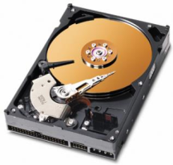

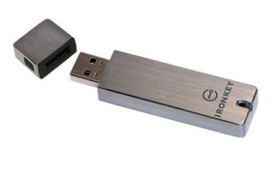
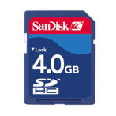

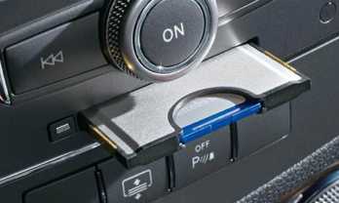
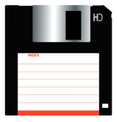

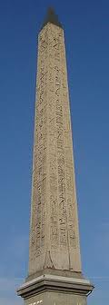
Identification of Resource Protection Needs
Example: Protection of Media
Most, if not all data storage media (include paper document) are “mobile”, except...
Protection includes:
  Marking & labeling of media
  Handling of media
    Transport
    Access
    Integrity of media

Slide 16
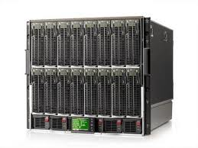
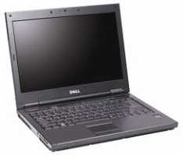
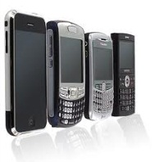


Identification of Resource Protection Needs
Example: Protection of IT Assets
Similar to data storage media, operations also deals with protection of IT assets (computing, network, and mobile platforms)
Protection includes:
  Asset inventory management (know what you have)
    Hardware, software, and virtual machine configuration items (HWCIs, SWCIs, and VMCIs)
  Configuration management (know how they are configured)
    80-90% of known vulnerabilities can be attributed to misconfigurations and missing patches
  Incident management

Slide 17
Topics
Operations Security Domain
Concept & Definition
Identification of Resource Protection Needs
Threats to Information Operations
Security Controls & Countermeasures

Slide 18
Threats to Information Operations
Threat Agents …(1/5)
Threat sources varies, but “insider” and business partners are a great concern …
  In 2008, CSO Magazine reported:
  In 2009, Verizon Data Breach Investigation Report:
Source of Incidents | 2007 | 2008
Unknown | N/A | 42%
Employees | 48% | 34%
Hackers | 41% | 28%
Former employees | 21% | 16%
Business partner | 19% | 15%
Customer | 9% | 8%
Other | 20% | 8%
Terrorist/ foreign government | 6% | 4%
Source of Data Breach Incidents | 2008 | 2009
External threat sources | 73% | 74%
Insiders | 18% | 20%
Business partner | 39% | 32%
Involved multiple parties | 30% | 39%
Reference:
The Global State of Information Security 2008. CSO Online.
Verizon 2009 Data Breach Investigations Report

Slide 19
Threats to Information Operations
Threat Agents …(2/5)
In 2009, a CERT/SEI CyLab study found that:
  68% of the insider attack occurred at the workplace
  73% of crimes were committed during working hours
  Over 3/4 of the insider had authorized access to information assets
  None of the insider had privileged access
  20% involved in theft of physical properties (e.g., document, laptops, PCs, removable media, etc.)
Reference:
Insider Theft of Intellectual Property for Business Advantage: A Preliminary Model. CERT Program, Software Engineering Institute and CyLab at Carnegie Mellon University, June 2009

Slide 20
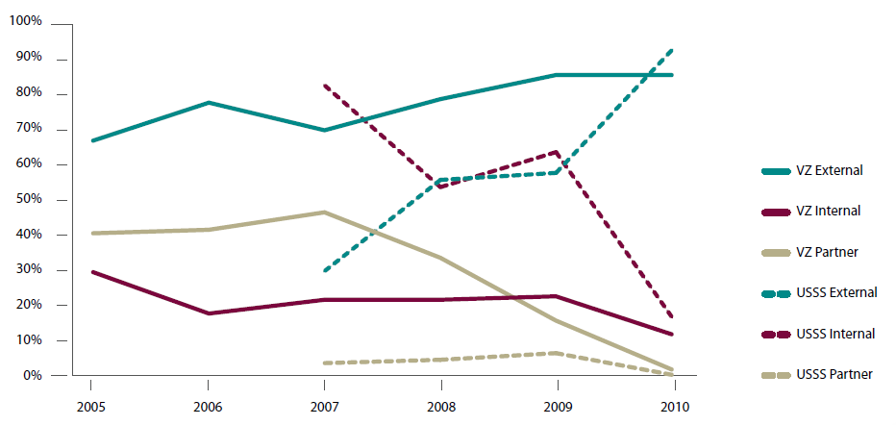
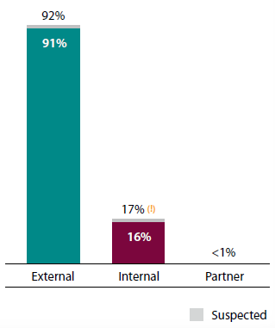
Threats to Information Operations
Threat Agents …(3/5)
Operations are getting better at addressing insider threats
        VZ (Verizon)
        USSS (United States Secret Service)
Most of threats are from external threat
agents
Reference: 2011 Data Breach Investigations Report, Verizon, January 2012 (http://www.verizonbusiness.com/resources/reports/rp_data-breach-investigations-report-2011_en_xg.pdf)

Slide 21
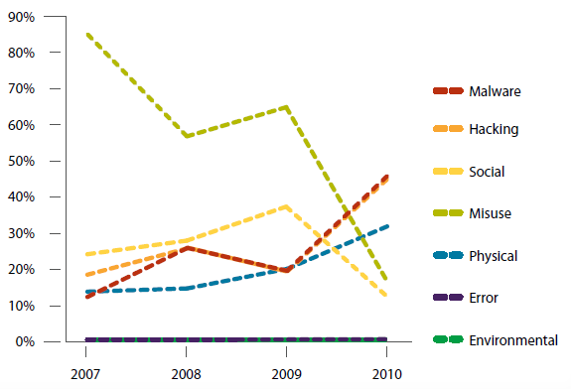
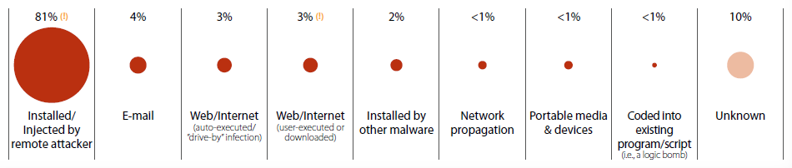
Threats to Information Operations
Threat Agents …(4/5)
Most of data breaches are from hacking and malware...
Majority of malware are installed remotely...
Reference: 2011 Data Breach Investigations Report, Verizon, January 2012 (http://www.verizonbusiness.com/resources/reports/rp_data-breach-investigations-report-2011_en_xg.pdf)

Slide 22
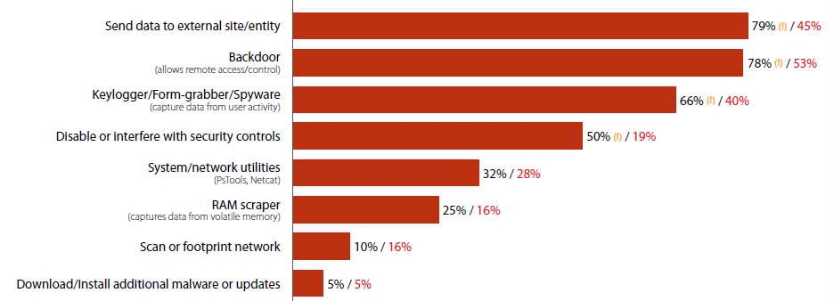
Threats to Information Operations
Threat Agents …(5/5)
Advanced Persistent Threat (APT) is very real
  Malware is now a tool for hackers
  They are stealing data...
Reference: 2011 Data Breach Investigations Report, Verizon, January 2012 (http://www.verizonbusiness.com/resources/reports/rp_data-breach-investigations-report-2011_en_xg.pdf)

Slide 23
Threats to Information Operations
Types of Threats …(1/2)
Theft / unauthorized configuration change
  Lost of information assets or computing equipment
Corruption / unauthorized modification
  Unauthorized changes to file permissions, data, or system configuration (software, hardware or firmware).
Unauthorized disclosure
  Release of information to unauthorized subject(s).
  Insider threats, where subjects with privileged access can compromise “need-to-know”.

Slide 24
Threats to Information Operations
Types of Threats …(2/2)
Unauthorized destruction
  Obliteration of information assets (e.g. deletion of data files, modification of log files) or destruction of computing equipment.
Service interruption / denial-of-services
  Personnel with privileged access may accidentally or intentionally disable or disconnect computing/networking equipment.

Slide 25
Topics
Operations Security Domain
Concept & Definition
Identification of Resource Protection Needs
Threats to Information Operations
Security Controls & Countermeasures

Slide 26
Security Controls & Countermeasures
Security Controls – Federal Information Systems
CLASS | FAMILY | IDENTIFIER
Management | Risk Assessment | RA
 | Planning | PL
 | System and Services Acquisition | SA
 | Certification, Accreditation, and Security Assessment | CA
 | Program Management | PM
Operational | Personnel Security | PS
 | Physical and Environmental Protection | PE
 | Contingency Planning | CP
 | Configuration Management | CM
 | Maintenance | MA
 | System and Information Integrity | SI
 | Media Protection | MP
 | Incident Response | IR
 | Awareness and Training | AT
Technical | Identification and Authentication | IA
 | Access Control | AC
 | Audit and Accountability | AU
 | System and Communications Protection | SC
Reference: NIST SP800-53, Rev.3, Recommended Security Controls for Federal Information Systems

Slide 27
Security Controls & Countermeasures
Security Controls – Commercial Information Systems
ISO/IEC 27001:2005, Information Technology – Security Techniques – Security Management System – Requirements
CONTROL CATEGORIES | SUB-CATEGORY OF CONTROLS
Security Policy | Information security policy
Organization of Information Security | Internal organization; External parties
Asset Management | Responsibility for assets; Information classification
Human Resource Security | Prior to employment; During employment; Termination or change of employment
Physical and Environmental Security | Secure areas; Equipment security
Communications and Operations Management | Operational procedures and responsibilities; Third party service delivery management; System planning and acceptance; Protection against malicious and mobile code; Back-up; Network security management; Media handling; Exchange of information; Electronic commerce services; Monitoring
Access Control | Business requirement for access control; User access management; User responsibilities; Network access control; Operating system access control; Application and information access control; Mobile computing and teleworking
Information Systems Acquisition, Development, and Maintenance | Security requirements of information systems; Correct processing in applications; Cryptographic controls; Security of system files; Security in development and support processes; Technical vulnerability management
Information Security Incident Management | Reporting information security events and weaknesses; Management of information security incidents and improvements
Business Continuity Management | Information security aspects of business continuity management
Compliance | Compliance with legal requirements; Compliance with security policies and standards, and technical compliance; Information system audit considerations

Slide 28
Security Controls & Countermeasures
Example Directive Controls for Operations – DoD
DoDD 5200.1, DoD Information Security defines the roles and responsibilities of operational organizations.
DoD 5200.1-M, Information Security Program prescribes rules for implementation operations security within DoD.
DoDD O-8530.1, Computer Network Defense (CND) defines the roles and responsibilities of DoD operational organizations for conducting CND.
DoDI O-8530.2, Support to Computer Network Defense (CND) defines the operational process for conducting CND.
DoDD 5200.2, DoD Personnel Security defines the personnel security program for DoD.

Slide 29
Security Controls & Countermeasures
Controls for Personnel Security
Directive controls:
  Define personnel security policy and procedures.
  Define job functions (roles) and responsibilities (e.g. position categorization).
Preventive controls:
  Personnel screenings.
    Background investigations, adjudications, and
    User authorization and user agreements (e.g. NDA, Rules of Behavior).
  Personnel transfer procedure to review roles & responsibilities.
  Personnel termination procedure (e.g. Exit interview).
Detective controls:
  Periodic re-investigations.
Corrective controls:
  Personnel sanctions.

Slide 30
Security Controls & Countermeasures
Controls for Configuration Management
Directive controls:
  Configuration management policy and
  procedures,
  Define configuration change control procedure.
Preventive controls:
  Baseline configuration (before change),
  Test change (in test environment), and
  Access restrictions for change (for trusted distribution).
Detective controls:
  Verify and validate change, and
  Monitor configuration changes.
Recovery controls:
  Baseline configuration (after change), and
  Trusted recovery.

Slide 31
Security Controls & Countermeasures
Contingency Planning …(1/2)
Directive controls:
  Contingency planning policy and procedures.
Preventive controls
  Contingency planning
    Address roles, responsibilities and define “chain-of-command”/reporting structure.
    Align objectives with Business Continuity Planning (BCP), using Business Impact Assessment (BIA).
    Coordinate planning with disaster recovery, COOP and incident response.
  Contingency training
    Cross-functional training on various roles. (Job rotation)
  Perform information system backups (level 0: full, partial, and incremental).

Slide 32
Security Controls & Countermeasures
Contingency Planning …(2/2)
Detective controls
  Contingency plan testing
    Walkthroughs (tabletop exercise), checklist, simulation, or full interruption test.
Corrective controls:
  Perform contingency plan update to ensure alignment with business objectives and configuration change.
Recovery controls:
  Information system recovery and reconstruction.
    Perform trusted recovery,
    Retrieve backups from storage sites (primary, alternate),
    Alternate processing sites, and
    Restore or enable alternate telecommunication services.

Slide 33
Security Controls & Countermeasures
Contingency Planning – Categories of Recovery Actions
Soft reboot (a.k.a. warm reboot). Restarting a system after shutting it down in a controlled manner.
Random reboot (a.k.a. panic reboot, emergency system restart). Unintended reboot of a system after it fails in an uncontrolled manner in response to a security kernel or media failure.
Hard reboot (a.k.a. cold start). When power to a computer is cycled. This is performed when unexpected security kernel or media failure occurs and the automated recovery procedures cannot bring the system back to a consistent state.
Reference: http://en.wikipedia.org/wiki/System_reboot

Slide 34
Security Controls & Countermeasures
Contingency Planning – Types of System Recovery
Manual recovery allows an evaluated product to only provide mechanisms that involve human intervention to return to a secure state.
Automated recovery provides for a least one type of service discontinuity recovery to a secure state without human intervention.
Automated recovery without undue loss provides for automated recovery but strengthens the requirements by disallowing undue loss of protected objects.
Function recovery provides for recovery at the level of particular security functions. It should ensure either successful completion of the security function or rollback to a secure state.

Slide 35
Security Controls & Countermeasures
Contingency Planning – Data Backups …(1/4)
Three types of data backups:
Full volume backup is backup performed on an entire disk volumes of a system(s).
Differential backup is a backup of changes since last full backup, but does not change the archive bit value.
Incremental backup is a backup of changes since last full or incremental backup and sets the archive bit to 0.
Reference: CISSP All-in-One CISSP Exam Guide, 5th Ed, 2010.
Notes:
Online tape vaulting. Data is transported to a tape backup service.
Remote Journaling. The same logging procedure used for a DBMS to create the onsite journal is used to create a second journal at the off-site storage location.
Database Shadowing. The system creates updates to the production system, journals them, and send them to the alternate computer.

Slide 36
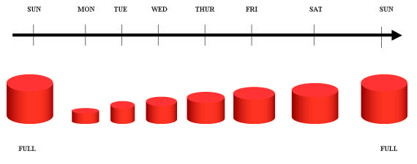
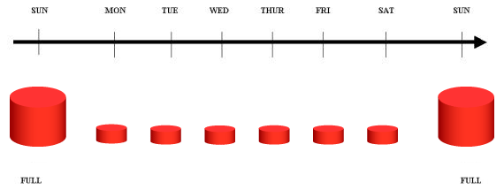
Security Controls & Countermeasures
Contingency Planning – Data Backups …(2/4)
Recovery steps: Full + differential backup.
Recovery steps: Full + sequence incremental backups
Reference: http://www.ibm.com/developerworks/data/library/techarticle/dm-0407tham/index.html
Notes:
Full
Differential
Incremental

Slide 37
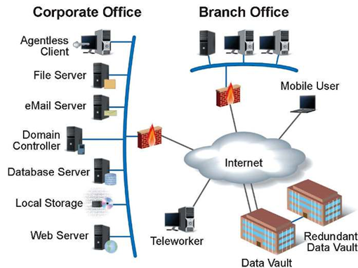
Security Controls & Countermeasures
Contingency Planning – Data Backups …(3/4)
Three types of electronic vaulting:
  Online tape vaulting: Data is transported through a trusted communications channel to a tape backup service.
  Remote transaction journaling: Journal of transactions are created in the primary system and sent to the secondary system.
Reference: CISSP All-in-One CISSP Exam Guide, 5th Ed, 2010.
Notes:
Online tape vaulting. Data is transported to a tape backup service.
Remote Journaling. The same logging procedure used for a DBMS to create the onsite journal is used to create a second journal at the off-site storage location.
Database Shadowing. The system creates updates to the production system, journals them, and send them to the alternate computer.

Slide 38
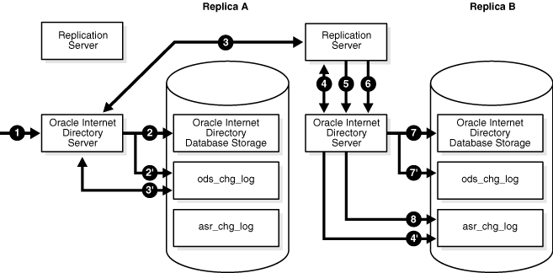
Security Controls & Countermeasures
Contingency Planning – Data Backups …(4/4)
Three types of electronic vaulting:
  Database shadowing (a.k.a. database replication): System updates the primary data volume, journals them, then send them to the secondary system.
Source: http://download.oracle.com/docs/cd/E12839_01/oid.1111/e10029/oid_replic_arch.htm
Notes:
Online tape vaulting. Data is transported to a tape backup service.
Remote Journaling. The same logging procedure used for a DBMS to create the onsite journal is used to create a second journal at the off-site storage location.
Database Shadowing. The system creates updates to the production system, journals them, and send them to the alternate computer.

Slide 39
Security Controls & Countermeasures
Controls for Maintenance …(1/2)
Directive controls:
  System maintenance policy and procedures.
Preventive controls:
  Periodic maintenance
    Keep inventory records for baseline configuration so organization may schedule and perform preventive or regular maintenance.
    Keep maintenance records of each system component.
  Utilize maintenance tools to:
    Monitor & track inventory & maintenance records
    Monitor & track service level and mean time between failure (MTBF) of system or components.
    Use workflow tools to facilitate change control and CM tools to track baseline.

Slide 40
Security Controls & Countermeasures
Controls for Maintenance …(2/2)
Preventive controls:
  Remote maintenance
    Ensure remote maintenance is performed under monitor & control, and it is executed in accordance to change control process.
  Maintenance personnel
    Ensure only authorized personnel can access systems
    Use “least privilege” principle when assign access levels to a specific role.
    Keep track of authorized 3rd party maintenance personnel and document actions performed.
  Ensure timely maintenance
    Define & monitor service level agreements (SLAs)
    Keep or arrange supply chain of spare parts for mission critical components.

Slide 41
Questions:
What is the difference between due care and due diligence?
Estimate for the lifespan of a computing equipment is?
Estimate for the amount of time to repair a computing equipment is?

Slide 42
Answers:
What is the difference between due care and due diligence?
  Due care is actions taken
  Due diligence is continual actions
Estimate for the lifespan of a computing equipment is?
  Mean Time Between failures (MTBF)
Estimate for the amount of time to repair a computing equipment is?
  Mean Time To Repair (MTTR)

Slide 43
Questions:
Recovery that involves human intervention to return a system back to a secure state is called?
Automated system recovery without undue loss is called?
What are the three types of data backup?

Slide 44
Answers:
Recovery that involves human intervention to return a system back to a secure state is called?
  Manual recovery
Automated system recovery without undue loss is called?
  Automated recovery without undue loss
What are the three types of data backup?
  Full volume backup
  Differential backup
  Incremental backup

Slide 45
Security Controls & Countermeasures
Controls for System and Information Integrity…(1/2)
Directive controls:
  System and information integrity policy and procedures.
    Define users (non-privilege & privilege) rules of behavior
    Define systems rules of behavior
Preventive controls:
  “Harden” systems
  Malicious code protection: periodic update of anti-virus signatures
  Intrusion prevention tools & techniques (IPS, file integrity tools)
  Issuance of security alerts and advisories (situation awareness)
  Information records handling and retention
    CM system baseline (i.e. hardware configuration items (CI’s) & software CIs)
    System log retention

Slide 46
Security Controls & Countermeasures
Controls for System and Information Integrity…(2/2)
Detective controls:
  Intrusion detection tools & techniques.
  Monitor system changes.
  Monitor user access (non-privilege & privilege).
  Security functionality verification
    Security audits for compliance.
    Periodic security assessments (to identify potential vulnerabilities & mitigate potential exposure).
Corrective controls:
  Practice change control for change management.
  Limit access to CM library of baseline configuration.
Recovery controls:
  Perform trusted recovery.
  Obtain baseline from CM.

Slide 47
Security Controls & Countermeasures
Controls for System and Information Integrity – Redundant Array of Inexpensive Disks (RAID)
RAID Level Descriptions
RAID Level | Description
0 | Striping. Stripes data across all disks.
1 | Mirroring. Mirroring data from one disk to another (i.e. hot spare).
2 | Hamming code parity. Bit-interleaves data across multiple disks with error correcting code (ECC) created using a Hamming code.
3 | Byte level parity. Stripes data across multiple drives & write parity to a dedicated drive.
4 | Block level parity. Stripes data across multiple drives & write parity to a dedicated drive.
5 | Interleaved parity. Stripes data & parity information at block level.
6 | Second parity data (or double parity). A second set of parity data written on all drives
10 | Striping and mirroring. Data are simultaneously mirrored and striped (RAID 0+1) across several drives and can support multiple drive failures
Reference: CISSP All-in-One Exam Guide, 5th Edition, by S. Harris

Slide 48
Security Controls & Countermeasures
Media Protection
Directive controls:
  Media protection policy and procedures.
  Define information classifications (i.e. unclassified, confidential, secret, top secret, or SCI).
Preventive controls:
  Media labeling.
  Limit media access in accordance to “need-to-know”, and “least privilege” principles.
  Define media storage: encryption, location, environment (on-site, off-site), storage period.
  Define media transport procedure (i.e. handling of FOUO, Classified information: SCI, NOFORN).
  Media sanitization (Not delete, but overwrite or degauss).
  Media destruction and disposal.

Slide 49
Security Controls & Countermeasures
Incident Response …(1/2)
Directive controls:
  Incident response policy and procedures.
  Create a Computer Security Incident Response Team (CSIRT/CIRT/CERT).
  Define levels of security response measures to maintain security posture. (e.g. INFOCON).
Preventive controls:
  Incident response training
    Know the incident response process, procedure, and standard response measures (Tier 1: Operator, call center; Tier 2: Helpdesk, NOC, SOC; Tier 3: CSIRT, system engineers).
    Professional training & education: technical, interpersonal, and managerial skills.
  Incident response testing
    Practice change control process, follow CM policy.

Slide 50
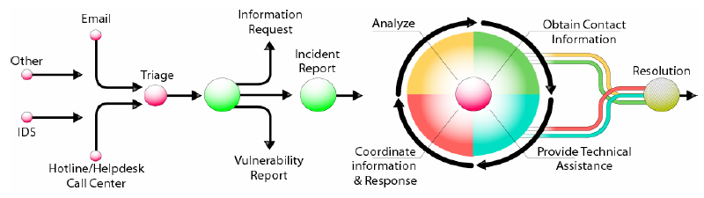
Security Controls & Countermeasures
Incident Response …(2/2)
Detective controls:
  Incident monitoring
    Define event severity, associate & correlate syslogs, event logs, access logs, firewall, IDS, anti-virus system logs.
    Document events and security incidents. Preserve evidence.
Corrective controls:
  Incident handling.
  Incident reporting.
  Incident response assistance.
Reference: Handbook for Computer Security Incident Response Teams (CSIRTs), CMU-SEI

Slide 51
Security Controls & Countermeasures
Incident Response – Life Cycle ...(1/3)
Preparation
  Concept of operations
  Service functions and definitions
  Processes and procedures
  Organizations & personnel
  Technology and communications Infrastructure
Detection
  Detection systems (detection of security events)
  Monitoring systems (monitoring of security controls)
  Reporting systems (incidents)
Reference: Incident Response: A Strategic Guide to Handling System and Network Security Breaches, E. Schultz, R Shumway, New Riders, 2002

Slide 52
Security Controls & Countermeasures
Incident Response – Life Cycle ...(2/3)
Containment
  Containment strategy
  Logics in containment (condition-based response level, ex. INFOCON)
  Processes & procedures (coordinated response)
Eradication
  Analyze the problem (investigation, assess impact & severity)
  Mitigate the problem (remediate, test, and document procedure)
  Communicate “change” and “clean-up”
Reference: Incident Response: A Strategic Guide to Handling System and Network Security Breaches, E. Schultz, R Shumway, New Riders, 2002

Slide 53
Security Controls & Countermeasures
Incident Response – Life Cycle ...(3/3)
Recovery (SOC is not a bunch of “cyber janitors”)
  Coordinate & perform recovery processes (technology, data, and business) (See BCP/DRP domain)
  Conduct audits and security tests
  Return to normal operations
Follow-up
  Conduct analysis to prevent repeat incident (i.e., lessons-learned)
  Propose countermeasures and preventive measures
  Plan and implement countermeasures
Reference: Incident Response: A Strategic Guide to Handling System and Network Security Breaches, E. Schultz, R Shumway, New Riders, 2002

Slide 54
Security Controls & Countermeasures
Incident Response – Organizational Structure
“Form follows function”
  Organizational structure of an effective computer (/cyber) security incident response team (CSIRT) should always follow mission needs
  Examples CSIRT organizational model:
    Central (for highly integrated organization)
    Distributed (for hierarchical, large enterprise), or
    Coordinated (for multiple, federated, autonomous enterprises)
Functions, activities, and tasks
  Function is organized based on activities and tasks:
    Triage (helpdesk, call centers) (Tier 1)
    Investigation and containment (Tier 2)
    Analysis and eradication (Tier 3)
    Recovery, engineering of countermeasures, testing
    Follow-up, planning, and prevention
Reference: Incident Response: A Strategic Guide to Handling System and Network Security Breaches, E. Schultz, R Shumway, New Riders, 2002

Slide 55
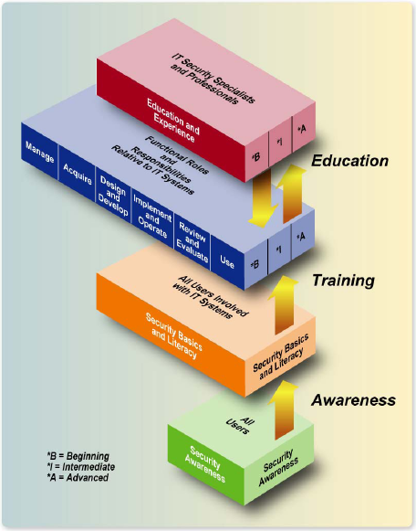
Security Controls & Countermeasures
Awareness and Training… (1/2)
Directive controls:
  Security awareness and training policy and procedures.
  Define training needs in accordance with roles & responsibilities.
  Professionalize discipline by certification.
Preventive controls:
  Security awareness (All users).
  Security training (based on roles & responsibilities).
Corrective controls:
  Keep track of security training
  records to ensure quality of workforce.
Reference: NIST SP800-50, Building an IT Security Awareness and Training Program

Slide 56
Security Controls & Countermeasures
Awareness and Training… (2/2)
NIST SP 800-50 defined three components to an IT information security training program:
  Security awareness trainings are designed to:
    Communicate management’s goals and expectation for the protection of organization’s information assets.
    Review the rule of behavior for securing information assets.
  Role-based security trainings are designed to:
    Provide specific job skills for a specific job function.
  Security education is to:
    provide personnel with knowledge specialize in information security.

Slide 57
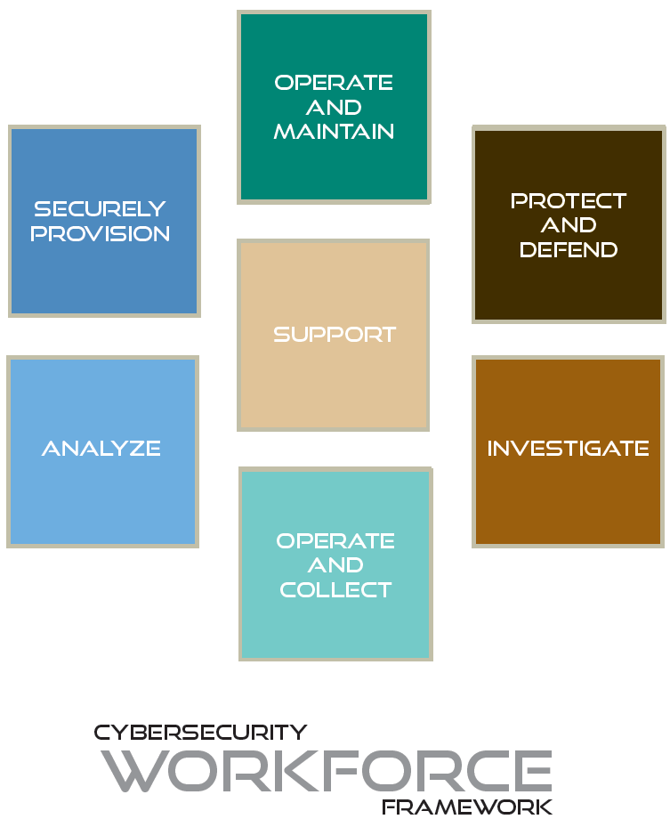
Security Controls & Countermeasures
Security Training and Education – the National Initiative for Cybersecurity Education (NICE) ...(1/2)
NICE is a part of Comprehensive National Cybersecurity Initiative (CNCI) where government and industry collaborated to create a training & educational framework for cybersecurity workforce.
Reference: http://csrc.nist.gov/nice/

Slide 58
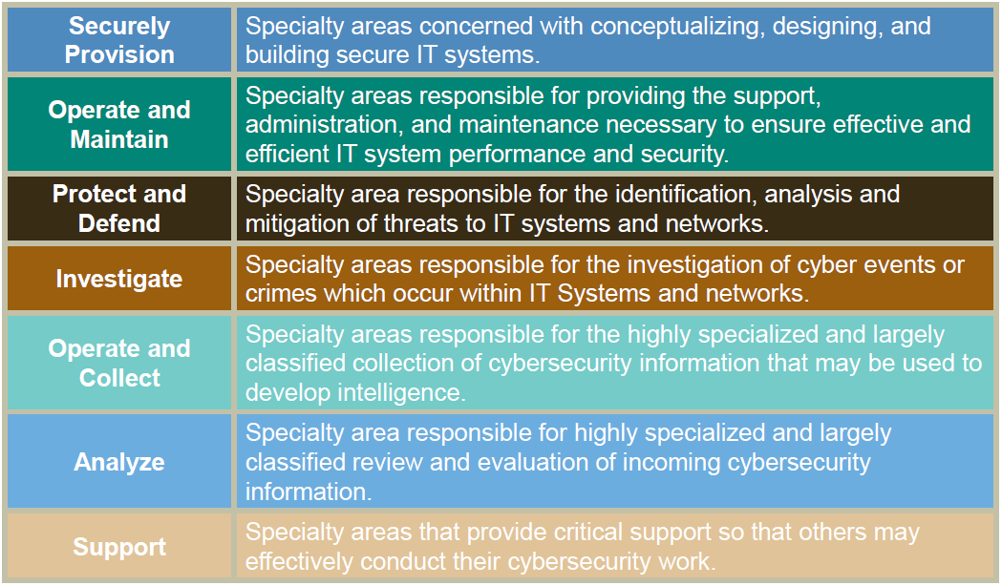
Security Controls & Countermeasures
Security Training and Education – the National Initiative for Cybersecurity Education (NICE) ...(2/2)
Reference: http://csrc.nist.gov/nice/

Slide 59
Questions:
What type of security control is intrusion detection?
Trainings that communicate management goals and expectations for protection of information assets are?
Trainings that enables an employee to perform his/her assigned security responsibilities are?

Slide 60
Answers:
What type of security control is intrusion detection?
  Detection control
Trainings that communicate management goals and expectations for protection of information assets are?
  Security awareness trainings
Trainings that enables an employee to perform his/her assigned security responsibilities are?
  Role-based security trainings

Slide 61
Background Study

Slide 62
Case Study 1: Effectiveness of Annual Security Awareness Training
In 2007, TIGTA conducted an audit on the effectiveness of IRS Annual Security Awareness Training – UNAX…
Attack Method: Social Engineer
  Auditor posed as IT helpdesk personnel seeking assistance to correct a network problem.
  Users where requested to change their passwords to the ones TIGTA auditor had suggested.
Result:
  60% IRS employees had bought-in on the social engineering attack and changed their passwords
  20% IRS employees cited awareness training as the primary reason for not buy-in on the social engineering attack
  In 2001, 70% IRS employees had bought-in on the same social engineering attack.

Slide 63
Case Study 1: People forget what they’ve learned
In 1870, Hermann Ebbinghaus pioneered an experimental study – “Forgetting Curve”
  2/3 of student retained the learned knowledge after an hour
  28% remember the specifics in 2 days
However, if the learned knowledge is
re-enforced in the following day,
more students were able to remember
what they’ve learned. – “Spacing Effect”

Slide 64
Case Study 2: Effectiveness of security awareness training re-enforced with “hands-on” exercises
In 2005, United States Military Academy (USMA) at West Point conducted a proof-of-concept on the effectiveness of their security awareness training…
  Per semester, all cadets receive security awareness training
  Every freshman were subjected to a 4-hr. security awareness course
Attack Method: Social Engineering
  A “phishing” e-mail message from a fictitious US Army colonel
  E-mails informed cadets of a problem with their current grade report and instructed them to click on the embedded hyperlink
Results:
  80% (over 400) cadets clicked on the embedded hyperlink
  90% of freshmen –with 4 hrs training- clicked on the link

Slide 65
Case Study 2: How people learn
In 1918, Edward Throndike defined a set of “Learning Principles”
  The most basic form of learning is trial and error learning
  Law of exercise: We learn by doing, we forget by not doing
    Law of use: Connection between a stimulus and a response are strengthened as they are used
    Law of disuse: Connection between a stimulus and a response are weakened as they are not used
  Law of effect: If the response in a connection is followed by a satisfying state of affairs, then the strength of connection is considerably increased. (Positive reinforcement)
West Point considered the study a success…
  Approved for USMA-wide deployment (4,400 Corps of Cadets)
  Added 3 additional variants

Slide 66
Case Study 3: A comparative study between game- and video-based security awareness training
In 2009, Jonathan Jones, et. al. conducted a pilot study comparing the educational effectiveness of:
  Game-based security awareness training – CyberCIEGE
  Video-based DoD IASE Information Assurance Awareness (DoD IAA) Training Course
Study:
  Pre-tests conducted to establish the baseline
  Post-tests conducted 2 weeks after to measure effectiveness of student’s learning
Result:
  The average improvement of “game group” (40%) is higher than the “video group” (33%)
  On average, “game group” had spent much more time (6.15 hr.) than the “video group” (1.75 hr.)

Slide 67
Case Study 3: Repeated learning with positive reinforcement
In 1965, Jean Piaget formalized the learning theory of “Constructivism”
  People learn to learn as they learn: learning consists both of constructing meaning and constructing systems of meaning.
  The crucial action of constructing meaning is mental: it happens in the mind. Physical actions, hands-on experience may be necessary for learning
Learning Principles: Laws of effect.
  Positive feedback is rewarding

Slide 68
Case Study 4: New technology but same operational issues
In early 2010, Cisco Systems published a study on top security issues in 2009.
Top security issue:
  Social networking media that uses Web 2.0 technologies became the new attack vector.
Method: Social Engineering
  Relying on social networkers’ willingness to respond to phishing messages originate from people they know and trust
  Threat vector:
    Twitter message with embedded hyperlink from TinyURL.com (URL redirection service) that leads to malicious websites
    Facebook e-mail messages from a friend with embedded link that leads to malicious websites requests to download malware
    Password reuse between Gmail, Yahoo, Facebook, Twitter, etc.

Slide 69
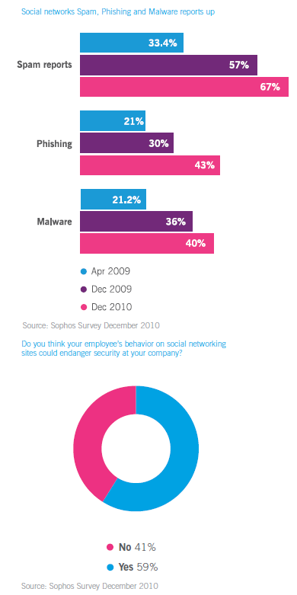
Social Engineering Simply Works …
Social engineering techniques now works even better through social networking services
  Facebook
  Twitter
  LinkedIn
Reference: Sophos Security Threat Report 2011, January 2011

