Slide 1
CISSP® Common Body of Knowledge Review:
Cryptography Domain –
Part 1
Version: 5.9.2

Slide 2
Learning Objective
Cryptography Domain
The Cryptography domain addresses the principles, means, and methods of applying mathematical algorithms and data transformations to information to ensure its integrity, confidentiality, and authentication.
The candidate is expected to know basic concepts within cryptography; public and private key algorithms in terms of their applications and uses; algorithm construction, key distribution and management, and methods of attack; the applications, construction and use of digital signatures to provide authenticity of electronic transactions, and non-repudiation of the parties involved; and the organization and management of the Public Key Infrastructure (PKIs) and digital certification and management.
Reference: CISSP CIB, January 2012 (Rev. 5)

Slide 3
Topics
Cryptography Domain – Part 1
Terms, Definition, Concept & History
Cipher Types
  Classic Ciphers
  Modern Ciphers
Cryptographic Algorithms
  Hash Function Cryptography
  Symmetric Key Cryptography
  Asymmetric Key Cryptography
  Hybrid Cryptography

Slide 4
Topics
Cryptography Domain – Part 2
Utilization of cryptography
  Public Key Infrastructure (PKI)
  HTTP, S-HTTP, IPsec, SSH, SET
  Single Sign-On (SSO)
  Secured E-mail
Types of crypto attacks
  Crypto-analytic Attacks
  Cryptographic Attacks
Discussion on export of crypto technologies

Slide 5
Concept
Security Principles and Cryptography
Objectives of Cryptography:
Confidentiality – unauthorized persons cannot access information.
Integrity – ensures the message remains unmodified.
Cryptography provides:
Confidentiality – Encryption.
Integrity – Hash/Message Digest.
  Authentication – to verify the identity of a subject.
  Non-repudiation – sender can’t deny sending.
Stuff To Look Out For…
Authentication – Is NOT part of the “C.I.A. Triad”.
Notes:
For CISSP Exam – Know the differences between identification, authentication, authorization, and accountability.

Slide 6
Terms & Definition
Cryptograph … (1/3)
Cryptography – the science of secret writing.
Cryptology – the study of cryptography and cryptanalysis.
Cryptosystem – hardware and/or software implementation of cryptography.
Algorithm – a precise rule (or set of rules) specifying how to solve some problem or accomplish a specific task.
Cipher – cryptographic transformation operating with bits or characters.

Slide 7
Terms & Definition
Cryptograph … (2/3)
Plaintext/Cleartext – data in unscrambled form.
Ciphertext/Cryptogram – scrambled data.
Encipher/Encrypt/Encode – act of scrambling using key.
Decipher/Decrypt/Decode – descrambling with key.
Cryptanalysis – the practice of breaking cryptosystems or obtaining plaintext from cipher text without a key.
Work Factor – time, effort, and resources necessary to break a cryptosystem.

Slide 8
Terms & Definition
Cryptograph … (3/3)
Key – For crypto, a secret value in the form of a sequence of characters used to encrypt and decrypt.
Key clustering – instance where two keys generate the same ciphertext from same plaintext.
Keyspace – All possible values used to construct keys. The larger keyspace the better.
Initialization Vector (IV) – In crypto, IV is a block of bits used as the initializing input algorithm for the encryption of a plaintext block sequence.
  IV increases security by introducing additional cryptographic variance and to synchronize cryptographic equipment

Slide 9
Terms & Definition
History of Cryptograph …(1/4)
For CISSP Exam… Read Secrets and Lies – Digital Security in a Networked World by Bruce Schneier, or Codebreaker: The History of Codes and Ciphers, by Stephen Pincock.
1500 BC: A Mesopotamian tablet contains an
enciphered formula for the making of glazes for pottery.
487 BC: The Greek used a device called the scytale/
skytale – a staff around which a long, thin strip of leather
was wrapped and written on.
50-60 BC: Julius Caesar used a simple substitution with
the normal alphabet (just shifting the letters a fixed
amount) in government communications.
1790: Thomas Jefferson invented wheel cipher.
(The order of the disks is the key).
1854: Charles Babbage re-invented the wheel cipher.
Reference: Secrets and Lies – Digital Security in a Networked World, B. Schneier, Wiley Publishing, 2004

Slide 10
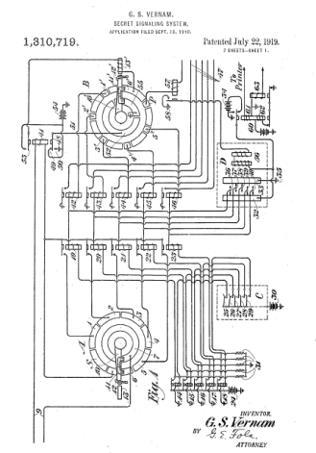
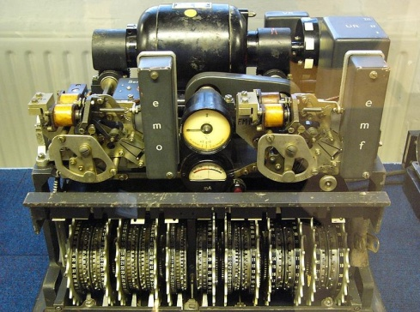
Terms & Definition
History of Cryptograph …(2/4)
1919-1922: Patents issued to Gilbert Vernam
for Vernam cipher.
1930-1941: German military used Lorenz
SZ 40 and SZ 42 cipher machines based on
Vernam stream cipher to encrypt
teleprinter messages.
  Stream cipher using pseudorandom bits to be
  XOR’ed with the plaintext.
1933-1945: German military field units used
Enigma cipher machine to encrypt
messages.
  Electro-mechanical rotor cipher machine uses
  polyalphabetic substitution
Reference: Secrets and Lies – Digital Security in a Networked World, B. Schneier, Wiley Publishing, 2004

Slide 11
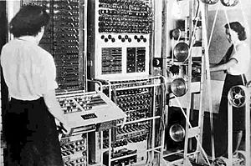
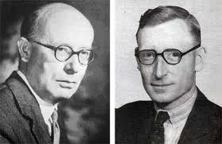
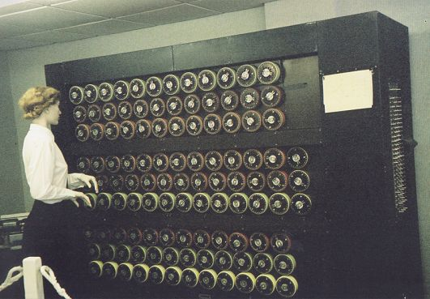

Terms & Definition
History of Cryptograph …(3/4)
1943-1944: British code breakers designed Colossus Mark 1 and Colossus Mark 2 to decrypt Lorenz cipher machine.
  Designed by Max Newman & Tommy Flowers
  Using frequency
  analysis.
1938-1944: British code breakers designed Bombe to decrypt Enigma cipher machine.
  Designed by Alan Turing
  Using frequency analysis
Reference: Bletchley Park National Codes Center (http://www.bletchleypark.org.uk/)

Slide 12
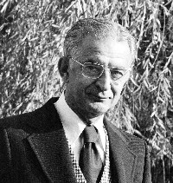

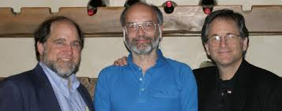
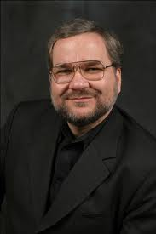
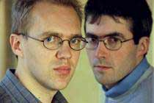
Terms & Definition
History of Cryptograph …(4/4)
1976: NSA chosen IBM’s modified Lucifer cipher to be
the Data Encryption Standard (DES).
1976: Whitfield Diffie & Martin Hellman published
New Directions in Cryptography.
1978: Ronald L. Rivest, Adi Shamir & Leonard M.
Adleman (RSA) published RSA Algorithm for Public
Key System.
1984: ROT13 cipher introduced on UNIX systems, it encrypts cleartext message by shifts letters 13 places.
1991: Phil Zimmermann released first version of PGP
(Pretty Good Privacy).
2000: Joan Daeman and Vincent Rijman’s Rijndael
algorithm was selected by NIST as the Advanced
Encryption Standard (AES).
Reference: Secrets and Lies – Digital Security in a Networked World, B. Schneier, Wiley Publishing, 2004

Slide 13
Terms & Definition
Cryptographic Algorithm & Operation
Cryptographic algorithm – A set of mathematical function and rules that takes plaintext and a key as input, and product ciphertext as output.
Cryptographic operation – Encryption/Decryption
  Encryption – An act to convert plaintext into ciphertext in order to preserve confidentiality of data.
  Decryption – An act to convert ciphertext back to plaintext.

Slide 14
Terms & Definition
Strength of Encryption
The goal of the cryptosystem is to make compromising it too expensive or time consuming to justify the effort.
The strength of the encryption method comes from:
  The algorithm
  Secrecy of the key
  Length of the key
  Initialization vectors (IV)
  And how they all work together (encryption method)
Strength (a.k.a. work factor) refers to how hard it is to figure out the algorithm or a key (whichever is not made public) used in the cryptosystem.
  “Work Factor” is an estimate of the effort it would take an attacker to compromise the encryption method.

Slide 15
Questions:
What is the definition of cryptography?
What is the definition of keyspace?
What is a scytale?
Who first invented wheel cipher?
What is the significance of Diffie-Hellman algorithm?
What is the significance of RSA algorithm?

Slide 16
Answers:
What is the definition of cryptography?
  The science of secret writing.
What is the definition of keyspace?
  All possible values used to construct keys.
What is a scytale?
  A staff which a long, thin strip of leather was wrapped and written on.
Who first invented wheel cipher?
  Thomas Jefferson.
What is the significance of Diffie-Hellman algorithm?
  It enables key-exchange.
What is the significance of RSA algorithm?
  Public key cryptography.

Slide 17
Questions:
Act of converting plaintext into ciphertext is…?
Act of converting ciphertext back to plaintext is…?
Instance where two different keys generate the same ciphertext from a plaintext is…?
The practice of breaking cryptosystems or obtaining plaintext from ciphertext without a key is…?

Slide 18
Answers:
Act of converting plaintext into ciphertext is…?
  Encryption
Act of converting ciphertext back to plaintext is…?
  Decryption
Instance where two different keys generate the same ciphertext from a plaintext is…?
  Key clustering
The practice of breaking cryptosystems or obtaining plaintext from ciphertext without a key is…?
  Cryptanalysis

Slide 19
Topics
Cryptography Domain – Part 1
Terms, Definition, Concept & History
Cipher Types
  Classic Ciphers
  Modern Ciphers
Cryptographic Algorithms
  Hash Function Cryptography
  Symmetric Key Cryptography
  Asymmetric Key Cryptography
  Hybrid Cryptography

Slide 20
Concept
Cipher Types
Classic Ciphers:
Substitution cipher
Transposition cipher
Polyalphabetic (or running key) cipher
Concealment
Modern Ciphers:
Block cipher
Stream cipher
Steganography
Combination: Complexity can be created by use combination above.

Slide 21
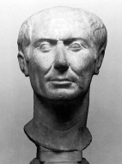
Classic Ciphers
Substitution Cipher
A substitution cipher substitutes one piece of information for another.
  This is most frequently done by offsetting letters of the alphabet. (a.k.a. “shift alphabet”)
Two examples are:
  Caesar cipher
  ROT13 cipher on UNIX
ABCDEFGHIJKLMNOPQRSTUVWXYZ
and sliding everything up by 3, you get
ABCDEFGHIJKLMNOPQRSTUVWXYZABC
so “D = A”, “E = B”, “F = C”, and so on.

Slide 22
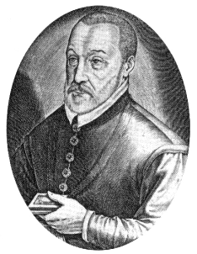
Classic Ciphers
Polyalphabetic (or Running Key) Cipher
The running key cipher is a type of substitution cipher
  Invented by Blaise de Vigenère in 19th century
  The cryptographic algorithm is polyalphabetic
  substitution, where the secret key is repeated
  along the length of plaintext/ciphertext
A | B | C | D | E | F | G | H | I | J | K | L | M | N | O | P | Q | R | S | T | U | V | W | X | Y | Z
B | C | D | E | F | G | H | I | J | K | L | M | N | O | P | Q | R | S | T | U | V | W | X | Y | Z | A
C | D | E | F | G | H | I | J | K | L | M | N | O | P | Q | R | S | T | U | V | W | X | Y | Z | A | B
D | E | F | G | H | I | J | K | L | M | N | O | P | Q | R | S | T | U | V | W | X | Y | Z | A | B | C
E | F | G | H | I | J | K | L | M | N | O | P | Q | R | S | T | U | V | W | X | Y | Z | A | B | C | D
F | G | H | I | J | K | L | M | N | O | P | Q | R | S | T | U | V | W | X | Y | Z | A | B | C | D | E
G | H | I | J | K | L | M | N | O | P | Q | R | S | T | U | V | W | X | Y | Z | A | B | C | D | E | F
H | I | J | K | L | M | N | O | P | Q | R | S | T | U | V | W | X | Y | Z | A | B | C | D | E | F | G
I | J | K | L | M | N | O | P | Q | R | S | T | U | V | W | X | Y | Z | A | B | C | D | E | F | G | H
J | K | L | M | N | O | P | Q | R | S | T | U | V | W | X | Y | Z | A | B | C | D | E | F | G | H | I
K | L | M | N | O | P | Q | R | S | T | U | V | W | X | Y | Z | A | B | C | D | E | F | G | H | I | J
L | M | N | O | P | Q | R | S | T | U | V | W | X | Y | Z | A | B | C | D | E | F | G | H | I | J | K
M | N | O | P | Q | R | S | T | U | V | W | X | Y | Z | A | B | C | D | E | F | G | H | I | J | K | L
N | O | P | Q | R | S | T | U | V | W | X | Y | Z | A | B | C | D | E | F | G | H | I | J | K | L | M
O | P | Q | R | S | T | U | V | W | X | Y | Z | A | B | C | D | E | F | G | H | I | J | K | L | M | N
P | Q | R | S | T | U | V | W | X | Y | Z | A | B | C | D | E | F | G | H | I | J | K | L | M | N | O
Q | R | S | T | U | V | W | X | Y | Z | A | B | C | D | E | F | G | H | I | J | K | L | M | N | O | P
R | S | T | U | V | W | X | Y | Z | A | B | C | D | E | F | G | H | I | J | K | L | M | N | O | P | Q
S | T | U | V | W | X | Y | Z | A | B | C | D | E | F | G | H | I | J | K | L | M | N | O | P | Q | R
T | U | V | W | X | Y | Z | A | B | C | D | E | F | G | H | I | J | K | L | M | N | O | P | Q | R | S
U | V | W | X | Y | Z | A | B | C | D | E | F | G | H | I | J | K | L | M | N | O | P | Q | R | S | T
V | W | X | Y | Z | A | B | C | D | E | F | G | H | I | J | K | L | M | N | O | P | Q | R | S | T | U
W | X | Y | Z | A | B | C | D | E | F | G | H | I | J | K | L | M | N | O | P | Q | R | S | T | U | V
X | Y | Z | A | B | C | D | E | F | G | H | I | J | K | L | M | N | O | P | Q | R | S | T | U | V | W
Y | Z | A | B | C | D | E | F | G | H | I | J | K | L | M | N | O | P | Q | R | S | T | U | V | W | X
Z | A | B | C | D | E | F | G | H | I | J | K | L | M | N | O | P | Q | R | S | T | U | V | W | X | Y
Plaintext: COMPUTING GIVES INSIGHT
Keyword: LUCKYLUCK YLUCK YLUCKYL
Ciphertext: NIOZSECPQ ETPGC GYMKQFE
Source: http://astro.ocis.temple.edu/~dhill001/vigenere/vigenere.html

Slide 23
Classic Ciphers
Transposition Cipher
Instead of replacing the characters with other characters, this cipher simply changes the order of the characters.
The key determines the positions that the characters are moved to
The key for this cipher is not standard.
  Instead of a list of alphabetic substitutions, it is a mapping order.
  Such as (1,2,3,4,5) = (3,4,5,2,1). This means that the third element is put in place of the first, thus followed by the fourth, then the fifth, second, and finally followed by the original first element.
  Example: "WORLD" -> "RLDOW"

Slide 24
Classic Ciphers
Transposition Cipher
Permutations of this cipher run in blocked matrices. This means that the message is spread out into a matrix.
Example: “I LOVE CISSP CBK REVIEW CLASS 2012"
ILOVECI
SSPCBKR
EVIEWCL
ASS2012
ICW2012
LBCLASS
OKREVIE
VECISSP

Slide 25
Classic Ciphers
Concealment Cipher
The concealment cipher hides a message in a longer message i.e. “a message WITHIN a message”
A paragraph is sent to you containing an embedded secret message.
Example:
  The agreed upon secret key is to use every sixth word.
  Selecting every sixth word in the paragraph will decrypt the message
“I have been trying to buy you a nice gift like gold or an antique but prices now are really high.”

Slide 26
Modern Ciphers
Block Cipher
Block Cipher
  Operate on fixed size block of plaintext.
  The encryption algorithm takes a fixed-length block of plaintext and create a block of ciphertext in the same length.
    Usually 8-byte (64-bit)
  Usually implemented in software.
  Generally, Block cipher encryption is slower than Stream cipher encryption.
  Example: DES, Triple DES, AES, IDEA

Slide 27
Modern Ciphers
Stream Cipher
Stream Cipher
  Operate on continuous streams of plaintext.
  Usually implemented in hardware.
  Well suited for serial communications.
  Functional complex, with long key that does not repeat.
  Statistically unpredictable.
  Keystream should NOT be linearly related to key.
  Example: RC4, SEAL, VEST

Slide 28
Modern Ciphers
Steganography
Steganography is a method of hiding data in another media so that the data's very existence is concealed.
  Microdot, very popular in World War II
  Computer files (graphic images, MP3, or video) contain unused or insignificant areas of data… Steganography takes advantage of these areas, replacing them with information.
  The files can then be exchanged without anyone knowing what really lies inside of them.
  Web Bugs – malicious version of Steganography.
  Can be used to insert concealed digital watermarks.
Note: For CISSP Exam… Steganography DOES NOT USE algorithms or keys to encrypt data…it hides data within another object.

Slide 29
Questions:
What are the four types of modern cipher?
What are the four types of classic cipher?

Slide 30
Answers:
What are the four types of modern cipher?
  Block cipher
  Stream cipher
  Steganography
  Combination
What are the four types of classic cipher?
  Substitution
  Transposition
  Polyalphabetic
  Concealment

Slide 31
Topics
Cryptography Domain – Part 1
Terms, Definition, Concept & History
Cipher Types
  Classic Ciphers
  Modern Ciphers
Cryptographic Algorithms
  Hash Function Cryptography
  Symmetric Key Cryptography
  Asymmetric Key Cryptography
  Hybrid Cryptography

Slide 32
Cryptographic Algorithms
Hash Function Cryptography
A hash function takes an input of arbitrary length and outputs a fixed size value – “Hash Value”.
The maximum number of input and output bits is determined by the design of the hash function.
  Pre-image resistance. A good hash function is “one-way”. Original input (message or file) can not be derived from the hash value.
  Collision resistance. Two inputs into a hash function should not produce the same hash value.

Slide 33
Cryptographic Algorithms
Hash Function Cryptography
Cryptographic hash functions are used to provide integrity, authentication and non-repudiation.
  Message digest, if the message or file is used as an input into a cryptographic hash function.
  Message authentication, if a secret key is used along with a message as inputs into a cryptographic hash function.
  Digital signature, if the private key is used as an input, and the output can be verified with the public key.
Cryptographic hash functions are also used as “randomness extractor” for pseudo-random number generators (PRNGs)

Slide 34
Cryptographic Algorithms
Hash Function Cryptography
There are two flavors and a hybrid hash functions:
Non-keyed digest (for integrity)
  Message Integrity Code (MIC).
  Modification Detection Code (MDC).
Keyed digest (for authentication)
  Message Authentication Code (MAC): Secret key + message.
  Keyed-hash MAC or Hashed MAC (HMAC): MAC + MDC.
Digital signature (for non-repudiation)
Popular message digest algorithms:
MD5, RIPE-MD, HAVAL,
FIPS 186-2: SHA-1, SHA-224, SHA-256, SHA-384, SHA-512.
Popular digital signature algorithms:
ElGamal,
FIPS 180-2: DSA, EC-DSA.

Slide 35
Cryptographic Algorithms
Hash Function Cryptography – Non-Keyed Digest
Non-keyed digest is used to provide integrity function. The output fixed-size “hash value” is called:
  Message Digest (MD) in cryptography world.
  Modification Detection Code (MDC-2) patented by IBM.

Slide 36
Cryptographic Algorithms
Hash Function Cryptography – Keyed Digest
Keyed digest is used to provide authentication function. The output fixed-size “hash value” is called:
  Message Authentication Code (MAC): Secret key (symmetric ephemeral key) + message. (a.k.a. Message Integrity Code (MIC) and Keyed-Hash MAC (HMAC).)
Reference: FIPS 198, The Keyed-Hash Message Authentication Code (HMAC), March 6, 2002.

Slide 37
Cryptographic Algorithms
Hash Function Cryptography – Digital Signature
Digital signature (or digital fingerprint) is used to provide non-repudiation function.
Digital signature is a hybrid cryptography that uses non-keyed hash function and asymmetric key-pair (public key & private key).
Reference: FIPS 186-2, Digital Signature Standard (DSS), January 27, 2000.

Slide 38
Cryptographic Algorithms
Hash Function Cryptography – Randomness Extractor
True random number is hard to find, what computing machines generates is “pseudo random”
  The most common pseudo-random number generator (PRNG) uses the linear congruential formula:
X_{n+1} = (aX_{n} +b) mod m
To add “randomness”, the PRNG output is put through a cryptographic hash function, because a good hash function is:
  Pre-image resistance and
  Collision resistance

Slide 39
Questions:
What is a hash function?
What are the difference between non-keyed digest and keyed digest?
  Non-keyed digest is used to provide ? function
  Keyed digest is used to provide ? function
What are the two key criteria of a good hash function?

Slide 40
Answers:
What is a hash function?
  A “one-way” mathematical function that take an input of arbitrary length and outputs a fixed size value.
What are the difference between non-keyed digest and keyed digest?
  Non-keyed digest is used to provide integrity function.
  Keyed digest is used to provide authentication function.
What are the two key criteria of a good hash function?
  Pre-image resistant, and
  Collision resistant.

Slide 41
Topics
Cryptography Domain – Part 1
Terms, Definition, Concept & History
Cipher Types
  Classic Ciphers
  Modern Ciphers
Cryptographic Algorithms
  Hash Function Cryptography
  Symmetric Key Cryptography
  Asymmetric Key Cryptography
  Hybrid Cryptography

Slide 42
Cryptographic Algorithms
Symmetric Key Cryptography
Symmetric key cryptography involves a single secret (symmetric) key.
Both the sender and the recipient must have the same secret key.
It is used by the sender to encrypt the message and by the recipient to decrypt it.

Slide 43
Cryptographic Algorithms
Symmetric Key Cryptography
The same secret key has to be possessed by both parties.
  Requires a secure mechanism to deliver keys.
Each pair of users needs a unique key.
  Key management can be difficult as the number of users grows.
  n*(n-1)/2: A user group of 100 people… 4,950 keys would be needed.
Symmetric key cryptography provides confidentiality only. Need to combine with MAC for message integrity and authentication.
Popular symmetric key algorithms: DES, 3DES, AES, RC6, Twofish, Blowfish, etc.
Reference: Communication Theory of Secrecy Systems, by Claude Shannon, 1949

Slide 44
Cryptographic Algorithms
Symmetric Key Cryptography – Algorithms
There are two (2) ciphers that uses symmetric key algorithms for encryption:
Block ciphers
  Taking a fixed-length block of plaintext data and create a block of ciphertext data of same length.
Stream ciphers
  Generating a keystream (sequence of bits), combining the keystream with plaintext data, bit-by-bit using XOR operations and create a stream of ciphertext data.
  One-time pad (a.k.a. Vernam cipher) is a type of stream cipher. The entire keystream is totally random and is used only once.

Slide 45
Cryptographic Algorithms: Symmetric Key Cryptography
Stream Cipher – XOR Operation
Exclusive-OR (XOR) is an operation that is applied to two bits.
It is a function in binary mathematics
  if both bits are the same, the result is zero (0)
    0 ⊕ 0 = 0
    1 ⊕ 1 = 0
  If both bits are different, the result is one (1)
    0 ⊕ 1 = 1
    1 ⊕ 0 = 1

Slide 46
Cryptographic Algorithms: Symmetric Key Cryptography
Stream Cipher – XOR Operation
Message 01011010 => ASCII “Z”
Keystream 01100011 => ASCII “c”
Ciphertext 00111001 => ASCII “9”
Ciphertext 00111001 => ASCII “9”
Keystream 01100011 => ASCII “c”
Message 01011010 => ASCII “Z”
XOR
XOR

Slide 47

Cryptographic Algorithms: Symmetric Key Cryptography
Block Cipher – Confusion vs. Diffusion
Block Ciphers use “confusion” and “diffusion” in
their encryption methods:
Confusion refers to making the relationship between the key and the ciphertext as complex and involved as possible.
Diffusion refers to the property that redundancy in the statistics of the plaintext is "dissipated" in the statistics of the ciphertext.
Reference: Communication Theory of Secrecy Systems, by Claude Shannon, 1949

Slide 48
Cryptographic Algorithms: Symmetric Key Cryptography
Block Cipher – Confusion
Confusion can be achieved through substitution cipher operations.
S-box provides element of confusion to a block cipher in symmetric key cryptosystem.
  An S-box takes some number of input bits – m, and transforms them into some number of output bits – n.
  Implemented as a “m × n” lookup table to provide element of confusion to block cipher.
S-box can be implemented as:
  Lookup table (e.g., DES)
  Linear transformation through matrix multiplication (e.g., AES), or
  Dynamically from the key (e.g., Blowfish or Twofish).

Slide 49
Cryptographic Algorithms: Symmetric Key Cryptography
Block Cipher – Diffusion
Diffusion can be achieved through transposition cipher operations.
Feistel network permutation provides element of diffusion to a block cipher of in a symmetric key cryptosystem.
  Feistel or modified Feistel: DES, TDES, Blowfish, Twofish, RC5, etc.
  Generalized Feistel: RC2, RC6, Skipjack, etc.
Columnar transposition is not a Feistel network permutation, but it also provides element of diffusion to a block cipher.
  AES’ ShiftRows and MixColumns operations

Slide 50
Cryptographic Algorithms: Symmetric Key Cryptography
Block Cipher Modes of Operation
In general all block ciphers operates in five (5) modes
Block Mode
  ECB (Electronic Code Book)
  CBC (Cipher Block Chaining)
Stream Mode
  CFB (Cipher Feed Back)
  OFB (Output Feed Back)
  CTR (Counter)
FIPS 81 specified only 4 modes as the Federal standard, counter mode was not considered.
NIST withdrew FIPS 81 on May 19th, 2005.
Reference: http://www.itl.nist.gov/fipspubs/withdraw.htm

Slide 51
Cryptographic Algorithms: Symmetric Key Cryptography
Block Cipher Modes of Operation– ECB
Electronic Code Book (ECB) Block Mode
c_{i} = E_{k}(p_{i})
  64-bit data blocks processed individually, one at a time.
  Decrypting starts at the beginning of ciphertext file and processes 64-bit block one at a time, until EOF.
Advantage: Fast & Simple.
Disadvantage: Susceptible to Known-plaintext attacks

Slide 52
Cryptographic Algorithms: Symmetric Key Cryptography
Block Cipher Modes of Operation– CBC
Cipher Block Chaining (CBC) Block Mode
c_{i} = E_{k}(p_{i} ⊕ c_{i-1}) , where: c₀ = IV
  64-bit plaintext blocks loaded sequentially.
  XOR’ed with 64-bit Initialization Vector (IV).
  Combination processed into cipher under secret key.
  First ciphertext XOR’ed with next plaintext block.
Most frequently used mode of operation.

Slide 53
Cryptographic Algorithms
Block Cipher – Initialization Vector (IV)
Initialization Vector (IV) is a block of bits used in the beginning of the encryption process for block or stream cipher.
IV is generated using:
  Random number generator (RNG) or
  Pseudo-random number generator (PRNG)
IV eliminates re-keying
  In stream cipher, the IV is loaded into the keyed internal secret state of the cipher, after which a number of cipher rounds is executed prior to releasing the first bit of output.
  In block cipher, the IV is linearly added to the first block of plaintext prior to encryption.

Slide 54
Cryptographic Algorithms: Symmetric Key Cryptography
Block Cipher Modes of Operation– CFB
Cipher Feed Back (CFB) Stream Mode
c_{i} = p_{i} ⊕ E_{k}(c_{i-1}) , where c₀ = IV
  Previous ciphertext block is encrypted and the output is combined with plaintext block using XOR to produce current ciphertext block.
  Initialization Vector (IV) is used as a “seed” for the process.
  Plaintext patterns are concealed by the XOR operation.

Slide 55
Cryptographic Algorithms: Symmetric Key Cryptography
Block Cipher Modes of Operation– OFB
Output Feed Back (OFB) Stream Mode
c_{i} = p_{i} ⊕ o_{i} ,where: o_{i} = E_{k}(o_{i-1}) and o₀ = IV
  Similar to CFB mode, except that quantity XOR’ed with each plaintext block is generated independently of both plaintext and ciphertext.
  Initialization Vector (IV) is used as a “seed” for the process.

Slide 56
Cryptographic Algorithms: Symmetric Key Cryptography
Block Cipher Modes of Operation– Counter
Counter (CTR) Stream Mode (Not a FIPS!)
c_{i} = p_{i} ⊕ E_{k}(n_{i-1}) , where: n_{i-1} = IV | t_{i-1}
  Similar to OFB mode the quantity XOR’ed with each plaintext block is generated independently of both plaintext and ciphertext.
  Encrypted CTR values generate a keystream to be XOR’ed with message stream, much like stream cipher.

Slide 57

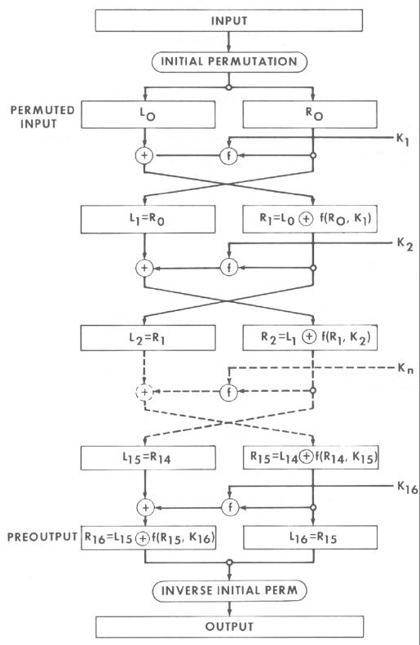
Cryptographic Algorithms: Symmetric Key Cryptography
Symmetric Key Cryptosystem – DES …(1/2)
Data Encryption Standard (DES), a symmetric key cryptosystem based on IBM’s Lucifer cipher. DES has been a FIPS 46-1 since 1977.
DES is a 64-bit block cipher algorithm (64-bit block = 56-bit secret key + 8-bit parity) that uses a key of 56 bits and 16 rounds of transposition and substitution to encrypt each group of 8 (64-bit) plaintext letters.
Feistel Network
Reference:
NIST FIPS 46-3, Data Encryption Standard, October 25, 1999

Slide 58
Cryptographic Algorithms: Symmetric Key Cryptography
Symmetric Key Cryptosystem – DES …(2/2)
For an animation of the 64-bit DES encryption process…
  Key schedule, 56-bit key divided into two 28-bit subkeys.
    For each successive rounds, both halves are rotated left by one or two bits.
  Initial Permutation (IP)
    Permutation of a 64-bit input block to a 64-bit IP matrix
  Rounds
    Expansion
    Key mixing
    Substitution
    Permutation
Reference: http://www.cryptool.org/en/

Slide 59
Cryptographic Algorithms: Symmetric Key Cryptography
Symmetric Key Cryptosystem – Triple-DES (TDES) …(1/2)
TDES is an interim solution from NIST to provide a stronger solution than DES…
  TDES uses 48 rounds of transposition and substitution functions in its computation.
  TDES is approximately 2⁵⁶ times stronger than DES.
TDES operates in four (4) different modes…
  DES-EEE: TDES encryption with 3 different keys
  DES-EDE: TDES operations (encrypt-decrypt-encrypt) with 3 different keys.
  DES-EEE2: TDES encryption with 2 different keys and 1st & 3rd operations use the same key.
  DES-EDE2: TDES operatons (encrypt-decrypt-encrypt) with 2 different keys and 1st & 3rd operations use the same key.
Reference: NIST FIPS 46-3, Data Encryption Standard, October 25, 1999

Slide 60
Cryptographic Algorithms: Symmetric Key Cryptography
Symmetric Key Cryptosystem – Triple-DES (TDES) …(2/2)
TDES is used as the underlying block cipher algorithm for the following modes of operations:
  Electronic Code Book (TECB in ANSI X9.52)
  Cipher Block Chaining (TCBC, TCBC-I in ANSI X9.52)
  Cipher Feed Back (TCFB, TCFB-P in ANSI X9.52)
  Output Feed Back (TOFB, TOFB-I in ANSI X9.52)
  Counter (CTR, not specified in ANSI X9.52)
For example: TECB (TDES-EEE in ECB) …
Reference:
NIST SP 800-38A, Recommendation for Block Cipher Modes of Operation, December 2001.
FIPS 46-3, Data Encryption Standard, October 25, 1999.

Slide 61
Cryptographic Algorithms: Symmetric Key Cryptography
Symmetric Key Cryptosystem –
Advanced Encryption Standard (AES) … (1/4)
NIST announced the need for a TDES replacement in 1997.
A request for candidate symmetric block algorithms supporting key sizes of 128, 192, and 256-bit was issued.
AES Candidates included:
  MARS – Developed by the IBM Team that developed Lucifer (the algorithm DES was developed from).
  RC6 – Developed by RSA.
  Serpent – Developed by Ross Anderson, Eli Biham, and Lars Knudsen.
  TwoFish – Developed by Counterpane Systems.
  Rijndael – Developed by Vincent Rijmen and Joan Deamon.
  CAST – Developed by Entrust Technologies.

Slide 62
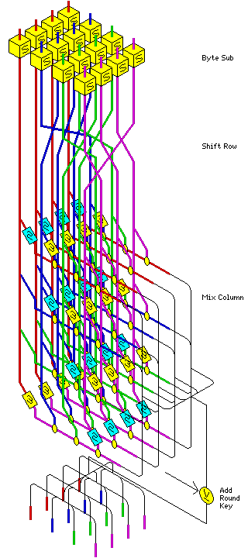
Cryptographic Algorithms: Symmetric Key Cryptography
Symmetric Key Cryptosystem –
Advanced Encryption Standard (AES) … (2/4)
The Rijndael algorithm developed by Vincent Rijman & Joan Daeman was selected after lengthy testing to become AES (FIPS 197)
AES is a symmetric block cipher that can…
  Process data blocks of 128 bits.
  Uses cipher keys with lengths of 128, 192, and 256 bits.
  Variable number of rounds, each round containing 4 steps (Byte Sub, Shift Row, Mix Column, Add Round Key)
  Rijndael was designed to handle additional block sizes and key lengths, however they are not adopted in the AES standard.
Reference:
NIST FIPS 197, Advanced Encryption Standard (AES), November 2001
http://www.quadibloc.com/crypto/co040401.htm

Slide 63
Cryptographic Algorithms Symmetric Key Cryptography
Symmetric Key Cryptosystem –
Advanced Encryption Standard (AES) … (3/4)
Like DES, AES is an block cipher algorithm for symmetric key cryptosystem.
  Uses confusion and diffusion principles
  Uses a substitute-permutation network (NOT Feistel network)
For both its cipher and inverse cipher, AES algorithm uses a “round function” that is composed of four different byte-oriented transformations:
  SubByte (Confusion)
  ShiftRow (Diffusion)
  MixColumn (Diffusion)
  AddRoundKey (Confusion)
Reference: NIST FIPS 197, Advanced Encryption Standard (AES), November 2001

Slide 64
Cryptographic Algorithms: Symmetric Key Cryptography
Symmetric Key Cryptosystem –
Advanced Encryption Standard (AES) … (4/4)
For an animation of the 128-bit AES encryption process… (http://www.formaestudio.com/rijndaelinspector/archivos/rijndaelanimation.html)
  KeyExpansion using Rijndael’s key schedule
  Initial Round
    AddRoundKey
  Rounds
    SubBytes
    ShiftRows
    MixColumns
    AddRoundKey
  Final Round (no MixColumns)
    SubBytes
    ShiftRows
    AddRoundKey
Reference: http://cryptool.org/en/

Slide 65
Cryptographic Algorithms: Symmetric Key Cryptography
Symmetric Key Cryptosystem – SKIPJACK
SKIPJACK is a symmetric key algorithm implemented in electronic devices.
  SKIPJACK algorithm is no longer classified.
  Single chip cryptoprocessors: CLIPPER, CAPSTONE, KEYSTONE, REGENT, KRYPTON, and FORTEZZA.
  SKIPJACK is a 64-bit codebook using an 80-bit cryptovariable (session key).
  Similar to DES, SKIPJACK has four (4) modes of operation but processes 32 rounds of transposition & substitution per operation:
    Electronic Code Book (ECB), 64-bit
    Cipher Block Chaining (CBC), 64-bit
    Output Feed Back (OFB), 64-bit
    Cipher Feed Back (CFB), 64/32/16/8-bit
  Skipjack uses DH for key exchange.
Reference: http://csrc.nist.gov/groups/ST/toolkit/documents/skipjack/skipjack.pdf

Slide 66
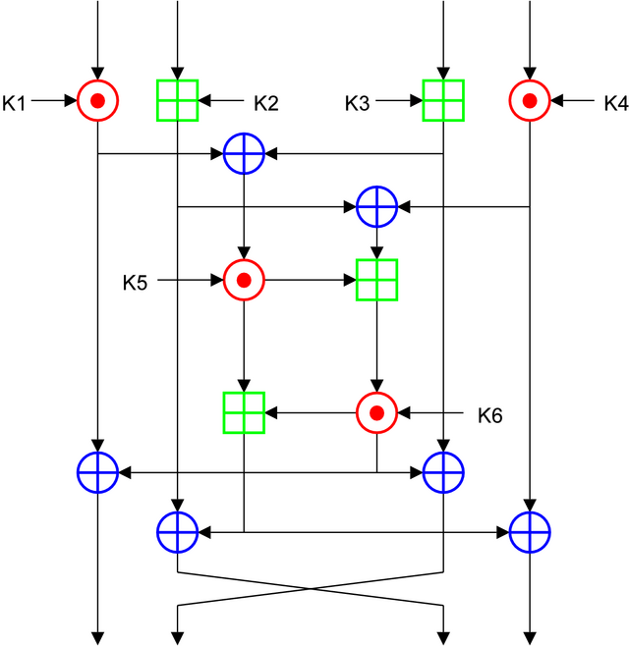
Cryptographic Algorithms: Symmetric Key Cryptography
Symmetric Key Cryptosystem – IDEA
International Data Encryption Algorithm (IDEA)
Uses 64-bit input and output data blocks.
Based on 3 mathematical functions
  XOR
  ADDITION modulo 2¹⁶ (65536)
  MULTIPLICATION modulo
  2¹⁶ + 1 (65537)
Uses 8 rounds of transposition and substitution.
Reference: http://en.wikipedia.org/wiki/International_Data_Encryption_Algorithm

Slide 67
Classes of Cryptography: Symmetric Key Cryptography
Symmetric Key Cryptosystem – Other Block Ciphers
RC5
  Designed by Ron Rivest of RSA Security
  Features data dependant rotations, variable block size (32,64, or 128 bits), variable key size (0 – 2040 bits), variable number of rounds
RC6
  Also designed by Ron Rivest. It was a candidate for AES.
  Based on RC5, RC6 has a block size of 128 bits, supports key size of 128, 192, and 256 bits.
Blowfish
  Highly efficient block cipher, designed by Bruce Schneier
  Key size: 32 – 448 bits (in steps of 8 bits)
  64-bit block size
  Optimized for 32-bit micro-processors

Slide 68

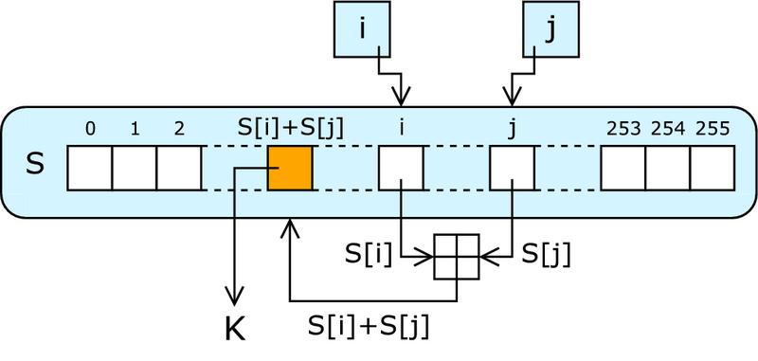
Classes of Cryptography: Symmetric Key Cryptography
Symmetric Key Cryptosystem – Stream Ciphers
RC4
  The most commonly implemented software stream cipher.
  Used in Secure Socket Layer (SSL) and Wired Equivalent Privacy (WEP).
  Designed by Ron Rivest of RSA Security.
  Using pseudo-random generation algorithm.
  Variable key size.
  Highly efficient, much faster than any block cipher.
  Stream ciphers can be difficult to implement correctly.
Source: http://en.wikipedia.org/wiki/RC4

Slide 69
Questions:
What is the key attribute of symmetric key cryptography?
What are the two key properties that all block cipher cryptosystems have?
What type of stream cipher cryptosystem is considered “unbreakable”?

Slide 70
Answers:
What is the key attribute of symmetric key cryptography?
  A single secret key.
What are the two key properties that all block cipher cryptosystems have?
  Confusion, and
  Diffusion.
What type of stream cipher cryptosystem is considered “unbreakable”?
  One-time pad.

Slide 71
Questions:
What are the two types of cipher that uses symmetric key algorithm for encryption?
What are the four modes of cryptography operations for DES?

Slide 72
Answers:
What are the two types of cipher that uses symmetric key algorithm for encryption?
  Block cipher, and
  Stream cipher.
What are the four modes of cryptography operations for DES?
  Electronic Code Book (ECB) Block Mode,
  Cipher Block Chaining (CBC) Block Mode,
  Cipher Feed Back (CFB) Stream Mode, and
  Output Feed Back (OFB) Stream Mode.

Slide 73
Topics
Cryptography Domain – Part 1
Terms, Definition, Concept & History
Cipher Types
  Classic Ciphers
  Modern Ciphers
Cryptographic Algorithms
  Hash Function Cryptography
  Symmetric Key Cryptography
  Asymmetric Key Cryptography
  Hybrid Cryptography

Slide 74
Cryptography Algorithm
Asymmetric Key Cryptography
Asymmetric key cryptography involves two mathematically related but different keys known as a key-pair (a private key & a public key).
The public key is derived from the private key.
  Only the owner has the private key.
  One-way mathematical link (a.k.a. “Trapdoor function”).
  The private key cannot be deduced (theoretically) by analyzing the public key.

Slide 75
Cryptography Algorithm
Asymmetric Key Cryptography
Secure message format:
Open message format:

Slide 76
Classes of Cryptograph
Asymmetric Key Cryptography – Algorithms
Asymmetric key cryptography is mathematically more complex than symmetric key cryptography.
Factorization algorithms
Discrete logarithm algorithms
  Discrete Logarithm with Finite Field
  Elliptic Curve Discrete Logarithm with Finite Field
The public-key cryptography process is substantially slower than symmetric key cryptography process. (100 times slower in software, 1,000 to 10,000 times slower in hardware)
Key sizes must be relatively large.

Slide 77
Classes of Cryptograph
Asymmetric Key Cryptography – Factorization Algorithms
Factorization Algorithms
Based on factoring “semi-prime” numbers (integers).
Larger the number, more computation is needed. 2, 3, … , 73, 2521, … , 2345347734339, 2⁷⁵⁶⁸³⁹-1, ...etc.
RSA PKCS#1
  Key generation: RSA public key and RSA private key.
  Public-key encryption: c = m^{e} mod n,
  where c is ciphertext, m is message, e is RSA public exponent and n is RSA modulus.
  Public-key decryption: m = c^{d} mod n,
  where d is RSA private exponent.
  Digital signature: m = s^{e} mod n,
  where s is signature representative.
Reference: http://en.wikipedia.org/wiki/RSA

Slide 78
Classes of Cryptograph
Asymmetric Key Cryptography – Discrete Logarithms
Discrete logarithm w/ finite field
Based on the mathematical proof of generalized discrete logarithm problem (GDLP),
  where computing exponentiation over a finite field is easy
  (Y^{x} mod P),
  but computing the discrete logarithm is hard.
  (find x where Y^{x} ≡ Z (mod P))
Parameters have to be as large as factoring (512, 1024, 2048-bit).
Diffie-Hellman, El Gamal, and DSA.
Brute force attacks are infeasible against discrete logarithms. But vulnerable to chosen-ciphertext attacks.
Reference: http://en.wikipedia.org/wiki/Diffie_hellman

Slide 79
Classes of Cryptograph
Asymmetric Key Cryptography – Diffie-Hellman (DH)
Diffie-Hellman (DH) is a key exchange algorithm for public-key cryptography. NOT for encryption!
DH uses finite field discrete logarithm as “trapdoor” function between private and public keys. Y^{X} (mod P)
Step | Alice | Exchange Methodology | Bob
1 | Select Y & P with Bob | Y^{X} (mod P) Public know to the world | Select Y & P with Alice
2 | Y = 11 P = 13 | 11^{X} (mod 13) | Y = 11 P = 13
3 | Alice chooses a secret number (2) | Select a secret number | Bob chooses a secret number (5)
4 | 11² (mod 13) 121 (mod 13) = 4 | Calculate one-way function using their secret number | 11⁵ (mod 13) 161051 (mod 13) = 7
5 | Alice sends the result “4” to Bob | Send the result of the one-way function to the other person | Bob sends the result “7” to Alice
6 | Calculate 7² (mod 13) 49 (mod 13) = 10 | Take received calculation and raise it to your secret number | Calculate 4⁵ (mod 13) 1024 (mod 13) = 10
7 | Symmetric key selected through calculation is 10 | Both people have the same number without revealing their “secret” | Symmetric key selected through calculation is 10
Reference: http://en.wikipedia.org/wiki/Diffie_hellman

Slide 80
Classes of Cryptograph
Asymmetric Key Cryptography – RSA Encryption Algorithm
Message: m = 3
Choose 2 random, prime numbers: p = 19, q = 13
n = pq, n = 247
Choose a random # to be e (encryption key): e = 7
Compute d (decryption key) (private key)
  d = e⁻¹ mod (p-1)(q-1)
  d = ((19-1)(13-1))/7 = 216/7 = 31 (round up)
Public key = (n,e) = (247,7)
To encrypt: c = m^{e} mod n ➔ c = 3⁷ mod 247 ➔
c = 211 (ciphertext)
To decrypt: m = c^{d} mod n ➔ m = 211³¹ mode 247 ➔
m = 3 (plaintext)
Reference:
CISSP All-in-One Exam Guide, 4th ed.
http://en.wikipedia.org/wiki/RSA

Slide 81
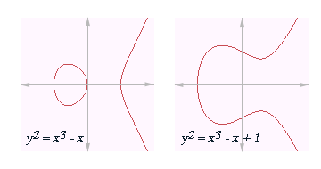
Classes of Cryptograph
Asymmetric Key Cryptography – Elliptic Curve Algorithm
Elliptic Curve Cryptography (ECC) uses algebraic system defined on points of elliptic curve to provide public-key cryptography.
ECC based on the mathematical
problem of factors that are
coordinate pairs that fall on
an elliptic curve.
Advantages:
  Highest strength/bit in current public-key cryptosystems.
  Fast encryption and signature speed.
  Small signatures & certificates. (Ideal for smart card).
Examples:
  ECC, EC-DH, EC-DSA, EC-ElGamal
Reference: http://en.wikipedia.org/wiki/Elliptic_curve

Slide 82
Classes of Cryptograph
Asymmetric Key Cryptography
While asymmetric key cryptography is more complex and slower than symmetric, but…
Key management is simplified.
  Only one party needs to know the private key.
  Knowledge of the public key does not compromise the security of message transmissions.
Key distribution is scalable.
  Each subject has just one key-pair (private & public keys) .instead of n*(n-1)/2 for symmetric key crypto.
  Number of keys = 2*n (1,000 users, 2,000 keys).
Key establishment can be authenticated.
  The key pair – private & public keys are mathematically related, but different.
  DH algorithm: (Y^{X} mod P, find X where Y^{X} ≡ Z (mod P)).

Slide 83
Question:
In asymmetric key cryptography, how is the public key is related to private key?
What are the two types of algorithms used in asymmetric key cryptography?
What are the three major advantages of asymmetric cryptography over symmetric cryptography?

Slide 84
Answers:
In asymmetric key cryptography, how is the public key is related to private key?
  Public key is generated through a “one-way” algorithm using the private key.
What are the two types of algorithms used in asymmetric key cryptography?
  Factorization algorithm, and
  Discrete logarithm.
What are the three major advantages of asymmetric cryptography over symmetric cryptography?
  Key management (is simplified),
  Key distribution (is scalable), and
  Key establishment (keys can be authenticated).

Slide 85
Topics
Cryptography Domain – Part 1
Terms, Definition, Concept & History
Cipher Types
  Classic Ciphers
  Modern Ciphers
Cryptographic Algorithms
  Hash Function Cryptography
  Symmetric Key Cryptography
  Asymmetric Key Cryptography
  Hybrid Cryptography

Slide 86
Classes of Cryptograph
Hybrid Use of Symmetric and Asymmetric Cryptography
Question:
How can one take advantage the speed of symmetric cryptography and keep the secret key secret?
Answer:
Make use of asymmetric cryptography to keep the ephemeral secret key secret.
Make use of hash functions to ensure integrity and non-repudiation of the ephemeral secret key.
Use the transported ephemeral secret key to perform bulk/ link encryption using symmetric cryptography.

Slide 87
Classes of Cryptograph
Hybrid Use of Symmetric and Asymmetric Cryptography
Example:
PKI enabled e-mail message, where a one-time secret key is generated for DES, TDES or AES to encrypt the content. E-mail recipient’s public key is used to encrypt the one-time secret key.
Secured SSL/TLS HTTPS sessions that uses public key cryptography to transport the session ephemeral secret key and perform symmetric crypto-operations.
KG-75, KG-175 are Type-1 cryptosystems that use FIREFLY public key from EKMS, and KSD-64 CIK. Then SKIPJACK-like keys are combined to perform symmetric cryptography operations.

Slide 88
Symmetric vs. Asymmetric Summary
Attribute | Symmetric | Asymmetric
Key | One shared secret key | Public/Private key pair
Key exchange | Difficult – must be done securely | Public/Private key relationship allows Public Key to be in the Open
Speed | Less complex & faster | More complex & much slower
Key Length (Bits) | Smaller (80 to 256+) | Much Larger (1024 to 2048+) *ECC (160 to 512+)
Use | Bulk encryption | Key encryption, key distribution
Security | Confidentiality/ Integrity | Confidentiality, Integrity, Authentication, Non-repudiation

Slide 89
Summary of Cryptography Algorithms
 | Encryption | Digital Signature | Hash Function | Key Distribution
Symmetric Key Algorithms
DES | X
3DES | X
AES | X
Blowfish | X
IDEA | X
RC4 | X
Asymmetric Key Algorithms
RSA | X | X |  | X
ECC | X | X |  | X
ElGamal, EC-ElGamal | X | X |  | X
DSA, EC-DSA |  | X
Diffie-Hellman (DH), EC-DH |  |  |  | X
Hash Function
RSA: MD2, MD4, MD5 |  |  | X
SHA-1, SHA-224, SHA-256, SHA-384, SHA-512 |  |  | X
HAVAL |  |  | X
Reference: CISSP All-in-One Exam Guide, 4th ed.

Slide 90
Validation Time… ☺
Classroom Exercise
Review Answers

Slide 91
Exercise #1: Polyalphabetic (/ Running Key) Cipher
Please decipher the followings…
  Ciphertext: JWCXOOQIYIZODHKDWBT
  Keyword: BLOCKCIPHERBLOCKCIP
A | B | C | D | E | F | G | H | I | J | K | L | M | N | O | P | Q | R | S | T | U | V | W | X | Y | Z
B | C | D | E | F | G | H | I | J | K | L | M | N | O | P | Q | R | S | T | U | V | W | X | Y | Z | A
C | D | E | F | G | H | I | J | K | L | M | N | O | P | Q | R | S | T | U | V | W | X | Y | Z | A | B
D | E | F | G | H | I | J | K | L | M | N | O | P | Q | R | S | T | U | V | W | X | Y | Z | A | B | C
E | F | G | H | I | J | K | L | M | N | O | P | Q | R | S | T | U | V | W | X | Y | Z | A | B | C | D
F | G | H | I | J | K | L | M | N | O | P | Q | R | S | T | U | V | W | X | Y | Z | A | B | C | D | E
G | H | I | J | K | L | M | N | O | P | Q | R | S | T | U | V | W | X | Y | Z | A | B | C | D | E | F
H | I | J | K | L | M | N | O | P | Q | R | S | T | U | V | W | X | Y | Z | A | B | C | D | E | F | G
I | J | K | L | M | N | O | P | Q | R | S | T | U | V | W | X | Y | Z | A | B | C | D | E | F | G | H
J | K | L | M | N | O | P | Q | R | S | T | U | V | W | X | Y | Z | A | B | C | D | E | F | G | H | I
K | L | M | N | O | P | Q | R | S | T | U | V | W | X | Y | Z | A | B | C | D | E | F | G | H | I | J
L | M | N | O | P | Q | R | S | T | U | V | W | X | Y | Z | A | B | C | D | E | F | G | H | I | J | K
M | N | O | P | Q | R | S | T | U | V | W | X | Y | Z | A | B | C | D | E | F | G | H | I | J | K | L
N | O | P | Q | R | S | T | U | V | W | X | Y | Z | A | B | C | D | E | F | G | H | I | J | K | L | M
O | P | Q | R | S | T | U | V | W | X | Y | Z | A | B | C | D | E | F | G | H | I | J | K | L | M | N
P | Q | R | S | T | U | V | W | X | Y | Z | A | B | C | D | E | F | G | H | I | J | K | L | M | N | O
Q | R | S | T | U | V | W | X | Y | Z | A | B | C | D | E | F | G | H | I | J | K | L | M | N | O | P
R | S | T | U | V | W | X | Y | Z | A | B | C | D | E | F | G | H | I | J | K | L | M | N | O | P | Q
S | T | U | V | W | X | Y | Z | A | B | C | D | E | F | G | H | I | J | K | L | M | N | O | P | Q | R
T | U | V | W | X | Y | Z | A | B | C | D | E | F | G | H | I | J | K | L | M | N | O | P | Q | R | S
U | V | W | X | Y | Z | A | B | C | D | E | F | G | H | I | J | K | L | M | N | O | P | Q | R | S | T
V | W | X | Y | Z | A | B | C | D | E | F | G | H | I | J | K | L | M | N | O | P | Q | R | S | T | U
W | X | Y | Z | A | B | C | D | E | F | G | H | I | J | K | L | M | N | O | P | Q | R | S | T | U | V
X | Y | Z | A | B | C | D | E | F | G | H | I | J | K | L | M | N | O | P | Q | R | S | T | U | V | W
Y | Z | A | B | C | D | E | F | G | H | I | J | K | L | M | N | O | P | Q | R | S | T | U | V | W | X
Z | A | B | C | D | E | F | G | H | I | J | K | L | M | N | O | P | Q | R | S | T | U | V | W | X | Y

Slide 92
Exercise #2: Cipher Operation for Block Cipher
Which of the following cipher operation is in stream mode?
  c_{i} = E_{k}(p_{i} ⊕ c_{i-1}) , where: c₀ = IV
  or
  c_{i} = p_{i} ⊕ E_{k}(c_{i-1}) , where c₀ = IV
How is IV generated?

Slide 93
Answers
Suggested

Slide 94
Exercise #1: Polyalphabetic (/Running Key) Cipher
Answer:
  Plaintext: I LOVE MITRE INSTITUTE
Using
  Ciphertext: JWCXOOQIYIZODHKDWBT
  Keyword: BLOCKCIPHERBLOCKCIP

Slide 95
Exercise #2: Cipher Operation for Block Cipher
Cipher Block Chaining (CBC)
c_{i} = E_{k}(p_{i} ⊕ c_{i-1}) , where: c₀ = IV
Cipher Feed Back (CFB)
c_{i} = p_{i} ⊕ E_{k}(c_{i-1}) , where c₀ = IV

Slide 96
Exercise #2: Cipher Operation for Block Cipher
How is IV generated?
It is usually done using a pseudo-random number generator (PRNG).
The most common PRNG is the linear congruential generator:
X_{n+1} = (aX_{n} +b) mod m
Then the random number is put in to a randomness extractor. Typically it is a cryptographic hash function.
Reference: L. Trevisan, Extractors and Pseudorandom Generators, UC Berkeley, 1999 (http://www.cs.berkeley.edu/~luca/pubs/extractor-full.pdf)

Slide 97
Public Key Cryptography Standards (PKCS)*
PKCS # 1: RSA Cryptography Standard. (Now includes PKCS #2 & #4)
PKCS # 3: Diffie-Hellman Key Agreement Standard.
PKCS # 5: Password-Based Cryptography Standard.
PKCS # 6: Extended-Certificate Syntax Standard. (This is currently being phased out in favor of X509 v3.)
PKCS # 7: Cryptographic Message Syntax Standard.
PKCS # 8: Private-Key Information Syntax Standard. (Key Information)
PKCS # 9: Selected Attribute Types. (This defines selected attribute types for use in other PKCS standards)
PKCS # 10: Certification Request Syntax Standard.
PKCS # 11: Cryptographic Token Interface Standard.
PKCS # 12: Personal Information Exchange Syntax Standard.
PKCS # 13: Elliptic Curve Cryptography Standard.
PKCS # 15: Cryptographic Token Information Format Standard.
*Source: http://www.rsasecurity.com/rsalabs/node.asp?id=2124

Slide 98
FIPS 140-2
Federal Information Process Standard (FIPS) 140-2: Security Requirements for Cryptographic Modules*
Specifies security requirements for protecting SBU information.
Covers areas related to the secure design and implementation of a cryptographic module.
Provides four (4) increasing, qualitative levels of security
Cryptographic Module Validation Program (CMVP)**
  All new products are to be tested under FIPS 140-2.
  Currently, all FIPS 140-1 validated modules are still valid.
Reference:
* http://csrc.nist.gov/publications/fips/
** http://csrc.nist.gov/cryptval/

Slide 99
FIPS 140-2, Security Requirements for Cryptographic Modules, December 2002
 | Security Level 1 | Security Level 2 | Security Level 3 | Security Level 4
Cryptographic Module Specification | Specification of cryptographic module, cryptographic boundary, Approved algorithms, and Approved modes of operation. Description of cryptographic module, including all hardware, software, and firmware components. Statement of module security policy.
Cryptographic Module Ports and Interfaces | Required and optional interfaces. Specification of all interfaces and of all input and output data paths. |  | Data ports for unprotected critical security parameters logically or physically separated from other data ports.
Roles, Services, and Authentication | Logical separation of required and optional roles and services. | Role-based or identity-based operator authentication. | Identity-based operator authentication.
Finite State Model | Specification of finite state model. Required states and optional states. State transition diagram and specification of state transitions.
Physical Security | Production grade equipment. | Locks or tamper evidence. | Tamper detection and response for covers and doors. | Tamper detection and response envelope. EFP or EFT.
Operational Environment | Single operator. Executable code. Approved integrity technique. | Referenced PPs evaluated at EAL2 with specified discretionary access control mechanisms and auditing. | Referenced PPs plus trusted path evaluated at EAL3 plus security policy modeling. | Referenced PPs plus trusted path evaluated at EAL4.
Cryptographic Key Management | Key management mechanisms: random number and key generation, key establishment, key distribution, key entry/output, key storage, and key zeroization.
 | Secret and private keys established using manual methods may be entered or output in plaintext form. |  | Secret and private keys established using manual methods shall be entered or output encrypted or with split knowledge procedures.
EMI/EMC | 47 CFR FCC Part 15. Subpart B, Class A (Business use). Applicable FCC requirements (for radio). |  | 47 CFR FCC Part 15. Subpart B, Class B (Home use).
Self-Tests | Power-up tests: cryptographic algorithm tests, software/firmware integrity tests, critical functions tests. Conditional tests.
Design Assurance | Configuration management (CM). Secure installation and generation. Design and policy correspondence. Guidance documents. | CM system. Secure distribution. Functional specification. | High-level language implementation. | Formal model. Detailed explanations (informal proofs). Preconditions and post-conditions.
Mitigation of Other Attacks | Specification of mitigation of attacks for which no testable requirements are currently available.

Slide 100
Symmetric – Asymmetric Key Size Comparisons
Size of Symmetric Keys
Effective Security (Bits) | Encryption Algorithm
80 | SKIPJACK
112 | 3DES
128 | AES-128
192 | AES-192
256 | AES-256
Size of Public Keys
DSA/DH | RSA | ECC
1024 | 1024 | 160
2048 | 2048 | 224
3072 | 3072 | 256
7680 | 7680 | 384
15360 | 15360 | 512

