Slide 1
CISSP® Common Body of Knowledge:
Business Continuity & Disaster Recovery Planning Domain
Version: 5.9.2

Slide 2
Learning Objective
Business Continuity and Disaster Recover Planning ...(1/3)
The Business Continuity and Disaster Recovery Planning domain addresses the preservation of the business in the face of major disruptions to normal business operations. BCP and DRP involve the preparation, testing and updating of specific actions to protect critical business processes from the effect of major system and network failures.
Business Continuity Planning (BCP) helps to identify the organization’s exposure to internal and external threats; synthesize hard and soft assets to provide effective prevention and recovery for the organization, and maintains competitive advantage and value system integrity. BCP counteracts interruptions to business activities and should be available to protect critical business processes from the effects of major failures or disasters. It deals with the natural and man-made events and the consequences, if not dealt with promptly and effectively.
...
Reference: CISSP CIB, January 2012 (Rev. 5)

Slide 3
Learning Objective
Business Continuity and Disaster Recover Planning ...(2/3)
...
Business Impact Analysis (BIA) determines the proportion of impact an individual business unit would sustain subsequent to a significant interruption of computing or telecommunication services. These impacts may be financial, in terms of monetary loss, or operational, in terms of inability to deliver.
Disaster Recovery Plans (DRP) contains procedures for emergency response, extended backup operation and post-disaster recovery, should a computer installation experience a partial or total loss of computer resources and physical facilities. The primary objective of the disaster recovery plan is to provide the capability to process mission-essential applications, in a degraded mode, and return to normal mode of operation within a reasonable amount of time.
...
Reference: CISSP CIB, January 2012 (Rev. 5)

Slide 4
Learning Objective
Business Continuity and Disaster Recover Planning ...(3/3)
...
The candidate is expected to know the difference between business continuity planning and disaster recovery; business continuity planning in terms of project scope and planning, business impact analysis, recovery strategies, recovery plan development, and implementation. Moreover, the candidate should understand disaster recovery in terms of recovery plan development, implementation and restoration.
Reference: CISSP CIB, January 2012 (Rev. 5)

Slide 5
Topics
Business Continuity Planning (BCP) Domain
Terms & Definition
Phase I: Project Management and Initiation
Phase II: Business Impact Analysis (BIA)
Phase III: Recovery Strategy
Phase IV: Plan Design & Development
Phase V: Implementation
Phase VI: Testing
Phase VII: Maintenance, Awareness, and Training

Slide 6
Terms & Definition
Business Continuity Planning (BCP)
Business continuity planning (BCP) addresses the preservation and recovery of business in the event of outages to normal business operations.
Business continuity plan is an approved set of arrangements and procedures that enables an organization to:
  Facilitate the recovery of business operations
  Minimize loss
  Repair or replace the damaged facilities or components as soon as possible.
Business (/mission) impact analysis (BIA) is the process of determining impacts of an IT service disruption to business operations in terms of financial loss. BIA is a part of BCP.
Reference: Official (ISC)^{2®} Guide to the CISSP® Exam

Slide 7
Terms & Definition
Business Continuity Planning (BCP)
Continuity of operations plan (COOP) focuses on restoring an organization’s essential business functions at an alternate site and performing those functions for up to 30 days before returning to normal operations. It is a part of BCP.
Business resumption planning (BRP) (or Business Recovery Planning) addresses the restoration of business processes after an emergency. It is often a part of BCP.
Crisis communications plan is a plan for both internal and public communications in a crisis event. It is often a part of BCP.
  Internal for coordination of organizational resources.
  External to ensure that only approved statements are released to the public.
Reference: NIST SP 800-34, Contingency Planning Guide for IT Systems

Slide 8
Terms & Definition
IT Contingency Planning
Cyber incident response plan is a specific BCP that establishes procedures to address cyber attacks against an organization’s IT system(s).
Disaster recovery planning (DRP) addresses the recovery of a damaged facility or components back to normal business operations.
Disaster recovery plan is a set of procedures that enables an organization to:
  Respond to disaster in accordance to a pre-defined disaster level.
  Assess damage & estimate time required to resume operations.
  Perform salvage & repair.
Reference: NIST SP 800-34, Contingency Planning Guide for IT Systems

Slide 9
Terms & Definition
Facility Contingency Planning
Occupant emergency plan (OEP) provides the response procedures for occupants of a facility in the event of a situation posing a potential threat to the health and safety of personnel, the environment, or property.
Reference: NIST SP 800-34, Contingency Planning Guide for IT Systems

Slide 10
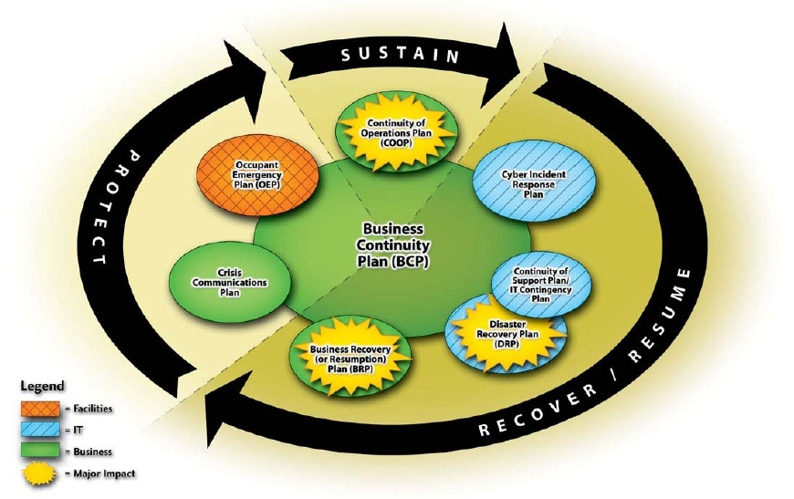
Terms & Definition
Life Cycle of Business Continuity
Sustain business operations
Recover / resume business operations
Protect business assets (People, reputation, and tangible assets)
Reference: NIST SP 800-34, Contingency Planning Guide for IT Systems

Slide 11
Creating a BCP
Process for Creating a BCP
Phase I: Project Initiation
Phase II: Business Impact
Analysis (BIA)
Phase III: Recovery Strategy
Phase IV: Plan Design &
Development
Phase V: Implementation
Phase VI: Testing
Phase VII: Maintenance, Awareness, and Training

Slide 12
Creating a BCP
Systems Engineering Approach for Creating a BCP
Understand the BCP needs
  Phase I: Project Initiation
Define the BCP requirements
  Phase II: Business Impact Analysis
Design the BCP
  Phase III: Recovery Strategy
Develop the BCP
  Phase IV: Plan Design &
  Development
Implement BCP
  Phase V: Implement
Support BCP
  Phase VII: Maintenance
Assess BCP effectiveness
  Phase VI: Testing

Slide 13
Questions:
What is the name of a management approved plan that addresses the preservation and recovery of business in the event of outages?
What is the name of a management approved plan that addresses the restoration of an organization’s essential business functions at an alternate site for up to 30 days?
What is the name of a management approved plan that addresses both internal and public communications in a crisis event?

Slide 14
Answers:
What is the name of a management approved plan that addresses the preservation and recovery of business in the event of outages?
  Business Continuity Plan (BCP)
What is the name of a management approved plan that addresses the restoration of an organization’s essential business functions at an alternate site for up to 30 days?
  Continuity Of Operations Plan (COOP)
What is the name of a management approved plan that addresses both internal and public communications in a crisis event?
  Crisis Communications Plan

Slide 15
Topics
Business Continuity Planning (BCP) Domain
Terms & Definition
Phase I: Project Management and Initiation
Phase II: Business Impact Analysis (BIA)
Phase III: Recovery Strategy
Phase IV: Plan Design & Development
Phase V: Implementation
Phase VI: Testing
Phase VII: Maintenance, Awareness, and Training

Slide 16
Business Continuity Planning (BCP)
Phase I: Project Management and Initiation
Procedure to initiate a BCP project…
  Step 1: Establish the need.
  Step 2: Obtain management support.
  Step 3: Identify stakeholders and resources.
  Step 4: Create an project management work plan.

Slide 17
Phase I: Project Management and Initiation
Establish the Need
Establish the need for a BCP.
  Perform a focused risk assessment to identify and document potential contingencies to critical information and information systems.
 |  | Magnitude of Impact
 |  | Low | Medium | High
 | High
 | Medium
 | Low
Likelihood Level
SC _{information type} = {(confidentiality, impact), (integrity, impact), (availability, impact)}, where the acceptable values for potential impact are low, medium, or high.

Slide 18
Phase I: Project Management and Initiation
Obtain Management Support & Plan Project
Obtain management support and identify stakeholders.
Identify strategic internal and external resources to ensure that BCP matches overall business and technology plans.
Establish the project management work plan, including the:
  Define scope and objectives of the project.
  Determine methods for organizing and managing development of the BCP.
  Establish members of the BCP team (both technical & functional).
  Identification of related tasks and responsibilities.
  Schedule project management reviews (PMR) and set project milestones.
Reference: NIST SP 800-34, Contingency Planning Guide for IT Systems

Slide 19
Phase I: Project Management and Initiation
Role & Responsibility of a BCP Coordinator
Business continuity planner/coordinator is the leader responsible for the development of BCP.
  To serve as the liaison between the planning development team and management.
  Have direct access and authority to interact with all employees necessary to complete the planning.
  Possess a thorough business knowledge to understand how an outage can affect the organization.
  Be familiar with the entire organization and in a position within the organization to balance the overall needs of the organization with the needs of individual business units that would be affected.
  Have easy access to executive management.
  Understand the charter, mission statement, and executive viewpoint when decisions need to be made.
Reference: Official (ISC)^{2®} Guide to the CISSP® Exam

Slide 20
Topics
Business Continuity Planning (BCP) Domain
Terms & Definition
Phase I: Project Management and Initiation
Phase II: Business Impact Analysis (BIA)
Phase III: Recovery Strategy
Phase IV: Plan Design & Development
Phase V: Implementation
Phase VI: Testing
Phase VII: Maintenance, Awareness, and Training

Slide 21
Phase II: Business Impact Analysis (BIA)
Business Impact Analysis (BIA)
BIA is a management-level functional analysis that identifies the impact to business operations should an outage occur.
BIA leverages information from risk assessment, but it is not an IT risk assessment.
Impact is measured by:
  Tangible attributes:
    Allowable business interruption – Maximum Tolerable Downtime (MTD) or Maximum Tolerable Outage (MTO)
    Financial cost considerations.
    Regulatory requirements.
  Intangible attributes:
    Organizational reputation.
Reference: Official (ISC)^{2®} Guide to the CISSP® Exam

Slide 22
Phase II: Business Impact Analysis (BIA)
Purpose
The purpose of BIA is to:
  Provide written documentation to assist the organization’s management in understanding the business impact associated with possible outages.
  Identify an organization’s business functions and associated information systems to determine how critical those functions are to the organization.
  Identify any concerns that staff or management may have regarding the ability to function in less than optimal modes
  Prioritize critical information systems.
  Analyze impact of an outage, such as loss revenue, additional operating expenses, delay of income, and loss of competitive advantage and public confidence
  Determine recovery windows for each business function, such as determining how long the organization may be able to perform critical functions manually or through some other alternative methods.
Reference: Official (ISC)^{2®} Guide to the CISSP® Exam

Slide 23
Phase II: Business Impact Analysis (BIA)
Example – Maximum Tolerable Downtime (MTD)
Example of Business Impact Categories & Maximum Tolerable Downtime (MTD)
Business Impact Category | MTD
Nonessential | 30 Days
Normal | 7 Days
Important | 72 Hours
Urgent | 24 Hours
Critical/Essential | Minutes to Hours

Slide 24
Phase II: Business Impact Analysis (BIA)
Process
Procedure to conduct BIA
Step 1: Determine information gathering techniques.
Step 2: Select interviewees (i.e. stakeholders.)
Step 3: Customize questionnaire to gather economic and operational impact information.
  Quantitative and qualitative questions.
Step 4: Analyze collected impact information.
Step 5: Determine time-critical business systems.
Step 6: Determine maximum tolerable downtimes (MTD).
Step 7: Prioritize critical business systems based on MTD.
Step 8: Document findings and report recommendations.
Reference: Official (ISC)^{2®} Guide to the CISSP® Exam

Slide 25
Questions:
What is the name of a management approved plan that addresses operational processes for the recovery of a damaged facility?
What is the first step to begin a business continuity program?
Who is the person responsible for managing the business continuity program?

Slide 26
Answers:
What is the name of a management approved plan that addresses operational processes for the recovery of a damaged facility?
  Disaster Recovery Plan
What is the first step to begin a business continuity program?
  Establish the need
Who is the person responsible for managing the business continuity program?
  Business continuity planner/coordinator

Slide 27
Topics
Business Continuity Planning (BCP) Domain
Terms & Definition
Phase I: Project Management and Initiation
Phase II: Business Impact Analysis (BIA)
Phase III: Recovery Strategy
Phase IV: Plan Design & Development
Phase V: Implementation
Phase VI: Testing
Phase VII: Maintenance, Awareness, and Training

Slide 28
Business Continuity Planning (BCP) & Disaster Recovery Planning (DRP)
Phase III: Disaster Recovery Strategy
Recovery strategy is a set of predefined & management approved actions implemented in response to a business interruption from a disaster.
  Natural / Environmental
    Earthquakes, floods, storms, hurricanes, fires, snow/ice, etc.
  Man made / political events
    Explosives, disgruntled employees, unauthorized access, employee errors, espionage, sabotage, arson/fires, hazardous/toxic spills, chemical contamination, malicious code, vandalism and theft, etc.
Recovery strategy focus on:
  Meeting the predetermined recovery time frames (i.e. MTD).
  Maintaining the operation of the critical business functions.
  Compiling the resource requirements.
  Identifying alternatives that are available for recovery.

Slide 29
Phase III: Disaster Recovery Strategy
Define “Disaster”
Disaster severity should be defined for “conditioned” recovery measures. (e.g. INFOCON, DEFCON, and DHS Threat Advisory)
Business continuity planner/coordinator should have a defined severity for declaring a “disaster”.
In general, there are two types of recovery strategy:
  General recovery, where the critical infrastructure remain in tact and recovery is within MTD.
  Disaster recovery, where the critical infrastructure severely disabled and contingency require alternate site(s).
Disaster Severity | Definition | Note
Level 1 | Threat impact and analysis | Normal operations
Level 2 | Minimal damage event | Zero impact to data systems
Level 3 | Single-system failure | Failover or restore system
Level 4 | Single critical failure or multiple non-critical failures | Perform general recovery procedure
Level 5 = Disaster | Imminent or actual data center failure | Enable recovery site and perform disaster recovery procedure

Slide 30
Phase III: Disaster Recovery Strategy
Procedure
Procedure for developing a recovery strategy:
Step 1: Document all costs associated with each contingencies.
Step 2: Obtain cost estimates for any outside services (using RFI, RFQ, or RFP).
Step 3: Develop written agreements for outside services (i.e. Service Level Agreement (SLA)).
Step 4: Evaluate resumption strategies based on a full loss of the facility.
Step 5: Identify risk reduction measures and update Business Resumption Plan (BRP).
Step 6: Document recovery strategies and present to management for comments and approval.
Reference: Official (ISC)^{2®} Guide to the CISSP® Exam

Slide 31
Phase III: Disaster Recovery Strategy
Elements of Recovery
Elements of recovery strategies:
Business recovery strategy
  Focus on recovery of business operations.
Facility & supply recovery strategy
  Focus on facility restoration and enable alternate recovery site(s).
User recovery strategy
  Focus on people and accommodations.
Technical recovery strategy
  Focus on recovery of IT services.
Data recovery strategy
  Focus on recovery of information assets.
Reference: Official (ISC)^{2®} Guide to the CISSP® Exam

Slide 32
Phase III: Disaster Recovery Strategy
Business Recovery
Business recovery strategy focuses on recovery of business operations by identifying:
  Critical business units and their associated business functions.
  Critical IT system requirements for each business function.
  Critical office equipment and supplies requirements for each business function.
  Essential office space requirements for each business unit.
  Key operations personnel for each business unit.
  Supporting infrastructure (i.e. telecom., utilities, and postal service) for service redirection to recovery site(s).
  Business unit interdependencies.
  Off-site storage.
Reference: Official (ISC)^{2®} Guide to the CISSP® Exam

Slide 33
Phase III: Disaster Recovery Strategy
Business Recovery
Mutual Aid Agreements
  An arrangement with another company that may have similar computing needs.
  Both companies agree to support each other in the case of a disruptive event.
  In most cases, a “perfect partner” is a company’s subsidiary.
Advantages:
  Obtain a recovery site at little or no cost.
Disadvantages:
  It is highly unlikely that each organization's infrastructure will have the extra capacity to enable full operational processing during the event.
  Need geographic diversity so that a major regional disaster doesn't disrupt both companies.
Reference: Official (ISC)^{2®} Guide to the CISSP® Exam

Slide 34
Phase III: Disaster Recovery Strategy
Facility & Supply
Facility & supply recovery strategy focuses on restoration and recovery of:
  Facility for critical business units.
  Facility for less critical business units.
  Security and operational needs at recovery site(s.
    Primarily physical security controls (i.e. personnel access control, fire/water detection & suppression, and intrusion detection systems, etc.)
  Transportation and supply chain logistics to recovery site(s)
    People, office supply, critical IT systems, and document, etc.
  Redirection of supporting infrastructure to recovery site(s)
    telecommunications, utilities, and postal service.
Reference: Official (ISC)^{2®} Guide to the CISSP® Exam

Slide 35
Phase III: Disaster Recovery Strategy
User Recovery
User recovery strategy focuses on:
  Contingency business operations procedures (manual or automated).
  Employee access procedure for recovery site.
  Transport and storage of critical business documentation and forms.
  Storage of vital records (i.e. personnel, legal business, and medical records, etc.)
  Employee notification procedures.
  Transportation arrangements for employee to recovery site.
  Employee accommodations (e.g. user workspace, equipment, food, water, sleeping, and plumbing, etc.)
Reference: Official (ISC)^{2®} Guide to the CISSP® Exam

Slide 36
Phase III: Disaster Recovery Strategy
Technical Recovery
Technical recovery strategy focuses on:
  Data Center Recovery
  Network and Data Communication Recovery Planning
  Telecommunications Recovery
The key elements to the technical recovery are:
  Subscription Services
    Hot Site
    Warm Site
    Cold Site
    Mirror Site or Multiple Processing Centers
    Mobile site
  Reciprocal or Mutual Aide Agreement
  Service Bureaus
Reference: Official (ISC)^{2®} Guide to the CISSP® Exam

Slide 37
Phase III: Disaster Recovery Strategy
Technical Recovery
Subscription Service: Hot Site
A Hot Site is a fully configured computer facility with complete customer required systems
  Computing infrastructure (i.e. servers, workstations, and networks)
  Critical infrastructure (i.e. electricity, water, HVAC, physical security, etc.)
Advantage
  24/7 availability.
Disadvantage
  Expensive to maintain.
  Need data restoration from backup. (Data is not mirrored)
  The service provider might oversell capacity, thus create possible contentions for resources between multiple companies during a regional disaster.
  Security control of information asset must be maintained in multiple places.
Reference: Official (ISC)^{2®} Guide to the CISSP® Exam

Slide 38
Phase III: Disaster Recovery Strategy
Technical Recovery
Subscription Service: Warm Site
A Warm Site is a facility readily available with electrical power and HVAC and computers, but the applications may not be installed.
Advantages
  Availability is assured for longer timeframes.
  Cost is less than a hot site subscription service.
  Flexible in the choice of sites (i.e. locations).
  Uses less administrative resources than a hot site.
Disadvantage
  Operational testing is not possible.
  Required resources may not be immediately available. (i.e. data restoration).
  More expensive than a cold site or in-house recovery sites.
Reference: Official (ISC)^{2®} Guide to the CISSP® Exam

Slide 39
Phase III: Disaster Recovery Strategy
Technical Recovery
Subscription Service: Cold Site
A Cold Site is a facility with critical infrastructure services only. It does not include any IT equipment, or resources.
Advantages
  Lower cost than hot or warm site subscription service.
  Available for longer periods of time.
  Site can be in various locations.
Disadvantage
  Required resources may not be immediately available. (i.e. equipment transport, setup, and data restoration)
  Operating testing is not possible.
  Costs are more expensive than in-house facilities.
Reference: Official (ISC)^{2®} Guide to the CISSP® Exam

Slide 40
Phase III: Disaster Recovery Strategy
Technical Recovery
Mirror Site or Multiple Processing Centers
The information processing is distributed over multiple data centers. The available resources are shared & fully redundant.
Advantage
  No MTD issue, minimal business impact when there is a disaster at one site.
  The organization have full control over all data centers.
  Resources are fully available.
Disadvantage
  For distributed Multiple Processing Centers: Shared computing resources may not maintain excess capacity, then a major disaster could easily overtake the processing capability of processing sites.
  If maintain excess capacity for major disaster, it can be cost prohibitive.
  Logistics of maintaining multiple sites may lead to CM problems.
Reference: Official (ISC)^{2®} Guide to the CISSP® Exam

Slide 41
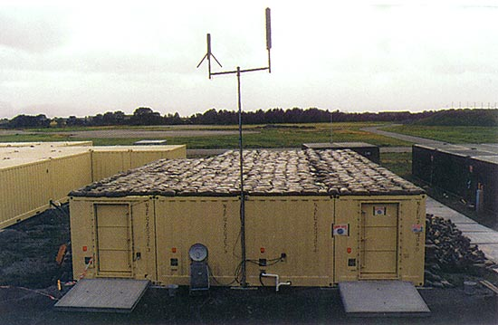
Phase III: Disaster Recovery Strategy
Technical Recovery
Mobile Site
A Mobile Site is self-contained, transportable shelter custom-fitted with specific telecommunications and IT equipment.
Advantage
  The organization have full control over all equipment.
Disadvantage
  May offer limited information processing capacity (, as compared to the primary data center.)
  Require advance coordination, resources may not be immediately available (i.e. equipment transport, setup, and data restoration.)
Reference: Official (ISC)^{2®} Guide to the CISSP® Exam

Slide 42
Phase III: Disaster Recovery Strategy
Technical Recovery
Service Bureaus (i.e. Business Process Outsourcing)
Service bureaus offer data processing services to many organizations.
Advantage
  Quick response and availability.
  Testing is possible.
Disadvantage
  Organization do not have full control of protection to its information asset.
  Most of service bureaus are optimized for current client base, adding additional processing loads during a major disaster may create resource contention.
Reference: Official (ISC)^{2®} Guide to the CISSP® Exam

Slide 43
Phase III: Disaster Recovery Strategy
Data Recovery
Data recovery strategy focuses on recovery of information:
  Backup and off-site storage
    Full backup
    Incremental backup
    Differential backup
  Electronic vaulting
    Online tape vaulting
    Remote journaling
    Database shadowing
  Standby service
  Software escrow
  Recovery Management
Reference: Official (ISC)^{2®} Guide to the CISSP® Exam

Slide 44
Security Controls & Countermeasures
Contingency Planning – Data Backups …(1/4)
Three types of data backups:
Full volume backup is backup performed on an entire disk volumes of a system(s).
Differential backup is a backup of changes since last full backup, but does not change the archive bit value.
Incremental backup is a backup of changes since last full or incremental backup and sets the archive bit to 0.
Source: All-in-One CISSP Exam Guide, 5th Ed, 2010.
Notes:
Online tape vaulting. Data is transported to a tape backup service.
Remote Journaling. The same logging procedure used for a DBMS to create the onsite journal is used to create a second journal at the off-site storage location.
Database Shadowing. The system creates updates to the production system, journals them, and send them to the alternate computer.

Slide 45
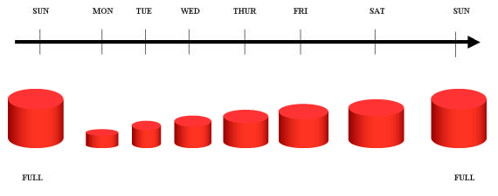
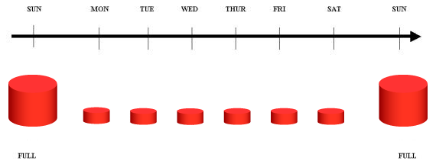
Security Controls & Countermeasures
Contingency Planning – Data Backups …(2/4)
Recovery steps: Full + differential backup.
Recovery steps: Full + sequence incremental backups
Source: http://www.ibm.com/developerworks/data/library/techarticle/dm-0407tham/index.html
Notes:
Online tape vaulting. Data is transported to a tape backup service.
Remote Journaling. The same logging procedure used for a DBMS to create the onsite journal is used to create a second journal at the off-site storage location.
Database Shadowing. The system creates updates to the production system, journals them, and send them to the alternate computer.

Slide 46
Phase III: Disaster Recovery Strategy
Data Recovery
Off-site storage requirements:
Facility
  Security controls. (i.e. access controls, inventory control, physical security, etc.)
  Environmental controls. (i.e. humidity & temperature controls, fire & water protection measures)
  Location. (i.e. distance to service clients)
Transportation
  Delivery vehicles are secure. (i.e. physical access controls & insured for liability)
  Defined handling procedure. (i.e. access controls & inventory controls for integrity & accountability)
  Transport availability. (i.e. 24/7 in case of an emergency)
Personnel
  Knowledgeable personnel with appropriate security clearances, and background checks, etc.
  Follow handling security procedure.
Reference: Official (ISC)^{2®} Guide to the CISSP® Exam

Slide 47
Phase III: Disaster Recovery Strategy
Data Recovery
Standby services represent the operation of critical operating systems and applications at an alternate site when called upon.
Software escrow is when a vendor places a copy of critical source code with a trusted 3rd party so that it can be obtained in the event that the vendor goes out of business.
Recovery management is a part of coordinated execution of data recoveries in a controlled manner.
Reference: Official (ISC)^{2®} Guide to the CISSP® Exam

Slide 48
Phase III: Disaster Recovery Strategy
Leaving the Primary Site…
Business Recovery Operations
Understand the severity of “disaster”
Coordinate the BCP (/ crisis) team
Execute the BCP according to the “disaster” :
  Business recovery,
  Facility & supply recovery,
  User recovery,
  Technical recovery,
  Data recovery
and the approved plan of actions:
  Business Resumption Plan
  IT Contingency Plan
  Crisis Communications Plan
  Cyber Incident Response Plan
  Disaster Recovery Plan
Communicate the crisis
  Crisis Communications Plan
Secure the primary site
Reference: CISSP Certification All-in-One Exam Guide, 4th Ed.

Slide 49
Phase III: Disaster Recovery Strategy
Returning to the Primary Site…
Restoration Operations
Complete a detailed assessment of all damage.
Review insurance policies and document information, as needed and coordinate with insurance company.
Contact restoration service contractors to salvage or disposal of damaged equipment, and procure new equipment.
Coordinate activities to have repairs made to the damaged area within the primary site.
Restore the primary site to minimum operating conditions.
  … reconstruction and restoration of facility (including government inspections)
  … restore critical infrastructure services (i.e. utilities, water, etc.)
Reactivate physical perimeter security systems (fire, IDS, water, etc.)
Implement and test the IT infrastructure. (i.e. networks, DNS, e-mail, etc.)
Certify the system is ready for operations.
Reference: CISSP Certification All-in-One Exam Guide, 4th Ed.

Slide 50
Questions:
What is the name of a written analysis that states the possible business impact associated with an outage?
In order to define the level of recovery effort, one has to define the severity of ____?
What are the five key elements in recovery strategy?

Slide 51
Answers:
What is the name of a written analysis that states the possible business impact associated with an outage?
  Business Impact Analysis (BIA)
In order to define the level of recovery effort, one has to define the severity of ____?
  Disaster
What are the five key elements in recovery strategy?
  Business recovery
  Facility & supply recovery
  User recovery
  Technical recovery
  Data recovery

Slide 52
Questions:
In most cases, who may be the best business recovery partner to enter into a mutual-aid agreement with?
What is a fully configured computing facility with complete customer required information systems but requires data restoration from backups?
What is an empty facility that equipped with critical infrastructure services only (e.g., water, electricity, HVAC)

Slide 53
Answers:
In most cases, who may be the best business recovery partner to enter into a mutual-aid agreement with?
  A company’s subsidiary
What is a fully configured computing facility with complete customer required information systems but requires data restoration from backups?
  A “Hot Site”
What is an empty facility that equipped with critical infrastructure services only (e.g., water, electricity, HVAC)
  A “Cold Site”

Slide 54
Questions:
What are the three types of data backups?
What is the name of a software recovery service that involves storage of specialized software in an entrusted 3rd party?

Slide 55
Answers:
What are the three types of data backups?
  Full complete backup
  Incremental backup
  Differential backup
What is the name of a software recovery service that involves storage of specialized software in an entrusted 3rd party?
  Software escrow service

Slide 56
Topics
Business Continuity Planning (BCP) Domain
Terms & Definition
Phase I: Project Management and Initiation
Phase II: Business Impact Analysis (BIA)
Phase III: Recovery Strategy
Phase IV: Plan Design & Development
Phase V: Implementation
Phase VI: Testing
Phase VII: Maintenance, Awareness, and Training

Slide 57
Phase IV: Plan Design & Development
Procedure … (1/3)
Procedure for developing BCP:
Step 1: Determine management concerns & priorities.
Step 2: Determine planning scope such as geographical concerns, organizational issues, and the various recovery functions to be covered in the plan.
Step 3: Establish outage assumptions.
Step 4: Define prevention strategies for risk management, physical security, information security, insurance coverage, and how to mitigate the emergency.
Step 5: Identify resumption strategies for mission critical- and non-mission critical-systems at alternate sites.
Step 6: Identify the location for the emergency operations center/ command center.
Reference: Official (ISC)^{2®} Guide to the CISSP® Exam

Slide 58
Phase IV: Plan Design & Development
Procedure … (2/3)
Procedure for developing BCP: …(continued)
Step 7: Develop service function recovery plans, including information processing, telecommunications, etc.
Step 8: Develop business function recovery plans and procedures.
Step 9: Develop facility recovery plans.
Step 10: Identify the response procedures, including:
  Evacuation and safety of personnel
  Notification of disaster
  Notifying alternate site(s)
  Initial damage assessment
  Securing home site
  Activating recovery teams, and emergency operations center/command center
  Relocating to alternate site(s)
Reference: Official (ISC)^{2®} Guide to the CISSP® Exam

Slide 59
Phase IV: Plan Design & Development
Procedure … (3/3)
Procedure for developing BCP: …(continued)
Step 11: Gather data required for plan completion. Develop support service plans, including human resources, public relations, transportation, facilities, information processing, telecommunications, etc.
Step 12: Review and outline how the organization will interface with external groups.
Step 13: Review and outline how the organization will cope with other complications beyond the actual disaster.
Reference: Official (ISC)^{2®} Guide to the CISSP® Exam

Slide 60
Topics
Business Continuity Planning (BCP) Domain
Terms & Definition
Phase I: Project Management and Initiation
Phase II: Business Impact Analysis (BIA)
Phase III: Recovery Strategy
Phase IV: Plan Design & Development
Phase V: Implementation
Phase VI: Testing
Phase VII: Maintenance, Awareness, and Training

Slide 61
Business Continuity Planning (BCP) & Disaster Recovery Planning (DRP)
Phase V: Implementation
Execute BCP as an integrated program that consists of…
  Business Resumption Plan
  Continuity of Operations (COOP) Plan
  IT Contingency Plan
  Crisis Communications Plan
  Cyber Incident Response Plan
  Disaster Recovery Plan
  Occupant Emergency Plan
Reference: CISSP Certification All-in-One Exam Guide, 4th Ed.

Slide 62
Phase V: Implementation
Business Continuity Life Cycle
Sustain business operations (COOP)
Recover / resume business operations (Business Recovery Plan, Incident Response Plan, IT Contingency Plan, and Disaster Recovery Plan)
Protect business assets (People, reputation, and tangible assets) (Crisis Communications Plan, Occupant Emergency Plan)
Reference: NIST SP 800-34, Contingency Planning Guide for IT Systems

Slide 63
Topics
Business Continuity Planning (BCP) Domain
Terms & Definition
BCP Phase I: Project Management and Initiation
BCP Phase II: Business Impact Analysis (BIA)
BCP Phase III: Recovery Strategy
BCP Phase IV: Plan Design & Development
BCP Phase V: Implementation
BCP Phase VI: Testing
BCP Phase VII: Maintenance, Awareness, and Training

Slide 64
Business Continuity Planning (BCP) & Disaster Recovery Planning (DRP)
Phase VI: Testing, Maintenance, Awareness, & Training
Types of Tests
Structured walk-through: Step-by-step review of BCP plans with organization’s functional representatives
Checklist test: Each functional representatives review BCP plans and check off the points that are listed to ensure all concerns and activities are addressed.
Simulation: A scenario-based practice execution of the BCP plans.
Parallel test: Operational test conducted at the alternate site(s).
Full interruption test: Full scale operational test including shutdown of primary site and recovery of business operations at alternate site(s).
Reference: Official (ISC)^{2®} Guide to the CISSP® Exam

Slide 65
Topics
Business Continuity Planning (BCP) Domain
Terms & Definition
BCP Phase I: Project Management and Initiation
BCP Phase II: Business Impact Analysis (BIA)
BCP Phase III: Recovery Strategy
BCP Phase IV: Plan Design & Development
BCP Phase V: Implementation
BCP Phase VI: Testing
BCP Phase VII: Maintenance, Awareness, and Training

Slide 66
Business Continuity Planning (BCP) & Disaster Recovery Planning (DRP)
Phase VII: Testing, Maintenance, Awareness, & Training
Plan Maintenance
Monitor configuration management (CM) and update BCP plans accordingly.
Plan & schedule BCP maintenance reviews (Minimum: Annually review).
Distribute updates to BCP plans.
Reference: Official (ISC)^{2®} Guide to the CISSP® Exam

Slide 67
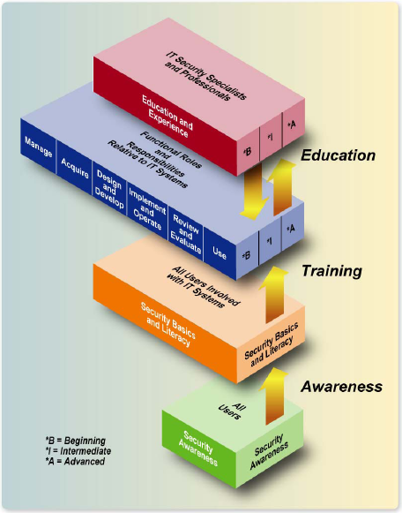
Business Continuity Planning (BCP) & Disaster Recovery Planning (DRP)
Phase VII: Testing, Maintenance, Awareness, & Training
BCP Awareness and Training
Like Security Awareness & Training…
BCP awareness on policy and procedures should be conducted annually to all employees & contractors.
BCP training should role-based that focuses on a specific functional area(s).
Reference: NIST SP800-50, Building an IT Security Awareness and Training Program

