Slide 1
Flow Analysis and Network Hunting
Ben Actis & Michael McFail
netflowanalysis@gmail.com
MITRE Approved for Public Release; Distribution Unlimited. 13-1139
Notes:
MITRE Approved for Public Release; Distribution Unlimited. 13-1139

Slide 2
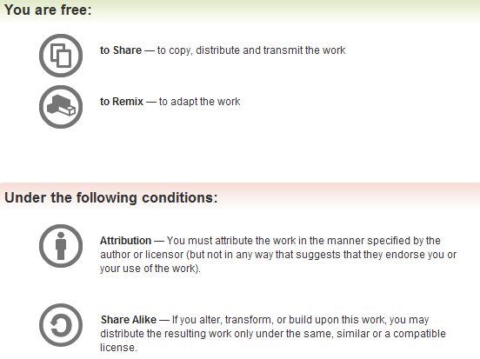
Creative Commons License
http://creativecommons.org/licenses/by-sa/3.0/
All materials are
licensed under a
Creative Commons
“Share Alike”
license

Slide 3
Additional Content/Ideas/Info Provided By
David Wilburn: initial topic outline
Willie Kupersanin: content review

Slide 4
About this class
The intent of this class is to expose you to …
  Netflow data
  Netflow tools
  Labs with real live netflow found in the wild
  Analytic tradecraft
    Situational awareness analytics
    Hunting analytics

Slide 5
Outline
Introduction
  What is Netflow?
  Sensor Location
  Sampling
Tools
  YAF
  SiLK
  iSiLK
  Argus
  Bro
Analytics
  Situational Awareness Analytics
  Hunting Analytics
  Data Fusion Analytics
Wrap Up

Slide 6
Pcap Recap: IPv4
Bit offset | 0-3 | 4-7 | 8-13 |  | 14-15 | 16-18 | 19-31
0 | Version | Internet Header Length | Differentiated Services Code Point |  | Explicit Congestion Notification | Total Length
32 | Identification |  |  |  |  | Flags | Fragment Offset
64 | Time to Live |  |  | Protocol |  | Header Checksum
96 | Source IP Address
128 | Destination IP address
160 | Options
160 or 192+ | Data
Adapted from: http://en.wikipedia.org/wiki/IPv4#Packet_structure

Slide 7
Pcap Recap: TCP
Octet | 0 |  |  |  |  |  |  |  | 1 |  |  |  |  |  |  |  | 2 |  |  |  |  |  |  |  | 3
Bit | 0 | 1 | 2 | 3 | 4 | 5 | 6 | 7 | 8 | 9 | 10 | 11 | 12 | 13 | 14 | 15 | 16 | 17 | 18 | 19 | 20 | 21 | 22 | 23 | 24 | 25 | 26 | 27 | 28 | 29 | 30 | 31
0 | Source port |  |  |  |  |  |  |  |  |  |  |  |  |  |  |  | Destination port
32 | Sequence number
64 | Acknowledgment number (if ACK is set)
96 | Data offset |  |  |  | Reserved |  |  | NS | CWR | ECE | URG | ACK | PSH | RST | SYN | FIN | Window size
128 | Checksum |  |  |  |  |  |  |  |  |  |  |  |  |  |  |  | Urgent pointer (if URG is set)
160 … | Options
Adapted from:
http://en.wikipedia.org/wiki/Transmission_Control_Protocol#TCP_segment_structure

Slide 8
Pcap Recap: UDP
Bit Offset | 0-15 | 16-31
0 | Source port | Destination port
32 | Length | Checksum
64 … | Data
Adapted from: http://en.wikipedia.org/wiki/User_Datagram_Protocol#Packet_structure

Slide 9
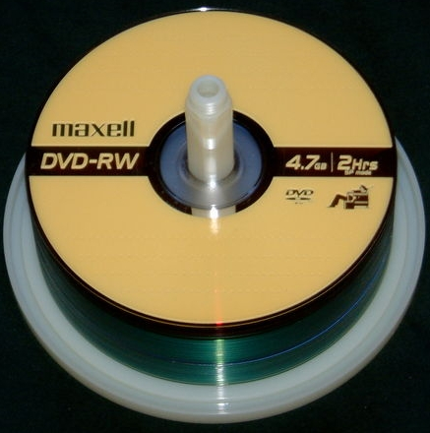

What is netflow?
Feeling bloated and fatigued carrying around DVDs of pcap data…then netflow is for you ☺
80 GB of PCAP can be converted to 300 MB of netflow data
=
80 GB of PCAP
300 MB of Netflow
http://commons.wikimedia.org/wiki/File:DVD-RW_crop.JPG
http://commons.wikimedia.org/wiki/File:Typical_Compact_Disc.svg

Slide 10
Netflow data, the “diet” pcap
Pcap
Packet Headers
NetFlow
Source IP
Header
-
=
Payload
Header
Dest IP
Payload
Source Port
Header
-
=
Payload
Header
Dest Port
Payload
Protocol
Header
-
=
TCP Flags
Payload
Header
Payload
Time Info
Byte Info
Header
-
=
Payload
Header
Packet Info
Payload
ICMP Info
Notes:
What is flow data

Slide 11
What netflow data is not
Replacement for full packet capture
If you care about the content of the message continue to use full packet capture
Netflow is like a phone bill
  You know who called who, but not what was said

Slide 12
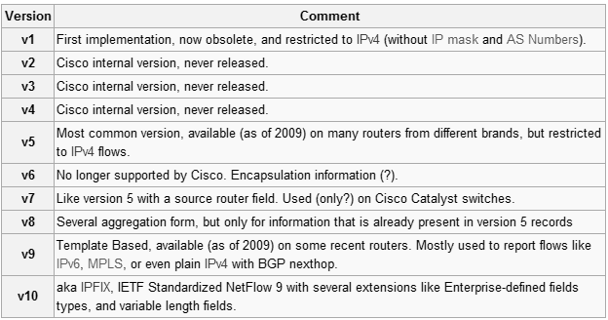
Netflow Versions
We really only care about v5 and v10 (IPFIX)
http://en.wikipedia.org/wiki/NetFlow#NetFlow_Versions
http://datatracker.ietf.org/wg/ipfix/charter/
Notes:
-more data on IPFix http://datatracker.ietf.org/wg/ipfix/charter/
See also RFC5101 - Specification of the IP Flow Information Export (IPFIX) Protocol for the Exchange of IP Traffic Flow Information (IPFIX)

Slide 13
TCP Connection Example
192.168.1.1
192.168.1.2
SYN
SYN ACK
ACK
Data (200 Bytes)
Data (3000 Bytes)
FIN
FIN ACK
ACK

Slide 14
Uniflow vs Biflow
Uniflow
Biflow
192.168.1.1 | 56981 | 192.168.1.2 | 80 | 1/17/12 15:23:30 | 300 bytes
192.168.1.2 | 80 | 192.168.1.1 | 56981 | 1/17/12 15:23:30 | 3060 bytes
192.168.1.1 | 56981 | -> | 192.168.1.2 | 80 | 1/17/12 15:23:30 | 3360 bytes
Why don’t the sizes listed match up with the amount of data transferred?

Slide 15
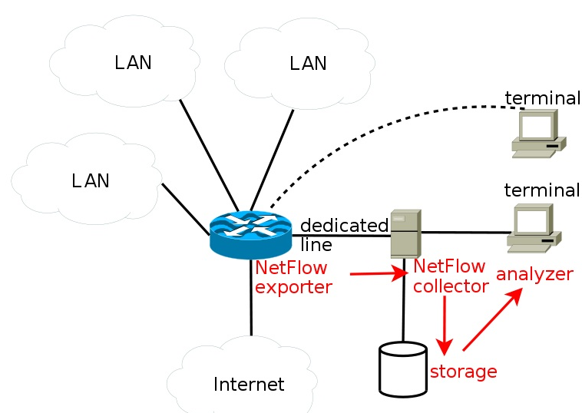
Architectural Discussion
http://en.wikipedia.org/wiki/File:Netflow_architecture_en.svg

Slide 16
Sensor deployment
Where are sensors deployed logically?
Sensor hardware limitations
  Relative to the bandwidth of the link being monitored
  Straight collection vs. pushing analytics forward
Bandwidth back to centralized processing and storage
Passive stand-alone sensor vs. getting netflow off of routers

Slide 17
Perimeter Visibility
http://www.cisco.com/web/about/ac50/ac47/PP_icons.zip

Slide 18
Enclave-Level Visibility
http://www.cisco.com/web/about/ac50/ac47/PP_icons.zip

Slide 19
Hostflow
MITRE developed tool
Collects netflow-like data from the host
  Requires deploying an agent on the device
Bridges the gap between network and host
Allows visibility when deploying network sensors at the access layer is cost prohibitive

Slide 20
Hostflow Visibility
http://www.cisco.com/web/about/ac50/ac47/PP_icons.zip

Slide 21
Bonus: Flow Sampling
Routers do flow sampling
  Selecting one out of every n packets
  Great for net ops, hard to use for security
Enclave-level sensors produce a lot of flows
Depending on your analytics you can do some intelligent sampling and aggregation
Particularly important if your enterprise is geographically distributed

Slide 22
Bonus: Flow Sampling
Collect only from n hosts in an area (e.g., subnet)
Collect only for a limited period of time
Sample only 1 in every n flows
Ignore common servers and their ports
Collect only for ports of interest
Collect only for flows destined for same subnet
Report only on new sip/sport or dip/dport pairs that haven’t been seen in the last hour, day, etc.
Aggregate into larger timespans
Notes:
Ignore common servers and their ports (e.g., I don’t care about SMTP traffic that involves my mail server)
Collect only for flows destined for the same subnet. This is particularly useful if you’ve got a netflow sensor at a higher level in the network such that you’re seeing traffic to/from the subnet.
Aggregate into larger timespans (e.g., there were x flows with a total of y bytes and z duration from sip s to dip d over the last day)

Slide 23
Outline
Introduction
  What is Netflow?
  Sensor Location
  Sampling
Tools
  YAF
  SiLK
  iSiLK
  Argus
  Bro
Analytics
  Situational Awareness Analytics
  Hunting Analytics
  Data Fusion Analytics
Wrap Up

Slide 24

Tool Time
http://commons.wikimedia.org/wiki/File:US_Navy_080728-N-9623R-009_Equipment_Operator_2nd_Class_Omar_Shariff_White_moves_dirt_that_will_be_used_in_the_hescos_at_an_Al_Qaim.jpg

Slide 25
Tool Time
Yaf, SiLK, iSilk, Argus, Bro
Lab data is supplied from ITOC competition
  Samples include port scanning, malware c2c behavior, SMTP, HTTP, FTP, SSH

Slide 26
High Level Tools Overview
YAF: DPI and P0f OS fingerprinting
SiLK: best analysis documentation, files can stay in binary
iSiLK: nice GUI front end, good for learning SiLK
Argus: simple server/client install process, many 3rd party tools
Bro: weird.log file is useful for picking up on strange evasion / misconfigurations

Slide 27
YAF
Yet Another Flowmeter

Slide 28
YAF Outline
What is YAF?
YAF optional features
Where do you get it?
Converting pcap to YAF netflow format
What does YAF netflow format look like?

Slide 29
YAF (Yet Another Flowmeter)
Pcap -> IPFIX netflow format
  Can also be run on pcap files or on the wire
Optional features
  Biflow extension
  Application labeling
  OS detection
  Deep packet inspection
See
  http://tools.netsa.cert.org/yaf/yafdpi.html
  http://tools.netsa.cert.org/yaf/applabel.html
  http://tools.netsa.cert.org/yaf/
  http://tools.netsa.cert.org/yaf/docs.html
Notes:
http://tools.netsa.cert.org/yaf/applabel.html
yaf can examine packet payloads and determine the application protocol in use within a flow, and export a 16-bit application label with each flow if yaf is built with application labeler support (using the --enable-applabel option to ./configure when yaf is built).
The exported application label uses the common port number for the protocol. For example, HTTP Traffic, independent of what port the traffic is detected on, will be labeled with a value of 80, the default HTTP port. Labels and rules are taken from a configuration file read by yaf at startup time. This rule file can be given on the command line with the --applabel-rules option or will try to be read from the default location of/usr/local/etc/yafApplabelRules.conf.
If yaf was installed in a nonstandard location, it may be necessary to set the LTDL_LIBRARY_PATH environment variable to the location of the application label plugins.
Application labeling requires payload capture to be enabled with the --max-payload option. A minimum payload capture length of 384 bytes is recommended for best results.
Application labeling is presently experimental, and not guaranteed to be 100% accurate. However, application labels are supported in yafscii and SiLK via rwflowpack, flowcap, and rwipfix2silk.
http://tools.netsa.cert.org/yaf/yafdpi.html
yaf can examine packet payloads, capture useful information for a specific protocol, and export it in a protocol-specific template within yaf'sSubTemplateMultiList if yaf is built with plugin support enabled (using the --enable-plugins option to ./configure). It may be necessary to set the LTDL_LIBRARY_PATH environment variable if the plugins were installed in a nonstandard location.
The DPI plugin requires payload capture to be enabled with the --max-payload option. A minimum payload capture length of 384 octets is recommended for best results. --applabel is also required, as the application label determines how the inspection will execute.
DPI in yaf is directly related to application labeling as it will only perform DPI if a match was found during the application labeling phase, and it will only execute an inspection specific to the protocol denoted by the application label.
In order to enable DPI in yaf the following should be added to the command line:
--plugin-name=/usr/local/lib/yaf/dpacketplugin.la
You can also add the option switch to specify which protocols to perform DPI:
--plugin-opts="53 80 21“
The above will perform DPI for DNS, HTTP, and FTP.

Slide 30
YAF Optional Feature: applabel
YAF application labeling
  Supports yafscii, rwflowpack, flowcap, and rwipfix2silk
  Adds an additional column of data
App Labeling Rules
  Rules located in /usr/local/etc/yafApplabelRules.conf
  label <N> regex <expression>
  label <N> plugin <library> <function> <arg-list>
  label <N> signature <expression>
  label 80 regex HTTP/\d\.\d\b
  label 53 plugin dnsplugin dnsplugin_LTX_ycDnsScanScan

Slide 31
YAF Optional Feature: p0f
P0f OS fingerprinting
  Passive OS identification using libP0f
    Packet size
    Window size
    Flags
    More info /usr/local/etc/p0f.fp
DHCP OS fingerprinting
  /usr/local/etc/dhcp_fingerprints.conf
Output viewed with yaf-file-mediator
http://tools.netsa.cert.org/yaf/yafdhcp.html
https://tools.netsa.cert.org/confluence/display/tt/libp0f

Slide 32
YAF Optional Feature: DPI
Deep packet inspection
App labeling needs to be used
  Different per application (HTTP, DNS, etc.)
In order to enable DPI in YAF:
  --plugin-name=/usr/local/lib/yaf/dpacketplugin.la
Specify which protocols to perform DPI:
  --plugin-opts="53 80 21"
  The above will perform DPI for DNS, HTTP, and FTP

Slide 33
YAF Optional Feature: DPI
FTP, HTTP, IMAP, SSH, DNS, SSL/TLS, IRC, POP3, MySQL
  FTP: commands/replies
  HTTP: server response header, user agent, location response header, response code, cookie headers
  IMAP: command and response, login and pass, authenticate mechanism, # of messages in mailbox
  SSH: version number
  DNS: query/response type, header field, etc.
  More info available /usr/local/etc/yafDPIRules.conf
Output viewed with yaf-file-mediator

Slide 34
YAF Optional Feature: DPI
Examples (FTP)
  label 21 yaf 131 (?i)(REST \d+|RETR \w+|STO[RU] \w+)\b
  label 21 yaf 132 (?i)USER (\w+)\b
  label 21 yaf 133 (?i)PASS ([\w.@]+)\b
  label 21 yaf 134 (?i)TYPE (A|E|I)\b
  label 21 yaf 135 (?i)([1-5][0-5][0-7] [\w\s]+)\b

Slide 35
Acquiring YAF
Easy way in a premade Linux
  http://tools.netsa.cert.org/livecd.html
RPMs are available for Fedora 15, and Redhat 5
  https://tools.netsa.cert.org/confluence/display/tt/RPMs+of+NetSA+Tools
Compiling from source
  http://tools.netsa.cert.org/yaf/docs.html
  https://tools.netsa.cert.org/confluence/pages/viewpage.action?pageId=23298051
  Have fun, some dependencies are only available at http://netsa.cert.org
  Remember, some of the optional features need flags when running ./configure when building YAF

Slide 36
Converting pcap to IPFIX
Standard conversion
  yaf –in filename.pcap --out filename.yaf
With application labeling
  Add --applabel-rules= /usr/local/etc/yafApplabelRules.conf --max-payload 300
P0f
  Add --p0fprint --p0f-fingerprints /usr/local/etc/ --max-payload 300
DHCP finger printing
  Add --plugin-name=/usr/local/lib/yaf/dhcp_fp_plugin.la
Deep Packet Inspection
  Add --plugin-name=/usr/local/lib/yaf/dpacketplugin.la
Man yaf and yafdpi

Slide 37
Binary IPFIX to ASCII
Necessary since many tools cannot display IPFIX data
Convert from binary YAF to ascii with yafscii
  yafscii --in filename.yaf
P0f and dpi data must use YAF 2.0 IPFIX file mediator
  yaf_file_mediator --input in_file.yaf --out out_file.txt
  https://tools.netsa.cert.org/confluence/display/tt/YAF+2.x+IPFIX+File+Mediator
http://tools.netsa.cert.org/yaf/yafscii.html

Slide 38
YAF Output: TCP Example
2009-04-21 08:07:08.676 - 08:07:08.719 (0.043 sec)
tcp 10.1.10.65:49157 => 10.2.250.136:80
3b3aa589 S/APR vlan 014 (5/336 ->) applabel: 80

Slide 39
YAF Output: TCP Reset
2009-04-21 08:08:02.042
tcp 10.2.254.116:443 => 10.2.200.248:49387
00000000 AR/0 (1/40 ->)

Slide 40
YAF Output: UDP
2009-04-21 08:06:36.713 - 08:07:08.874 (32.161 sec)
udp 10.2.196.253:137 => 10.2.255.255:137
(12/1080 ->) idle applabel: 137

Slide 41
SiLK
System for Internet-Level Knowledge

Slide 42
SiLK Installation
Time consuming to install from source, handbook here http://tools.netsa.cert.org/silk/install-handbook.html
There is a live cd http://tools.netsa.cert.org/livecd.html
Back in my day we didn’t have Redhat/Fedora RPMS https://tools.netsa.cert.org/confluence/display/tt/RPMs+of+NetSA+Tools

Slide 43
SiLK Optional Tools
Country codes
DNS lookups
IPv6
For more info
  http://tools.netsa.cert.org/silk/install-handbook.html
  http://tools.netsa.cert.org/silk/install-handbook.html#x1-160002.3
Notes:
Put talking points here

Slide 44
SiLK Familarization
Learning to crawl with rwcut
Learning to walk with rwcut & rwfilter
SiLK commands are piped to form a workflow
  Same idea as Linux commands

Slide 45
Building SiLK
Needs YAF, python-dev
http://tools.netsa.cert.org/silk/install-handbook.html#x1-160002.3

Slide 46
SiLK Commands: rwfileinfo
Provide basic metadata on a SiLK file
Try it:
rwfileinfo 20120501-1400-1500.rwf

Slide 47
SiLK Commands: rwcut
View flow records as text
  rwcut --num-rec=10 20120501-1400-1500.rwf
You can also specified fields to print
  rwcut --num-rec=10 --fields=sip,dip,proto,sport,dport,stime 20120501-1400-1500.rwf

Slide 48
SiLK Commands: rwtotal
Count how much traffic matched specific keys
What layer 4 protocols (TCP, UDP, etc) are running?
rwtotal --proto --skip-zero 20120501-1400-1500.rwf
Note: the above is identical to rwuniq --field=proto --values=records,bytes,packets --sort-output 20120501-1400-1500.rwf
rwtotal runs faster and uses a fixed amount of memory, but has less functionality.

Slide 49
SiLK Commands: rwuniq
Like rwtotal, but with more key options
We want common servers and src ports with at least 50 flows. For each server/port pair display flows, total bytes and distinct dips.
rwfilter --proto=6,17 --pass=stdout 20120501-1400-1500.rwf | rwuniq --field=sip,sport --flows=50 --bytes --values=dip-distinct | sort -nr -k 3,3 -t '|' | head

Slide 50
SiLK Commands: rwstats
Generate top-N/bottom-N lists or overall stats
What does the distribution of bytes, packets and bytes/packet look like?
rwstats --overall-stats 20120501-1400-1500.rwf

Slide 51
SiLK Commands: rwstats (cont’d)
How about the 10 top destination ports?
rwstats --fields=dport --count=10 20120501-1400-1500.rwf
And the top 10 source ports?
rwstats --fields=sport --count=10 20120501-1400-1500.rwf
We can also use percentage based cutoffs
rwstats --fields=dport --percentage=1 20120501-1400-1500.rwf

Slide 52
SiLK Commands: rwcount
Examine traffic binned over time
Let’s chop our hour into five minute intervals
rwcount --bin-size=300 20120501-1400-1500.rwf

Slide 53
SiLK Commands: rwcount (cont’d)
Why are there bins after 15:00 if the traffic is from 14:00-15:00?
How does this output differ?
rwcount --bin-size=300 --load-scheme=1 20120501-1400- 1500.rwf
The above is nearly identical to
rwstats --fields=stime --values=records,bytes,packets --bin- time=300 --percentage=1 20120501-1400-1500.rwf | tail -n +4 | sort -t '|'
Notes:
Our data goes from 14:00-15:00, so what’s with all the flows after 15:00? By default rwcount allocates flow attributes in the following way: “Assume the traffic is evenly distributed during each millisecond that the flow is active. For a flow whose duration spans five bins, each bin will receive a portion of the flow-, packet-, and byte-counts weighted by the amount of time the flow spent in each bin.”

Slide 54
SiLK Commands: rwfilter
Swiss-army knife for filtering flows
There are switches for every flow attribute
Let’s see what our top webservers are located
rwfilter 20120501-1400-1500.rwf --sport=80,443,8080 -- protocol=6 --packets=4- --ack-flag=1 --pass=stdout | rwstats --fields=sip --percentage=1 --bytes

Slide 55
SiLK Commands: rwscan
Employs two algorithms to detect scans
rwsort --fields=sip,proto,dip 20120501-1400-1500.rwf| rwscan --scan-model=2
The other scan model doesn’t work well for this particular data

Slide 56
Other ways to look for scanning
rwfilter 20120501-1400-1500.rwf --bytes=0-2048 -- packets=1-3 --flags-all=/RF --pass=stdout | rwuniq -- fields=sip --values=dip-distinct,records | sort -k 3,3 -n -r -t '|' | head -n 30
Meaning:
  Size less than 2048 bytes
  1 to 3 packets
  No RST or FIN flags
  Per sip, |dip| and record count

Slide 57
SiLK Commands: IP Sets
Useful for dealing with summaries of data
Describe collections of arbitrary IP addresses
Set operations are supported by rwsettool
  Intersection
  Difference
  Union
Rwfilter can take IP sets as parameters
Example: you can build an IP set for all of your webservers and then profile their traffic

Slide 58
SiLK Commands: IP Sets
Simple example:
  Look for sources in 10.0.0.0/24
echo 10.0.0.0-255 > set_a.txt
rwsetbuild set_a.txt a.set
rwfilter 20120501-1400-1500.rwf --sipset=a.set --pass=stdout | rwcut --num-rec=10

Slide 59

SiLK Commands:
IP Bags
No, not that
http://commons.wikimedia.org/wiki/File:White_paper_bag_on_white_and_black_background.jpg

Slide 60
SiLK Commands: IP Bags
Bags are like sets, but include volume
Convert rwscan output to a bag with flow counts
rwsort --fields=sip,proto,dip 20120501-1400-1500.rwf| rwscan -- scan-model=2 --no-titles | cut -d '|' -f 1,5 | rwbagbuild --bag- input=stdin > rwscan-output.bag
View the output
rwbagcat rwscan-output.bag | sort -t '|' -k 2,2 -rn | head

Slide 61
SiLK Commands: IP Bags (cont’d)
Capture our rwfilter scanning output in a bag
rwfilter 20120501-1400-1500.rwf --bytes=0-2048 -- packets=1-3 --flags-all=/RF --pass=stdout | rwbag --sip- flows=rwfilter-scan-output.bag
What does the data look like?
rwbagcat rwfilter-scan-output.bag | sort -t '|' -k 2,2 -rn | head –n 20

Slide 62
SiLK Commands: IP Bags (cont’d)
Limit it to 10k flows (after eyeballing the data)
rwbagtool --mincounter=10000 rwfilter-scan-output.bag > rwfilter-scan-output-10k.bag

Slide 63
SiLK Commands: IP Bags (cont’d)
Combine bags from our two scanning methods (this could also be done with ipsets)
rwbagtool --maximize rwscan-output.bag rwfilter-scan- output-10k.bag > union-scan.bag
View the output
rwbagcat union-scan.bag | sort -t '|' -k 2,2 -rn | head

Slide 64
iSiLK
http://tools.netsa.cert.org/isilk/index.html

Slide 65
iSilk Overview
GUI for silk tools
Provides subset of command line functionality
Windows installer
Build instructions
  http://tools.netsa.cert.org/isilk/isilk-admin-guide.pdf
  http://tools.netsa.cert.org/isilk/isilk-user-guide.pdf

Slide 66
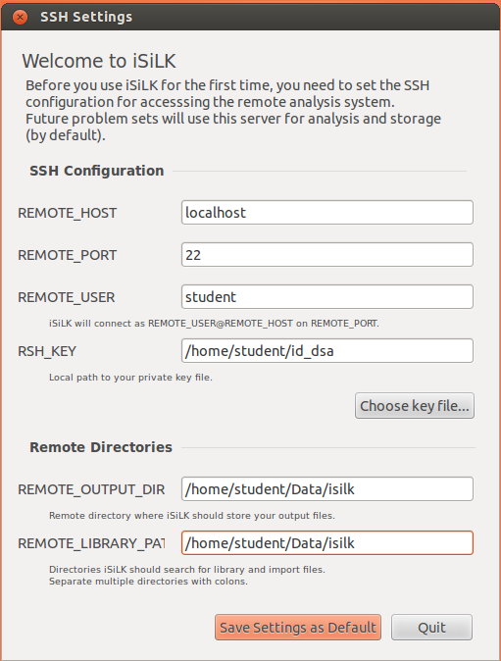
iSilk: Setup
Note: isilk needs country codes http://tools.netsa.cert.org/silk/rwgeoip2ccmap.html

Slide 67
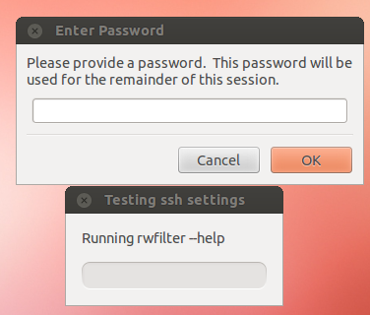
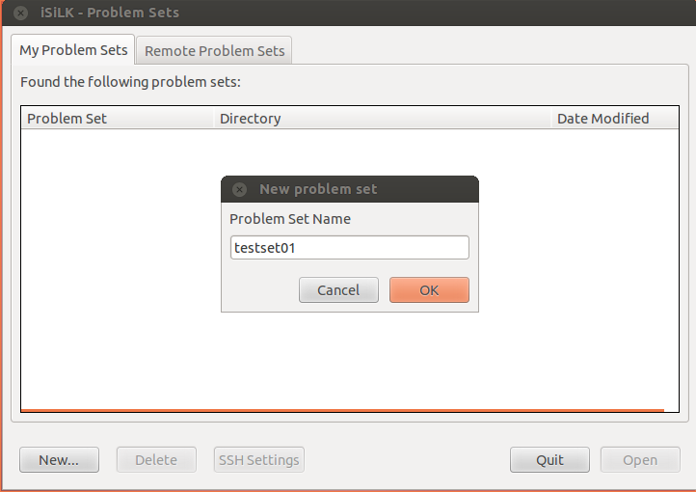
iSiLK: Setup
http://tools.netsa.cert.org/isilk/isilk-admin-guide.pdf
http://tools.netsa.cert.org/isilk/isilk-user-guide.pdf

Slide 68
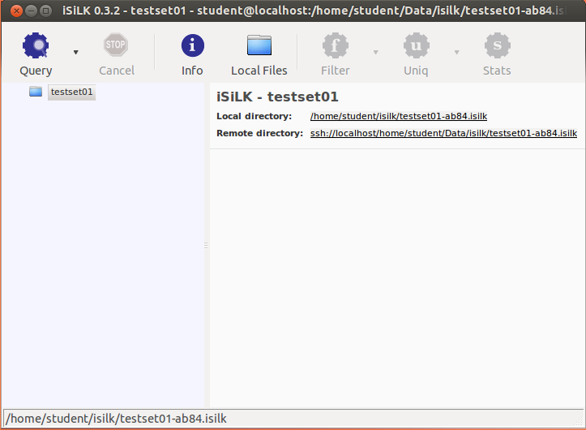
iSilk: Adding Files

Slide 69
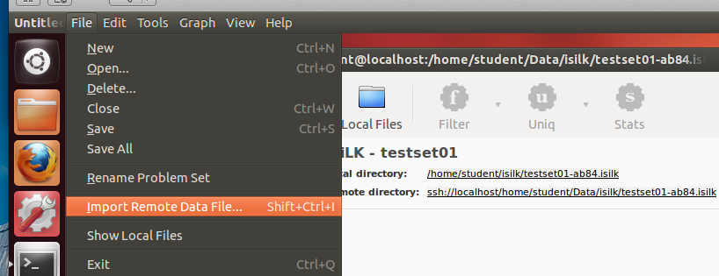
iSilk: Adding Files

Slide 70
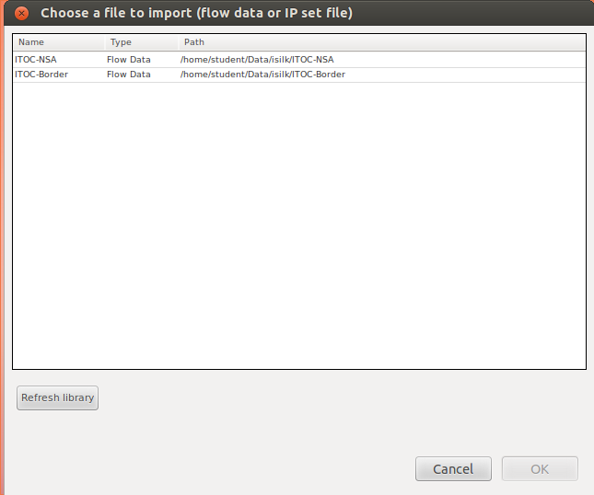
iSiLK: Adding Files

Slide 71
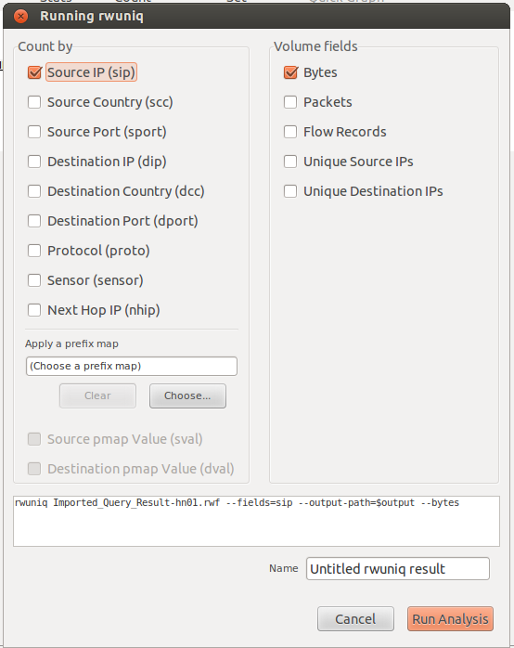
iSiLK: rwuniq

Slide 72
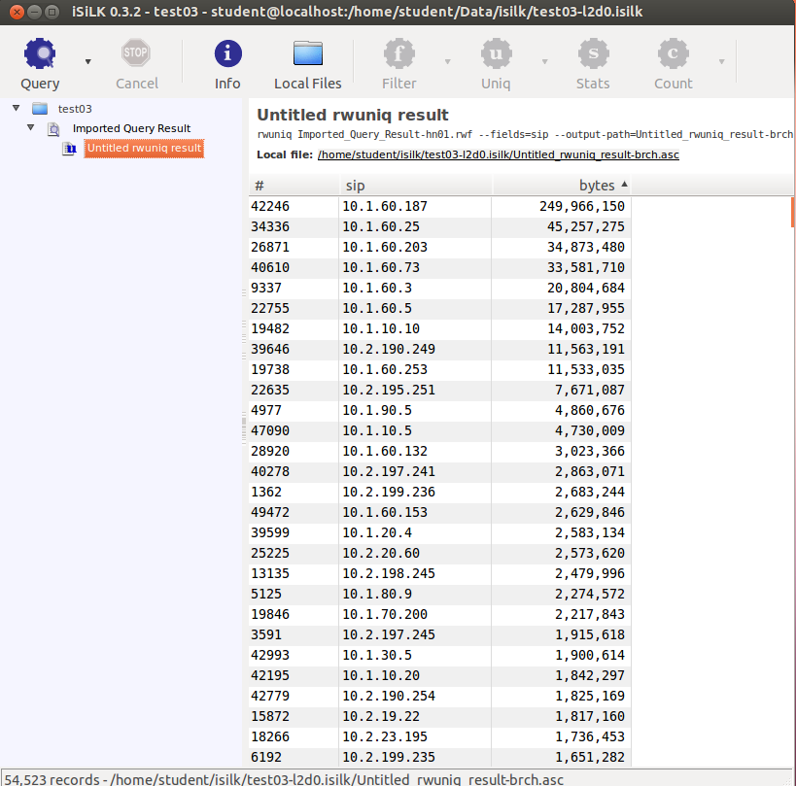
iSilk: rwuniq output

Slide 73
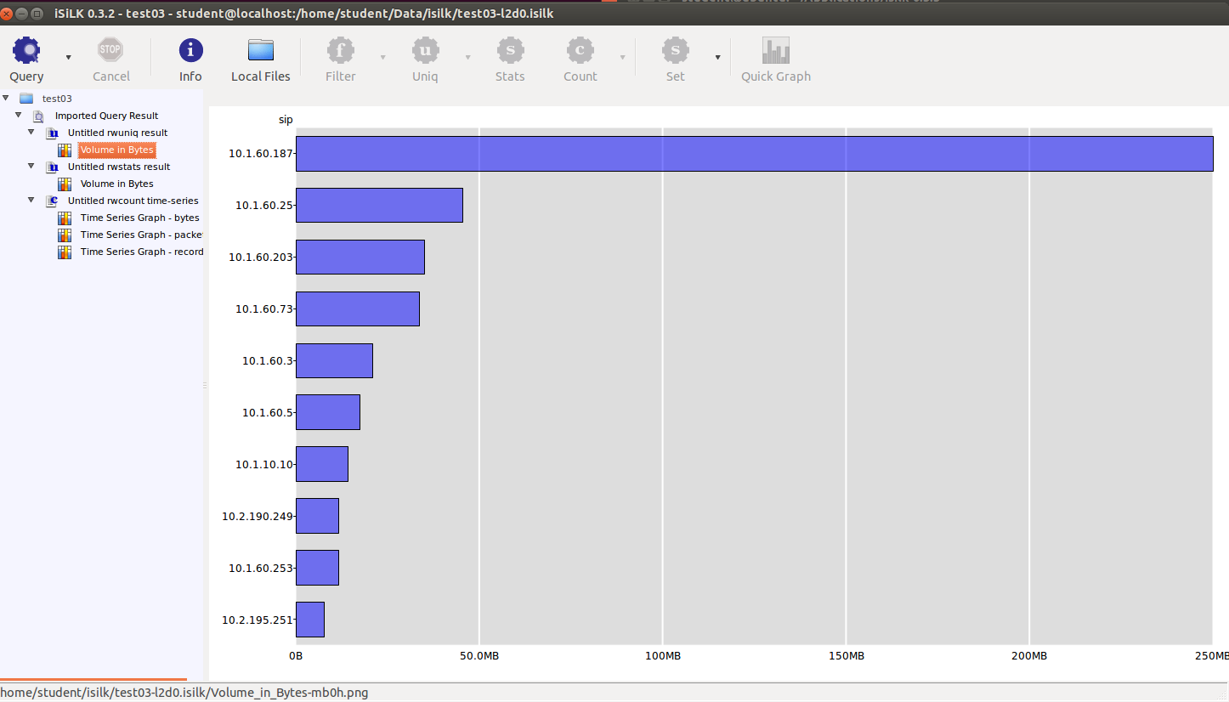
iSilk: rwuniq graph

Slide 74
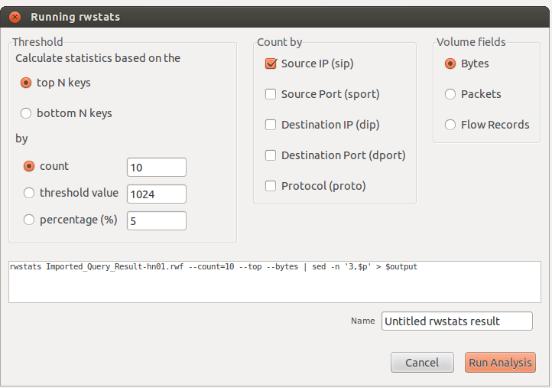
iSiLK: rwstats

Slide 75
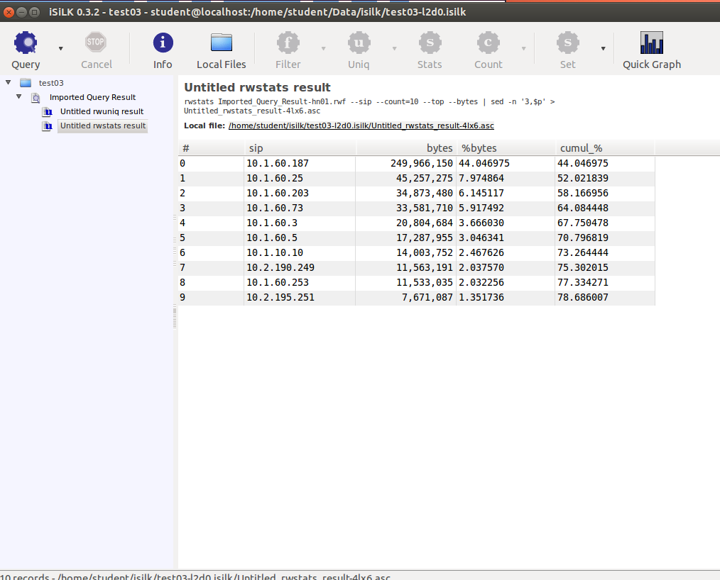
iSilk: rwstats output

Slide 76

iSilk: rwstats graph

Slide 77
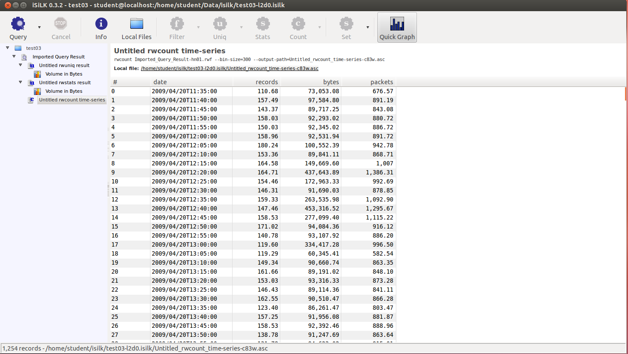
iSiLK: rwcount

Slide 78
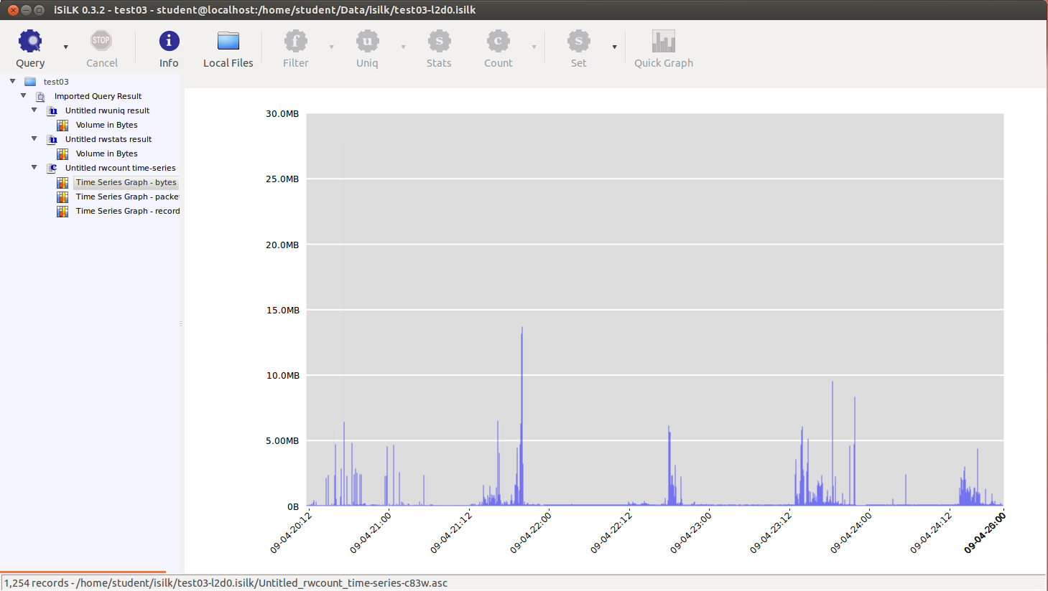
iSiLK: rwcount graph

Slide 79
iSiLK: Lab Network Data
For this lab we will be using data from the ITOC competition from 2009.
Information ITOC (CRC) competition
  http://www.westpoint.edu/crc/SitePages/About.aspx
  http://static.usenix.org/event/cset09/tech/full_papers/sangster.pdf
Download location
  http://www.westpoint.edu/crc/SitePages/DataSets.aspx
Other data for practicing
  http://www.netresec.com/?page=PcapFiles

Slide 80
SiLK lab key information
Bad guys: 10.2.x.x
Good guys: 10.1.60.x
  Each team has unique IP range
  Servers have designated IP addresses

Slide 81
iSiLK: Lab ITOC Competition
NSA Red Team
&
Simulated Internet
10.2.x.x
AF1T2
AF1T1
NPS
RMC
USAFA
USCGA
USMMA
USMA
USNA

Slide 82
iSilk: Lab10.1.60.x Team Network
Web
Server
10.1.60.187
DNS
Server
10.1.60.5
Jabber
Server
10.1.60.73
Email
Server
10.1.60.25
Client PC
Client PC
Client PC

Slide 83
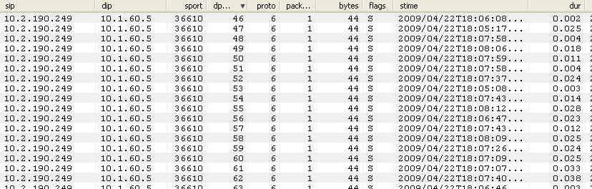
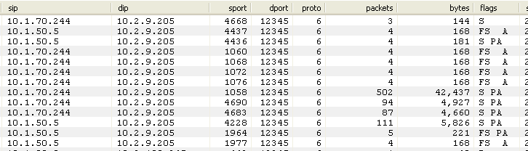
iSiLK: Lab Port Scan & Netbus

Slide 84
Argus

Slide 85
Argus: Commands
Converting Pcap to netflow
  Argus –r packet.pcap –w packet.argus
Reading a netflow file
  ra –r netflowfile
http://www.qosient.com/argus/gettingstarted.shtml

Slide 86
Argus: ra Core Clients
Client | Info
ra | Basic argus record reading and printing and storing
rabins | Align argus data to time based bins.
racluster | Argus data aggregation
racount | Tally various aspects of an argus stream.
radium | Argus record collection and distribution.
ranoymize | Anonymization of argus data.
rasort | Argus file or stream sorting.
rasplit | Splits and distributes argus data streams, writes the data to files.
http://www.qosient.com/argus/ra.core.examples.shtml

Slide 87
Argus: ra Output Fields
Output field | Info
time | When the argus server is running in default mode, ra reports the transaction starting time. When the server is in DETAIL mode, the transaction ending time is reported.
mac | mac.addr is an optional field, specified using the -m flag. mac.addr represents the first source and destination MAC addresses seen for a particular transaction. These addresses are paired with the host.port fields, so the direction indicator is needed to distinguish between the source and destination MAC addresses.
proto | see next slides. 1st field is protocol specific, 2nd is upper protocol used

Slide 88
Argus: ra Protocol Field
Proto | The proto indicator consists of two fields. The first is protocol specific and the designations are:
m | MPLS encapsulated flow
q | 802.1Q encapsulated flow
p | PPP over Ethernet encapsulated flow
E | Multiple encapsulations/tags
s | Src TCP packet retransmissions
d | Dst TCP packet retransmissions
* | Both Src and Dst TCP retransmissions
i | Src TCP packets out of order
r | Dst TCP packets out of order
& | Both Src and Dst packet out of order

Slide 89
Argus: ra Protocol Field
Proto | Info
S | Src TCP Window Closure
D | Dst TCP Window Closure
@ | Both Src and Dst Window Closure
x | Src TCP Explicit Congestion Notification
t | Dst TCP ECN
E | Both Src and Dst ECN
M | Multiple physical layer paths
I | ICMP event mapped to this flow
S | IP option Strict Source Route
L | IP option Loose Source Route

Slide 90
Argus: ra Protocol Field
Proto | Info
T | IP option Time Stamp
+ | IP option Security
R | IP option Record Route
A | IP option Router Alert
O | multiple IP options set
E | unknown IP options set
F | Fragments seen
f | Partial Fragment
V | fragment overlap seen

Slide 91
Argus: ra Direction Field
Field | Info
direction | The dir field will have the direction of the transaction, as can be best determined from the datum, and is used to indicate which hosts are transmitting. For TCP, the dir field indicates the actual source of the TCP connection, and the center character indicating the state of the transaction.
- | Transaction was NORMAL
| | Transaction was RESET
o | Transaction TIMED OUT.
? | Direction of transaction is unknown

Slide 92
Argus: ra Output Fields
Output Field | Info
host | The host field is protocol dependent, and for all protocols will contain the IP address/name. For TCP and UDP, the field will also contain the port number/name, separated by a period.
count | An optional field, specified using the -c option. There are 4 fields that are produced. The first 2 are the packet counts and the last 2 are the byte counts for the specific transaction. The fields are paired with the previous host fields, and represent the packets transmitted by the respective host.
status | Indicates the principle status for the transaction report, and is protocol dependent. For all the protocols, except ICMP, this field reports on the basic state of a transaction. See next slide for more info

Slide 93
Argus: ra Status Field
Output field | Info
REQ|INT (requested|initial) | This indicates that this is the initial status report for a transaction and is seen only when the argus-server is in DETAIL mode. For TCP connections this is REQ, indicating that a connection is being requested. For the connectionless protocols, such as UDP, this is INT.
ACC (accepted) | This indicates that a request/response condition has occurred, and that a transaction has been detected between two hosts. For TCP, this indicates that a connection request has been answered, and the connection will be accepted. This is only seen when the argus-server is in DETAIL mode. For the connectionless protocols, this state indicates that there has been a single packet exchange between two hosts, and could qualify as a request/response transaction.

Slide 94
Argus: ra status field
Output field | Info
EST|CON (established connected) | This record type indicates that the reported transaction is active, and has been established or is continuing. This should be interpreted as a status report of a currently active transaction. For TCP, the EST status is only seen in DETAIL mode, and indicates that the three way handshake has been completed for a connection.
CLO (closed) | TCP specific, this record type indicates that the TCP connection has closed normally.
TIM (timeout) | Activity was not seen relating to this transaction, during the argus server's timeout period for this protocol. This status is seen only when there were packets recorded since the last report for this transaction.
ICMP | See ra man file for details on ICMP status

Slide 95
Argus: racount
racount | Sum
records | 574583
Total packets | 5474657
Source packets | 1363063
Destination packets | 4111594
Total bytes | 3789669692
Source bytes | 391088052
Destination bytes | 3398581640
Data created with racount –r itoc.argus
man racount

Slide 96
Bro
Intrusion Detection System

Slide 97
Bro: Summary
Behavior and signature-based IDS, framework
Version 2.0 is much more streamlined than 1.5
Conn.log is the “netflow” of the Bro outputs
Bro also supplies detailed data on called scripts/policy (2.0/1.5)
  HTTP traffic
  DNS
  SSH
  Strange behavior
http://www.bro-ids.org/

Slide 98
Bro: 1.5 vs. 2.0
Works much better out of the box
  64 bit packages
  Security onion VM
  Compiling from source very quick
  No site config file needed for analysis
  Custom Bro 1.5 code won’t port well
Bro 1.5 scripts were in /policy now in /scripts
Difference in conn.log (the netflow of Bro)

Slide 99
Bro: Conn.log 1.5
Protocol
Org bytes sent
Res byte sent
State
Flags
Tag
Start
Duration
Local IP
Remote IP
Service
Local Port
Remote port
http://www-old.bro-ids.org/wiki/index.php/
Reference_Manual:_Analyzers_and_Events#Connection_summaries

Slide 100
Bro: Reading pcap
Bro -r filename.pcap
  Default analysis
Bro –r filename.pcap local
  More detection options
Bro –r filename.pcap protocols/ssl/validate-certs
  Base analysis and SSL cert validation
http://www.bro-ids.org/documentation/quickstart.html#using-brocontrol

Slide 101
Bro: Conn.log 2
Bro Fields
Time Stamp
Unique Connection Identifier
Id.orig_h
Id.orig_p
Id.resp_h
Id.resp.p
proto
service
duration
Orig bytes
Resp bytes
Data Sample UDP DNS
1240301181.402707
2KEu8Pvr2Oi
10.1.90.5
1209
10.2.20.52
53
UDP
DNS
0.000623
47
111
http://www.bro-ids.org/documentation/quickstart.html#browsing-log-files

Slide 102
Bro: Conn.log 2
Bro Fields
Conn_state
Local_orig
Missed_bytes
history
Orig_pkts
Orig_ip_bytes
resp_pkts
Resp_ip_bytes
Tunnel_parents
Data Sample UDP DNS
SF
-
0
Dd
1
75
1
139
(empty)
http://www.bro-ids.org/documentation/_downloads/main14.bro

Slide 103
Bro: TCP Flags
S0 | Connection attempt seen, no reply.
S1 | Connection established, not terminated.
SF | Normal establishment and termination. Note that this is the same symbol as for state S1. You can tell the two apart because for S1 there will not be any byte counts in the summary, while for SF there will be.
REJ | Connection attempt rejected.
S2 | Connection established and close attempt by originator seen (but no reply from responder).
S3 | Connection established and close attempt by responder seen (but no reply from originator).

Slide 104
Bro: TCP Flags
RSTO | Connection established, originator aborted (sent a RST).
RSTR | Established, responder aborted.
RSTOS0 | Originator sent a SYN followed by a RST, we never saw a SYN-ACK from the responder.
RSTRH | Responder sent a SYN ACK followed by a RST, we never saw a SYN from the (purported) originator.
SH | Originator sent a SYN followed by a FIN, we never saw a SYN ACK from the responder (hence the connection was "half" open).
SHR | Responder sent a SYN ACK followed by a FIN, we never saw a SYN from the originator.
OTH | No SYN seen, just midstream traffic (a "partial connection" that was not later closed).

Slide 105
Bro: Conn.log Additional Info
Field | explanation
Local_orig | T – connection orginated locally F- connection orignated remotely Blank - bro::site::local_nets variable is undefineded
Missed_bytes | Number of bytes missed in content gaps (if missed_bytes > 0 protocol analysis will fail)
Tunnel_parents | If this connection was over a tunnel, indicate the *uid* values for any encapsulating parent connections used over the lifetime of this inner connection.

Slide 106
Bro: Conn.log History Field
Field value | info
s | a SYN w/o the ACK bit set
h | a SYN+ACK ("handshake")
a | a pure ACK
d | packet with payload ("data”)
f | packet with FIN bit set
r | packet with RST bit set
c | packet with a bad checksum
i | inconsistent packet (e.g. SYN+RST bits both set)
lowercase | from the responder,
uppercase | from the originator,

Slide 107
Bro: Additional Logs
Weird.log
  Contains unusual/exceptional activity that can indicate malformed connections, traffic that doesn’t conform to a particular protocol, malfunctioning/ misconfigured hardware, or even an attacker attempting to avoid/confuse a sensor.
  Without context, it’s hard to judge whether this category of activity is interesting and so that is left up to the user to configure.
Notice.log
  Identifies specific activity that Bro recognizes as potentially interesting, odd, or bad. In Bro-speak, such activity is called a “notice”
http://www.bro-ids.org/documentation/quickstart.html#browsing-log-files

Slide 108
Analytics

Slide 109
Outline
Introduction
  What is Netflow?
  Sensor Location
  Sampling
Tools
  YAF
  SiLK
  iSiLK
  Argus
  Bro
Analytics
  Situational Awareness Analytics
  Hunting Analytics
  Data Fusion Analytics
Wrap Up

Slide 110
Analytics Outline
Situational awareness analytics
Hunting analytics
Fusing netflow with other data
Sensor visibility differences

Slide 111
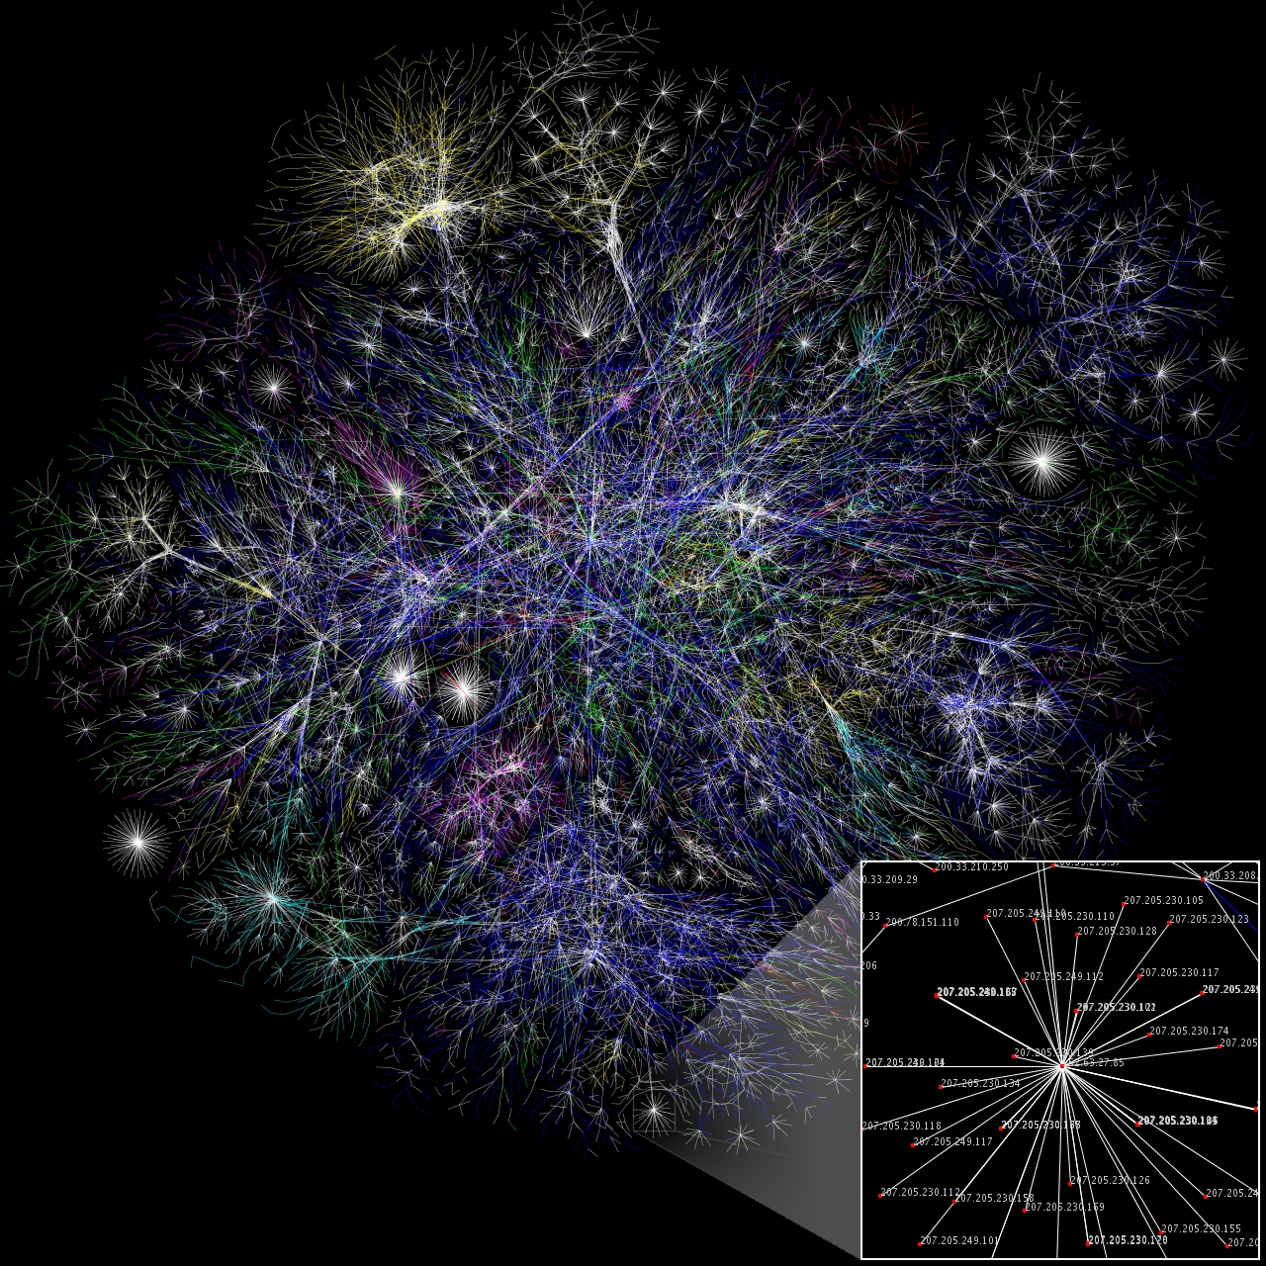
Situational Awareness
http://en.wikipedia.org/wiki/File:Internet_map_1024.jpg

Slide 112
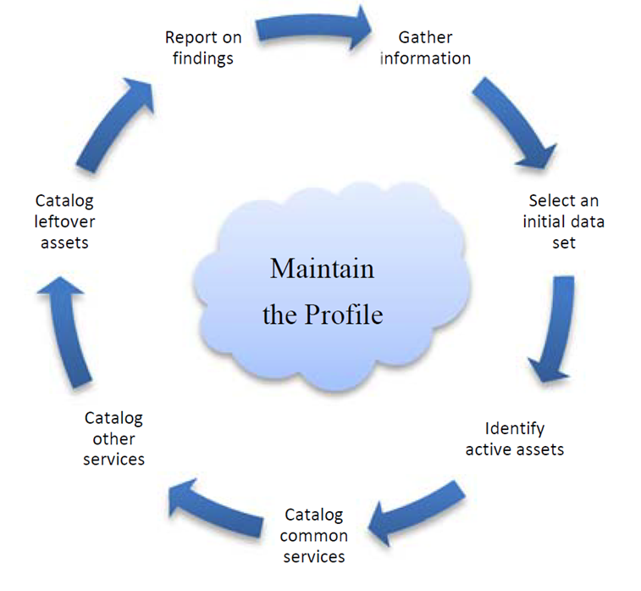
Network Profiling
Useful for inventorying server assets
See the CMU SEI
CERT technical
report Network
Profiling Using
Flow
  http://www.sei.cmu.edu/library/abstracts/reports/12tr006.cfm

Slide 113
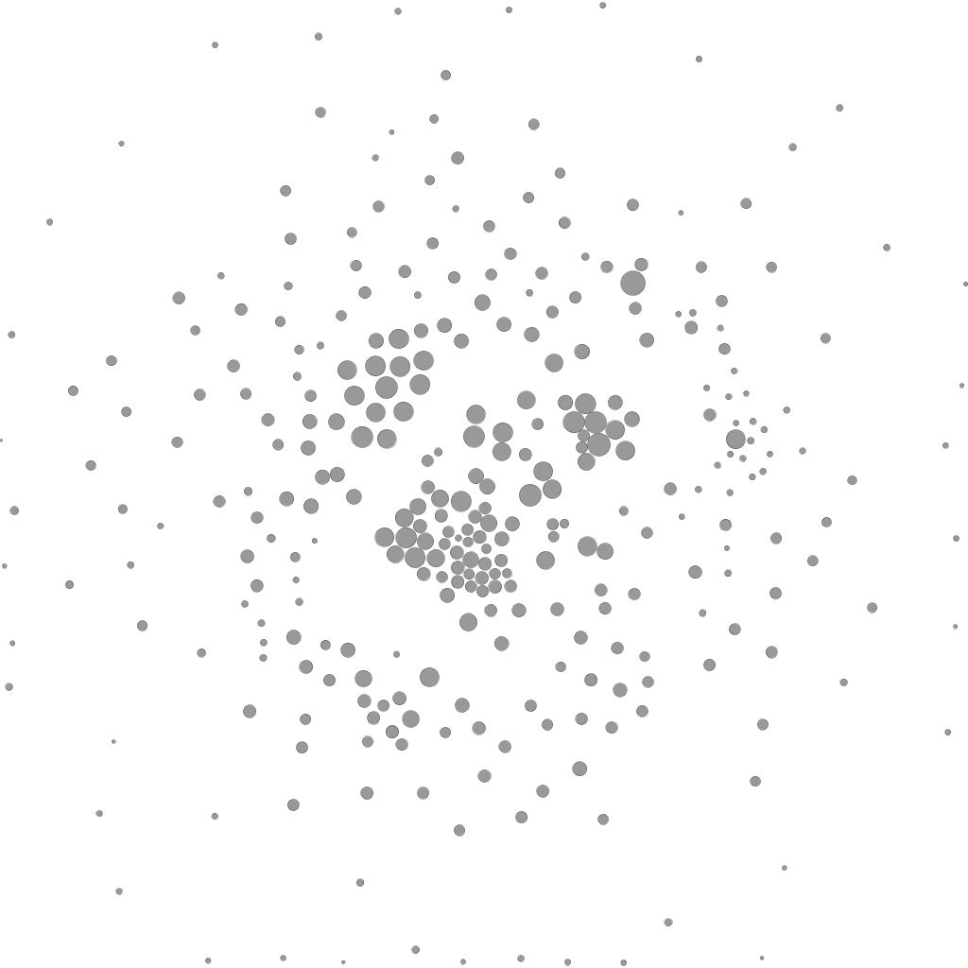
Network Profiling

Slide 114
Network Profiling: Features
Look at IP address and hostname
Top 3 src/dst ports by percentage of traffic and byte count
Average for number of flows, duration, byte/packet count
Ratio of sent vs received for above
Other layer 3 and 4 protocols in use
Feature space is very rich. Choose wisely.

Slide 115
Host Clustering
Data overload is a problem for network analysts
Goal: allow analysts to spend more time on things which require expert human attention
Inform situational awareness, e.g.,
  What does “normal” look like on a given network?
  What do normal host behaviors look like?
  Which hosts have changed recently?
  Which hosts are using a particular protocol differently?

Slide 116
Clustering informs questions like
What do “normal” behaviors look like? What’s abnormal?
  What web servers also act as web clients?
  Which hosts have similar users?
  Which hosts have had significant changes in behavior relative to themselves?
  Which hosts are acting differently from their peers with respect to a particular protocol?
  How many peers does a host have?
  What cliques are present in the network?

Slide 117
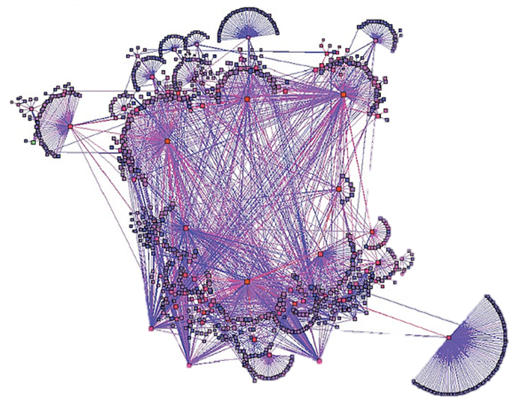
Example Network Diagram
http://www.flickr.com/photos/caseorganic/4397663442/sizes/z/in/photostream/

Slide 118
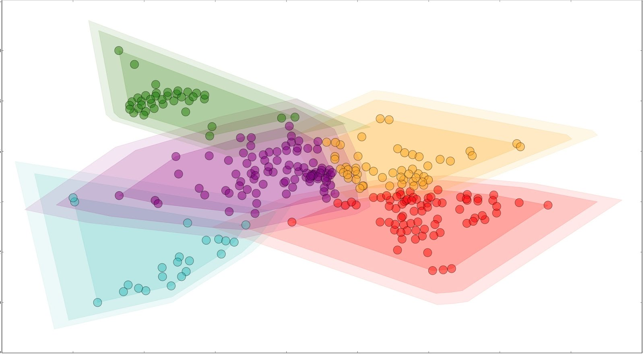
Diagram with Clustering
Domain Controllers
FTP Servers
Web Servers
Web Servers
DNS Servers
Windows Desktops
Large Byte count
Clients
DNS Servers
Many packets / flow

Slide 119
Operational Issues with Clustering
Correct selection of features and distances
  We want to differentiate groups of interest
Selecting the number of clusters on an arbitrary network
Need an external frame of reference
  External labels

Slide 120
Darkspace Monitoring
Darkspace: routable IP address space with no hosts attached
By definition, traffic to darkspace is unsolicited
Darkspace traffic contains
  Misconfigurations
  Reconnaissance
  Backscatter (from scanning or DoS attacks)
  Automated worm/virus spreading

Slide 121
Darkspace Monitoring
If you’ve got darkspace on your network (the DoD has plenty), keep an eye on it
Entropy in IP Darkspace Data by Tanja Zseby, FloCon 2012
  Work tracks distribution of entropy in {sip, dip, sport, dport} and characterizes common events

Slide 122
Volumetric Analysis
Top sources and sinks
Ratio of sent/received data
Dips contacted per sip
Examine rates of change
Consider ways to partition the data
  Sip
  Dip
  Server (individual server or server type)
  User
  Protocol (layer: 2, 3, 4, or 7)

Slide 123
Unproxied Connections
Connections bypassing the proxy are not being inspected or logged
MITRE’s firewall has open ports:
21 FTP
22 SSH
23 Telnet
119 NNTP
389 LDAP
554 RTSP
636 LDAP
2401 CVS
707 Real Audio
Notes:
Splunk demo of Outside IPs of Death Tabled and Long Connections Traversing Firewall

Slide 124
Anomalies in Netflow
Good for finding things that are loud
  Outages and misconfigurations
  Denial of Service
  Port scanning
  Worms
Mechanisms for discovering this behavior are standard in many commercial tools

Slide 125
Anomalies in Netflow
See Mining Anomalies Using Traffic Feature Distributions by Lakhina, et al.
Look for change in the distribution of packet header fields

Slide 126
Anomalies in Netflow
Protocols of interest
  DNS
  NTP
  SMB/CIFS
  SNMP
  LDAP
They tend to be regular
  As opposed to protocols like HTTP

Slide 127
Anomalous DNS Discovery
Use case: tunnel detection (IP over DNS, etc.)
See Detection of DNS Anomalies using Flow Data Analysis by Karasaridis, et al.
Separate DNS packets into requests, responses and unknown
Calculate histograms over packet size per hour of day
Look for changes in the histogram distribution
Other analytics: HTTP flows not preceded by a DNS request
Notes:
The use case for anomalous DNS activity in the Karasaridis paper is the Sinit trojan.

Slide 128
Anomalies in SMB

Slide 129
Anomalies in SMB
Use case: lateral movement between Windows workstations
TTP: net use, xcopy, and at commands
The commands are multiplexed over a single TCP session
  Result: large duration and byte count
Caveat: You need sensors placed to see this

Slide 130

Hunting Analytics
http://www.flickr.com/photos/balnaves/50840576/

Slide 131
Beacon Detection
Beaconing
  Periodic behavior in the network
Many kinds of malicious software beacon
  Remote Access Tools (RATs)
  Bots
Lots of things beacon
  We do not care about most of them
Malicious activity is often beaconing paired with other network activity
A beacon detector can be married with other signature-based tools to detect specific threats

Slide 132
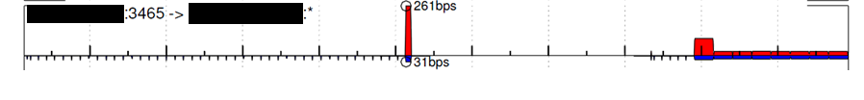
Beacon Detection: Poison Ivy
Poison Ivy is characterized by
  A series of beacons during the “phone home” phase
    Three packets with SYN flag set
  One long flow with a roughly symmetric byte count during the actual desktop session
  Some versions change ports based on system date
Beaconing Detector
Interactive Session Detector

Slide 133
Beacon Detection: Limitations
False positives: beacons that are uninteresting
  Web 2.0 – AJAX
  Periodic software updates (Windows, browsers, etc.)
  Network Time Protocol (NTP) updates
False negatives: interesting beacons that are missed
  Noise in the channel
  Intentional evasion (e.g., randomness)
  Steganography and covert channels
Finer grained methods (beyond netflow)
  Individual packet headers
  Deep packet inspection
  Examine attributes besides time

Slide 134
Chaining
Temporally correlated netflows that satisfy a common link predicate
Host A
Host B
Host C
Host D
Host E
Host F
Start Time
09:37:02
Start Time
09:36:24
Start Time
09:37:03
Start Time
11:11:36
Start Time
11:07:55

Slide 135
Chaining
Example predicates
  dport equals 3389 or 22
  dport equals 137, 138, 139 or 445
Use cases
  Worm detection
  Lateral propagation detection
  Network scanner detection
  Root cause analysis
  Attribution
  Proxy/NAT detection
  Tunnel detection

Slide 136
Ghost In The Machine
192.168.1.1
192.168.1.2
192.168.1.3
192.168.1.4
Router A
Router B
192.168.1.5
192.168.1.6

Slide 137
Ghost In The Machine
192.168.1.1
192.168.1.2
192.168.1.3
192.168.1.4
Router A
Router B
192.168.1.5
192.168.1.6

Slide 138
Ghost In The Machine
Looking for love flows in all the wrong places
192.168.1.1
192.168.1.2
192.168.1.3
192.168.1.4
Router A
Router B
192.168.1.5
192.168.1.6

Slide 139
Ghost In The Machine
What are some reasons you might see this?

Slide 140
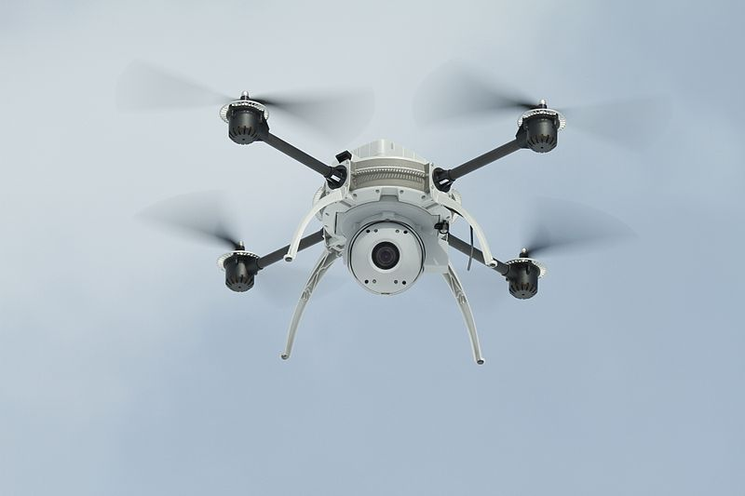
Ghost In The Machine
http://commons.wikimedia.org/wiki/File:Aeryon_Scout_With_Camera.jpg

Slide 141
Ghost In The Machine
  Maybe you’re seeing a C2 or exfil channel
  SQL Injection to MIPS Overflows: Rooting SOHO Routers presented at DefCon 2012
    SQL injection attack -> initial access
    Input sanitization vulnerability -> arbitrary file access
    Buffer overflow -> arbitrary code execution
  Supply chain risks
    FBI investigation of counterfeit Cisco routers from PRC (2008)
Notes:
SQL Injection to MIPS Overflows: Rooting SOHO Routers focused on rooting Netgear routers, but the point is applicable generally

Slide 142
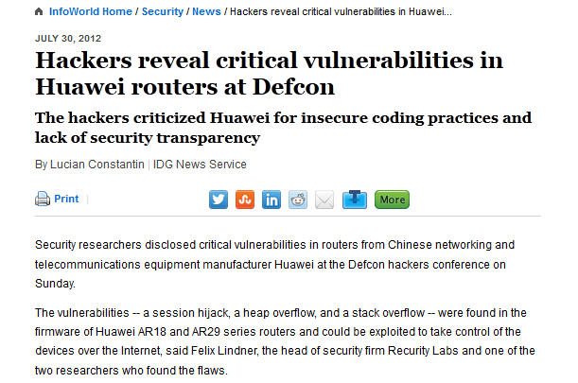
Ghost In The Machine
The vulnerabilities -- a session hijack, a heap overflow, and a stack overflow -- were found in the firmware of Huawei AR18 and AR29 series routers and could be exploited to take control of the devices over the Internet
During the Defcon talk, which Lindner gave together with Recurity Labs security consultant Gregor Kopf, the researchers pointed out that there are over 10,000 calls in the firmware's code to sprintf, a function that's known to be insecure.
http://www.infoworld.com/d/security/hackers-reveal-critical-vulnerabilities-in-huawei-routers-defcon-198983

Slide 143
Ghost In The Machine
Detection
  Diff flows seen at sensors
    Computationally expensive
  Hostflow is helpful for visibilty

Slide 144

Data Fusion Analytics
Image courtesy of NASA Goddard Laboratory for Atmospheres

Slide 145
Data Fusion Analytics
Enrich netflow with other data
  Additional network-based data
  Host-based data
  Non-computer data
What are some examples of each?

Slide 146
Data Fusion Analytics: Hostflow
Client-to-client traffic baseline
  Lateral movement detection
Blacklisted domain access when off network
Diff hostflows and netflows
Link users to netflows, pivot
Correlate processes to network sessions
  Discover processes with abnormal port usage

Slide 147
Wrap Up

Slide 148
Outline
Introduction
  What is Netflow?
  Sensor Location
  Sampling
Tools
  YAF
  SiLK
  iSiLK
  Argus
  Bro
Analytics
  Situational Awareness Analytics
  Hunting Analytics
  Data Fusion Analytics
Wrap Up

Slide 149
Analytic Platforms
Tool-specific data stores (e.g., SiLK)
  Difficult to impossible to fuse with other data
Traditional SIEMS (e.g., ArcSight)
  Good for live queries
  Issues scaling and querying retrospectively
MapReduce
  Batch-oriented
    Cloudera Impala provides real-time query capability
    Splunk provides real-time analysis on top of MR

Slide 150
Open Problems
Analytic tradecraft
  Data fusion
Deep diving into pcap from flow
Sensor deployment strategies
Visualization
Systems engineering for distributed analysis

Slide 151
Resources
Flocon
  Annual conference organized by CMU SEI CERT
  http://www.cert.org/flocon/

Slide 152
Wrap Up
Recap
  What is netflow?
  Sensor architecture
  Tools
  Analytic tradecraft
    Situational awareness analytics
    Hunting analytics
What worked well? What didn’t?

Slide 153
Further reading
IDS evasion techniques
  http://insecure.org/stf/secnet_ids/secnet_ids.html
  http://www.blackhat.com/presentations/bh-usa-06/BH-US-06-Caswell.pdf
  http://www.securitytube.net/video/5280

