Slide 1
Hacking Techniques & Intrusion Detection
Ali Al-Shemery
arabnix [at] gmail

Slide 2
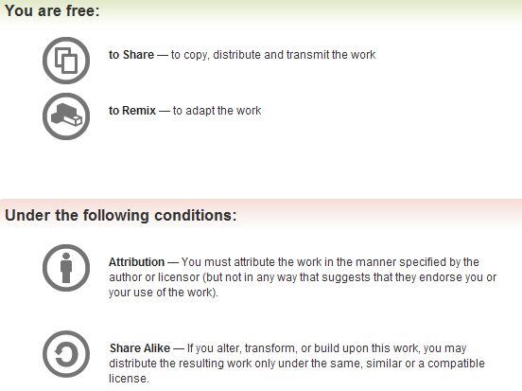
All materials is licensed under a Creative Commons “Share Alike” license.
http://creativecommons.org/licenses/by-sa/3.0/

Slide 3
# whoami
Ali Al-Shemery
Ph.D., MS.c., and BS.c., Jordan
More than 14 years of Technical Background (mainly Linux/Unix and Infosec)
Technical Instructor for more than 10 years (Infosec, and Linux Courses)
Hold more than 15 well known Technical Certificates
Infosec & Linux are my main Interests

Slide 4
Physical Pentesting
What good is your firewall or IDS/IPS if I can grab your box?

Slide 5
Outline – Physical Pentesting
Intro.
The Process
Techniques

Slide 6
Overview
A Physical Penetration Test identifies the security weaknesses and strengths of the client's physical security.
The goal of the test is to demonstrate the existence or absence of deficiencies in operating procedures concerning physical security.

Slide 7
Continue…
Did You Know?
Physical Security is often overlooked in an organization
Physical Security breaches can have the same impact as computer breaches
Physical Security Attack & Penetration Tests should be conducted on high value facilities and locations annually
Physical Security Attack & Penetration Tests should be conducted by qualified personnel with years of experience

Slide 8
The Process
Building an Operating Team
Project Planning
Rules of Engagement
Conducting Preliminary Research
Evaluating Risk
The Test Plan
Legal Issues and Documentation

Slide 9
Building an Operating Team
Operator – all are operators
Team Leader – onsite/HQ
Coordinator or Planner – offsite/HQ
Social Engineer
Computer Intrusion Specialist
Physical Security Specialist
Surveillance Specialist

Slide 10
Project Planning
Plan your project, create a workflow to be sure that you cover all aspects of the assignment. A recommended approach (Wil Sopp):
Receiving the assignment – contracts signed and certain legal formalities observed.
Negotiating the Rules of Engagement – Define what you can and can’t do during testing and their purpose is usually to limit testers to a certain scope.
Performing Preliminary Research – Pursue the initial IG phase.
  Determining Risk – Very important to accurately gauge the risk a project poses both to the company and to the team members executing it.
  Writing a Test Plan – A formal (but flexible) test plan is a good idea from both project management and legal perspectives.
  Gathering Equipment – Important for the team to take gear that’s appropriate to the test without being over encumbered.
Providing documentation and legal requirements – Once the planning stage is complete you will have a not insignificant amount of documentation.

Slide 11
Rules of Engagement
Determine areas of security the client considers to be weak and wants tested.
Determine areas of testing the client wishes to avoid for legal reasons, such as close surveillance of staff.
Agree on team members that will carry out testing (Clearances might not be given to all).
Agree on test duration, or the maximum time permitted.
Agree about the information given in advance {white, grey, black} box testing.
Agree on the target assets (overall goals): something the team must acquire, identify, gain access to, or photograph. Examples include network operation centers, passwords or target personnel.
Agree on test success, failure, and abortion circumstances.
Agree on the actions to be taken directly following successful, failed and aborted tests.
Determine a schedule for presentation and post testing report.
After agreement is reached, document the RoE to be added to the project documentation.

Slide 12
Conducting Preliminary Research
Human Intelligence (HUMINT).
Signals Intelligence (SIGINT).
Open Source Intelligence (OSINT).
Imagery Intelligence (IMINT).

Slide 13
Evaluating Risk
Team leader’s responsibility to determine what constitutes an acceptable level of project risk. If level of risk is too high then the RoE should be reassessed or the test should not be carried out.
RISK acronym – COLE:
Contractual Risks
  Unable to complete assingment
Operational Risks
  Inexperienced team members, technical communication failure
Legal Risks
  Getting arrested
Environmental Risks
  Presence of machinery or high voltage
  Climbing and falling
  Guard dogs
  Extremes of heat or cold
  Confronting armed security

Slide 14
The Test Plan
Strategic:
  High-level view of the project that details the goals, assets, team members, potential COLE risks, and necessary equipment.
Tactical:
  List of milestones and the order of completion.
Operational:
  Requirements to complete each milestone and how its completion will affect the whole engagement.

Slide 15
Legal Issues and Documentation
Includes but not limited to:
RoE
Test plan
Signed contracts
Copies of ‘get out of jail free’ cards
Scan of official ID of operating team members (passport, driving license)

Slide 16
Techniques
Practical physical security testing
Site exploration
Tactical approaches
  Tailgating to Gain Entry
  Clothes Maketh the Man
  Visiting a Nonexistent Employee
Badge security
Security mechanisms

Slide 17
Physical Pentesting
Countermeasure
Mitigation
Remediation
?

Slide 18
SUMMARY
The importance of physical penetration testing, and why it must not be overseen,
Howto prepare for a physical pentesting,
Techniques used for physical pentesting,
Countermeasures, Mitigation, and Remediation for physical pentesting.

Slide 19
References
[-] Lock picking info., http://www.lockwiki.com/index.php/Main_Page
[-] Lock picking tools, http://toool.us/
[-] Learn Lock Picking, http://www.learnlockpicking.com
[-] Video on Lock picking, http://video.google.com/videoplay?docid=-8536478434720082857&ei=8sKpSrG0J5jqqwK4tsytAw&q=lock+picking+physical+security&hl=en
[-] Journal of Physical Security (JPS), http://jps.anl.gov/
[-] Hardware Tools for Physical Pentesting, http://www.darkreading.com/vulnerability-management/167901026/security/vulnerabilities/231600749/tech-insight-three-hardware-tools-for-physical-penetration-testing.html

