Slide 1
Hacking Techniques & Intrusion Detection
Ali Al-Shemery
arabnix [at] gmail

Slide 2
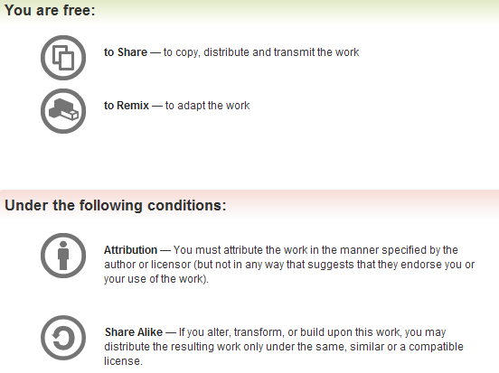
All materials is licensed under a Creative Commons “Share Alike” license.
http://creativecommons.org/licenses/by-sa/3.0/

Slide 3
# whoami
Ali Al-Shemery
Ph.D., MS.c., and BS.c., Jordan
More than 14 years of Technical Background (mainly Linux/Unix and Infosec)
Technical Instructor for more than 10 years (Infosec, and Linux Courses)
Hold more than 15 well known Technical Certificates
Infosec & Linux are my main Interests

Slide 4
<< backtrack
the quieter you become, the more you’re able to hear !!!

Slide 6
Backtrack 5 R3
About BackTrack
Installing BackTrack 5 R3
I Know Your Password!
Starting X
Configuring Network (DHCP|Static)
Configuring Basic Network Services
Exploring the Pentest Directory
Keeping Your Arsenal up2date
Knowing Your Toolbox
Backtrack 5 R3 Toolbox
Other Useful CLI’s

Slide 7
About BackTrack
First release was 2007.
The evolution of BackTrack spans many years of development, penetration tests, and unprecedented help from the security community.
BackTrack originally started with earlier versions of live Linux distributions called Whoppix, WHAX, and Auditor.
When BackTrack was developed, it was designed to be an all in one live cd used on security audits and was specifically crafted to not leave any remnants of itself on the laptop.
It has since expanded to being the most widely adopted penetration testing framework in existence and is used by the security community all over the world.

Slide 8
Installing BackTrack
BackTrack can be installed in different ways, I recommend you installing it using Virtualbox (Open Source).
By using Virtualbox, its easy to copy, replicate and clone the whole system in case something wrong happens.
No need to dedicate a machine for the system, use resources already available (only if you want to pay the price of getting a new machine).

Slide 9
I Know Your Password!!!
Change your Password, before some1 does!
Imagine getting into war and your own machinery store is played with by someone behind your lines, “the enemy!”
Before doing any security tests for people, you must protect yourself. Start that by changing the BackTrack’s default password (root/toor):
# passwd

Slide 10
Starting X
You prefer to work in a GUI environment with windows and a mouse? All you need is to start the X Window System:
# startx
Just as simple as that !!!

Slide 11
Configuring Network (DHCP|Static)
Dynamic Configuration (DHCP):
# dhclient
OR
# /etc/init.d/networking restart
Manual Configuration (Static)
# ifconfig eth0 up
# ifconfig eth0 [youripaddress] netmask [your netmask]
# route add default gw [your gateway] eth0
# echo nameserver [yourDNS]> /etc/resolv.conf

Slide 12
Configuring Basic Network Services
Sometimes you need to test stuff locally, or import data to a database, or even copy files. That’s why Backtrack comes with a different set of services we can use for such scenarios:
SSH (OpenSSH)
FTP (vsftpd)
Web (Apache)
Database (MySQL, Postgress)
TFTP

Slide 13
Exploring the Pentest Directory
Going to battles without knowing what arsenal you’re carrying can lead to failure !
Lets take a walk through the BackTrack penetration testing tools directory.
# cd /pentest

Slide 14
Keeping Your Arsenal up2date
It is very important to keep your tools up to date,
New features and enhancement are added,
Bugs are fixed,
New tools maybe added!
# apt-get update
# apt-get upgrade
OR
# apt-get dist-upgrade

Slide 15
Knowing Your Toolbox
You want to know nearly all your toolbox?
# dpkg --list
You want to know if a specific tool is installed?
# dpkg --list | grep <tool-name>

Slide 16
Backtrack 5 R3 Toolbox
Backtrack’s main toolbox categories:
Information Gathering Analysis
Vulnerability Assessment
Exploitation Tools
Privilege Escalation
Maintaining Access
Reverse Engineering
RFID Tools
Stress Testing
Forensics
Reporting Tools
Doesn’t end here !!!

Slide 17
Other Useful CLI’s
Getting Help
man <command-name>
info <command-name>
<command-name> --help
GNOME Help
Searching
find
locate <filename>
GNOME Search
Creating and Editing Files
GNOME gedit
vim
nano
Fetching File From Internet
wget -c <URL>
Installing new software/packages
apt-cache <software-name>
apt-get install <exact-software-name>
0.1% of what’s out there ☺ !!!

Slide 18
Appendix – Linux Ref.
Taken from:
Linux Arab Community, http://linuxac.org

Slide 19
Appendix – The Lab
What is Needed?
Virtualbox
BackTrack 5 R3
OWASP Broken Web Applications Project (1 NIC’s needed)
Slackware VM for Software Exploitation (1 NIC’s needed)
Windows XP/2003 (2 NIC’s needed)
Exploit KB, grab vulnerable software
Use a Host-only Network!

Slide 20
SUMMARY
What is Backtrack and howto prepare it for pentesting,
Available Backtrack Toolbox,
Backtrack basic usage,
Creating a simple lab for security testing.

Slide 21
References
[-] Backtrack Linux Distro., http://www.backtrack-linux.org/
[-] Slackware Exploitation VM, http://opensecuritytraining.info/slack12.zip
[-] OWASP Broken Web Applications VM, http://downloads.sourceforge.net/project/owaspbwa/1.0/OWASP_Broken_Web_Apps_VM_1.0.7z

