Slide 1
Hacking Techniques & Intrusion Detection
Ali Al-Shemery
arabnix [at] gmail

Slide 2
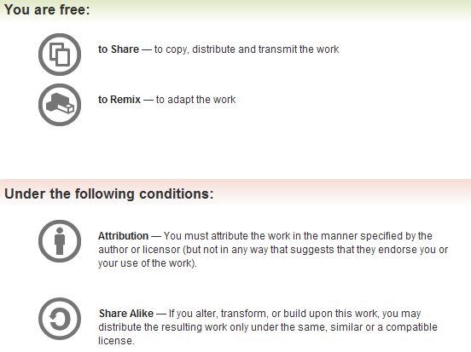
All materials is licensed under a Creative Commons “Share Alike” license.
http://creativecommons.org/licenses/by-sa/3.0/

Slide 3
# whoami
Ali Al-Shemery
Ph.D., MS.c., and BS.c., Jordan
More than 14 years of Technical Background (mainly Linux/Unix and Infosec)
Technical Instructor for more than 10 years (Infosec, and Linux Courses)
Hold more than 15 well known Technical Certificates
Infosec & Linux are my main Interests

Slide 4
Pre-Engagement, and Reconnaissance

Slide 5
Outline – Pre-Engagement
Pre-Engagement Process:
Scoping
Goals
Communication Lines
Rules of Engagement
Capabilities and Technology in Place

Slide 6
Scoping
Scoping is arguably one of the more important and often overlooked components of a penetration test.
Scoping is specifically tied to what you are going to test. This is very different from covering how you are going to test.
A penetration test is not an activity to see if the tester can "hack" you. It should be about identifying the business risk associated with an attack.

Slide 7
Howto Scope
Figure out exactly how you as a tester are going to spend your time.
Some engagements will have a wide canvas of IP addresses to test and choose from to try and access a network as part of a test.
Highly focused tests will spend weeks (if not months) on one specific application.
The key is knowing the difference!

Slide 8
Metrics for Time Estimation
Much of this will be based upon your experience in the area you are going to test.
Try to estimate consultant overhead.
  Meeting Creep, Site problems, etc
  Provide additional service if no overhead
Specify clearly the starting and ending date and the hours required to work.

Slide 9
Scoping Meeting
The goal of the scoping meeting is to discuss what it is you are to test. It is not to about RoE or Costs.
In many cases the scoping meeting will happen after the contract has been signed.
There are some blissful scenarios where you can cover many of the topics relating to scope before a contract is signed. For those situations an NDA must be signed before any in-depth scoping discussions occur.
Need to ask them explicitly what IP ranges are in scope for the engagement.
Need to identify which countries the target environment operates in.

Slide 10
Additional Support Based on Hourly Rate
Anything that is not explicitly covered within the scope of the engagement should be handled very carefully.
These tasks can easily eat the profits of your engagement and create confusion and anger with the customer.
Additional requests has to be documented in the form of a Statement of Work that clearly identifies the work to be done.
Clearly state in the contract that additional work will be done for a flat fee per hour and explicitly state that additional work cannot be completed until a new SOW is signed.

Slide 11
Questionnaires
Communication starts with the customer by a set of questions that you will need answered before you can accurately scope the penetration test engagement.
These questions are critical to ask and should give you a better understanding of:
  what the client is looking to gain out of the penetration test
  why the client is looking to have a penetration test performed against their environment,
  and whether or not they want certain types of tests performed during the penetration test.
Check the Questionnaires document for examples.

Slide 12
Scope Creep
Often one of the most effective ways that a penetration testing company can cease to exist.
Couple of things to remember when battling scope creep:
  If you have done a great job it is very common for a customer to request additional work.
  Do not gouge your existing customers when they ask for additional work.
  Specify start and end dates.
  Put in contract retesting after final report (ex: 30 days).
  Your best source for future work is through your existing customers. Treat them well and they will return.

Slide 13
Specify IP Ranges and Domains
You must know what the targets you will be attempting to penetrate are.
Targets obtained from the customer during the initial questionnaire phase.
Targets can be given in the form of specific IP addresses, network ranges, or domain names.
In some instances, the only target the customer gives you is the organization’s name.
Important to define systems that are between the target and the tester like: firewalls and IDS/IPS or networking equipment.

Slide 14
Dealing with Third Parties
Some situations where you will be asked to test a service or an application that is being hosted by a third party.
Important to remember that you may have permission to test from your customer, but you also need to receive permission from the third party!
  Cloud Services
  ISP
  Web Hosting
  Managed Security Service Providers (MSSP)
  Countries Where Servers are Hosted
  Verify the laws yourself, don’t depend on others!

Slide 15
Define Acceptable Social Engineering Pretexts
Social engineering and spear-phishing attacks are currently widely used by many attackers today.
Most of the successful attacks use pretexts like sex, drugs and rock and roll some of these pretexts may not be acceptable in a cooperate environment.
Obtain written approval for the pretext that will be used in the test.

Slide 16
DoS Testing
Stress testing or Denial of Service testing should be discussed before you start your engagement.
Many organizations are uncomfortable with due to the potentially damaging nature of the testing.
If an organization is only worried about the confidentiality or integrity of their data:
  stress testing may not be necessary
If the organization is worried about the availability of their services:
  stress testing should be conducted in a non-production environment that is identical to their production environment

Slide 17
Payment Terms
Net 30
Total amount is due within 30 days of the delivery of the final report. Usually associated with a per month percentage penalty for non-payment.
Half Upfront
Require half of the total bill upfront before testing begins. This is very common for longer-term engagements.
Recurring
May have a recurring payment schedule. This is more of a long-term engagement.

Slide 18
Goals
Every penetration test should be goal oriented.
The test is to identify specific vulnerabilities that lead to a compromise of the business or mission objectives of the customer (not finding un-patched systems).
  Primary – not compliance driven
  Secondary – can be compliance driven
Secondary goals mean something for compliance and IT. Primary goals get the attention of the C-O’s.
  Business Analysis - depends on maturity of the customer

Slide 19
Establish Lines of Communication
One of the most important aspects of any penetration test is communication with the customer.
How often you interact with the customer, and the manner in which you approach them, can make a huge difference in their feeling of satisfaction.

Slide 20
Emergency Contact Information
Being able to get in touch with the customer or target organization in an emergency is vital.
Create an emergency contact list.
Not only do you need contact information from the customer, but they may need to contact you.
The list should preferably include the following people:
  All penetration testers
  The manager of the test group
  Two technical contacts at each target organization
  One upper management or business contact at the customer

Slide 21
Rules of Engagement (RoE)
Scope defines what it is you are supposed to test, the rules of engagement defines how testing is to occur.
Timeline
Locations
Disclosure of Sensitive Information
Evidence Handling
Regular Status Meetings
Time of the Day to Test
Dealing with Shunning
Permission to Test
Legal Considerations

Slide 22
Capabilities and Technology in Place
Testing the capabilities of the target organization in regards to the ability to detect and respond to:
  Information gathering, foot printing, scanning and vulnerability analysis, infiltration (attacks), etc
Important Note:
when tracking this information be sure to collect time information.

