Slide 1
Hacking Techniques & Intrusion Detection
Ali Al-Shemery
arabnix [at] gmail

Slide 2
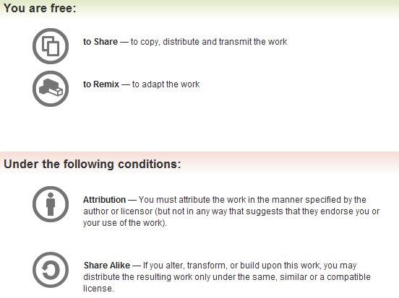
All materials is licensed under a Creative Commons “Share Alike” license.
http://creativecommons.org/licenses/by-sa/3.0/

Slide 3
# whoami
Ali Al-Shemery
Ph.D., MS.c., and BS.c., Jordan
More than 14 years of Technical Background (mainly Linux/Unix and Infosec)
Technical Instructor for more than 10 years (Infosec, and Linux Courses)
Hold more than 15 well known Technical Certificates
Infosec & Linux are my main Interests

Slide 4
Reconnaissance
(RECON)
With great knowledge, comes successful attacks!

Slide 5
Outline - Reconnaissance
Intelligence Gathering
Target Selection
Open Source Intelligence (OSINT)
Covert Gathering
Footprinting

Slide 6
Intelligence Gathering
What is it
Why do it
What is it not
Open source intelligence (OSINT) is a form of intelligence collection management that involves finding, selecting, and acquiring information from publicly available sources and analyzing it to produce actionable intelligence.

Slide 7
Target Selection
Identification and Naming of Target
Consider any Rules of Engagement limitations
Consider time length for test
Consider end goal of the test

Slide 8
Open Source Intelligence (OSINT)
Simply, it’s locating, and analyzing publically (open) available sources of information.
Intelligence gathering process has a goal of producing current and relevant information that is valuable to either an attacker or competitor.
- OSINT is not only web searching!

Slide 9
Open Source Intelligence (OSINT)
Takes three forms:
Passive Information Gathering
Semi-passive Information Gathering
Active Information Gathering
Used for:
Corporate
Individuals

Slide 10
Corporate - Physical
Locations
  Public sites can often be located by using search engines such as:
  Google, Yahoo, Bing, Ask.com, Baidu, Yandex, Guruji, etc
Relationships

Slide 11
Corporate - Logical
Business Partners
Business Clients
Competitors
Product line
Market Vertical
Marketing accounts
Meetings
Significant company dates
Job openings
Charity affiliations
Court records
Political donations
Professional licenses or registries

Slide 12
Job Openings Websites
Bayt, http://bayt.com
Monster, http://www.monster.com
CareerBuilder, http://www.careerbuilder.com
Computerjobs.com, http://www.computerjobs.com
Indeed, LinkedIn, etc

Slide 13
Corporate – Org. Chart
Position identification
Transactions
Affiliates

Slide 14
Corporate – Electronic
Document Metadata
Marketing Communications

Slide 15
Corporate – Infrastructure Assets
Network blocks owned
Email addresses
External infrastructure profile
Technologies used
Purchase agreements
Remote access
Application usage
Defense technologies
Human capability

Slide 16
Corporate – Financial
Reporting
Market analysis
Trade capital
Value history

Slide 17
Individual - History
Court Records
Political Donations
Professional licenses or registries

Slide 18
Individual - Social Network (SocNet) Profile
Metadata Leakage
Tone
Frequency
Location awareness
Social Media Presence

Slide 19
Location Awareness - Cree.py
Cree.py is an open source intelligence gathering application.
Can gather from Twitter.
Cree.py can gather any geo-location data from flickr, twitpic.com, yfrog.com, img.ly, plixi.com, twitrpix.com, foleext.com, shozu.com, pickhur.com, moby.to, twitsnaps.com and twitgoo.com.

Slide 20
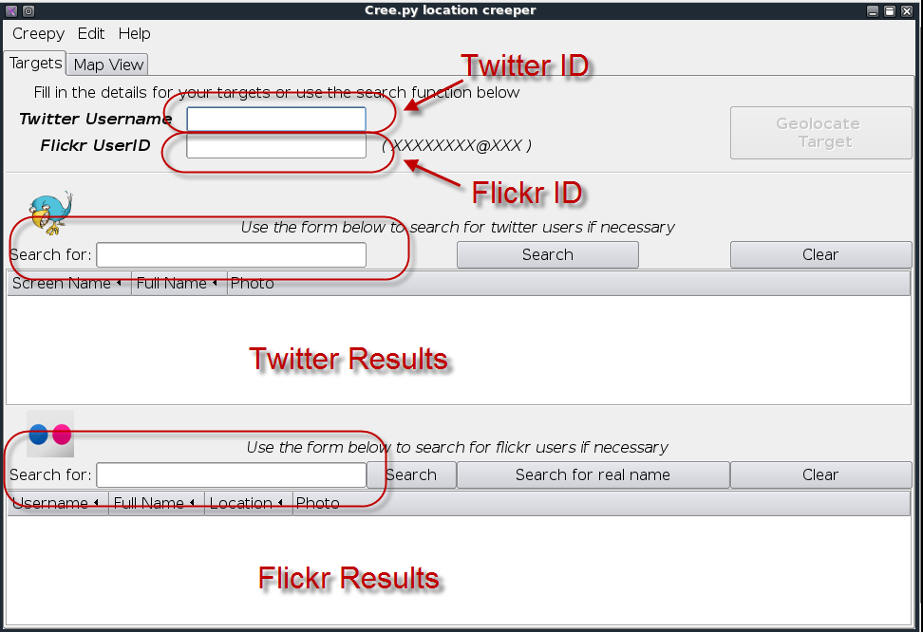
Cree.py

Slide 21
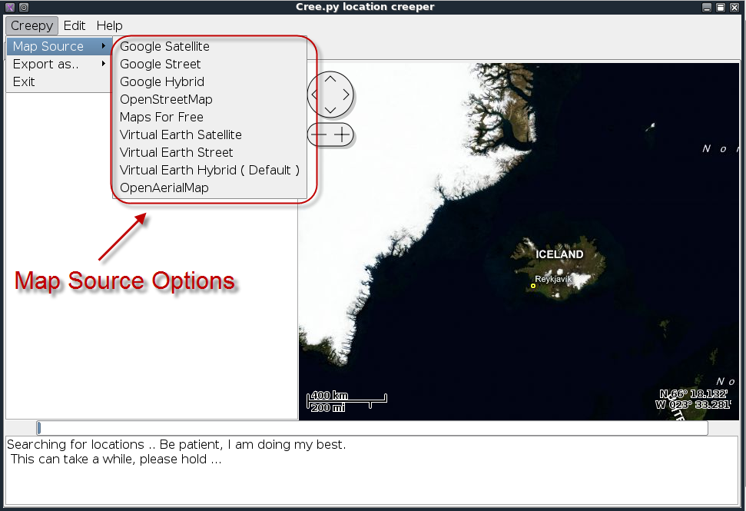
Cree.py

Slide 22
Individual - Internet Presence
Email Address
Personal Handles/Nicknames
Personal Domain Names registered
Assigned Static IPs/Netblocks

Slide 23
Maltego
Paterva Maltego is a data mining and information-gathering tool that maps the information gathered into a format that is easily understood and manipulated.
It saves you time by automating tasks such as email harvesting and mapping subdomains.

Slide 24
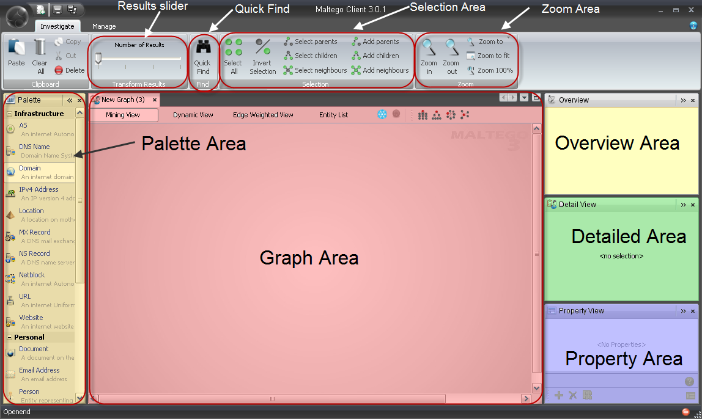
Maltego

Slide 25
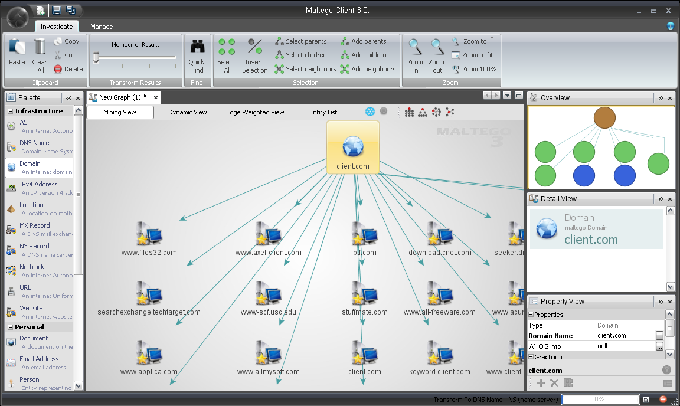
Maltego

Slide 26
NetGlub
NetGlub is an open source data mining and information-gathering tool that presents the information gathered in a format that is easily understood, (Similar to Maltego).
Consists of: Master, Slave, and GUI

Slide 27
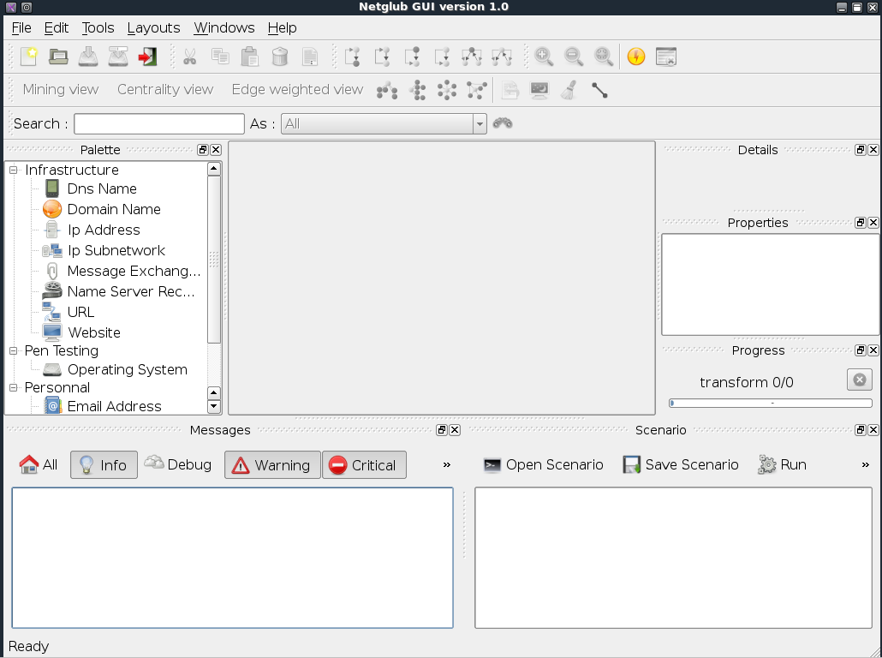
NetGlub

Slide 28
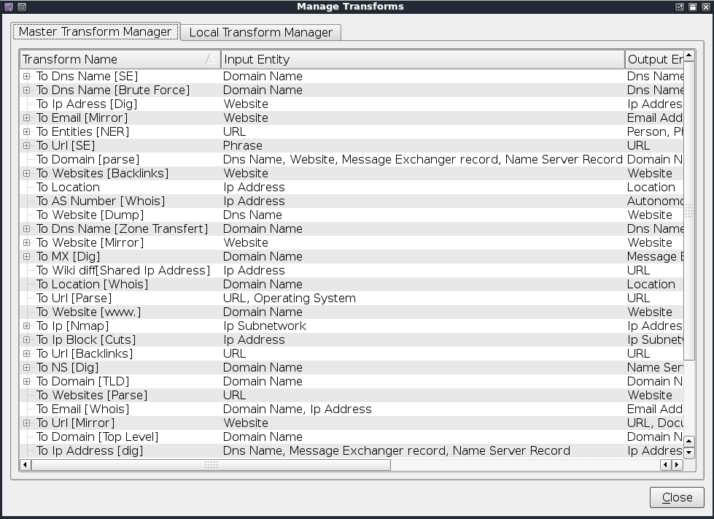
NetGlub

Slide 29
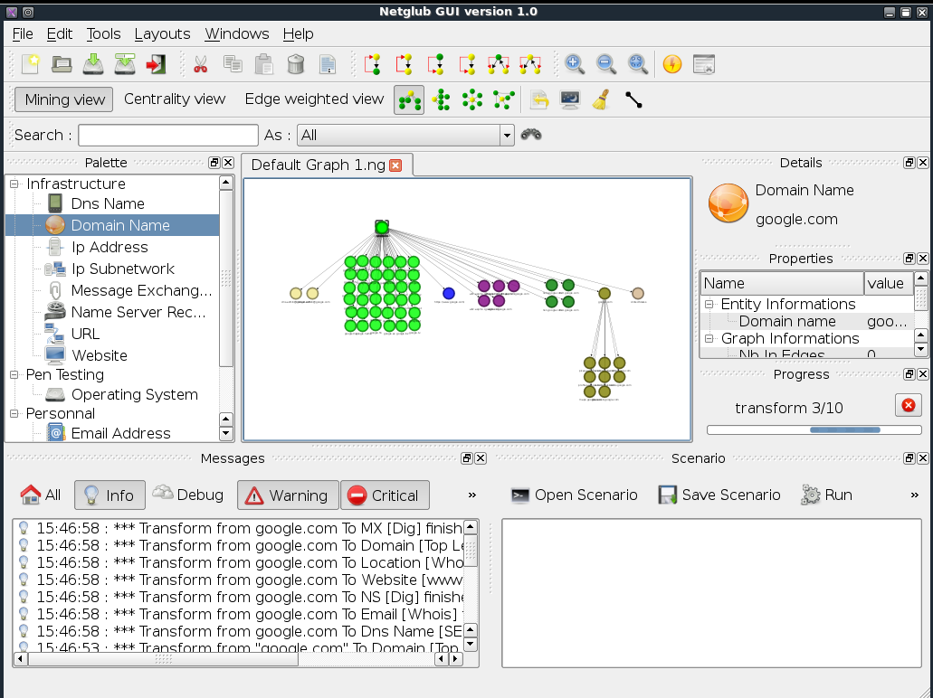
NetGlub

Slide 30
TheHarvester
TheHarvester is a tool, written by Christian Martorella, that can be used to gather e-mail accounts and subdomain names from different public sources (search engines, pgp key servers).
DEMO:
./theHarvester.py -d linuxac.org -l 500 -b google

Slide 31
Social Networks
Check Usernames - Useful for checking the existence of a given username across 160 Social Networks.
http://checkusernames.com/

Slide 32
Social Networks
Newsgroups
Google - http://www.google.com
Yahoo Groups - http://groups.yahoo.com
Mail Lists
The Mail Archive - http://www.mail-archive.com

Slide 33
Audio / Video
Audio
iTunes, http://www.apple.com/itunes
Podcast.com, http://podcast.com
Podcast Directory, http://www.podcastdirectory.com
Video
YouTube, http://youtube.com
Yahoo Video, http://video.search.yahoo.com
Bing Video, http://www.bing.com/
Vemo, http://vemo.com

Slide 34
Archived Information
There are times when we will be unable to access web site information due to the fact that the content may no longer be available from the original source.
Being able to access archived copies of this information allows access to past information.
Perform Google searches using specially targeted search strings: cache:<site.com>
Use the archived information from the Wayback Machine (http://www.archive.org).

Slide 35
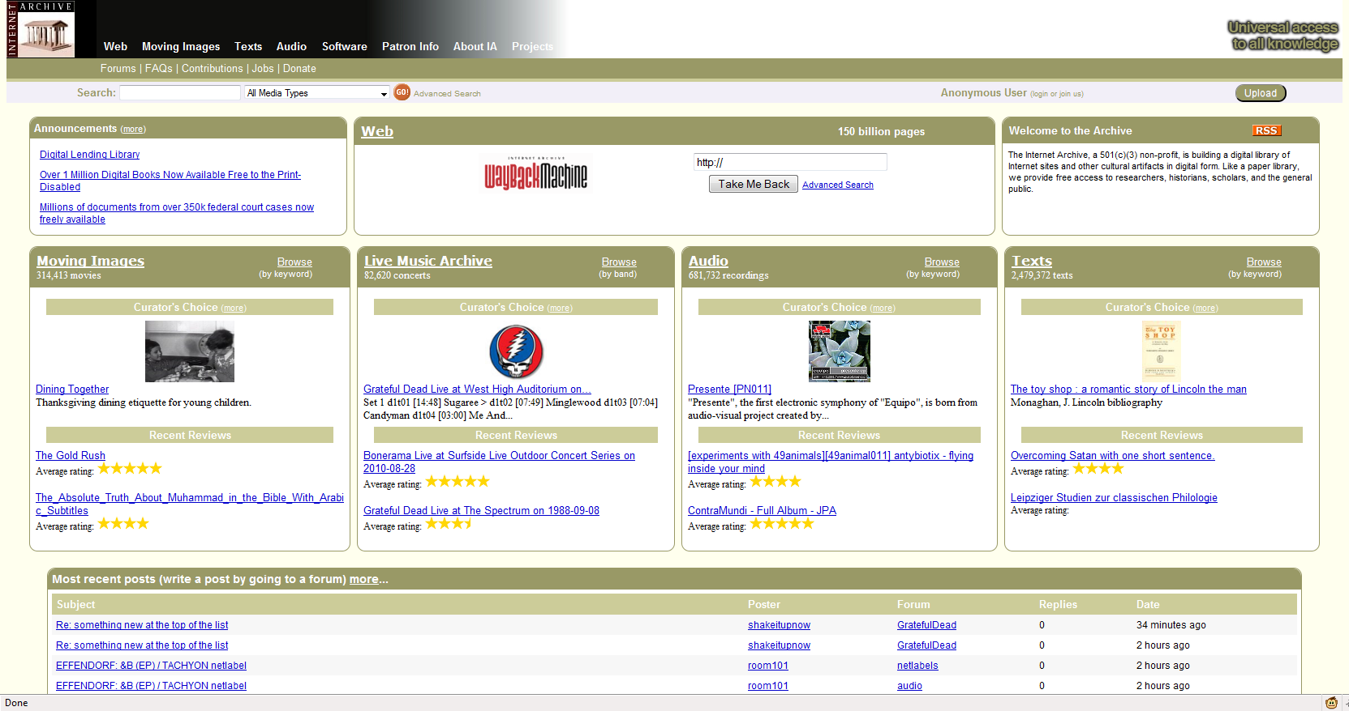
Archived Information

Slide 36
Metadata leakage
The goal is to identify data that is relevant to the target corporation.
It may be possible to identify locations, hardware, software and other relevant data from Social Networking posts.
Examples:
  ixquick - http://ixquick.com
  MetaCrawler - http://metacrawler.com
  Dogpile - http://www.dogpile.com
  Search.com - http://www.search.com
  Jeffery's Exif Viewer - http://regex.info/exif.cgi

Slide 37
Metadata leakage - FOCA
FOCA is a tool that reads metadata from a wide range of document and media formats.
FOCA pulls the relevant usernames, paths, software versions, printer details, and email addresses.
DEMO (WinXP VM_Box)

Slide 38
Metadata leakage - Foundstone SiteDigger
Foundstone has a tool, named SiteDigger, which allows us to search a domain using specially strings from both the Google Hacking Database (GHDB) and Foundstone Database (FSDB).

Slide 39
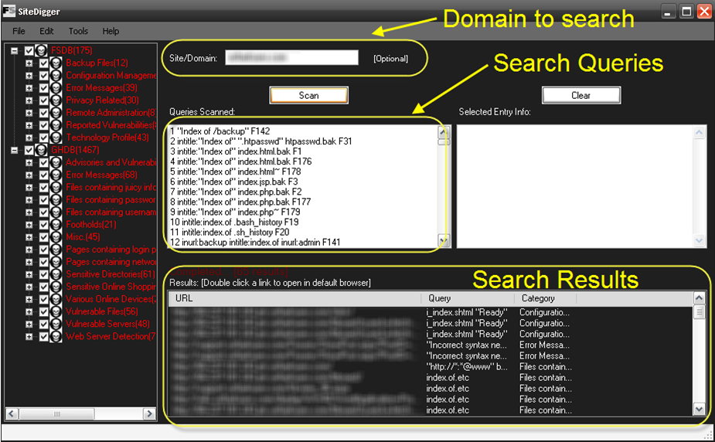
Metadata leakage - Foundstone SiteDigger

Slide 40
Metadata leakage - Metagoofil
Metagoofil is a Linux based information gathering tool designed for extracting metadata of public documents (.pdf, .doc, .xls, .ppt, .odp, .ods) available on the client's websites.
Metagoofil generates an html results page with the results of the metadata extracted, plus a list of potential usernames that could prove useful for brute force attacks. It also extracts paths and MAC address information from the metadata.

Slide 41
Individual - Physical Location
Physical Location

Slide 42
Individual - Mobile Footprint
Phone #
Device type
Installed applications

Slide 43
Covert Gathering - Corporate
On-Location Gathering
Physical security inspections
Wireless scanning / RF frequency scanning
Employee behavior training inspection
Accessible/adjacent facilities (shared spaces)
Dumpster diving
Types of equipment in use
Offsite Gathering
Data center locations
Network provisioning/provider

Slide 44
Other Gathering Forms
Human Intelligence (HUMINT)
Methodology always involves direct interaction - whether physical, or verbal.
Gathering should be done under an assumed identity (remember pretexting?).
  Key Employees
  Partners/Suppliers

Slide 45
Other Gathering Forms
Signals Intelligence (SIGINT):
Intelligence gathered through the use of interception or listening technologies.
Example:
  Wired/Wireless Sniffer
  TAP devices

Slide 46
Other Gathering Forms
Imagery Intelligence (IMINT):
Intelligence gathered through recorded imagery, i.e. photography.
IMINT can also refer to satellite intelligence, (cross over between IMINT and OSINT if it extends to Google Earth and its equivalents).

