Slide 1
Hacking Techniques & Intrusion Detection
Ali Al-Shemery
arabnix [at] gmail

Slide 2
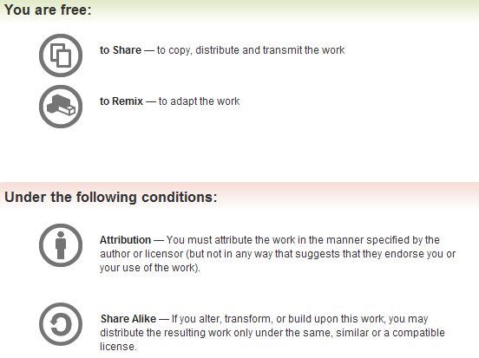
All materials is licensed under a Creative Commons “Share Alike” license.
http://creativecommons.org/licenses/by-sa/3.0/

Slide 3
# whoami
Ali Al-Shemery
Ph.D., MS.c., and BS.c., Jordan
More than 14 years of Technical Background (mainly Linux/Unix and Infosec)
Technical Instructor for more than 10 years (Infosec, and Linux Courses)
Hold more than 15 well known Technical Certificates
Infosec & Linux are my main Interests

Slide 4
Scanning and Fingerprinting

Slide 5
Outline
Diving into Important Network Protocols (TCP, UDP, ICMP, ARP, etc)
Nmap – Intro.
Host Discovery
Tracing the Route
Port Scanning
OS and Service Fingerprinting
Learning Python in 4 Slides
Packet Crafting

Slide 6
Diving into Important Network Protocols
Diving into Important Network Protocols:
  TCP
  UDP
  ICMP
  ARP
  HTTP
  etc

Slide 7
Nmap
"Network Mapper” is a free and open source utility for network discovery and security auditing.
- Fyodor
IMO: #1 tool in your security arsenal!
Important Note:
A huge difference between running Nmap as a privileged/unprivileged user!

Slide 8
Host Discovery
Identifying Live Systems
Also called “Network Sweep”
Nmap ping sweeps:
  Ping Only (-sP)
  ARP Ping (-PR)
  ICMP Echo Request Ping (-PE)
  TCP SYN Ping (-PS)
  TCP ACK Ping (-PA)
  UDP Ping (-PU)
DEMO

Slide 9
Assignment #1
Why do host discovery or network sweeping if we already have the target list of IP(s)?

Slide 10
Tracing the Route
Nmap --traceroute option
DEMO
DEMO

Slide 11
Port Scanning
The act of testing a remote port to know in which state it is.
Common port states:
  Open,
  Closed,
  and Filtered.
DEMO

Slide 12
Port Scanning - Techniques
TCP SYN or Stealth Scan (-sS)
TCP Connect Scan (-sT)
TCP ACK Scan
UDP Scan (-sU)
TCP FIN Scan (-sF)
TCP NULL Scan (-sN)
XMAS Scan Scan (-sX)
Custom Scan (--scanflags)
IP Protocol Scan (-sO)
DEMO

Slide 13
OS and Service Fingerprinting
Operating System Detection (-O)
Service Version Detection (-sV)
Or
Enables OS detection and Version detection, Script scanning and Traceroute (-A)
DEMO

Slide 14
Evasion Techniques
Fragment Packets (-f)
Specific MTU (--mtu)
Using a Decoy (-D)
Specify source port (--source-port)
Append Random Data (--data-length)
Spoof MAC Address (--spoof-mac)
Send Bad Checksum (--badsum)
That’s all? Nope, check the next slide.

Slide 15
IDLE Scan
A completely blind port scanning technique, that attackers can use to scan a target without sending a single packet to the target from their own IP address!
Nmap IDLE Scan (-sI)

Slide 16
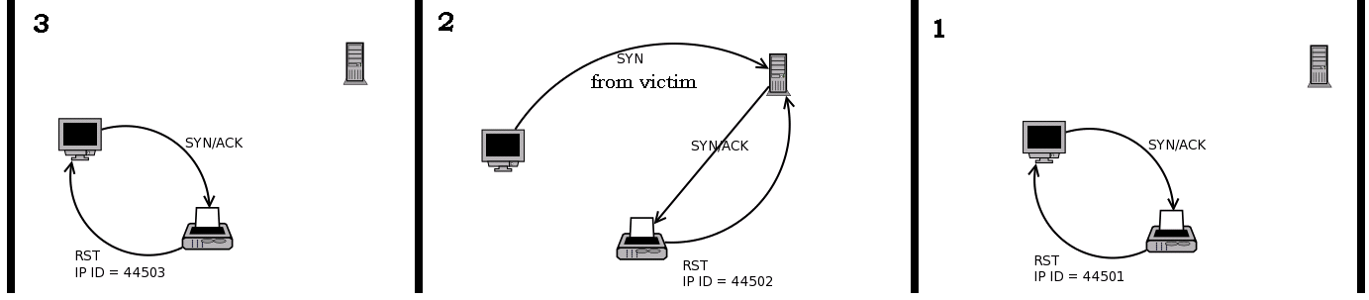
IDLE Scan – Open Port

Slide 17
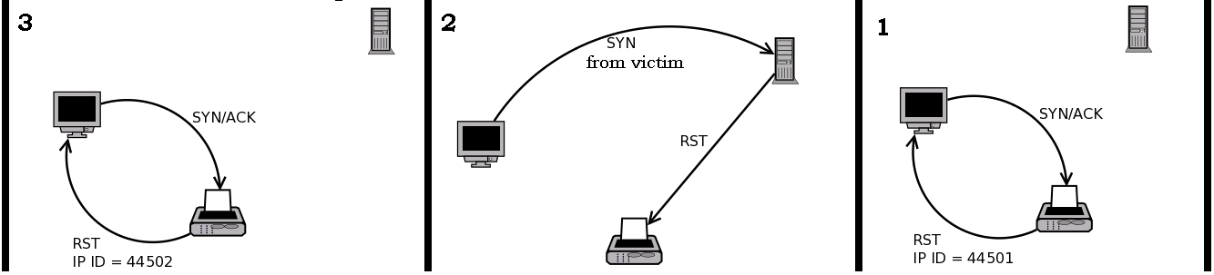
IDLE Scan – Closed Port

Slide 18
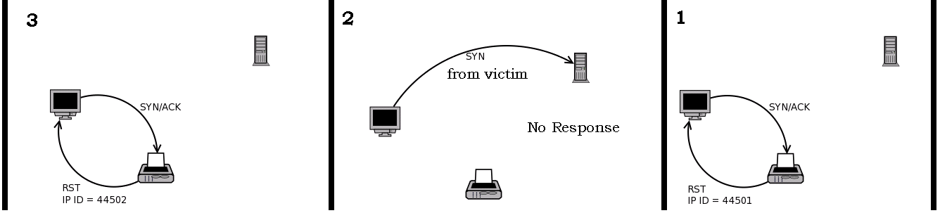
IDLE Scan – Filtered Port

Slide 19
Assignment #2
Choose One:
How can we find an IDLE machine?
What is Nmap’s Scripting Engine? And how can we benefit from it?

Slide 20
Learning Python in 4 Slides!!!

Slide 21
Python in 4 Slides (1/4)
Python is an open source scripting language.
Developed by Guido van Rossum in the early 1990s.
Name came from TV series “Monty Python’s Flying Circus”.
Python is cross platform (Linux, Windows, Mac, etc).
Ideal language for scripting and rapid application development in many areas on most platforms.
If you’re involved in vulnerability research, reverse engineering or penetration testing, I suggest “Python” for you.

Slide 22
Learning Python in 4 Slides (2/4)
Why Python for Penetration Testers?
  Simple, and easy to learn,
  Free and Open Source,
  powerful high-level programming language
  relatively fast,
  widely used, and
  Portable,
  Extensive Libraries,
  Interpreted, Extensible, Embeddable

Slide 23
Learning Python in 4 Slides (3/4)
This is an int (signed, 32bits) : 88
This is a long (signed, infinite): 88L
This is a str : "bell\x07\n" or ’bell\x07\n’ (" ⇐⇒ ’)
This is a tuple (immutable): (0,1,“33")
This is a list (mutable): [8,4,2,"1"]
This is a dict (mutable): { "one":1 , "two":2 }

Slide 24
Learning Python in 4 Slides (4/4)
if condition1:
instruction1
instruction2
elif condition2:
instruction
else:
instruction
try:
instruction
except exception:
instruction
else:
instruction
def fact(x):
if x == 0:
return 1
else:
return x*fact(x-1)
while condition:
instruction
instruction
lambda x,y: x+y
import httplib
from scapy.all import ARP
from scapy.all import *
import scapy.all as scapy
for variable in set:
instruction

Slide 25
Packet Crafting

Slide 26
Packet Crafting
What is Packet Crafting?
The art of manually generating packets to test network devices,
Packets are crafted to test Firewalls, IDS, TCP/IP Stack,....,etc,
Auditing network protocols looking for vulnerabilities to exploit,
Find inconsistencies and poor network protocol implementations.

Slide 27
Packet Crafting – Cont.
Crafting test Packets is an Art!
Different tools are available to Craft Packets,
BUT the process of Crafting Packets in such a way that will stress test protocols, firewalls and any other network devices for the purpose of uncovering faults, is an Art.

Slide 28
Packet Crafting Composition
Packet Crafting consist of:
  Packet Assembly,
  Packet Editing,
  Packet Re-Play,
  and Packet Decoding

Slide 29
Packet Crafting Tools
Best Packet Crafters:
Scapy - http://www.secdev.org/projects/scapy/
hping3 - http://www.hping.org/
Netdude - http://netdude.sourceforge.net/
tcpreplay - http://tcpreplay.synfin.net/trac/

Slide 30
Packet Crafting with Scapy

Slide 31
Scapy Overview
Scapy is a Python program that enables the user to send, sniff and dissect and forge network packets.
This capability allows construction of tools that can probe, scan or attack networks.
It can replace hping, arpspoof, arp-sk, arping, p0f and even some parts of Nmap, tcpdump, and tshark.

Slide 32
Scapy Overview – Cont.
Scapy was created by Philippe Biondi and runs in Python:
  Can be used interactively at a Python prompt
  Included within Python scripts for more complex interactions
Must run with root privileges to craft packets,
Don’t need to be a Python Guru to use Scapy!

Slide 33
Scapy Basics - 1
Supported protocols:
>>> ls()
Details about a specific protocol:
>>> ls(TCP)
Available commands/functions:
>>> lsc()

Slide 34
Scapy Basics - 2
Crafting a SYN/ACK Packet
>>> pkt = IP(dst="192.168.122.101")
>>> pkt /= TCP(dport=80, flags="SA")
Crafting ICMP Host Unreachable Packet
>>> pkt = IP(dst="192.168.122.101")
>>> pkt /= ICMP(type=3,code=1)

Slide 35
Scapy Basics - 3
Single Line:
ICMP echo request Packet
>>> mypkt = IP(dst="192.168.122.101") /ICMP(code=0,type=8)
TCP FIN, Port 22, Random Source Port, and Random Seq#
>>> mypkt = IP(dst="192.168.122.101") /TCP(dport=22,sport=RandShort(),seq=RandShort(),flags="F")

Slide 36
Sending and Receiving Packets – @L3
Send packet at layer 3
>>> send(packet)
Send packet at L3 and receive one response
>>> resp = sr1(packet)
Send packet at L3 and receive all responses
>>> ans,unans = sr(packet)

Slide 37
Sending and Receiving Packets – @L2
Send packet at layer 2
>>> sendp(Ether()/packet)
Send packet at L2 and receive one response
>>> resp = srp1(packet)
Send packet at L2 and receive all responses
>>> ans,unans = srp(packet)

Slide 38
Displaying Packets
Get a summary of each packet:
>>> pkts.summary()
Get the whole packet list:
>>> pkts.show()

Slide 39
Scapy Host Discovery
>>> ans,unans = srp(Ether(dst="ff:ff:ff:ff:ff:ff")/ARP(pdst="192.168.122.0/24"),timeout=2)
>>> ans.summary(lambda(s,r): r.sprintf("Ether: %Ether.src% \t\t Host: %ARP.psrc%"))

Slide 40
Scapy Port Scanning
TCP SYN Scanner
>>> sr1(IP(dst="192.168.122.101") /TCP(dport=90,flags="S"))
>>> a,u = sr(IP(dst="192.168.122.101") /TCP(dport=(80,100),flags="S"))
>>> a.summary(lambda(s,r): r.sprintf("Port: %TCP.sport% \t\t Flags: %TCP.flags%"))

Slide 41
Scapy Sniffing - 1
Scapy has powerful capabilities to capture and analyze packets.
Configure the network interface to sniff packets from:
>>> conf.iface="eth0“
Configure the scapy sniffer to sniff only 20 packets
>>> pkts=sniff(count=20)

Slide 42
Scapy Sniffing - 2
Sniff packets and stop after a defined time:
>>> pkts=sniff(count=100,timeout=60)
Sniff only packets based on a filter:
>>> pkts = sniff(count=100,filter="tcp port 80")

Slide 43
Scapy Sniffing - 3
>>> pkts = sniff(count=10,prn=lambda x:x.sprintf("SrcIP={IP:%IP.src% -> DestIP=%IP.dst%} | Payload={Raw:%Raw.load%\n}"))
What is that doing ???

Slide 44
Exporting Packets
Sometimes it is very useful to save the captured packets in a PCAP file for future work:
>>> wrpcap(“file1.cap", pkts)
Dumping packets in HEX format:
>>> hexdump(pkts)
Dump a single packet in HEX format:
>>> hexdump(pkts[2])
Convert a packet to hex string:
>>> str(pkts[2])
Exporting to Base64 encoded packets:
>>> export_object(pkts)

Slide 45
Importing Packets
To import from a PCAP file:
>>> pkts = rdpcap(“file1.cap")
Or use the scapy sniffer but with the offline argument:
>>> pkts2 = sniff(offline="file1.cap")

Slide 46
Create your own tools
>>> def handler(packet):
hexdump(packet.payload)
>>> sniff(count=20, prn=handler)
>>> def handler2(packet):
sendp(packet)
>>> sniff(count=20, prn=handler2)

Slide 47
Create your own tools – 2
arpping.py
listpacket.py
arppoisonor.py

Slide 48
Assignment #3
Create your own tools
Choose any two:
[1] Create a TCP ACK Port Scanner
[2] Create a TCP Replay Tool
[3] Create a UDP Ping Tool
[4] Create a Sniffer that filters based on user input

Slide 49
SUMMARY
Diving into Important Network Protocols (TCP, UDP, ICMP, HTTP, etc)
Sweep Networks to discover hosts
Scan systems to discover open ports
Fingerprint OS’s and services
Craft your own packets using Scapy

Slide 50
References
[1] William Zereneh, http://www.scs.ryerson.ca/~zereneh/cn8822/PacketCrafting.pdf
[2] Mike Poor, Packet Craft for Defense-in-Depth, http://www.inguardians.com/research/docs/packetfoo.pdf
[3] SecTools.Org: Top 125 Network Security Tools, http://sectools.org/tag/packet-crafters/
[4] Scapy Documentation, http://www.secdev.org/projects/scapy/doc/
[5] Python, http://www.python.org/
[6] Python tools for penetration testers, http://www.dirk-loss.de/python-tools.htm
[7] Nmap Book Online, http://nmap.org/book/

