Slide 1
Hacking Techniques & Intrusion Detection
Ali Al-Shemery
arabnix [at] gmail

Slide 2
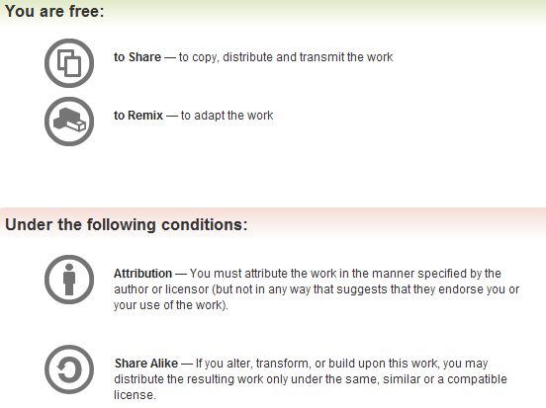
All materials is licensed under a Creative Commons “Share Alike” license.
http://creativecommons.org/licenses/by-sa/3.0/

Slide 3
# whoami
Ali Al-Shemery
Ph.D., MS.c., and BS.c., Jordan
More than 14 years of Technical Background (mainly Linux/Unix and Infosec)
Technical Instructor for more than 10 years (Infosec, and Linux Courses)
Hold more than 15 well known Technical Certificates
Infosec & Linux are my main Interests

Slide 4
Software Exploitation

Slide 5
Shellcode
/* the Aleph One shellcode */
"\x31\xc0\x31\xdb\xb0\x17\xcd\x80\xeb\x1f\x5e\x89"
"\x76\x08\x31\xc0\x88\x46\x07\x89\x46\x0c\xb0\x0b"
"\x89\xf3\x8d\x4e\x08\x8d\x56\x0c\xcd\x80\x31\xdb"
"\x89\xd8\x40\xcd\x80\xe8\xdc\xff\xff\xff/bin/sh";

Slide 6
Outline – Part 3
Introduction
System Calls
Shellcode Basics
Shellcode Types
Considerations
Useful Shellcode Tools

Slide 7
Shellcode?
AKA bytecode
Small piece of code used as the payload in the exploitation of a software vulnerability.
Problems of writing shellcodes:
  Not easy to write
  Architecture and OS dependent
  Must remove all string-delimiting characters

Slide 8
System Calls
Kernel trap calls used by user-space programs to access kernel-space functions.
Linux:
  INT \x80, Sysenter, etc
Windows
  INT 0x2e, Sysenter, DLL(s), API(s), etc
System Call # stored in EAX.
1st ARG in EBX, 2nd in ECX, and so on.

Slide 9
Shellcode Basics
Spawning the process
  Linux/Unix: execve
  Windows: CreateProcess
How child process deals with input and output is very important
File descriptors (regardless of OS):
  0 for Standard Input (stdin)
  1 for Standard Output (stdout)
  2 for Standard Error (stderr)

Slide 10
Shellcode Types
Port Binding
Reverse
Find Socket
Command Execution Code
File Transfer
Multistage
System Call Proxy
Process Injection
Kernel Space

Slide 11
Port Binding Shellcode
AKA “bind shell”
Why/When to use this type of SC?
What it does:
  Create TCP socket
  Bind socket to port (hardcoded and specified by the attacker)
  Make socket Listen
  Dup listening socket onto stdin, stdout, and stderr
  Spawn command shell (bash, cmd.exe, etc)
Attacker connects to that port to get control
Problems:
  Firewalls
  Not Invisible
  Can’t distinguish between connections made to it

Slide 12
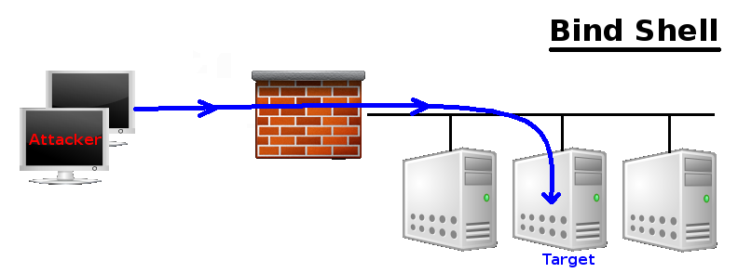
Port Binding Shellcode

Slide 13
Reverse Shellcode
AKA ‘callback shellcode”, solves bind shell problems
Why connect to the target, were we can make the target connect to us?
What it does:
  Create TCP socket
  Make socket connect back to the attacker on IP+Port (hardcoded and specified by the attacker)
  Connect to the IP and port
  Dup the socket onto stdin, stdout, and stderr
  Spawn command shell (bash, cmd.exe, etc)
Problems
  Outbound Filtering
  Attacker must be listening on the specified port
  Attacker behind NAT
  Target behind some proxy
  Not invisible too

Slide 14
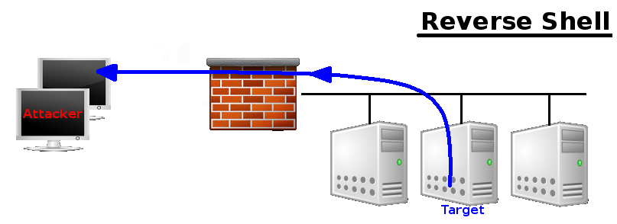
Reverse Shellcode

Slide 15
Find Socket Shellcode
Search for the file descriptor that represents attackers connection.
  POSIX (file descriptors)
  Windows (File Handlers)
Query each descriptor to find which is remotely connected to the attackers computer.
Hardcode the outbound port into the shellcode, makes find much easier on target.
No new network connection (hard to detect)!

Slide 16
Find Socket Shellcode - 2
Steps:
  Find file descriptor for the network connection.
  Duplicate the socket onto stdin, stdout, and stderr.
  Spawn a new command shell process (will use original socket for I/O).
Problem:
  Attacker behind NAT device, can’t control the outbound port from which his connection originated (P.S. won’t know what file descriptor is used for his connection!)

Slide 17
Command Execution Shellcode
Why create a network session when all needed to do is run a command?
  ssh-copy-id to target
  Adding/modifying a user account
  Modify configuration file
Steps:
  Assemble command name
  Assemble arguments required (if any!)
  Invoke system call to execute the command
Often very small

Slide 18
File Transfer Shellcode
Very simple, all needed is to upload a file to the target
Steps:
  Open new file on target
  Read data from the network connection, and write it to the opened file (Note: connection obtained using previous discussed network shellcodes)
  Repeat RW until file successfully transferred.
  Close the open file
Can be combined with a CE Shellcode

Slide 19
Multistage Shellcode
Vulnerability contains un-sufficient space for injecting shellcode
Consist of 2 or more shellcode stages
Steps:
  Stage1:
    read more shellcode,
    pass control to Stage2 shellcode
  Stage2: accomplish the functionality required

Slide 20
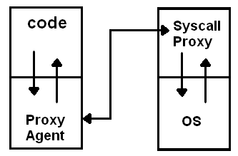
System Call Proxy Shellcode
AKA Syscall Proxy
Technique first introduced by Maximiliano Caceres (CORE Impact creators) which can provide a real remote interface to the target's kernel
Local process running
has no idea it is running
remotely!
Syscall proxy payload can
continue to run in the
context of the exploited
process.

Slide 21
System Call Proxy – Cont.
Use many tools without installing anything on the target machine
Memory resident
Kernel Interface
Request Local, Execute Remote
Remote Debugging
Others? use your own imagination!
Means What?

Slide 22
Process Injection Shellcode
Loading libraries of code running under a separate thread of execution within the context of an existing process on the target.
Host process can be:
  Process exploited.
  Migrate to a complete different process.
Injected library might never get written to the hard drive and harness in memory (hard even for forensics to discover)!
Ex: Metasploit’s Meterpreter (next week).

Slide 23
Important Stuff
Disassemble
  Maybe running a backdoor !
Encoding
  Bad char(s) is chasing you!
Others?
  Please add …

Slide 24
Assignments – Choose 2
What is a Kernel Space Shellcode?
Can we categories Metasploit’s Meterpreter as a Multi-Stage Shellcode?
How can we debug a shellcode?

Slide 25
Debugging a Shellcode
char shellcode[] =
“Insert shellcode/bytecode here";
int main(int argc, char **argv)
{
int (*func)();
func = (int (*)()) code;
(int)(*func)();
}

Slide 26
Useful Tools
GCC: gcc -c shellcode.s
Objdump: objdump -d shellcode.o
LD: ld binary.o -o binary
NASM: nasm -f elf64 shellcode.asm
strace: trace system calls and signals
Corelan’s pveWritebin.pl and pveReadbin.pl
BETA3 --decode
Ndisasm
Immunity Debugger
GDB

Slide 27
Summary
What Shellcodes are, and problems that face shellcode developers,
Types of Shellcodes,
Why it’s important to disassemble a shellcode you didn’t write,
Why sometimes you need to encode your shellcode,
List of useful tools related to shellcode development.

Slide 28
References (1)
Papers/Presentations/Links:
  ShellCode, http://www.blackhatlibrary.net/Shellcode
  Introduction to win32 shellcoding, Corelan, http://www.corelan.be/index.php/2010/02/25/exploit-writing-tutorial-part-9-introduction-to-win32-shellcodeing/
  Hacking/Shellcode/Alphanumeric/x64 printable opcodes, http://skypher.com/wiki/index.php/Hacking/Shellcode/Alphanumeric/x64_printable_opcodes
  Learning Assembly Through Writing Shellcode, http://www.patternsinthevoid.net/blog/2011/09/learning-assembly-through-writing-shellcode/
  Shellcoding for Linux and Windows Tutorial, http://www.vividmachines.com/shellcode/shellcode.html
  Unix Assembly Codes Development, http://pentest.cryptocity.net/files/exploitation/asmcodes-1.0.2.pdf
  Win32 Assembly Components, http://pentest.cryptocity.net/files/exploitation/winasm-1.0.1.pdf

Slide 29
References (2)
Papers/Presentations/Links:
  64-bit Linux Shellcode, http://blog.markloiseau.com/2012/06/64-bit-linux-shellcode/
  Writing shellcode for Linux and *BSD, http://www.kernel-panic.it/security/shellcode/index.html
  Understanding Windows’s Shellcode (Matt Miller’s, aka skape)
  Metasploit’s Meterpreter (Matt Miller, aka skape)
  Syscall Proxying fun and applications, csk @ uberwall.org
  X86 Opcode and Instruction Reference, http://ref.x86asm.net/
  Shellcode: the assembly cocktail, by Samy Bahra, http://www.infosecwriters.com/hhworld/shellcode.txt

Slide 30
References (3)
Books:
  Grayhat Hacking: The Ethical Hacker’s Handbook, 3rd Edition
  The Shellcoders Handbook,
  The Art of Exploitation, 2nd Edition,
Shellcode Repositories:
  Exploit-DB: http://www.exploit-db.com/shellcodes/
  Shell Storm: http://www.shell-storm.org/shellcode/
Tools:
  BETA3 - Multi-format shellcode encoding tool, http://code.google.com/p/beta3/
  X86 Opcode and Instruction Reference, http://ref.x86asm.net/
  bin2shell, http://blog.markloiseau.com/wp-content/uploads/2012/06/bin2shell.tar.gz

