Slide 1
Hacking Techniques & Intrusion Detection
Ali Al-Shemery
arabnix [at] gmail

Slide 2
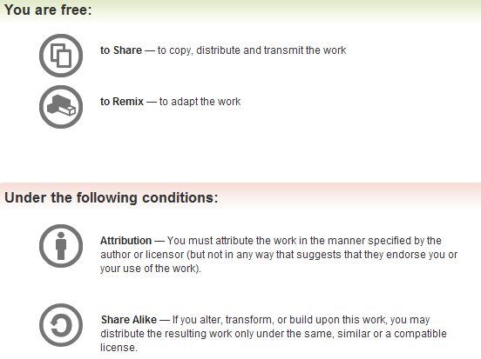
All materials is licensed under a Creative Commons “Share Alike” license.
http://creativecommons.org/licenses/by-sa/3.0/

Slide 3
# whoami
Ali Al-Shemery
Ph.D., MS.c., and BS.c., Jordan
More than 14 years of Technical Background (mainly Linux/Unix and Infosec)
Technical Instructor for more than 10 years (Infosec, and Linux Courses)
Hold more than 15 well known Technical Certificates
Infosec & Linux are my main Interests

Slide 4
Post-Exploitation
“Shell is Only the Beginning” Darkoperator

Slide 5
Outline
Why Post-Exploitation
Post-Exploitation RoE
Infrastructure Analysis
Pillaging
Sensitive Data
User Information
System Configurations
High Value/Profile Target
Data Exfiltration
Persistence
Cleanup

Slide 6
Why?
Determine the value of the machine compromised,
Maintain control of the machine for later use,
Value depends on sensitivity of data and usefulness in further compromising the network,
Helps identify and document:
  sensitive data,
  identify configuration settings,
  communication channels,
  and relationships with other network devices.
Go beyond Exploit verification
Shows how vulnerabilities can be chained to gain higher level of access (real-life attacks!!!)

Slide 7
Post-Exploitation RoE
Protect the client
Protect yourself

Slide 8
Infrastructure Analysis

Slide 9
Network Config.
Interfaces
Routing
DNS Servers
Proxy Servers (Net/App Level)
ARP Table

Slide 10
Network Services
Listening Services (TCP, UDP, etc),
VPN Connections,
Directory Services,
Neighbors

Slide 11
Pillaging
Obtaining information from targeted hosts
  files containing personal information,
  credit card information,
  passwords, etc.
Satisfy the goals or as part of the pivoting process.
Location of this data will vary depending on the type of data.
Knowledge of commonly used applications, server software and middleware is very important.
Special tools may be necessary to obtain, extract or read the targeted data from some systems.

Slide 12
Check?
Installed Software,
Installed Services:
  Security Services
  File/Printer Shares
  Database Servers
  Directory Servers
  Name Servers
  Deployment Services
  Certificate Authority
  Source Code Management Server
  Dynamic Host Configuration Server
  Virtualization
  Messaging
  Monitoring and Management
  Backup Systems
  Others please add…

Slide 13
Sensitive Data
Key-logging,
Screen Capture,
Network Traffic Capture,
Previous Audit Reports (lucky day)!

Slide 14
User Information
On System,
Web Browsers,
IM Clients

Slide 15
System Configuration
Password Policy,
Security Policies,
Configured WiFi Networks and Keys.

Slide 16
High Value/Profile Targets
Can be identified and further expanded from the targets identified in the pre-engagement meetings thru the analysis of:
  Data gathered,
  Interactions of those systems,
  Services they run.
This view of the operation and interactions of these high value/profile targets helps in the identification and measurement of impact that can be gained to the business do to the data and processes and to the overall integrity of the client’s infrastructure and services.

Slide 17
Data Exfiltration
Mapping of all possible exfil paths,
Testing exfiltration paths,
Measuring control strengths

Slide 18
Persistence
Autostart Malware
Reverse Connections
Rootkits
  User Mode
  Kernel Based
C&C medium (http, dns, tcp, icmp)
Backdoors
VPN with credentials

Slide 19
Diving Further (Infra.)
From Compromised System:
  Upload tools, local system tools, ARP Scan, Sweeping, DNS Enum, Directory Services Enum, Brute force, Execute Further Exploits
Thru Compromised System:
  Port Forwarding, Proxy, VPN, Execute Further Exploits

Slide 20
Cleanup
Process of cleaning the system after completing the penetration test.
  User account: connect-back users
  Binaries installed: executables, scripts, backdoors, rootkits, etc
  Temp Files
Restore original configuration setting if modified.
Leave no trace
Proper archiving and encryption of evidence to be handed back to customer
Note: Ensure documented steps of exploitation

Slide 21
Special Thanks
to the Penetration Testing Execution Standard (PTES) Team …

Slide 22
Summary
Explained what is PE, and why its needed,
The need to check the Post-Exploitation RoE,
What do we mean by Infrastructure Analysis,
What is Pillaging,
What is Sensitive Data, and how to identify it,
What User Information we need to gather,
What are System Configurations, and where to check for them,
Explained what is High Value/Profile Target, and what business impact they could lead if compromised,
What do we mean by Data Exfiltration,
What is Persistence, and methods to perform it,
What is the Cleanup phase, and why is it necessary.

Slide 23
References
Penetration Testing Execution Standard, http://www.pentest-standard.org/index.php/Main_Page,
Linux/Unix/BSD Post-Exploitation Command List, https://docs.google.com/document/d/1ObQB6hmVvRPCgPTRZM5NMH034VDM-1N-EWPRz2770K4/edit?pli=1,
Windows Post-Exploitation Command List, https://docs.google.com/document/d/1U10isynOpQtrIK6ChuReu-K1WHTJm4fgG3joiuz43rw/edit?pli=1,
OSX Post-Exploitation, https://docs.google.com/document/d/10AUm_zUdAQGgoHNo_eS0SO1K-24VVYnulUD2x3rJD3k/edit?pli=1,
Metasploit Post Exploitation Command List, https://docs.google.com/document/d/1ZrDJMQkrp_YbU_9Ni9wMNF2m3nIPEA_kekqqqA2Ywto/edit?pli=1,
Post-Exploitation Command List, http://www.room362.com/blog/2012/8/25/post-exploitation-command-lists-request-to-edit.html,

