Slide 1
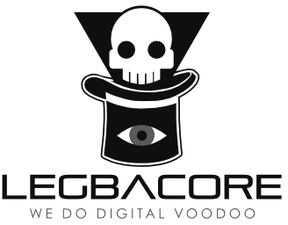
Advanced x86:
BIOS and System Management Mode Internals
Motivation
Xeno Kovah && Corey Kallenberg
LegbaCore, LLC

Slide 2
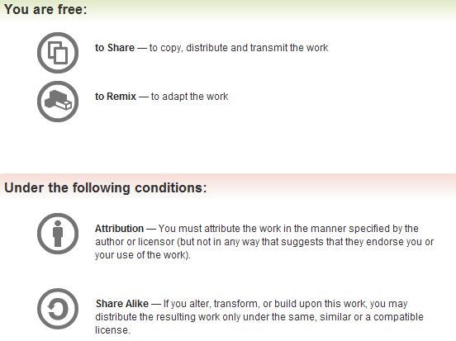
All materials are licensed under a Creative Commons “Share Alike” license.
http://creativecommons.org/licenses/by-sa/3.0/
Attribution condition: You must indicate that derivative work
"Is derived from John Butterworth & Xeno Kovah’s ’Advanced Intel x86: BIOS and SMM’ class posted at http://opensecuritytraining.info/IntroBIOS.html”
Notes:
Attribution condition: You must indicate that derivative work
"Is derived from John Butterworth & Xeno Kovah’s ’Advanced Intel x86: BIOS and SMM’ class posted at http://opensecuritytraining.info/IntroBIOS.html”

Slide 3
Background
Things you should ideally know before you start to learn BIOS attack/defense:
  x86 assembly
    http://OpenSecurityTraining.info/IntroX86.html
  x86 architecture (execution modes, segmentation, virtual vs. physical addresses, port IO)
    http://OpenSecurityTraining.info/IntermediateX86.html
  Reverse engineering
    http://opensecuritytraining.info/IntroductionToReverseEngineering.html
  Portable Executable binary format
    http://OpenSecurityTraining.info/LifeOfBinaries.html
  All the different way to find and exploit vulnerabilities (except the ways to get around anti-exploit techniques, because there are none :))
    http://OpenSecurityTraining.info/Exploits1.html

Slide 4
How computers do useful things
BIOS
(Basic Input/Output System)
Configures hardware
Boot Loader
Loads full-featured environment
OS/Hypervisor
Manages resources
Applications
Do useful things

Slide 5


A brief history of the world('s insecurity)
"Insanity: doing the same thing over and over again and expecting different results." – Albert Einstein
This is why I think people need to put more research effort in my hobby-horse area of Timing-Based Attestation…which can actually win at the same privilege level[18], but that's a story for another day ;)
BIOS
(Basic Input/Output System)
Boot Loader
OS/Hypervisor
Applications
Notes:
http://icons.iconarchive.com/icons/hopstarter/malware/icons-390.jpg
http://www.iconarchive.com/show/windows-8-icons-by-icons8/Security-Security-Checked-icon.html

Slide 6
One of these things is not like the others
One of these things is not well understood
BIOS
(Basic Input/Output System)
Firmware
Lives in flash chip soldered to motherboard
Boot Loader
Software
Lives on hard drive
Software
Lives on hard drive
OS/Hypervisor
Software
Lives on hard drive
Applications
Notes:
The point is, people understand how to recover from other problems. They wipe/replace the hard drive and reinstall software. They don't know how to recover from firmware attacks.

Slide 7
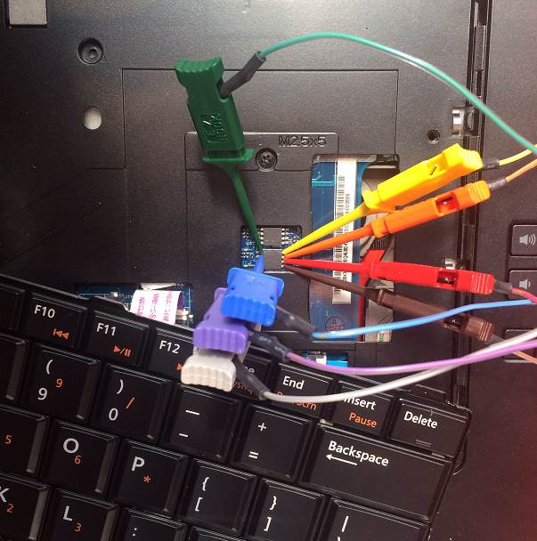
Having to fix this across thousands of machines would be very costly & unpleasant.
Notes:
This is the best possible case, where the BIOS is exposed for easy reflash.

Slide 8
Why Hack the BIOS?
Why would someone want to hack the BIOS?
  “Because it is a free pass for persistence forever.”
  Because very few organizations, are checking the BIOS
  If you get a foothold there, it’s likely to be there for years
  Low level code initializes the system so the lower the attacker goes the further up the malware food chain he is
Is hacking the BIOS itself the end-goal?
  Likely not, it’s a stepping stone to get into SMM or some other portion of the system
  And to keep the foothold for years and years
  Likely one target will be SMM, since this provides the attacker nigh-maximum privileges (aka "God Mode”), but there are other targets too
What can attackers who have infiltrated the BIOS do?
  “Anything the hardware lets them!”
  If the processor can reach out and touch it, then infiltrating the BIOS gives you power over it
  He who runs first, runs best

Slide 9

Example Attacks
BIOS "Bricking"
BIOS
(Basic Input/Output System)
Firmware is corrupted (1 byte is all that's needed)
System will not boot
The CIH virus did this as a time-bomb attack on (supposedly 60 million) computers in 1998http://en.wikipedia.org/wiki/CIH_(computer_virus)
Notes:
http://www.wickes.co.uk/content/ebiz/wickes/invt/213633/Facing-Brick_large.jpg

Slide 10


Example Attacks
BIOS Backdooring
BIOS
(Basic Input/Output System)
Infect Boot Loader
Boot Loader
Infect OS
OS
Infect Applications
This attack was seen in China in 2011 in the Mebromi malware.
http://www.webroot.com/blog/2011/09/13/mebromi-the-first-bios-rootkit-in-the-wild/
Applications
Steal useful things
Notes:
http://www.veryicon.com/icons/system/agua-stacks/evil-stack.html
https://cdn1.iconfinder.com/data/icons/Gifts/512/box1.png

Slide 11
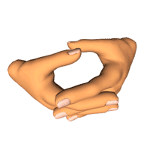
Example Attacks
Uber Evil Maid
BIOS
(Basic Input/Output System)
Hook Full Disk Encryption (FDE) software in memory
Boot Loader & FDE Prompt
Capture FDE password
Store in BIOS or unused HD space
Steal full HD contents at one's leisure
Notes:
"It's one thing for someone to say what's clearly architecturally possible, and it's another to show a video of specific software being compromised or security software being bypassed."
http://2.bp.blogspot.com/-BtStmGpZOts/TsCIMLUXvwI/AAAAAAAACAc/N19iHf_pGms/s1600/hands_twiddling_thumbs_fast_lg_nwm.gif

Slide 12

Example Attacks
Cloud Bursting
BIOS
(Basic Input/Output System)
Infect Boot Loader
Boot Loader
Infect hypervisor binary or
infect virtual BIOS
Hypervisor
Infect ALL virtual machines
VMs
VMs
Steal or smash the eggs
VMs
Notes:
http://peteandgerrys.com/tag/pete-gerrys-heirloom-eggs/
http://peteandgerrys.com/wp-content/uploads/2012/04/Combo-in-Basket.jpg

Slide 13

One Stealth Malware Taxonomy
Your view of the world?
Ring 3 – Userspace-Based
Ring 0 – Kernel-Based
Yeah, I’m pretty fuckin badass…
I totally broke into the web browser (userspace application) remotely
Nah bro, I’m the hot shit here
I totally broke into the kernel and am now running my uber1337 r00tk4t

Slide 14

One Stealth Malware Taxonomy
Welcome to the Deep Dark!
Ring 3 – Userspace-Based
Ring 0 – Kernel-Based
“Ring -1” – Virtualization-Based
  Intel VT-x(Virtualization Technology for x86), AMD-V (AMD Virtualization), Hypervisor subverted
"Ring -1.5?" - Post-BIOS, Pre OS/VMM
  e.g. Master Boot Record (MBR) "bootkit"
  Peripherals with DMA(Direct Memory Access) (this can be ring 0, -1, or -1.5 depending on whether VT-d is being used)
  Not a generally acknowledged "ring", but the place I think it fits best
"Ring -2" – System Management Mode (SMM)
"Ring -2.25 – SMM/SMI Transfer Monitor (STM)
  A hypervisor dedicated to virtualizing SMM
  Another one of my made up "rings", I just added this ring for this presentation :)
"Ring -2.5" - BIOS (Basic Input Output System), EFI (Extensible Firmware Interface)
  because they are the first code to execute on the CPU and they control what gets loaded into SMM
  Not a generally acknowledged "ring", but the place I think it fits best
“Ring -3” – Chipset Based - not valid anymore on modern architectures
  Intel AMT(Active Management Technology)/ME(Management Engine) – Now just ring ?
  Could maybe be argued that any off-CPU, DMA-capable peripherals live at this level?
We start where others end!
But BIOS could use VT-d to prevent DMA, and it initializes peripherals, so…?
Yeah, things get squishy (non-precise) at the bottom with non-real-rings.

Slide 15


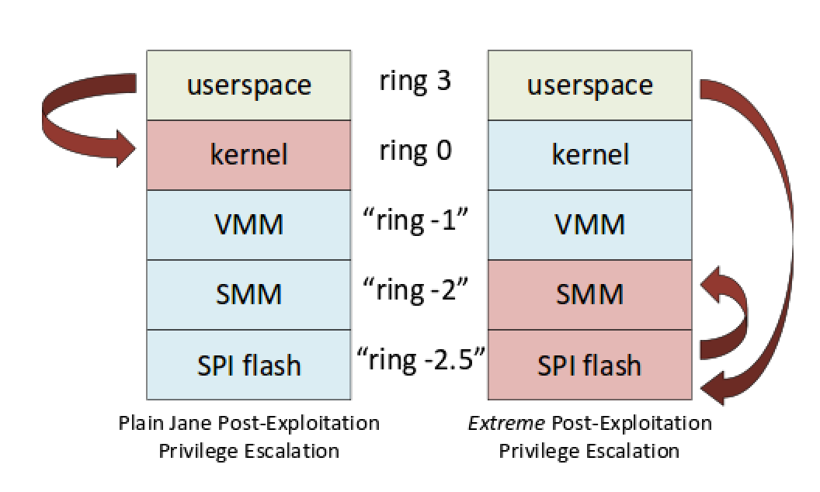


Which is why what we can do is Extreme!

Slide 16
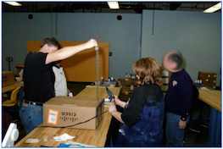
System Management Mode (SMM) is the true “God Mode” on x86 systems
BIOS loads SMM code
SMM can read/write everyone else’s memory
No one can read/write SMM’s memory once it has been locked by the BIOS
  Unless they have an exploit ;)
Only the PC makers should be able to change the code in the BIOS (digitally signed)
  Unless they have an exploit ;)
  Or unless they have physical access ;)

Slide 17
Threats
In Sept. 2011 the first crimeware (Mebromi) was found using BIOS infection [13]
In Dec. 2013 NSA defensive director said other states are developing BIOS attack capabilities [14]
In Dec. 2013 Snowden leaks said NSA’s offensive side had a catalog of capabilities that includes BIOS/SMM implants [15]
In Jan. 2014 CrowdStrike said that some malware they attributed to Russia is collecting BIOS version info (but they didn’t say they had seen BIOS infection itself) [16]
In Jun. 2015 the HackingTeam leaks[18] showed that they had developed a UEFI-based persistence mechanism to install their typical Windows RAT
Notes:
“For people like us, who work entirely by building upon unclassified sources, this was great, because it provided very important publicly citable evidence that we could point to of a threat actor with intent to attack at this level.”
“The next data about a threat actor did not make me as happy. One of the documents Snowden leaked was a catalog of US offensive capabilities, which included placing implants in the BIOS. Now that exposure is theoretically great for us. NO ONE can ever argue with us again that BIOS level attackers are realistic. And as damaging as that revelation might be to US national security, I would say that it was by far more damaging to world security. What it meant was that every tom, dick, and harry at every intelligence agency in every country in the world now knows unequivocally that it is possible to attack at the BIOS level. If they ever had any doubts that such things could be weaponized, those doubts were erased. And in my mind I see all the intelligence agencies of the world going to their bosses with that document in hand saying “I can totally build these capabilities for you. I just need a budget plus up” ☺. A final point: Stuxnet was the face that launched a thousand ships for SCADA and ICS defense. But unfortunately we haven’t seen the same response for caring about the x86 firmware that’s in our personal and enterprise computers. It’s unfortunate, but I feel like people are not going to learn their lesson until they get owned. Hard.”
“And for this reference I’m loath to cite it, because they didn’t really provide any actual proof. But in an interview CrowdStrike stated that they had seen what they considered to be russian actors collecting information about what BIOS versions the systems they had infected were running. They didn’t say they had seen actual BIOS infection, so it might be a capability not yet deployed, not possible to be spotted during deployment, or it might just laying the ground work for an aspirational capability. I don’t really know

Slide 18
“DarkSeoul”
Attributed to the North Koreans
Targeted at South Korea banks
Included MBR wiper malware that induced direct economic loss
“Tens of thousands” of machines rendered unbootable
  Aided by compromising software update servers

Slide 19
Sony Hack
Attributed to the North Koreans
Primarily theft of information and extortion
Included MBR wiper malware that induced direct economic loss
I was a bit skeptical at first, until it was said that the reason the FBI was so certain was because the NSA folks said so :)
  http://www.nytimes.com/2015/01/19/world/asia/nsa-tapped-into-north-korean-networks-before-sony-attack-officials-say.html

Slide 20
“Shamoon”
Attack against Saudi Aramco
Attributed to Iranians against their regional rival Saudi Arabia
Included HD wiper malware introduced direct economic loss
Took down 30,000+ systems
  What if it had been BIOS malware? :)

Slide 21
BIOS/SMM/OROM/DMA/ACPI/ME/TXT/Firmware Attack Talks
(from bit.ly/1bvusqn)
From ShmooCon 2015 talk “Betting BIOS Bugs Won’t Bite Y’er Butt?”
http://www.legbacore.com/Research_files/2015_ShmooCon_BIOSBugs.pdf
First BIOS exploit, by ITL
Date of leaked NSA documents showing existing weaponized BIOS infection capability
A bunch of people say
“I can do what NSA can do!”
Notes:
Criteria: everything that could allow for code execution before a VMM starts, excluding VMM vulns and traditional MBR/VBM/GPT bootkitting
Voice track: I took out all the Virtualization/Bootkit attacks

Slide 22
Number of Novel Attacks in
BIOS/SMM/OROM/DMA/ACPI/ME/TXT/Firmware Attack Talks
(from bit.ly/1bvusqn)
Cumulatively: 99 novel vulnerabilities or malware techniques
2015: Know of at least 4 vulns under disclosure not yet publicly talked about
Notes:
Point being, it’s actually growing pretty significantly

Slide 23
So the questions are:
Can you tell a limited and targeted BIOS corruption from a hardware failure?
Are you going to give BIOS attackers a free pass to live on your machines & networks forever?
Would you know what to do to detect them even if you wanted to?
What if a HD-wiping adversary steps up their game and becomes a BIOS-wiping one? Are you prepared to recover from that?
Do you want to learn about REAL ULTIMATE POWER?!

Slide 24

BRING IT ON!
Notes:
http://www.character-shop.com/tcslargescale/alien%20queen/aliens-ripley-alien-queen.jpg

Slide 25
References
[1] Evil Maid Just Got Angrier: Why Full-Disk Encryption With TPM is Insecure on Many Systems – Yuriy Bulygin – Mar. 2013 http://cansecwest.com/slides/2013/Evil%20Maid%20Just%20Got%20Angrier.pdf
[2] BIOS Chronomancy: Fixing the Core Root of Trust for Measurement – Butterworth et al., May 2013 http://www.nosuchcon.org/talks/D2_01_Butterworth_BIOS_Chronomancy.pdf
http://dl.acm.org/citation.cfm?id=2516714
[3] A Tale of One Software Bypass of Windows 8 Secure Boot – Bulygin et al.– Jul. 2013 http://blackhat.com/us-13/briefings.html#Bulygin
[4] All Your Boot Are Belong To Us (MITRE portion) – Kallenberg et al. – Mar. 2014, delayed from publicly disclosing potential for bricking until HITB at Intel’s request https://cansecwest.com/slides/2014/AllYourBoot_csw14-mitre-final.pdf
http://www.kb.cert.org/vuls/id/758382
[5] All Your Boot Are Belong To Us (Intel portion) – Bulygin et al. – Mar. 2014 https://cansecwest.com/slides/2014/AllYourBoot_csw14-intel-final.pdf

Slide 26
References
[6] Defeating Signed BIOS Enforcement – Kallenberg et al., Sept. 2013 http://conference.hitb.org/hitbsecconf2013kul/materials/D1T1%20-%20Kallenberg,%20Kovah,%20Butterworth%20-%20Defeating%20Signed%20BIOS%20Enforcement.pdf
http://www.kb.cert.org/vuls/id/912156
http://www.kb.cert.org/vuls/id/255726 (not yet released)
[7] DE MYSTERIIS DOM JOBSIVS Mac EFI Rootkits - Loukas K (snare), Jul. 2012 https://media.blackhat.com/bh-us-12/Briefings/Loukas_K/BH_US_12_LoukasK_De_Mysteriis_Dom_Jobsivs_Slides.pdf
[8] Thunderstrike – Trammel Hudson, Dec. 2014 https://trmm.net/Thunderstrike_31c3 CVE-2014-4498
[9] Speed Racer: Exploiting an Intel Flash Protection Race Condition – Kallenberg & Wojtczuk, Dec. 2013 https://frab.cccv.de/system/attachments/2565/original/speed_racer_whitepaper.pdf
http://www.kb.cert.org/vuls/id/912156
[10] Extreme Privilege Escalation on UEFI Windows 8 Systems – Kallenberg et al., Aug 2014 https://www.blackhat.com/docs/us-14/materials/us-14-Kallenberg-Extreme-Privilege-Escalation-On-Windows8-UEFI-Systems.pdf
http://www.kb.cert.org/vuls/id/766164
[11] Attacking UEFI Boot Script – Wojtczuk & Kallenberg, Dec. 2013
https://frab.cccv.de/system/attachments/2566/original/venamis_whitepaper.pdf
http://www.kb.cert.org/vuls/id/552286
[12] See all the rest of stuff here: http://timeglider.com/timeline/5ca2daa6078caaf4

Slide 27
References
[13] “Mebromi: the first BIOS rootkit in the wild” http://www.webroot.com/blog/2011/09/13/mebromi-the-first-bios-rootkit-in-the-wild/
[14] “NSA Speaks Out on Snowden Spying” http://www.cbsnews.com/news/nsa-speaks-out-on-snowden-spying/
[15] "To Protect And Infect” https://www.youtube.com/watch?v=vILAlhwUgIU (contains leaked classified NSA documents)
[16] “U.S. Gas, Oil Companies Targeted in Espionage Campaigns” http://threatpost.com/u-s-gas-oil-companies-targeted-in-espionage-campaigns/103777
[17] “Summary of Attacks Against BIOS and Secure Boot” https://www.defcon.org/images/defcon-22/dc-22-presentations/Bulygin-Bazhaniul-Furtak-Loucaides/DEFCON-22-Bulygin-Bazhaniul-Furtak-Loucaides-Summary-of-attacks-against-BIOS-UPDATED.pdf also worth a read, even though it’s incomplete and they don’t include all our work ;)
[18] https://twitter.com/NikolajSchlej/status/618076694117789696

