Slide 1
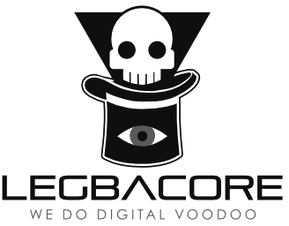
Advanced x86:
BIOS and System Management Mode Internals
Boot Process
Xeno Kovah && Corey Kallenberg
LegbaCore, LLC

Slide 2
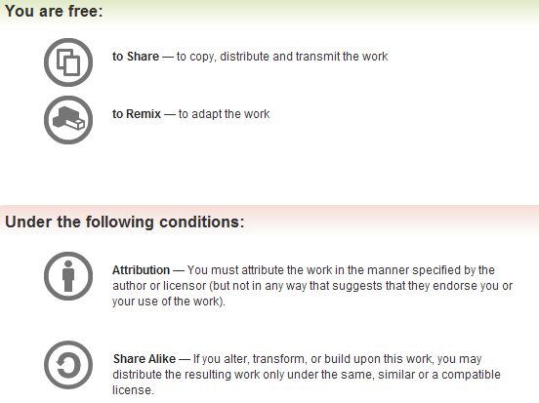
All materials are licensed under a Creative Commons “Share Alike” license.
http://creativecommons.org/licenses/by-sa/3.0/
Attribution condition: You must indicate that derivative work
"Is derived from John Butterworth & Xeno Kovah’s ’Advanced Intel x86: BIOS and SMM’ class posted at http://opensecuritytraining.info/IntroBIOS.html”
Notes:
Attribution condition: You must indicate that derivative work
"Is derived from John Butterworth & Xeno Kovah’s ’Advanced Intel x86: BIOS and SMM’ class posted at http://opensecuritytraining.info/IntroBIOS.html”

Slide 3
This covers an example of a minimal BIOS boot process, just to give an idea of what the BIOS does before your operating system starts to load.
It doesn’t include everything of course because it’s geared towards minimal-configuration to achieve 100% functionality.

Slide 4
Boot Process at a glance*
Power-up
  16-bit Real Mode accessing address FFFF_FFF0h
Operating mode selection
  Flat protected mode
Preparation for memory initialization
  CPU microcode update
  Set up CPU Cache as RAM (CAR)
  Chipset initialization (MCHBAR, PCIEXBAR, etc.)
Memory initialization
  Configure the memory controller
Post memory initialization
  Memory test
  Copy firmware from flash to memory for faster execution*
    In the doc this is listed as firmware shadowing but I’m modifying it somewhat since the BIOS can perform the copying of flash components to memory
    As a general rule, it’s better to copy things to memory before execution as soon as possible
  Memory transaction redirection (PAM registers)
  Setting up the stack (before memory initialization, stack will be in CPU cache)
  Transfer to DRAM (the BIOS flash that was copied to memory is now executed)
*This list composed from Intel Minimal Architecture Boot Loader
Notes:
Acronyms not yet defined:
PAM = Programmable Attribute Map

Slide 5
Boot Process at a glance*
Miscellaneous platform enabling
  Platform dependent: Initialize clocks to operate at N Hz, configure general-purpose I/O, etc.
Interrupt enabling - PIC (Programmable Interrupt Controller), LAPIC (Local Advanced PIC), I/O APIC, etc.
Interrupt tables
  Interrupt Vector Table (IVT)
    Interrupt Service Routine (ISR) – INT 10h, etc…
  Interrupt Descriptor Table (IDT)
    Exceptions
Setting up timers
  In ICH: RTC (, HPET, 8254 Programmable Interrupt Timer (PIT), TCO timer (used as watchdog)
  In CPU: LAPIC timer
Memory caching control
Processor discovery and initialization
  CPUID
  Startup Inter-Processor Interrupts (SIPIs) are written to a processor’s LAPIC telling it to wake up and where to start executing code at (must be a 4KB aligned boundary)
    Intel SW Programmer’s Guide has more detail on this
  Each processor will awaken in Real Mode
*This list composed from Intel Minimal Architecture Boot Loader
Notes:
Acronyms not yet defined:
RTC = Real Time Cock
HPET = High Performance Event Timer
TCO = "In this document the acronym TCO (Total Cost of Ownership) refer to a logic block in the Intel ICH products family. The Watchdog Timer (WDT) is one of the functions of that logic block."

Slide 6
Boot Process at a glance*
I/O devices
  Super I/O can control PS/2 keyboard, serial, parallel, etc. interfaces
PCI device discovery
  Enumerate PCI devices
  Assign address space (port IO, Memory Mapped IO)
  Detect and execute Expansion ROMs (XROMs)
Memory map
  Region types
    Memory
    Reserved
    ACPI Reclaim
    ACPI NVS
    ROM
    IOAPIC
    LAPIC
  Region locations
    Consult your datasheet for a complete list, but we’ll cover some of the more relevant ones
Non-Volatile (NV) storage
  CMOS
  NV SPI flash
Handoff to boot-loader
*This list composed from Intel Minimal Architecture Boot Loader

Slide 7
Only 16 steps? BIOS is simple!
Easy to summarize, not so easy to implement
Very complex implementations
Even if it’s only a couple MB, it’s a very DENSE couple of MB
That list taken from the Intel Minimal Architecture Boot Loader which provides a pretty good list of functional requirements
What is left out is:
  Initializing SMM and locking down SMRAM
  Locking down the BIOS Flash
*This list composed from Intel Minimal Architecture Boot Loader

Slide 8
How do you learn about all that stuff?
You could go review open source BIOSes’ code (CoreBoot or UEFI’s TianoCore reference code)
Or you can sign an NDA with Intel and read their very large “BIOS Writer’s Guide” and associated documentation for each CPU/chipset
At the end of the day, the open source code is more or less just doing what they’re told to do by the Intel documentation

