Slide 1
Advanced x86: BIOS and System Management Mode Internals UEFI Reverse Engineering
Xeno Kovah && Corey Kallenberg
LegbaCore, LLC

Slide 2
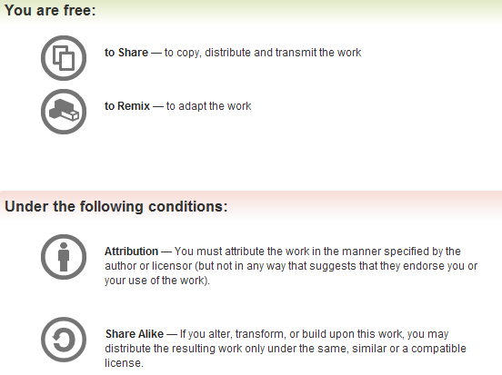
All materials are licensed under a Creative Commons “Share Alike” license.
http://creativecommons.org/licenses/by-sa/3.0/
Attribution condition: You must indicate that derivative work
"Is derived from John Butterworth & Xeno Kovah’s ’Advanced Intel x86: BIOS and SMM’ class posted at http://opensecuritytraining.info/IntroBIOS.html”
Notes:
Attribution condition: You must indicate that derivative work
"Is derived from John Butterworth & Xeno Kovah’s ’Advanced Intel x86: BIOS and SMM’ class posted at http://opensecuritytraining.info/IntroBIOS.html”

Slide 3
And the people yelled:
WE WANT TO ANALYZE SOME CODE!
WE WANT TO ANALYZE SOME CODE!
WE WANT TO ANALYZE SOME CODE!
WE WANT TO ANALYZE SOME CODE!
WE WANT TO ANALYZE SOME CODE!
WE WANT TO ANALYZE SOME CODE!!!1!
Notes:
http://www.bbc.co.uk/news/special/uk/11/london_riots/img/panel/liverpool_riot_624.jpg

Slide 4
Simmer down y'all.
I reckon what ya best do is…
Find some subset of interesting code
You *could* search for B/D/F address of interest
But better is to narrow down what you want to look at, by slicing and dicing the firmware filesystem with one of:
EFIPWN
https://github.com/G33KatWork/EFIPWN
UEFITool
https://github.com/LongSoft/UEFITool
UEFI Firmware Parser
https://github.com/theopolis/uefi-firmware-parser
We're not going to cover this for now, since I haven't built it on Windows yet
Notes:
http://ak9.picdn.net/shutterstock/videos/4150873/preview/stock-footage-old-small-town-america-man-whittling-sitting-on-rocking-chair-american-flag-on-sidewalk-and-old.jpg

Slide 5
Firmware Storage
SPI Flash
Flash Descriptor
Gigabit Ethernet
Platform Data
Management Engine
Firmware Device refers to the flash chip
UEFI/BIOS
UEFI utilizes the physical flash device as a storage repository
Comprised of 4 basic components:
Firmware Device
Firmware Volume
Firmware File System
Firmware Files
Notes:
Offhand I can think of no benefits nor detractions as to why the FFS should start at the beginning of the SPI BIOS region.
Question: Does FFS have to be aligned? Perhaps that’s the reason.

Slide 6
Firmware Volumes (FVs)
SPI Flash
Firmware Volume(s)
Flash Descriptor
FV0
FV does not have to align with the start of the BIOS region as configured in the Flash Descriptor
Gigabit Ethernet
Platform Data
Management Engine
FV1
UEFI/BIOS
A Firmware Device is a physical component such as a flash chip.
We mostly care about Firmware Volumes (FVs)
We often see separate volumes for PEI vs. DXE code
And occasional “duplicate” volumes for restore-from-backup
FVs can contain multiple firmware volumes (nesting)
FVs are organized into a Firmware File System (FFS)
The base unit of a FFS is a file

Slide 7
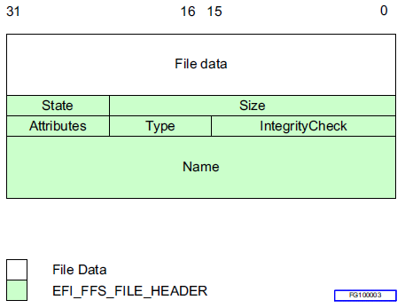
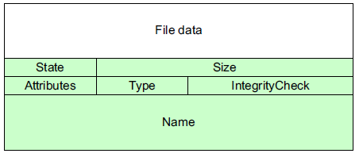
Firmware File System (FFS)
FV0
FV1
FFS
FVs are organized into a Firmware File System (FFS)
A FFS describes the organization of files within the FV
The base unit of a FFS is a file
Files can be further subdivided into sections

Slide 8
Firmware Files
We mostly care about file sections that are in PE (Portable Executable) file format
Alternatively can be a TE (Terse Executable) which is a “minimalist” PE
Oh, how interesting! My BIOS uses "Windows" executables? I know how to analyze those!
Oh, how interesting! My BIOS uses "Windows" executables? I know how to analyze those!
Notes:
http://images3.cinema.de/imedia/1183/1941183,tSXmey_NGQbRtRW8NSo2juLGRhXmEl4D_F15wvnp4ZD1thX0VkrPYDmrT+Q7AzjHHzox6TD3w0f8YtjpzzAfXw==.jpg

Slide 9
Yay Standardization!
A standard way of putting together the firmware filesystem, with nice human readable names, makes it easier for me to find my way around to the likely locations I want to attack
A standard way of putting together the firmware filesystem, with nice human readable names, makes it easier for me to understand the context of what might have been attacked if I see a difference there
Notes:
http://www.stevetierney.org/wp-content/uploads/2013/07/aa-angel-and-devil-on-mans-shoulder.jpg

Slide 10
UEFITool/UEFIExtract
The best and most up-to-date firmware filesystem parser

Slide 11
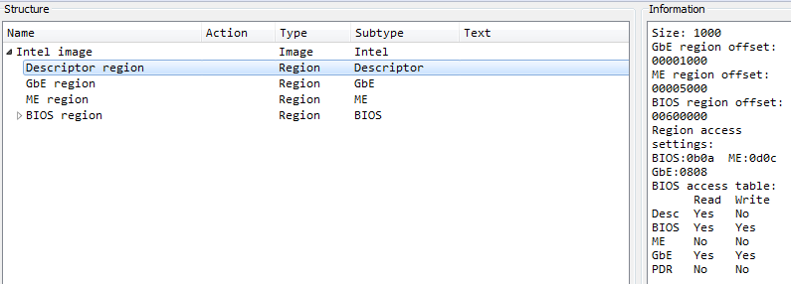
Go to File->Open and select the file dump (I selected the "e6430A03.bin")
Navigation by expanding portions here
Parsed metadata here
Here it's interpreting the Flash Descriptor and telling us which regions the BIOS can access

Slide 12
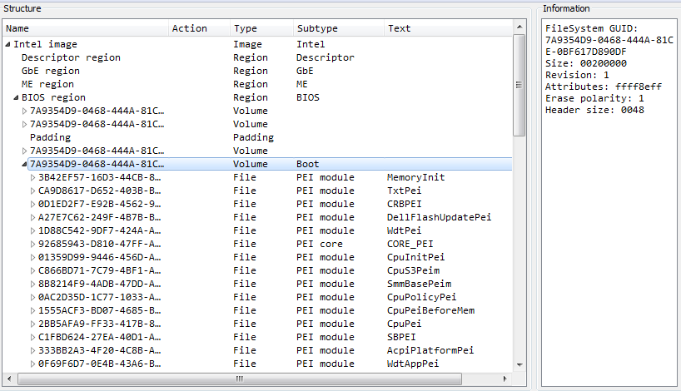
This volume holds a bunch of PEIMs (and the one above it a bunch of DXE drivers.)

Slide 13
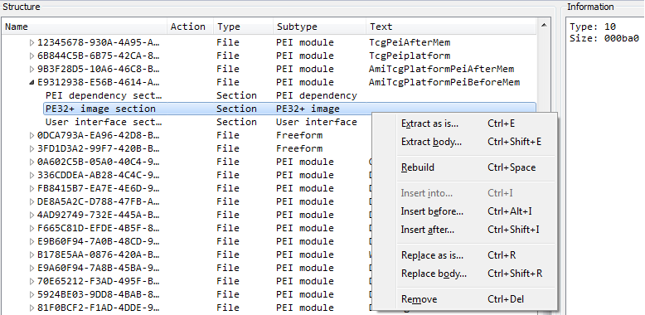
"AmgTcgPlatformPeiBeforeMem" is the PEIM we're going to be interested in shortly
To get a well-formed PE file, we extract it by right clicking and selecting "Extract body"

Slide 14
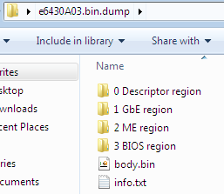
UEFIExtract is a simple command line tool that just dumps everything out to the filesystem instead of making it navigable from a GUI
The metadata will be stored off to the side in .txt files

Slide 15
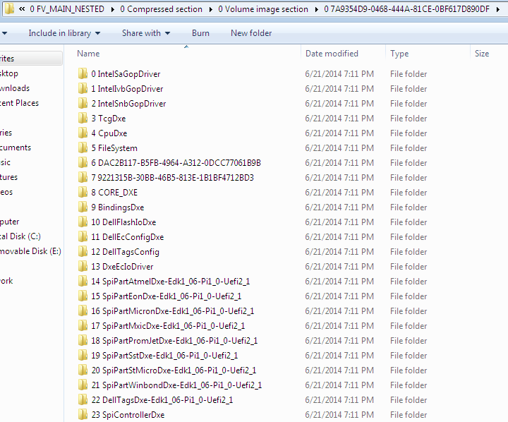
This is good if you want to search all the files for a pattern. But it's less easy to navigate if you want to just get a single file (in that case just use the GUI)

Slide 16
Identifying Changes in BIOS (bios_diff.py)
So as we know, Copernicus provides us the full dump of the BIOS flash
Repeated from previous: Copernicus maintains the FLA offsets for each region by reading even those which the CPU/BIOS master has no permissions to read (like the Management Engine, typically)
Any BIOS dump should work as long as it’s a UEFI BIOS (structured for better parsing)
Comparing BIOS dumps over a period of time can provide change detection
How this differs from observing the TPM PCR registers is this:
When a PCR tells you a change has been made, it cannot tell you where the change has been made
Bios_diff.py uses the decomposition capability of EFIPWN to tell us the particular module(s) in which the change(s) is/are located

Slide 17
Identifying Changes in BIOS (bios_diff.py)
This script uses EFIPWN to parse and diff the modules between two BIOS dumps
EFIPWN decomposes the BIOS into its firmware volumes (FVs) and then decomposes each into the files/modules that comprise it
In this example we’re analyzing an earlier “known-good” BIOS with one which we notice has changed
We took a known good and purposefully made a small change in the “suspicious” one

Slide 18
Identifying Changes in BIOS (bios_diff.py)
The script has found a difference located in firmware volume 3
Some files/modules have user-friendly names and if this is the case the script outputs this name
AmiTcgPlatformPeiBeforeMem
Tcg could be Trusted Computing Group and this is likely a PEIM that executes before memory is established

Slide 19
Identifying Changes in BIOS (bios_diff.py)
If more than 1 diff is found they will all be listed here in this manner
In this case it is just a single diff found
Diff was found at offset 0x40C in the file “AmiTcgPlatformPeiBeforeMem”
The length of the diff is 7 bytes

Slide 20
Identifying Changes in BIOS (bios_diff.py)
Files in the UEFI Flash File System are in the PE format (or TE [Terse Executable], which is a minimalist PE file)
But still PE
For this reason we can identify whether diffs are located in the .data or .text (code) sections of a given file
In this case the change occurs in the code section

Slide 21
Identifying Changes in BIOS (bios_diff.py)
Also from the PE file we can get the Virtual Address of the change in the file
From this we can derive both the Flash Linear Address of the change on the serial flash (provided the size of the BIOS region) and therefore its location in mapped high-memory
The output also identifies the Relative-Virtual Address (RVA), which is the segment offset from the start of the PE file

Slide 22
Identifying Changes in BIOS (bios_diff.py)
We can use the VA and RVA information to locate this PE file in the BIOS hex dump
VA – RVA = beginning of PE file
But first let’s convert that VA to a flash linear address:
FFFF_FFFFh – FFE6_D090h = 19_2F6Fh
<.bin size> - 19_2F6Fh = BF_FFFFh - 19_2F6Fh = A6_D090h
A6_D090h – 40C = A6_CC84h

Slide 23
Analyzing UEFI Files with IDA (Search for “MITRE Copernicus Analyzing BIOS Differences with IDA Pro”)

Slide 24
Analyzing UEFI Files
Following our example of finding a “diff” across multiple BIOS, let’s find out how to analyze the change using IDA
This should strike a sharp contrast to trying to analyze a legacy BIOS which does not follow public standards
Not to say they don’t have internal standards, just that those standards are not public
The free version of IDA will be adequate for these purposes

Slide 25
The first step having identified a change between two BIOS dumps is to first locate the specific files in which the change(s) were detected
In our example, the changes occur in Firmware Volume 3
Find the directory where EFIPWN decomposed the UEFI binary and go to firmwareVolume3

Slide 26
Analyzing UEFI Files
Inside the firmwareVolume3 directory is a directory listing of GUIDS
Find the GUID in which this diff was detected
In this case it is GUID:
e9312938-e56b-4614-a252-cf7d2f377e26
Inside this directory you will find the PE32_94 file which contains the file that has changed
You can locate both of these files in this manner: the previous one which is assumed to be good, and the new one in which the change has been observed

Slide 27
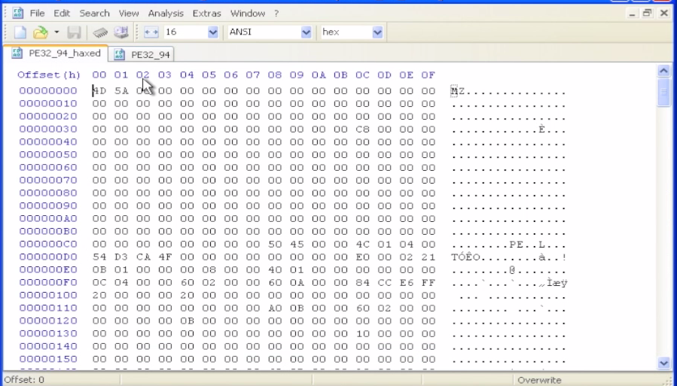
Quick look in hex editor
One of the first things you can do upon acquiring both files is to observe them in a hex editor
HxD allows you to easily perform binary comparisons between 2 files (Analysis > File-Compare > Compare, and then select the 2 files you want to compare)

Slide 28
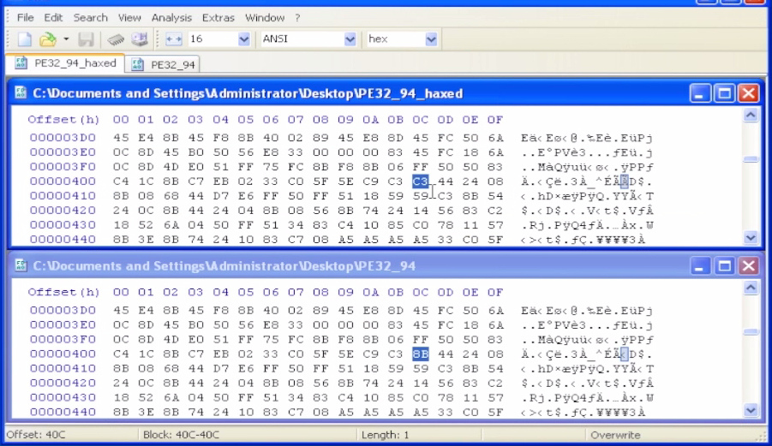
Quick look in hex editor
HxD’s file comparison compares each file in parallel and highlights each byte that differs
It’s a quick way to “eyeball” changes which have been detected
This is less helpful when the file-sizes differ and the area where you want to analyze the change occurs at an offset other than where it usually does

Slide 29
Quick look in hex editor
In this simple example, the “haxed” version of the PE file has opcode 0xC3 at offset 0x40C while the original file has 0x8B
Those who are familiar with the x86 instruction set may recognize the 0xC3 opcode as the RET (return) instruction
Note that at the bottom of the HxD window it shows the file offset of the highlighted diff byte (“Block 40C-40C”)
This corresponds to the information outputted by our bios_diff.py

Slide 30
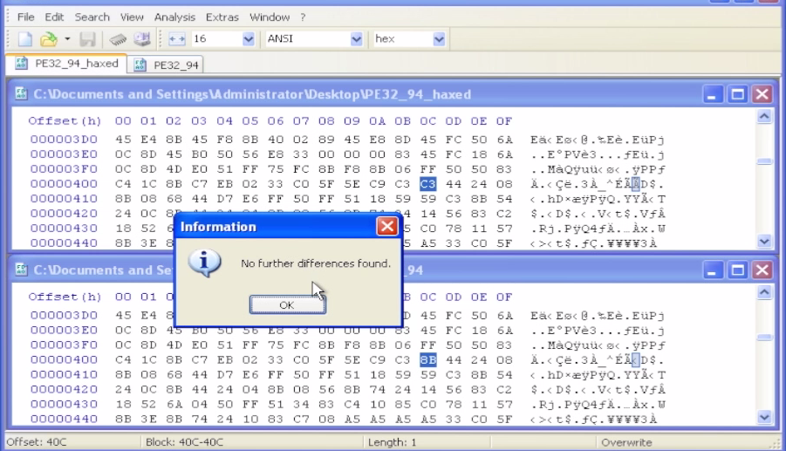
Quick look in hex editor
You can cycle through each byte that is different by pressing ‘F6’ (Next Difference)
In this simple example, there is only this single byte that is different

Slide 31
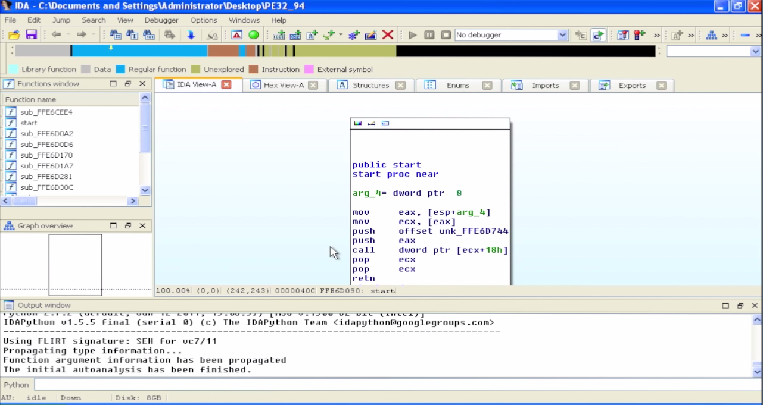
Analyzing UEFI Files with IDA
Now we’ll actually take a look at these files in IDA
Free version is mostly adequate, minus the Hex-Rays pseudo-code view
Notice IDA recognizes the PE file format and opens the file accordingly
IDA 6.7 will recognize UEFI files! (but can’t distinguish between PEI and DXE drivers, and so just applies a DXE entry point definition in both cases)
Shown here is the non-hacked version of the TPM driver showing real instructions at the entry point

Slide 32
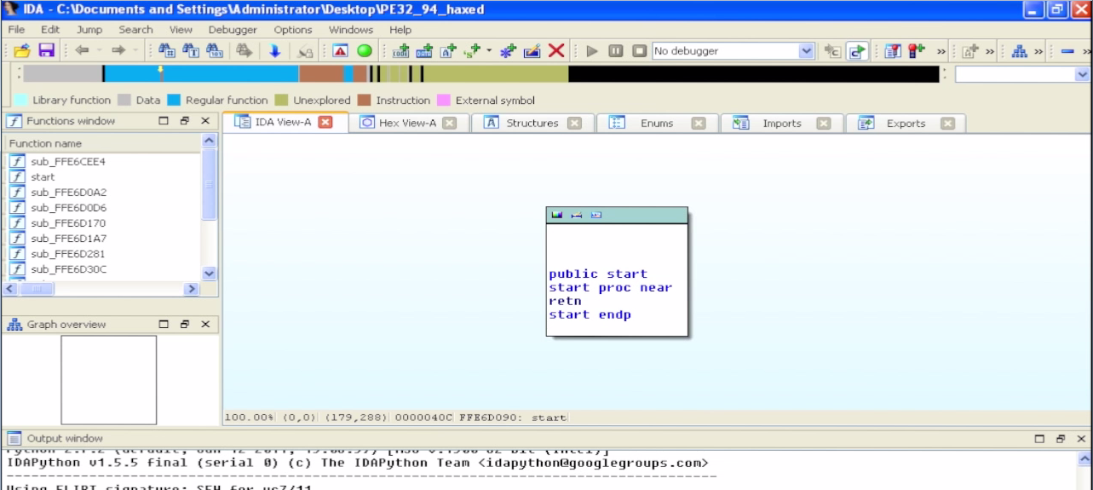
Analyzing UEFI Files with IDA
Shown above is the hacked file with just the RET at the entry point
This simple example assumes the attacker has placed this instruction here so that the TPM driver never performs any of its activities

Slide 33
Analyzing UEFI Files with IDA
To see the pseudo-code you will need the full version of IDA Pro with Hex-Rays
The non-hacked file is dereferencing a DWORD at offset 24 of arg 2
IDA displays offsets in base 10 by default; 24 is 0x18
The dereference is followed by a call: (a2, &unk_FFE6D744)
So this appears to be calling a function pointer from out of a table

Slide 34
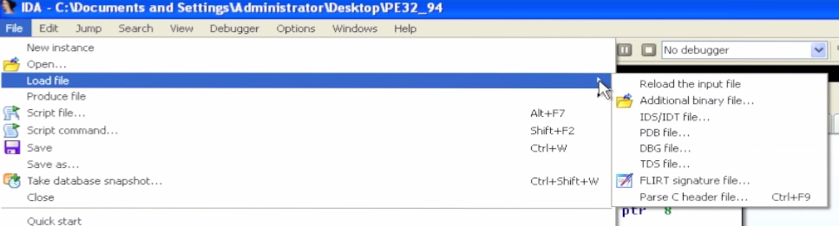
Applying UEFI Structure Definitions
UEFI uses publically-defined data structures
We’re going to import ‘behemoth.h’ which was created by Snare (using scripts)
https://github.com/snarez/ida-efiutils/blob/master/behemoth.h
Snare has done a talk on attacking Apple’s EFI implementation
Black Hat USA 2012: http://ho.ax/downloads/De_Mysteriis_Dom_Jobsivs_Black_Hat_Slides.pdf
White Paper: http://ho.ax/De_Mysteriis_Dom_Jobsivs_Black_Hat_Paper.pdf

Slide 35
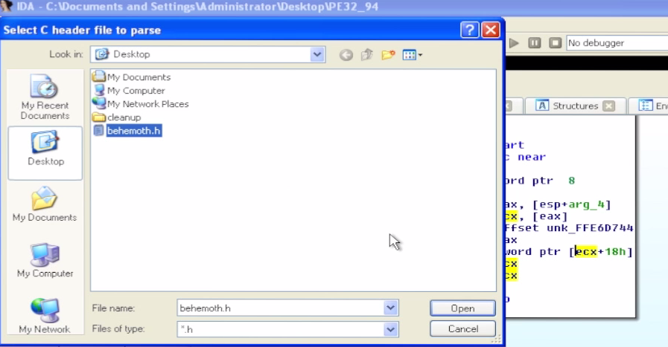
Applying UEFI Structure Definitions
Our behemoth.h file is located in the C:\Tools\ directory
It contains a lot of structure definitions from the EFI Specification
Plus enumerated values and types

Slide 36
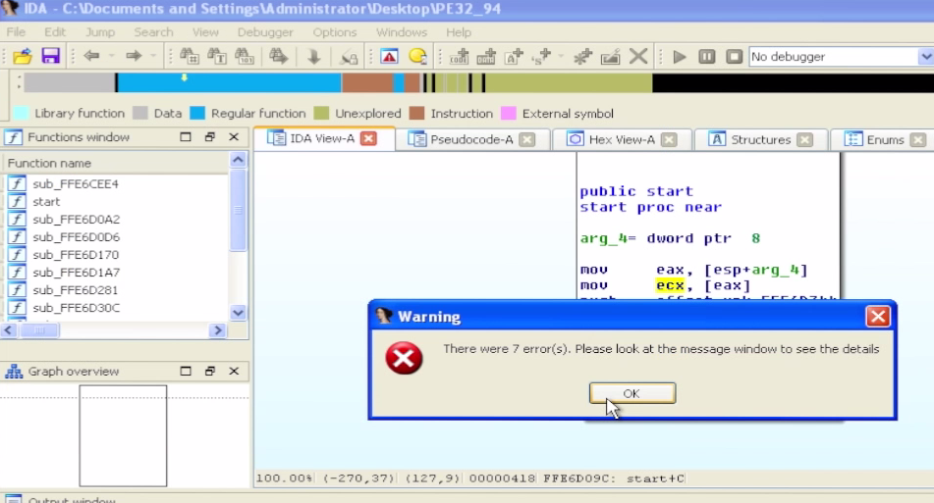
Applying UEFI Structure Definitions
Ignore any errors you see when importing this file
Importing the structures we use will still work

Slide 37
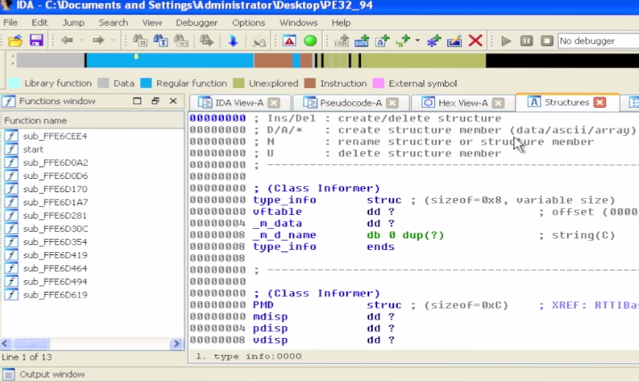
Applying UEFI Structure Definitions
Now go to the Structures tab
Hit ‘Insert’

Slide 38
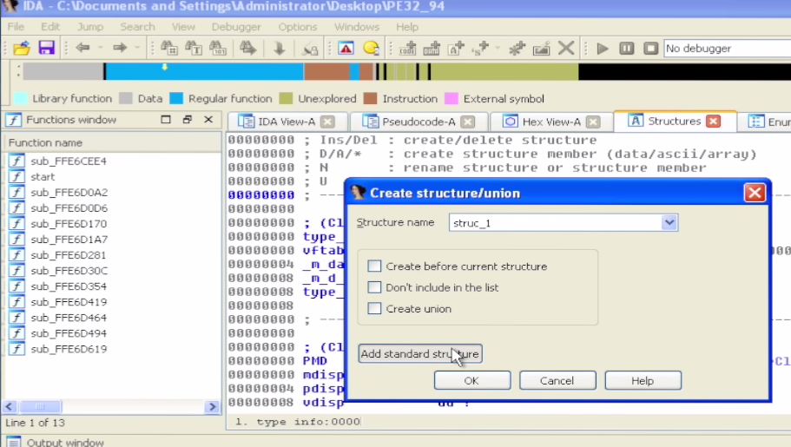
Applying UEFI Structure Definitions
Select ‘Add a Standard Structure’

Slide 39
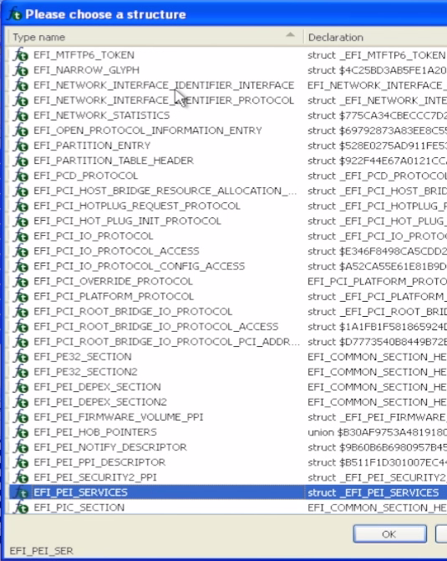
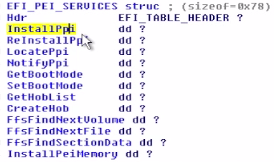
We can sort the structures by name to make search easier
We’re looking for EFI_PEI_SERVICES
These are services used by PEIMs during the PEI phase
An (incomplete) sampling is below:

Slide 40
Applying UEFI Structure Definitions
Now we’re going to add an EFI_GUID structure

Slide 41
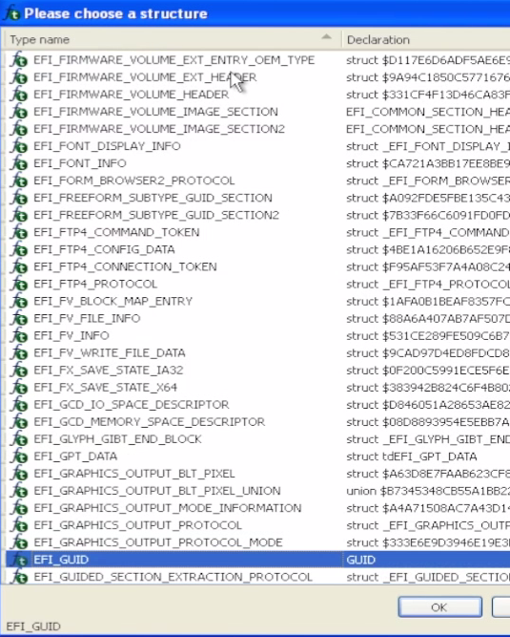
A GUID is a 16-byte data structure used as a name for many of the EFI objects:
Dword
Word
Word
Char array[8]

Slide 42
Applying UEFI Structure Definitions
Likely this file will be using the PEI Services table:
The name of the file is ‘AmiTcgPlatformPeiBeforeMem’
It’s a common structure used during the PEI phase so PEIMs can use common services

Slide 43
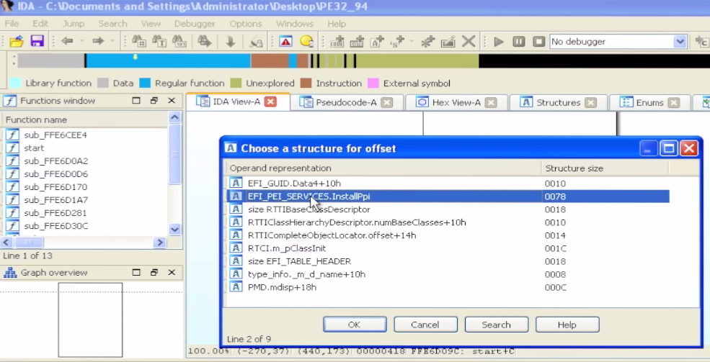
Applying UEFI Structure Definitions
Hit ‘t’ to have IDA interpret that value as a structure
Select EFI_PEI_SERVICES based on our hypothesis

Slide 44
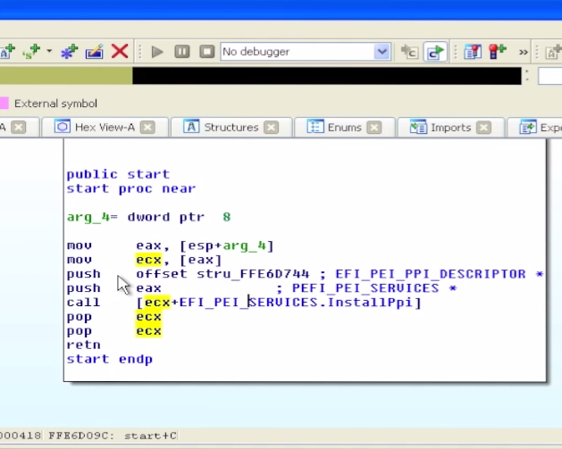
Applying UEFI Structure Definitions
Hit Ok or ‘y’ to accept this definition
IDA does not have an undo, so it’s always good to save first
But we have a hunch that this is the right object

Slide 45
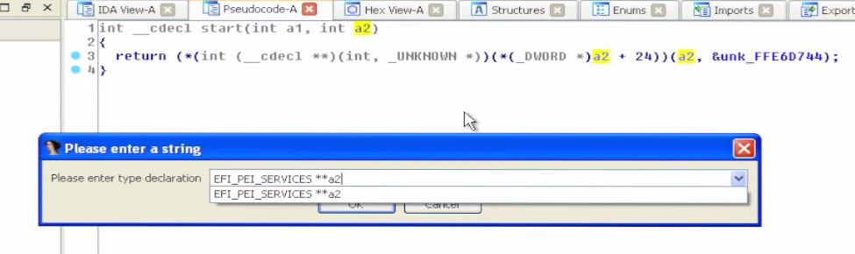
Applying UEFI Structure Definitions
In the pseudo-code view you can do the same thing
Select the a2 argument and hit ‘t’
Select the EFI_PEI_SERVICES structure
When we enter the above, we see the code simplifies:

Slide 46
Applying UEFI Structure Definitions
We see that this function immediately calls the InstallPpi() PEI Service
InstallPpi() takes 2 arguments:
The EFI_PEI_SERVICES structure
Some Unknown argument
Per the EFI Specification, InstallPpi installs an interface in the PEI PEIM-to-PEIM Interface (PPI) database by GUID
We could look up the prototype in the spec:

Slide 47
Always let the GUIDs be your GUIDe
UEFI uses a lot of “GUIDs” – Globally Unique IDentifiers.
Used to identify files on the filesystem
Filesystem GUIDs often reused between EDK & production systems. Or between the same IBV code on different OEMs’ systems
Used to identify structures (PPIs in PEI phase, Protocols in DXE phase) that contain data and/or function pointers

Slide 48
EFI_ARP_PROTOCOL_GUID
EFI_DEBUG_AGENT_GUID
EFI_ACPI_TABLE_GUID
DXE_CORE_FILE_NAME_GUID
EFI_DHCP4_PROTOCOL_GUID
EFI_CERT_TYPE_PKCS7_GUID

Slide 49
Tracing PPIs
But in this case IDA also recognizes this structure
We can double-click on it to see that IDA has identified it as an EFI_PEI_PPI_DESCRIPTOR :
First is the Flags 80000010h
Second is the pointer to the GUID
Third is the pointer to the PPI that will be installed

Slide 50
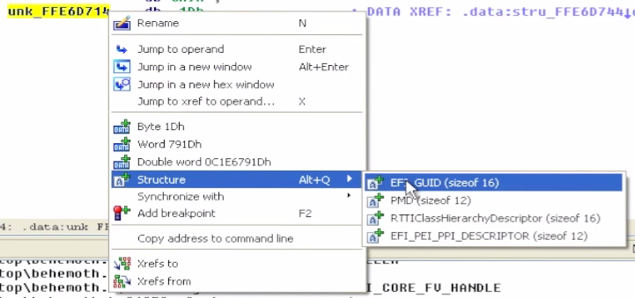
Tracing PPIs
Select the GUID structure
One thing we can do is try and determine if this is a known-GUID or an unknown GUID
The UDK defines a lot of GUIDS, these would likely be the same across all vendors
Vendors also implement their own proprietary GUIDS

Slide 51
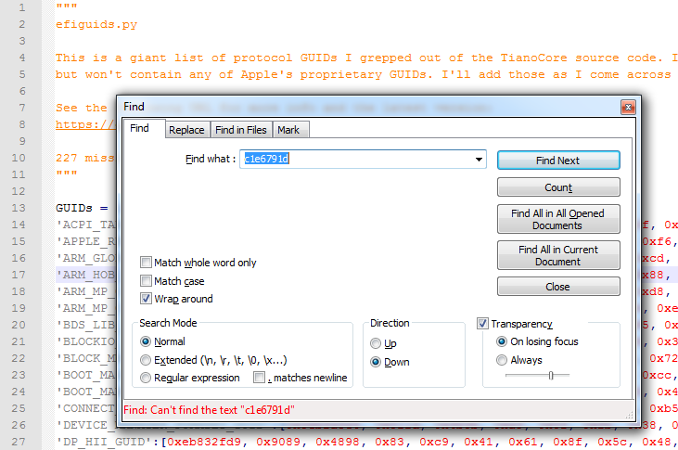
Tracing PPIs
Snare also provides the efiguids.py file which contains GUIDs he pulled out of the UDK
Our efiguids.py is located in C:\Tools\ and contains previously identified GUIDs
In this case it is not in this file. We can name it ‘UnknownGuid1’

Slide 52
Tracing PPIs
Now if we follow the pointer it will take us to the PPI that is going to be installed
This function is what will get called when someone uses this PPI

Slide 53
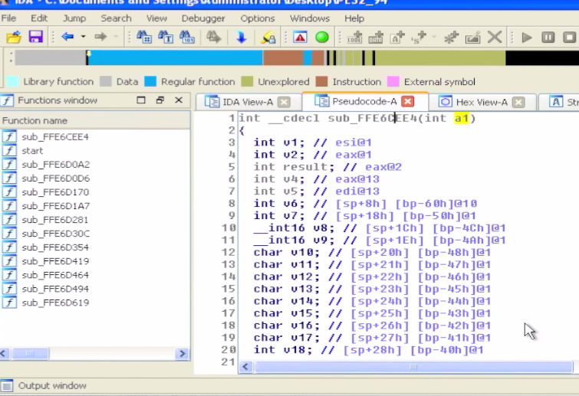
Recurse & define
We can analyze this is pseudo-code or the main view
Since it accepts one argument we can hypothesize again that it takes in an instance of the EFI_PEI_SERVICES structure

Slide 54
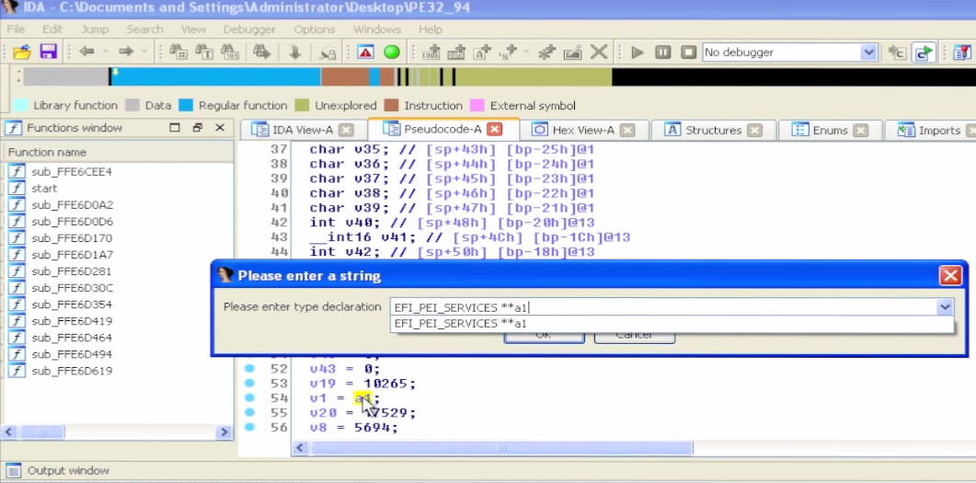
Recurse & define
As before, we can define this as EFI_PEI_SERVICES**a1

Slide 55
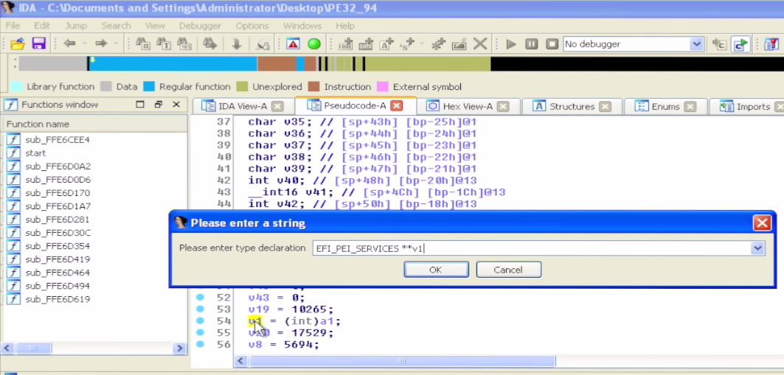
Recurse & define
Also we can define v1 in the same way since its equal to a1
EFI_PEI_SERVICES**v1

Slide 56
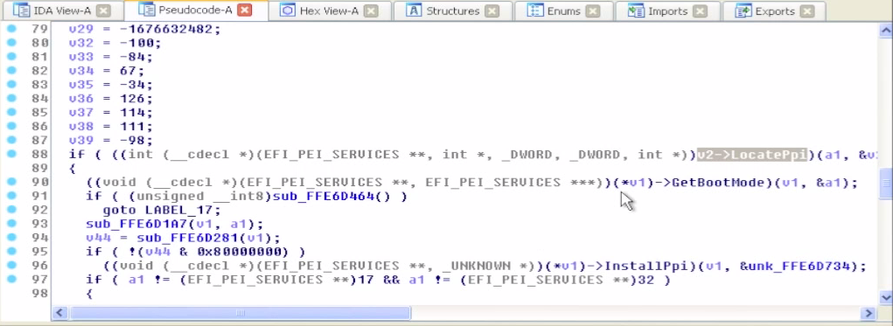
Recurse & define
Now we can scroll down and see that we were right in assuming this was an instance of a EFI_PEI_SERVICES
We see a call to LocatePpi(), and then GetBootMode(), followed by InstallPpi()
This series of EFI services “makes sense”

Slide 57
Recurse & define
We can look up the definitions for the new services LocatePpi(), GetBootMode()
Can we identify the GUID located in the EFI_PEI_PPI_DESCRIPTOR passed into InstallPpi?

Slide 58
Analyzing UEFI Files with IDA
So from here the strategy would be to use the same methodology to identify and “fill out” LocatePpi(), GetBootMode(), etc.
For you, cross-correlating where the PPIs are defined that you see getting called later will take a bit of grunt work (grepping for guids, finding their usage, etc)…
For us, it’s already scripted ;)

Slide 59
Further GUID-based analysis strategies
If you binary grep for a GUID (or search by GUID in UEFITool), you may find that it is specifically referenced/loaded by some other file.
Pick a GUID in the spec that you’re interested in. E.g. EFI_DHCP4_PROTOCOL_GUID
If you grep for it, you’ll find everywhere that particular protocol/PPI is used (to include installation, lookup, and things that have registered to be notified when it’s available)
Then you just have to sift through the results

Slide 60
TODO:
Add discussion of diffing things against EDK & against other known stuff
Here comes a new challenger!
http://joxeankoret.com/blog/2015/03/13/diaphora-a-program-diffing-plugin-for-ida-pro/

Slide 61
UEFI/Secure Boot Summary
Secure boot can help you protect your firmware
If your BIOS is UEFI but Secure Boot isn’t used, you can self-sign keys and turn it on
But if the SPI flash isn’t locked down, secure boot doesn’t provide any protection
And neither does System Management Mode, or signed firmware updates, or TPM Measured Boot…
UEFI does add complexity to locking down the SPI flash SPI Protected Range (PR) registers can be used to lock down the UEFI executable firmware
But the NVRAM variables must remain writeable

Slide 62
A Locked Down UEFI/BIOS Does the Following:
Has a properly-configured flash descriptor
Read-only, provides proper Flash Master permissions
Protects the UEFI executable code using the PR registers
Locks down the SPI flash configuration registers (FLOCKDN)
Uses BIOS_CNTL to protect the flash
Implements signed firmware updates
Implements Secure Boot
Ensures SMM_BWP is asserted so that the flash is writeable only when the processor is in SMM
Ensures SMRAM is locked down (D_LCK is set and SMRR are used)
Ensures SMI’s are enabled and cannot be suppressed
If possible uses Measured Boot and observes PCRs
Sounds simple enough…

Slide 63
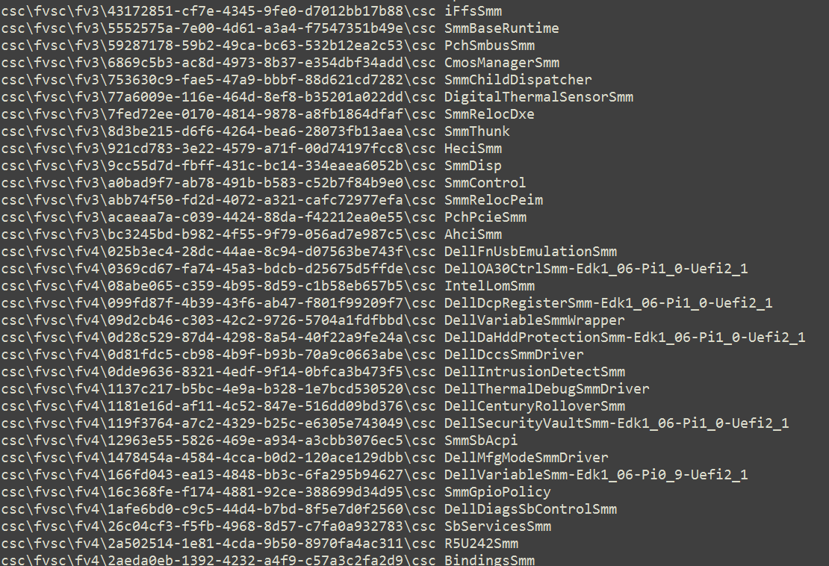
Oh but vendors also need to ensure that none of the code they implement in SMRAM is buggy
On the Dell Latitude E6430, ~144 out of 495 EFI modules appear to contribute code to SMM …

Slide 64
Backup
Used EFIPWN to backup because we don’t recommend its use as a primary tool anymore (but it is still used behind the scenes for Copernicus’ bios_diff.py)

Slide 65
EFIPWN
https://github.com/G33KatWork/EFIPWN

Slide 66
Setting up EFIPWN
This describes using a version of EFIPWN modified by Sam Cornwell who added some improvements:
EFIPWN requires the following:
Python (I use 2.7.x-something)
Mako: http://www.makotemplates.org/
ArgParse: https://pypi.python.org/pypi/argparse
Pylzma: http://www.joachim-bauch.de/projects/pylzma/
I have an easier time downloading the source and installing using “python setup.py install”
You will also need the ‘xz’ utility
Mac and Linux: you get it either automatically or by easy download
Windows: http://tukaani.org/xz/
The pre-built binaries work fine. I tested it by putting the bin_x86-x64 version into the local EFIPWN directory and it worked fine

Slide 67
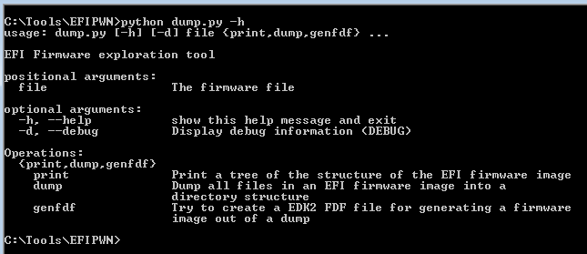
Testing EFIPWN Functionality
Once you have all the dependencies installed, typing the following ‘python dump.py –h’ should yield the above output
The arguments are a little confusing for EFIPWN, as a general rule they go like this:
Python dump.y <file> <print, dump> <output>
* The genfdf function does not work yet

Slide 68
EFIPWN ‘print’
Specify ‘print’ to gather information about the structure of the UEFI binary
Redirect this output to a text file
Before we decompose a UEFI binary, we’ll use the ‘print’ functionality to print a text file containing the UEFI firmware volume information and the PE files/modules contained therein

Slide 69
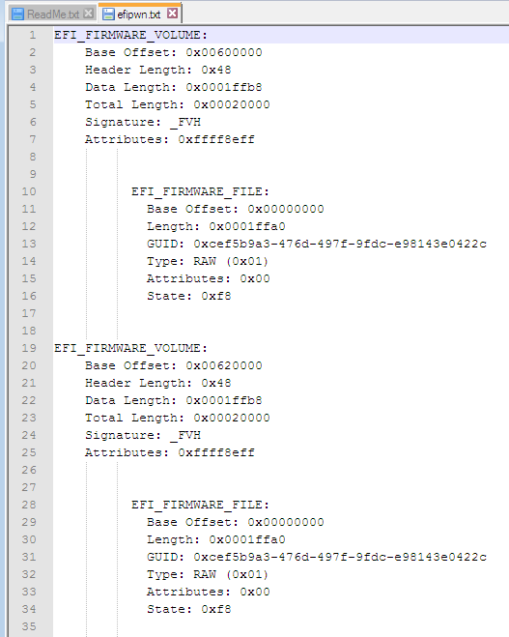
EFIPWN ‘print’: Firmware Volume
The base offset is the Flash Linear Address (FLA) in the file where the volume begins
This page shows one FV beginning at 60_0000h and another immediately following it at 62_0000h

Slide 70
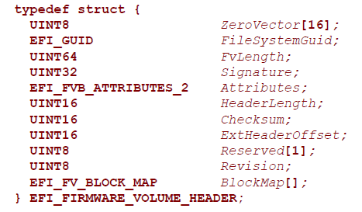
EFIPWN ‘print’: Firmware Volume
The Header length refers to the length in bytes of the FV header
The Data length refers to the length in bytes of the FV minus the header
The Total length refers to the total length of the FV including the header

Slide 71
EFIPWN ‘print’: Firmware Volume
The Signature of a firmware volume is {‘_’, ‘F’, ‘V’, ‘H’}
The signature field only applies to Firmware Volumes

Slide 72
EFIPWN ‘print’: Firmware Volume
The attributes field declares capabilities and power-on defaults for the firmware volume

Slide 73
EFIPWN ‘print’: Firmware Volume
// Attributes bit definitions
#define EFI_FVB2_READ_DISABLED_CAP 0x00000001
#define EFI_FVB2_READ_ENABLED_CAP 0x00000002
#define EFI_FVB2_READ_STATUS 0x00000004
#define EFI_FVB2_WRITE_DISABLED_CAP 0x00000008
#define EFI_FVB2_WRITE_ENABLED_CAP 0x00000010
#define EFI_FVB2_WRITE_STATUS 0x00000020
#define EFI_FVB2_LOCK_CAP 0x00000040
#define EFI_FVB2_LOCK_STATUS 0x00000080
#define EFI_FVB2_STICKY_WRITE 0x00000200
#define EFI_FVB2_MEMORY_MAPPED 0x00000400
#define EFI_FVB2_ERASE_POLARITY 0x00000800
#define EFI_FVB2_READ_LOCK_CAP 0x00001000
#define EFI_FVB2_READ_LOCK_STATUS 0x00002000
#define EFI_FVB2_WRITE_LOCK_CAP 0x00004000
#define EFI_FVB2_WRITE_LOCK_STATUS 0x00008000
#define EFI_FVB2_ALIGNMENT 0x001F0000
#define EFI_FVB2_WEAK_ALIGNMENT 0x80000000
#define EFI_FVB2_ALIGNMENT_1 0x00000000
#define EFI_FVB2_ALIGNMENT_2 0x00010000
#define EFI_FVB2_ALIGNMENT_4 0x00020000
#define EFI_FVB2_ALIGNMENT_8 0x00030000
#define EFI_FVB2_ALIGNMENT_16 0x00040000
#define EFI_FVB2_ALIGNMENT_32 0x00050000
#define EFI_FVB2_ALIGNMENT_64 0x00060000
#define EFI_FVB2_ALIGNMENT_128 0x00070000
#define EFI_FVB2_ALIGNMENT_256 0x00080000
#define EFI_FVB2_ALIGNMENT_512 0x00090000
#define EFI_FVB2_ALIGNMENT_1K 0x000A0000
#define EFI_FVB2_ALIGNMENT_2K 0x000B0000
#define EFI_FVB2_ALIGNMENT_4K 0x000C0000
#define EFI_FVB2_ALIGNMENT_8K 0x000D0000
#define EFI_FVB2_ALIGNMENT_16K 0x000E0000
#define EFI_FVB2_ALIGNMENT_32K 0x000F0000
#define EFI_FVB2_ALIGNMENT_64K 0x00100000
#define EFI_FVB2_ALIGNMENT_128K 0x00110000
#define EFI_FVB2_ALIGNMENT_256K 0x00120000
#define EFI_FVB2_ALIGNMENT_512K 0x00130000
#define EFI_FVB2_ALIGNMENT_1M 0x00140000
#define EFI_FVB2_ALIGNMENT_2M 0x00150000
#define EFI_FVB2_ALIGNMENT_4M 0x00160000
#define EFI_FVB2_ALIGNMENT_8M 0x00170000
#define EFI_FVB2_ALIGNMENT_16M 0x00180000
#define EFI_FVB2_ALIGNMENT_32M 0x00190000
#define EFI_FVB2_ALIGNMENT_64M 0x001A0000
#define EFI_FVB2_ALIGNMENT_128M 0x001B0000
#define EFI_FVB2_ALIGNMENT_256M 0x001C0000
#define EFI_FVB2_ALIGNMENT_512M 0x001D0000
#define EFI_FVB2_ALIGNMENT_1G 0x001E0000
#define EFI_FVB2_ALIGNMENT_2G 0x001F0000
Defined in Vol. 3 Shared Architectural Elements

Slide 74
EFIPWN ‘print’: Firmware Files
Firmware files are code and/or data stored within firmware volumes
Combined, Firmware Files are described/contained within a Firmware File System
Base offset refers to its relative location within the volume
Length refers to the length of the file
GUID is its ID

Slide 75
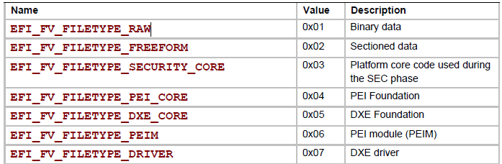
EFIPWN ‘print’: Firmware File
. . .
There are different enumerated types of Firmware Files
Defined in Vol3 Shared Architectural Elements Section 2.1.4.1

Slide 76
EFIPWN ‘print’: Firmware Files
Firmware Files have attributes like Firmware Volumes do (and are the same)
The State of the file is intended to preserve integrity

Slide 77
EFIPWN ‘print’: Firmware Files
Bits 6, 7 are reserved bits.
You can see that it includes the provision for marking files as deleted, which is kind of interesting. But unlike filesystem forensics, all these tools should basically show you all files, whether they’re deleted or not

