Slide 1
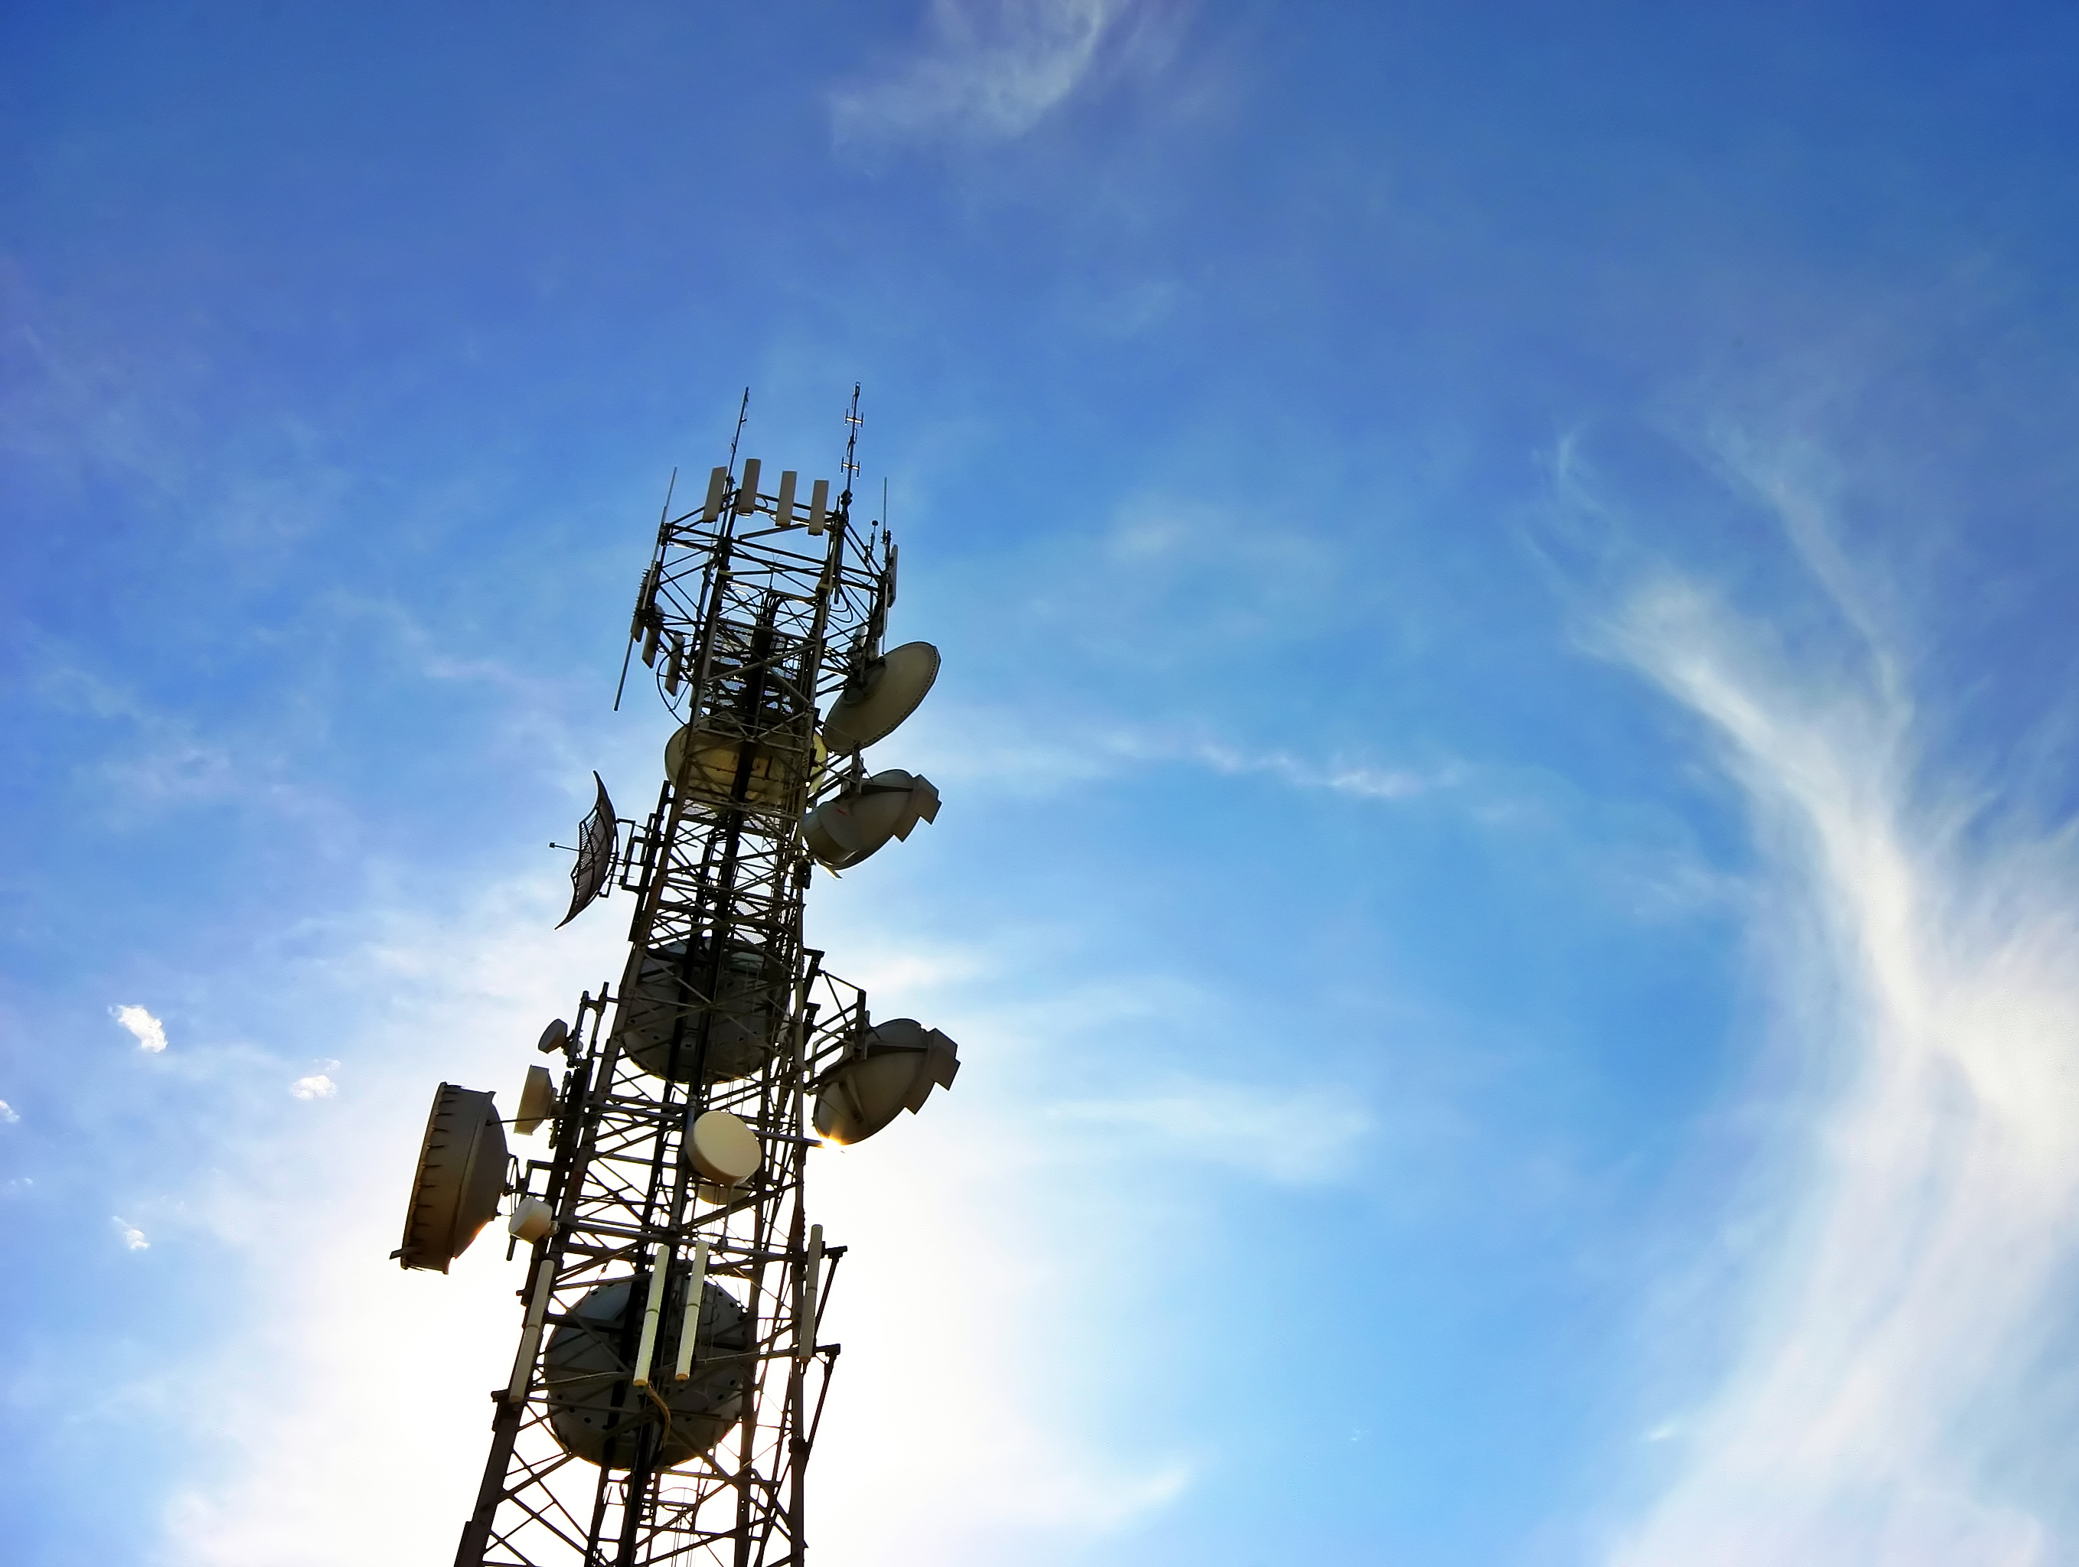
An Introduction
to Cellular Security
Joshua Franklin

Slide 2

License
Last Changed: 20140121
Intro
Creative Commons:
Attribution, Share-Alike
http://creativecommons.org/licenses/by-sa/3.0/

Slide 3
Introduction
Intro
Cellular networks are a dense subject
  This is not a deep dive
The standards are large, complicated documents
Involves physics, telecommunications, politics, geography, security...
We will discuss older cellular networks first and build upon this knowledge
The GSM, UMTS, and LTE standards are more or less backwards compatible
  Major consideration during standards development

Slide 4
Who Am I?
Intro
Joshua Franklin
I hold a Masters in Information Security and Assurance from George Mason
  Graduate work focused on mobile operating systems
I work in election and mobile security

Slide 5
Learning Objectives
Intro
Become familiar with the GSM, UMTS, and LTE family of cellular standards
Be introduced to spectrum allocation and antennas
Learn the security architecture of cellular networks
Be introduced to how cellular networks have been hacked in the past
We will deeply explore LTE security while only touching on GSM and UMTS. LTE is the new standard moving forward (a.k.a., the new hotness). Previous cellular standards are being phased out.

Slide 6
Excluded Topics
Intro
This class does not cover:
Wireless physics
Ancient wireless networks (AMPS, IMS, smoke signals )
Wired systems (PSTN/POTS/DSL)
Standards other GSM, UMTS, and LTE
  CDMA2000, EV-DO, WiMax
In-depth discussion of GPRS, EDGE, and HSPA variants
SMS and MMS (text messaging)
Mobile operating systems (iOS, Android, Windows Phone)
QoS , Mobility management, and VoLTE
Internetwork connections
Warning: This class is U.S.-centric but the standards are used worldwide. The network operators, frequencies, and implementations vary.

Slide 7
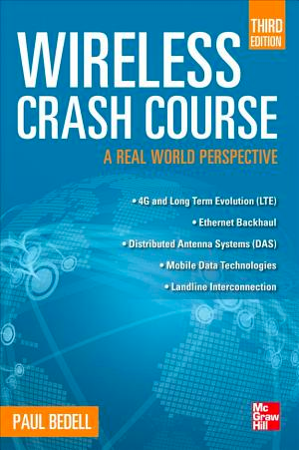
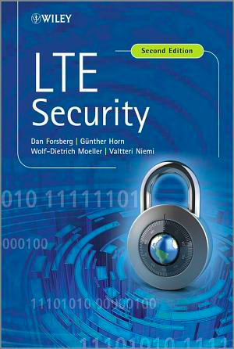
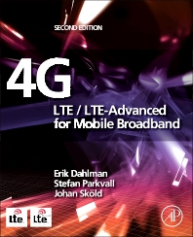
Books
Intro
Wireless Crash Course
3rd edition
LTE Security
2nd edition
LTE-Advanced for Mobile
Broadband - 2nd edition
Easy Mode
Intermediate
God Mode
Note: Many papers and presentations were also useful and are cited inline, but check the last slide for a complete listing.

Slide 8
Terminology
Intro
Cellular standards use jargon and abbreviations frequently
  LTE, EPS, BTS, K[ASME]
  Nested acronyms are common
  GERAN = GPRS Evolution Radio Access Network
  LTE is often referred to as Evolved Packet System (EPS) in technical situations
Learn to be comfortable with the jargon and acronyms
  There is an associated glossary and cheatsheet
  If something needs to be added or modified, please let me know
  Especially to improve the course and associated documentation

Slide 9
Prerequisites
Intro
Basic understanding of networks and network protocols
Familiar with core cryptographic concepts
Basic knowledge of information security
Basic understanding of physics
Have made a phone call
There are no labs in this class

Slide 10
Agenda
Intro
Wireless spectrum and cellular bands
Important cellular concepts
Overview of cellular standards
Discussion of the following for GSM, UMTS, and LTE:
  Network components
  Security architecture (hardware tokens, authentication, cryptography)
  Threats to these technologies
  Notable attacks
SIM Hacking
Baseband Hacking
Femtocells

Slide 11
What is LTE
Intro
LTE is Long Term Evolution
Fourth generation cellular technology standard from the 3rd Generation Partnership Project (3GPP)
Deployed worldwide and installations are increasing
All implementations must meet baseline requirements
  Increased Speed
  Multiple Antennas (i.e., MIMO)
  IP-based network (All circuits are gone/fried!)
  New air interface: OFDMA (Orthogonal Frequency-Division Multiple Access)
  Also includes duplexing, timing, carrier spacing, coding...
LTE is always evolving and 3GPP often drops new “releases”
  This class is modeled around LTE-Advanced, but we won’t dig deep enough to tell

Slide 12
Cellular Network Operators
Intro
Telecommunications company (telco)
  Purchases spectrum
  Builds out network (base stations and backhaul network)
  Verizon, AT&T, T-Mobile, Sprint
Mobile Virtual Network Operator (MVNO)
  Does not have to purchase spectrum
  Rents the towers but runs a distinct network
  Cricket, Ting, MetroPCS, ...

Slide 13
Radio Frequency Spectrum
Spectrum
Describes a range of frequencies of electromagnetic waves used for communication and other purposes
RF energy is alternating current that, when channeled into an antenna, generates a specific electromagnetic field.
This field is can be used for wireless communication
Cellular spectrum ranges from 300 MHz to 3 GHz

Slide 14
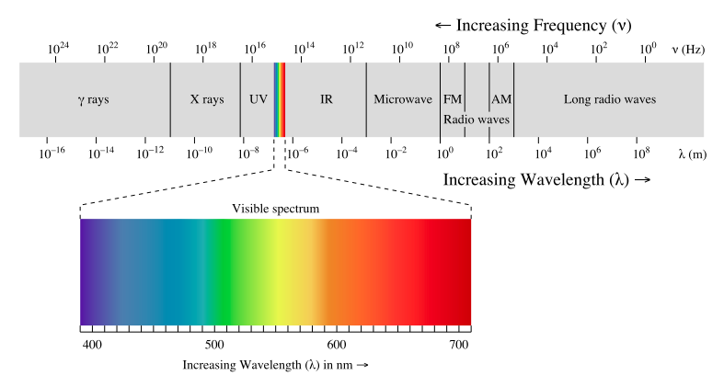
EM Spectrum
Spectrum
Thanks to Wikipedia
Notes:
Source: http://commons.wikimedia.org/wiki/File:EM_spectrum.svg
Bidell, p 49

Slide 15
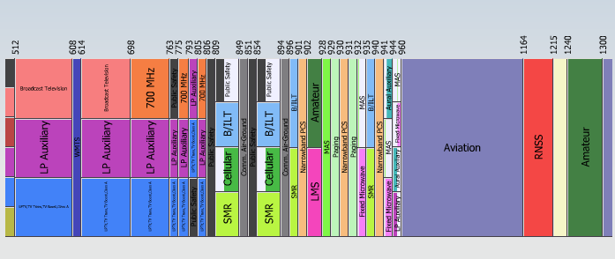
Wireless Spectrum
Spectrum
From an interactive map available via the FCC
Notes:
Source and interactive diagram available at http://reboot.fcc.gov/spectrumdashboard/searchSpectrum.seam

Slide 16
Popular Cellular Bands
Spectrum
700 Mhz Band (Blocks A - E)
  Considered uniquely useful to cellular activities
  Verizon, US Cellular, AT&T and others own various portions
  Will be used for 4G
  Includes reserved spectrum for public safety
850 MHz
  Great for cellular service
  Easily bounces off objects
1900 MHz band (PCS)
2100 MHZ (Blocks A - F)
  Mostly T-Mobile, but includes Cricket and MetroPCS
This information changes periodically as spectrum is purchased & released
Notes:
Penetrates walls

Slide 17
Chipset
Spectrum
In the past, phones have typically been tied to a single carrier
A phone’s hardware is tied to a carrier based on many things (like the IMEI), but the major ones are the cellular standard and frequencies the carrier uses
Phones are manufactured to work on specific radio frequencies
  Specific chips needed for a given frequency range, thus chipset
Nowadays, phones concurrently operate on many frequencies (and therefore networks)
  Modern multi-band chips allow a single device to operate on multiple frequency ranges

Slide 18
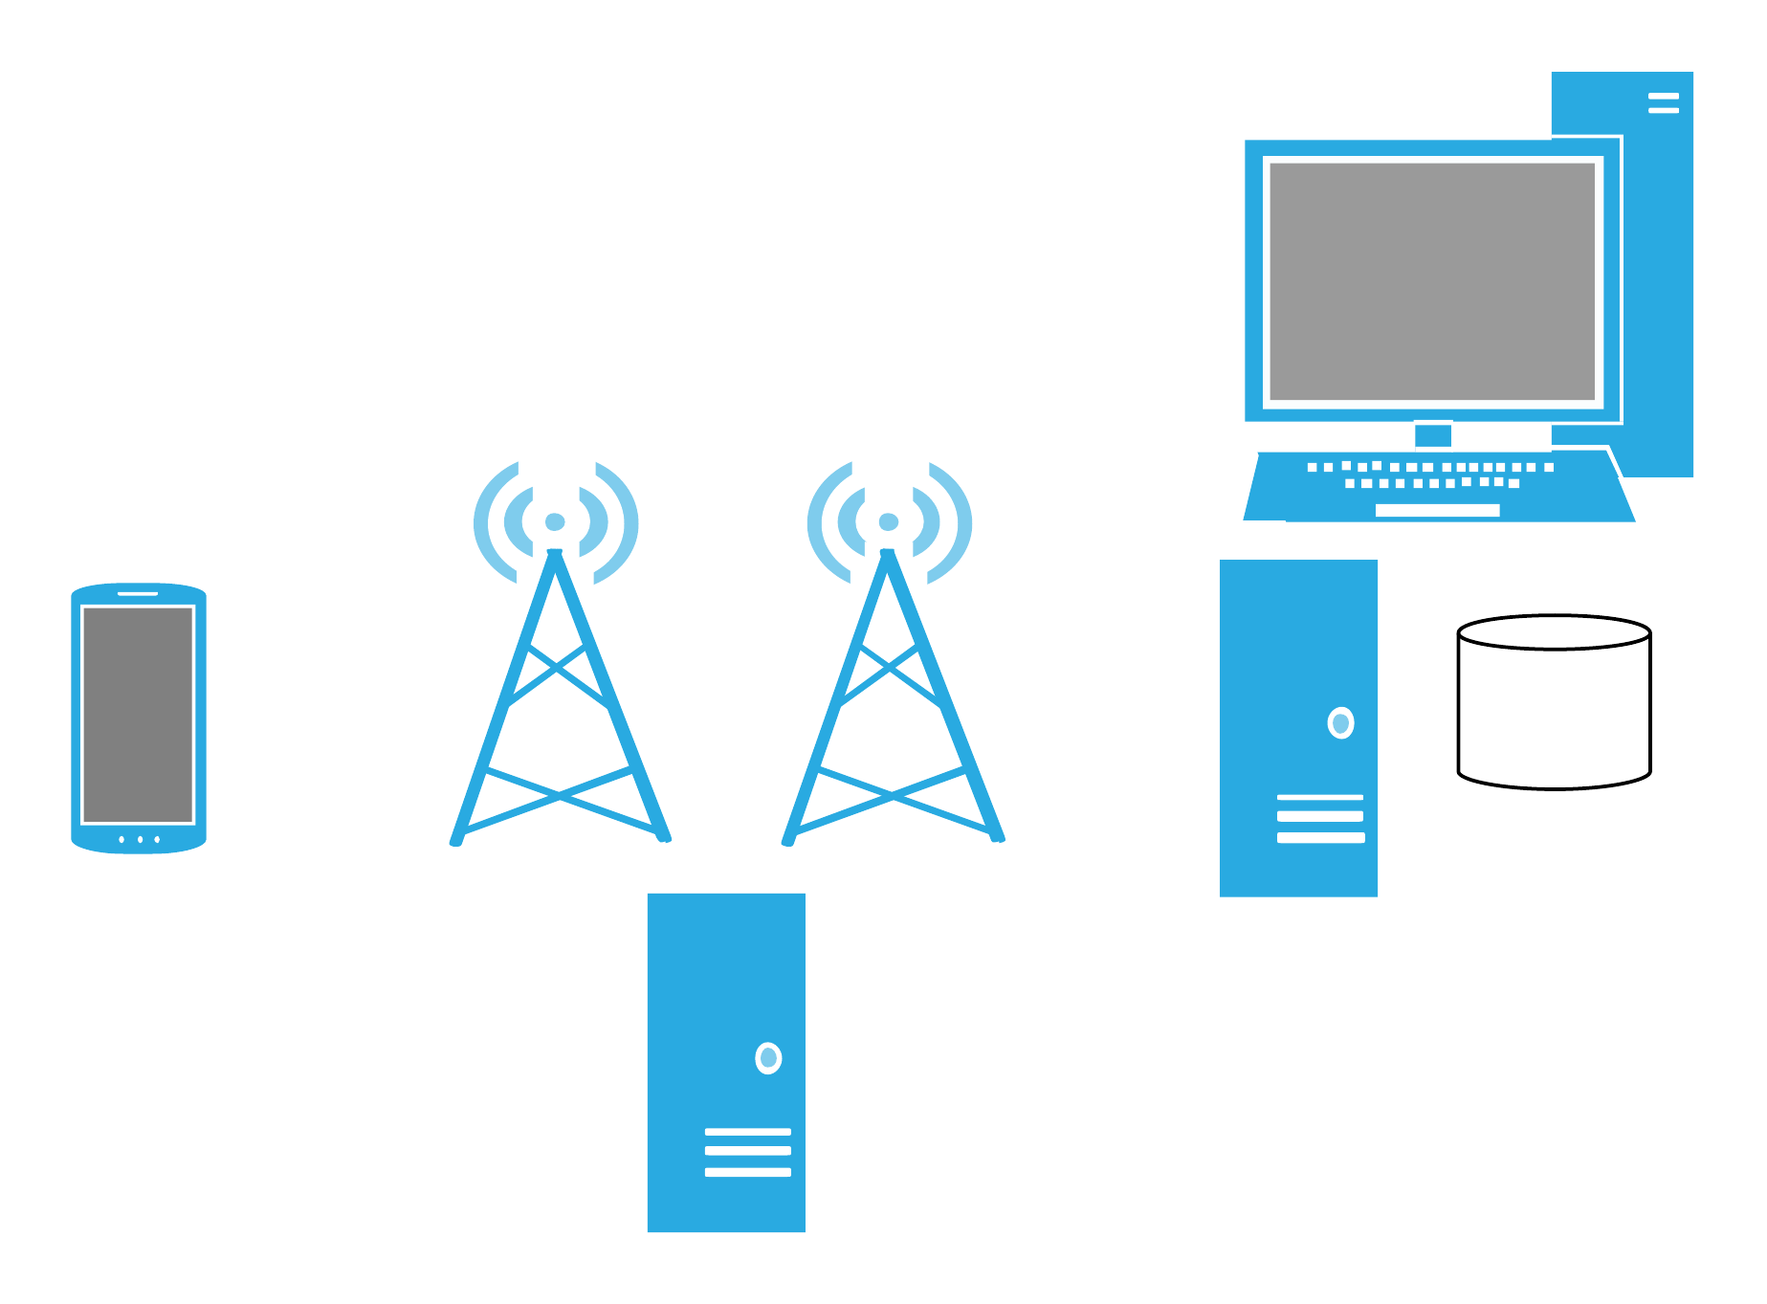
Channel Allocation
Spectrum
Typically there is a downlink channel and an uplink channel
These channels needs to be spaced in frequency sufficiently far so that they do not interfere with each other
Uplink
Downlink

Slide 19
Antenna
Spectrum
There are 2 main types of antennas, each with unique properties
Omnidirectional
  Emits energy in a spherical radius
Directional
  Emits energy in the shape of the antenna and in the direction and angle at which it is pointed

Slide 20
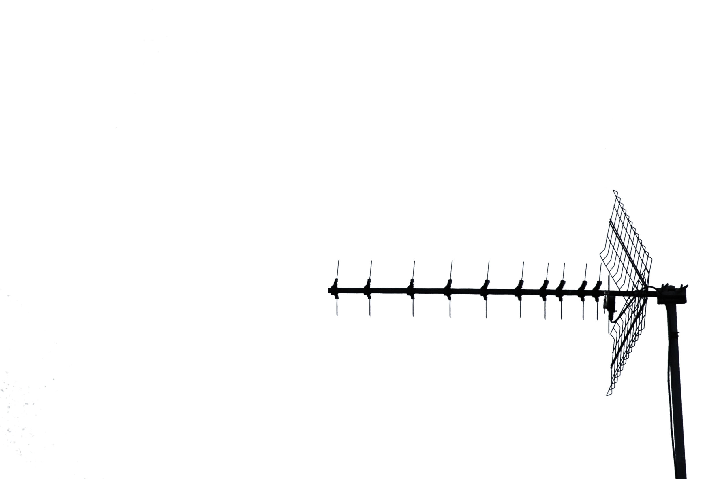
Directional Antenna
Spectrum
Designed to radiate in a specific direction
  The radiation is focused (see below)
There are “panel” direction antennas on the front cover of this presentation

Slide 21
Omnidirectional Antenna
Spectrum
Designed to radiate in across a specific plane
  The radiation spreads outward from a center point
  A donut is a reasonable visual

Slide 22
Device Antenna
Spectrum
There are multiple antenna in your mobile device - although some are shared
Designed to transmit and receive at various frequencies
  Cellular (300 MHz - 3 GHz)
  WiFi (Primarily 2.4 GHz, 5 GHz) [there are other odd frequencies specified]
  Bluetooth (2400–2480 MHz)
  NFC (13.56 MHz)

Slide 23
Multiple Antennas
Spectrum
LTE has a feature called Multiple-Input Multiple-Output (MIMO)
Multiple antennas are on the mobile device and are used simultaneously to transmit and receive
  Can significantly increase throughput
Multiple types
  Spatial diversity
  Spatial multiplexing
Further divided:
  SISO - Single in, single out
  SIMO - Single in, multiple out
  MISO - Multiple in, single out
  MIMO - Multiple in, multiple out

Slide 24
Important Concepts

Slide 25
Big Picture
Concepts
Mobile devices (1) connect to a base station (2) which connects to a backhaul network (3), which connects to the internet (4).
1
2
3
4

Slide 26
Network Components
Concepts
The network between mobile devices and base stations is the Radio Access Network (RAN)
  This name slightly changes with new standards
Base stations are permanent cellular sites housing antennas
Base stations and the backhaul network are run by telco, but there are interconnections and shared sites
  AT&T customers need to be able to contact Verizon (vice versa)
Base stations often connect to backhaul via wired technologies (i.e., fiber)
  Base stations often communicate with each other via wireless

Slide 27
Mobile Devices
Concepts
These are the devices with wireless radios that connect to cell towers
  Radios are inside phones, tablets, laptops, etc. . .
LTE uses the term User Equipment (UE), previously ~ Mobile Station (MS)
The parts of the UE we are concerned with:
  The handset, aka the ME (Mobile Equipment)
  USIM (Universal SIM)
  Baseband processor

Slide 28
Baseband
Concepts
Typically a separate processor on the phone
  From companies like Qualcom, Infineon, etc.
Handles all of the telecommunications-related functions
  Sends, receives, processes signals
  Base station and backhaul network communication
  Has direct access to microphone, speakers…
Runs a real time operating system (RTOS)
  Performance matters!
  OSs include ThreadX, Qualcomm’s AMSS w/ REX kernel, OKL4
Sometimes shares RAM with application processor (baseband as a modem), sometimes each processor has distinct RAM(shared architecture)
  In a shared configuration the baseband is often the master
May be virtualized

Slide 29
Planes of Communication
Concepts
Many control systems divide communication into two planes - one for processing information from users and another for how to setup/breakdown the channel and other important functions
Think of this similar to how FTP uses two ports
  TCP port 20 - data
  TCP port 21 - control
Control Plane (CP)
  A private communication channel that is distinct from data the UE operator can influence
  Used to send control messages to components
  Mobile users should not be able to influence this in any way
User Plane (UP) signaling
  Voice and data information
Cellular networks use this design extensively
User Plane
Control Plane

Slide 30
Packets and Circuits
Concepts
Pre-LTE, cellular networks used circuit switching technology for voice
  LTE uses VoLTE which is VoIP over LTE
  Not implemented currently, calls fall back to previous networks
Data traffic is sent over nearly distinct interconnected packet switching networks
  GSM first used GPRS, then moved to EDGE
  UMTS used HSPA technologies including HSPA+
Since LTE is completely IP based, it does not use circuits
We’re not there yet, but soon.

Slide 31
Network Interconnection
Concepts
Circuit switched networks need to be able to connect with packet switched networks and other distinct cellular networks
  The internet is a good example
  This is a complex process
GPRS (General packet radio service)
  2.5G packet switched technology
EDGE (Enhanced Data Rates for GSM Evolution)
  2.75G packet switched technology
HSPA (High Speed Packet Access)
  3.5/3.75 packet switched data technology
  There were a few quick iterations on this technology, thus “variants”

Slide 32
Attachment, Handoff, & Paging
Concepts
The first step in a mobile device connecting to a network is referred to as network attachment
  Mobile devices request network access to a base station, which passes this request onto the backhaul network
  Authentication of the mobile device is then performed
If a mobile device is moving (such as on a freeway) a call will need to be transferred from one base station to another
  This is called handoff
  This is a very common, yet is complex, process
Paging is the process of how a backhaul network locates and directs calls a mobile device
  Base stations provide a list of active devices to the backhaul

Slide 33
Connection Management
Concepts
EPS Connection Management (ECM)
UE related information is released after a certain period of time without use or connection
ECM-states
  ECM-CONNECTED
  ECM-IDLE
TS 23.401for more information

Slide 34
Subscriber Identity
IMSI
GSM, UMTS, and LTE all contain a unique ID for a cellular subscriber
  International Mobile Subscriber Identity (IMSI)
  15 digit number stored on the SIM
Consists of 3 values: MCC, MNC, and MSIN
  Possibly a software version (SV) appended (IMSI-SV)
Mobile Country Code (MCC) - Identifies the country
Mobile Network Code (MNC) - Identifies the network
Mobile Subscriber ID number (MSIN) - Identifies a user
Temporary identities also exist
  Temporary Mobile Subscriber Identity (TMSI)
  Globally Unique UE Identity (GUTI)
This information is stored on the SIM/USIM
Mobile Subscriber ISDN Number (MSISDN) – The phone number, which is distinct from the MSIN

Slide 35
IMSI Example
IMSI
Mobile
Network
Code
310150123456789
Mobile
Country
Code
Subscriber ID
The MNC may be 2 or 3 digits, depending on region. 3 is common in the USA while 2 is common in Europe.
Thanks to Wikipedia for the sample IMSI

Slide 36
Terminal Identity
IMSI
GSM, UMTS, and LTE all contain a unique ID for a terminal ME/UE
  International Mobile Equipment Identity (IMEI)
It is16 digits with the first 14 indicating equipment identity
  The last 2 indicates software version (SV)
  Referred to as IMEISV
Dial *#06# to display your IMEI
Illegal in some countries to change a phone’s IMEI

Slide 37
SIM Cards
SIM
A removable hardware token used for GSM, UMTS, and LTE
  Verizon is changing to LTE and is also using the hardware token
Over 7 billion SIMs in circulation
Houses a processor and runs an OS
Java Card runs atop the OS, which is a type of Java Virtual Machine (JVM) for applications
Stores cryptographic keys and sometimes SMSs and contacts
SIM application toolkit (STK) is used to create mobile applications
SIMs are deprecated – the modern term is USIM
  The USIM runs atop the UICC which is the physical card

Slide 38
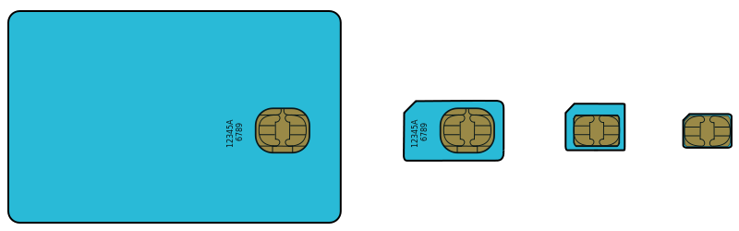
SIM Card
SIM
Full-size SIM
Micro-SIM
Mini-SIM
Nano-SIM
From left to right, we are only removing plastic. The integrated circuit remains static.
Thanks to Wikipedia

Slide 39
Threats to Cellular Networks
Concepts
The communication medium is open and accessible by all – Jamming and femtocells
SIM Cloning
  Copying a phone’s unique information to steal another customer’s service
  Cloning is not as common today
Threats to Privacy
  Cellular networks need, or be able to quickly locate, where the a mobile device is at all times
Battery life
  Pay phones don’t need to be charged once a day
Mobile network operators have a large and complex network to defend

Slide 40
Jamming
Concepts
Cellular devices send information via radio transmissions
  Interrupting these transmissions is called jamming
It is possible to jam a large frequency range, such as all GSM traffic in an area, or only specific frequencies, like those used for control signals
3GPP standards state that jamming attacks are outside of their threat model
You can buy jammers online, and depending on the range and power requirements, they can be quite cheap
  Beware the wrath of the FCC, other three letter agencies, and your local law enforcement

Slide 41
Femtocells
Concepts
Femtocells are small extensions of the cellular network - often for personal or business use
  Technically the standard refers to them as Home Node B (HeNB)
  Limited range and relatively affordable
They may be provided by telcos if requested and of course you pay for this convenience
  The purchaser (often the user) does not have full administrative control of the device, similar to set-top boxes
  The purchaser has complete physical access
These devices introduce many new threats
  Customers retain physical control and can perform offline attacks
  Attacks on the core network through the femtocell
  Jamming requires less power because an attacker can be closer
  Attackers can quickly set one up in new location to attract UEs

Slide 42
Cellular Standards

Slide 43
3GPP
Standards
An international standards body
Evolves and/or standardizes GSM, UMTS, LTE among others
From their page:
The 3rd Generation Partnership Project (3GPP) unites [Six] telecommunications standard development organizations (ARIB, ATIS, CCSA, ETSI, TTA, TTC), known as “Organizational Partners” and provides their members with a stable environment to produce the highly successful Reports and Specifications that define 3GPP technologies
We will primarily discuss 3GPP standards
Other standards exist from a distinct standards body known as 3GPP2
  CMDA2000 and the now deprecated UMB

Slide 44
Major Standards
Standards
Multiple standards bodies involved
Standards grow and evolve from one another
GSM
CDMA
UMTS
EV-DO
WiMAX
LTE

Slide 45
Cellular Standards
Standards
3GPP
Circuit Switched
3GPP
Packet Switched
3GPP2
Wimax
Forum
Generation
2G
GSM
cdma
One
GPRS
2.5G
2.75G
EDGE
3G
CDMA
2000
UMTS
3.5G
HSPA/+
CDMA
EV-DO
4G
LTE
UMB
WiMAX

Slide 46
A Note on 3GPP
Standards
LTE is a 3GPP specification
  Therefore we will be discussing 3GPP specifications in depth
We will introduce GSM and associated security issues
We will then build on these concepts from GSM to UMTS to LTE
Packet switched technologies will be discussed as well
3GPP2 and WiMax Forum standards are not included

Slide 47
LTE Security Architecture
Standards
The primary 3GPP standard governing LTE is TS 33.401
  Get to know it
  Other standards exist and are referenced
I link to the overarching page for the standard so the most recent version of the standard is attainable
  Download and extract the zip for the word document

Slide 48
GSM

Slide 49
GSM
GSM
Global System for Mobile Communications
2G digital voice
Air interface: TDMA
  Multiple users on the same channel
Operates at various spectrums worldwide
There are 4 separate systems:
  Base station subsystem (BSS)
  Network subsystem (NSS)
  Operations and support subsystem (OSS)
  Mobile station subsystem (MSS)
Each subsystem has a distinct purpose

Slide 50
GSM Component Description
GSM
Mobile station subsystem (MSS)
  Mobile handset and SIM
The base station subsystem BSS consists of a controller and transceiver
  Base station transceiver (BTS) is the cell tower
  Base station controller (BSC) controls 1 or more BTSs
  Housed at the Mobile Telephone Switching Office (MTSO)
Network subsystem (NSS):
  MSC (Mobile Switching Center) and MTSO
  MTSO-switch connects cell network to PSTN
  MTSO houses the HLR, which supports the AuC
Operations and Support (OSS)
  Manages the network as a whole

Slide 51
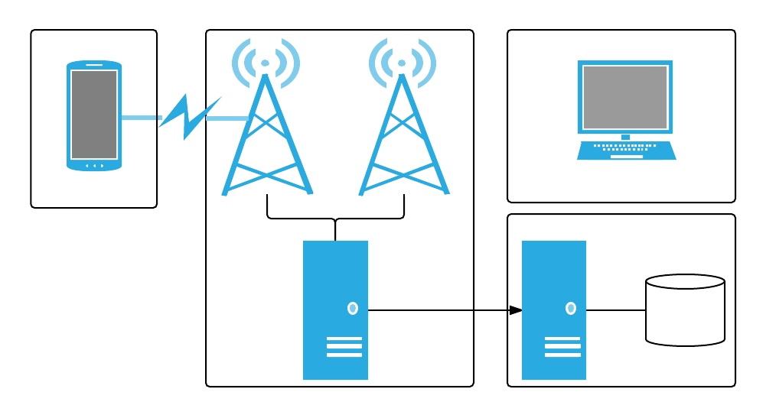
GSM Architecture Diagram
GSM
BTS
Operations and Support
Subsystem
MS
Mobile Station
Subsystem
MSC
HLR/AuC
BSC
Base Station
Subsystem
Network
Subsystem

Slide 52
GSM Security Design
GSM
Meant to achieve equivalent or greater security than wired systems of that time
Security mechanisms should not have a negative impact on the system
Primary security mechanisms:
  Subscriber authentication
  Privacy achieved via temporary identities
  Encryption of the Radio Area Network and backhaul
  ME to BTS and BTS to MMC - using a key known as Kc

Slide 53
GSM SIM
GSM
Tamper resistant hardware token
Stores 128-bit key, called Ki, which is used to derive Kc
  Ki never leaves the card
  Also stored in AuC
Contains key generation software
Subscribers are authenticated to the network by proving knowledge of Ki
  How? The Authentication and Key Agreement (AKA)

Slide 54
GSM AKA
GSM
AKA is a challenge and response authentication protocol
  Authentication is not mutual
A devices IMSI is sent to the BTS, which is passed to the HLR/AuC
The HLR/Auc sends the Kc, 128-bit random number, and an Expected Response (XRES) to the BTS
  Kc is a session encryption key
The BTS passes the random number to the ME
The ME uses the Ki and the random number to arrive at Kc and provides the BTS with an SRES
The BTS checks if SRES is equal to XRES
  If so they subscriber is authenticated
The BTS provides the ME with an encrypted Temporary Mobile Subscriber Identity (TMSI)
  Not always encrypted

Slide 55
GSM AKA Ladder Diagram
GSM
ME (with IMSI)
SIM (with Ki)
Backhaul
AuC (with IMSI, Ki)
BTS
IMSI
IMSI
Random
Random, XRES, Kc
A3(Random, Ki) = SRES
A8(Random, Ki) = Kc
SRES
SRES = XRES?

Slide 56
GSM Cryptographic Algorithms
GSM
Families of algorithms: A3, A5, and A8
A3 is used for subscriber authentication to derive XRES
A5 is used to encrypt data in motion such as radio encryption
  ME to BTS
  A5/0 – no encryption
  A5/1, A5/2, and A5/3 are 64-bit stream ciphers
  A5/4 is a 128-bit stream cipher
  An efficient attack exists against A5/2 and it is deprecated
A8 is used to derive the 64-bit symmetric key, Kc
  The final 10 bits are zeroes
The A3 and A5 families are non-standardized
  They only need to be on devices and equipment owned by the carrier (USIM, BTS, backhaul)
  MILENAGE is provided if needed
Note: GPRS and EDGE use different algorithms

Slide 57
MILENAGE
GSM
Set of five cryptographic one-way functions specified by 3GPP
  Usage is optional as telcos can specify their own
  Block ciphers with 128-bit key
  GSM, UMTS, and LTE
Used during AKA for key and parameter generation
  We will explore this further during the LTE segment
These are the ‘f boxes’ (f1, f2, f3, f4, f5)[Nyberg04]

Slide 58
Threats to GSM
GSM
Cryptography-based
  Short 64-bit keys
  A5/2 efficient attack
  A5/1 attack with large amounts of plaintext
    Implementation flaw exists [Hulton08]
Weak cipher renegotiation and null cipher attacks possible
SIM cloning
Man-in-the-Middle (MitM) attack via rogue base station (femtocell)
  During AKA, the handset cannot authenticate the network
Only radio traffic is encrypted - once information is in the backhaul it is cleartext [Hulton08]
IMSI sometimes sent in the clear [Hulton08]
Some control signaling may be unprotected

Slide 59
Notable Attacks
GSM
Hulton et al, Blackhat 2008
  Showed how to intercept GSM signals with software defined radio
  Showed a practical method to crack A5/1 (as did Karsten Nohl)
Paget, Defcon 2010
  Demonstrated a homegrown GSM BTS
  Intercepted calls

Slide 60
UMTS

Slide 61
UMTS
UMTS
Universal Mobile Telecommunications System
3G digital voice
Air interface: W-CDMA
Operates at various spectrums worldwide

Slide 62
UMTS Components
UMTS
Consists of the core network (CN), Universal Terrestrial Radio Access Network (UTRAN), and UE
Runs 2G packet switched and 3G circuit switched components concurrently - it looks confusing at first
The UTRAN contains:
  Node B (think of the phone as Node A)
  Radio Network Controller (RNC)
The CN contains:
  Serving Mobile Switching Center (GMSC)
  Gateway Mobile Switching Center (GMSC)
  Serving GPRS support node (SGSN)
  Gateway GPRS support node (GGSN)
  Home Location Register/Authentication Center (HLR/AuC)
We are not discussing GPRS-related nodes

Slide 63
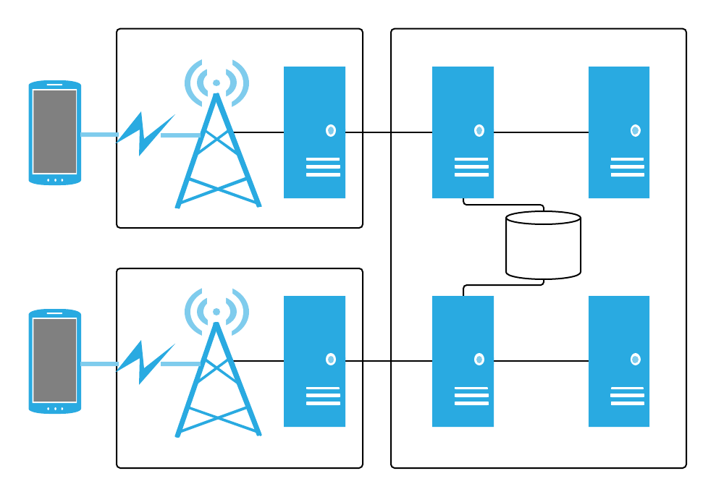
UMTS Architecture Diagram
UMTS
BTS
BSC
SMSC
GMSC
Packet Switched
UE
GERAN
HLR/AuC
Circuit Switched
UE
Node B
RNC
SGSN
GGSN
UTRAN
Core Network

Slide 64
UMTS & GSM Compatibility
UMTS
UMTS was designed to work concurrently with GSM
2G SIMs were included
Much of the terminology is slightly modified
  BTS -> Node B

Slide 65
UMTS Security Design
UMTS
Iterative enhancement on GSM security
Enhanced AKA
New confidentiality and integrity cryptographic algorithms
Introduction of Network Domain Security for IP-based protocols (NDS/IP)
  IPSec

Slide 66
UMTS Hardware Token
UMTS
The GSM SIM now labeled the USIM
  USIM application runs atop the UICC
Contains a new hardware protected 128-bit key: K
  As in GSM, never moves from UICC and HLR/AuC
  Keys are derived from K as needed
  HLR/AuC stores an IMSI and K per subscriber

Slide 67
UMTS AKA
UMTS
Similar to GSM - challenge & response protocol
  UE proves knowledge of a key
  UE somewhat authenticates the home network
  Femtocells can still create a fake connection
  New algorithms (f1 through f5 and f1* through f5*)
  AKA algorithms are network specific and don’t need to be standardized
UE gains assurance that confidentiality key (CK) and integrity key (IK) were generated by the serving network
  True serving network authentication is not achieved
  Man in the middle still possible

Slide 68
UMTS Cryptography
UMTS
Completely public algorithms
Increased key-length to 128-bits
  Yay!
Two new families of algorithms
  UMTS Encryption Algorithm 1 and 2 (UEA1, UEA2)
  UMTS Integrity Algorithm 1 and 2 (UIA1, UIA2)
UEA1 and UIA1 are based on KASUMI
  Block-cipher related to AES
UEA2 and U1A2 are based on SNOW 3G
  Stream cipher

Slide 69
UMTS NDS/IP
UMTS
Provides protection for control-plane traffic, including authentication and anti-replay
  Enter NDS/IP
  Typically does not apply to user plane traffic
A security domain under control of mobile network operator
Certain connections between components may not be protected due to optional requirements in 3GPP standards
Can internetwork with external NDS domains

Slide 70
Threats to UMTS
UMTS
Cryptography-based
  There are many attacks against KASUMI [Kühn 2001, Dunkelmann and Keller 2008, Jia et al. 2011, Dunkelmann et al. 2010]
  Attacks against Snow 3G [Brumley et al. 2010, Debraize and Corbella 2009]
Backward compatibility
  When a GSM SIM is used in UMTS only 64-bit keys are used
IMSI catchers during AKA process
U. Meyer and S. Wetzel, “A man-in-the-middle attack on UMTS,” in ACM WiSec, 2004, pp. 90–97

Slide 71
LTE

Slide 72
LTE
LTE
Long Term Evolution
  Also known as the Evolved Packet System (EPS)
4G data and voice technology
Air interface: OFDMA
3 main components:
  Evolved U-TRAN (E-UTRAN) - Radio Network
  Evolved Packet Core (EPC) - Backhaul
  IP Multimedia Subsystem (IMS) - Extended backhaul functionality
Remember: LTE is a completely packet-switched technology for both data and voice
  LTE currently falls back to older networks for voice (Circuit-switched fallback)
VoLTE (voice over LTE) is in the works
  I’ll likely need to update this bullet in a year

Slide 73
LTE Security Requirements 1
LTE
EPS shall provide a high level of security
Any security lapse in one access technology must not compromise other accesses
EPS should provide protection against threats and attacks
Appropriate traffic protection measures should be provided
EPS shall ensure that unauthorized users cannot establish communications through the system
EPS shall allow a network to hide its internal structure from the terminal
Security policies shall be under home operator control
Security solutions should not interfere with service delivery or handovers in a way noticeable by end users
EPS shall provide support lawful interception

Slide 74
LTE Security Requirements 2
LTE
Rel-99 (or newer) USIM is required for authentication of the user towards EPS
USIN shall not be required for re-authentication in handovers (or other changes) between EPS and other 3GPP systems, unless requested by the operator
EPS shall support IMS emergency calls
EPS shall provide several appropriate levels of user privacy for communication, location and identity
Communication contents, origin and destination shall be protected against disclosure to unauthorized parties
EPS shall be able to hide user identities from unauthorized parties
EPS shall be able to hide user location from unauthorized parties, including another party with which the user is communicating

Slide 75
High-Level Threats to LTE
LTE
Tracking identity, privacy or devices
Jamming handsets or network equipment or other attacks on availability
Physical attacks on base stations or network equipment
Manipulating control plane or user plane data
Threats related to interaction between base stations, or dropping to older standards or other networks
Jamming attacks are not within the threat model of LTE

Slide 76
LTE Components
LTE
User equipment (UE)
Evolved Node B (eNodeB)
Mobility Management Entity (MME)
Serving Gateway (S-GW)
Packet Data Network Gateway (P-GW)
Home Subscriber Server (HSS)

Slide 77
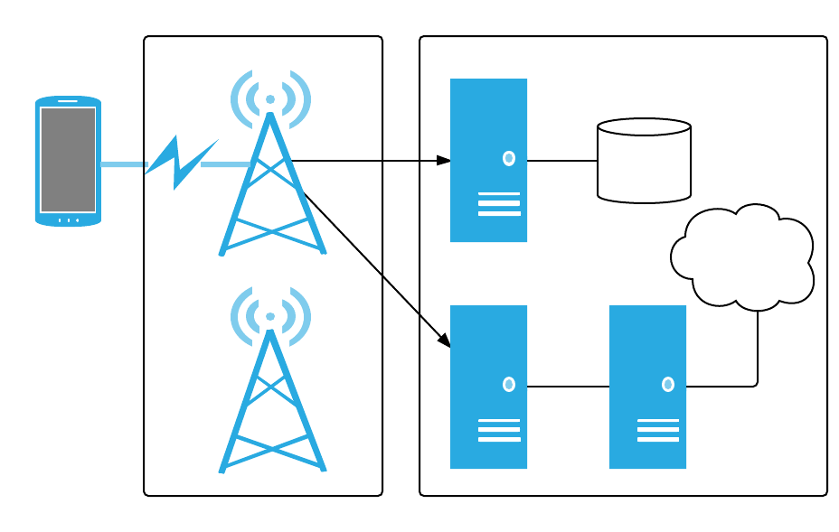
LTE/EPS Architecture Diagram
LTE
eNB
MME
EPC
HSS/AuC
UE
IMS
S-GW
P-GW
E-UTRAN

Slide 78
Component Descriptions
LTE
User equipment (UE) – The LTE device
Evolved Node B (eNodeB or eNB) – An evolved Node B (BTS)
E-UTRAN - The radio network that exists between UEs and eNBs
Mobility Management Entity (MME) – Primary signaling node (no user traffic). Large variation in functionality including managing/storing UE contexts, creating temporary IDs, sending pages, controlling authentication functions, and selecting the S-GW and P-GWs
Serving Gateway (S-GW)- Carries user plane data, anchors UEs for intra-eNB handoffs, and routes information between the P-GW and the E-UTRAN
Packet Data Network Gateway (P-GW) – Allocates IP addresses, routes packets, and interconnects with non 3GPP networks
Home Subscriber Server (HSS) - This is the master database with the subscriber data
Authentication Center (AuC) - Resides within the HSS, maps an IMSI to K, performs cryptographic calculations during AKA
IP Multimedia Subsystem (IMS) – Paging, connections to the PSTN, and

Slide 79
E-UTRAN & EPC Protocols
LTE
eNB
MME
Green boxes depict the radio protocol layers. White boxes depict the functional entities of the control plane
Intercell RRM
NAS Security
RB Control
Idle State Mgmt
…
EPS Bearer Control
RRC
PDCP
S-GW
P-GW
RLC
IP Allocation
Mobility Anchor
MAC
Packet Filtering
PHY
E-UTRAN
EPC
Adapted from 3GPP TS 36.300

Slide 80
Protocol Discussion
LTE
There are a number of additional capabilities provided by the enB
  IP header compression of user data stream
  Selection of an MME at UE attachment when no routing to an MME can be determined from the information provided by the UE
  Routing of User Plane data towards Serving Gateway
Radio Resource Control (RRC) – Transfers NAS messages, AS information may be included, signaling, and ECM
Packet Data Convergence Protocol (PDCP) – header compression, radio encryption
Radio Link Control (RLC) – Readies packets to be transferred over the air interface
Medium Access Control (MAC) – Multiplexing, QoS

Slide 81
CP Protocols
LTE
UE
eNB
MME
NAS Security
NAS Security
RRC
RRC
PDCP
PDCP
RLC
RLC
MAC
MAC
PHY
PHY
Adapted from 3GPP TS 36.300

Slide 82
UP Protocols
LTE
UE
eNB
PDCP
PDCP
RLC
RLC
MAC
MAC
PHY
PHY
Adapted from 3GPP TS 36.300

Slide 83
Interfaces
LTE
Interfaces are the communications paths LTE components use to communicate
Each one is provided with its own label
  There may be unique protocols between various interfaces
There are many interfaces - we are discussing a subset
  X2 - eNB to eNB
  S1-U - eNB to S-GW
  S1-MME (sometimes S1-C) - eNB to MME
  S5/S8 - S-GW to P-GW

Slide 84
LTE/EPS Interface Diagram
LTE
eNB
MME
EPC
S1-MME
HSS/AuC
UE
IMS
X2
S-GW
P-GW
S1-U
S5/S8
E-UTRAN

Slide 85
LTE Security Mechanisms
LTE
Continue to use the USIM hardware module
Subscriber and network authentication via AKA
Cryptography
  Algorithms
  Key hierarchy
  Protected Interfaces
  Protected Planes
Independent Domains
  Access Stratum (AS)
  Non-access Stratum (NAS)

Slide 86
LTE Hardware Token
UMTS
The LTE USIM/UICC is identical to UMTS
Contains a new hardware protected 128-bit key: K
  As in GSM, never moves from UICC and HLR/AuC
  Keys are derived from K as needed
  AuC stores an IMSI and K

Slide 87
LTE AKA
LTE
Very similar to GSM and UMTS AKA
  Anchored in hardware token (UICC/USIM)
2G SIMs are deprecated
  They are unable to authenticate to LTE
  UEs may drop down to UMTS or GSM
We will discuss LTE AKA in detail
  Overall ladder diagram
  Generation of AKA security parameters
  Verification within the USIM

Slide 88
LTE AKA Discussion
LTE
UMTS and LTE AKA are extremely similar
  Originally specified in TS 33.102
  So much so, the LTE standard doesn’t even fully describe it (See TS 33.401)
Largest update to AKA: network separation
  Prevents a breach on one telco’s network to spill into another’s
  Network identity is bound to certain keys
  AKA directly authenticates network identity
New key derivation function specified in LTE

Slide 89
LTE AKA Ladder Diagram
LTE
UE (with IMSI)
USIM (with K)
HSS
AuC (with IMSI, K)
eNodeB
MME
GUTI/IMSI
GUTI/IMSI, SN id
Generate Authentication
Vectors
XRES, AUTN,
RAND, K[ASME]
RAND, AUTN
AUTN Verification
SRES Generation
SRES
SRES = XRES?
GUTI = Globally Unique Temporary Identity
  Adatpted from 3GPP TS 33.102

Slide 90
AVs Generation
LTE
The authentication vectors (AVs)are necessary to perform AKA
They are requested by the MEE
  Generated by the HSS/AuC
LTE Authentication Vector = (XRES || AUTN || RAND || K[ASME])
AK = Anonymity key
AUTN = (SQN xor AK || AMF || MAC)
  MAC = Message authenticate code in this instance
AMF = Authentication Management Field
CK = Cipher key
IK = Integrity key
KDF = Key derivation function
MAC = A message authentication function
SQN = Sequence Number
XRES = Expected response
SRES = Signed response

Slide 91
AVs Generation Diagram
LTE
SQN
Generate SQN
Generate RAND
RAND
AMF
K
f1
f2
f3
f4
f5
MAC
XRES
CK
IK
AK
SQN xor AK
KDF
SN id
Note: SQN and RAND are generated in a non-standardized manner.
K
ASME
Adatpted from 3GPP TS 33.401

Slide 92
USIM Verification
LTE
To verify the AVs in the USM, the authentication process is reversed
The same functions f1 through f5 are implemented in the USIM
If XMAC != MAC then an authentication failure occurs
  There is a distinct process for this

Slide 93
USIM Verification Diagram
LTE
RAND
AUTN = (SQN xor AK || AMF || MAC)
f5
AK
SQN
K
f1
f2
f3
f4
XMAC
RES
CK
IK
XMAC = MAC?
Adatpted from 3GPP TS 33.401

Slide 94
Cryptography in LTE
LTE
Large change to cryptographic key structure
  Introduced a new set of intermediate keys
  Unique keys for each connection/bearer - large complicated hierarchy
Similar to UMTS, we have 2 sets of algorithms for confidentiality and integrity
  EEA1/EIA1 - based on SNOW 3G
  EEA2/EIA2 - based on AES (USA)
  EEA3/EIA3 - based on ZUC (China)
CP and UP may use different algorithms

Slide 95
Key Hierarchy
LTE
Stored in USIM
K
Stored in Auc
Stored in UE
CK, IK
Stored in HSS
Stored in UE
K
Stored in MME
ASME
Stored in UE
Stored in eNB
K
K
eNB
NASenc
K
K
K
K
K
NASint
RRCint
RRCenc
NASint
NASenc
Adatpted from 3GPP TS 33.401

Slide 96
Key Discussion
LTE
K – The master key. Permanent pre-shared key stored in hardware. Located on USIM and HSS/AuC
CK and IK – Cipher key and Integrity key
K[ASME] – Local master. The serving network ID (SNid) is used to derive this key in addition to CK and IK.
K[eNB] – Used to derive additional keys used in handoff
K[NASent] & K[NASint]- Protection of NAS traffic
K[RRCent] & K[RRCint] - Protection of RRC traffic

Slide 97
LTE Non-Access Stratum
LTE
Security-related signaling between UE and the backhaul
  Algorithm selection occurs between the UE and the MME
  MME contains a list of confidentiality and integrity algorithms in a priority order
NAS negotiation precedes AKA
Negotiation begins when an MME sends an integrity protected Security Mode Command to UE
  Contains evolved key set identifier (eKSI), list of security capabilities and algorithms, IMSI request, and additional cryptographic information
The UE responds with an integrity protected encrypted message called the NAS Security Mode Complete containing its IMEI and a MAC of the message

Slide 98
LTE NAS Negotiation
LTE
UE
MME
NAS Security Mode Command
Encrypted with
UE capabilities, list of algorithms, IMEI request, eKSI, cryptographic information
K
NASenc
Protected with
K
NASint
NAS Security Mode Complete
(IMESVI, NAS-MAC)
Notes:
LTE Sec, p 136

Slide 99
LTE Access Stratum
LTE
Signaling between UE and eNB
  Algorithm selection occurs between these components
  eNB contains a list of confidentiality and integrity algorithms in a priority order
AS and RRC communication occur on the Packet Data Convergence Protocol (PDCP)
AS protection is optional
Notes:
LTE Sec, p 134

Slide 100
LTE AS Negotiation
LTE
UE
MME
AS Security Mode Command
List of algorithms, AS-MAC
Encrypted with
K
UPenc
Protected with
K
AS Security Mode Complete
UPint
(AS-MAC)

Slide 101
Signaling Protection
LTE
Network components create protected channels for each component that it is communicating with, for example:
  UE and eNB communicate with a unique key
  UE and MME communicate with a unique key
  eNB and S-GW communicate with a unique key
NAS security is always setup if a UE is registered to the network
AS security is setup as needed
A common claim is that LTE is “fully encrypted”
  Initial radio access and signaling is not, but no data is being transmitted at that point
  The standard states that ciphering may be provided to RRC-signaling
  “RRC signaling confidentiality is an operator option.”

Slide 102
Handover
Unfortunately, UEs are constantly on the move
This causes the need to be able to switch from eNB to eNB, and possibly from network to network
The procedures for this are quite complex as keys and other protected information needs to be transferred or renegotiated
  Cryptographic keys and encryption/integrity algorithms may need to be changed
  Refer to our LTE Security book for additional details and the relevant 3GPP standard for additional information

Slide 103
Security Contexts
LTE
Security contexts are a collection of security-related information
  Algorithms, keys, and other parameters
Many contexts are defined:
  NAS and AS
  Current and non-current
  Native and mapped
Depending on sensitivity they are stored in the USIM or the RAM of the UE
Notes:
LTE Sec, p 134
Extended key hierarchy allows fast key refreshing for intra-LTE handovers
• Security context transferred in handovers with GERAN/UTRAN
• After completion of HO, possibility for key renewal
• Possibility to refresh keys also during long sessions with no handovers

Slide 104
Backwards Compatibility
LTE
At times LTE service may be lost and a 2G or 3G system may be available
Security Contexts are mapped from one system to another
A NAS security context is generated if moving to LTE
K[ASME] is used to derive GSM/UMTS security contexts if needed
Once mapping has occurred - a new native security context is reestablished as soon as possible
  AKA can be run again as well

Slide 105
Lawful Interception
LTE
Lawful interception mechanisms are built into 3GPP standards
Call/message content and related data provided from certain network elements to the law enforcement side
Assumes typically that the content appears in clear in the network element
End-to-end encryption is still possible if keys are provided
No weak algorithms introduced for LI purposes
  All 3GPP algorithms are publicly known
National variations exist
Check TS 33.106, 33.107, and 33.108 more additional information

Slide 106
Research Considerations

Slide 107
SIM Hacking
SIMs can be locked using a PIN
  PIN is required on phone reboot
  If PIN is not provided a special code from the telco is required (Personal unlocking key = PUK)
Stamped on most SIMs is the ICCID (Integrated Circuit Card Identifier
  18 digit unique identifier for the SIM
SIMs are updated by over the air (OTA) text messages never displayed to a user
Rooting SIM Cards, Blackhat 2013
SIM Forensics
  Exploring the OS of the SIM, looking for data

Slide 108
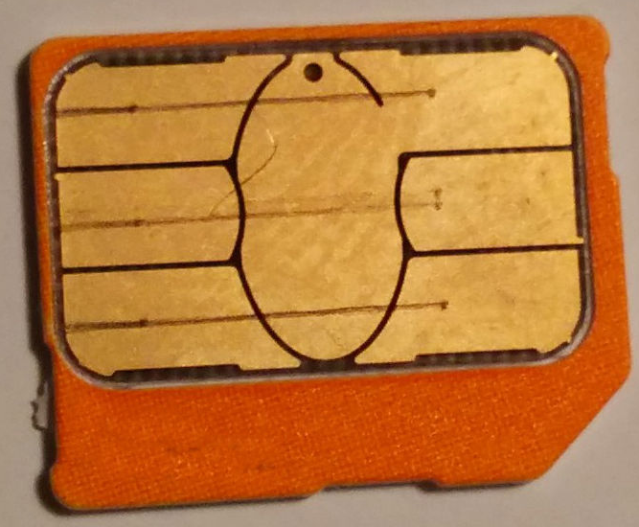
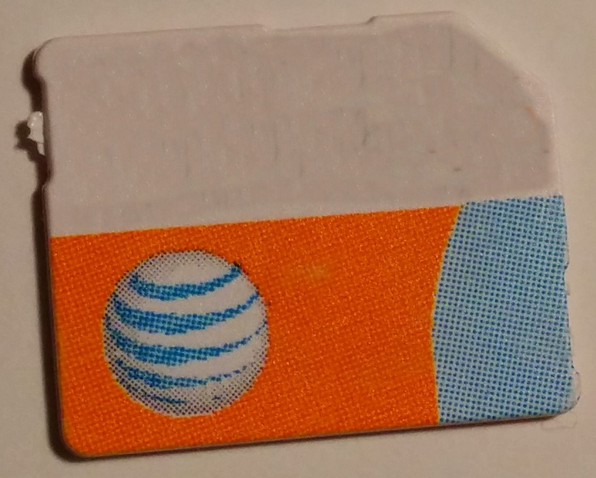
SIM Hacking
Metal Contact
8991101200
003204510

Slide 109
SIM Hacking
Metal Contact
Chip
The UICC contains a CPU, ROM, RAM, EEPROM and I/O, and metal contacts.
Plastic Card Body
Adopted from Anthony, Sebastian in references

Slide 110
Femtocells
Often runs a Linux distro
  To be used maliciously, root access is required
Previous femtocell hacks exploit software vulnerabilities and factory reset procedures
Phones automatically attach to the tower with the strongest signal, which is typically the closest tower
IMSI-catcher – femtocell that is configured to look like a real base station to steal IMSIs from nearby devices
  Often used by law enforcement
  IMSIs are important for device/subscriber tracking and call interception
Femtocells: A poisonous needle in the operator’s hay stack, Borgaonkar et al at Blackhat 2011
Traffic Interception & Remote Mobile Phone Cloning with a Compromised CDMA Femtocell, Doug DePerry et al Defcon 21

Slide 111
HeNB
Home eNode Bs (HeNBs) connect to the backhaul via a distinct Security Gateway (SeGW)
  Tunnel is protected with IPsec
A hardware root of trust is included in modern HeNBs
  Used to assist in secure boot and integrity check
  Ensures that upon boot, key firmware and other sensitive security parameters are not modified
The status of integrity checks are communicated to the SeGW

Slide 112
Baseband Hacking
Going through baseband, one can attack the cellular software stack and the mobile operating system (i.e., Android, iOS)
  Often leads to unlocking
Some cellular stacks leverage legacy code
  Often missing ASLR, NX, heap protection
  Code not publicly available, reverse engineering of leaked binaries necessary
Allows injection of packets via the air interface
The IMEISV + IMEI often identifies the baseband software version
You may need an external clock to assist with timing, as precision is required
Notable work includes R.-P. Weinmann 2010, R.-P. Weignmann 2013 and Guillaume Delugre
Femtocells: A poisonous needle in the operator’s hay stack, Borgaonkar et al at Blackhat 2011
Traffic Interception & Remote Mobile Phone Cloning with a Compromised CDMA Femtocell, Doug DePerry et al Defcon 21

Slide 113
FIN

Slide 114
In Conclusion
More detailed security information can be found within:
  LTE Security book,
  3GPP Standards (TS 33.401 especially), and
  Various presentations and whitepapers throughout the web:
    Security Investigation in 4G LTE Wireless Networks
    Technical Overview of 3GPP LTE
There’s a lot more to cellular security than what is contained within this presentation
  Study up!

Slide 115

Questions || Thoughts?
I want this presentation to be accurate
  Please report errors and omissions (acknowledgement will be provided)
  Many links went dark while developing this presentation
  External documents and references (other than videos) are also hosted on my personal domain to ensure they live on
  All links are properly referenced in the final slide
Cellular Security - Part 2 will include a much deeper analysis of LTE networking protocols, crypto, IMS, handover, network interconnection, SIM forensics, and SIM/baseband hacking
  And other requested topics
Joshua Franklin
www.jfranklin.me
josh dot michael dot franklin at gmail
– @thejoshpit

Slide 116
Resources & References
[Hulton08] Hulton, Steve, Intercepting GSM Traffic, Black Hat 2008.
Paget, Practical Cellphone Spying, Defcon 2010.
Nohl, Karsten, Attacking phone privacy, Blackhat 2010.
[Borgaonkar11] Borgaonkar, Nico, Redon, Femtocells: a Poisonous Needle in the Operator's Hay Stack.
[Perez11] Perez, Pico, A practical attack against GPRS/EDGE/UMTS/HSPA mobile data communications, Black Hat DC 2011.
[Nyberg04] Cryptographic Algorithms for UMTS
Dr. Maode Ma, Security Investigation in 4G LTE Wireless Networks
  Muyung, A Technical Overview of 3GPP LTE
  Agilent, LTE and the Evolution to 4G Wireless: Bonus Material: Security in the LTE-SAE Network, Agilent
  Anthony, Sebastian, The humble SIM card has finally been hacked: Billions of phones at risk of data theft, premium rate scams
  Nohl, Karsten, Rooting SIM Cards, Black Hat 2013
  Weinmann, R., The Baseband Apocalypse
  Weinmann, R., Baseband Exploitation in 2013
  Guillaume Delugre, Reverse engineering a Qualcomm baseband
  TS 33.401 – LTE Security Architecture
  TS 33.102 - 3G security; Security architecture
  TS 36.300 – Overall description of E-UTRAN

Slide 117
Errors and Omissions
Thanks to all that helped make this possible by providing feedback and identifying errors and omissions:
Tomasz Miklas
ph0n3Ix
Skrattar
Baddkrash
Netsecluke
Nechered
Chloeeeeeeeee
Dr. Kerry McKay
BuildTheRobots

