Slide 1
Introduction to Intel x86-64 Assembly, Architecture, Applications, & Alliteration
aka
Understanding x86-64 Assembly for Reverse Engineering & Exploits
Xeno Kovah – 2014
xkovah at gmail

Slide 2
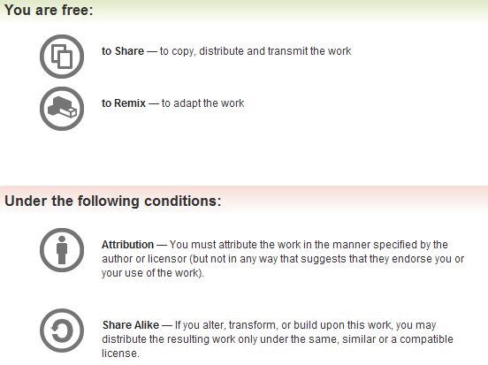
All materials is licensed under a Creative Commons “Share Alike” license.
http://creativecommons.org/licenses/by-sa/3.0/
Attribution condition: You must indicate that derivative work
"Is derived from Xeno Kovah's 'Intro x86-64’ class, available at http://OpenSecurityTraining.info/IntroX86-64.html”
Notes:
Attribution condition: You must indicate that derivative work
"Is derived from Xeno Kovah's ‘Intro x86-64’ class, available at http://OpenSecurityTraining.info/IntroX86-64.html"

Slide 3
Special Thanks To:
Veronica Kovah & Sam Cornwell, for helping with the update for 64 bit!

Slide 4
Additional Content/Ideas/Info Provided By:
Jon A. Erickson, Christian Arllen, Dave Keppler, Dillon Beresford
Who suggested what, is inline with the material
Your name here! Just suggest/contribute some content that ultimately makes its way into the class

Slide 5
Why learn x86 assembly?
Because x86 is pervasive on PCs & servers (and you better believe that Intel is going to claw their way on to mobile ;))
Because it’s basically a given that some talk at a security conference will at some point flash some x86 assembly in order to explain what’s going on. But even more talks just assume you know it and will be able to fill in the implied asm next steps.
Because it’s essential to writing memory corrupting exploits on PCs & servers
Because it’s essential to reverse engineering programs (goodware or malware) on
Because there are plenty of people who know network security but those who know host-based security are more rare and therefore more valuable
Because all the other architectures are super simple by comparison and easier to learn afterwards
Because a lot of the top hackers who have come before you knew x86 assembly, and in order to get to where they got, you need to know what they knew

Slide 6
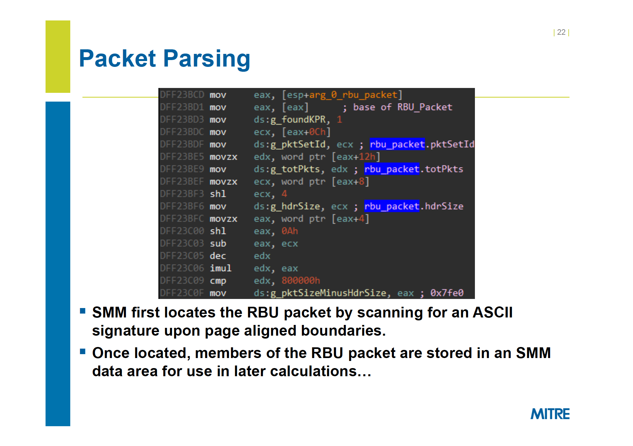
Defeating Signed BIOS Enforcement - Kallenberg et al., HITB 2013

Slide 7
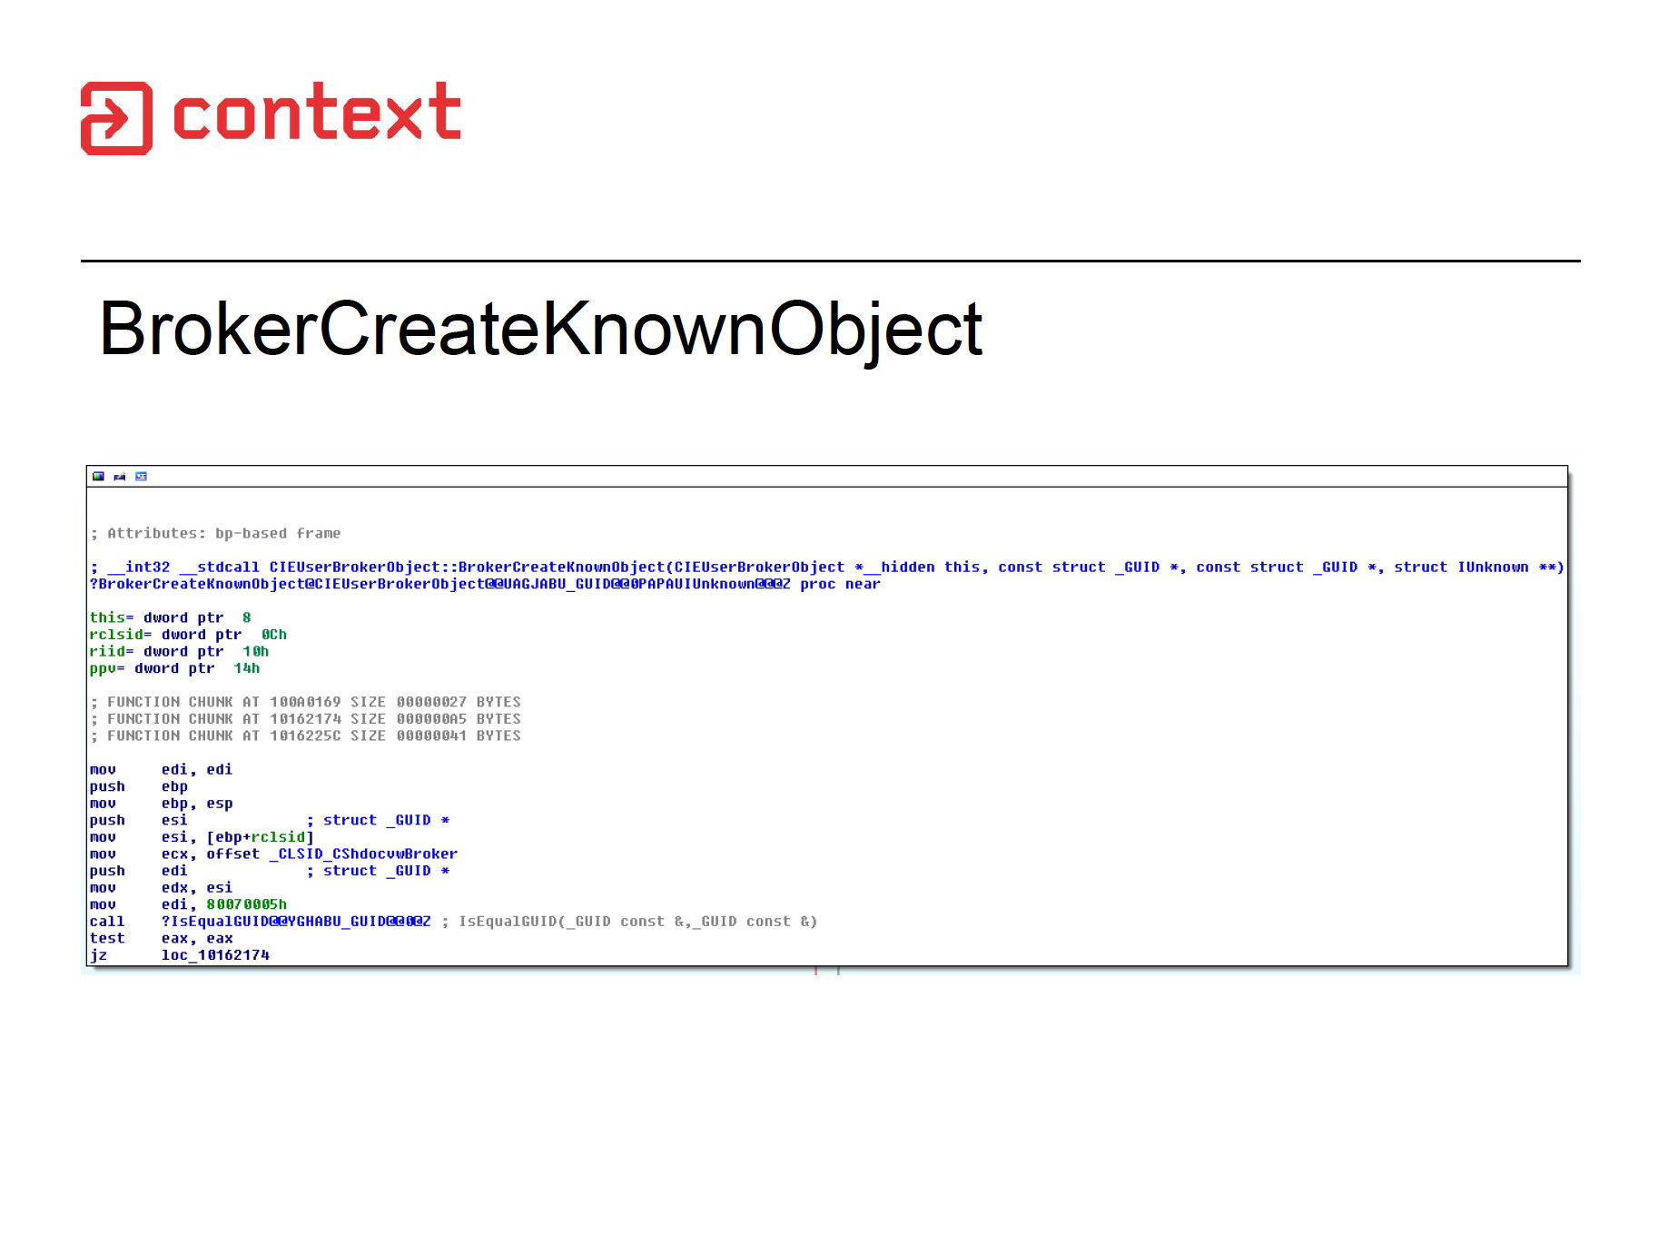
Digging for Sandbox Escapes - Forshaw, BlackHat USA 2014

Slide 8
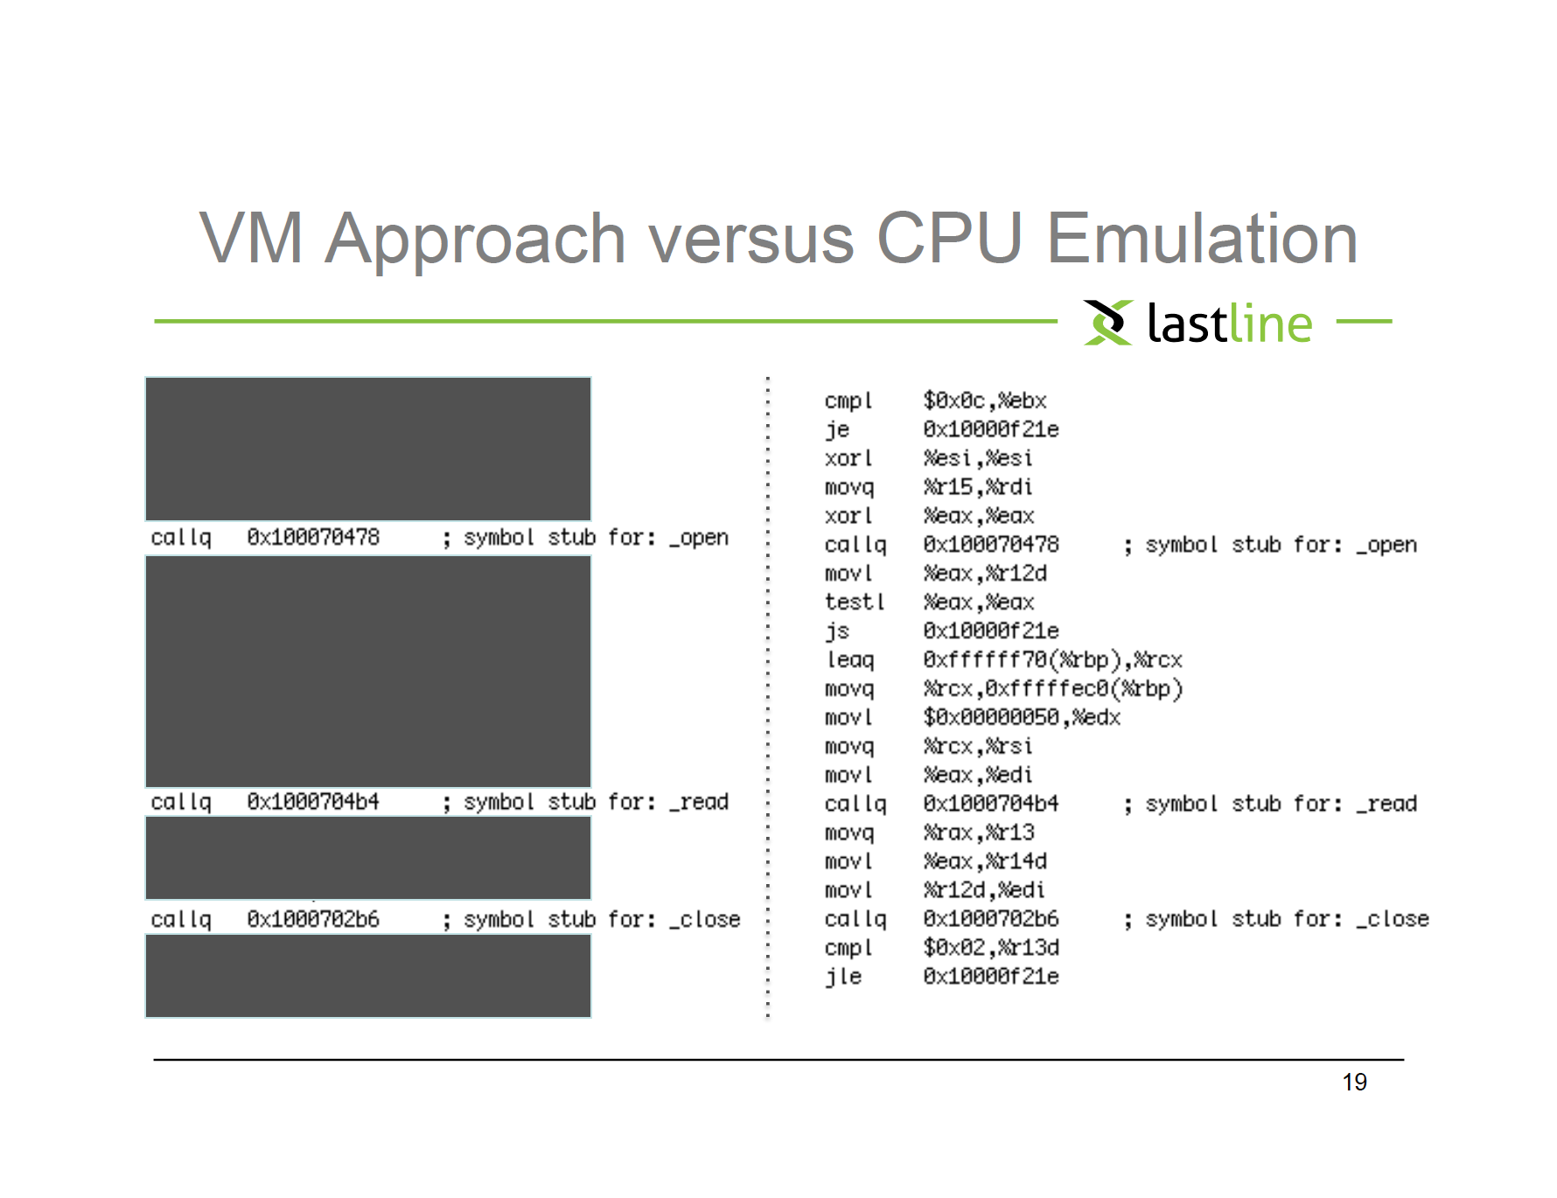
Full System Emulation: Achieving Successful Automated Dynamic Analysis of Evasive Malware, Kruegel, BlackHat USA 2014

Slide 9
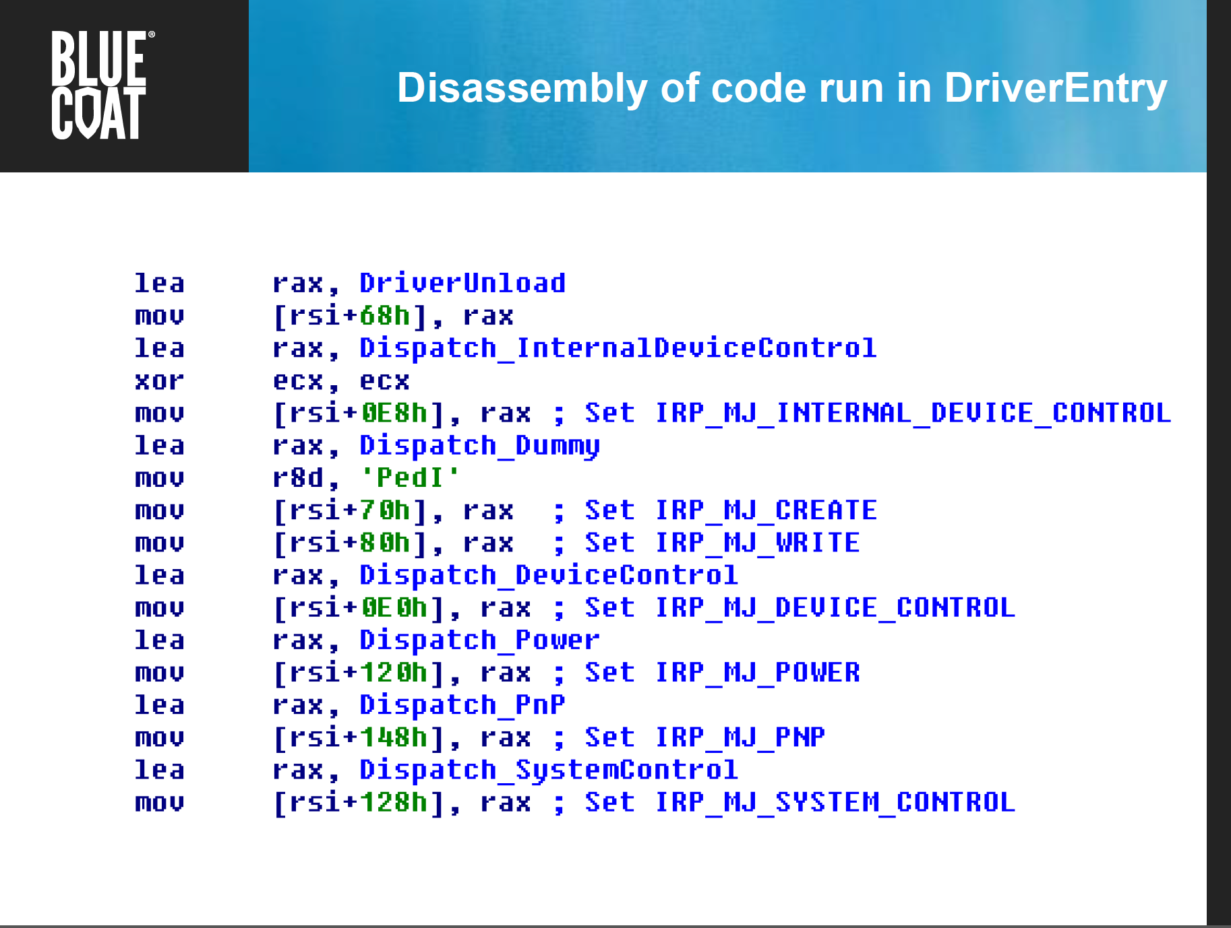
Exposing Bootkits with BIOS Emulation - Haukli, BlackHat USA 2014

Slide 10
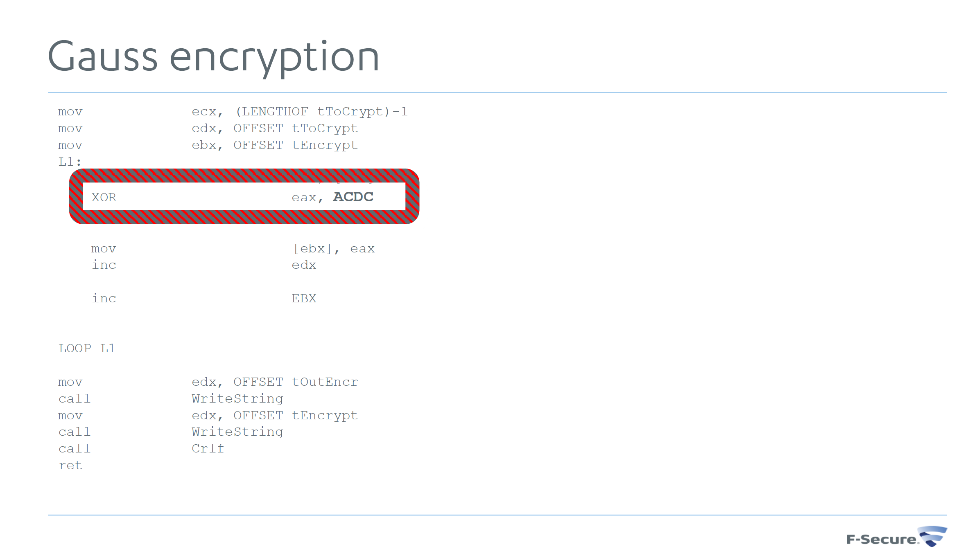
Governments as Malware Authors - Hypponen, BlackHat USA 2014

Slide 11

About Me
Security nerd – T-Shaped!¹
Realmz ~1996, Mac OS 8, BEQ->BNE FTW!
x86 ~2002
Know or have known ~5 assembly languages(x86, SPARC, ARM, PPC, 68HC12). x86 is by far the most complex.
Routinely read assembly when debugging my own code, reading exploit code, and reverse engineering things
¹http://www.valvesoftware.com/company/Valve_Handbook_LowRes.pdf
Notes:
5 min

Slide 12
About You?
Name & Company
Why did you want to take the class?
If you know you will be applying this knowledge, to which OS and/or development environment?
Notes:
10 min

Slide 13
About the Class
The intent of this class is to expose you to the most commonly generated assembly instructions, and the most frequently dealt with architecture hardware.
  64 bit instructions/hardware
  Implementation of a Stack
  Common tools
Many things will therefore be left out or deferred to later classes.
  Floating point instructions/hardware
  16 bit instructions/hardware
  Complicated or rare instructions
  Instruction pipeline, caching hierarchy, alternate modes of operation, hw virtualization, etc (see other classes for those)
Notes:
2 min

Slide 14
About the Class 2
The hope is that the material covered will be provide the required background to delve deeper into areas which may have seemed daunting previously.
Because I can’t anticipate the needs of all job classes, if there are specific areas which you think would be useful to certain job types, let me know. The focus areas are currently primarily influenced by my security background, but I would like to make the class as widely applicable as possible.

Slide 15
Agenda
Day 1 - Part 1 - Architecture Introduction, Windows tools
Day 1 - Part 2 - Windows Tools & Analysis, Learning New Instructions
Day 2 - Part 1 - Linux Tools & Analysis
Day 2 - Part 2 - Inline Assembly, Read The Fun Manual, Choose Your Own Adventure
Notes:
2 min

Slide 16
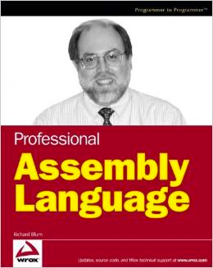
Book
Whenever you see “Book page *” mentioned throughout the class, it is referring to “Professional Assembly Language” by Richard Blum.
This optional book was originally picked after the creation of the 32 bit class because it uses AT&T assembly syntax & linux as an example, in contrast to the majority of this class.
Therefore it just serves as an alternative source of explanation in case something from the class isn’t clear and you want a second opinion
Notes:
2 min

Slide 17
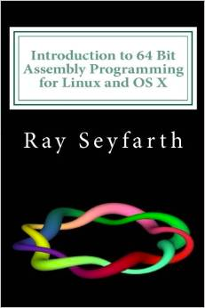
Book 2
If I were to pick a new book for this class, it would probably be “Introduction to 64 Bit Assembly Programming for Linux and OS X: Third Edition” by Ray Seyfarth
I haven’t got around to buying a copy yet to look through it, but based on the Amazon preview it looks generally like what I’m looking for in a class book (mostly just that it’s using 64 bit. ;) Whereas the previous book is 32 bit only.)
Once I get around to buying a copy and evaluating it, I’ll update the class materials to indicate they’re referring only to this book
Notes:
2 min

Slide 18
Miss Alaineous
Questions: Ask ‘em if you got ‘em
  If you fall behind and get lost and try to tough it out until you understand, it’s more likely that you will stay lost, so ask questions ASAP.
Browsing the web and/or checking email during class is a good way to get lost
2 hours, 10 min break, 1.5 hours, lunch, 1 hour/5 min break after that
It’s called x86 because of the progression of Intel chips from 8086, 80186, 80286, etc. I just had to get that out of the way. :)

Slide 19
Miss Alaineous 2
Intel originally wanted to break from x86 when moving to 64 bit. This was Itanium aka IA64 (Intel Architecture 64 bit). However, AMD decided to extend x86 to 64 bits itself, leading to the AMD64 architecture. When Itanium had very slow adoption, Intel decided to bite the bullet and license the 64 bit extensions from AMD.
In the Intel manuals you will see the 64 bit extensions referred to as IA32e or EMT64 or Intel 64 (but never IA64. Again, that's Itanium, a completely different architecture).
You might sometimes see it called amd64 or x64 by MS or some linux distributions
In this class we're going to go with x86-64

Slide 20
What you’re going to learn:
#include <stdio.h>
int main(){
  printf(“Hello World!\n”);
  return 0x1234;
}

Slide 21
Is the same as…
main:
000000013F511000 sub rsp,28h
000000013F511004 lea rcx,[__globallocalestatus-10h (13F513000h)]
000000013F51100B call qword ptr [__imp_printf (13F512100h)]
000000013F511011 mov eax,1234h
000000013F511016 add rsp,28h
000000013F51101A ret
Windows Visual C++ 2012 Express
/GS (buffer overflow protection) option turned off
Disassembled with Visual C++

Slide 22
which could be viewed as…
0000000140001000 <.text>:
140001000: 48 83 ec 28 sub $0x28,%rsp
140001004: 48 8d 0d ad 11 00 00 lea 0x11ad(%rip),%rcx # 0x1400021b8
14000100b: ff 15 07 11 00 00 callq *0x1107(%rip) # 0x140002118
140001011: b8 34 12 00 00 mov $0x1234,%eax
140001016: 48 83 c4 28 add $0x28,%rsp
14000101a: c3 retq
Windows Visual C++ 2012 Express
/GS (buffer overflow protection) option turned off
Disassembled with objdump -d from cygwin

Slide 23
which is equivalent to…
08048374 <main>:
8048374: 8d 4c 24 04 lea 0x4(%rsp),%rcx
8048378: 83 e4 f0 and $0xfffffff0,%rsp
804837b: ff 71 fc pushl -0x4(%rcx)
804837e: 55 push %rbp
804837f: 89 e5 mov %rsp,%rbp
8048381: 51 push %rcx
8048382: 83 ec 04 sub $0x4,%rsp
8048385: c7 04 24 60 84 04 08 movl $0x8048460,(%rsp)
804838c: e8 43 ff ff ff call 80482d4 <puts@plt>
8048391: b8 2a 00 00 00 mov $0x1234,%eax
8048396: 83 c4 04 add $0x4,%rsp
8048399: 59 pop %rcx
804839a: 5d pop %rbp
804839b: 8d 61 fc lea -0x4(%rcx),%rsp
804839e: c3 ret
804839f: 90 nop
Ubuntu 12.04, GCC 4.2.4
Disassembled with “objdump -d”

Slide 24
which is equivalent to…
_main:
0000000100000f40 pushq %rbp
0000000100000f41 movq %rsp, %rbp
0000000100000f44 subq $0x10, %rsp
0000000100000f48 leaq 0x3f(%rip), %rdi ## literal pool for: "Hello World!"
0000000100000f4f movl $0x0, -0x4(%rbp)
0000000100000f56 movb $0x0, %al
0000000100000f58 callq 0x100000f6e ## symbol stub for: _printf
0000000100000f5d movl $0x1234, %ecx
0000000100000f62 movl %eax, -0x8(%rbp)
0000000100000f65 movl %ecx, %eax
0000000100000f67 addq $0x10, %rsp
0000000100000f6b popq %rbp
0000000100000f6c ret
Mac OS 10.9.4, Apple LLVM version 5.1 (clang-503.0.40)
Disassembled from command line with “otool -tV”

Slide 25
But it all boils down to…
.text:0000000140001000 main
.text:0000000140001000
.text:0000000140001000 sub rsp, 28h
.text:0000000140001004 lea rcx, Format ; "Hello World!\n"
.text:000000014000100B call cs:__imp_printf
.text:0000000140001011 mov eax, 1234h
.text:0000000140001016 add rsp, 28h
.text:000000014000101A retn
Windows Visual C++ 2012, /GS (buffer overflow protection) option turned off
Optimize for minimum size (/O1) turned on
Disassembled with IDA Pro 6.6 (with some omissions for fitting on screen)

Slide 26

Take Heart!
By one measure, only 14 assembly instructions account for 90% of code!
  http://www.blackhat.com/presentations/bh-usa-06/BH-US-06-Bilar.pdf
I think that knowing about 20-30 (not counting variations) is good enough that you will have the check the manual very infrequently
You’ve already seen 10 instructions, just in the hello world variations!

