Slide 1
Introduction to Intel x86-64 Assembly, Architecture, Applications, & Alliteration
Xeno Kovah – 2014
xkovah at gmail

Slide 2
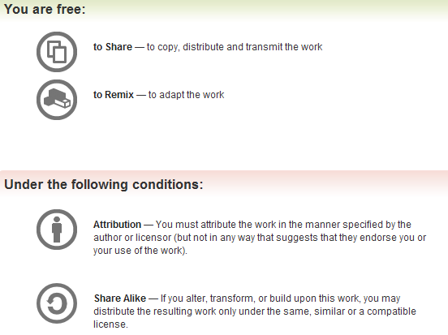
All materials is licensed under a Creative Commons “Share Alike” license.
http://creativecommons.org/licenses/by-sa/3.0/
Attribution condition: You must indicate that derivative work
"Is derived from Xeno Kovah's 'Intro x86-64’ class, available at http://OpenSecurityTraining.info/IntroX86-64.html”
Notes:
Attribution condition: You must indicate that derivative work
"Is derived from Xeno Kovah's ‘Intro x86-64’ class, available at http://OpenSecurityTraining.info/IntroX86-64.html"

Slide 3
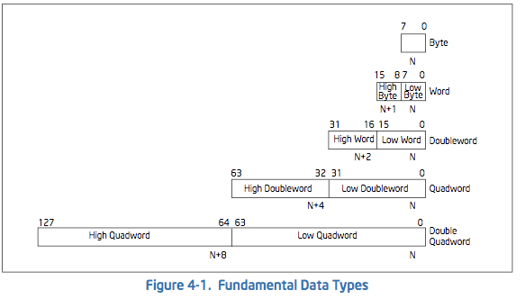
Refresher - Data Types
In C: char
In C: short
In C: int/long
aka “DWORD”
on Windows
In C: double/long long
aka “QWORD”
on Windows
?->
In C: long double?
Intel Vol 1 Sec 4.1 - page 4-1 -
(All citations will be from the included June 2014 manual,
because things move around slightly between revisions)

Slide 4
Refresher - Alt. Radices Decimal, Binary, Hexidecimal
If you don’t know this, you must memorize tonight
Decimal (base 10) | Binary (base 2) | Hex (base 16)
00 | 0000b | 0x00
01 | 0001b | 0x01
02 | 0010b | 0x02
03 | 0011b | 0x03
04 | 0100b | 0x04
05 | 0101b | 0x05
06 | 0110b | 0x06
07 | 0111b | 0x07
08 | 1000b | 0x08
09 | 1001b | 0x09
10 | 1010b | 0x0A
11 | 1011b | 0x0B
12 | 1100b | 0x0C
13 | 1101b | 0x0D
14 | 1110b | 0x0E
15 | 1111b | 0x0F

Slide 5
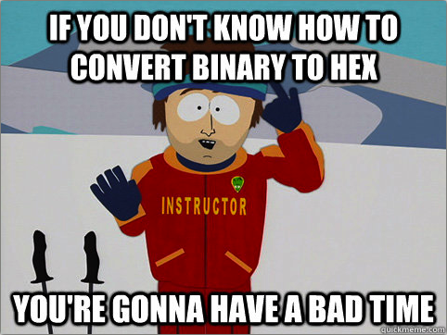
Maybe go practice here?
http://forums.cisco.com/CertCom/game/binary_game_page.htm

Slide 6
Refresher - Negative Numbers
Negative numbers are defined as the “two’s complement” of the positive number
“one’s complement” = flip all bits. 0->1, 1->0
“two’s complement” = one’s complement + 1
0x01 to 0x7F positive byte, 0x80 to 0xFF negative byte
0x00000001 to 0x7FFFFFFF positive dword
0x80000000 to 0xFFFFFFFF negative dword
Number | One’s Comp. | Two’s Comp. (negative)
00000001b : 0x01 | 11111110b : 0xFE | 11111111b : 0xFF : -1
00000100b : 0x04 | 11111011b : 0xFB | 11111100b : 0xFC : -4
00011010b : 0x1A | 11100101b : 0xE5 | 11100110b : 0xE6 : -26
? | ? | 10110000b : 0xB0 : -?

Slide 7
Refresher - Boolean (“bitwise”) logic
AND “&”
OR “|”
XOR “^”
0 | 0 | 0
0 | 1 | 0
1 | 0 | 0
1 | 1 | 1
0 | 0 | 0
0 | 1 | 1
1 | 0 | 1
1 | 1 | 1
0 | 0 | 0
0 | 1 | 1
1 | 0 | 1
1 | 1 | 0
Operands
Result
NOT “~”
0 | 1
1 | 0

