Slide 1
Introduction to Intel x86-64 Assembly, Architecture, Applications, & Alliteration
Xeno Kovah – 2014
xkovah at gmail

Slide 2
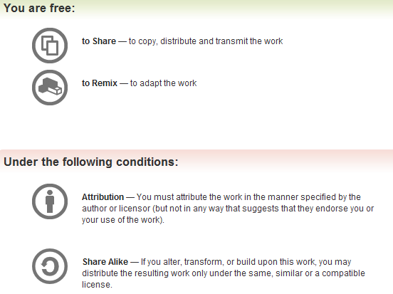
All materials is licensed under a Creative Commons “Share Alike” license.
http://creativecommons.org/licenses/by-sa/3.0/
Attribution condition: You must indicate that derivative work
"Is derived from Xeno Kovah's 'Intro x86-64’ class, available at http://OpenSecurityTraining.info/IntroX86-64.html”
Notes:
Attribution condition: You must indicate that derivative work
"Is derived from Xeno Kovah's ‘Intro x86-64’ class, available at http://OpenSecurityTraining.info/IntroX86-64.html"

Slide 3
Architecture - CISC vs. RISC
Intel is CISC - Complex Instruction Set Computer
Many very special purpose instructions that you will never see, and a given compiler may never use - just need to know how to use the manual
Variable-length instructions, between 1 and 15 bytes long.
Other major architectures are typically RISC - Reduced Instruction Set Computer
Typically more registers, less and fixed-size instructions
Examples: PowerPC, ARM, SPARC, MIPS

Slide 4
Take a look, it’s in a book!
Thanks to Dillon Beresford for sending concrete examples of the longest possible instructions, back when my slides said I was unsure on the max length:
“Longest x86 instruction is 15 bytes in 16-bit mode and 13 bytes in 32-bit mode:
[16-bit]
66 67 F0 3E 81 04 4E 01234567 89ABCDEF
add [ds:esi+ecx*2+0x67452301], 0xEFCDAB89
[32-bit]
F0 3E 81 04 4E 01234567 89ABCDEF”
You’ll be able to interpret those by the end of the class :)

Slide 5
Architecture - Endian
Endianness comes from Jonathan Swift’s Gulliver’s Travels. It doesn’t matter which way you eat your eggs
Little Endian - 0x12345678 stored in RAM “little end” first. The least significant byte of a word or larger is stored in the lowest address. E.g. 0x78563412
Intel is Little Endian
Big Endian - 0x12345678 stored as is.
Network traffic is Big Endian
Most everyone else you’ve heard of (PowerPC, ARM, SPARC, MIPS) is either Big Endian by default or can be configured as either (Bi-Endian)
Book p. 163
Optional book for this class is “Professional Assembly Language” by Blum

Slide 6
Endianess pictures
Big Endian
(Others)
Little Endian
(Intel)
High Memory
Addresses
Register
Register
00
00
0x5
00
00
FE
ED
FA
CE
FE
ED
FA
CE
0x4
CE
FA
ED
FE
0x3
FE
ED
FA
CE
0x2
0x1
0x0
Low Memory
Addresses

Slide 7
How you’ll probably usually see endianness expressed:
low
high
high
low
high
Memory dump windows are typically shown in typical English writing left-to-right, top-to-bottom form, with the upper left being the lowest address
Register view windows always show the registers in big endian order

Slide 8
But if you change the display size…
low
high
high
low
high
If you start asking the debugger to display things, 2, 4, or 8 bytes at a time, it will typically take those chunks and display them each big endian order

Slide 9
Architecture - Registers
Registers are small memory storage areas built into the processor (still volatile memory)
16 “general purpose” registers + the instruction pointer which points at the next instruction to execute
But two of the 16 are not that general
On x86-32, aka IA32 registers are 32 bits long
On x86-64, aka IA32e they’re 64 bits
Book p. 25

Slide 10
Architecture - Register Conventions 1
These are Intel’s suggestions to compiler developers (and assembly handcoders). Registers don’t have to be used these ways, but if you see them being used like this, you’ll know why. But I simplified some descriptions. I also color coded as GREEN for the ones which we will actually see in this class (as opposed to future ones), and RED for not.
RAX - Stores function return values
RBX - Base pointer to the data section
RCX - Counter for string and loop operations
RDX - I/O pointer
Intel Arch v1 Section 3.4.1 - General-Purpose Registers, page 3-11
Also MS’s conventions: http://msdn.microsoft.com/en-us/library/9z1stfyw.aspx
Notes:
http://msdn.microsoft.com/en-us/library/9z1stfyw.aspx

Slide 11
Architecture - Registers Conventions 2
RSI - Source pointer for string operations
RDI - Destination pointer for string operations
RSP - Stack top pointer
RBP - Stack frame base pointer
RIP - Pointer to next instruction to execute (“instruction pointer”)

Slide 12
Architecture - Registers Conventions 3
Caller-save registers (also called “volatile” registers by MS)
If the caller has anything in the registers that it cares about, the caller is in charge of saving the value before a call to a subroutine, and restoring the value after the call returns
Put another way - the callee can (and is highly likely to) modify values in caller-save registers
VisualStudio: RAX, RCX, RDX, R8-R11
GCC: RAX, RCX, RDX, RSI, RDI, R8-R11
Callee-save registers (also called “non-volatile” registers by MS)
If the callee needs to use more registers than are saved by the caller, the callee is responsible for making sure the values are stored/restored
Put another way - the callee must be a good citizen and not modify registers which the caller didn’t save, unless the callee itself saves and restores the existing values
VisualStudio: RBX, RBP, RDI, RSI, R12-R15
GCC: RBX, RBP, R12-R15
http://msdn.microsoft.com/en-us/library/6t169e9c.aspx, http://en.wikipedia.org/wiki/X86_calling_conventions
Notes:
http://msdn.microsoft.com/en-us/library/6t169e9c.aspx
http://msdn.microsoft.com/en-us/library/9z1stfyw.aspx

Slide 13
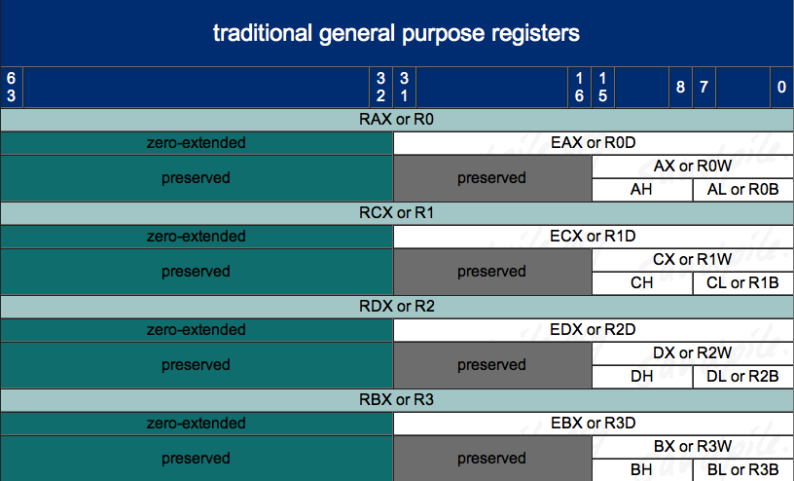
Architecture - Registers – 8/16/32/64 bit addressing 1
http://www.sandpile.org/x86/gpr.htm

Slide 14
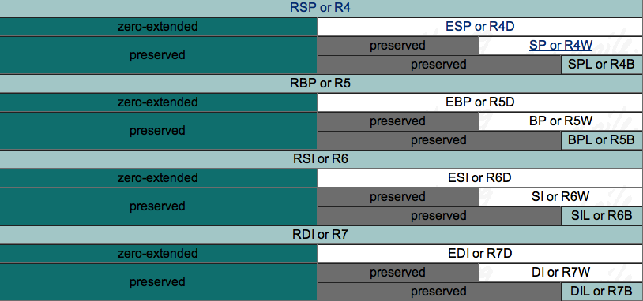
Architecture - Registers – 8/16/32/64 bit addressing 2
(note: we didn’t previously have low-byte access to *SP, *BP, *SI, or *DI!)
http://www.sandpile.org/x86/gpr.htm

Slide 15
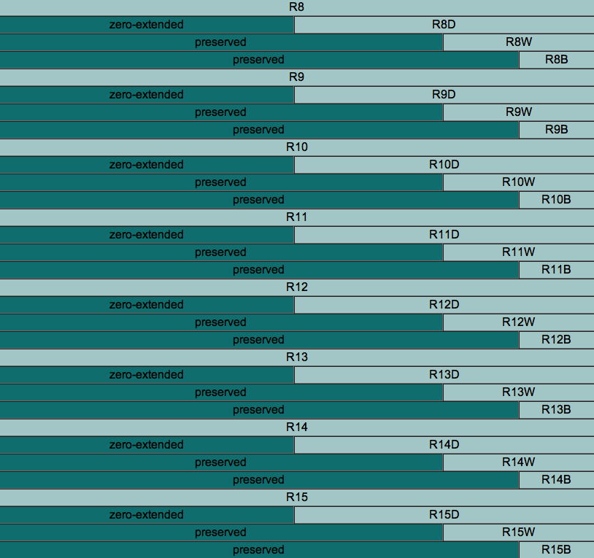
Architecture - Registers – 8/16/32/64 bit addressing 3
http://www.sandpile.org/x86/gpr.htm
Notes:
note to scornwell: maybe a simple game here like:
“DIL is the 8 least-significant-bit access for which 64 bit register?” (RDI)
“What is the word-sized access register for R14 called?” (R14W)
“What is the 16 bit access for R14 called?” (R14W)

Slide 16
Architecture - RFLAGS
“In 64-bit mode, EFLAGS is extended to 64 bits and called RFLAGS. The upper 32 bits of RFLAGS register is reserved. The lower 32 bits of RFLAGS is the same as EFLAGS.”
RFLAGS register holds many single bit flags. Will only ask you to remember the following for now.
Zero Flag (ZF) - Set if the result of some instruction is zero; cleared otherwise.
Sign Flag (SF) - Set equal to the most-significant bit of the result, which is the sign bit of a signed integer. (0 indicates a positive value and 1 indicates a negative value.)
Intel Vol 1 Sec 3.4.3.1 - page 3-22 - May 2012 manuals

Slide 17
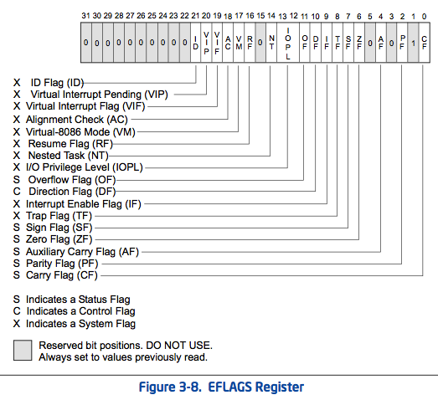
= Intro x86-64
= Intermediate x86-64
I
O
P
L
I
D
R
F
O
F
D
F
I
F
T
F
S
F
Z
F
A
F
P
F
C
F
Intel Vol 1 Sec 3.4.3.1 - page 3-21 - May 2012 manuals

Slide 18
Architecture - RFLAGS
I only want you to memorize zero flag and sign flag for now, but for your own curiosity and later reference here’s how others work
Carry flag (CF) - Set if an arithmetic operation generates a carry or a borrow out of the most-significant bit of the result. This flag indicates an overflow condition for unsigned-integer arithmetic.
Overflow flag (OF) — Set if the integer result is too large a positive number or too small a negative number (excluding the sign-bit) to fit in the destination operand. This flag indicates an overflow condition for signed-integer (two’s complement) arithmetic.
Parity flag (PF) — Set if the least-significant byte of the result contains an even number of 1 bits
Adjust flag (AF) — Set if an arithmetic operation generates a carry or a borrow out of bit 3 of the result; cleared otherwise. This flag is used in binary-coded decimal (BCD) arithmetic.
You will only ever see instructions that depend on the PF or AF in very specialized circumstances
Intel Vol 1 Sec 3.4.3.1 - page 3-21 to 3-22 - May 2012 manuals
Notes:
Note to scornwell: In one-step, three-step, we can teach PF and AF-based jumps in the later advanced rounds. It should start with SF/ZF-based ones, then move on to CF/OF-based ones, and then eventually PF/AF-based ones

Slide 19
1
Your first x86-64 instruction: NOP
NOP - No Operation! No registers, no values, no nothin’!
Just there to pad/align bytes, or to delay time
Bad guys use it to make simple exploits more reliable. But that’s another class ;)
OpenSecurityTraining.info/Exploits1.html

Slide 20
Extra! Extra! Late-breaking NOP news!
Amaze those who know x86 by citing this interesting bit of trivia:
“The one-byte NOP instruction is an alias mnemonic for the XCHG (E)AX, (E)AX instruction.”
I had never looked in the manual for NOP apparently :)
Every other person I had told this to had never heard it either.
Thanks to Jon Erickson for cluing me in to this.
XCHG instruction is not officially in this class. But if I hadn’t just told you what it does, I bet you would have guessed right anyway.
XCHG in book p. 112

Slide 21
Instructions we now know (1)
NOP

