Slide 1
Introduction to Intel x86-64 Assembly, Architecture, Applications, & Alliteration
Xeno Kovah – 2014
xkovah at gmail

Slide 2
All materials is licensed under a Creative Commons “Share Alike” license.
http://creativecommons.org/licenses/by-sa/3.0/
Attribution condition: You must indicate that derivative work
"Is derived from Xeno Kovah's 'Intro x86-64’ class, available at http://OpenSecurityTraining.info/IntroX86-64.html”
Notes:
Attribution condition: You must indicate that derivative work
"Is derived from Xeno Kovah's ‘Intro x86-64’ class, available at http://OpenSecurityTraining.info/IntroX86-64.html"

Slide 3
Control Flow
Two forms of control flow
Conditional - go somewhere if a condition is met. Think “if”s, switches, loops
Unconditional - go somewhere no matter what. Procedure calls, goto, exceptions, interrupts.
We’ve already seen procedure calls manifest themselves as call/ret, let’s see how goto manifests itself in asm.

Slide 4
GotoExample.c
//Goto example
#include <stdio.h>
int main(){
goto mylabel;
printf("skipped\n");
mylabel:
printf("goto ftw!\n");
return 0xf00d;
}
main:
0000000140001010 sub rsp,28h
0000000140001014 jmp 0000000140001023
0000000140001016 lea rcx,[40006000h]
000000014000101D call qword ptr [40008368h]
$mylabel:
0000000140001023 lea rcx,[40006010h]
000000014000102A call qword ptr [40008368h]
0000000140001030 mov eax,0F00Dh
0000000140001035 add rsp,28h
0000000140001039 ret

Slide 5
13
JMP - Jump
Change rip to the given address
Main forms of the address
Short relative (1 byte displacement from end of the instruction)
“jmp 0000000140001023” doesn’t have the number 0000000140001023 anywhere in it, it’s really “jmp 0x0E bytes forward”
Some disassemblers will indicate this with a mnemonic by writing it as “jmp short”
Near relative (4 byte displacement from current eip)
Absolute (hardcoded address in instruction)
Absolute Indirect (address calculated with r/m32)
jmp -2 == infinite loop for short relative jmp :)
Book p. 129

Slide 6
GotoExample.c takeaways
goto == jmp in asm :)
//Goto example
#include <stdio.h>
int main(){
goto mylabel;
printf("skipped\n");
mylabel:
printf("goto ftw!\n");
return 0xf00d;
}
main:
0000000140001010 sub rsp,28h
0000000140001014 jmp 0000000140001023
0000000140001016 lea rcx,[40006000h]
000000014000101D call qword ptr [40008368h]
$mylabel:
0000000140001023 lea rcx,[40006010h]
000000014000102A call qword ptr [40008368h]
0000000140001030 mov eax,0F00Dh
0000000140001035 add rsp,28h
0000000140001039 ret

Slide 7
IfExample.c
main:
0000000140001010 sub rsp,18h
0000000140001014 mov dword ptr [rsp+4],1
000000014000101C mov dword ptr [rsp],2
0000000140001023 mov eax,dword ptr [rsp]
0000000140001026 cmp dword ptr [rsp+4],eax
000000014000102A jne 0000000140001033
000000014000102C mov eax,1
0000000140001031 jmp 0000000140001058
0000000140001033 mov eax,dword ptr [rsp]
0000000140001036 cmp dword ptr [rsp+4],eax
000000014000103A jle 0000000140001043
000000014000103C mov eax,2
0000000140001041 jmp 0000000140001058
0000000140001043 mov eax,dword ptr [rsp]
0000000140001046 cmp dword ptr [rsp+4],eax
000000014000104A jge 0000000140001053
000000014000104C mov eax,3
0000000140001051 jmp 0000000140001058
0000000140001053 mov eax,0DEFEA7h
0000000140001058 add rsp,18h
000000014000105C ret
int main(){
int a=1, b=2;
if(a == b){
return 1;
}
if(a > b){
return 2;
}
if(a < b){
return 3;
}
return 0xdefea7;
}
Jcc

Slide 8
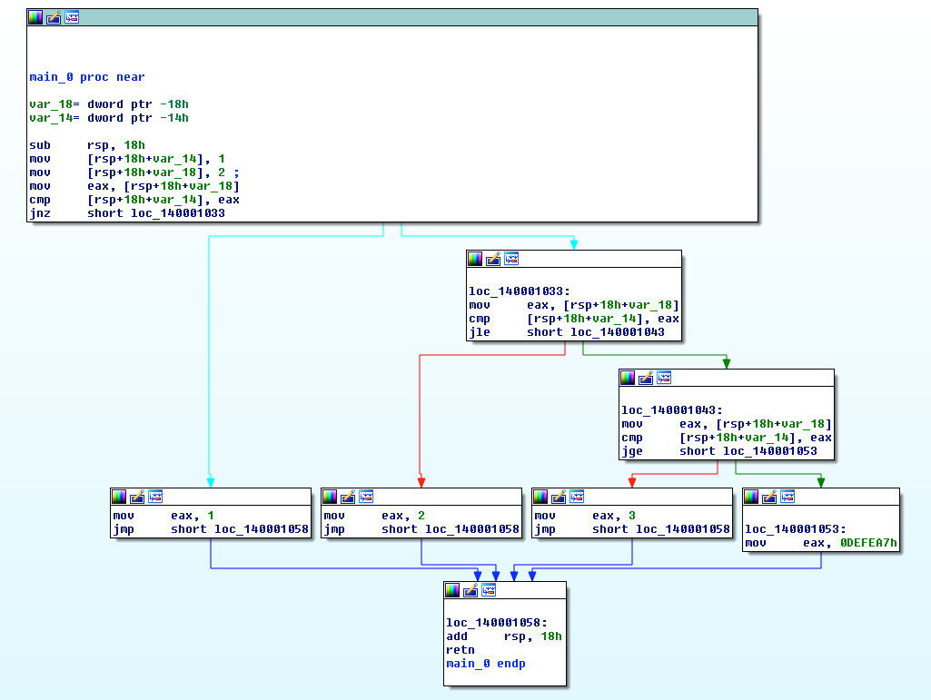
Ghost of Xmas Future:
Tools you won’t get to use today
generate a Control Flow Graph (CFG)
which looks much nicer.
Not that that helps you. Just sayin’ :)

Slide 9
14
Jcc - Jump If Condition Is Met
There are more than 4 pages of conditional jump types! Luckily a bunch of them are synonyms for each other.
JNE == JNZ (Jump if not equal, Jump if not zero, both check if the Zero Flag (ZF) == 0)
Book p. 137

Slide 10
Some Notable Jcc Instructions
JZ/JE: if ZF == 1
JNZ/JNE: if ZF == 0
JLE/JNG : if ZF == 1 or SF != OF
JGE/JNL : if SF == OF
JBE: if CF == 1 OR ZF == 1
JB: if CF == 1
Note: Don’t get hung up on memorizing which flags are set for what. More often than not, you will be running code in a debugger, not just reading it. In the debugger you can just look at rflags and/or watch whether it takes a jump.

Slide 11
Flag setting
Before you can do a conditional jump, you need something to set the condition flags for you.
Typically done with CMP, TEST, or whatever instructions are already inline and happen to have flag-setting side-effects

Slide 12
15
CMP - Compare Two Operands
“The comparison is performed by subtracting the second operand from the first operand and then setting the status flags in the same manner as the SUB instruction.”
What’s the difference from just doing SUB? Difference is that with SUB the result has to be stored somewhere. With CMP the result is computed, the flags are set, but the result is discarded. Thus this only sets flags and doesn’t mess up any of your registers.
Modifies CF, OF, SF, ZF, AF, and PF
(as we already saw, SUB modifies all those too)
Book p. 138

Slide 13
IfExample.c takeaways
Conditional logic, like if statements, manifests in assembly as conditional jumps (Jcc). “If condition true, jump there, else fall through”
Conditions involving in/equality are often checked with a CMP instruction, which is the same thing as a SUB, but it just throws the results away after the relevant RFLAGS bits are set
The RFLAGS bits are fundamentally what are checked by the Jccs
int main(){
int a=1, b=2;
if(a == b){
return 1;
}
if(a > b){
return 2;
}
if(a < b){
return 3;
}
return 0xdefea7;
}
main:
0000000140001010 sub rsp,18h
0000000140001014 mov dword ptr [rsp+4],1
000000014000101C mov dword ptr [rsp],2
0000000140001023 mov eax,dword ptr [rsp]
0000000140001026 cmp dword ptr [rsp+4],eax
000000014000102A jne 0000000140001033
000000014000102C mov eax,1
0000000140001031 jmp 0000000140001058
0000000140001033 mov eax,dword ptr [rsp]
0000000140001036 cmp dword ptr [rsp+4],eax
000000014000103A jle 0000000140001043
000000014000103C mov eax,2
0000000140001041 jmp 0000000140001058
0000000140001043 mov eax,dword ptr [rsp]
0000000140001046 cmp dword ptr [rsp+4],eax
000000014000104A jge 0000000140001053
000000014000104C mov eax,3
0000000140001051 jmp 0000000140001058
0000000140001053 mov eax,0DEFEA7h
0000000140001058 add rsp,18h
000000014000105C ret

Slide 14
BitmaskExampleExample.c
main:
0000000140001010 sub rsp,18h
0000000140001014 mov dword ptr [rsp],1301h
000000014000101B mov eax,dword ptr [rsp]
000000014000101E and eax,100h
0000000140001023 test eax,eax
0000000140001025 je 0000000140001030
0000000140001027 mov eax,1
000000014000102C jmp 0000000140001035
000000014000102E jmp 0000000140001035
0000000140001030 mov eax,2
0000000140001035 add rsp,18h
0000000140001039 ret
#define MASK 0x100
int main(){
int a=0x1301;
if(a & MASK){
return 1;
}
else{
return 2;
}
}

Slide 15
16
TEST - Logical Compare
“Computes the bit-wise logical AND of first operand (source 1 operand) and the second operand (source 2 operand) and sets the SF, ZF, and PF status flags according to the result.”
Like CMP - sets flags, and throws away the result
Book p. 232

Slide 16
BitmaskExample.c takeaways
Conditions depending on bit tests (which is often expressed with boolean logic instructions) will often see the RFLAGS set with the CMP instruction. CMP is like AND, but throws the results away
The reason for the extraneous jmp here is because it’s unoptimized code so it’s following a simpler set of asm construction rules
main:
0000000140001010 sub rsp,18h
0000000140001014 mov dword ptr [rsp],1301h
000000014000101B mov eax,dword ptr [rsp]
000000014000101E and eax,100h
0000000140001023 test eax,eax
0000000140001025 je 0000000140001030
0000000140001027 mov eax,1
000000014000102C jmp 0000000140001035
000000014000102E jmp 0000000140001035
0000000140001030 mov eax,2
0000000140001035 add rsp,18h
0000000140001039 ret
#define MASK 0x100
int main(){
int a=0x1301;
if(a & MASK){
return 1;
}
else{
return 2;
}
}

Slide 17
Instructions we now know (17)
NOP
PUSH/POP
CALL/RET
MOV
ADD/SUB
IMUL
MOVZX/MOVSX
LEA
JMP/Jcc (family)
CMP/TEST

