Slide 1
Introduction to Intel x86-64 Assembly, Architecture, Applications, & Alliteration
Xeno Kovah – 2014
xkovah at gmail

Slide 2
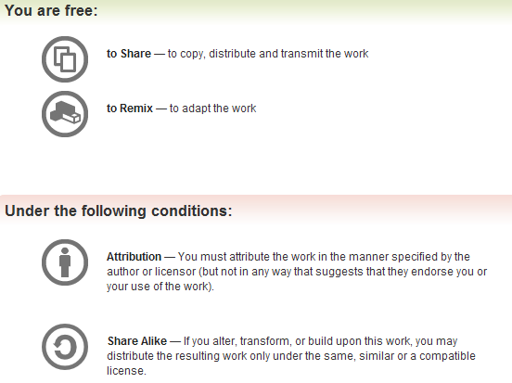
All materials is licensed under a Creative Commons “Share Alike” license.
http://creativecommons.org/licenses/by-sa/3.0/
Attribution condition: You must indicate that derivative work
"Is derived from Xeno Kovah's 'Intro x86-64’ class, available at http://OpenSecurityTraining.info/IntroX86-64.html”
Notes:
Attribution condition: You must indicate that derivative work
"Is derived from Xeno Kovah's ‘Intro x86-64’ class, available at http://OpenSecurityTraining.info/IntroX86-64.html"

Slide 3
MulDivExample.c
int main(){
unsigned int a = 1;
a = a * 6;
a = a / 3;
return 0x2bad;
}
main:
0000000140001010 sub rsp,18h
0000000140001014 mov dword ptr [rsp],1
000000014000101B mov eax,dword ptr [rsp]
000000014000101E imul eax,eax,6
0000000140001021 mov dword ptr [rsp],eax
0000000140001024 xor edx,edx
0000000140001026 mov eax,dword ptr [rsp]
0000000140001029 mov ecx,3
000000014000102E div eax,ecx
0000000140001030 mov dword ptr [rsp],eax
0000000140001033 mov eax,2BADh
0000000140001038 add rsp,18h
000000014000103C ret
Notes:
We already saw that when a C operand is a power of 2, it uses shifts instead of multiplies/divides, but this shows that in other cases, it uses multiply or divide instructions.

Slide 4
Book p. 221
27
DIV - Unsigned Divide
Three forms
Unsigned divide ax by r/m8, al = quotient, ah = remainder
Unsigned divide edx:eax by r/m32, eax = quotient, edx = remainder
Unsigned divide rdx:rax by r/m64, rax = quotient, rdx = remainder
If dividend is 32/64bits, edx/rdx will just be set to 0 by the compiler before the instruction (as occurred in the MulDivExample.c code)
If the divisor is 0, a divide by zero exception is raised.
initial
ax | r/m8(cx)
0x8 | 0x3
edx | eax | r/mX(ecx)
0x0 | 0x8 | 0x3
operation
div ax, cx
div eax, ecx
ah | al
0x2 | 0x2
edx | eax | r/mX(ecx)
0x1 | 0x2 | 0x3
result
Notes:
Note that there’s no form which takes an immediate.

Slide 5
Book p. 222
28
IDIV - Signed Divide
If you were to then change MulDivExample to signed, you would see the IDIV instruction appear
Three forms
Unsigned divide ax by r/m8, al = quotient, ah = remainder
Unsigned divide edx:eax by r/mX, eax = quotient, edx = remainder
Unsigned divide rdx:rax by r/m64, rax = quotient, rdx = remainder
If dividend is 32/64bits, edx/rdx will just be set to 0 by the compiler before the instruction
If the divisor is 0, a divide by zero exception is raised.
initial
ax | r/m8(cx)
0xFE | 0x2
edx | eax | r/mX(ecx)
0x0 | 0x8 | 0x3
operation
div ax, cx
div eax, ecx
ah | al
0x0 | 0xFF
edx | eax | r/mX(ecx)
0x1 | 0x2 | 0x3
result
Notes:
Note that there’s no form which takes an immediate.

Slide 6
MulDivExample.c takeaways
When a multiply or divide is not by a power of 2, compilers will use normal multiply/divide instructions
VS compiler prefers IMUL over MUL (unsigned multiply) for simple multiplies, due to its option to use 3 parameters
int main(){
unsigned int a = 1;
a = a * 6;
a = a / 3;
return 0x2bad;
}
main:
0000000140001010 sub rsp,18h
0000000140001014 mov dword ptr [rsp],1
000000014000101B mov eax,dword ptr [rsp]
000000014000101E imul eax,eax,6
0000000140001021 mov dword ptr [rsp],eax
0000000140001024 xor edx,edx
0000000140001026 mov eax,dword ptr [rsp]
0000000140001029 mov ecx,3
000000014000102E div eax,ecx
0000000140001030 mov dword ptr [rsp],eax
0000000140001033 mov eax,2BADh
0000000140001038 add rsp,18h
000000014000103C ret
Notes:
We already saw that when a C operand is a power of 2, it uses shifts instead of multiplies/divides, but this shows that in other cases, it uses multiply or divide instructions.

Slide 7
Instructions we now know (28)
NOP
PUSH/POP
CALL/RET
MOV
ADD/SUB
IMUL
MOVZX/MOVSX
LEA
JMP/Jcc (family)
CMP/TEST
AND/OR/XOR/NOT
INC/DEC
SHR/SHL/SAR/SAL
DIV/IDIV

