Slide 1
Introduction to Intel x86-64 Assembly, Architecture, Applications, & Alliteration
Xeno Kovah – 2014
xkovah at gmail

Slide 2
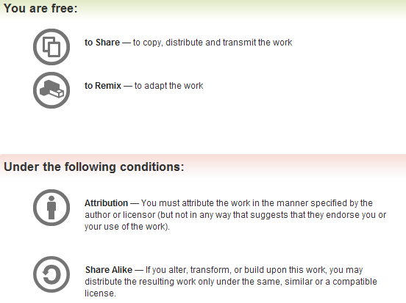
All materials is licensed under a Creative Commons “Share Alike” license.
http://creativecommons.org/licenses/by-sa/3.0/
Attribution condition: You must indicate that derivative work
"Is derived from Xeno Kovah's 'Intro x86-64’ class, available at http://OpenSecurityTraining.info/IntroX86-64.html”
Notes:
Attribution condition: You must indicate that derivative work
"Is derived from Xeno Kovah's ‘Intro x86-64’ class, available at http://OpenSecurityTraining.info/IntroX86-64.html"

Slide 3
Guess what? I have repeatedly misled you!
Simplification is misleading
Time to learn the fascinating truth…
Time to RTFM!

Slide 4
Read The Fun Manuals
http://www.intel.com/products/processor/manuals/
Vol.1 is a summary of life, the universe, and everything about x86
Vol. 2a & 2b explains all the instructions
Vol. 3a & 3b are all the gory details for all the extra stuff they’ve added in over the years (MultiMedia eXtentions - MMX, Virtual Machine eXtentions - VMX, virtual memory, 16/64 bit modes, system management mode, etc)
Reminder, we’re using the pre-downloaded May 2012 version as the standardized reference throughout this class so we’re all looking at the same information
We’ll only be looking at Vol. 2a & 2b in this class
Notes:
Googling is fine to start with, but eventually you need to learn to read the manuals to get the details from the authoritative source

Slide 5
Interpreting the Instruction Reference Pages
The correct way to interpret these pages is given in the Intel Manual 2a, section 3.1
I will give yet another simplification
Moral of the story is that you have to RTFM to RTFM ;)

Slide 6
Here’s what I said:
AND - Logical AND
Destination operand can be r/mX or register
Source operand can be r/mX or register or immediate (No source and destination as r/mXs at the same time)
and al, bl
and al, 0x42
 | 00110011b (al - 0x33)
AND | 01010101b (bl - 0x55)
result | 00010001b (al - 0x11)
 | 00110011b (al - 0x33)
AND | 01000010b (imm - 0x42)
result | 00000010b (al - 0x02)

Slide 7
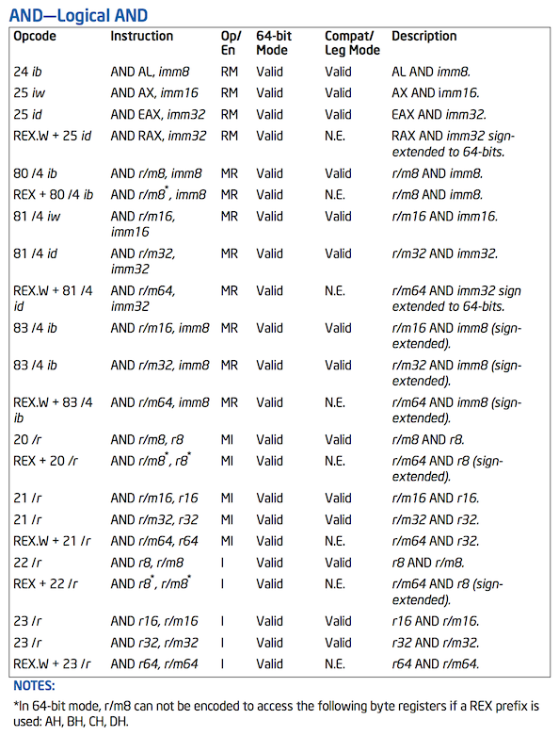
Here’s what the manual says:

Slide 8
Opcode Column
Represents the literal byte value(s) which correspond to the given instruction
In this case, if you were to see a 0x24 followed by a byte or 0x25 followed by 4 bytes, you would know they were specific forms of the AND instruction.
Subject to correct interpretation under x86’s multi-byte opcodes as discussed later.
See Intel Vol. 2a section 3.1.1.1 (“Opcode Column in the Instruction Summary Table”)

Slide 9
If it was 0x25, how would you know whether it should be followed by 2 bytes (imm16) or 4 bytes (imm32)? Because the same single opcode byte is used for both, the length of the operand depends on if the processor is in 16-bit, 32-bit, or 64-bit mode. Each mode has a default operand size (i.e. the size of the value).
For 64-bit mode, the default operand size is 32-bits for most instructions and the default address size is 64-bits
This means the default interpretation will usually be the ones with the r/m32, r32, imm32, or in this case a specific register like EAX
Notes:
There are many instructions which are “overloaded” with equivalent 16 bit and 32 bit versions shown in the manual.

Slide 10
Opcode Column
In some cases the operand or address size can be overridden with special prefix bytes that come before the regular instruction opcode
There are REX prefixes, address size prefixes, and operand size prefixes
Will not go into detail for all of them, but the REX.W byte shown in this example (0x48) will cause the instruction to use 64-bit operands if in 64-bit mode (rather than 32-bit operands)
Therefore, to encode this instruction to use 64-bit operands (RAX in this case), the code would have byte sequence 0x48 0x25 …
Notes:
There are many instructions which are “overloaded” with equivalent 16 bit and 32 bit versions shown in the manual.

Slide 11
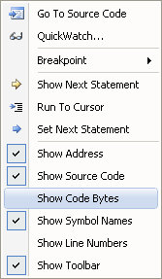
Opcode Column
How to see the opcodes in VisualStudio:
Seeing the exact opcode will
help confirm the exact version of an
Instruction
(to show bytes in gdb, use:
disassemble/r optionally passing
an address to disassemble at)

Slide 12
Instruction Column
The human-readable mnemonic which is used to represent the instruction.
This will frequently contain special encodings such as the “r/mX format” which I’ve previously discussed
See Intel Vol. 2a section 3.1.1.3 (Instruction Column in the Opcode Summary Table)

Slide 13
Should be I, fixed in latest
Should be RI, fixed in latest
Operand Encoding Column
This column was added in more recent manuals. I would find it more useful it there weren’t so many errors :-/
Should allow for imm8/16/32, not fixed in latest
See Intel Vol. 2a section 3.1.1.4

Slide 14
64bit Column
Whether or not the opcode is valid in 64 bit mode.

Slide 15
Compatibility/Legacy Mode Column
Whether or not the opcode is valid in 32/16 bit code.
The N.E. Indicates an an instruction encoding which is only encodable in 64-bit mode
See Intel Vol. 2a section 3.1.1.5
“64/32-bit Mode Column in the Instruction Summary Table”

Slide 16
Description Column
Simple description of the action performed by the instruction
Typically this just conveys the flavor of the instruction, but the majority of the details are in the main description text
See Intel Vol. 2a section 3.1.1.7
“Description Column in the Instruction Summary Table”

Slide 17
Further AND variations
Looking at some other forms, we now see those “r/mX” things I told you about
We know that for instance it can start with an 0x80, and end with a byte, but what’s that /4?
Unfortunately the explanation goes into too much detail for this class. Generally the only people who need to know it are people who want to write disassemblers. But I still put it in the Intermediate x86 class :)
The main thing you need to know is that any time you see a r/mX, it can be either a register or memory value.

Slide 18
AND Details
Description
“Performs a bitwise AND operation on the destination (first) and source (second) operands and stores the result in the destination operand location. The source operand can be an immediate, a register, or a memory location; the destination operand can be a register or a memory location. (However, two memory operands cannot be used in one instruction.) Each bit of the result is set to 1 if both corresponding bits of the first and second operands are 1; otherwise, it is set to 0.
This instruction can be used with a LOCK prefix to allow the it to be executed atomically.”
Flags effected
“The OF and CF flags are cleared; the SF, ZF, and PF flags are set according to the result. The state of the AF flag is undefined.”

Slide 19
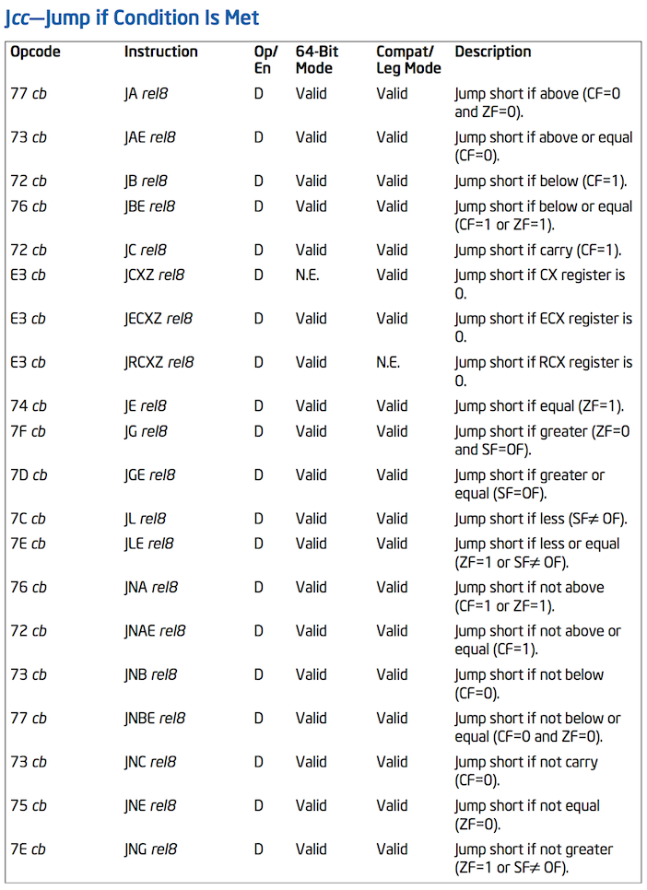

Slide 20
Jcc Revisited
If you look closely, you will see that there are multiple mnemonics for the same opcodes
0x77 = JA - Jump Above
0x77 = JNBE - Jump Not Below or Equal
0x74 = JE / JZ - Jump Equal / Zero
Which mnemonic is displayed is disassembler-dependent

Slide 21
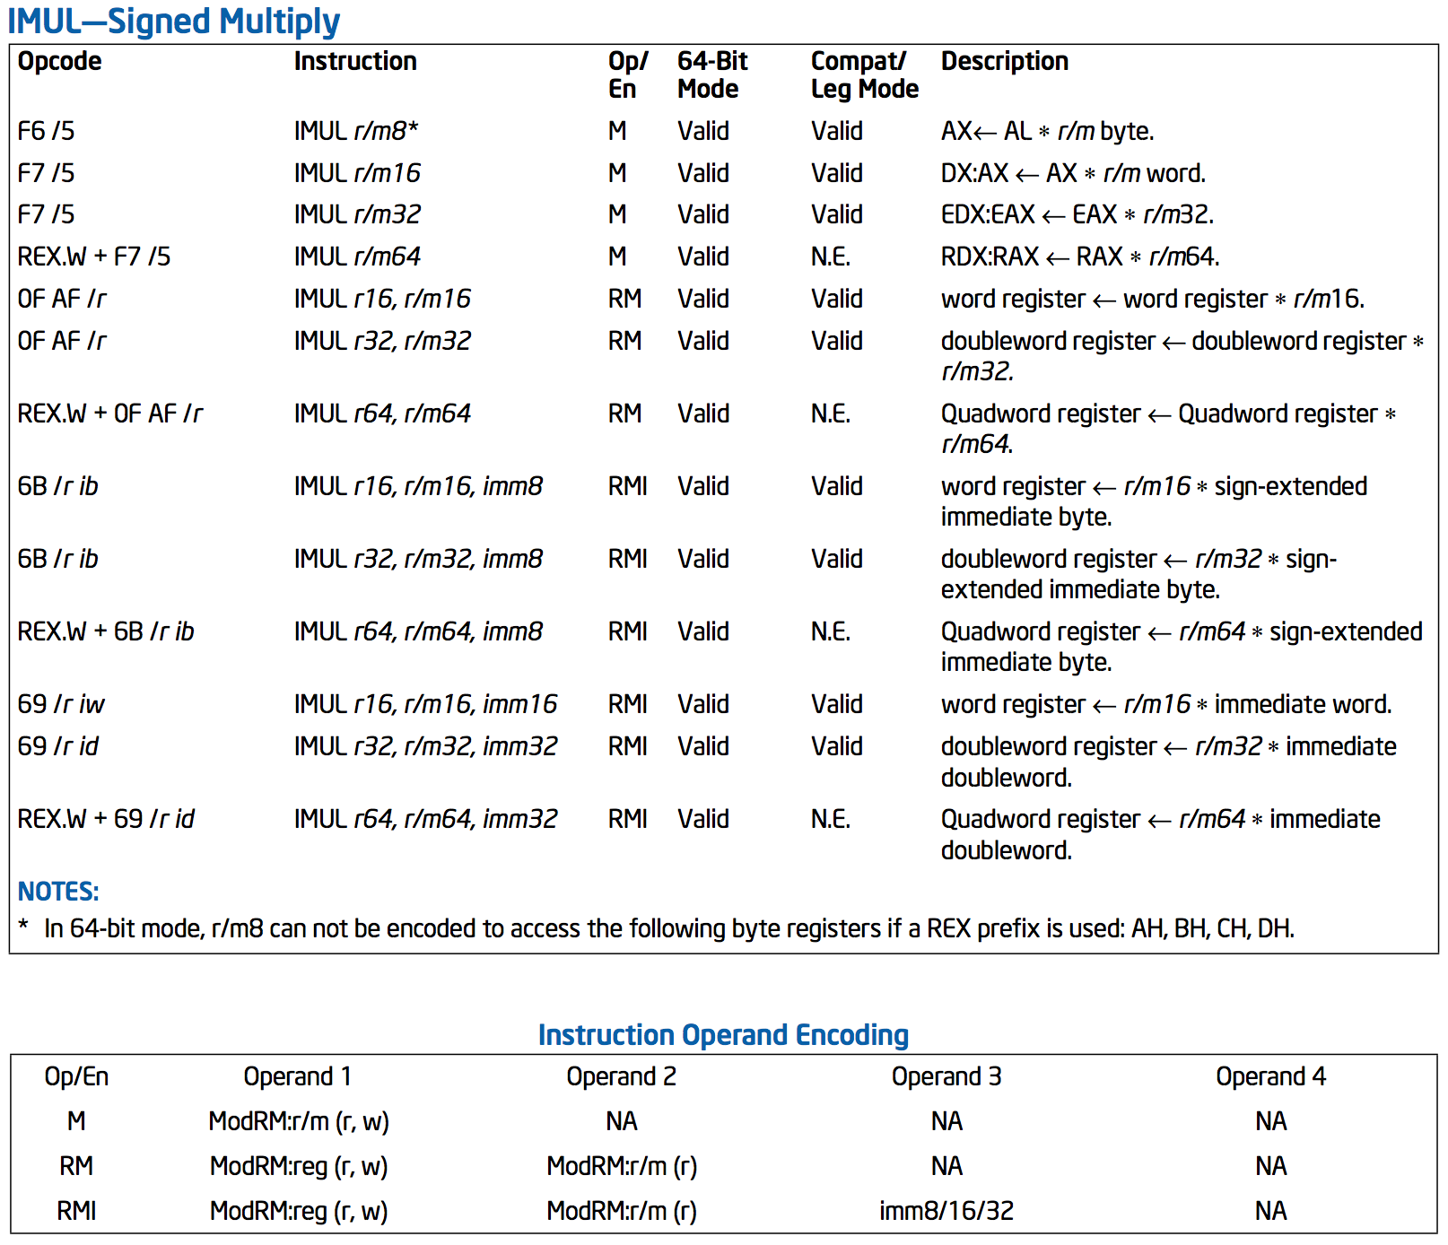

Slide 22
IMUL Revisited
Scavenger hunt: for “extra credit” (i.e. getting credited in the slides ;)) find me another “basic” instruction, that’s not part of a special add-on instruction set (like VMX, SMX, MMX, SSE*, AES, AVX, etc) and isn’t a floating point instruction, which uses >= 3 operands
hint: if you see a “CPUID feature flag” column, it means it’s a special instruction set

