Slide 1
Introduction to Intel x86-64 Assembly, Architecture, Applications, & Alliteration
Xeno Kovah – 2014
xkovah at gmail

Slide 2
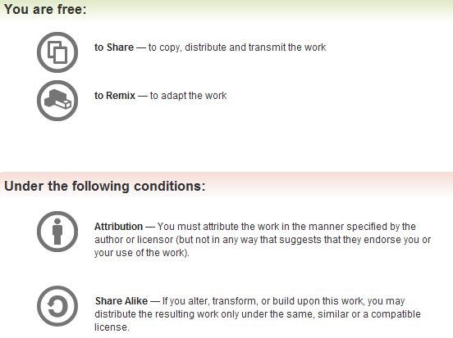
All materials is licensed under a Creative Commons “Share Alike” license.
http://creativecommons.org/licenses/by-sa/3.0/
Attribution condition: You must indicate that derivative work
"Is derived from Xeno Kovah's 'Intro x86-64’ class, available at http://OpenSecurityTraining.info/IntroX86-64.html”
Notes:
Attribution condition: You must indicate that derivative work
"Is derived from Xeno Kovah's ‘Intro x86-64’ class, available at http://OpenSecurityTraining.info/IntroX86-64.html"

Slide 3
Discussion: variable-length opcodes
Any given sequence of bytes can be interpreted in different ways, depending on where the CPU starts executing it from
This has many subtle implications, but it seems to get abused the most in the security domain
Examples: inability to validate intended instructions, return-oriented-programming, code obfuscation and polymorphic/self-modifying code
In comparison, RISC architectures typically have fixed instruction sizes, which must be on aligned boundaries, and thus makes disassembly much simpler

Slide 4
Variable-length opcode decoding example
(gdb) x/10i $rip
0x4004ed <main>: push %rbp
0x4004ee <main+1>: mov %rsp,%rbp
0x4004f1 <main+4>: movl $0xdeadbeef,-0x4(%rbp)
0x4004f8 <main+11>: mov -0x4(%rbp),%eax
0x4004fb <main+14>: mov %eax,%eax
0x4004fd <main+16>: mov %eax,%eax
0x4004ff <main+18>: mov %eax,-0x4(%rbp)
0x400502 <main+21>: pop %rbp
0x400503 <main+22>: retq
(gdb) x/10i $rip+9
0x4004f6 <main+9>: lods %ds:(%rsi),%eax
0x4004f7 <main+10>: fimul -0x3f7603bb(%rbx)
0x4004fd <main+16>: mov %eax,%eax
0x4004ff <main+18>: mov %eax,-0x4(%rbp)
0x400502 <main+21>: pop %rbp
0x400503 <main+22>: retq
(gdb) x/10i $rip+3
0x4004f0 <main+3>: in $0xc7,%eax
0x4004f2 <main+5>: rex.RB cld
0x4004f4 <main+7>: out %eax,(%dx)
0x4004f5 <main+8>: mov $0x458bdead,%esi
0x4004fa <main+13>: cld
0x4004fb <main+14>: mov %eax,%eax
0x4004fd <main+16>: mov %eax,%eax
0x4004ff <main+18>: mov %eax,-0x4(%rbp)
0x400502 <main+21>: pop %rbp
0x400503 <main+22>: retq
(gdb) x/10i $rip+15
0x4004fc <main+15>: rorb $0x5d,-0x3ba7640(%rcx)
0x400503 <main+22>: retq
Notes:
x86 has been called “self-synchronizing” because it does eventually seem to get back to the correct asm. That’s not a useful property for execution, only for disassemblers trying to speculate on a correct disassembly.

Slide 5
Discussion: variable-length opcodes
An interesting property of x86 is that even if you pick a wrong offset to start disassembling from, very frequently the disassembly will re-synchronize with the original, intended, instruction sequence
In the preceding examples you can see that when disassembly is started at +3 bytes in, it re-synchs by +14 bytes. When started at +9, it re-synchs by +16, etc.
This was noted also in “Obfuscation of Executable Code to Improve Resistance to Static Disassembly” by Linn & Debray
  http://www.cs.arizona.edu/solar/papers/CCS2003.pdf

