Slide 1
Introduction to Intel x86-64 Assembly, Architecture, Applications, & Alliteration
Xeno Kovah – 2014
xkovah at gmail

Slide 2
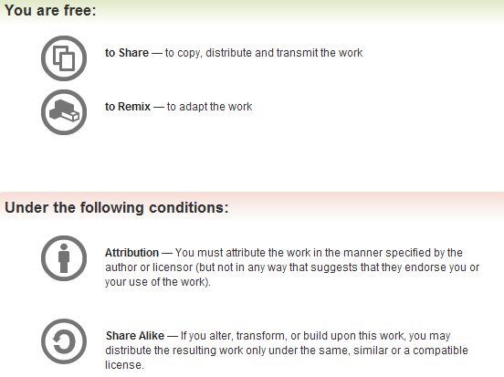
All materials is licensed under a Creative Commons “Share Alike” license.
http://creativecommons.org/licenses/by-sa/3.0/
Attribution condition: You must indicate that derivative work
"Is derived from Xeno Kovah's 'Intro x86-64’ class, available at http://OpenSecurityTraining.info/IntroX86-64.html”
Notes:
Attribution condition: You must indicate that derivative work
"Is derived from Xeno Kovah's ‘Intro x86-64’ class, available at http://OpenSecurityTraining.info/IntroX86-64.html"

Slide 3
Effects of Compiler Options
Our standard build
main:
140001000 sub rsp,38h
140001004 mov eax,1
140001009 imul rax,rax,27h
14000100D mov byte ptr [rsp+rax],2Ah
140001011 mov eax,0B100Dh
140001016 add rsp,38h
14000101A ret
//Example8.c
int main(){
char buf[40];
buf[39] = 42;
return 0xb100d;
}

Slide 4
Effects of Compiler Options 2
/O1 (minimum size) or
/O2 (maximum speed)
Debug information format
Disabled (viewed from WinDbg) or
/Z7 (C7 Compatible)
(no change)
main:
140001000 mov eax,0B100Dh
140001005 ret
main:
140001000 sub rsp,38h
140001004 mov eax,1
140001009 imul rax,rax,27h
14000100D mov byte ptr [rsp+rax],2Ah
140001011 mov eax,0B100Dh
140001016 add rsp,38h
14000101A ret

Slide 5
Effects of Compiler Options 3
/GS - Buffer Security Check (default enabled nowadays)
aka “stack cookies” (MS term)
aka “stack canaries” (original research term)
main:
140001000 sub rsp,38h
140001004 mov rax,qword ptr [__security_cookie (0140004000h)]
14000100B xor rax,rsp
14000100E mov qword ptr [rsp+28h],rax
140001013 mov eax,1
140001018 imul rax,rax,27h
14000101C mov byte ptr [rsp+rax],2Ah
140001020 mov eax,0B100Dh
140001025 mov rcx,qword ptr [rsp+28h]
14000102A xor rcx,rsp
14000102D call __security_check_cookie (0140001190h)
140001032 add rsp,38h
140001036 ret

Slide 6
Book p. 369
Effects of source options
/O1 optimization when the volatile keyword is present
main:
140001000 sub rsp,38h
140001004 mov eax,1
140001009 imul rax,rax,27h
14000100D mov byte ptr [rsp+rax],2Ah
140001011 mov eax,0B100Dh
140001016 add rsp,38h
14000101A ret
int main(){
volatile char buf[40];
buf[39] = 42;
return 0xb100d;
}
main:
140001000 sub rsp,38h
140001004 mov byte ptr [rsp+27h],2Ah
140001009 mov eax,0B100Dh
14000100E add rsp,38h
140001012 ret
This is a trick I picked up from a 2009 Defcon presentation
http://www.defcon.org/images/defcon-17/dc-17-presentations/defcon-17-sean_taylor-binary_obfuscation.pdf
He also talked a little bit about control flow flattening which is covered in an academic paper in the “Messing with the disassembler” section.

