Slide 1
Introduction to Intel x86-64 Assembly, Architecture, Applications, & Alliteration
Xeno Kovah – 2014
xkovah at gmail

Slide 2
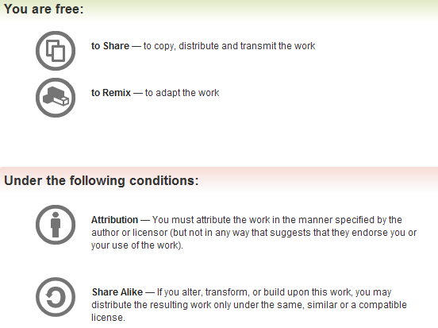
All materials is licensed under a Creative Commons “Share Alike” license.
http://creativecommons.org/licenses/by-sa/3.0/
Attribution condition: You must indicate that derivative work
"Is derived from Xeno Kovah's 'Intro x86-64’ class, available at http://OpenSecurityTraining.info/IntroX86-64.html”
Notes:
Attribution condition: You must indicate that derivative work
"Is derived from Xeno Kovah's ‘Intro x86-64’ class, available at http://OpenSecurityTraining.info/IntroX86-64.html"

Slide 3
Are you ready to feel the POWER (buffer over)flow through you?!?!
53
Notes:
http://img3.wikia.nocookie.net/__cb20090813201436/starwars/images/1/17/Naga_Sadow_WotC.jpg

Slide 4
BasicBufferOverflow.c:
Don’t be lame! Force it to call AwesomeSauce()!
#include <stdio.h>
#include <stdlib.h>
#include <string.h>
int lame(__int64 value){
__int64 array1[4];
__int64 array2[4];
array2[0] = array2[1] = array2[2] = array2[3] = value;
memcpy(&array1, &array2, 4 * sizeof(__int64));
return 1;
}
int lame2(__int64 size, __int64 value){
__int64 array1[4];
__int64 array2[4];
array2[0] = array2[1] = array2[2] = array2[3] = value;
memcpy(&array1, &array2, size * sizeof(__int64));
return 1;
}
void AwesomeSauce(){
printf("Awwwwwww yeaaahhhhh! All awesome, all the time!\n");
}
int main(unsigned int argc, char ** argv){
__int64 size, value;
size = _strtoi64(argv[1], "", 10);
value = _strtoi64(argv[2], "", 16);
if(!lame(value) || !lame2(size,value)){
AwesomeSauce();
}
else{
printf("I am soooo lame :(\n");
}
return 0xdeadbeef;
}
Awesome
53
Notes:
http://www.tropicaltraditions.com/images/organic_applesauce.jpg

Slide 5
HINT!
Seriously though, make a stack diagram, it will help…
Notes:
http://i2.kym-cdn.com/photos/images/newsfeed/000/127/137/TrollQuote.JPG

Slide 6
Lab time!
53
Notes:
http://www.myteespot.com/images/Images_d/img_fAauYb.jpg

Slide 7
Solution
Simple, right? :)
53

Slide 8
The stack looks like this at line 9 in lame() before the memcpy():
00000000`0012FE80 | arg1 = ecx = value
00000000`0012FE78 | return address = 00000001400010f0
00000000`0012FE70 | undef
00000000`0012FE68 | array2[3] = undef
00000000`0012FE60 | array2[2] = undef
00000000`0012FE58 | array2[1] = undef
00000000`0012FE50 | array2[0] = undef
00000000`0012FE48 | array1[3] = value
00000000`0012FE40 | array1[2] = value
00000000`0012FE38 | array1[1] = value
00000000`0012FE30 | array1[0] = value
RSP+0x20

Slide 9
The stack looks like this at line 10 in lame() after the memcpy():
00000000`0012FE80 | arg1 = ecx = value
00000000`0012FE78 | return address = 00000001400010f0
00000000`0012FE70 | undef
00000000`0012FE68 | array2[3] = value
00000000`0012FE60 | array2[2] = value
00000000`0012FE58 | array2[1] = value
00000000`0012FE50 | array2[0] = value
00000000`0012FE48 | array1[3] = value
00000000`0012FE40 | array1[2] = value
00000000`0012FE38 | array1[1] = value
00000000`0012FE30 | array1[0] = value
RSP+0x20

Slide 10
The stack looks like this at line 17 in lame2() before the memcpy():
addresses look familiar?
00000000`0012FE80 | arg1 = ecx = value
00000000`0012FE78 | return address = 00000001400010f0
00000000`0012FE70 | undef
00000000`0012FE68 | array2[3] = “undef” but still actually = value
00000000`0012FE60 | array2[2] = “undef” but still actually = value
00000000`0012FE58 | array2[1] = “undef” but still actually = value
00000000`0012FE50 | array2[0] = “undef” but still actually = value
00000000`0012FE48 | array1[3] = value
00000000`0012FE40 | array1[2] = value
00000000`0012FE38 | array1[1] = value
00000000`0012FE30 | array1[0] = value
RSP+0x20

Slide 11
The stack looks like this at line 17 in lame2() before the memcpy():
addresses look familiar?
00000000`0012FE80 | arg1 = ecx = value
00000000`0012FE78 | return address = value! WINNER!
00000000`0012FE70 | value
00000000`0012FE68 | array1[3] = value
00000000`0012FE60 | array1[2] = value
00000000`0012FE58 | array1[1] = value
00000000`0012FE50 | array1[0] = value
00000000`0012FE48 | array1[3] = value
00000000`0012FE40 | array1[2] = value
00000000`0012FE38 | array1[1] = value
00000000`0012FE30 | array1[0] = value
So set the size to 6 QWORDs to copy, and set the value to the address of AwesomeSauce() and collect your winner winner chicken dinner!
RSP+0x20

Slide 12
Exploit mitigations
This is a good example of how MS’s compiler has exploit mitigations baked in.
I was trying to just take my old, simple, and explicitly exploitable piece of code and port it to x86-64.
But when I would put my buffers so that the big one would overwrite the small one, it placed the big buffer next to the stack pointer.
This is smart since presumably writes will tend to be from the small to the big. But even if it’s from the big to the small, it still won’t naturally overflow into the stack pointer with contents from the buffer

Slide 13
Exploit mitigations 2
params
params
params
params
params
params
return address
return address
return address
return address
return address
big buffer
big buffer
big buffer
big buffer
big buffer
big buffer
return address
small buffer
small buffer
big buffer
big buffer
small buffer
small buffer
small buffer
small buffer
small buffer
http://msdn.microsoft.com/en-us/library/bb430720.aspx

Slide 14
True power can not be had so simply, novice…
NX, ASLR, SEHOP…all these would stand in your way.
For a taste of true power, you must start start down a different path…a darker path
http://opensecuritytraining.info/Exploits1.html
Notes:
http://img3.wikia.nocookie.net/__cb20090813201436/starwars/images/1/17/Naga_Sadow_WotC.jpg

