Slide 1
Introduction to Intel x86-64 Assembly, Architecture, Applications, & Alliteration
Xeno Kovah – 2014
xkovah at gmail

Slide 2
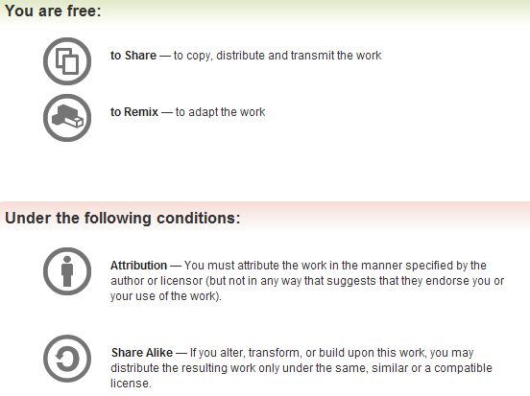
All materials is licensed under a Creative Commons “Share Alike” license.
http://creativecommons.org/licenses/by-sa/3.0/
Attribution condition: You must indicate that derivative work
"Is derived from Xeno Kovah's 'Intro x86-64’ class, available at http://OpenSecurityTraining.info/IntroX86-64.html”
Notes:
Attribution condition: You must indicate that derivative work
"Is derived from Xeno Kovah's ‘Intro x86-64’ class, available at http://OpenSecurityTraining.info/IntroX86-64.html"

Slide 3
Wrap up - instructions
Learned around 30 instructions and variations
About half are just math or logic operations
NOP
PUSH/POP
CALL/RET
MOV/MOVZX/MOVSX/LEA
ADD/SUB
IMUL/DIV/IDIV
JMP/Jcc (family)
CMP/TEST
AND/OR/XOR/NOT
INC/DEC
SHR/SHL/SAR/SAL
REP STOS/REP MOVS
53

Slide 4
Wrap up
Learned about the basic hardware registers and how they’re used
Learned about how the stack is used
Saw how C code translates to assembly
Learned basic usage of compilers, disassemblers, and debuggers so that assembly can easily be explored
Learned about Intel vs AT&T asm syntax
Learned how to RTFM
Learned that classes that claim to teach you hacking/RE in a couple days are selling the illusion of understanding. An illusion which soon fades.

Slide 5
Notes:
http://www.geofftaylor-artist.com/system/files/imagecache/normal/covers/wells_hg-shape_of_things_to_come.jpg

Slide 6
The shape of things to come
How does a system map a limited amount of physical memory to a seemingly unlimited amount of virtual memory?
How does debugging actually work? How can malware detect your debugger and alter its behavior?
How is “user space” actually separated from “kernel space”? I’ve heard there’s “rings”, but where are these fabled rings actually at?
What if I want to talk to hardware beyond the CPU?
Intermediate x86 has it all!
http://opensecuritytraining.info/IntermediateX86.html
Notes:
http://www.geofftaylor-artist.com/system/files/imagecache/normal/covers/wells_hg-shape_of_things_to_come.jpg

Slide 7
Keep skilling up! Climb the r0x0r skill tree!
Take this class and teach others!
Contribute a new class in your expertise area!

Slide 8
Use these skills towards the hardest game in town: defense!
Learn what trusted computing technologies can (and can’t) offer!

Slide 9
Or suit up just because it’s the hardcore thing to do!

Slide 10

56

