Slide 1
Introduction
Vulnerability Assessment Course

Slide 2
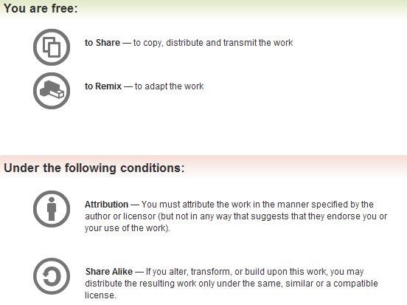
All materials are licensed under a Creative Commons “Share Alike” license.
http://creativecommons.org/licenses/by-sa/3.0/

Slide 3
Agenda
Administrivia
Introductions
Course Description
Course Goals
Prerequisites
Course Outline
Expectations
3

Slide 4


Administrivia
Please silence all cell phones
Avoid other distractions while in class
Do not practice what you learn here in any other network without appropriate permissions
Questions...
4

Slide 5
Introductions
Name
Relevant Experience
Expectations
5

Slide 6
Course Description
Purpose
  Overview of Vulnerability Assessment practices
  Basic tools and techniques used to test technical security controls implemented within an information system or network infrastructure
Present a standard methodology for conducting vulnerability assessments
How to identify vulnerabilities in a networked environment; examine the configuration of networking devices, critical services, operating systems, and databases; and test the security controls implemented in a Web-based application
Course will also discuss the impact of vulnerabilities and recommended methods of mitigation
Course contains some hands-on exercises
6

Slide 7
Course Objectives
Learning a general methodology for conducting assessments
Scanning and mapping network topology
Identifying listening ports/services on hosts
Fingerprinting operating systems remotely
Conducting automated vulnerability scans
Auditing router, switch, and firewall security
Auditing UNIX and Windows configuration and security
Performing Web application and associated database security assessments
7

Slide 8
Prerequisites
Participants should have...
A good understanding of the UNIX operating system
A good understanding of Windows operating systems
A good understanding of networking
A good understanding of computer and/or network security
8

Slide 9

Target Audience
People who wish to increase their understanding and skills in vulnerability assessment processes and techniques
9

Slide 10
Day One - Monday
Time | Subject | Instructor
0830-0900 | Introduction
0915-1000 | Terms, Methods, Preparations
1015-1100 | Findings
1100-1200 | Lunch
1200-1400 | Tools
1415-1630 | Unix OS Assessment
10

Slide 11
Day Two - Tuesday
Time | Subject | Instructor
0830-1200 | Windows OS Assessment
1200-1300 | Lunch
1300-1630 | Network Devices/Services
11

Slide 12
Day Three - Wednesday
Time | Subject | Instructor
0830-1200 | Applications Assessment
1200-1300 | Lunch
1300-1500 | DB Assessment
1515-1600 | Best Practices
12

Slide 13
Expectations
A three-day course consisting of:
  Lectures and discussion designed to introduce the conceptual approach to vulnerability assessment
  Supporting laboratory time to introduce various tools and techniques used to identify common vulnerabilities and mis-configurations
Successful participation in this course requires the student to complete hands-on exercises
This is not a hacker’s course
13

Slide 14

Questions
14

