Slide 1
Findings
Vulnerability Assessment Course

Slide 2
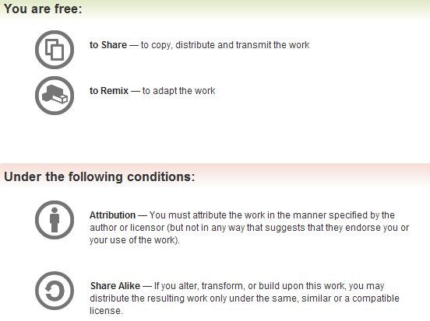
All materials are licensed under a Creative Commons “Share Alike” license.
http://creativecommons.org/licenses/by-sa/3.0/

Slide 3
Agenda
Developing the perfect finding
Describing the Finding
Describing the Impact of the Vulnerability
Providing Actionable Recommendations
Characterizing the Finding

Slide 4
The Perfect Finding
Several different formats
All typically provide three essential elements
  Description
  Impact
  Recommendation
Optional characterizations
  Risk Level
  Ease of Fix
  Level of Effort
Other Information

Slide 5
Description
The observation
Describe the vulnerability, mis-configuration, or compliance issue that was observed
How was the observation made?
  Analysis of script output
  Results of automated scanning
  Manipulation of parameters
Affected systems
Provide enough information that the finding can be duplicated or retested

Slide 6
Impact
Provide enough information to define the risk to the system or its components if the vulnerability is exploited
Address important information security concerns
  Confidentiality
  Integrity
  Availability
Dependency on other conditions
Transitive risk
Describe the negative affect if the finding is left uncorrected

Slide 7
Recommendation
Provide detailed actionable remediation
Eradication versus Mitigation
Provide alternatives if they are available
Only the System Approving Authority can accept risk

Slide 8
Characterizations
Characterizations provide a means for prioritization, grouping, and management
Risk Level (or Severity Code)
Ease of Fix
Estimated Work Effort
Other useful descriptors and tags

Slide 9
Risk Level – Federal Civil Agencies
The Risk Level is, in actuality, an assessment of the priority with which each Business Risk shall be viewed
The Risk Level takes into account many factors including information at risk, ease of exploitation, exposure level of the vulnerability, and other situational factors
High
Moderate
Low

Slide 10
High Risk Level
Exploitation of the technical or procedural vulnerability will cause substantial harm
Significant political, financial, and/or legal damage is likely to result
The threat exposure is high, thereby increasing the likelihood of occurrence
Security controls are not effectively implemented to reduce the severity of impact if the vulnerability was exploited
Vulnerabilities that allow an attacker immediate access into a machine, allow privileged access, or bypass a firewall
Vulnerabilities that provide information that has a high potential of giving access to an intruder

Slide 11
Moderate Risk Level
Exploitation of the technical or procedural vulnerability will significantly impact the confidentiality, integrity, and/or availability of the system, application, or data
Exploitation of the vulnerability may cause moderate financial loss or public embarrassment
The threat exposure is moderate-to-high, thereby increasing the likelihood of occurrence
Security controls are in place to contain the severity of impact if the vulnerability were exploited, such that further political, financial, or legal damage will not occur
Vulnerabilities that provide information that potentially could lead to compromise
The vulnerability is such that it would otherwise be considered High Risk, but the threat exposure is so limited that the likelihood of occurrence is minimal

Slide 12
Low Risk Level
Exploitation of the technical or procedural vulnerability will cause minimal impact to operations
The Confidentiality, Integrity and Availability (CIA) of sensitive information are not at risk of compromise
Exploitation of the vulnerability may cause slight financial loss or public embarrassment
The threat exposure is moderate-to-low
Security controls are in place to contain the severity of impact if the vulnerability were exploited, such that further political, financial, or legal damage will not occur
Vulnerabilities, when resolved, will prevent the possibility of degraded security
The vulnerability is such that it would otherwise be considered Moderate Risk, but the threat exposure is so limited that the likelihood of occurrence is minimal

Slide 13
Ease of Fix
The Ease of Fix value is an assessment of how difficult or easy it will be to complete reasonable and appropriate corrective actions required to close or reduce the impact of the vulnerability
Easy
Moderately Difficult
Very Difficult
No Known Fix

Slide 14
Estimated Work Effort
The Estimated Work Effort value is an assessment of the extent of resources required to complete reasonable and appropriate corrective actions
Minimal
Moderate
Substantial
Unknown

Slide 15
Other Information
Security Reference
Source of the finding
Numbering scheme
Status

Slide 16

Questions

