Slide 1
Vulnerability Assessment Tools
Vulnerability Assessment Course

Slide 2
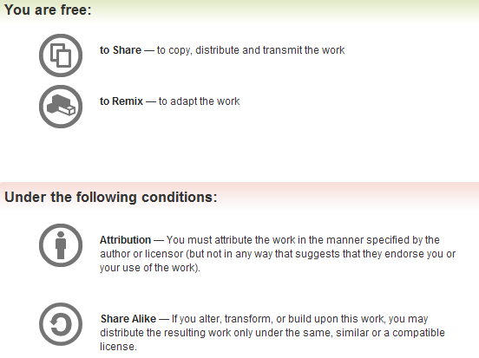
All materials are licensed under a Creative Commons “Share Alike” license.
http://creativecommons.org/licenses/by-sa/3.0/

Slide 3
Agenda
Introduction to Backtrack Linux
Lab
Monitoring Network Traffic
Tcpdump: lab
Wireshark: lab
Host and service enumeration
Nmap: lab
Vulnerability scanning
Nessus: lab

Slide 4
Disclaimer
The tools herein should be “safe” when used properly
But unsafe under certain conditions
Even a “safe mode” vulnerability scanner can crash a host or firewall
Do not try on any system or network without approval!
If you want to practice any techniques
Do it at home at your own risk!
Using resources that don’t belong to someone else
YOU HAVE BEEN WARNED!

Slide 5
Vuln-Assessment Tools: Getting Started

Slide 6
Initiating Lab Setup
Your lab workstation is running VMware on Windows
This is so you can run and use multiple different “machines”
One of your lab workstation VM images is BackTrack Linux
One of your lab workstation VM images is Windows XP
One of your lab workstation VM images is Solaris (UNIX)
Crank up your lab workstation, start the BackTrack image

Slide 7
Testing Backtrack
Did BackTrack Linux launch okay?
Do you have a UNIX command prompt?
Do you see an XWindows graphic (windows) interface?
When you type “ifconfig –a”, do you have an IP address?
Try pinging your own IP address (“ping x.x.x.x”)
Then try pinging a neighbor’s IP address “ping y.y.y.y”)
DO *NOT* SCAN OR ATTACK OTHER
LAB MACHINES UNLESS TOLD TO DO SO

Slide 8
Backtrack Lab
Play around with the BackTrack Linux interface + windows
Try clicking bottom left corner (like Windows “Start” Menu)
Navigate through the various menus and utilities
Pay particular attention to the “BackTrack Utilities” menu
If you want to experiment with a utility, now is a good time
BREAK TIME – keep playing around or take a breather

Slide 9
Sniffing Traffic with tcpdump

Slide 10
Introduction
Tcpdump is the de facto tool for recording network traffic
Available on Linux, BSD, other *nixes
Solaris (Sun UNIX) uses both ‘tcpdump’ and ‘snoop’ (older)
A “packet sniffer” collects/analyze packets from a network
Generally works by putting NIC in “promiscuous mode”
Typically my network-card ignores traffic not meant for me
But in ‘promiscuous mode’ whatever I see I collect/record
IMPORTANT DISTINCTION HERE: “hub” versus “switch”
[will impact your sniffing/traffic-collection results]
Several different formats for recorded traffic data
[.pcap (“packet-capture”) format seems to be universal]

Slide 11
Modes Of Operation
Packet Logging Mode
Writing packets to a file on disk (or a Unix pipe)
Good for record-keeping, good for later analysis
Traffic Analysis Mode
Header analysis
Displays many details of each packet’s header, layers 1-4
Full packet capture analysis
Also records packet contents, payload, application-type, flags, etc.
Generally used for diagnosing network issues
Recording your OWN assessment traffic = Good Idea
Sort of a chain-of-custody issue…could keep you out of jail
Write all network traffic to a file (see following slides on how)

Slide 12
Tcpdump -- Options
By default tcpdump captures the first 68 bytes of a packet
This can be adjusted…“tcpdump –s 25” “tcpdump –s 128”
“tcpdump –s 0” will capture the *entire* packet (all bytes)
Reverse DNS-resolution (IP → name) can be slow/stressful
“tcpdump –n” will list IP addresses only, not resolve names (faster)
You can view tcpdump packet data in hexadecimal or ASCII
“tcpdump –X” will let you see the data both ways
If you have multiple NICs, tell tcpdump which to sniff on
“tcpdump –i eth0” is one example [will listen to eth0]

Slide 13
Capture Filters
This is similar to a search filter… “only what I want to sniff”
Can filter various packet flags, packet fields
Can filter “only show traffic from specific IP addresses”
Can filter “only show traffic going to specific IP addresses”
Can filter “only show traffic from specific MAC addresses”
Can filter “only show traffic which contains the number 15”
Can filter “only show port 80 traffic”
Can filter “only show HTTP protocol traffic”
Can combine these with AND, OR
These filters almost get to be like programming languages

Slide 14
Capture Filters – Examples
Addresses
host 10.10.10.1
src host 192.168.1.1
dst host zeus
ether src AA:BB:CC:DD:EE:FF
dst net 192.168.0.0
Port Numbers
port 22
tcp dst port 8080

Slide 15
Capture Filters – More Examples
Operators
dst host 10.10.10.1 and not tcp port 22
host bilbo and ( cheiron or nettos )
Protocol keywords
TCP flags: tcp-syn, tcp-ack, tcp-fin, etc.
ICMP: icmp-echoreply, icmp-unreach
Used as an offset
tcp[tcpflags] & ( tcp-syn|tcp-fin ) != 0
icmp[icmptype] = icmp-echoreply

Slide 16
Interpreting Tcpdump Output
15:39:05.435985 < nettos.1264 > zeus.ftp: S 2138865536:2138865536(0) win 65535 <mss 1460,nop,nop,sackOK> (DF)
15:39:05.511620 < zeus.ftp > nettos.1264: S 4198232748:4198232748(0) ack 2138865537 win 5840 <mss 1460,nop,nop,sackOK> (DF)
15:39:05.511632 < nettos.1264 > zeus.ftp: . 1:1(0) ack 1 win 65535 (DF)
15:39:05.588085 < zeus.ftp > nettos.1264: P 1:62(61) ack 1 win 5840 (DF)
15:39:05.728369 < nettos.1264 > zeus.ftp: . 1:1(0) ack 62 win 65474 (DF)
Connection from nettos to zeus
Three way handshake during first three lines
Note that tcpdump displays *relative* sequence and ack numbers
Followed by some data transfer
Note the Don’t Fragment (DF) bit is set
Full packet capture similar, just provides application data

Slide 17
tcpdump Usage
Typical uses
Diagnosing problems on a network
Capturing packets for later analysis
Keeping a record of network activity during assessments
[your own activity *and* other stuff you see on the network]
Caveats
Don’t over-filter at first…you might miss something
[start broad, then filter in narrow, don’t exclude stuff like ICMP/ping]
Remember your own SSH connection may pollute the tcpdump
[ex: you ssh in, then tcpdump, it shows thousands of port 22]
[prevent this by using ‘not ( tcp port 22 and host <my_own_ip> )’ ]

Slide 18
Lab
Create an account on the demo phpbb server and post the decoded tcdpump output showing your password.
Hints
Use filters like port (possibly 80?), protocol (http?)
-X
Oh you’ll need more then the default number of bytes
Bonus point
Capture your neighbors password :-)

Slide 19
Pointers
http://www.tcpdump.org/
http://netgroup-serv.polito.it/winpcap/
http://www.robertgraham.com/pubs/sniffing-faq.html

Slide 20
Questions
Common tcpdump usage during a assessment:
tcpdump –w outfile.cap –s 1580
Consider running your own tcpdump in a background window
[might show interesting things in later analysis]
[might also serve as valuable evidence if you are accused later]
???

Slide 21
Analyzing Traffic with Wireshark

Slide 22
Welcome to WireShark
Used to be called Ethereal (two products have diverged)
WireShark is a sniffer *and* network protocol analyzer
Handles just about every application you’ve heard of
List at http://www.wireshark.org/faq.html#q1.10
Essentially “the Windows tcpdump” with a useful GUI
WireShark runs on Windows, Linux, BSD, all sorts of platforms
You may find valuable vulnerabilities w. WireShark traffic alone
Allows for capture-filtering, using text expressions or GUI
Like tcpdump, can sniff data “live” or using a capture file
May have trouble handling very large packet-capture files

Slide 23
WireShark – Sample Demo

Slide 24
Wireshark Demo
Start up your lab-workstation BackTrack Linux image
Find WireShark in your application menus, launch it
Click “Start Capture” or “Capture on Interface <whatever>”
Generate your own traffic by pinging other workstations
Generate your own traffic by web-surfing
Generate your own traffic by getting files from FTP server
Stop the capture and see if/how WireShark saw your traffic

Slide 25
WireShark – Display Filters
Boolean syntax
Supported data types
Numeric (integer, float)
String
Boolean
Various addresses (Ethernet, IP, IPX, etc.)
Nearly every tree view is filterable
Similar to the ‘capture filters’ from earlier, but can do more

Slide 26
WireShark – Display Filters (cont.)
GUI Filter Constructor
Filter string can also be crafted by hand
See how WireShark knows the FTP request structure (above)?
Notes:
Here is an example of the detection of rejected FTP connections in data streams. The login failed code is 530, and implementing this filter on a rejected FTP connection will show all failed logins.

Slide 27
WireShark – Decoding Protocols
Notes:
Here is an SMTP connection running through localhost, ultimately to be tunneled over SSH. At first, it does not decode correctly in Ethereal, simply showing you that a TCP connection was established. After decoding with the SMTP decoder, the packets decode correctly and provide quite a bit more information about the application layer protocol.

Slide 28
WireShark – Stream Re-Assembly Plugin
Can rebuild host-to-host conversation from multiple packets
Can be viewed in both ASCII and Hex
Good for analyzing FTP, IM chat, SMTP mail, TELNET, any cleartext

Slide 29
Pointers
http://www.wireshark.org/
http://netgroup-serv.polito.it/winpcap/
http://www.robertgraham.com/pubs/sniffing-faq.html

Slide 30
Break!
Keep playing with WireShark if you like
Ask me whatever questions you like
Go take a breather when you’re done, or to clear your head

Slide 31
Vuln-Assessment: Enumeration, Reconnaissance and Scanning
Notes:
This lecture and lab is on “Network Mapping with SolarWinds” and covers the use of those two tools for the purposes of mapping a network.
The lecture should last approximately an 45 minutes, including demonstrations.
The lab should last approximately half an hour. A 10 minute break will be given between the lecture and the lab.

Slide 32
Overview
Purpose
Why to scan? What to look for? What to ‘enumerate’ ?
What mindset to use while scanning, probing, investigating?
What the does he mean by ‘enumerate’, anyway?
Gain some [brief] exposure to scanning tools, such as NMAP
Format
Discussion of network mapping and surrounding issues
Lecture and demonstration of Nmap, w. specific techniques
Hands-on lab with instructor supervision

Slide 33
Network Mapping
Definition
Collect information on a target network-address range
Learn about (document) visible hosts, devices, protocols
Accurately represent, understand the target for future reference
When we’re done, we should have:
Host IP addresses and MACs of all targets within scope
Operating system versions
Ports, protocols, and (usually) service version information
DO **NOT** BLINDLY TRUST YOUR SCAN RESULTS
These tools are notorious for false positives
What you think you’re seeing may not be reality
Try to corroborate with network maps, host-internal outputs
[ifconfig –a, netstat –a, netstat –an, netstat –rn, other…]
Notes:
Now let’s talk about “Network Mapping” to some degree--what it is, how you can do it, and what we’re really looking for when we’re mapping networks.
I define network mapping as the process of collecting information on a target network address range with regard to visible hosts, devices, and allowable protocols in order to accurately represent and understand the target network for future reference.
Let’s say you have completed preparatory discussions with the target organization for which you are performing a vulnerability assessment. You’ve established what network you will be working with, perhaps identified crucial hosts and assets, etc. You’ve obtained permission to do your work and coordinated with the right people. Using football metaphors, that would all be considered pre-game activity. Network mapping is the kick-off.
But more than that, your network mapping activities will be the foundation of the rest of your vulnerability assessment. Therefore, it’s important that you are thorough in this aspect of your work and get an accurate representation of the target organization’s network infrastructure.

Slide 34
Methodologies
Rumor (unreliable)
Informed Estimate, Interviews (nice start, but incomplete)
Physical Inventory (thorough, but time consuming)
Automated Discovery Tools (hopefully reliable, fast(er))
Use a network-mapping tool from one point on the network
Repeat from another point on the network if you need 2+ views
Consolidate that data for future reference, attack-planning
A ‘realistic’ map may require different maps from diff. points
DO **NOT** BLINDLY TRUST DESIGN DOCS OR MAPS
They age (become out-of-date), may even omit intentionally
Build, plan and report from your own scans + enumeration
Notes:
How can you and how should you perform network mapping?
One way to obtain the overall picture of a network is through rumor. “Bob says we have a web server running on so-and-so subnet.” Okay. That’s a start. But it’s unreliable--water cooler discussion isn’t going to get you an accurate network map.
But what if Bob’s the Senior Network Engineer? Then it’s not just rumor, it’s an informed estimate. Not bad, but still this is going to be incomplete at best. There are some smart network engineers out there, but they’re human--so they’re liable to forget things. Even if they give you a network map, you should still only consider it an informed estimate.
Some of you might think this is quite a silly thing to even list these first two methods of network mapping, but there’s a point to this silliness. Your vulnerability assessment should be the result of your own efforts--naturally you shouldn’t completely shun providence or assistance.
When you’re in the midst of a vulnerability assessment and someone attempts to fill in the blanks via rumor or even informed estimate, make a mental or minor note and follow up with something a bit more reliable to validate.
Physical inventory is by far the most thorough mechanism for mapping a network. This entails physically going to each and every network connected device and documenting its network settings. From this information you can piece together an accurate network map. But this may not be feasible given manpower and time constraints in relation to the size of the target organization’s network.
That’s where automated network discovery tools come to the rescue.
Automated network discovery tools are somewhat reliable, but best of all, they’re FAST. The basic premise here is that packets can travel to the network devices faster than YOU can.
Ideally, from one point on the network, you would use a network mapping tool to reach all the points on the network, and consolidate the resultant data for future reference. In a perfect world and for simple network architectures like today’s lab, that may actually work. Do not count on it working in the real world, though.
Realistically, you will probably have to map a network from different physical and logical points to get a thorough and accurate mapping. Here’s where the informed estimates from Bob the Senior Network Engineer will come in handy. Use the IT shop’s general guidance, previous network diagrams, continuing scan results to cover all bases with your automated network discovery tool backing you up.

Slide 35
Scanning – a Typical Approach
Inform appropriate authorities “I am about to scan XYZ”
[Scanning can be seen as an ‘act of war’, may sound alerts]
From **OUTSIDE** the firewall (“outsider’s attack view”)
Scan the target area for running hosts with ping and TCP scans
Once you have a list of “live” hosts, port-scan all those hosts
Document hosts that ‘should be there’ but didn’t show up as live
Consider doing TCP scans, UDP scans *and* RPC scans on the hosts
Re-scan any expected hosts or services that didn’t show up as ‘live’
Repeat this scan-process from **INSIDE** the firewall
[form a composite picture, inside-view *and* outside-view]
Unexpected hosts/services are most interesting – pursue them

Slide 36
Forming a Picture – Scanning + Analysis
What parts of the network are visible to an outsider?
Which of these were expected to be externally-visible?
What parts of the network are visible to an insider?
Which of these were unexpected, not seen in any docs/maps?
What parts of the network are “highest-value” targets?
Which of the targets most need protection?
Which ports/protocols/services are now exposed/visible?
Compare what-should-be against what-you-actually-see
Very common to find great discrepancies here
Very common to find more ports open than “should be”
Sometimes you will even discover information-leakage

Slide 37
Common Network/Port Scanners
Cheops-NG
IP Sonar
Scanrand
Very fast, hard to get working
SolarWinds
Visio Enterprise Edition
Expensive, not a good fit (for inventory, not vuln-assessment)
ISS (Internet Security Scanner)
Now IBM-owned, also called “IS”, “ES”, “Proventia”
eEye Retina
Now McAfee-owned, McAfee also owns Foundstone utilities
NMAP

Slide 38
SolarWinds
Commercial set of utilities for network discovery
Runs on Windows
Point & click interface
Easy to use
Powerful discovery tools (IP Network Browser, SNMP Sweep, MAC Address Discovery, Ping Sweep)
Website: http://www.solarwinds.net
Cost: $695 Professional Edition (30 Day FREE Evaluation)

Slide 39
NMAP
The “classic Mustang muscle-car” of port-scanners
Runs on just about everything
Purists use a command-line (text) interface
Various GUI point-and-click front ends are also available
MANY scan options (TCP, UDP, SYN-scan, version-probe)
Widespread use + support throughout the security world
Website: http://www.insecure.org/nmap

Slide 40
NMAP – Just a Few Sample Port-Scan Options
Vanilla TCP connect() scanning ** [–sT]
TCP SYN (half open) scanning ** [–sS]
TCP FIN (stealth) scanning [– sF]
TCP ftp proxy (bounce attack) scan [-b <ftp relay>]
SYN/FIN scan using IP fragments [–f]
UDP scanning ** [–sU]
UDP raw ICMP port unreachable scanning [–sO]
ICMP scanning (ping-sweep) ** [–sP]
Try-to-figure-out-version scanning ** [–sV]
Do not try to resolve DNS names (this saves time) ** [–n]
Verbose mode (lots of extra debug-like output) ** [–v] [–vv]
Reverse-ident scanning [– I]
EXAMPLE: nmap –O –sS –sV 192.168.1.*

Slide 41
Lab: Running NMAP

Slide 42
Configuring NMAP

Slide 43
Running NMAP

Slide 44
NMAP Output
Service banner grabbing with version numbers?! Outstanding!

Slide 45
NMAP – Common Pitfalls
Choose ports-to-scan carefully… speed vs. missing stuff
Often critical services are listening on a non-standard port #
Web (HTTP) servers don’t have to listen on port 80, or 443…
NMAP version-probe functionality… exceptionally useful
Will try to figure out not only the port/service, but its version
Fantastic feature, but DO *NOT* BLINDLY TRUST THIS OUTPUT
Sometimes advertising a precise service version is bad/unsafe
Some specialists advise falsifying or not showing versions
Scanning a host that doesn’t respond to PING is painful
You have to use the –P0 option, scan may take 10x as long
Consider scan-timing carefully, might overwhelm a target
Use the nmap –T flag (–T 0 is polite/slow, –T 5 is max/insane)

Slide 46
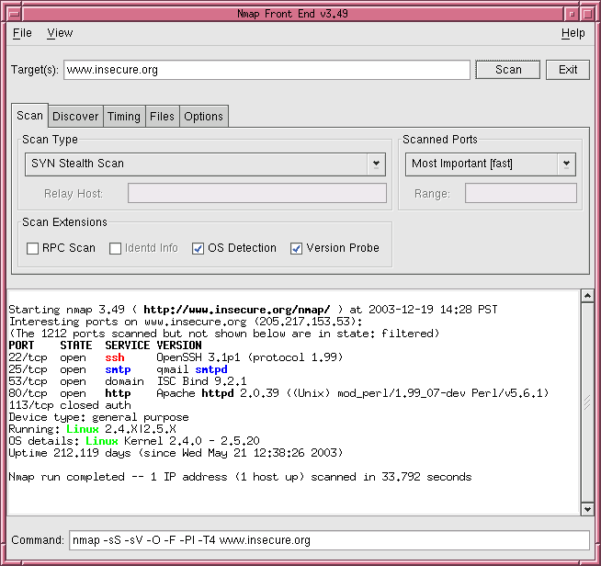
Nmap Screenshot

Slide 47
Lab
Perform a TCP nmap scan of the solaris and windows server IP addresses
Write the output in all file formats (-oA)
Save the results for tomorrow, you will need them

Slide 48
Break!
Take a breather, ask the instructor questions, experiment…
(But don’t work through all the breaks, you’ll lose focus)

Slide 49
Vulnerability Scanning
Notes:
This briefing and demonstration is entitled “Vulnerability Scanning with Nessus and Retina” and covers using those two tools for the purpose of scanning networks for vulnerabilities.
The lecture should last approximately an 45 minutes, including demonstrations.
The lab should last approximately half an hour. A 10 minute break will be given between the lecture and the lab.

Slide 50
Overview
Purpose
Basic instruction in the use of Nessus
Familiarity such that students can use tools on their own
Maybe a sprinkling of associated vuln-scan techniques
Format
Discussion of vuln-scanning and surrounding issues
Lecture and demonstration of Nessus (possibly others)
Hands-on lab with instructor supervision

Slide 51
Vulnerability Scanning
Definition
Probing specific services/protocols for weaknesses
Not just generic IP addresses anymore
Most useful when working from pre-gathered info
[such as a network-wide NMAP scan you ran earlier]
Methodology
Manual Attempts and Permutation (this will take a long time…)
Manual Version Probe (slightly better, but still very sloooow…)
Custom Protocol-Specific Attacks (requires special knowledge)
Automated Vuln-Scanner (simple, fairly reliable, fast, thorough)
DO *NOT* TRUST VULN-SCANNER OUTPUTS BLINDLY
IF SCANNER FINDS A “VULNERABILITY”, VERIFY IT

Slide 52
Vulnerability Scanning
Vuln-Assessment Analysis
What vulnerabilities are visible from an outside-eye view?
What vulnerabilities are visible from an inside-firewall view?
What is the severity of the vulnerabilities discovered?
Are the vulnerabilities false-positives? Could you verify them?
There will likely be too many vulnerabilities to handle in a visit
Ranking by “severity” and “outside exposure” helps prioritize
It also helps the system owner understand, you can tell a better story

Slide 53
Common Network Vuln-Scanners
Nessus
Tenable Scanner
ISS Vulnerability Scanner
eEye Retina
Microsoft Baseline Security Analyzer (MBSA)
SAINT

Slide 54
eEye Retina (now McAfee-owned)
Commercial utility for automated vulnerability scanning
Widely used in DoD
Runs on Windows
Point and click interface
Generates professional looking reports
Website: http://www.eeye.com
Cost: $995 - $2995 or more.

Slide 55
Nessus
Nessus is a fast and modular vulnerability scanner
Widely used and accepted by the security community
Runs as a client/server or browser/web server installation
Your Nessus ‘client’ connects to a ‘server’, gets policy, plugins
Highly configurable and intelligent
Thousands of attack/vulnerability plugins available
Users can even write their own plugins with NASL scripting
Runs on Linux, BSD, and even Windows
Now does local host scanning
Website: http://www.nessus.org
Cost: FREE (kind of, be careful here)
2.0 is still open source
3.0 and beyond are closed-source

Slide 56
Nessus Architecture
nessusd (server) controls the attacks
nessus (client) front end to configure the server
Multi user with ACLs for each user
Secure communications between server and client
Notes:
4
Nessus is composed of a server component installed on a host where all the tests are launched and client software deployed on another system to control the scan. The scan outputs are in the form of complete
exportable reports reflecting the detected vulnerabilities, the risk level, and a remedy to the exploit.

Slide 57
Starting Nessus in BackTrack (or similar)

Slide 58
Starting Nessus…

Slide 59
Logging Into Nessus
Notes:
Here is the start screen for the Nessus client. Nessus is a client-server application, so before getting here you have hopefully created a user with 'nessus-adduser', and then started the server, using 'nessusd -D'.
The Nessusd host should be the hostname or IP address of the host running the Nessus server. This is usually localhost, but the ability to specify this as something else gives us a unique ability to distribute scanners at physical or logical locations separate from the client. We could, for instance, set up a bunch of Nessus server all around the network, and choose which one is the best to use for our scans. This could make periodic scanning much easier. The connection is encrypted.
With the initial logon, you should use a username and password combination that you specify in your nessusd configuration. During the initial login, the client and server will negotiate a key. At subsequent logins, you will usually use a username and the previously negotiated key that is usually saved locally.

Slide 60
More Logging In…

Slide 61
Nessus Plugin Intelligence
All plug-ins have the ability to share their information
(they work together, not just run the same checks repeatedly)
Example
A first plug-in determines port UDP/137 and TCP/139
A second plug-in retrieves the remote host netbios name
A third attempts to login with the null session
A fourth retrieves the remote host SID
A fifth enumerates the users/shares on the host
This method provides for a more comprehensive audit
Don’t be too optimistic… Nessus scans are still pretty slow
Notes:
4
Nessus Plug-ins
By default, Nessus can perform various security tests classified in the following plug-ins families:
+ Backdoors
+ CGI abuses
+ CISCO
+ Default Unix Accounts
+ Denial of Service
+ Finger abuses
+ Firewalls
+ FTP
+ Gain a shell remotely
+ Gain root remotely
+ General
+ Misc.
+ Netware
+ Port scanners
+ Remote file access
+ RPC
+ Settings
+ SMTP problems
+ SNMP
+ Untested
+ Useless services
+ Windows
+ Windows: User management

Slide 62
Nessus – Plugin Updates
Nessus parent company (Tenable) releases these regularly
Some delay between “paying” customers and “free” users
Update by clicking “Update” or running “nessus-fetch”
YOU MUST GET INTO THE HABIT OF DOING THIS REGULARLY
False positives are preferred over false negatives
I’d rather alert on something that’s not there than miss stuff
The Nessus developers (who write plugins) feel this way too
Plugins are duly tested and reviewed before publishing
Published in CVS version-sourcing and on the web
Can be customized via NASL scripting language
Notes:
4

Slide 63
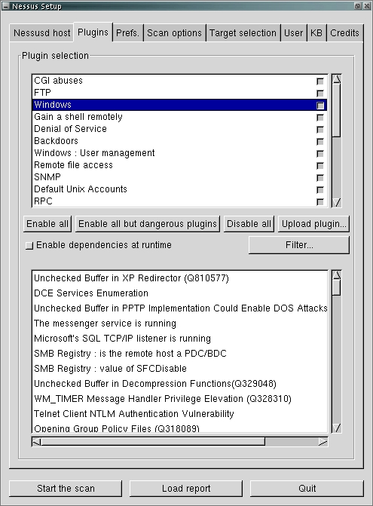
DANGEROUS PLUGINS ARE SECURITY TESTS THAT CAN CRASH OR DAMAGE A TARGET SYSTEM

Slide 64
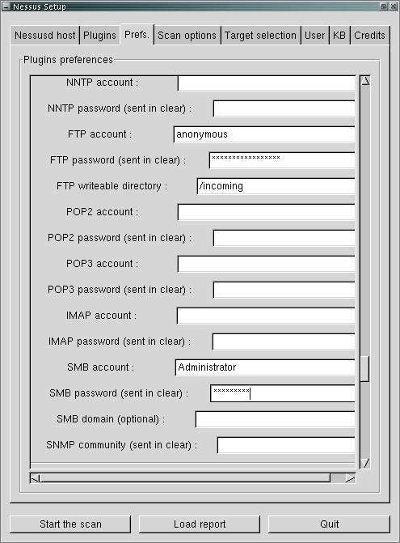

Slide 65
Nessus Scan Method
Banner grabbing (method 1)
Pros
Tests are easy to write
Scanner is not intrusive
It will not harm the remote host
Cons
What if there is no banner (RPC)?
False negatives
Non standard application/custom banners
Notes:
4

Slide 66
Nessus Scan Method
Actually testing for the vulnerability (method 2)
Pros
Reliable against unknown servers
Results valid at a later time
Find new bugs
Cons
May harm the remote host (crash the service)
Tests are more difficult to write
May produce false positives
Notes:
4
You will want to be careful on which method you choose depending on the system you are scanning. As an example a system in a development or test environment it would not matter if you crash it actually checking for known vulnerabilities with exploits. However, in a production environment you will want to refrain from running the actual exploits and just use the safe checks via banner grabs.

Slide 67
Configuring Nessus: Scan Options
Be careful of anything that requires DNS while in the lab!
Notes:
Here we have the scan options page. These options can have a significant effect on the scalability and thoroughness of the scan.
If you want to be very thorough, make sure it will scan through all 65535 possible ports. This may make the scan very slow, though.
If there are many hosts you want to scan, and the host that nessusd is running on is beefy enough, you may want to increase the number of threads. Be careful not to go overboard, though.
If you know that some of the web servers that you are going to test have unusual cgi-bin directories, specify them on this screen.

Slide 68
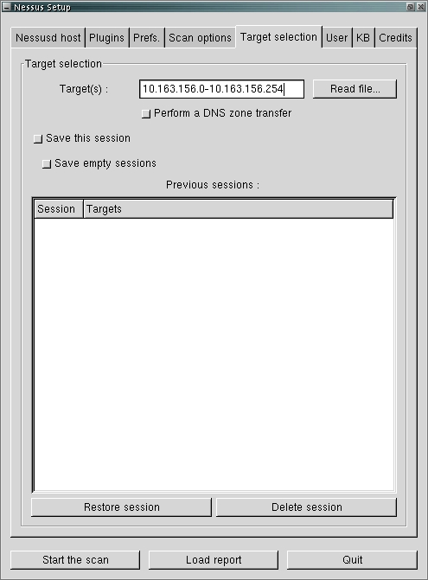

Slide 69
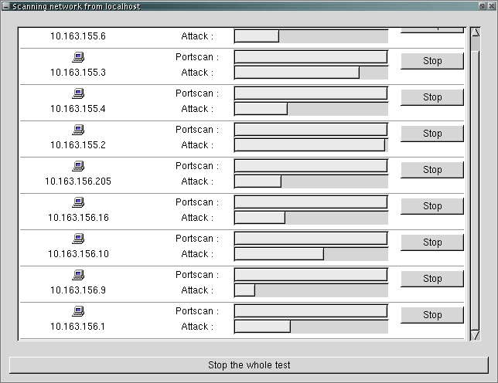

Slide 70
Reports
Multiple formats
HTML
HMTL with charts/graphics
Text
NBE (proprietary Nessus report format)
(can be re-loaded, re-read, re-used by a Nessus scanner)
Detailed results of scans
We (your instructors) typically save .HTM and .NBE copies
The .HTML reports are easy to read, include in system owner reports
The .NBE dumps can be easily picked up and re-run on followup visits
Notes:
4

Slide 71
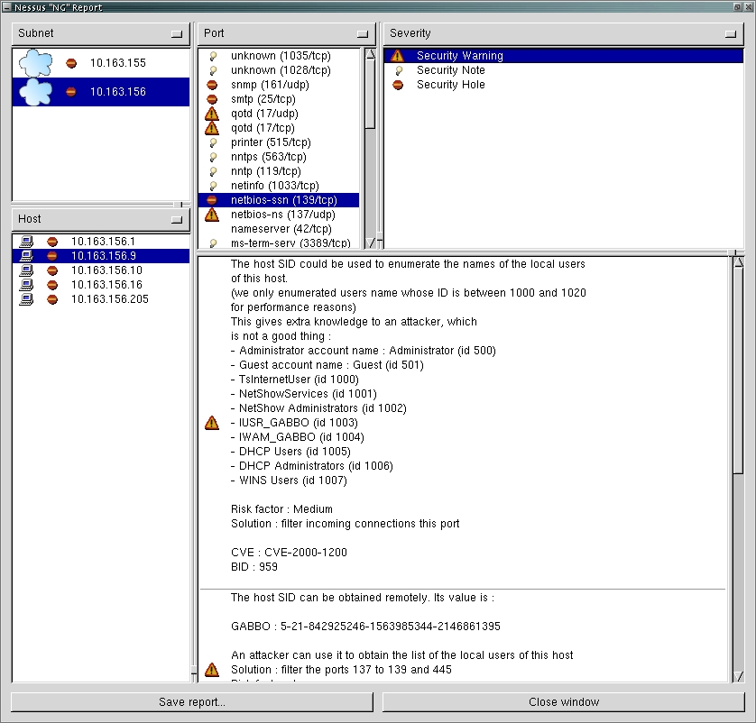

Slide 72
Common Nessus Pitfalls
DO *NOT* RUN NESSUS, SAY “DONE” AND WALK AWAY
Nessus will almost certainly generate false positives
Treat as a preliminary indicator (“something might be wrong”)
Must follow-up/confirm/verify (look at target’s config files, etc.)
Proceed carefully with Nessus config/settings
I love to run “dangerous” plugins, but that’s really very risky
Should *NOT* run these without explicit permission
Even “non-dangerous” Nessus plugins can crash a host
It’s regrettable (and a bit embarrassing) when this happens
*BUT* write it up as a finding, the system owner needs to know
If you can do it by accident, an outsider could as well…

Slide 73
Nessus Lab
Perform a scan of the solaris and windows server IP addresses
Write the output in all file formats (-oA)
Save the results for tomorrow, you will need them
Bonus points if you manage to crash something in the process

Slide 74
Questions?
Break?
Stay tuned for the bonus slides…

Slide 75
A Few Places to Get Tools
Much of this stuff (tools) comes pre-canned in Linux CDs
If using BSD, “portupgrade –rR security/???” syntax
Freshmeat (http://www.freshmeat.net)
Fyodor (http://insecure.org) maintains the NMAP scanner
PacketStorm (http://www.packetstormsecurity.org)
Tenable (http://www.nessus.org) has the Nessus scanner
[pls check the commercial license on this tool, it’s not “free”]
Subsequent instructors will make other recommendations
Various conventions will have stuff as well, but be careful!
(BlackHat, CanSecWest, DefCon, ShmooCon, ToorCon)

Slide 76
Questions

