Slide 1
Windows Assessment
Vulnerability Assessment Course

Slide 2
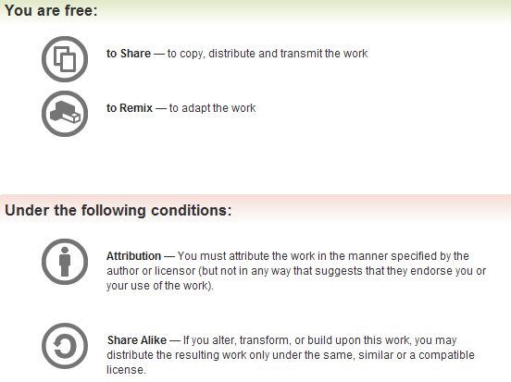
All materials are licensed under a Creative Commons “Share Alike” license.
http://creativecommons.org/licenses/by-sa/3.0/

Slide 3
Agenda
Windows Security Overview
Active Directory
Computers and Their Role in the Network
Built-in tools
Exercise
Sources of secure configuration information
Analysis Tools
Secure Host Configuration
Other Sources of Vulnerabilities
3

Slide 4
Windows Security Overview
Local Security Authority (LSA)
Security Account Manager (SAM)
Security Reference Monitor (SRM)
4
Notes:
Local Security Authority: This is also known as the Security Subsystem. It is the central component of NT security. It handles local security policy and user authentication. LSA also handles generating and logging audit messages.
Security Account Manager: SAM handles user and group accounts, and provides user authentication for LSA.
Security Reference Monitor: SRM enforces access validation and auditing for LSA. It checks user accounts as the user tries to access various files, directories, etc, and either allows or denies access. Auditing messages are generated as a result. The SRM contains a copy of the access validation code to ensure that resources are protected uniformly throughout the system, regardless of resource type.
Components of a SID
Position Meaning
1 Revision number
2 Identifier authority value (always 5 in Windows 2000)
3-6 Sub-authorities (randomly generated during installation)
7 Relative Identifier (RID)

Slide 5
SAM and Active Directory
On Windows 2K, 2K3, and 2K8 Domain Controllers the user account and hashes are stored in Active Directory
  Uses Kerberos for authentication
In Windows NT/2K-2K8/XP/Vista/Windows 7 non-domain hosts all user names and hashes are kept in the SAM
  Early versions of Windows (pre-NT) have LAN Manager (NLM) Hash weaknesses that make password retrieval trivial
  Legacy protocol support for backward compatibility in later versions of Windows
  New Technology (NT) LM Hash version 2 in NT 4 Service Pack 4
  NTLM does not support any federal compliant cryptographic methods (AES or SHA-256)
  NTLM still widely used for non-AD networks
  As of Windows Vista, the protocol is disabled by default
5
Notes:
By default the SAM is located in %systemroot%\system32\sam.
Passwords are not actually stored in the SAM; what is stored is a hash of the actual password. This hash cannot be revered engineered to obtain the clear text password. Even thought this hash cannot be attacked, is still susceptible to guessing attacks that pass the password thru the same algorithm used to generate the hash and then compare the two hashes.
AD replaces the SAM on domain controllers as the primary repository for security information. It stores both user credentials and access control information. Member servers and workstations retain their local SAM for locally defined users, groups, and security settings.
By default the AD is found in %systemroot%\ntds\ntds.dit
In Win NT4 SP3 Microsoft introduced SYSKEY, which derives a 128-bit key and encrypts each hash. In Windows NT, it was necessary to manually enable SYSKEY, but in Windows 2K or later it is enabled by default.
There are 3 modes of operation for SYSKEY
Mode 1 Stored in the registry and make it available at boot time
Mode 2 Stored in the registry, but protected with a password which must be provided
at boot time
Mode 3 Stored on floppy that must be provided at boot time.

Slide 6
Security Identifiers (SIDs)
Used to identify a security principal or security group
Known SIDs are generic groups or users
Known Relative Identifiers (RIDs)
  500 Administrator
  501 Guest
  1000 First User Created
SID
  S-1-5-21-1736975974-7891275630-7896350200-500
RID
6
Notes:
Other known SIDs
S-1-0-0 Null SID Indicates an empty or NULL group. It is defined as a group with no users and is typically used to indicate nobody.
S-1-2 Local Authority
S-1-5-1 Dialup Indicates a group of which all user accounts are automatically made members while they are logged on to a Windows system via dialup.
S-1-5-2 Network Indicates a group of which all user accounts are automatically made members while they are logged on to a Windows system via the network.
S-1-5-3 Batch Indicates a group of which all user accounts are automatically made members while they are logged on to a Windows system via a batch logon.
S-1-5-4 Interactive Indicates a group of which all user accounts are automatically made members while they are logged on to a Windows system via an interactive logon.
S-1-5-6 Service Indicates a group of which all user accounts are automatically made members while they are logged on to a Windows system as a service.
S-1-5-7 AnonymousLogon Associated with a null session logon.
S-1-5-9 ServerLogon Associated with a domain controller account.
S-1-5-10 Self (or Principal Self) Acts as a placeholder and applies only to the access lists of group or user accounts. When present, it indicates the trustee account for which the access list applies.
S-1-5-11 Authenticated User Indicates a well-known group of which all currently authenticated user accounts are implicitly members.
S-1-5-13 Terminal Server Associated with a user logged on to a terminal server.
S-1-5-18 LocalSystem This special account, which many service processes run under, exists on all Windows systems.
S-1-16-0 Untrusted Mandatory Level
S-1-5-32-XXX Windows 2003 Domain Authority
S-1-5-21 or 32 domain-XXX Windows 2008 Domain Authority

Slide 7

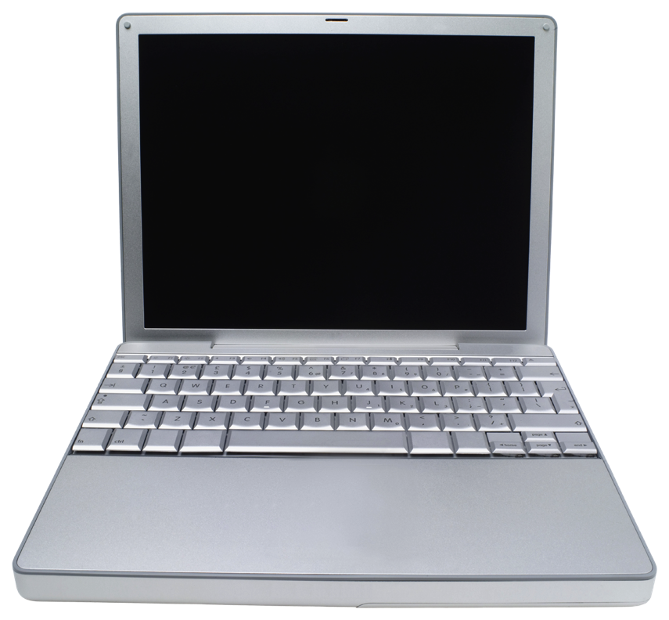

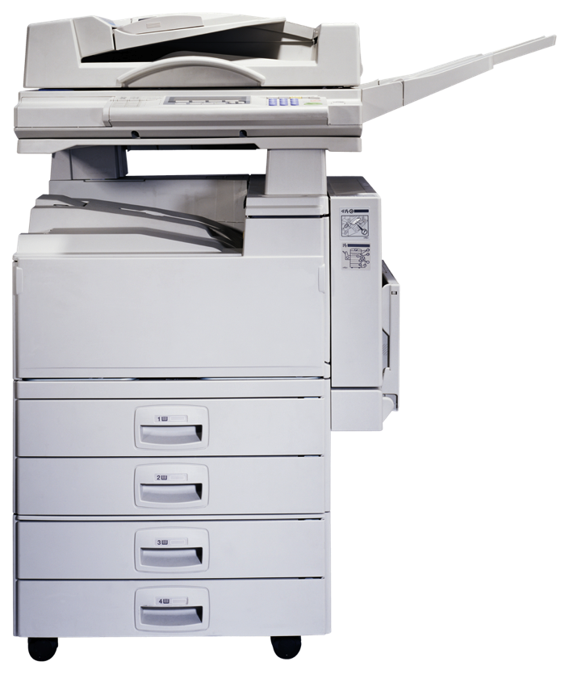
Active Directory Structure
Forest
Forest
Contains domains. Used to define the scope of authority for administrators.
Domain
Tree
Domain
Domain
Domain
Contains OUs. Used to partition the directory data structure and control replication.
OU
OU
OU
Organizational Unit (OU)
Contains users, computer accounts, and resources. Used to delegate control and apply policies.
Objects
7

Slide 8
Key Active Directory Attributes
Trusts between domains
  NT
  Active Directory
Domain Name Service (DNS)
Security group nesting strategies – AGDLP
Local versus Group Policy
8
Notes:
Trust direction and transitivity
Is the Trust intended or authorized?
Is user re-authentication required from a trusted domain?
WINS – used for backward compatibility with NT4
DNS service
Access to a secure, properly configured DNS server
Integrated with AD
Group nesting strategies
A-G-DL-P: accounts are added to global groups, global groups are added to domain local groups, and resource permissions are granted to domain local groups

Slide 9
Security Features of Windows 2008 R2 and Windows 7
More secure settings by default
Improved User Account Control (UAC)
Managed service accounts
  Provides service isolation at the cost of ease of administration
Stronger NTLM authentication
Windows 2008 enhanced audit
  10 versus 9 audit categories
  55 granular audit settings
Improved host-based firewall implementation
9

Slide 10
Methodology
10
Phase 1 – Planning
Phase 2 – Information Collection
Phase 3 – Enumeration
Phase 4 – Testing and Evaluation
Phase 5 – Reporting
Notes:
During this section we will be touching on phase 4 of the methodology as it relates to application assessment.

Slide 11
Computers and Their Roles
Find what hosts are connected to the network and their purpose in the environment
Examples
  Domain Name Service (DNS)
  Dynamic Host Control Protocol (DHCP)
  Windows Internet Name Service (WINS)
  Lightweight Directory Access Protocol (LDAP)
  Domain Controllers
  Internet Information Services (IIS)
  Exchange
  File and Print Services
  Others (Certificate, SQL, SharePoint)
Many tools needed for this are already included in your system (i.e., ‘net’ command)
11
Notes:
NET [ ACCOUNTS | COMPUTER | CONFIG | CONTINUE | FILE | GROUP | HELP |
HELPMSG | LOCALGROUP | NAME | PAUSE | PRINT | SEND | SESSION |
SHARE | START | STATISTICS | STOP | TIME | USE | USER | VIEW ]

Slide 12
What hosts are in the domain?
Find what domains are available on the network
  net view /domain
List computers in a domain
  net view /domain:DOMAIN-NAME
You can get the same information from the Windows Explorer but…
12

Slide 13
What other hosts do I know about?
Find out which other computers and networks a computer knows about
  nbtstat –a Computer-Name
  nbtstat –A IP-Address
Found on every Windows based computer
The biggest drawbacks to nbtstat is that it operates on a single computer at a time
13
Notes:
See attached list of NetBIOS information.

Slide 14
NLTEST
A command-line utility included in the NT resource kit
Used to test trust relationships and the state of domain controller replication
  nltest /dclist:DOMAIN
  nltest /whowill:DOMAIN USER
  nltest /finduser:USER
  nltest /server:SERVER /trusted_domains
14
Notes:
nltest [/options]
/SERVER:<ServerName> Specify <ServerName>
/QUERY Query <ServerName> netlogon service
/REPL Force replication on <ServerName> BDC
/SYNC Force SYNC on <ServerName> BDC
/PDC_REPL Force UAS change message from <ServerName> PDC
/SC_QUERY:<DomainName> Query secure channel for <Domain> on <ServerName>
/SC_RESET:<DomainName> Reset secure channel for <Domain> on <ServerName>
/DCLIST:<DomainName> Get a list of DC’s for <DomainName>
/DCNAME:<DmainName> Get the PDC name for domain <DomainName>
/DCTRUST:<DomainName> Get name of DC is used for trust of <DomainName>
/WHOWILL:<Domain>* <User> [<Iteration>] See if <Domain> will log on <User>
/FINDUSER:<User> See which trusted domain will log on <User>
/TRANSPORT_NOTIFY Notify of netlogon of new transport
/RID:<HexRid> RID to encrypt Password with
/USER:<UserName> Query user info on <ServerName>
/TIME:<Hex LSL> <Hex MSL> Convert NT GMT time to ASCII
/LOGON_QUERY Query number of cumulative logon attempts
/TRUSTED_DOMAINS Query names of domain trusted by workstation
/BDC_QUERY:<DomainName> Query replication status of BDCs for <DomainName>
/SIM_SYNC:<DomainName> <MachineName> Simulate full sync replication
/LIST_DELTAS:<FileName> Display the content of given change log file
/LIST_REDO:<FileName> Display the content of given redo log file
For a more detailed explanation of all switches and usage go to: http://support.microsoft.com/default.aspx?scid=kb;EN-US;q158148

Slide 15
NBTSCAN
A command-line tool that scans for open NETBIOS nameservers on a network
Based on functionality of standard Windows tool nbtstat, but operates on a range of addresses instead of just one
  nbtscan 10.0.0.0/24 – scan all class C network
  nbtscan –v 10.0.0.24-35 – scan all addresses from 24-35 and displays verbose output
15
Notes:
nbtscan [-v] [-d] [-e] [-l] [-t timeout] [-b bandwidth] [-r] [-q] [-s separator] [-m retransmits] (-f filename)|(<scan_range>)
-v verbose output. Print all names received from each host
-d dump packets. Print whole packet contents.
-e Format output in /etc/hosts format.
-l Format output in lmhosts format. Cannot be used with -v, -s or -h options.
-t timeout wait timeout seconds for response. Default 1.
-b bandwidth Output throttling. Slow down output so that it uses no more that bandwidth bps.
Useful on slow links, so that outgoing queries don't get dropped.
-r use local port 137 for scans. Win95 boxes respond to this only. You need
to be root to use this option on Unix.
-q Suppress banners and error messages,
-s separator Script-friendly output. Don't print column and record headers, separate fields with
separator.
-h Print human-readable names for services. Can only be used with -v option.
-m retransmits Number of retransmits. Default 0.
-f filename Take IP addresses to scan from file filename
<scan_range> what to scan. Can either be single IP like 192.168.1.1 or range of addresses in one
of two forms: xxx.xxx.xxx.xxx/xx or xxx.xxx.xxx.xxx-xxx

Slide 16
Exercise
Identify all Windows hosts in the LAB
  Hint: NET VIEW ?
16

Slide 17
Methodology
17
Phase 1 – Planning
Phase 2 – Information Collection
Phase 3 – Enumeration
Phase 4 – Testing and Evaluation
Phase 5 – Reporting
Notes:
During this section we will be touching on phase 4 of the methodology as it relates to application assessment.

Slide 18
Sources of Secure Configuration Policy
System Owner Policy
Center for Internet Security Configuration Guides (http://www.cisecurity.com/)
NSA’s Configuration Guides (http://www.nsa.gov/snac/)
MS Security Central (http://www.microsoft.com/security)
MS Security Bulletin Search (http://www.microsoft.com/technet/security/current.aspx)
BugTraq (http://www.securityfocus.com/)
18

Slide 19
Useful Analysis Tools
Utilities
  WinGrep
    http://www.wingrep.com/
  GNU Grep for Windows
    http://gnuwin32.sourceforge.net/packages/grep.htm
  WinDiff Utility
    XP CD-ROM in the Support\Tools folder
    http://www.microsoft.com/downloads/details.aspx?familyid=3E972E9A-E08A-49A2-9D3A-C0519479E85A&displaylang=en
  GNU DiffUtils for Windows
    http://gnuwin32.sourceforge.net/packages/diffutils.htm
  WinMerge
    http://winmerge.org/downloads/
Checklists
19

Slide 20
Secure Host Configurations
What do we look for?
  Service Packs, Hot Fixes, open ports, processes, IP settings, installed software
  Disk information - using NTFS
  Shares and permissions
  Accounts – password settings
  Users – Name of Administrator and Guest, password required and expiration for users
  Groups
  Rights
  Registry security settings
  Services – Host-based security applications (AV, HIDS, firewall)
  Audit settings
  File ACL and auditing
  Registry ACL and auditing
20
Notes:
Handout and Review Windows Script output
Shares
Everyone has access to files
Users have Full Control
Right
Access computer from network
Force shutdown from remote system
Logon as batch/service
Logon locally
Shutdown system
Registry Security
Make sure you know the difference between group and local policies
Services
What’s running
What’s not running
Auditing settings
File permissions
Does Everyone have any access
Does Users have access to system files
Registry permissions
Does Everyone have any access (exceptions)

Slide 21
Other Sources of Vulnerabilities
Network diagrams
  Relationship between systems and network segments
Nessus reports
  Scanners lie
Interviews
  You get to ask the admin any clarification about what you have seen
The rest of your team
21

Slide 22

Questions
22

Slide 23
Port Scans
Interesting Windows Ports
  25 SMTP
  20,21 FTP
  23 TELNET
  53 DNS
  80, 8080, 8088 HTTP
  88 Kerberos
  135 RPC/DCE Endpoint mapper
  137 NetBIOS Name Service
  138 NetBIOS Datagram Service
  139 NetBIOS Session Service (SMB/CIFS over NetBIOS)
  161 SNMP
  389 LDAP
  443 HTTPS
  445 Direct Host
  464 Kerberos kpasswd
  500 Inet Key Exch, IKE (IPSec)
  593 HTTP RPC Endpoint Mapper
  636 LDAP over SSL/TLS
  1433 MS-SQL Server
  1434 MS-SQL Monitor
  3268 AD Global Catalog
  3269 AD Global Catalog over SSL
  3389 Windows Terminal Server
  1243, 6711, 6776, 1349, 12345, 12346, 31337 – Trojan Ports *
23
Notes:
* Most trojan programs allow you to install them on different ports to evade detection. More known/default trojan ports can be found at http://www.xploiter.com/security/trojanport.html

