Slide 1
Network Security
Vulnerability Assessment Course

Slide 2
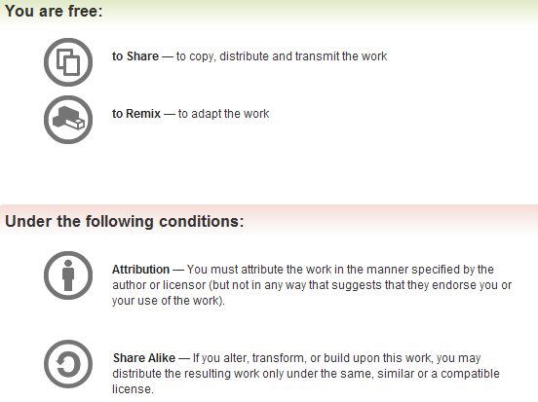
All materials are licensed under a Creative Commons “Share Alike” license.
http://creativecommons.org/licenses/by-sa/3.0/

Slide 3
Agenda
Why Assess
What’s needed
Router and Switch Security
Firewall Security
IDS Security
VPN Security
Network Services

Slide 4
Vulnerability Assessment
Provides the opportunity to address weaknesses before an enemy can exploit them
Implementation: Scanning tools that identify vulnerabilities in computer hardware, software, networks and operating systems
Common techniques
  Multiple tools – one tool may not identify all vulnerabilities
  Ability to identify backdoors security perimeter, e.g., modems, VPNs, etc. – all potential vulnerabilities need to be assessed
  Correction verification mechanism – ability to check if vulnerability has been eliminated
Compliance with OMB, DOD, DHS policy
  Utilize NIST 800-53 and 800-53A
  DOD 8500 series

Slide 5
What’s Needed
Networking experience
  Hands on experience: configuration, managing, building various devices
  Working knowledge of best practices
Security Experience
  Intimate knowledge of how to secure a system
  Prior experience with CIS Benchmark, DISA STIG/SRR
Data Collection
  Network scans from NMAP and Nessus
  Running device configuration
Other Skills
  Need to work with administrators
  Put vulnerability in their language
  Be tedious while looking for vulnerabilities
  Work well in a team

Slide 6
Router and Switch Security

Slide 7
What are Routers and Switches
Router
  Determines the next point to forward a packet using distance and cost algorithms
  Routes can be static or dynamic
  A router maintains a table of routes (paths to the next hop in the network) and the conditions they are used
Switch
  Forwards packets to specific host by MAC address
  Newer OS’s can route and perform other functions
  Packets sent to single host via MAC address (unless a broadcast packet)
  Opposite of a Hub, Individual hosts do not see everyone’s traffic
Notes:
At their core, the above description is accurate for these devices. However it is important to note that most devices can provide more capability. For example most switches can now perform basic routing, trunking, VLAN segmentation, and other features that have implications on security. Likewise routers can do more then route packets. They can share routing information with additional protocols such as BGP RIP or OSPF, they can implement simple access control lists to deny communications, providing NAT, load balancing, and failover capabilities.
In any case the configuration and use of these devices on a network can impact the security of the network.

Slide 8
Threats
Direct attacks
  Could exploit vulnerabilities in the IOS
  Pass through or direct attacks
Denial of Services attacks
  Alt routing and upstream provider support
  Not much can be done to defend against a DDOS
Compromise from poor configuration
  Allowing telnet from external
  Not restricting access to console ports
  VLAN hopping via poor configuration

Slide 9







Manufactures
Several vendors and different types of products for network routing and switching
  Not all products are created equal
  Differ in command syntax, capabilities, cost

Slide 10
Router Woes
The bad news
  All vendors have implemented capabilities differently
  Syntax and configurations are different
  Management unique
The good news
  At the core the capabilities (forwarding packets) are the same
  Understand the principles Ethernet and TCP/IP
  Most vendors documentation available free online

Slide 11
Router Security Practices
Configuration
  Run the most recent IOS (OS) and security patches
  Disable unneeded services - TFTP, TELNET, HTTP
  Disable unneeded protocols - BGP, OSPF, RIP
  Perform EGRESS INGRESS and Anti-Spoofing
  Encrypt routing updates with strongest algorithm available
Management
  Perform secure remote management with SSH or SNMPv3
  User RADIUS or TACACS+ authentication, authorization, and auditing (AAA)
  Manage out of band using a direct console connection

Slide 12
Switch Best Practices
Configuration
  Run the most recent IOS (OS) system and security patches
  Disable all unnecessary services
  Don’t implement VLAN’s across multiple security zones
  Disable unnecessary services - HTTP, SNMP, TELNET, ROUTING
Management
  Perform secure remote management with SSH or SNMPv3
  User RADIUS or TACACS+ authentication, authorization, and auditing (AAA)
  Manage out of band using a direct console connection

Slide 13
VLAN Security
Where possible do not use VLAN’s
  Technology has come a long way since the beginning
  A misconfiguration or failure could allow data to traverse multiple VLAN’s
If you must use VLAN’s ensure:
  Different security zones do not share the same physical switch
    Don’t mix external and internal traffic on different vlans within the same switch
  Ensure all recommendations in CISCO VLAN security guide are followed
  Consider use of a layer 2 firewall to add additional segmentation and detection capability

Slide 14
MPLS/VRF Security
Multi Protocol Label Switching (MPLS)
  Routing packets based on labels versus packet content
  Layer 2.5 protocol – Can carry IP ATM SONET or Ethernet
  Creates virtual networks
Virtual Private Network Routing and Forwarding (VRF)
  Acts like a virtual Router
  Virtually segments traffic
  Multiple routing instances coexist in one router

Slide 15
MPLS/VRF Security
Validate MPLS/VRF Configurations
  Route leaking through inter VRF Static routes
  Misconfigurations
  Firewall challenges
If you must use them ensure:
  Architecture is key
  Do not expose internal routing information to the outside
  Use IPSec on a hostile network
  Routing becomes critical
  Labels should not be set outside of the network
  External or edge routers should not accept labeled information

Slide 16
Router Audit Tool (RAT)
A simple tool that validates the configuration of CISCO routers, switches, and PIX firewalls
  http://www.cisecurity.org/bench_cisco.html
Requirements
  Windows or Unix OS
  Complete electronic version of configuration file
  Some CISCO knowledge
Results
  Provided in HTML and txt output
  Includes false positives
  Does not account for business policy
Notes:
RAT is a decent start for reviewing the configuration of a CISCO router/switch/PIX. As a command line tool it only has a few options so it is fairly simplistic to run. It is critical to review the findings produced by RAT to ensure that it has reported accurate findings. RAT compares the configuration file provided against the CISCO Gold security standard for their IOS.
Some examples:
-If the organizational policy allow for the use of SNMP for network devices management, then the RAT findings could be a false positive.
-The tool does not review ACL’s to ensure that they make sense. It may check to see that there is an ACL on the LINE or AUX interface, but it does not realize that the ACL is an entire /16 (192.168.0.0)
-Does not complain about placement or implementation in the architecture, these are things that the auditor needs to recognize and review.

Slide 17
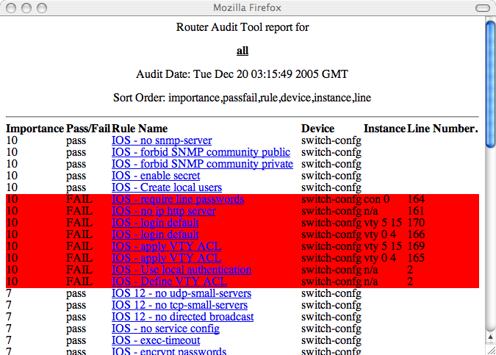
RAT Findings

Slide 18
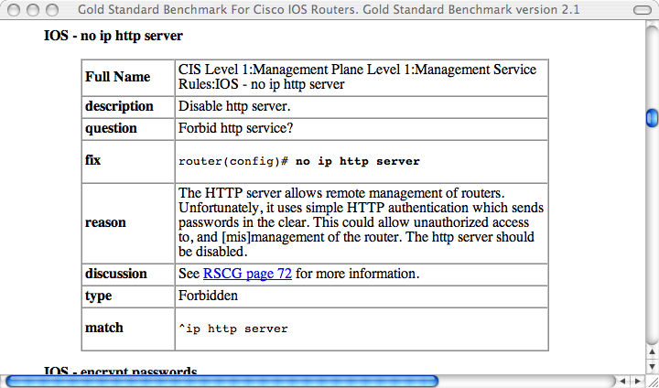
Security Baseline (RAT)

Slide 19
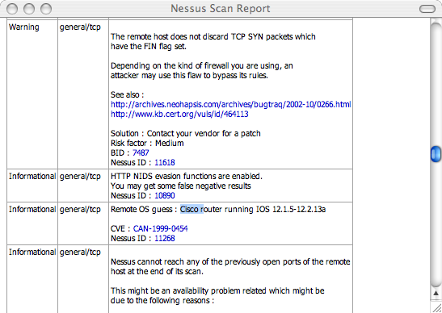
Nessus Information

Slide 20
Manual Review
While RAT does provide a quick look at a device
  Output may report a missing setting, that exists; just not as expected
  Does not account for things that are excepted - SNMP use
  Unique settings, ACL’s or business decisions
Review the configuration for:
  Inconsistencies with RAT or Nessus output
  Authentication methods (AAA, local)
  Review ACLs
  Determine how the device is administered
    How is the administrator authenticated, what commands are they allowed to run
  Ensure strong md5 passwords are used
  Check for VLAN implementation (see VLAN security guidance)

Slide 21
Common Findings
Poor ACL’s
  Allow entire subnets or large ranges of unneeded ports is a security risk
  Depending on the source and destination IP address this could be a high finding
  Best practice is to have a permit by exception rule base with specific IP to IP and port to port rules
Lack of Auditing
  Logging should be done for outbound and inbound network communications
  This is a Low finding depending on the quality of the ACL’s in place on the device
  Reviewing firewall log data on a daily basis can aid in detecting malicious external attacks, or potential compromises of internal machines

Slide 22
Common Findings
Poor Configuration
  The device itself must be securely configured and managed
  This could be a high finding depending on the severity of the vulnerabilities or configuration errors on the firewall
  This system should be one of the most secure on the network. It should be well maintained, securely managed, from a secure platform. Unneeded and insecure services should be disabled
    All passwords on the device must be stored encrypted
    All routing updates must be encrypted
    All management traffic must be encrypted
  Limit access to the device, especially enable mode
  For administrators, authenticate administrators with TACACS+ and consider using two-factor logins and single-use passwords with SecureID

Slide 23
Conclusion
Each vendor is unique, however the basic principals are still the same
Routers should be used for only one thing – ROUTING
Additional functions such as network ACL’s, DHCP, and TFTP should not be done on a router
Ensure that the device does implement ACL’s to protect itself from attack and unauthorized management
Be prepared and knowledgeable on specific device configuration and issues.
Visit the vendor’s web site for security patches (try to test before deploying).

Slide 24
Exercise
Review scan of available device and discuss findings
What services are running?
What does he actual configuration look like?
What are the vulnerabilities?

Slide 25
References
http://www.cisecurity.org/bench_cisco.html
NSA Router Security Guidance Activity
Cisco IOS Security Configuration Guide, Release 12.4
http://www.cisco.com/en/US/tech/tk436/tk428/technologies_white_paper09186a00800a85c5.shtml
http://www.cisco.com/en/US/docs/net_mgmt/vpn_solutions_center/1.1/user/guide/VPN_UG1.html#wp1018833

Slide 26
Firewall Security

Slide 27
What is a Firewall
Software or Hardware
  Limits network access between one or more networks
  Provides separation between trusted/untrusted/DMZ
  Could reside at a network or host level
Firewalls are one layer of security - They do NOT
  Typically do not ensure confidentiality, integrity or non repudiation
  Protect from an insider threat
  Function as a silver bullet
Threatened by
  Direct attacks (unlikely)
  Denial of Services attacks
  Information leakage via poor configuration
Notes:
How would you define a firewall? Depending on the environment and requirements the type of firewall, vendor, and implementation will be different. The good news is that all firewalls generally function the same. They all permit or allow communications. The implementations, configuration, and capabilities all vary.
One thing you should always keep in mind when assessing firewalls, is the big picture, or the overall architecture. Firewalls are just one layer of security in the infrastructure. For example, if there is a VPN concentrator in the architecture, you need to think about whether the traffic coming to the firewall is encrypted or not, etc.
Many times, you will notice that once a firewall is bypassed, it is fairly trivial to access any of the devices the firewall was trying to protect. This is known as ‘crunchy outside, soft and chewy inside’. Again, I will stress that you need to pay attention to the overall architecture when assessing the firewall.
Many are based on *NIX operating systems (i.e., customized kernel).

Slide 28





Vendors
Several vendors and different types of products for network and host level “firewalls”
  Not all products are created equal
  IP Filter, IP Tables

Slide 29
Types of Firewalls
Packet Filter (Non stateful connections )
  Similar to router Access Control Lists (ACLs)
  Requires two rules to make a unidirectional connect work
    One for the port 80 outbound
    One for the return traffic to port 80 from a high port
Stateful packet inspection
  Determining what connections to allow or deny based off of the packet state.
  Only one rule is needed to allow a unidirectional session like HTTP
Application Layer Proxies
  These are a newer breed of firewalls and perform more detailed packet inspection
  Validation of protocol standards
  Actual content inspection

Slide 30
Packet Filter Firewalls
Also called packet filters
Usually stateless
Function by directing packets based on source/destination IP addresses and/or ports
Fairly cheap to deploy
Fast and scalable
Administrator needs to have knowledge of protocols to manage effectively
Examples: iptables, Older CISCO’s PIX, Router ACL’s
Notes:
Packet filtering firewalls are fairly common. The are also called packet filters and are usually stateless. Packet filters function by directing packets based on information such as source/destination IP addresses and/or ports, and are fairly cheap to deploy. Their advantage mainly lies in being fast and scalable. This is very helpful for large networks. One downside is that the administrator needs to have good knowledge of protocols the firewall is encountering.

Slide 31
Stateful Inspection Firewalls
Tries to bridge packet filtering and application-level filtering technologies
Usually does not proxy connections
Knows about expected protocol behavior
Newest firewall model
Expensive to deploy
Examples: Checkpoint FW-1, NetScreen firewall, IPFilter
Notes:
Stateful inspection firewalls attempt to bridge packet filter technology and protocol analysis technology.

Slide 32
Application Layer Firewalls
Also called proxy or protocol-based
Most secure firewall implementation
More processing intensive
Not highly scalable
More expensive to deploy
Examples: Sidewinder firewall, Teros, Reactivity,
Notes:
Application-layer filtering, or protocol-based firewalls are well-respected. There is a reason for this;
the protocol analysis ability. OK, this is the biggest reason. Otherwise, protocol based firewalls are fairly expensive, processing intensive, and not really scalable.

Slide 33
Firewall Woes
The bad news
  All firewall vendors have implemented these capabilities differently
  Rule structures are different
  Management unique
The good news
  At the core the capabilities (allowing and denying) are the same
  Understand the principles of firewalls and TCP/IP
  Most vendors documentation available free online
Notes:
There are too many different types of firewalls to go through auditing each and every one. What makes this worse is that each vendor has chosen to implement packet filtering in their own way. Rule structures, management ports, proxy settings, default configurations are all different. I recommend downloading the configuration documentation for the particular vendor that you are performing an assessment of before hand to familiarize yourself with the unique syntax of that specific firewall.
On the positive side, all firewalls do the same thing. At the core all of the firewalls are either allowing or denying communications despite how it is implemented. This makes it easy to review a firewall that you have not seen before as long as you thoroughly understand TCP/IP and the concept how a firewall should work.

Slide 34
Best Security Practices
A firewall that implements a deny-by-default or permit-by-exception rule base
  This limits communications to what is required
  Deny all to the firewall directly (except for management)
  INGRESS EGRESS and Anti-spoofing rules
Rules should be specific
  Subnet to subnet rules are not restrictive
  Port ranges or objects like high ports are not restrictive
  IP to IP on a specific port or group of ports is preferred
Management of the firewall should be done out-of-band
  This allows for centralized logging and management to be done safe and secure isolated from production traffic

Slide 35
Common Architecture
Internet
Business APPS
DMZ
DMZ
Extranet
DMZ
Router
IDS
Internal
Perimeter
Internal
Firewall
Firewall
Users

Slide 36
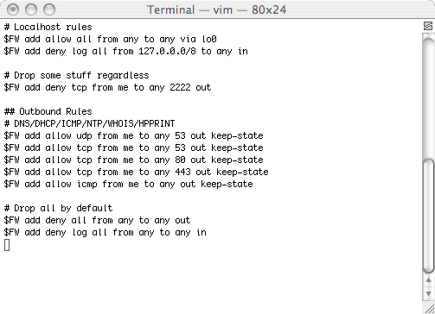
IPFW Rule Syntax

Slide 37
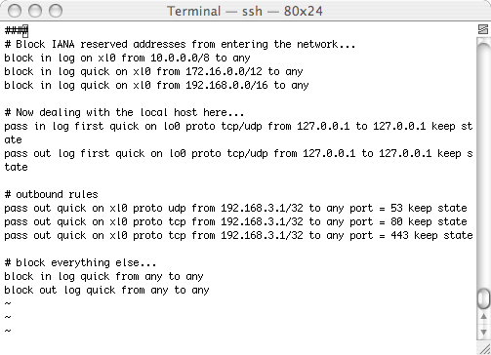
IPFilter Rule Syntax

Slide 38
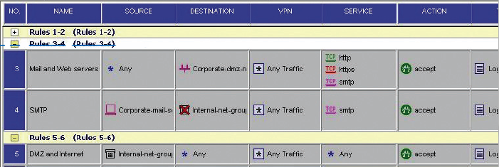
Checkpoint Rule Syntax

Slide 39
Manual Review
There are no automated tools that evaluate the business case of a rule set
  Network access may not be provided during assessment
  There are some tools to audit the configuration of the firewall (RAT for PIX)
  Most configurations are manually reviewed
  Each vendor is unique in their options and syntax
  Nmap and Nessus scans are not very valuable
A quick look for bad stuff
  Insecure communications
  Any communications
  Entire subnet communications
  Large ranges or groups of ports
  Duplicate entries

Slide 40
Manual Review
Firewall rule base review are generally done by hand
  It is important to have a network diagram, a list of all objects and groups and a lot of time
Once the easy stuff is done
  Begin checking from the top down
  Looking for rules that do not make sense
  Allow excessive access to devices
  Bridged network segments without ACL’s
  Ensure that the firewall is dedicated to being a firewall

Slide 41
Firewall Testing Tools
Some tools can be used to audit a firewall if:
  You have network access to the firewall
  You are allowed to assess the firewall in real-time
  You are performing a penetration test
hping
  http://hping.org
  Sends custom packets to test firewall filters
    Supports ICMP, UDP, TCP, RAW-IP
fragroute
  http://monkey.org/~dugsong/fragroute
  Intercepts, modifies, and rewrites egress traffic
    Use to test against stateful inspection firewalls

Slide 42
Firewall Testing Tools
Firewalk
  http://packetfactory.net/firewalk
  Tries to determine filter rules on gateway devices and map the network
  Old tool which uses older libraries
IRPAS (taken off line because of DE laws)
  http://phenoelit.de/irpas
  Internet Routing Protocol Attack Suite
  Manipulates routes on gateway devices to bypass filters
    Takes advantage of unauthenticated communications between routing devices
    Protocols supported include CDP, IGRP, HSRP, RIP, OSPF
Notes:
Egressor
http://packetfactory.net/Projects/Egressor
Old tool, many errors with compilation
Tests egress filtering
If egress filters are poorly configured, a DoS attack could be launched from internally
Nemesis
http://jeff.wwti.com/nemesis/
Old tool, compilation errors
Generates and spoofs packets
Can be used effectively with fragroute for testing
lsrscan
http://synacklabs.net/projects/lsrscan
Checks hosts to determine responses to source routed frames
Reversing source routes opens up hosts to spoofing attacks
Forwarding source routed frames can expose internal-only IP addresses

Slide 43
Common Findings
Poor ACL’s
  Allow entire subnets or large ranges of unneeded ports is a security risk
  Depending on the source and destination IP address this could be a high finding
  Best practice is to have a permit by exception rule base with specific IP to IP and port to port rules
Lack of Auditing
  Logging should be done for outbound and inbound network communications
  This is a Low finding depending on the quality of the ACL’s in place on the firewall
  Reviewing firewall log data on a daily basis can aid in detecting malicious external attacks, or potential compromises of internal machines

Slide 44
Common Findings
Poor Configuration
  The firewall itself must be securely configured and managed securely
  This could be a high finding depending on the severity of the vulnerabilities or configuration errors on the firewall
  This system should be one of the most secure on the network. It should be well maintained, securely managed, from a secure platform.

Slide 45
Conclusion
Each vendor is unique, however the basic principles are still the same (restricting communications)
Firewalls should be used to segment different levels of trust (internal from external, servers, from users, DMZ, from internal)
Firewalls must be securely configured
ACL’s or Rule base must be a permit by exception with granular access control

Slide 46
Firewall Exercise
Will demonstrate the effectiveness of firewall rules via tcpdmp and nmap
Your Solaris 10 VM can be used
  IPFilter is configured
  Rulebase /etc/ipf/ipf.conf
  Active rulebase ipfstat –hio
  Reload rulebase ipf –Fa –f /etc/ipf/ipf.conf

Slide 47
References
http://www.faqs.org/rfcs/rfc2267.html
http://www.sans.org/y2k/egress.htm

Slide 48
Observations
Firewalls work well
  The entire network security is dependent on the weakest link
  Not all assets are behind the firewall
Operational requirements always dictate some “holes” in the firewall security policy
Intrusion detection must be used to monitor “holes”
  If a VPN is used IDS cannot be done at the network perimeter
Firewalls must be supplemented with host level scanning

Slide 49
Questions

Slide 50
Vuln-Assessment: IDS, IPS, etc.

Slide 51
IDS – Approach and Purpose
We’re technically on the other side of the fence here
  Intrusion-Detection Systems are a defensive measures
  Intrusion-Detection Systems *catch* people like us
Advise/review IDS installations
You will run into plenty of IDS systems in your vuln-audits
A wide variety of intrusion-detection capabilities now exist
  The challenge is making good use of these capabilities
  Surprisingly difficult… our syste owners could use help here
Your vuln-assessments should incorporate IDS systems
Know which questions to ask, which answers are “good”

Slide 52
IDS – Agenda
Refining our scope
Alphabet Soup – NIDS, NIPS, HIDS, HIPS, SIM, SEM
File integrity checkers, signatures, anomalies, flows… etc.
Common IDS design/deployment patterns
  Placement
  Technology versus threat match
What to examine on a VA
  Proper use of IDS
  Proper care and feeding of IDS

Slide 53
Old School IDS, In Brief
IDS detects unwanted host/network activity in real-time
  Host IDS (HIDS) = a software agent running on a desktop/server
  Network IDS (NIDS) = a free-standing passive listener (“sniffer”)
  Report to – and managed by – a central console
Network-based IDS (NIDS)
  Commonly deployed at perimeter or along DMZ
  Sometimes deployed internally
Host-based IDS (HIDS)
  Generally used selectively (high-value targets, laptops)
  Very handy if host-to-host communications are encrypted

Slide 54
Intrusion Prevention Systems
IPS is essentially IDS technology, on crack
  Can fight back… drop packets or stop programs from running
  NIPS typically run on customized hardware, inline on network
  HIPS run close to OS kernel, insight into program, sys behavior
  IPS is the next step in IDS technology
  IDS has been criticized for high false-alarm rates and poor ROI
  IPS can be even *worse*, counterattacking your own network !!!
  Tuning the system to block ‘bad’ and allow ‘good’ is nontrivial
IPS’s key value propositions:
  Block “bad” traffic and/or host activity w/o human intervention
  Provide defense against attacks during the “vulnerability gap”

Slide 55
Managing The Vulnerability Gap
Vulnerability Gap
Discovery
Patch Available
Systems Protected
Vendor Develops Patch
Vendor Tests Patch
User Tests Patch
Patch Deployment
SIM and IPS
VA/VM
VA/VM
Highest-Risk
Period
Patch Management

Slide 56
Other IDS-type Technologies
File integrity checkers (e.g. Tripwire)
  Monitor changes to key system configuration files
Flow-based IDS (NetFlow)
  Tracks network connections
  Establishes patterns of normal traffi
  Alert when unusual services/patterns/protocols/behaviors seen
  Can give a good overall situational view on large network(s)
Exotic detection capabilities
  Augment or replace signature-based detection
  Usually anomaly/behavior-based (pseudo-artificial intelligence)
  Often require “training” periods to establish a baseline
Note: IDS/IPS/SIM/NetFlow distinctions are blurring…

Slide 57
Typical SIM Architecture
Manager & Correlation Engine
Event DB
Remote Site
Data Aggregator
Data Aggregator
Agent
Agent
Agent
Agent
Agent
Agent
Agent
Agent
Agent
Agent
Agent
Agent
Agent

Slide 58
Near-Realtime Intrusion Detection:
Not a One-Device Job Any More…

Slide 59
Seen This Picture Before?
$20k
InfoSec best-practice = Defense-In-Depth
  How many hops from user to the Internet?
NIDS + NIPS are not the same (diff foci)
  Ex: very different attack-views and auditing
They are not designed to be the same
  Can’t just ignore NIPS technology
  High capital cost, lower ops + maintenance
  Can they afford $50k+ per NIDS appliance?
  Can they pay that and still keep their IDS?
Cost efficacy, not just cool technology
  How to assemble this mis-mash?
  Balance capital investment and O&M
$5k
$75k
$5k
$75k
$50k
$200k
$20k
$20k
$15k
Still getting 0wn3d by 7 year-old exploits because your OS vendor didn’t anticipate every corner case in the RFCs… priceless.

Slide 60
Deploying the Right IDS…
There are a variety of IDS technologies currently available
  You will run into them during Vas
Consider how IDS are placed, if/how they are layered, etc…
  Correctly positioned in the architecture
  [very similar to the inside-fw vs. outside-fw vuln assessment views]
  Appropriate choice of detection technology
  Be careful not to recommend “IDS overkill” to your customer
Let’s discuss a few IDS examples across the enterprise…

Slide 61
Good Uses of IDS: In The Data Center
Use of Host-based IDS/IPS is paramount on high-val targets
  Every production Windows/*NIX server should have it
  Some mainframes might not support modern IDS; Tripwire or judicious system logging might be best
Enclave-based NIPS is a good idea
Enclave deployments of passive IDS is a bonus

Slide 62
Good Uses of IDS: In Userland
Be careful recommending/using IDS on the desktop
  HUGE volume of alerts, security analysts are drowning already
Good idea to put a NIPS betw. users and the Internet
  Keep the job of content monitoring to purpose-built devices
Flow-based IDS at the core is a good idea
Be cautious of all-in-one firewall + IPS + content filtering
  Immature technology, may not scale to large enterprises
  Putting all the eggs in one basket (if it fails or doesn’t detect…)

Slide 63
Good Uses of IDS: On the DMZ
Host-based HIDS/HIPS should be on all servers
Use service-specific IDS/firewall products where possible
  And NIPS where you can’t

Slide 64
Questions

Slide 65
VPN Security

Slide 66
What is a Virtual Private Network (VPN)
Software or Hardware
  Provides a protected communications path
  Could reside at a network or host level
  SSL VPNs versus IPSec
VPNs are one layer of security - They do NOT
  Ensure authorization or protection from malicious logic
  Protect from an insider threat
  Function as a silver bullet
Threatened by
  Direct attacks (unlikely)
  Denial of Services attacks
  Information leakage via poor configuration
Notes:
A VPN is a private network that utilizes an untrusted network to connect remote sites or users together. A VPN utilizes encryption to provide a secure connection through an otherwise insecure network to expand a private network beyond its immediate geographical area. VPNs are generally cheaper than real private networks using private lines but rely on having the same encryption system at both ends. The encryption may be performed by software or implemented with hardware.

Slide 67




Vendors
Several vendors and different types of products for network and host level VPNs
  Not all products are created equal

Slide 68
Types of VPNs
Site to Site
  Generally done in hardware to extend campus networks
  Lowers security to lowest common denominator
  Mainly for providing confidentiality
  Network architecture critical to ensuring security
User to Site
  Software on local client connecting to VPN server
  Can provide confidentiality, integrity and access control
  Network architecture critical to ensuring security
SSL VPNs
  These are a newer breed of VPN and do not require client
  Based on SSL standard
  Wide support and capability
  Provides confidentiality
Notes:
Using a VPN exposes the private network to attack from any system that has the ability to connect to the VPN. Since a VPN is an extension of a private network, the remote client has direct access to the less secure internal network of the private network. It is critical to the security of the private network that any VPN connections be tightly controlled and monitored for suspicious activity.

Slide 69
Best Security Practices
A VPN that implements a deny-by-default or permit-by-exception rule base
  Limits access to authorized users only!
  Limits communications to what is required for external business
Authentication
  Two factor authentication
  User groups
  Certificates for mutual key exchange
Architecture
  Restricts access or terminates in a DMZ where further security inspection can be accomplished
  Enforce Client configuration where possible (split tunneling, host based firewall rules, software versions, AntiVrius config, etc.)

Slide 70
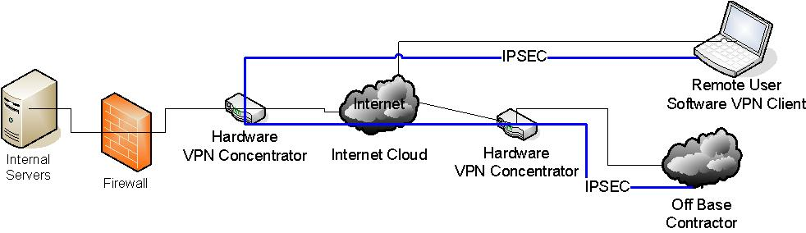
Common Architecture

Slide 71
Common Findings
Poor Configuration
  Weak ciphers or encryption algorithms
  Single factor authentication
  NO client configuration enforcement
  NO auditing
  Improper network architecture
  Shared VPN servers

Slide 72
Other Topics
Load Balancers (F5, ACE)
  Used to load balance across multiple devices
  Critical that they are secure
  Equally critical how they distribute information
Proxy servers (Websense, Squid, Webwasher)
  Content filtering
  Malware detection/removal
  Signatures/polices
All in one devices (ASA)
  Firewall, VPN, SSL VPN, IDS
Home Grown
  Look out, you’ll see some crazy stuff
Notes:
Using a VPN exposes the private network to attack from any system that has the ability to connect to the VPN. Since a VPN is an extension of a private network, the remote client has direct access to the less secure internal network of the private network. It is critical to the security of the private network that any VPN connections be tightly controlled and monitored for suspicious activity.

Slide 73
Common Findings
Poor Configuration
  Capabilities not understood
  Logging not implemented
  Updates not performed
  Insecure authentication

Slide 74
Questions

Slide 75
Network Services

Slide 76
Agenda
What’s needed
DNS Security
DHCP Security
SSH Security
NTP Security
Conclusion

Slide 77
What’s Needed
Networking experience
  Hands on experience: configuration, managing, building various devices
  Working knowledge of best practices
Security Experience
  Intimate knowledge of how to secure a system
  Prior experience with CIS Benchmark, DISA STIG/SRR
Data Collection
  Network scans from NMAP and Nessus
  Running device configuration
Other Skills
  Need to work with administrators
  Put vulnerability in their language
  Be tedious while looking for vulnerabilities
  Work well in a team

Slide 78
DNS Security

Slide 79
What is DNS
Software that:
  Is a hierarchal distributed database
  Maps host names to IP addresses - forward
  Translates IP address to names - reverse
  Supplies mail routing information and other domain data
Threatened by
  Direct attacks via vulnerabilities
  Denial of Services attacks
  Spoofing information
  Information leakage via poor configuration

Slide 80
BIND
Berkeley Internet Name Domain (BIND)
Opensource DNS server maintained by the Internet Software Consortium (ISC)
Current Version 9.7.3 release 02/15/2011
Widest availability and support
Notes:
This discussion focuses on BIND, however there are other implementations in use that should also be assessed if discovered in use on a network.

Slide 81
Named Config
acl - to restrict access to the server
  internal ( 192.168.1.0/24; };
  xfer (172.16.1.53/32; };
options - global server settings
  version “None of your Business”;
  listen-on { 192.168.1.53; 127.0.0.1; };
  allow-query { internal; };
  blackhole { };
  allow-transfer { }; -global and per zone
  recursion { }; - define per zone
Notes:
There are many options that can be specified in the named configuration file. I have discussed a few of the more important ones. A good reference to creating a secure server is located at
http://www.cymru.com/Documents/secure-bind-template.html

Slide 82
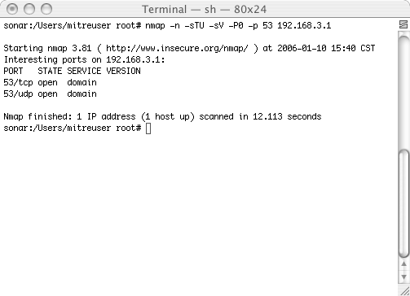
Nmap Information
Notes:
In this case, Nmap was not very useful other than identifying that there is a service enabled and active on TCP/IDP 53. This can be a good way to find DNS servers if you are mapping an entire network only looking for DNS servers. Simply change from a single host to an entire subnet and review the results.

Slide 83
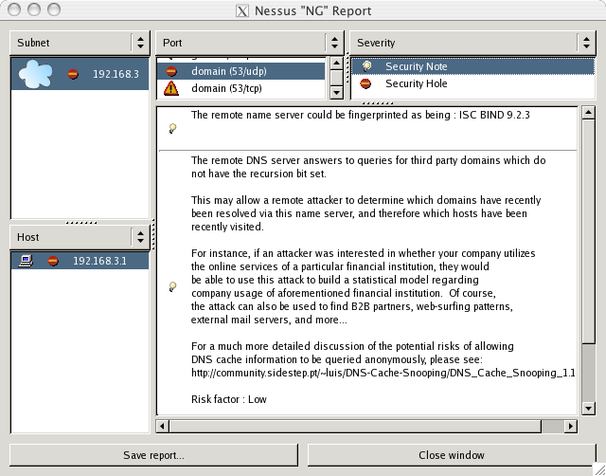
Nessus Information
Notes:
A quick nessus scan returns multiple results against a incorrectly configured DNS server. This slide shows that recursion is allowed. This setting can be configured on the named.conf and disabled or allowed based on ACL’s.

Slide 84
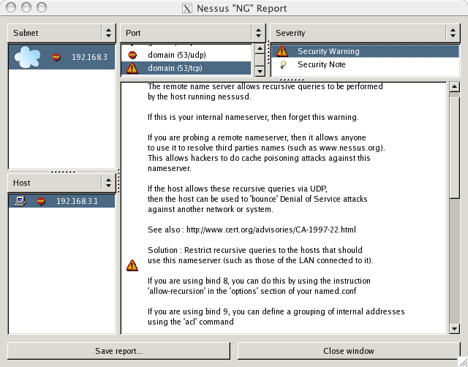
Nessus Warning
Notes:
The detail security warning about using recursion

Slide 85
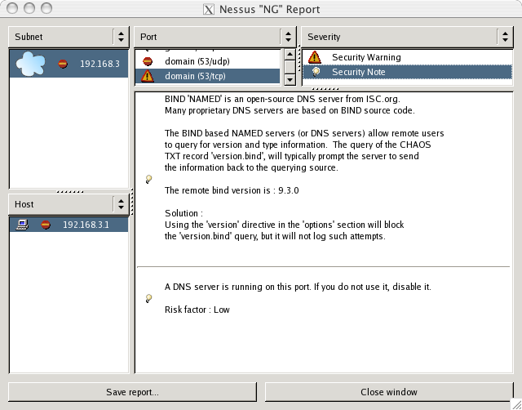
Nessus Notes
Notes:
Here is a note telling you that the have not used the version option to disable the ability to query and obtain the version of Bind. This does not effect the ability to fingerprint the services based on other characteristics. The version may always be able to be fingerprinted even with the version option set.

Slide 86
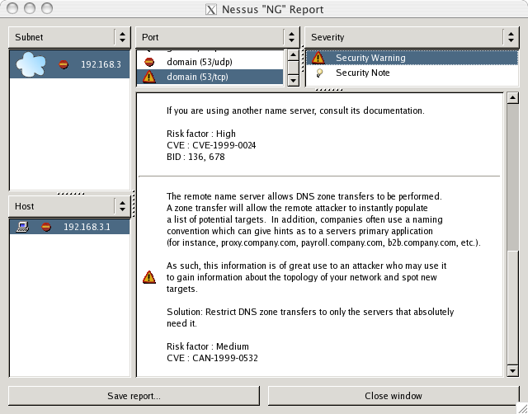
Nessus Warning
Notes:
A security warning about allowing zone transfers. This is configured in the named configuration file by setting allow-transfer option.

Slide 87
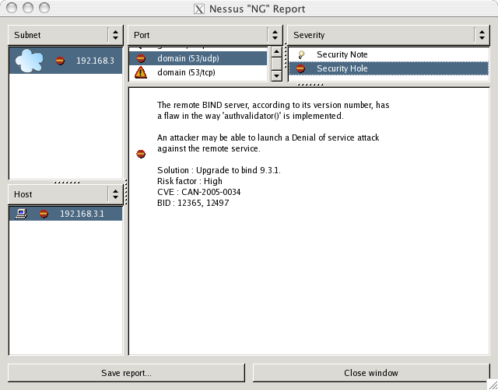
Nessus Security Hole
Notes:
In most cases, you will want to verify with the system administrator about the version of Bind they are using because Nessus could be wrong. In this case, it is accurate and it is vulnerable. The best recommendation is to upgrade to the most current version.

Slide 88
Manual Review
dig - Domain Information Groper
  Allows more control than nslookup
  Specify domain
  Query type (mx, axfr, ns, soa, txt,……)
  Server @myserver.mydomain.net
  Query for mail exchange records in a domain
    Dig mydomain.net mx
dnswalk - DNS database debugger
  Perl Script that Analyzes zone transfer data
  Requires Zone transfers to be enabled (not a good thing)
  Reports configuration warnings and errors
  Requires Perl module Net::DNS

Slide 89
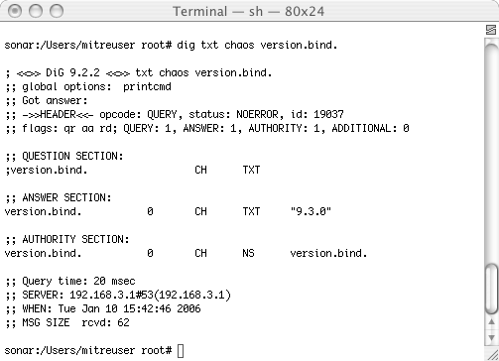
Dig Version Info

Slide 90
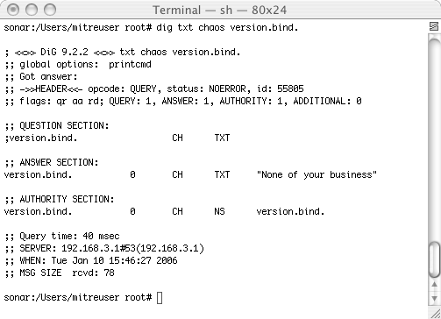
Dig Without Version

Slide 91
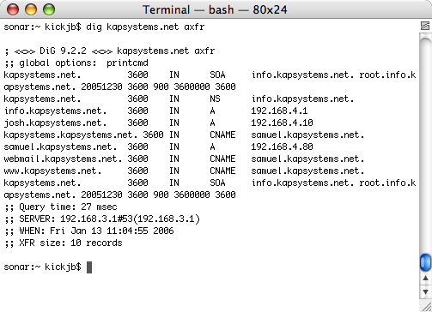
Dig - Zone Transfer

Slide 92
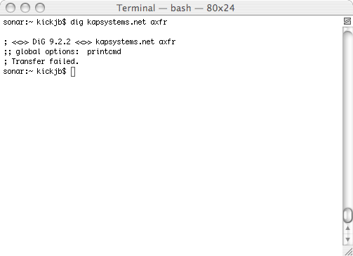
Dig - Zone Failure

Slide 93
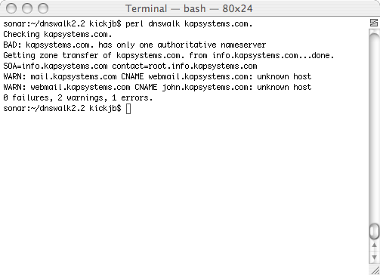
dnswalk Output

Slide 94
Common Findings
Jail not implemented
  Failure to run BIND in a controlled environment exposes the entire system to compromised instead of just the BIND server
  This is a high finding, especially if bind has vulnerabilities
  Using the -t flag only chroots the name server process not the entire application and libraries
  http://www.cymru.com/Documents/secure-bind-template.html
BIND version displayed
  Advertising the version of any software provides attackers unneeded information and should not be done
  This is a medium finding, High if vulnerabilities are present
  Add the the version option with a value other than the BIND version (e.g. version “Not Advertising”;)

Slide 95
Common Findings
Zone transfers not configured correctly
  A zone transfer could allow all information for a zone to be taken or updated by an attacker
  This could be a high finding if transfer is external
  Ensure that zone transfers are implemented correctly using ACL’s
ACL’s not implemented or incorrect
  ACL’s are incorrectly configured
  This could be a high medium or low depending on where the server is within the infrastructure
  If the ACL’s allow unauthorized address to query then use high
  External users should not be able to use the DNS server to resolve addresses other then domains for which the server is authoritative

Slide 96
Common Findings
External recursion allowed
  Allowing recursion from outside will allow anyone to use your DNS server to perform lookups (cache poisoning)
  High finding
  It is a best practice to split DNS function between an internal external server
    Internal for all clients; does not respond to external queries
    External for external entities to resolve authoritative answers for your domain
Inadequate logging
  Logging on the most communicated with device besides a mail gateway is critical
  Medium finding
  Logging is a critical aspect of detecting malicious use of a DNS server

Slide 97
Common Findings
Incorrect records
  Having correct DNS records is essential to the success and purpose of a DNS server
  This could be a low finding provided the system is not compromised
  Ensure that the records are accurate

Slide 98
Conclusion
DNS is a necessary evil in today’s world
  IPv4 addresses are easy to remember, but what about IPv6
  What’s the IP address of www.google.org??
There are critical security implications of improper DNS configuration
Thorough evaluation of DNS must be completed
  Automated tools provide a network view of the service (nessus, nmap, dig, dnswalk)
  Automated tools will not tell you additional information such as improper ACL’s, logging config, transfer hosts and other details
  Manual review of named.conf or equivalent
Evaluator should have DNS references on hand during review if not familiar with DNS configuration settings

Slide 99
DNS Exercise
Determine what mail servers exist in the testlab domain
What possible security errors/vulnerabilities exist in the configuration of the testlab domain server

Slide 100
References
http://www.oreilly.com/catalog/dns4/chapter/ch11.html
CERT CC “Securing an Internet Name Server” August 2002
Secure BIND Template By Rob Thomas http://www.cymru.com/Documents/secure-bind-template.html
Chroot-BIND HOWTO By Scott Wunsch http://www.linuxsecurity.com/docs/LDP/Chroot-BIND-HOWTO.html

Slide 101
Questions

Slide 102
DHCP Security

Slide 103
What is Dynamic Host Configuration Protocol (DHCP)
Software that
  Passes dynamic host configuration data in a TCP/IP network
  Implemented as a client server model
  Can perform dynamic DNS updates
  Provides client information like IP, netmask, DG, hostname
  Sets network server information such as NTP, DNS, LOG
Threatened by
  Poor configuration
  Denial of Services attacks
  Spoofing attacks
Notes:
Many people do not even realize what DHCP does for them, or that there is a server out there providing them an ip address and other information. DHCP make connecting to a network simple for the user.
DHCP could also be used to perform some type of attacks on systems that use the service. The server itself could be exploited by a vulnerability in the actual software. This is easily combated by keeping the software updated. Clients can be attacked in many ways. As an example a rouge DHCP server on a network could assign the wrong ip addresses, or other network information to clients denying them access or providing a means to spoof valid servers and to capture/manipulate traffic.

Slide 104
ISC Dynamic Host Configuration Protocol (DHCP)
Opensource DHCP server/client maintained by the Internet Software Consortium (ISC)
Current Version 4.2.0p2 release 12/10/2010
Widest availability and support
Built from RFC2131 and RFC1533
Notes:
This discussion focuses on ISC’s DHCP, however there are other implementations in use that should also be assessed if discovered in use on a network.

Slide 105
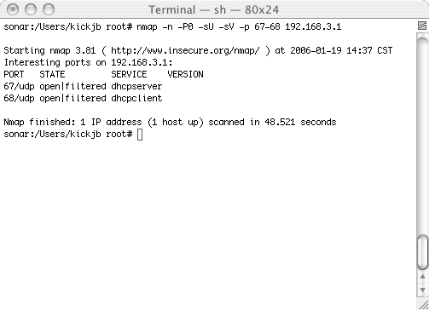
Nmap Information

Slide 106
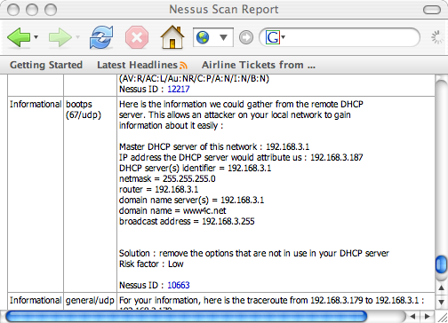
Nessus Information
Notes:
A quick Nessus scan reveals the information that it was able to obtain from the DHCP server. In this case it was thorough, but did not find any errors.

Slide 107
Common Findings
Jail not implemented
  Failure to run dhcpd in a controlled environment exposes the entire system to compromised instead of just the DHCP server
  This is a low/medium finding
  Need to ensure that the entire process and libraries are isolated versus just the proces
  Similar to BIND or Apache jailing
Unauthorized access to server
  Allowing access to the DCHP server from external or unauthorized devices could expose the server to compromise
  Depends on the situation, generally low
  DHCP services should only be available internally

Slide 108
Common Findings
Failure to check for rogue DHCP server
  A rouge DHCP server on a network could assign the wrong IP addresses, or other network information to clients denying them access or providing a means to spoof valid servers and to capture/manipulate traffic.
  Depends on situation and clients low or medium
  Scan network looking for dhcp server or monitor dhcp requests/responses
Inadequate logging
  Logging is essential to detecting malicious user and misconfigurations
  Medium finding
  Ensure that proper diligence is performed on logging

Slide 109
Common Findings
Improper configuration
  This should be a low finding but could be higher
  Allowing clients to modify their own records could create conflicts or other issues on the network
  Ensure that ignore client-updates is set

Slide 110
Conclusion
DHCP is a useful service in a client environment
  Dynamic address assignment, various options and DNS update functions
DHCP has limited security impacts
  Can be used to spoof systems and possibly disclose information
A review of DHCP server should be completed
  Automated tool is sufficient (nessus, nmap)
  Manual review of dhcpd.conf or equivalent just as easy
Evaluator should have DHCP references on hand during review if not familiar with DHCP configuration settings

Slide 111
References
https://www.isc.org - DHCP
http://www.faq.org/rfcs/rfc2131.html - DHCP Protocol
http://www.faq.org/rfcs/rfc1533.html - DHCP Options

Slide 112
Secure Shell

Slide 113
What’s SSH
SSH (Secure Shell) is a protocol
  Uses a variety of crypto algorithms
  Version 1 outdated and weak
  Version 2 best option
Many implementations
  F-Secure
  Data Fellows Secure CRT
  OpenSSH (Unix OS, Cygwin)
Noticeable differences between implementations (key formats, syntax files)
Notes:
4

Slide 114
Why Use SSH
It provides cryptographic transmission security (not clear text like Telnet/FTP)
Replaces telnet, FTP, RSH type activities
Commonly accepted in industry/DoD
Adds many capabilities
  Port forwarding
  Key-based authentication
  Key-based host authentication (shosts)
Notes:
4

Slide 115
sshd_config
Important options
  AllowPortForwarding ?
  Protocol 2
  LogFacility ?
  AllowRootLogin no
  PamEnabled ?
  HostBasedAuthentication ?
  AllowFrom 192.168.3.1 johndoe ?
Notes:
4

Slide 116
Key Based Authentication
Stronger form of authentication
  Requires access to private key for authentication
  Protected with a pass phrase
  Pre-distributed public key
  Can not be guessed/brute forced like a password
Higher confidence of user identity
Works great with ssh-agents for authentication
Notes:
4

Slide 117
Two key formats
F-Secure/Secure CRT format (SSH Commercial)
  Convert from SSH-Compatible to Openssh
  Ssh-keygen –X –f my_fsecure_key.pub
Openssh format
  Convert Openssh to SSH2-Compatible
  Ssh-keygen –x –f id_dsa
Notes:
Some times a public key that is generated in F-secure needs to be converted to an OpenSSH format.

Slide 118
Questions

Slide 119
SSH Detection
Determine where SSH is running
  nmap
Determine what versions of the SSH protocol are use
  ssh-keyscan
Notes:
4

Slide 120
NTP

Slide 121
What is Network Time Protocol (NTP)
Software that
  Designed to synchronize clocks on a network
  Master/Slave model
Implementations
  Appliances, hosts, servers, GPS time servers
  Required for proper auditing and analysis
  Accurate and reliable
  Has some security features
Threatened by
  Poor configuration
  Denial of Services attacks
  Spoofing attacks

Slide 122
Common Findings
Not implementing a time synchronization process
  Creates challenges in auditing events and analysis log system logs
Allow every client to contact external NTP servers
  There should be at least two primary NTP servers within an enclave for use by all clients
Not standardizing on a time zone or offset for systems across multiple geographic regions
  Complicates log event correlation and analysis

Slide 123
SMTP

Slide 124
Simple Mail Transfer Protocol (SMTP)
Software that
  Designed to relay mail messages between systems
Implementations
  Appliances, hosts, servers, GPS time servers
  Required for proper auditing and analysis
  Accurate and reliable
  Has some security features, not widely used
Threatened by
  Poor configuration
  Denial of Services attacks
  Spoofing attacks

Slide 125
Common Findings
Not disabling unneeded features
  EXPN and VRFY
  Relaying
  IMAP/POP
Missing security
  Spam detection
  Malware checking
  SPF records
Outdated/vulnerable versions

Slide 126

Questions

