Slide 1
Applications Assessment
Vulnerability Assessment Course

Slide 2
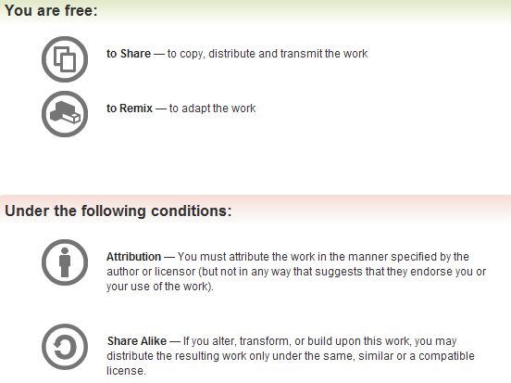
All materials are licensed under a Creative Commons “Share Alike” license.
http://creativecommons.org/licenses/by-sa/3.0/

Slide 3
Agenda
Introduction
Application – what is it? Why do we care?
Assessment preparations
Application assessment tools
Application Vulnerabilities
Lab: Spider and scan a Web application
3
Notes:
Assessing application vulnerabilities may be the most complex and least understood area of Vulnerability Assessment. The forthcoming discussions are not intended to make you an expert in this area. However you will, hopefully, come away with a better appreciation of what is involved with application vulnerability assessment.
As with other areas of Vulnerability Assessment, there are a number of pitfalls that we want to try to make you aware of.
In this section we will briefly discuss the types of applications typically assessed, vulnerabilities common to them, and introduce some of the concepts helpful to discovery of application vulnerabilities.
Application assessment is not glamorous. It is very time consuming, demanding and challenging. Effective application evaluators must expend a great deal of time and effort maintaining technical knowledge and skills, learning the functionality of each application, and poring over countless lines of code. Much of this is accomplished outside of normal work hours. And because so few truly understand what is involved with application assessment, these efforts often go unappreciated and without recognition.

Slide 4

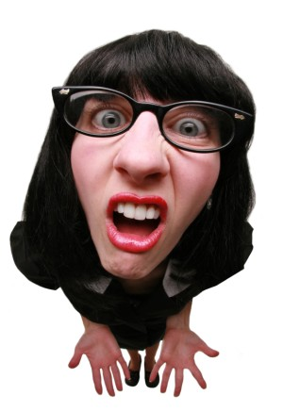
Some Assumptions
This is just the starting point – an introduction
Not all risks discussed
Application testing is hard and time consuming
We can't cover everything
Not here to debate terminology
4
Notes:
This is an introductory course…just a taste.

Slide 5
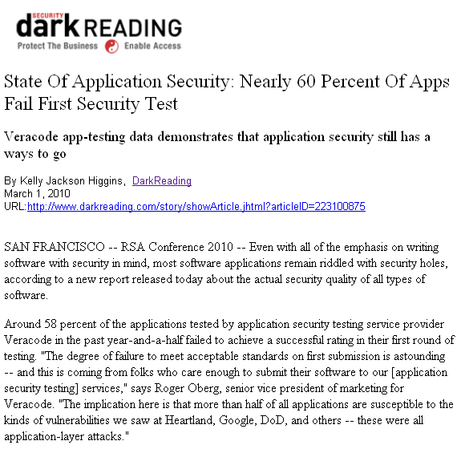
The Problem
You have applications…
Your applications have weaknesses!!
How do you know what weaknesses they contain?
Application vulnerability assessment will help you find them…
5
Notes:
Differentiate between what this course is about (vulnerability assessment) and other kinds of testing.

Slide 6
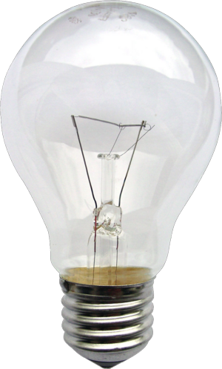

Applications
Distinguish from system/infrastructure
Provide business logic to support functionality of/for an organization
  Enterprise level
    Examples may include accounting, personnel, payroll
  Department level
    Examples may include resource management, information management
6
Notes:
An application is a computer program designed to help people perform a certain type of work.
The power plant generates electricity, not itself of any real use until harnessed to an application like the electric light that performs a function/capability that benefits the user. In this analogy the electric power generation plant is a system; the electric light bulb is an application.
Applications support mission fulfillment.
What types of data would you expect to find stored, processed and transmitted by these applications?
Business needs vary widely, so the associated applications are very unique.
App vs Infrastruture
Dangerous HTTP methods
TLS encryption

Slide 7
Understanding Each Other
7
Notes:
As with practically everything, there is of course the matter of vernacular.

Slide 8
Application Vulnerabilities
Unauthenticated or unauthorized access
  Viewing
  Modifying
  Deleting
Failure to enforce security controls
  Secure communication
  Password length, complexity, age, history
  Least privilege
  Session management, lockout, termination
  Hard-coded or default password
  Inactive, temporary, training, test, demo accounts
  Input validation
Pretty simple, right?
8
Notes:
Unauthenticated or unauthorized access: confidentiality, integrity, availability
Application vulnerabilities present opportunities for malicious individuals to:
obtain information/functionality that is intended to be restricted;
modify information/functionality in a manner that adversely affects intended decisions/outcomes, and/or;
disrupt operations

Slide 9

Application Attack Vectors
Parameter manipulation
Script and SQL injection
Session management
Interception
Malware
Buffer overflow
houseofhackers.ning.com/profile/whatitry
All found in the CWE/SANS Top 25 Programming Errors
9

Slide 10
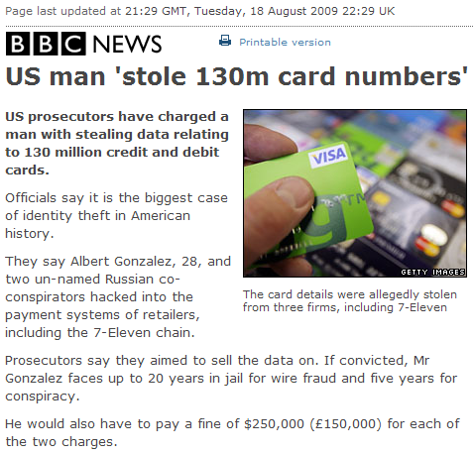
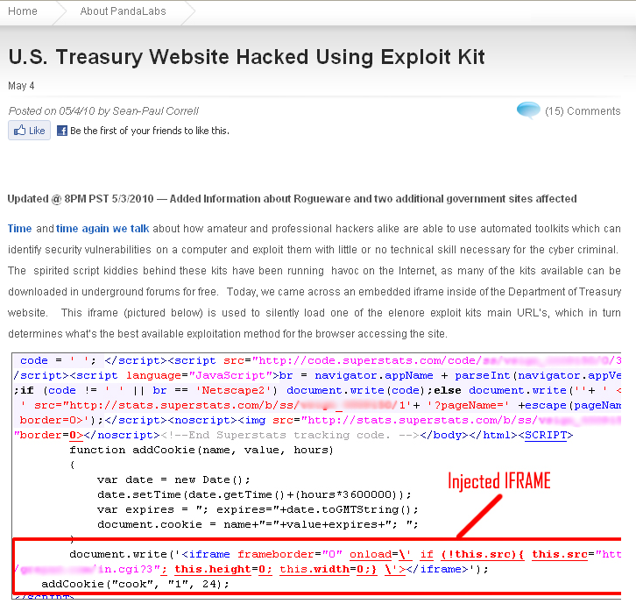
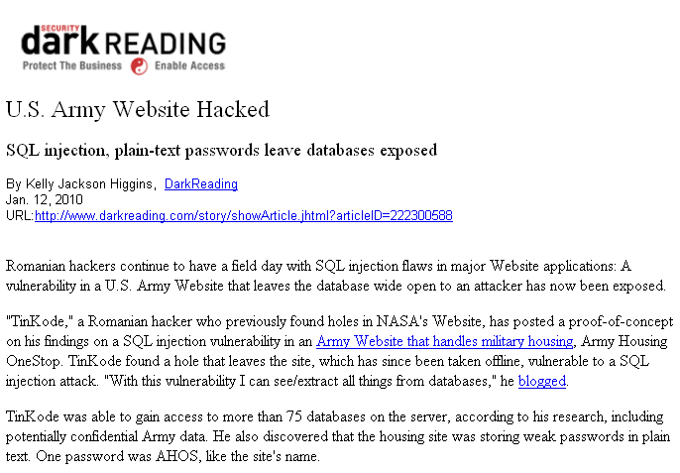
The Result
10

Slide 11
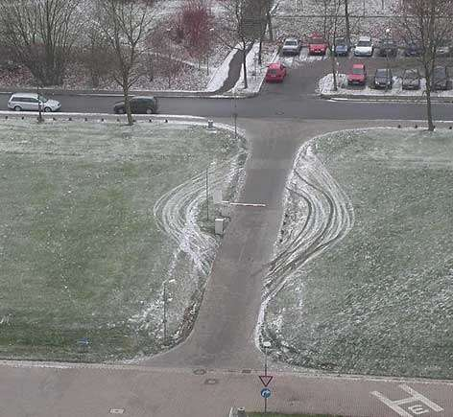
Some Things to Ponder
Looking at and using the application in ways a "normal" user would not
  Exposes weaknesses
  Bad guys don’t follow rules
  Problems due to unintentional user actions
Use the expected client environment...but also try "unexpected" environments
Phased application implementation
Assessment location
How long should it take?
11
Notes:
You can’t predict what a user might do…

Slide 12
Caveats
Production versus development environments
  Potential to modify production data
  In some cases production is preferable
  Advantages of manual testing over automated tools
Impact of specific testing
Development or test systems that mimic production
Some testing can only be performed in production
12

Slide 13
Methodology
Phase 1 – Planning
Phase 2 – Information Collection
Phase 3 – Enumeration
Phase 4 – Testing and Evaluation
Phase 5 – Reporting
13
Notes:
The Vulnerability Assessment methodology introduced earlier in the course is very relevant to an effective application assessment. Over the next few sections we will expand upon this methodology in relation to assessing vulnerabilities in applications.

Slide 14

Required Information
Business description of the application
  Purpose/function – business rules
  Types of information
  Types of Users/Roles
    Users and their locations
Technical description
  All methods of access
  Site URLs as applicable
  Application Account(s)
    All roles, including administrator/super user
  Data flow/transaction logic/use cases
14
Notes:
Remember, this is application vulnerability assessment, not penetration testing. Therefore we can ask for, and expect to receive, any and all information that will help us to perform an effective assessment.
Normally an application assessment is conducted over a relatively short period of time. When the application being assessed is large and/or complex, weaknesses may be difficult to discover within the time constraints placed on the assessment. Malicious individuals are usually not operating under any time constraints. The application evaluator must discover, usually within a matter of days, any vulnerabilities that may take a malicious individual months or perhaps even years.
Therefore it is important for the system owner and any supporting contractors to understand that a cooperative effort will yield the most thorough and effective assessment, given the time constraints.

Slide 15

Application Familiarization
What is the application’s purpose?
  What does the application evaluator know about the business processes?
Who are its users?
  Are there various user roles with distinctive privileges?
How is it accessed?
What are the underlying technologies?
Remember me?
What is most important? What, if not working properly, would cause major problems? What are the critical functions?
15
Notes:
As mentioned at the beginning of this section, the application assessment should not begin when the evaluator sits down in front of the application. A much more thorough and effective assessment will result from advance preparation. The application evaluator who has a good understanding of the application’s purpose and functionality prior to first contact with it will be ready to focus on the technical activities required to discover any vulnerabilities.
Therefore the application evaluator should dedicate time for the purpose of reviewing the information discussed in the previous slides. This review should prior to arriving on site and is intended to provide a good understanding of the application’s purpose and functionality. Administrator/Operator and User manuals/guides and/or training materials can be very helpful in this regard. If hands-on training is available, the application evaluator should consider this too.
Having familiarity with any underlying technologies that support the application will help the evaluator understand any inherent weaknesses and provide the opportunity to make any special preparations prior to arriving on site. This might include brushing up on skills, or collecting any tools unique to the technology.

Slide 16
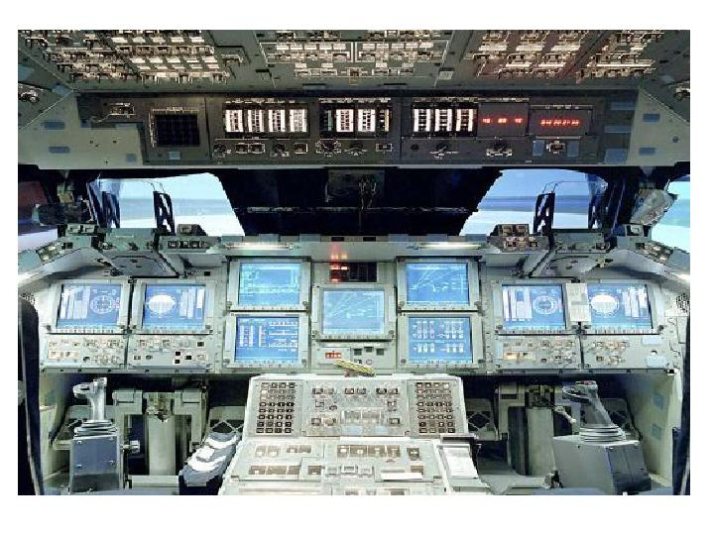
16
Notes:
Uh Houston? We may have a problem…

Slide 17
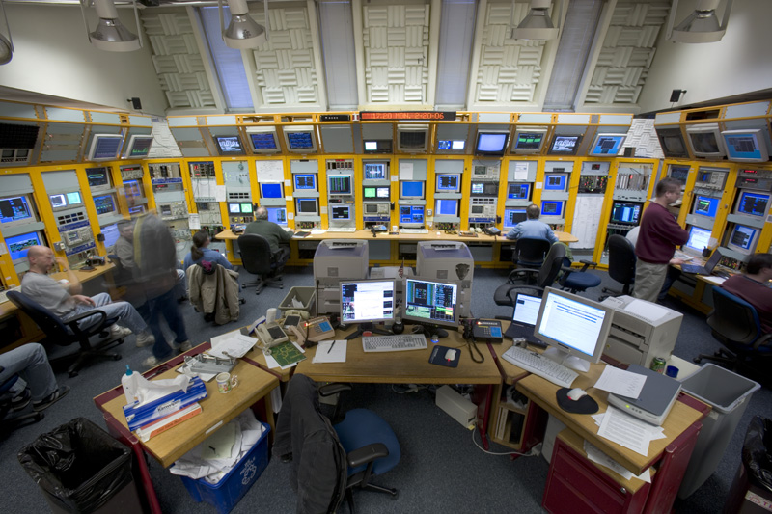
17
Notes:
In the event you thought that previous slide was little too far out there, perhaps you would feel more at home here?

Slide 18

Basic Tools – Yours or The System Owner’s
Web Browser
Application Proxy
Network Protocol Analyzer
Tools are not THE solution!
They don’t understand business logic and produce false positives…
18
Notes:
The use forms, parameters, logic and functions that comprise Web applications are very unique and dynamic. Existing Web application security scanners usually can help to identify the potential for script injection (such as XSS and SQL), Secure Sockets Layer (SSL) certificate issues, SSL protocol and cipher weaknesses, directory indexing, directory traversal and the like. These are primarily Web server issues. Web application security scanners really do not test application functionality and therefore will not discover most vulnerabilities related to parameter manipulation and unauthorized access to privileged functionality.
Paros is a Java-based client HTTP/HTTPS proxy. Edit/view HTTP messages on-the-fly. Also spidering, proxy-chaining, intelligent scanning for XSS and SQL injections.

Slide 19
Additional Online Tools
Google Hacking
  Using Google to search publicly accessible Web applications for vulnerabilities and to discover sensitive information
    site:<webapp> filetype:doc (try other file extensions too)
      Example: site:yahoo.com filetype:xls
Netcraft – http://www.netcraft.com/
Wayback Machine – http://www.archive.org/
19

Slide 20
Methodology
20
Phase 1 – Planning
Phase 2 – Information Collection
Phase 3 – Enumeration
Phase 4 – Testing and Evaluation
Phase 5 – Reporting
Notes:
During this section we will be touching on phase 4 of the methodology as it relates to application assessment.

Slide 21
Application Mapping
Now that you have your hands on the application, you *really* get to see what's what
Discover application functionality
  Identify channels for user input
  Identify implemented security controls
  Determine where critical data resides
  “Reality" doesn't always match the documentation
  Lack of or incomplete documentation
21
Notes:
You have a limited amount of time to test the application, so it is important that you understand where most vulnerabilities might reside and test those areas first. Map the application and its functionality looking for areas of interest.

Slide 22
Methodology
22
Phase 1 – Planning
Phase 2 – Information Collection
Phase 3 – Enumeration
Phase 4 – Testing and Evaluation
Phase 5 – Reporting
Notes:
During this section we will be touching on phase 4 of the methodology as it relates to application assessment.

Slide 23
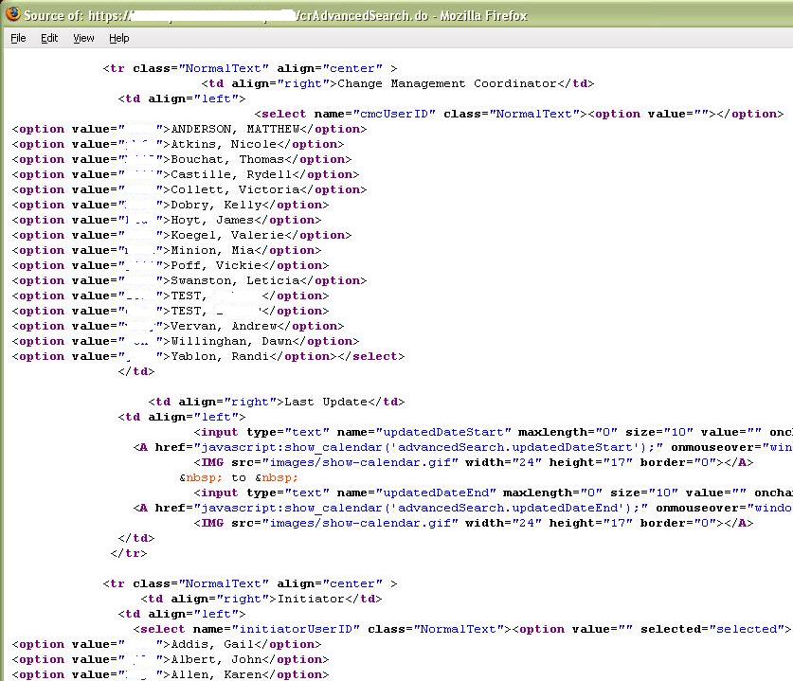
Information Exposures – Hidden Functionality
23

Slide 24
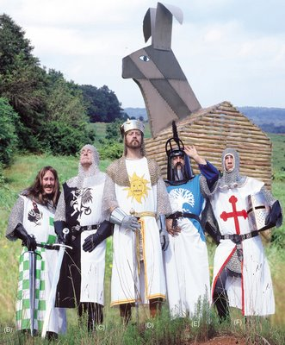
Malicious File Uploads
Web applications that accept file uploads may
present Trojan or directory traversal vulnerabilities
  Type of file should be restricted to only those required
  Text is the only safe file type left
24

Slide 25
Account Lockout and Session Inactivity
Account Lockout
  Number of failed attempts
  Length of lockout
  Client-side processing
  Automatic lockout for unused account
Termination of session due to inactivity or logout
25

Slide 26
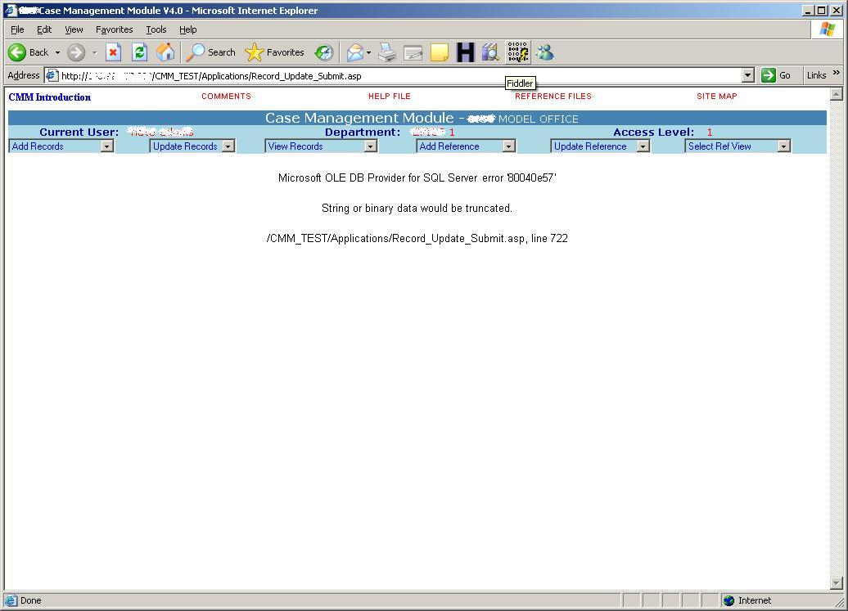

Force Errors in the Application
Errors can reveal application weaknesses
26
Notes:
Use client side proxy to insert more characters than are specified in HTML form field length
Verbose errors
Supplying format type specifiers in application input might crash the application creating a core dump in the hosting folder
http://hostname/html/en/index.htm%n%n%n
Vulnerable CGI scripts may result in stack data being printed out to browser
http://hostname/cgi-bin/query.cgi?name=john%x.%x.%x&code=123%x.%x

Slide 27
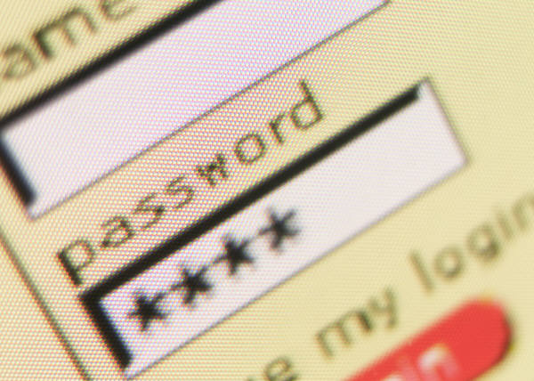
Authentication Issues
Length
Complexity
  Dictionary words
History
Aging
  Minimum days
  Maximum days
Error messages
Client-side processing
Hard-coded passwords
27
Notes:
Provide information about how these may present application weaknesses

Slide 28
Change User Passwords
Attempt to substitute parameters that are passed from the client to the server when a password change is made
Attempt to reset passwords by guessing answers to easy “security” questions
Account enumeration
    Published technique
    Login error messages
    Brute force
28

Slide 29
Session State
A chain of trust
HTTP is a stateless protocol, therefore Web servers respond to client requests without coupling them together
Valid Session token exposure may permit a malicious user to take over the session
Session Exercise
29
Notes:
HTTP is a stateless protocol, therefore Web servers respond to client requests without coupling them together
No problem while anonymously browsing the Web
But with all this concern about only permitting authorized access, how does the system know it’s me when we need it to?
“Sessions” and session management
Upon authentication, the system associates an identification token (usually in the form of a session ID, or cookie) with the user
This identification token is then presented by the client with each request
Session management can be provided by:
Web server software
Middleware
“Home grown”
Obtaining a valid session token may permit a malicious user to take over, or “hijack” the session
Hijacked sessions are usually terminated when the legitimate user logs off
Attacker may use this for denial of service
Exposure of session token
Token should be protected by SSL encryption during transmission
Session ID in URL rewrite
Switching between secure and non-secure pages
Cached on the client
Tools such as Paros may help identify token exposure
Session tokens that are not properly invalidated by the server may provide hijacking opportunities
Session tokens that are predictable may also present vulnerability to session hijacking
Steps of the attack:
collection of a sufficient number of cookie samples
analysis of the cookie in an attempt to determine the generation algorithm
attempt to forge a valid cookie
How many tokens does the application use
Do tokens remain static throughout the session
Tokens may be delimited
Token analysis tools
CookieDigger (older tool and doesn’t work on many current sites)
WebScarab: http://www.owasp.org/
Perl scripts by Rogan Dawes: http://archives.neohapsis.com/archives/sf/www-mobile/2003-q1/0308.html

Slide 30

Data Transmission Confidentiality
Protecting data in transit
  Application data
  Session tokens
30

Slide 31
Business Logic and Workflows
Validate Business Logic
Hardest risk to detect…application walk-through helps
Cannot be detected by vulnerability scanners
Assumptions by developers…requires creative thinking
  Parameter manipulation
  Perform steps 1, 2, 3 in order, what happens if step 2 is skipped
  Level=1, role=user, etc
  http://<testurl>/admin/ or http://<testurl>/pwdchange/
Impact examples
  Horizontal and vertical role escalation
  Unauthorized process flows
What is most important? What, if not working properly, would cause major problems? What are the critical functions?
31

Slide 32
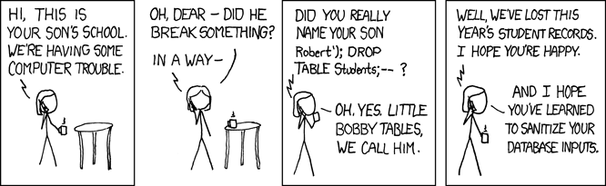
Input Validation
Lack of input validation results in code insertion via user supplied data
Caused when…
  User input incorrectly filtered can result in executed code
  User input is not strongly typed and thereby unexpectedly executed
User input cannot be trusted
Client-side validation inadequate
32

Slide 33
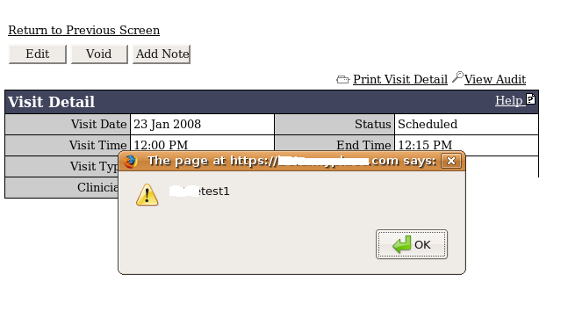
Cross Site Scripting (XSS)
Code injection attack into the various interpreters in the Web browser
  HTML, JavaScript, VBScript, ActiveX, Flash, etc.
Types
  Persistent
  Non-Persistent
Used for…
  Account hijacking
  Changing user settings
  Cookie theft/poisoning
  Denial of Service
  Scanning for vulnerabilities
33
Notes:
Code injection vs exploiting existing functionality

Slide 34
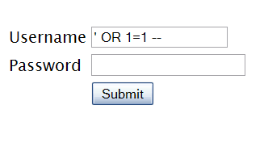
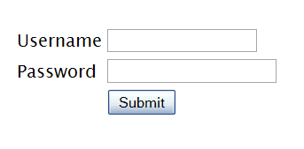

SQL Injection
Account Summary
Acct:5424-6066-2134-4334
Acct:4128-7574-3921-0192
Acct:5424-9383-2039-4029
Acct:4128-0004-1234-0293
"SELECT * FROM accounts WHERE acct=‘’ OR 1=1--’"
Account:
Account:
Database
SKU:
HTTP response
‘
DB Table ‘
SKU:
HTTP request
SQL query
Application Code
1. Application presents a form to the attacker
2. Attacker sends SQL code in the form data
App Server
3. Application forwards code to the database in a SQL query
Web Server
Hardened OS
4. Database runs query containing attack code and sends results back to application
Firewall
Firewall
5. Application sends results to the attacker
Derived from OWASP AppSec DC 2009 presentation by Dave Wichers
34

Slide 35
Lab 1 and 2 – Hidden Information
Getting started
  Open Student Windows VM … password is “guest”
  Click “WebGoat Server”
  Open “WebGoat User”
  Log in as "guest" ... password is “guest”
Lab 1 – Instructor Guided
  Code Quality … Discover Clues in the HTML
Lab 2 – Instructor Guided
  Parameter Tampering … Exploit Hidden Fields
35
Notes:
Potential spidering pitfalls
Endless loops (e.g., calendar functions)
Logout
Robots.txt
Proxy chaining
False positives

Slide 36
Lab 3 – Web Application Tools
Getting started
  Open Student Windows VM … password is “guest”
  Click “WebGoat Server”
  Open “WebGoat User”
  Log in as "guest" ... password is “guest”
  Open Paros
Lab 3 – Instructor Guided
  Use Paros to spider WebGoat, then scan
36

Slide 37

Questions
37

Slide 38
Additional Labs (all student driven)
Lab 1: URL manipulation (privilege escalation)
  Access Control Flaws ► Remote Admin Access
Lab 2: URL manipulation (hidden functionality)
  Insecure Configuration ► Forced Browsing
Lab 3: SSL (insecure communications)
  Authentication Flaws ► Basic Authentication
Lab 5: Directory traversal
  Access Control Flaws ► Bypass a Path Based Access Control Scheme
Lab 1: SQL injection
  Injection Flaws ► Numeric SQL Injection
Lab 2: SQL injection
  Injection Flaws ► String SQL Injection
Lab 3: XSS
  Cross-Site Scripting (XSS) ► Stored XSS Attacks
Lab 4: Client side validation
  Parameter Tampering ► Bypass Client Side JavaScript Validation
38

