Slide 1
Database Assessment
Vulnerability Assessment Course

Slide 2
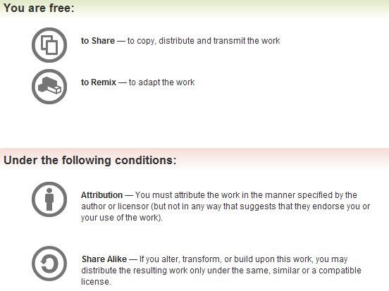
All materials are licensed under a Creative Commons “Share Alike” license.
http://creativecommons.org/licenses/by-sa/3.0/

Slide 3
Agenda
Introduction
Configuration Guidance
Operating System Configuration
Database Installation
Default Database Configurations
Identification and Authentication
Auditing and Monitoring
Overview of Oracle Testing
Overview of SQL Server Testing

Slide 4
Introduction
Database Security focuses on the use of database management systems to protect systems and data from unauthorized:
  Access
  Creates
  Reads
  Updates
  Deletes

Slide 5
Relational Database Management Systems
Sublanguages
  Data Definition Language (DDL) defines structure
  Data Control Language (DCL) defines security/access controls
  Data Manipulation Language (DML) for data query/updates
Interface drivers – code libraries for prepare statements, execute statements, and fetch results
  SQL*Net/Net8
  Open Database Connectivity (ODBC)
  Java Database Connectivity (JDBC)
SQL Engine interprets/executes DDL, DCL, and DML
Other Engines
  Transaction – statements either succeed or fail as a group
  Relational – integrity constraints
  Storage – data modification, commit/rollback, and backup/recovery

Slide 6

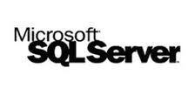






Breadth of Technology
Examples of Databases
  Oracle
  Microsoft SQL
  MySQL
  DB2
  Informix
  TeraData
  Sybase
Examples of Database Applications
  Oracle Financials
  SAP
  SAS

Slide 7
Considerations
Majority of tests performed on live production systems
  Limit to non-destructive testing
  Penetration testing vs. Vulnerability Assessment/Compliance
Database similarities allow for similar tests
  Different products use different commands/procedures
  Features are similar yet different between products
Must be very familiar with the product and add-ons to
  Eliminate false positives
  Be taken seriously by administrators
  Know most important product add-ons
  Where is the database within the system architecture
  Understand the database purpose

Slide 8
Security Configuration Guidance
DISA Guidance – Secure Technical Implementation Guides (STIGS) and Checklists
NSA Security Configuration Guidance
NIST Security Configuration Checklists
Center for Internet Security (CIS) Benchmarks
Vendor Database Security Guidance

Slide 9

What is a STIG?
What is a Database STIG?
  Guidance on technical security policy, requirements, and implementation details
  Covers major vendors’ database product
  Provides classification guidance for weaknesses found
What it is not?
  Step by step implementation guide
  Guidance to be taken literally
  Always consistent and up to date
  Always applicable to commercial or non-DoD environments

Slide 10
What Else Is It Not?
Not Addressed
Addressed
Partially Addressed
Partially Addressed
Notes:
Need to run additional test, come up with additional questions / test cases to at least partially cover the non-addressed or partially addressed situations

Slide 11
Common Pitfalls
Guidance can be out-of-date
  Covers only the “core” product
  What about add-on options?
  Some add-on options are not so optional
  Infrastructure and system architecture in which the DB operates not taken into account
Familiarity with a variety of vendor add-on products or 3rd party tools used to
  Manage the database
  Monitor the database
  Backup the database
  Perform ETL operations on the database
  Authentication constraints imposed by tools
  Permissions required to run tools
  Constraints imposed by application using DB

Slide 12
Operating System Configuration
Permissions on the OS directories and on the binary files
  Why bother to break into the database if you can just take the database files
Permissions of critical configuration files
Permissions of installation, log, trace, and files

Slide 13
Database Installation
Root of many problems
  “All or nothing” option when installing some products
Removal of options difficult if not impossible
  If at all possible, vendor technical services needed in some cases
Demonstration code in the database and on the binary install base
Java Virtual Machines (JVM) and Java Runtime Environments (JRE) inside the database and in the binary install base
Fully functioning, unsecured J2EE containers
DBMS version maintenance
Updated patch and fix installation

Slide 14
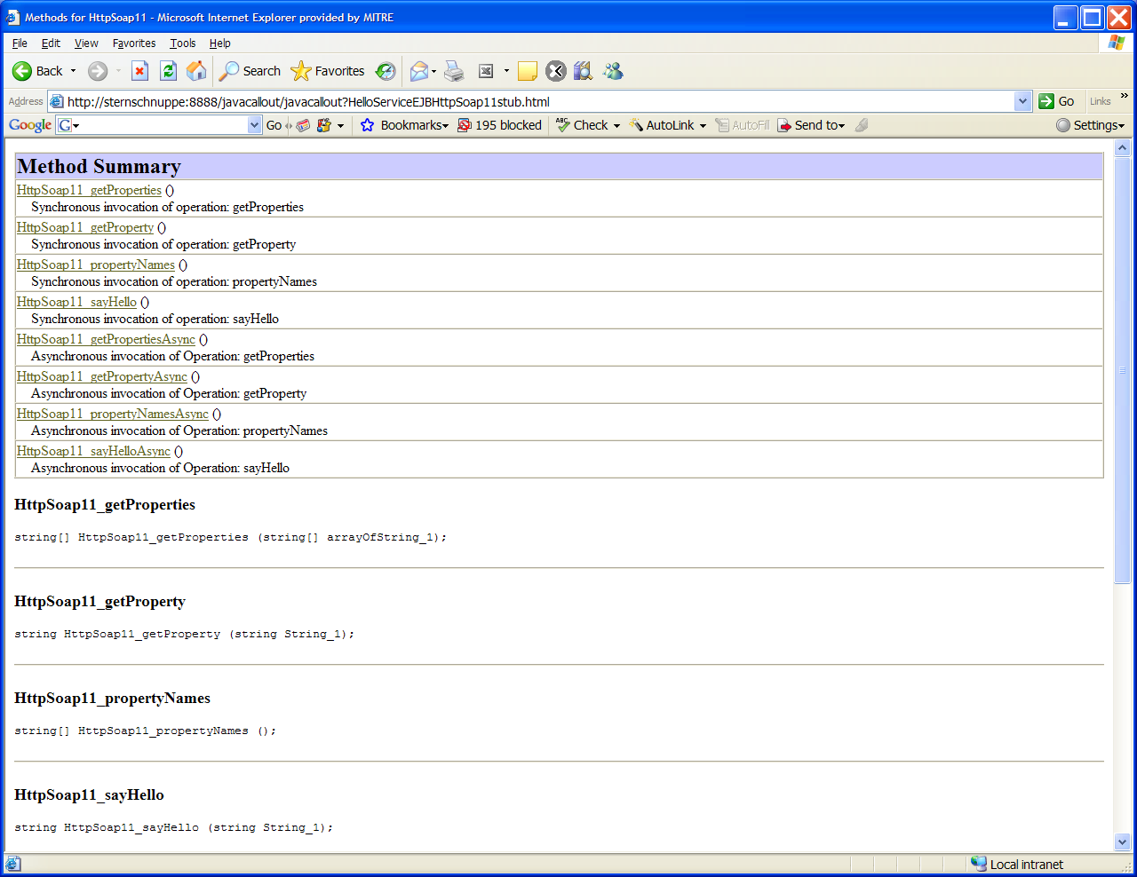
When Your Database Looks Like The Web

Slide 15
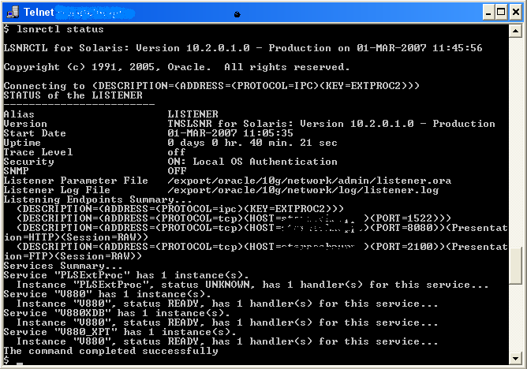
Default Oracle LISTENER Configuration 10g

Slide 16
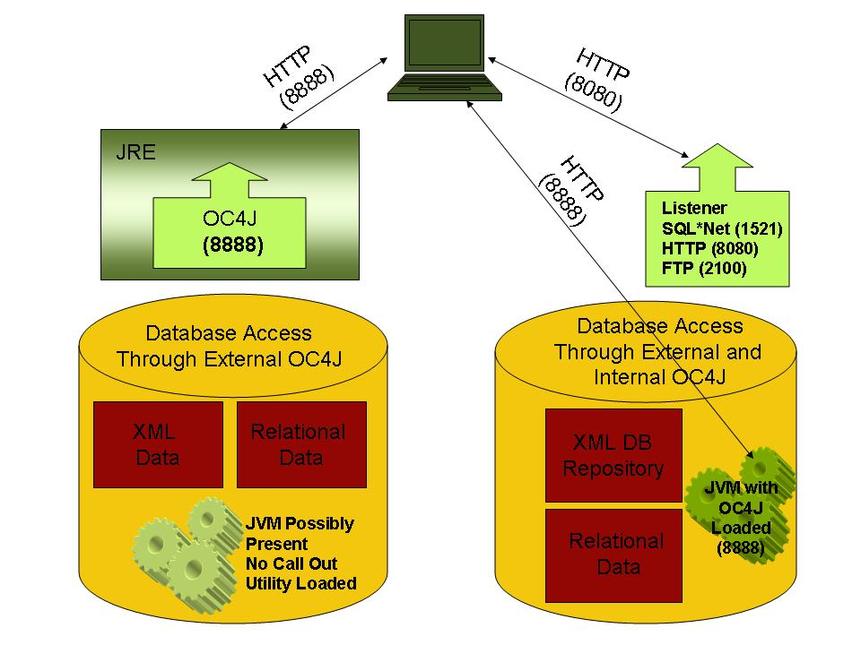
Default Oracle 11g Database Access
Notes:
J2EE container by OC4J.jar with no password required
java –jar oc4j.jar
Insecure HTTP server on port 8888
These JVMs are sometimes unknown to many DBAs
Oracle 10.0.1 WebDAV configuration on port 8080
After version 10.0.1 no longer default configuration, but if XML DB is configured the same behavior exists

Slide 17
More Exploits, No Checklists
Previous examples showed default installation issues
  Database is no longer accessible with SQL*Net only
  JRE installed as an external component to the database
  Internal JVM is another potential vulnerability
Next example demonstrates
  Behavior of invoker vs. definer rights
  PUBLIC assignment of privileges
  Exploit using both to elevate user privileges from next to none to DBA
What you should take away from these examples
  Some guidance does not always address vulnerabilities
  Gap needs to be addressed by manual testing and ad-hoc probing
  There are no checklists for this!

Slide 18
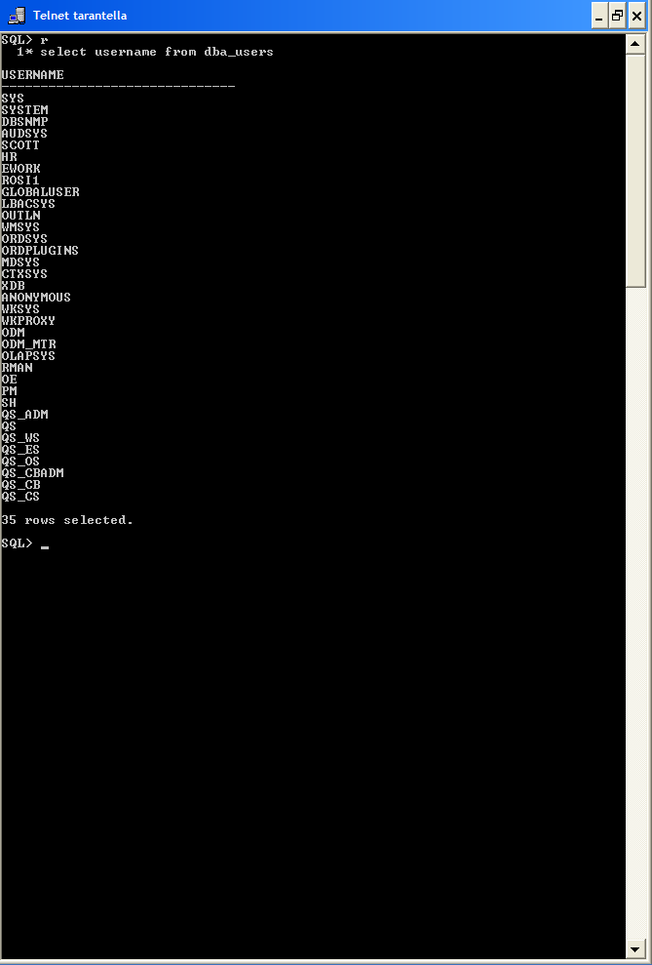
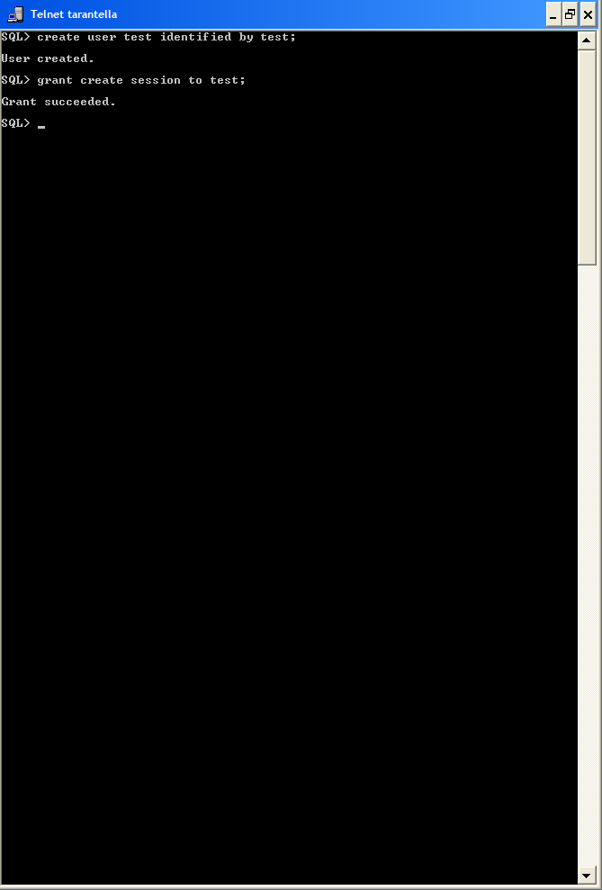
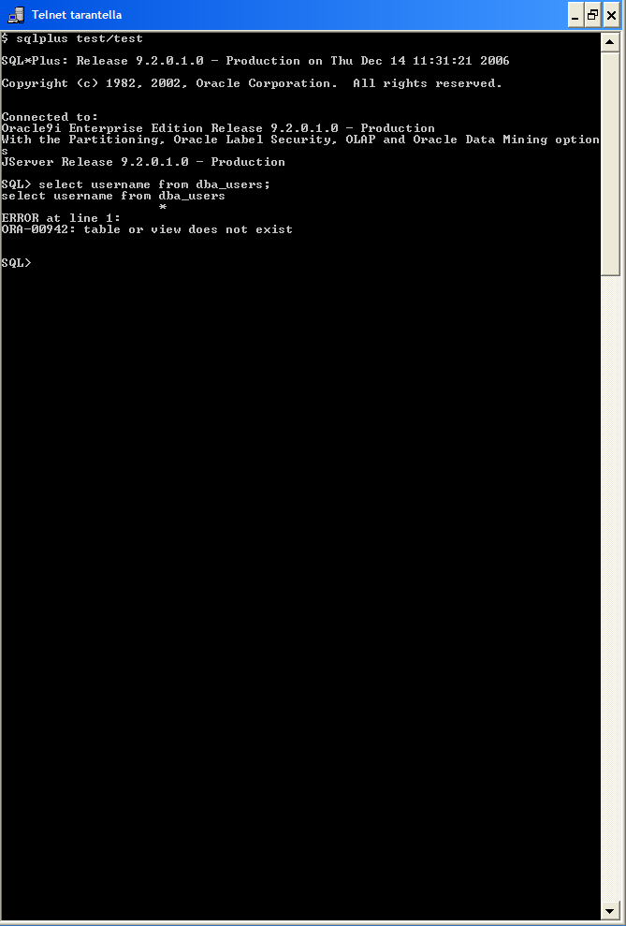
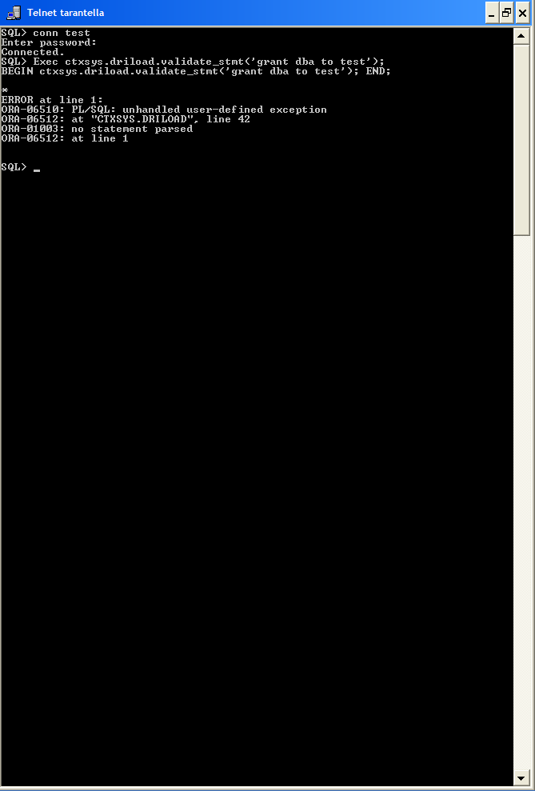
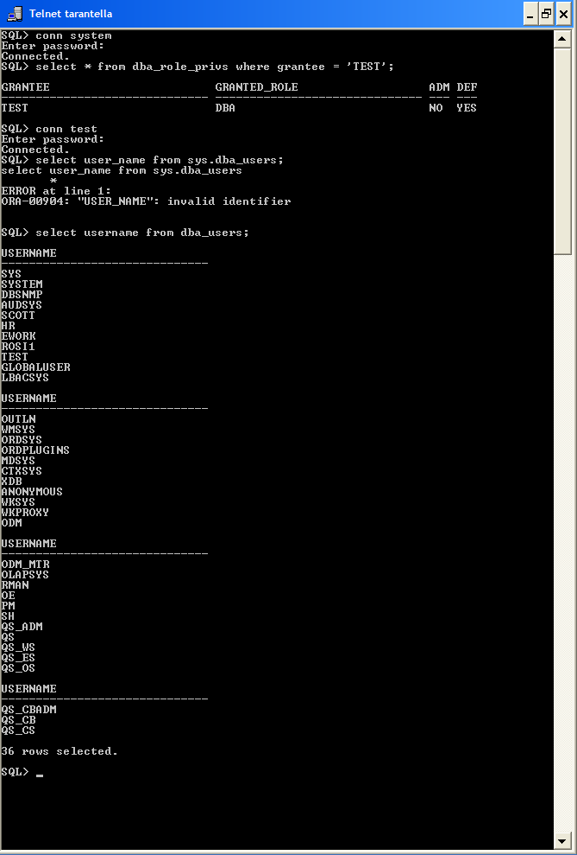
Escalation of privileges
Unpatched Oracle 9i
Create user (TEST)
Minimal privilege (CREATE SESSION and PUBLIC privileges)
TEST user executes CTXSYS package with rogue command
TEST user has DBA privileges
Notes:
Objective is to create a user with minimal privileges; shows that users with minimal privilege assignments are still exploitable
High privilege assignments tested, but neglects to test for exploitable packages
initial privilege assignment is irrelevant
CAVEAT: Unpatched Oracle 9i databases
Privileged user querying user view to show existing Users
User TEST logs onto database
TEST user executes CTXSYS package (default user)
Stored procedure validate_stmt error, but rogue command (‘grant dba to test’) passed is executed
Command not intended to be used with this package
TEST user attempts to query the dba_users view
TEST user only has PUBLIC privileges
So what happened?
Procedure and package owned by CTXSYS granted to PUBLIC
TEST had execution privilege because PUBLIC is allowed to execute the stored procedure
Stored procedure runs as SYS and the rogue command is executed as SYS and therefore TEST is elevated to DBA

Slide 19
DBA Role
DBA role is very powerful and access to it should be restricted
Verify that any database account granted the DBA role is explicitly authorized
Individual DBA accounts should be created for each DBA
DBA accounts used only for DBA functions

Slide 20
Identification and Authentication
OS-based authentication mode
  Different databases, different modes
    MS SQL Server – Windows or server authentication
    Oracle – OS authentication or remote authentication
Default or blank passwords
  Oracle accounts…too many!!!
    483 unique default accounts
    46 accounts have multiple default passwords, depending on version
    597 total default password possibilities
Oracle LISTENER security
  Local OS authentication is used for listener security in Oracle 10g and higher version
  Prior to 10g, password did not follow best practices
    Age, strength, history, and lockout
Notes:
If user is a member of ORA_DBA local group, then the user logs on SYSDBA which means no SYS password needs to be provided.
Oracle uses the NTLM SSPI AcceptSecurityContext() function. If the user presents a correct userid and password then the function creates a token and the log on is successful If simple file sharing is enabled, all user logons are successful, because the user is authenticated as “guest”.
Oracle does not know the notion of “guest” and takes the authentication name the remote user has supplied. If the supplied name is a valid entry in the ORA_DBA group, for example “oracle”, then the user is given SYSDBA access.
The assumption is made in good faith, that the user must have supplied the correct password.
Attackers need to guess or discover valid names in the ORA_DBA group.

Slide 21
Oracle Connection Security
listener.ora file
  Program = extproc
sqlnet.ora file
  TCP.VALIDNODE_CHECKING = yes
  TCP.INVITED_NODES = list of accepted TCP/IP addresses
  TCP.EXCLUDED_NODES = list of unallowed TCP/IP addresses
Notes:
In the listener, the default config is for the extproc to be enabled.
For the sqlnet.ora file…when TCP is used node validation should be used. IP addresses can be spoofed, but this adds a layer of protection.

Slide 22
Database Links and Remote Connections
Available for almost all databases
Are they required for this database to operate?
Ensure that the database object containing the link and password information is not accessible

Slide 23
Data Confidentiality
Data in transit
  Per default, database connections are not encrypted
  Some vendors’ encryption capabilities are add-on purchases and expensive
  Consider encrypting JDBC connections
Data at rest
  Encryption of Personally Identifiable Information (PII) data in the database
  Encryption of database data means
    Examine any custom code used to encrypt data
    Examine the encryption algorithms used and the implementation details
    Some use Vormetric or Decru…issues with key management
  Newer versions of Oracle and SQL Server offer data encryption
Notes:
Custom code may not be needed as it was with the older database products. Encryption was introduced in Oracle 10g Release 2, Transparent Data Encryption (TDE). SQL Server offered this with SQL Server 2005.

Slide 24
Data Integrity
Assurance that data is consistent throughout various data operations
Most guidance does not cover this aspect
Application and business process dependent
Highest levels of data integrity are in databases with rigid business process frameworks like Oracle Financials and SAP
Both Oracle and SQL Server allow developers to wrap custom code
  SQL Server – Encrypted Stored Procedures
  Oracle – Database Source Code Object Encryption/Encoding

Slide 25
Auditing and Monitoring – A Sore Subject
Auditing and Monitoring is resource intensive
  Human resources
  Computing resources
Different audit settings for different databases
  Audit the privileged and database users
  Various level of audit settings
  Location of audit data
    Choice of OS, DB, extended, XML (Oracle)
    Set audit destination (SQL Server)
  Permissions on audit data files
Most guidance is excessive – balance it with resources
Frequently no auditing is performed at all
Fine-grained auditing installed 90%, but only used 10% of time
Notes:
Auditing and Monitoring is resource intensive
Human resources: archive the audit information, monitor and evaluate the audit information, ensure performance is not impacted
Computing resources: extra write operations, extra space needed to collect audit information and archive audit data
Different audit settings
Audit the SYS user
Audit database users
Various level of audit settings
Location of audit data
Choice of OS, DB, extended, XML format
SYS operations captured in OS files only
Audit information in OS files: watch out for OS permissions
STIG requires entirely too many audit settings
Do not take script output at face value
Investigate infrastructure, architecture, purpose of DB first
Result is frequently that no auditing is performed at all
Blanket reasons given are labor and resource related
Fine-grained auditing is installed 9 out of 10 times, but only 1 out of 10 times used!
Valuable audit data does not only come in form of audit data
Look for log files, trace files, alert log files
Since all this information is collected in OS files, check permissions
Almost always find lax OS permissions

Slide 26
Backup and Recovery
Main focus is on backup procedures
  Poor OS permissions
  “Cold” backup files – entire database at a point in time
  “Hot” backup or archive log files – incremental data changes written to the redo logs
Backup can also mean a quick export file, which may have World OS permissions
Backup procedure usually involves
  Oracle Recovery Manager (RMAN)
  SQL Server Management Studio
  Third-party backup tool

Slide 27
Overview of Oracle Testing
Built-in users installed with excess privileges
Default passwords and roles assigned to users
Demo and sample schemas; well known passwords
All or most users assigned to default tablespaces
Users have SYSTEM tablespace assigned
Every DBA uses SYSTEM or SYS account to manage database
Database was not patched after installation
Specific parameters left at default setting
Default profiles used
No or inadequate password management
LISTENER has default port, name, and no security settings
Audit not enabled
Notes:
Try to form an opinion about the level of security engineering made
Still find numerous databases with zero or minimal effort
Way to tell is to look at the default installation behavior of the installer
Tell tale signs of a default installation:
Built-in users installed with options
Default passwords
Demo and sample schemas; well known passwords
Default (built-in) roles assigned to users
All or most users assigned to default tablespaces
Users have SYSTEM tablespace assigned
Every DBA uses SYSTEM or SYS account to manage database
Database was not patched after installation
Specific parameters left at default setting
Default profiles used
No or inadequate password management
LISTENER has default port, name, no security settings, e.g. password, invited node settings, connection timeouts …
LISTENER has external procedure listener configured

Slide 28
Overview of SQL Server Testing
Big differences between SQL Server 2000, 2005, and 2008
Built-in user account name left unchanged
Guest User account enabled in database
SA account password left null
SYSADMIN fixed server role assigned to BUILTIN/Administrators
Fixed server and database roles used instead of custom roles
Xp_cmdshell not removed
Demo databases installed on the server
DBMS object permissions granted to PUBLIC role
SQL Server vs. Windows authentication
Audit not enabled; audit flags not set
Notes:
Quite a difference between SQL Server 2000, 2005, and 2008
Try to form an opinion about the level of security engineering made
Still find numerous databases with zero or minimal effort
Way to tell is to look at the default installation behavior of the installer
Stay close to the person assessing the Windows OS
Similar default installation signs as with Oracle:
Built-in user account name left unchanged
Caveat: Watch out for version of SQL Server tested
Are the demo databases installed on the server?
Is PUBLIC assigned to DBO
SQL Server vs. Windows authentication
This is not a clear cut yes or no answer
STIG allows for some deviation from policy
Need to understand the infrastructure and reason why decision to deviate from best practice guidance has been made before declaring this a finding
Audit is not enabled, audit flags not set
Specifically the C2 audit mode is not enabled
Network encryption is not enabled
SYSADMIN fixed server role assigned to BUILTIN/Administrators
Fixed server and database roles primarily used instead of custom roles
In SQL Server test for SQL Server Mail enabled:
DM0900: SQL Mail is enabled
Guest User Id enabled in the database
SA account password left null
Xp_cmdshell Procedure Has Not Been Removed
Look out for database “extensions”
In the form of Startup Stored Procedures
Extended Stored Procedures to execute functions external to SQL Server
OLE Automation Procedure Permissions allowing a Windows NT DLL to be referenced as a stored procedure
Registry Procedure Permissions
SQL Server Agent to create and schedule TSQL job types that execute SQL commands on the selected subsystem depending on the job type
CmdExec Jobs can run commands or execute programs just as if they were executed at an operating system prompt
Are the transaction logs encrypted?
Web Service requests and HTTP Access
DBMS remote system credential use and access
Scan for startup procs option
clr enabled option (Command Runtime Language)
XML web service access
Service broker access

Slide 29

Questions

