Slide 1
Malware Dynamic Analysis
Veronica Kovah
vkovah.ost at gmail
http://opensecuritytraining.info/MalwareDynamicAnalysis.html

Slide 2
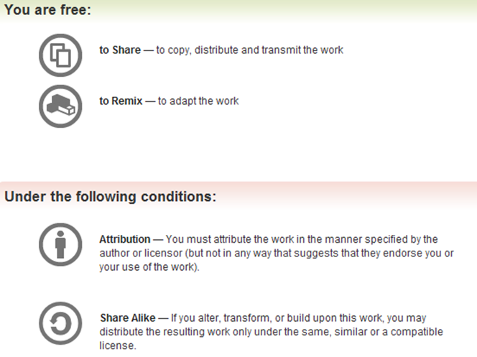
All materials is licensed under a Creative Commons “Share Alike” license
http://creativecommons.org/licenses/by-sa/3.0/

Slide 3
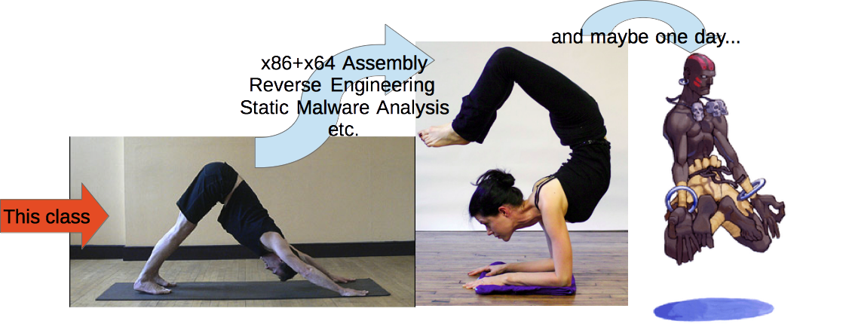

This class is for people
Who are interested in computer security
Who want to understand how malware works
Who want to start working on malware analysis, or who have recently started
Notes:
[Image Sources]
Left, http://test3-img.ehowcdn.com/article-new/ehow/images/a01/vv/m9/start-yoga-as-male-beginner-800x800.jpg
Middle-left, http://www.bbc.co.uk/northyorkshire/content/images/2006/04/05/downward_dog_400x300.jpg
Middle-right, http://www.spiritualhealingportal.com/images/photo/yoga9.jpg
Right, http://media.giantbomb.com/uploads/0/3/665089-a2dhalsim_thumb.png

Slide 4



Thanks to
Xeno Kovah, Ben Schmoker and Frank Poz for reviewing class materials
Ezra Moses, MITRE Institute tech support for setting up Ubuntu on the lab machines
Openmalware.org (offensivecomputing.net) for sharing samples, very good resource
Notes:
[Image Sources]
Top, http://www.thirdcoastrs.com/AP-353%20ASIAN%20GNOME%20-%20BOWING%204web.jpg
Middle, http://thumbs.dreamstime.com/thumblarge_510/127589357290776N.jpg

Slide 5
About me and you
BE in CS and MS in CE (but mostly CS background)
Security related work experience:
  Malware analysis and analysis tool development
  Security product reverse engineering
  Windows memory integrity measurement/verification
  Vulnerability research
  Network IDS/IPS signature development
Like hands-on work (coding, debugging, and reversing)
How about you? Any particular topic that you want to learn from this class?

Slide 6

Outline (1)
Part 1: Introduction
  Observing an isolated malware analysis lab setup
  Malware terminology
  RAT exploration - Poison IVY
  Behavioral analysis
Part 2: Persistence techniques
  Using registry keys
  Using file systems
  Using Windows services
Notes:
[Image Sources]
http://domaingang.com/wp-content/uploads/2012/10/domain-list.jpg

Slide 7
Outline (2)
Part 3: Maneuvering techniques
  (How malware strategically positions itself to access critical resources)
  DLL/code injection
  DLL search order hijacking...
Part 4: Malware functionality
  Keylogging, Phone home, Security degrading, Self-destruction, etc.

Slide 8
Outline (3)
Part 5: Using an all-in-one sandbox
  Cuckoo Sandbox
  Malware Attribute Enumeration and Characterization (MAEC)
  Different sandbox results comparison
Part 6: Actionable output
  Yara
  Snort

Slide 9
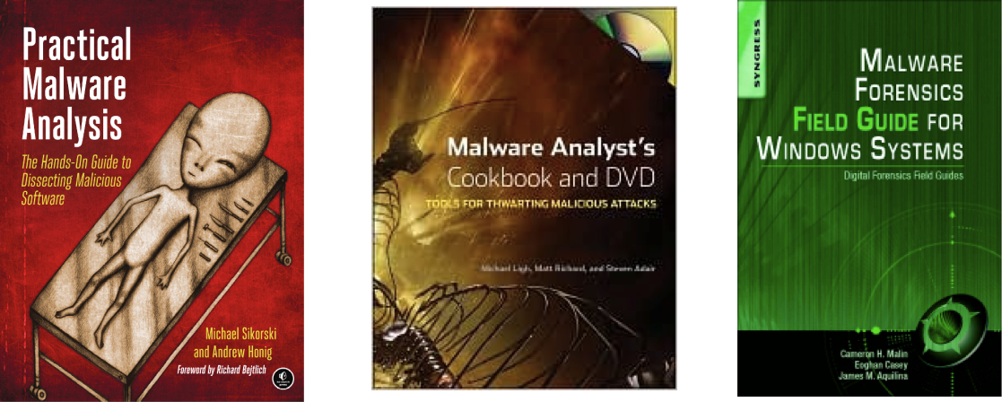
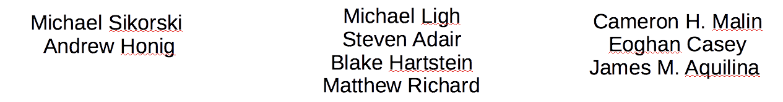
Books
Notes:
[Image Sources]
Left, http://nostarch.com/sites/default/files/imagecache/product_main_page/practical_malware_analysis.png
Middle, http://img2.imagesbn.com/images/77180000/77183529.JPG
Right, http://secure-ecsd.elsevier.com/covers/80/Tango2/large/9781597494724.jpg

Slide 10
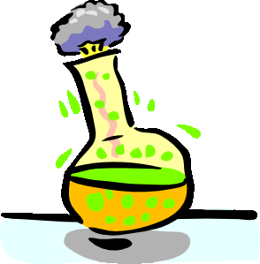

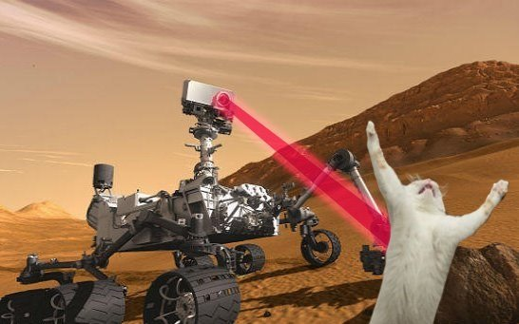
Class Conventions (1)
Slides with on the left corner means we will perform hands-on lab activities
Slides with include
answers to lab questions,
which often follows lab slides.
Please do not read the answers
before you finish a lab ;)
Slides with a green bar on top means it’s background context
Notes:
[Image Sources]
Top, http://thetalentcode.com/wp-content/uploads/119498535838791757esperimento_chimico_arch_01.svg_.med_.png
Middle, Microsoft clip art
Right, http://static.fjcdn.com/pictures/Curiosity+killed+the+cat.+source+smosh+facebook+page_06d5f5_3980829.jpg

Slide 11
Class Conventions (2)
Lines starting with
  C:\> means, you are asked to type in a DOS window on the Windows XP VM but it does not mean the command needs to be executed at the top level
  $ means, you are asked to type in a Linux terminal on the Ubuntu host machine

Slide 12
Class Materials
On the Ubuntu host machine
  $ cd ~/MalwareClass && ls
  $ cd ~/Updates && ls
  $ virtualbox &
On the victim VM
  On Desktop, open MalwareClass directory
Please see Notes for citation and check out the original works

