Slide 1
Malware Dynamic Analysis Part 2
Veronica Kovah
vkovah.ost at gmail
http://opensecuritytraining.info/MalwareDynamicAnalysis.html

Slide 2
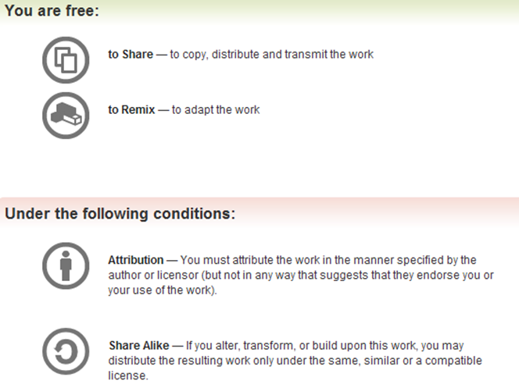
All materials is licensed under a Creative Commons “Share Alike” license
http://creativecommons.org/licenses/by-sa/3.0/

Slide 3
Where are we at?
Part 1: Introduction
Observing an isolated malware analysis lab setup
Malware terminology
RAT exploration - Poison IVY
Behavioral analysis
Part 2: Persistence techniques
Using registry keys
Using file systems
Using Windows services

Slide 4
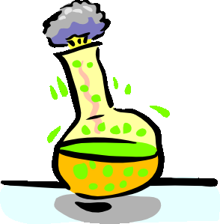
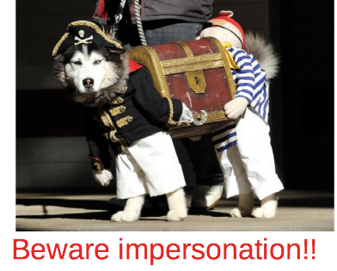
Identifying File Types
Identify 5 files' formats in ~/MalwareClass/samples/unknown/
By using file and TrID tools on Ubuntu
$ file ~/MalwareClass/samples/unknown/sample04.exe
$ cd ~/MalwareClass/tools/TrID/
$ ./trid ~/MalwareClass/samples/unknown/sample04.exe
By using TrIDNet on the victim VM
File extension
Don't rely on the file extension at all!!
exe, dll, pdf, doc, docx, xls, xlsx, ppt, pptx, jpg, etc.
This class focuses on malware in PE files (.exe, .dll, .sys, .scr, .ocx, etc.)
Notes:
[References]
Marco Pontello, TrID, http://mark0.net/soft-trid-e.html
[Image Sources]
Right, http://www.gadgetreview.com/wp-content/uploads/2012/05/Dog-Pirate-Costume-650x472.jpg

Slide 5
PE File
PE (Portable Executable) is the file format for Windows' executable binaries
You can find imported libraries/functions from the PE headers
3 conventional ways to use libraries
Dynamic link at compile time: .dll files are loaded into the memory space of a process at load time, and the main executable just calls the needed functions in the DLLs
LoadLibrary at run time: .dll files are loaded into the memory space of a process on run time
Static link at compile time: .lib files are combined into a PE file to make a big fat file that doesn't have external dependencies
Notes:
[References]
Matt Pietrek, An In-Depth Look into the Win32 Portable Executable File Format, http://msdn.microsoft.com/en-us/magazine/cc301805.aspx
Xeno Kovah, The Life of Binaries, http://opensecuritytraining.info/LifeOfBinaries.html

Slide 6
CFF Explorer
PE editor/analysis tool
Follow the mini-lab to take a look at calc.exe (Calculator) with CFF Explorer
Revert the victim VM to ‘RC8’ snapshot
Start CFF Explorer and open C:\Windows\System32\calc.exe
start button->CFF Explorer
How many functions are imported from Kernel32.dll?
List 3 functions imported from Kernel32.dll
Notes:
[References]
Daniel Pistelli, Explorer Suite, http://www.ntcore.com/exsuite.php

Slide 7
Packers
Originally used to compress executables back when disk space was at a premium
The executable then decompresses itself in memory and runs as normal
Nowadays they are mostly used for obfuscating binaries. Specifically since all the data for the original binary is compressed and/or encrypted, it prevents analysts from being able to infer things about the binary based on strings or function imports
UPX, ASPack, MPRESS, Themida, etc.
For dynamic analysis, since we will actually execute a sample, this is not a hindrance
Notes:
[References]
UPX, http://upx.sourceforge.net/
ASPack, http://www.aspack.com/aspack.html
MPRESS, http://www.matcode.com/
Themida, http://www.oreans.com/themida.php

Slide 8
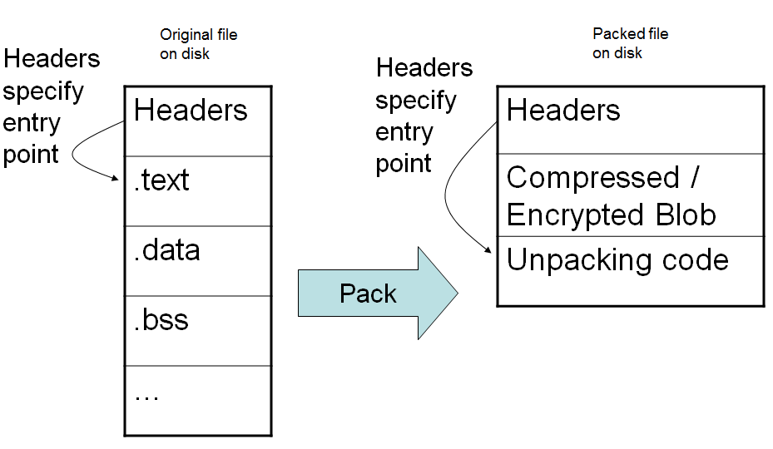
Packing: File On Disk
From the Life of Binaries class
Notes:
[References]
Xeno Kovah, The Life of Binaries, http://opensecuritytraining.info/LifeOfBinaries.html

Slide 9
Windows Library Files
DLL Name | Description
Kernel32.dll | Provides APIs for memory management, file operations, process/thread creation
User32.dll | Implements Windows USER component to provide graphical user interface such as menu bar, scroll bar, button, mouse pointer cursor, etc.
GDI32.dll | Exports Graphics Device Interface functions for drawing, text output, font management, etc.
Ntdll.dll | Interface to kernel for memory management, file operations, process/thread creation. It is not normally used by Windows applications directly
Ws2_32.dll | Exports Windows Sockets APIs
Wininet.dll | Provides high level network API such as HttpOpenRequest and FtpGetFile
Notes:
[References]
Michael Sikorski et al., Chapter 1. Basic Static Techniques, Practical Malware Analysis
Microsoft Windows library files, http://en.wikipedia.org/wiki/Microsoft_Windows_library_files
Windows USER, http://en.wikipedia.org/wiki/Windows_USER

Slide 10
Kernel
User
Ntdll.dll
NtWriteFile(){
mov eax, 0x112
int 0x2E OR sysenter
}
Kernel32.dll
WriteFile(){
Call IAT:NtWriteFile()
}
Start
Here
MyApp.exe
…
Call IAT:WriteFile()
…
From the Rootkits class
Notes:
[References]
Xeno Kovah, Rootkits: What they are, and how to find them, http://opensecuritytraining.info/Rootkits.html

Slide 11
The Registry (1)
Repository for configuration and control of Windows systems
Systemwide
Which device drivers to load, how to configure memory manager, process manager, etc.
Applications read systemwide settings
Per-user settings
Per-user preferences
Most-recently accessed documents
Notes:
[References]
Mark Russinovich et al., Chapter 4. Management Mechanisms, Windows Internals 4th Edition

Slide 12
The Registry (2)
Registry key is a container consisting of other keys (subkeys) or values
Registry value stores data whose type can be REG_SZ, REG_DWORD, REG_BINARY, etc.
5 Root Key | Stored Information | Link
HKEY_CLASSES_ROOT (HKCR) | File association and Component Object Model (COM) object registration (e.g ProgID and CLSID) | Merged
HKEY_CURRENT_USER (HKCU) | Data associated with the currently logged-on user | Yes
HKEY_LOCAL_MACHINE (HKLM) | Global settings for the machine | No
HKEY_USERS (HKU) | All the accounts on the machine | No
HKEY_CURRENT_CONFIG (HKCC) | Current hardware profile | Yes
Notes:
[References]
Registry Value Types, http://msdn.microsoft.com/en-us/library/windows/desktop/ms724884(v=vs.85).aspx
Predefined Keys, http://msdn.microsoft.com/en-us/library/windows/desktop/ms724836(v=vs.85).aspx
HKEY_CLASSES_ROOT Key, http://msdn.microsoft.com/en-us/library/windows/desktop/ms724475(v=vs.85).aspx
Merged View of HKEY_CLASSES_ROOT, http://msdn.microsoft.com/en-us/library/windows/desktop/ms724498(v=vs.85).aspx

Slide 13
The Registry (3)
REG_LINK
HKEY_CURRENT_USER is a link to HKEY_USERS\Security ID (SID) of current user
HKEY_CURRENT_CONFIG is a link to HKLM\SYSTEM\CurrentControlSet\Hardware Profiles\Current
HKLM\SYSTEM\CurrentControlSet is a link to HKLM\SYSTEM\ControlSet00X, where X is a number
Registry Hive
“Logical group of keys, subkeys and values in the registry that has a set of supporting files containing backups of its data” ^{[see notes]}
HKLM\SAM is stored in c:\windows\system32\config\SAM
Or constructed dynamically in memory
HKLM\HARDWARE is a volatile hive in memory only
Notes:
[References]
Mark Russinovich et al., Chapter 4. Management Mechanisms, Windows Internals 4th Edition
Registry Hives, http://msdn.microsoft.com/en-us/library/windows/desktop/ms724877(v=vs.85).aspx
Heige Klein, http://www.sepago.de/d/helge/2008/05/04/free-tool-list-registry-links-reglink

Slide 14
Checking The Registry
On the victim VM
Which registry location does HKCU point to?
Use Registry Editor (regedit.exe)
start→run→regedit
Use PsGetSid.exe to get the current user's SID
C:\> cd c:\SysinternalSuite
C:\> psgetsid.exe student
Nirsoft's regscanner.exe provides various search options

Slide 15
Persistence
Techniques to survive after reboot
Registry Key
File System
Startup locations
DLL search order hijacking
Trojanizing system files
Master Boot Record (MBR)
Basic Input/Output System (BIOS)
Uranium Enrichment Centrifuge PLCs :P
Notes:
[References]
Michael Sikorski et al., Chapter 11. Malware Behavior, Practical Malware Analysis
Nick Harbour, Malware Persistence without the Windows Registry, https://blog.mandiant.com/archives/1207
Reverend Bill Blunden, Chatper 6. Patching System Routines, The Rootkit Arsenal
Marco Guiliani, Mebromi: the first BIOS rootkit in the wild, http://www.webroot.com/blog/2011/09/13/mebromi-the-first-bios-rootkit-in-the-wild/
Nicolas Falliere et al., W32.Stuxnet Dossier, http://www.symantec.com/content/en/us/enterprise/media/security_response/whitepapers/w32_stuxnet_dossier.pdf

Slide 16
autoruns.exe
Provides comprehensive list of items which malware could use to be persistence
Notes:
[References]
Mark Russinovich et al., Autoruns, http://technet.microsoft.com/en-us/sysinternals/bb963902.aspx

Slide 17
autoruns.exe
On the victim VM
Select Options→Filter Options...→Include Empty Locations, then press F5 to refresh
You can see all locations that autoruns.exe checks
Deselect the option to have cleaner view for the rest of the class
Highlight a registry key, then double click
You can see the selected registry in Registry Editor
Click the different category tabs and look around how they are grouped

Slide 18
Where are we at?
Part 1: Introduction
Observing an isolated malware analysis lab setup
Malware terminology
RAT exploration - Poison IVY
Behavioral analysis
Part 2: Persistence techniques
Using registry keys
Using file systems
Using Windows services

Slide 19
Frequently Used Registry Key (1)
Administrator privilege is required to update HKLM (The list is not comprehensive nor more important than others, which are not listed here)
HKLM\SOFTWARE\Microsoft\Windows\CurrentVersion\Run
HKLM\SOFTWARE\Microsoft\Windows NT\CurrentVersion\Winlogon\”Shell” and “UserInit”
HKLM\SOFTWARE\Microsoft\Windows NT\CurrentVersion\Windows\”Appinit_Dlls”
HKLM\System\CurrentControlSet\Control\Session Manager\KnownDlls
HKLM\System\CurrentControlSet\Services
HKLM\Software\Microsoft\Windows NT\CurrentVersion\Image File Execution Options
HKLM\Software\Microsoft\Windows\CurrentVersion\Explorer\Browser Helper Objects

Slide 20
Frequently Used Registry Key (2)
Without administrator privileges, malware can persist with the following registry keys (The list is not comprehensive nor more important than others, which are not listed here)
HKCU\Software\Microsoft\Windows\CurrentVersion\Run
HKCU\Software\Policies\Microsoft\Windows\System\Scripts\Logon
HKCU\SOFTWARE\Microsoft\Windows NT\CurrentVersion\Winlogon\Shell

Slide 21
Observing “Image File Execution Options” registry key
Start regedit on the victim VM
Search the following registry key “HKLM\Software\Microsoft\Windows NT\CurrentVersion\Image File Execution Options”
Check if registry key taskmgr.exe exists
Run procexp.exe and select Options→Replace Task Manager
In the Registry Editor hit F5 to refresh the data
How could malware use this to persist?

Slide 22
Where are we at?
Part 1: Introduction
Observing an isolated malware analysis lab setup
Malware terminology
RAT exploration - Poison IVY
Behavioral analysis
Part 2: Persistence techniques
Using registry keys
Using file systems
Using Windows services

Slide 23
Persistence Using File System
Startup locations
For the logged-in user: %USERPROFILE%\Start Menu\Programs\Startup
For all users: %ALLUSERSPROFILE%\Start Menu\Programs\Startup
Check the environment variables
C:\> set
To see the above two environment variables only
C:\> echo %USERPROFILE%
C:\> echo %ALLUSERSPROFILE%

Slide 24
How does IMworm persist?
On the host machine, make sure inetsim is not running to observe the same results for this lab
$ sudo ps -ef | grep inetsim
$ sudo kill -9 {PID}
Using Autoruns on the victim VM
Start Autoruns, then File→save
Run IMworm/malware.exe
Press F5 to refresh Autoruns
File→Compare
Q1. How does the malware persist?
Observe what files are created in which directories
Observe what registry keys are created/modified

Slide 25
Answers for the IMworm Lab (1)
A1. Autoruns shows that malware persists by using the following registries and the Startup directory
lsass.exe is created in c:\WINDOWS\system
“c:\WINDOWS\system\lsass.exe” is added to HKLM\SOFTWARE\Microsoft\Windows NT\CurrentVersion\Winlogon\Userinit
“c:\WINDOWS\system\lsass.exe” is added to HKLM\SOFTWARE\Microsoft\Windows NT\CurrentVersion\Winlogon\Shell
msconfig.exe is created in C:\Documents and Settings\All Users\Start Menu\Programs\Start up
Notes:
[References]
Local Security Authority Subsystem Service, http://en.wikipedia.org/wiki/Local_Security_Authority_Subsystem_Service

Slide 26
Answers for the IMworm Lab (2)
lsass.exe and msconfig.exe are identical files.
You cannot see the two files via Windows Explorer or the DOS prompt. We will have a lab to analyze how the malware hides these files
Notice that the file names are chosen to impersonate existing MS files
lsass.exe: Local Security Authority Subsystem Service
msconfig.exe: System Configuration

Slide 27
Observing IMworm with Regshot
In this lab, we will use Regshot to observe how the malware persists
Using Regshot on the victim VM
Start Regshot (MalwareClass/tools/v5_regshot_1.8.3...)
Click 1st shot button→Shot
Run IMworm/malware.exe
Click 2nd shot button→Shot
Click Compare button
Compare the current results with the previous lab's results
Notes:
[References]
Regshot, http://code.google.com/p/regshot/

Slide 28
Where are we at?
Part 1: Introduction
Observing an isolated malware analysis lab setup
Malware terminology
RAT exploration - Poison IVY
Behavioral analysis
Part 2: Persistence techniques
Using registry keys
Using file systems
Using Windows services

Slide 29
Process
An instance of program code in execution
An executable file itself is not a process
Each process has own virtual memory address space and executable and library files, stacks, and heap reside on it
APIs to access to other process's memory
ReadProcessMemory, WriteProcessMemory, VirtualAllocEx
On process context switch, the state of the process and the resources are stored in Process Control Block for resumption later
Notes:
[References]
Silberscharz Galvin, Chapter 4. Processes, Operating System Concepts 5th Edition

Slide 30
Loader Overview
Virtual Memory
Address Space
Files on Disk
Kernel
WickedSweetApp.exe
Code
Data
Import MyLib1
Import MyLib2
Import LibC
Executable Loader
MyLib1.dll
Code
Data
Import MyLib2
…
Userspace
Stack
MyLib2.dll
Heap
Code
Data
…
WickedSweetApp.exe
LibC
MyLib1.dll
MyLib2.dll
30
Notes:
[References]
Xeno Kovah, The Life of Binaries, http://opensecuritytraining.info/LifeOfBinaries.html

Slide 31
Many processes, each with their own view of memory, and the kernel schedules different ones to run at different times
PID: 123
PID: 422
PID: 17
PID: 105
PID: 4
Kernel
Kernel
Kernel
Kernel
Kernel
(“System process”)
Userspace
Userspace
Userspace
Userspace
Stack
Stack
Stack
Stack
Heap
Heap
Heap
Heap
WickedSweetApp.exe
Explorer.exe
Calc.exe
iexplore.exe
Ntdll.dll
Ntdll.dll
Ntdll.dll
Ntdll.dll
MyLib1.dll
User32.dll
User32.dll
User32.dll
MyLib2.dll
Kernel32.dll
Kernel32.dll
Kernel32.dll
Currently Running Code

Slide 32
Checking Running Processes
On the victim VM
Use Task Manager
Start→Run...→type “taskmgr”
Select “Processes” tab
View→Select Columns...→check PID
Use SysInternals tools (a shortcut key is on the desktop)
Process Explorer (procexp.exe)
Process Monitor (procmon.exe)
Show registry, network, file system activities
What's the calc.exe's PID and which process is its parent?
Notes:
[References]
Mark Russinovich, Sysinternals Suite, http://technet.microsoft.com/en-us/sysinternals/bb842062.aspx

Slide 33
Finding DLL dependencies
Use CFF Explorer
Open c:\Windows\notepad.exe
How many DLLs are imported directly by notepad.exe?
Start notepad.exe
Use Process Explorer
On the menu bar, select
View→Show Lower Pane
View→Lower Pane View→DLLs
How many DLLs are loaded?
Another good tool: Dependency Walker

Slide 34
Microsoft Windows Services
Long-running executables without user interaction (like a *nix daemon)
Can be automatically started when the computer boots
CreateService() Windows API is called to register a service
Registered services can be found under the registry key HKLM\System\CurrentControlSet\Services
Notes:
[References]
Mark Russinovich et al., Chapter 4. Management Mechanisms, Windows Internals 4th Edition

Slide 35
SvcHost
C:\Windows\System32\svchost.exe is a generic host process for services that run from DLLs
Multiple instances are often running
One instance contains a group of services
Groups are listed in the registry key HKLM\Software\Microsoft\Windows NT\CurrentVersion\Svchost
It is common to have malware name itself svchost.exe but run from somewhere other than C:\Windows\System32, e.g. C:\Windows
Or alternatively they will just add a new DLL for the real svchost to run as a service

Slide 36
Checking Running Services
On the victim VM
Use Services, a Windows administrative tool
Start → Control Panel → Administrative Tools → Services
Use PsService.exe, a SysInternals tool
C:\> cd c:\SysinternalSuite
C:\> PsService.exe
Or you can also use a Windows tool, sc.exe
C:\> sc query state= all
Find “Terminal Services” service, what's its status?

Slide 37
Checking SVCHOST Services
How many svchost.exe instances are running?
Use Process Explorer
List service groups run by svchost.exe by checking the following registry key
HKLM\Software\Microsoft\Windows NT\CurrentVersion\Svchost
Look at the DcomLaunch group – it has two services, “DcomLaunch” and “TermService”
Check the following registry key to identify services
HKLM\System\CurrentControlSet\Services\TermService
Under the TermService registry key,
What is the ImagePath value?
In the subkey Parameters, what's in ServiceDLL value?

Slide 38
Checking Normal Services
Check the following registry key to identify services
HKLM\System\CurrentControlSet\Services\CiSvc
Under the CiSvc registry key.
What is the ImagePath value?
For this service the image path is the executable that's invoked directly
The Start value determines whether this starts at boot, when the user logs in, or only manually

Slide 39
How does Hydraq persist?
Using Autoruns on the victim VM
Start Autoruns, then File→save
Run Hydraq/malware.exe
Press F5 to refresh Autoruns
File→Compare
Q1. How does the malware persist?
Observe what files are created in which directories
Observe what registry keys are created/modified

Slide 40
Answers for the Hydraq lab
A1. Autoruns shows that malware persists by registering a service RaS???? (the last 4 characters are random)
Double click the newly added RaS???? service
ImagePath value's data is “%SystemRoot%\System32\svchost.exe -k netsvcs”
RaS???? runs as part of netsvcs service group
Parameters→ServiceDll value's data is “c:\windows\system32\rasmon.dll”
Check if RaS???? is added to HKLM\SOFTWARE\Microsoft\Windows NT\CurrentVersion\SvcHost\netsvcs

Slide 41
Observing Hydraq with Regshot (1)
In this lab, we will use Regshot to observe how the malware persists
Using Regshot on the victim VM
Start Regshot (MalwareClass/tools/v5_regshot_1.8.3...)
Click 1st shot button→Shot
Run Hydraq/malware.exe
Click 2nd shot button→Shot
Click Compare button

Slide 42
Observing Hydraq with Regshot (2)
Compare the current results with the previous lab's results
Notes
HKLM\SYSTEM\CurrentControlSet is a pointer to HKLM\SYSTEM\ControlSet00X
Check HKLM\System\Select
Start value
0: Boot (loaded by kernel loader)
1: System (loaded by I/O subsystem)
2: Automatic (loaded by Service Control Manager)
3: Manual
4: Disabled
Notes:
[References]
Start, http://technet.microsoft.com/en-us/library/cc959920.aspx

