Slide 1
Malware Dynamic Analysis Part 5
Veronica Kovah
vkovah.ost at gmail
http://opensecuritytraining.info/MalwareDynamicAnalysis.html

Slide 2
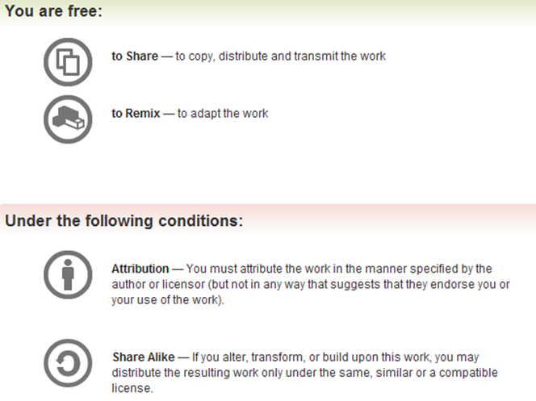
All materials is licensed under a Creative Commons “Share Alike” license
http://creativecommons.org/licenses/by-sa/3.0/

Slide 3
Where are we at?
Part 5: Using an all-in-one sandbox
Cuckoo Sandbox
Malware Attribute Enumeration and Characterization (MAEC)
Different sandbox results comparison
Part 6: Actionable output
Yara
Snort

Slide 4
Malware Analysis Sandbox
Provides file system, registry keys, and network traffic monitoring in controlled environment and produces a well formed report
Using a sandbox is more efficient and sometimes more effective
Configure your own sandbox such as Joebox, GFI Sandbox, and Cuckoo Sandbox.
Use public sandbox such as ThreatExpert, GFI ThreatTrack, and Anubis
Do not submit malware to a public sandbox if it reveals sensitive information about your organization and/or customer.
Notes:
[References]
Joe Sandbox, http://www.joesecurity.org/index.php/joe-sandbox-standalone
GFI Sandbox, http://www.gfi.com/malware-analysis-tool
Cuckoo Sandbox, http://www.cuckoosandbox.org
ThreatExpert, http://www.threatexpert.com/submit.aspx
GFI ThreaetTrack, http://www.threattrack.com/
Anubis, http://anubis.iseclab.org/
[Image Sources]
http://plannerwire.net/wp-content/uploads/2011/02/Playing-Sandbox_meeting_planners.gif

Slide 5
Cuckoo Sandbox
Open source automated malware analysis system
Analyzes PE, PDF, MS Office, PHP scripts, etc.
Outputs JSON/HTML/MAEC reports
Customization
Machinery Modules: virtualization software
Analysis Package: how to conduct the analysis procedure
Processing Modules: how to analyze raw results
Signatures
Reporting Modules
Auxiliary Modules: to be executed in parallel to every analysis
Notes:
[References]
Cuckoo Sandbox Book, http://docs.cuckoosandbox.org/en/latest
[Image Sources]
http://www.cuckoosandbox.org/graphic/cuckoo.png

Slide 6
Poison Ivy
Revert the victim VM to “cuckoo” snapshot
Open three terminals
Terminal #1, run inetsim
$ sudo inetsim
Terminal #2, run Cuckoo Sandbox v1.0
$ cd ~/MalwareClass/tools/cuckoo
Edit conf/auxiliary.conf (to sniff on vboxnet1)
$ python ./cuckoo.py
Terminal #3, submit piagent.exe to Cuckoo
$ cd ~/MalwareClass/tools/cuckoo/utils
$ python ./submit.py~/MalwareClass/samples/PoisonIvy/piagent.exe

Slide 7
Cuckoo Sandbox Results
Task results are generated under {Cuckoo Root}/storage/analysis/[task number]/
{Cuckoo Root} = ~/MalwareClass/tools/cuckoo
reports directory includes reports in different formats
logs directory includes raw data named <process id>.bson
shots directory includes screen shots
files directory includes dropped files. You can then run dropped executables through on their own
Submitted sample will be copied to {Cuckoo Root}/storage/binaries/MD5NAME, where MD5NAME is the md5 of the submitted sample
A symbolic link (named binary) exists under the task result directory

Slide 8
Poison Ivy Results
$ cd ~/MalwareClass/tools/cuckoo/storage/analysis/1/reports
$ firefox report.html &
$ gedit report.json &
$ firefox report.maec-4.0.1.xml &

Slide 9
Malware Attribute Enumeration and Characterization (MAEC)
“a standardized language for encoding and communicating high-fidelity information about malware based upon attributes such as behaviors, artifacts, and attack patterns”
A standard is necessary to provide a common way to share malware analysis results among organizations to avoid duplicate, inaccurate work
https://maec.mitre.org/about/index.html
Notes:
[References]
MAEC, https://maec.mitre.org

Slide 10
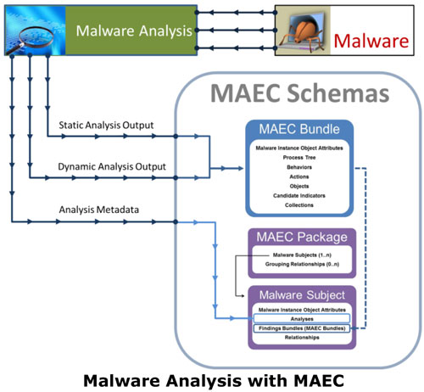
MAEC (2)
Supported tools
Native: Cuckoo Sandbox
Via a translator: Anubis, ThreatTrack, ThreatExpert
Would be very useful to search openmalware.org samples based on attributes, could make a new search engine: “Ask MAEC!”
Notes:
[References]
MAEC Use Cases, http://maec.mitre.org/language/usecases.html
MAEC in Use, http://maec.mitre.org/about/inuse.html
[Image Sources]
http://maec.mitre.org/language/images/usecases-1.jpg

Slide 11
Parite (1) – Cuckoo v1.0
We will learn how to interpret a sandbox’s results based on what we have learned so far
Submit parite sample to Cuckoo Sandbox v1.0
$ cd ~/MalwareClass/tools/cuckoo/utils
$ python submit.py ~/MalwareClass/samples/parite/malware.exe
Kill the cuckoo.py process with ctrl-c once the analysis is done

Slide 12
Parite (2) - Cuckoo v0.5
Install Cuckoo Sandbox v0.5’s agent on the victim VM
Copy agent.py from the host machine to the victim VM
Use WinSCP on the victim VM
It’s located at ~/Updates/cuckoo/agent/agent.py in the host machine
Open a DOS terminal and start the agent C:\python27\python.exe c:\agent.py
Make a snapshot with the name “cuckoo05”

Slide 13
Parite (3) - Cuckoo v0.5
Terminal #2, run Cuckoo Sandbox v0.5
$ cd ~/Updates/cuckoo
$ python ./cuckoo.py
Terminal #3, submit parite sample to Cuckoo
$ cd ~/Updates/cuckoo/utils
$ python submit.py ~/MalwareClass/samples/parite/malware.exe

Slide 14
Parite (4)
Consult public sandbox results as well under ~/Updates/public_sandbox_results/parite/
anubis: $ evince ./anubis/report.pdf
threatexpert: $ firefox ./threatexpert/report.html
threattrack: $ evince ./threattrack/analysis.pdf
Q1. (SKIP) Does this drop files with randomized names?
Q2. How does it persist?
Q3. How does it maneuver?
Q4. Does it have self-avoidance?
Q5. Does it self-destruct?
Q6. Where does it try to connect to?

Slide 15
Answers for Parite Lab (1)
A2.
Created “Run” registry value HKLM\Software\Microsoft\Windows\CurrentVersion\RUN\fmsiocps to “C:\Windows\fmsiocps.exe”
Modified “AppInit_Dlls” registry value HKLM\Software\Microsoft\Windows NT\CurrentVesion\Windows\AppInit_Dlls to “fmsiocps.dll”

Slide 16
Answers for Parite Lab (2)
A3.
Dll injection via AppInit_Dlls
Dll injection using CreateRemoteThread() API
OpenProcess (PID=1760)→VirtualAllocEx → NtWriteVirtualMemory →CreateRemoteThread
Now you are interested in the process name of PID 1760 :D
A4. Yes, mutex “Residented” is created
A5. Yes, the submitted sample file was deleted
A6. 192.5.5.241 (per ThreatExpert result)

Slide 17
Nitol
Consult “Parite” lab slides for how to submit the sample to both versions of Cuckoo Sandbox and answer the following questions about Nitol:
Q1. (SKIP) Does this drop files with randomized names?
Q2. How does it persist?
Q3. How does it maneuver?
Q4. Does it have self-avoidance?
Q5. Does it do self-destruction?
Q6. Where does it try to connect to?

Slide 18
Answers for Nitol (1)
A2.
Registered an auto-start service
HKLM\System\CurrentControlSet\Services\Distribuijq
Created lpk.dll under multiple directories for DLL search order hijacking; this technique also makes the malware persistent
A3. DLL search order hijacking (lpk.dll)

Slide 19
Answers for Nitol (2)
A4. Yes, Distribuijq (per ThreatExpert result)
ShimCacheMutex is opened by side effect
A5. Yes, it moves itself to C:\DOCUME~1\student\LOCALS~1\Temp\SOFTWARE.LOG
A6. tutwl.3322.org
Microsoft took down the entire 3322.org (google “Operation b70”) but they came back online after agreeing to clean out malware users
Notes:
[References]
Andrew Davis, Leveraging the Application Compatibility Cache in Forensic Investigations, https://dl.mandiant.com/EE/library/Whitepaper_ShimCacheParser.pdf

Slide 20
IMworm
Consult “Parite” lab slides for how to submit the sample to both versions of Cuckoo Sandbox and answer the following questions about IMworm:
Q1. (SKIP) Does this drop files with randomized names?
Q2. What's the file's original name?
Q3. How does it persist?
Q4. Does it have self-avoidance?
Q5. Does it do self-destruction?
Q6. Where does it try to connect to?

Slide 21
Answers for IMworm (1)
A2. worm2007.exe
A3. Using file system and registry key
Created C: \Document and Settings\All Users\Start Menu\Programs\Startup\MSconfig.exe, which is a copy of the malware itself
Set registry values HKLM\SOFTWARE\Microsoft\Windows NT\CurrentVersion\Winlogon\Userinit & Shell to C:\Windows\system\lsass.exe, which is a copy of the malware itself

Slide 22
Answers for IMworm (2)
A4. No apparent mutex
ShimCacheMutex is opened by side effect
A5. No apparent self-destruction
A6. Tried to get http://quicknews.info/YMWorm.exe

