Slide 1
Malware Dynamic Analysis
Part 6
Veronica Kovah
vkovah.ost at gmail
http://opensecuritytraining.info/MalwareDynamicAnalysis.html

Slide 2
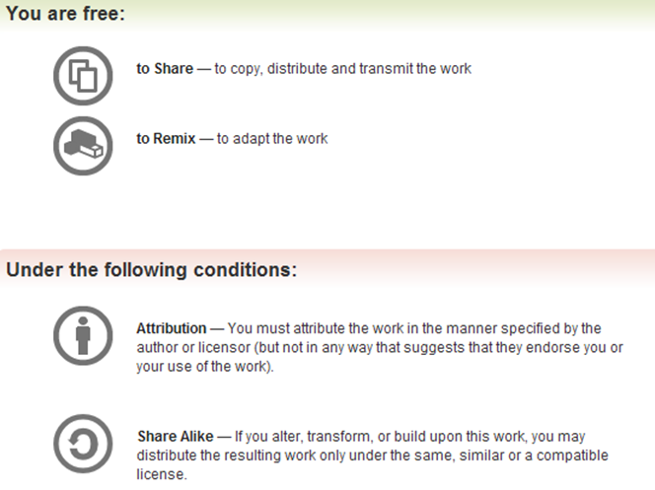
All materials is licensed under a Creative Commons “Share Alike” license
http://creativecommons.org/licenses/by-sa/3.0/

Slide 3
Where are we at?
Part 5: Using an all-in-one sandbox
  Cuckoo Sandbox
  Malware Attribute Enumeration and Characterization (MAEC)
  Different sandbox results comparison
Part 6: Actionable output
  Yara
  Snort

Slide 4
Yara
Open source tool to identify and classify malicious files based on textual or binary patterns
Light-weight way of performing signature checks
Can be used for any binary data (exe, pdf, pcaps, etc)
Useful in an email server for tip-offs, and filtering
Notes:
[References]
yara-project, http://code.google.com/p/yara-project/

Slide 5
Yara Signature (1)
rule silent_banker : banker
{
meta:
description = "This is just an example"
thread_level = 3
in_the_wild = true
strings:
$a = {6A 40 68 00 30 00 00 6A 14 8D 91}
$b = {8D 4D B0 2B C1 83 C0 27 99 6A 4E 59 F7 F9}
$c = "UVODFRYSIHLNWPEJXQZAKCBGMT"
condition:
$a or $b or $c
}
http://code.google.com/p/yara-project/

Slide 6
Yara Signature (2)
Identifier
  Any alphanumeric characters and underscores but cannot start with a number
String definition
  A string identifier starts with $ followed by alphanumeric character and underscores
  Values
    Text strings enclosed by double quotes
    Hex strings enclosed by curly brackets
    Regular expression enclosed by slashes
Notes:
[References]
Víctor Manuel Álvarez, YARA User's Manual 1.6, http://code.google.com/p/yara-project/downloads/detail?name=YARA%20User%27s%20Manual%201.6.pdf

Slide 7
Yara Signature (3)
Condition operators
  Boolean
    and, or, not
  Relational
    >=, <=, <, >, ==, !=
  Arithmetic
    +, -, *, /
  Bitwise
    &, |, <<, >>, ~
Counting strings
  strings:
    $a = “text”
  condition:
    #a == 6

Slide 8
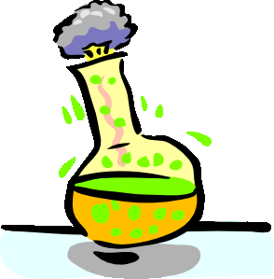
Bot classification
We will make a Yara signature for a bot malware in this lab
Identify characteristic strings from the agobot sample
  $ strings ~/MalwareClass/samples/agobot/malware.exe > /tmp/agobot.txt
Make an Yara signature using combination of the identified strings
  Create a file (e.g. detection.yar) for the signature
Run Yara
  $ yara detection.yar ~/MalwareClass/samples/agobot/malware.exe

Slide 9

One possible answer
rule Agobot
{
strings:
$msg = "PhatBNC" nocase
$conf1 = "ddos_maxthreads"
$conf2 = "scan_maxsockets"
$conf3 = "scan_maxthreads"
$cmd1 = "do_stealth"
$cmd2 = "do_avkill"
$cmd3 = "do_speedtest"
$cmd4 = "bot_topiccmd"
$cmd5 = "bot_meltserver"
$cmd6 = "bot_randnick"
condition:
(#msg > 10) and $conf1 and $conf2 and $conf3
and (any of ($cmd1, $cmd2, $cmd3, $cmd4, $cmd5, $cmd6))
}

Slide 10
Where are we at?
Part 5: Using an all-in-one sandbox
  Cuckoo Sandbox
  Malware Attribute Enumeration and Characterization (MAEC)
  Different sandbox results comparison
Part 6: Actionable output
  Yara
  Snort

Slide 11

Snort (1)
Open source network intrusion
detection/prevention tool (NIDS/NIPS)
3 modes
  Sniffer: read packets off the network and display on the screen
  Packet Logger: logs the packets to a log file
  NIDS: analyze network traffic and match with user-defined signatures and make actions (e.g. alert, drop, etc.)
Notes:
[References]
Snort, http://www.snort.org/
Snort Users Manual 2.9.4, http://s3.amazonaws.com/snort-org/www/assets/166/snort_manual.pdf
[Image Sources]
http://4.bp.blogspot.com/_2IvFH57W8Hc/TPfpzDtwQwI/AAAAAAAAAFk/YFngxr8jLgI/s1600/snort_large.gif

Slide 12
Snort (2)
Preprocessors provides various pre-detection processing
  Frag3: IP defragmentation
  Stream5: TCP/UDP session tracking
  RPC decode: RPC record defragmentation
  HTTP Inspect: HTTP fields identification, normalization etc.
A preprocessor may depends on the other
Supports custom preprocessor

Slide 13
Snort Signatures (1)
Detection can be implemented in preprocessor, Snort (text) rules, or SO (shared object) rules.
Snort rules
Rule headers
  Rule action tells Snort what to do (e.g. alert, log, drop)
  IP addresses in Classless Inter-Domain Routing (CIDR) notation
  Port numbers
  Direction operator should be “->” or “<>” (bidirectional)
SRC IP PORT
DEST IP PORT
alert tcp any any -> any 80 (msg:”No deadbeef”; content:”DEADBEEF”;)
Notes:
[References]
Pre-Compile SO Rules: Supported Platforms, https://www.snort.org/snort-rules/shared-object-rule

Slide 14
Snort Signatures (2)
Rule options
  Separated by semicolon (;)
  msg: message to be displayed in log
  content: ascii string or binary to match
  content modifiers
    nocase, depth, offset, distance, within, http_header, http_client_body, http_uri, file_data
  pcre: match can be written in perl compatible regular expression
  flags: checks TCP flag bit
  sid: required field, Snort rule identifier

Slide 15
Detect Beaconing Traffic (1)
We will write a NIDS signature for this lab on the host machine
  $ wireshark ~/MalwareClass/misc/darkshell.pcap &
Lab is already configured
  Fixed the permission violation error
  $ sudo usermod -aG snort student
  Set HOME_NET to 192.168.57.0/24 in
  /etc/snort/snort.conf
Let's run Snort with the existing Snort rules
  $ snort -c /etc/snort/snort.conf -r
  ~/MalwareClass/misc/darkshell.pcap -l /tmp

Slide 16
Detect Beaconing Traffic (2)
Open a new file to write a Snort rule
You can start with the following template and fill up detection rule options
alert tcp any any -> any any ( <your rule options here> )
To test your rule
$ snort -c <rule file path> -r <pcap file path> -l /tmp

Slide 17
Phone Home Format
// Darkshell bot-to-CnC comms
struct {
// Header:
DWORD dwMagic; // always 0x00000010 for Darkshell
// Obfuscated section:
char szComputerName[64]; // Name of infected host, NULL-terminated/extended
char szMemory[32]; // Amount of memory in infected host; format "%dMB"; NULL-terminated/extended
char szWindowsVersion[32]; // Specifies version of Windows; one of: Windows98, Windows95,
// WindowsNT, Windows2000, WindowsXP, Windows2003, or Win Vista;
// NULL-terminated/extended
char szBotVersion[32]; // Specifies version of bot; NULL-terminated/extended;
DWORD szUnknown1[4]; // ??? - Always NULL-terminated 'n'
// Binary section:
char szPadding1[32]; // Filled with 0x00 bytes
WORD wUnknown2; // ??? - We have seen 0x00A0, 0x00B0, and 0x00C0
WORD wUnknown3; // ??? - Always 0xFD7F
char szPadding2[20]; // Filled with 0x00 bytes
WORD wUnknown4; // ??? - Always 0xB0FC
BYTE cUnknown5; // ??? - We have seen 0xD6, 0xD7, 0xE6, 0xE7, and 0xF1
BYTE cZero; // Always 0x00
DWORD dwSignature[8]; // Always 0x00000000, 0xFFFFFFFF, 0x18EE907C, 0x008E917C,
// 0xFFFFFFFF, 0xFA8D91&C, 0x25D6907C, 0xCFEA907C
};
http://ddos.arbornetworks.com/2011/01/darkshell-a-ddos-bot-targetting-vendors-of-industrial-food-processing-equipment/

Slide 18
What we learned in Part 1
How an isolated malware analysis lab is setup
  Ubuntu, Virtualbox, inetsim
Malware terminology
  Bot, RAT, etc.
  Heterogeneous vendor naming
RAT exploration - Poison IVY
  Implant and Controller
Behavioral malware analysis approaches
  Diffing, monitoring, API tracing, etc.

Slide 19
What we learned in Part 2
Background concepts
  PE files, Windows Libraries, Processes, Registry, Windows Services
  TrID, Process Explorer, Process Monitor, PsService, CFF Explorer
Persistence techniques
  Registry, File system, Windows services
  Autoruns, Regshot

Slide 20
What we learned in Part 3
Background concepts
  API, Threads
Maneuvering techniques
(How malware strategically positions itself to access critical resources)
  DLL and code injection, DLL search order hijacking, IAT, EAT, and inline hooking
  Procmon, WinApiOverride, Winobj

Slide 21
What we learned in Part 4
Background concepts
  How to analyze network traffic with Wireshark
Malware functionality
  Key logging
  Phone home
  Beaconing
  Self-Avoidance
  Security degrading
  Simple stealth techniques (non-rootkit techniques)
    Self-destruction
    Hiding files

Slide 22
What we learned in Part 5/6
Using an all-in-one sandbox
  Good for automation and the first cut
  How to use Cuckoo Sandbox
  How to analyze sandboxes’ results
  Malware Attribute Enumeration and Characterization (MAEC)
Actionable output – detection signatures
  Snort: network intrusion detection/prevention system
  Yara: Malware identification and classification tool

Slide 23
All samples are from openmalware.org
101d00e77b48685bc02c1ff9672e1e94 eldorado/malware.exe
9250281b5a781edb9b683534f8916392 agobot/malware.exe
3349eab5cc4660bafa502f7565ff761d conficker/malware.exe
9f880ac607cbd7cdfffa609c5883c708 Hydraq/malware.exe
a10b9b75e8c7db665cfd7947e93b999b parite/malware.exe
d7578e550c0a4d4aca0cfd01ae19a331 spyeye/malware.exe
df150905e2537db936ef323f48e2c1bb magania/malware.exe
4a29d41dfda9cfcbcde4d42b4bbb00aa Darkshell/malware.exe
1a36fb10f0a6474a9fea23ee4139d13e nitol/malware.exe
db19c23c5f77a697500075c790cd331c IMworm/malware.exe
a9a2fb545068995f30df22f8a3f22a10 onlinegames/2/malware.exe
f1bae35d296930d2076b9d84ba0c95ea onlinegames/1/malware.exe

Slide 24
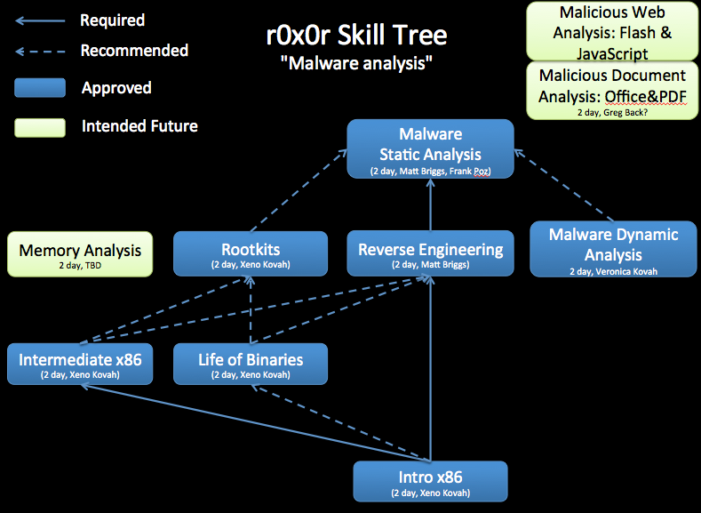
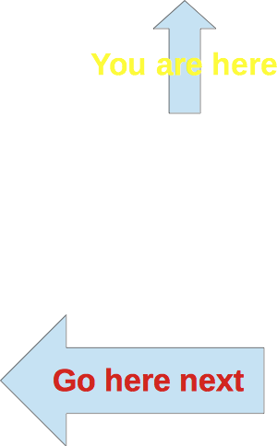

Slide 25
The End

