Slide 1
Network Monitoring & Forensics
Jim Irving

Slide 2
Agenda
Network Forensics
Usefulness
Intro to forensic data types
Working with PCAP data
What it looks like
How to interpret it
How to get it
Working with flow data
What it looks like
How to interpret it
How to get it
Host Forensics
PCAP and flow recap
Working with logs and alerts
What they look like
How to interpret them
Getting them all in one place
SIEM’s and their familiars
Fielding a monitoring solution

Slide 3
Introduction
Network forensics is the capture, recording, and analysis of network events in order to discover the source of security attacks or other problem incidents.
Course Goal: To give the student a broad understanding of the main types of network forensic data gathering and an introduction to low level concepts necessary for a proper understanding of the task of performing network forensics. After completion, a student should be able to plan and execute a reasonable network monitoring program and use the gathered forensic data to perform a wide range of investigations.

Slide 4
Benefits
Why do you care
If this isn’t in your toolbelt already, you’ll get a lot of new capabilities when you go on a project.
If you’re already seasoned, you can learn from everyone else here.
Why do I care
The Socratic method works.

Slide 5
Disclaimer
The information and views presented during this course concerning software or hardware does not in any way constitute a recommendation or an official opinion. All information presented here is meant to be strictly informative. Do not use the tools or techniques described here unless you are legally authorized to do so.

Slide 6
Agenda
Day 1
Agenda and motivation
Intro to forensic data types
Working with PCAP data
What it looks like
How to interpret it
How to get it
Working with flow data
What it looks like
How to interpret it
How to get it
Day 2
PCAP and flow recap
Working with logs and alerts
What they look like
How to interpret them
Getting them all in one place
SIEM’s and their familiars
Fielding a monitoring solution

Slide 7
Performing Network Forensics What do we need to know?
What does our network even look like?
Are we being attacked?
Is anything compromised?
How did it get compromised?
Where are the attacks coming from?

Slide 8
Performing Network Forensics What do we have to work with?
Loads of recorded network data (PCAP and flow)
Logs and alerts from security products
Logs from applications

Slide 9
Main types of forensic data
We’ll be grouping forensic data into three main data types based on the tools and analysis techniques used
Full packet capture (PCAP)
Flow data (netflow, IPFIX, etc.)
Log / alert data (giant text files)

Slide 10
Forensic Data Type #1 Full Packet Capture (PCAP)
A full copy* of a set of packets travelling over the network
The most complete form of monitoring possible
Takes up a lot of space
*it’s possible to do partial captures, too

Slide 11
Forensic Data Type #2 Flow Data
Records of conversations on the network
Stores info such as time, duration, number of packets, total bytes sent, received, etc.
Does not contain any application layer data
Good for understanding how data flows on your network quickly

Slide 12
Forensic Data Type #3 Log/Alert data
Any text that gets written to a file that we can monitor
Some of it is very important (firewall alerts, availability alerts, etc.) and some of it is less so
We have to set up things to produce GOOD alerts
There are a lot of log sources, so some sort of management is preferable

Slide 13
Forensic Bonus Data People
This is when someone comes up to you and tells you that they can’t connect to the network, the mail server is down, etc.
Pretty darned close to real time
Hard to digitize…

Slide 14
Forensic Data Type Comparison How do they differ?
 | Collection | Storage | What it can reveal | Tools used to Analyze | Typical use
PCAP | Done by machines on the network, taps, and anything that can read 1’s and 0’s off the network | Consumes lots of disk space. For a project of any size, you’ll have to spend money on a storage solution. | Exactly what went across the network. | Wireshark, Firewalls, Content Filters, etc. | Deep dive, finding out exactly what commands were issued and how compromises occurred.
Flow | Done by apps on computers on the network or by decent routers | Low space requirements, so it’s easy. Generally unified for large networks. | Patterns about conversations, amount of data sent, time, etc. | Silk, Argus, etc. | Retrospective analysis, finding attackers and compromised machines.
Log/Alert | Done by whatever app creates them, wherever it’s set to write them. | Generally either left where they were created or consolidated by a log manager or SIEM | Events that occur and are noticed by some piece of software, e.g. attacks, outages, etc. | Splunk, Arcsight, SIEM’s | Alerting us to major problems when they occur (or as soon as our log handling methodology shows it to us)

Slide 15
So what do we capture and when?
Whatever they’ll let you capture
A lot of times the people/systems that you’re working with will be totally opposed to you actually using the network for anything because the world might end or people might explode. I’ll try to give you ways to work your way around this.

Slide 16
So what do we capture and when?
First get your easy wins
Turn on flow data recording on your switches and routers and pump it to some machine.
Figure out what log and alert sources are already present and get them into a log manager.
Now you’ve got some flow data and some log/alert data! For free(-ish)!

Slide 17
So what do we capture and when?
Find out what you’re missing
Look at your network diagram and if there’s any part where you’re not getting data from, toss a sensor out there.
Look at your data and find trouble spots
Find events/hosts of interest by analyzing the flow and log data that you’re getting. (More on how to do this later.)

Slide 18
So what do we capture and when?
Increase monitoring in trouble spots
Grab PCAP data from links where you think compromises are occurring.
Set up IDS/SIEM/etc. products to produce alerts tailored to the problems you see.
Throw host based monitoring apps on suspect machines.

Slide 19
So what do we capture and when? Breakdown
Log/alert data: Whenever possible, and particularly once you’ve tweaked your alerts.
Flow data: Whenever possible. It’s easy to capture and easy to work with.
PCAP data: When you need to look closer than flow or log/alert data allows OR when you have tons of resources to blow on disk space.

Slide 20
How you’ll typically start an investigation
SIEM pops up an alert to your screen, fellow coworker, cell phone, etc saying “Something is horribly wrong on host X!”
You then go look at other logs on host X. Maybe you find something scary. Maybe you can’t see the forest for the trees.
Then you open up your flow data for the time in question. See any patterns? Identify suspicious conversations, capture the packets (if you can) and investigate further. Mount some sort of defense against whatever you find.
OR

Slide 21
How you’ll typically start an investigation
Somebody hands you a big pile of PCAP or flow data.
Put it through an app to create flow data or IDS alert data (if you don’t have it already)
Look for patterns using some analysis tool. Focus down to specific data using those patterns or human reports of problems and get as close to the problem as possible.
Figure out what kind of monitoring you need to get the data you truly need to find the problem, catch the bad guy, or get the conviction. Then go deploy it, assuming you can get client buy-in. (or… create ticket, walk away)

Slide 22
How we’re going to learn this
We’ll be exploring the data types starting at the most finely grained (PCAP) and working up, so that we’ll better understand the limitations of each type, even though in a real investigation, you’d end up using the data in the reverse order.

Slide 23
Agenda
Day 1
Agenda and motivation
Intro to forensic data types
Working with PCAP data
What it looks like
How to interpret it
How to get it
Working with flow data
What it looks like
How to interpret it
How to get it
Day 2
PCAP and flow recap
Working with logs and alerts
What they look like
How to interpret them
Getting them all in one place
SIEM’s and their familiars
Fielding a monitoring solution

Slide 24
PCAP data Things to think about
PCAP is a straight copy of ALL* network traffic that flows through the pipe for as long as you keep recording. That can be a LOT of data!
How long do you need to listen?
Can your NIC capture it fast enough?
Can your hard drive store it fast enough?
How long can you listen before you have to free up space?

Slide 25
PCAP data Line speed and storage
Link type | mb/s | ~MB/s | ~GB/day
Ethernet | 10 | 1 | 87
Fast Ethernet | 100 | 10.1 | 875
OC-12 | 622.08 | 63 | 5,446
Gigabit Ethernet | 1,000 | 101.3 | 8,755
OC-48 | 2,488.32 | 252.1 | 21,785
10 Gigabit Ethernet | 10,000 | 1,013.3 | 87,547
Keep in mind, a single width PCI slot can handle, at most, 133 MB/s. Past that you’ll need PCI-E NIC’s to capture.
Also, commodity hard drives are going to have a maximum write speed around 125 MB/s on a good day.
You’ll likely need to either limit your capture time, or spend some money on a RAID solution.

Slide 26
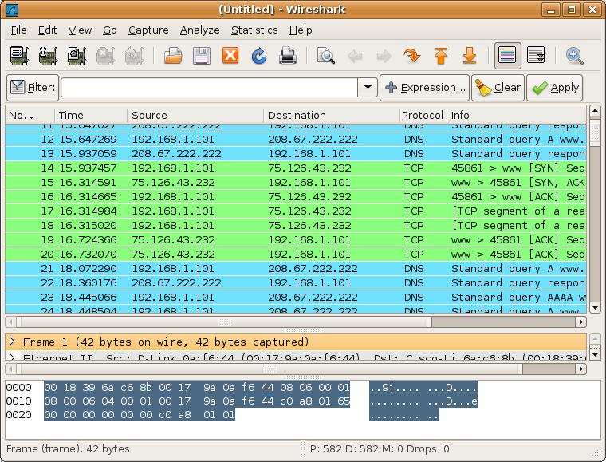
PCAP data What does it look like?
Source: screenshot of wireshark interface

Slide 27
PCAP data How we get it
Network taps
Devices that are connected between two other network devices
Passively monitors traffic, and reproduces it on one or more monitor ports
Available for all media types and speeds

Slide 28
PCAP data How we get it
Network taps - keywords
Half-duplex: Multiple monitor ports only reproduce one side of the conversation at once
Regenerating: Incoming data is copied to multiple monitor ports (for multiple receivers)
Aggregating: Receives on multiple ports and combines the data onto a single (full-duplex) monitor port (see problems with oversubscription and timing?)
Fail open/closed: when depowered, open lets traffic through, closed does not

Slide 29
PCAP data How we get it
Network taps – dealing with fiber
Fiber taps actually split a portion of the light used to carry the signal, causing the signal downstream to be weaker. When dealing with this, there’s a lot more math involved. You will need to calculate a “Loss Budget”. This will involve the transmitter power, receiver sensitivity, cable loss, distance, tap characteristics, and anything else that will affect photons. If we end up having lots of extra time, we’ll cover this.

Slide 30
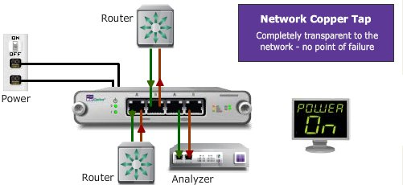
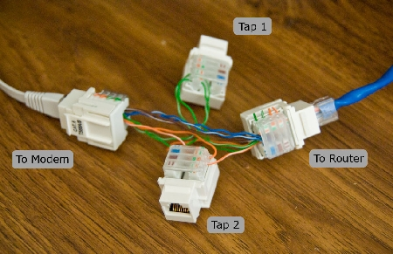
PCAP data How we get it
Network taps
Source: netoptics.com, hackaday.com
Notes:
Sources: netoptics, hackaday.com

Slide 31
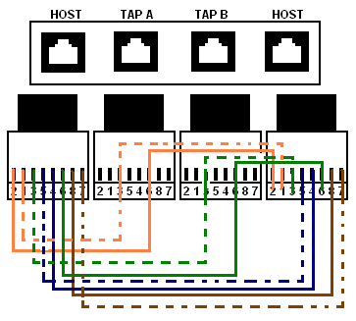
PCAP data How we get it
Making a field expedient cat5 tap
Instructions can be found at
http://thnetos.wordpress.com/2008/02/22/create-a-passive-network-tap-for-your-home-network/
Or
http://hackaday.com/2008/09/14/passive-networking-tap/
Source: thnetos.wordpress.com
Notes:
Sources: netoptics, hackaday.com

Slide 32
PCAP data How we get it
SPAN ports
Ports on most enterprise grade switches/routers which mirror all* traffic on other ports.
Will drop packets if there’s not enough bandwidth on the port.
You’ll still need a machine connected to it to do the capture.
DON’T FORGET TO DO TX AND RX!
Make your own impromptu SPAN port with the ARP flood trick ☺

Slide 33
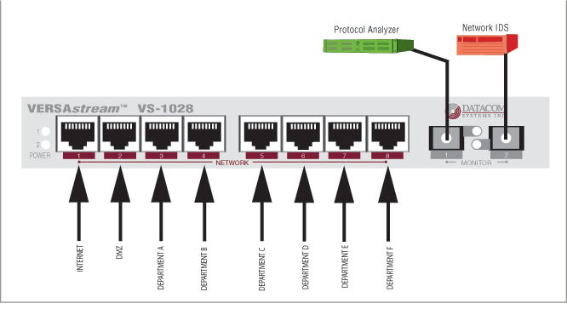
PCAP data How we get it
SPAN ports
Source: datacomsystems.com
Notes:
Source: datacomsystems.com

Slide 34
PCAP data How we get it
Direct capture from the NIC on a machine
You’ll always do this at some point.
Very easy and convenient in low traffic settings. Just start capturing to the hard drive and stop when you feel like it.
Storage becomes an issue when (traffic * time) > hard drive capacity OR (traffic / time) > hard drive write speed
Can only see the traffic going to that host (so use taps or SPAN ports to gain visibility)

Slide 35
PCAP data How we get it
Direct capture from the NIC on a machine
tcpdump
wireshark
Netwitness
etc.

Slide 36
Network coverage – an aside
Network coverage is how much of the traffic on the network that your sensor network can see. You can have different types of monitoring on different parts of the network, but the main idea is to avoid blind spots. This applies to PCAP, flow, logs, and everything else.

Slide 37
Network coverage – an aside
Since different segments of the network carry different traffic, where you decide to place you sensors will determine what you can see.
What would you see on the outside of the border firewall that you wouldn’t see inside? What kinds of things do you WANT to see?

Slide 38
Network coverage – an aside
Things to think about
NAT – solve with placement of sensors
VPN – solve with placement of sensors or VLAN specific configuration
Multiple border gateways – solve using channel bonding/aggregation

Slide 39
Network coverage – an aside
On the outside of your firewall, you see the attacks that didn’t get through in addition to the things that did. On the inside of your firewall you see things that actually got through. The outside tells you who’s attacking and how. The inside tells you what attacks worked.

Slide 40
Network coverage – an aside
In addition to the amount of the network that’s covered, we can also think about WHEN the network is being covered.
Sometimes you’ll want PCAP data for a couple of hours, but couldn’t handle 24/7. When might that be? Could you perhaps trigger full PCAP for a time based on some event? Absolutely!

Slide 41
PCAP data Hands on
Now that we know where, why, and how to collect PCAP data, let’s go do some captures.

Slide 42
PCAP data Doing analysis - Wireshark
Wireshark is your good old fashioned, run of the mill, go-to, protocol analyzing, packet capturing, file carving buddy. Learn to love it.

Slide 43
PCAP data Doing analysis - Wireshark
What we’ll be doing today
Learning the layout of the interface
Capturing PCAP data
Looking at the structure of packets
Filtering packets to find interesting things
Following a TCP session
Carving files
Reading emails

Slide 44
PCAP data Doing analysis - Wireshark
Sources for pcaps
http://wiki.wireshark.org/SampleCaptures
http://packetlife.net/captures/
http://www.pcapr.net
http://www.icir.org/enterprise-tracing/download.html
Your own machine

Slide 45
PCAP data Doing analysis - Wireshark
So that’s Wireshark. Pretty nice, huh? When it comes to finding out exactly how your machine got pwned (aka owned, pwnt, etc.), it’s pretty effective.
Also, the functionality of Wireshark can be extended by coding up plugins and decoders, and anything else you want. It’s open source!

Slide 46
PCAP data Doing analysis - Wireshark
But what if we don’t have time to do all that poking about and sifting through packets? Is there a better way to look through a big pile of PCAP data?
I thought you’d never ask…

Slide 47
PCAP data Doing analysis - Netwitness
What we’ll be doing today
Learning the interface
Importing some PCAP data
Doing (almost) everything we just did in Wireshark in less time than it took us before
Catching things that we might have missed before

Slide 48
PCAP data Doing analysis - Netwitness
Netwitness is a tool for getting a quick picture of what someone was doing on the network, especially if you’re going after less advanced threats, like insider threats or the average criminal.
Currently there’s a freeware version and a paid version. Give it a try next time you get stuck during an investigation. Often you can catch certain clues via the session based view that you wouldn’t simply by digging through PCAPs.

Slide 49
PCAP data Doing analysis – Other tools
In addition to sitting down and doing deep dive analysis on PCAP data by hand, we can also run it through automated processes (sometimes even at line speed!) to do all sorts of other stuff. This is how firewalls and IDS work, after all.
Depending on the audience, this is where we discuss our organization’s custom tools ☺

Slide 50
PCAP data Generating flow and alert data
Useful when someone hands you a big wad of PCAP and you have no other data
Can be done when you’ve got data from before you fielded your flow monitoring or alert generating apps (IDS, firewall, etc.)
Makes analysis of large data sets easier since it’s faster to look at coarse grained data.
We’ll cover this when appropriate.

Slide 51
PCAP Data Conclusion
When you have PCAP you can see pretty much everything.
It’s very heavy weight whenever you start dealing with enterprise level networks.
It’s the only way you’ll see what’s being said on the network, but it’s not as good as flow or log/alert data for figuring out what’s important to look at.

Slide 52
Agenda
Day 1
Agenda and motivation
Intro to forensic data types
Working with PCAP data
What it looks like
How to interpret it
How to get it
Working with flow data
What it looks like
How to interpret it
How to get it
Day 2
PCAP and flow recap
Working with logs and alerts
What they look like
How to interpret them
Getting them all in one place
SIEM’s and their familiars
Fielding a monitoring solution

Slide 53
Flow data Things to keep in mind
This is easy data to get, so make sure you do.
Better used to figure out where to look, than to figure out exactly what happened.
Even when you’re not on an investigation, you should collect flow data to do baselining.
Visualization helps a lot.

Slide 54
Flow data What is flow data?
There’s some variation, but generally a record contains the following:
Source and dest ip
Source and dest port
Protocol
Start time + (duration | end time)
# of packets
# of bytes
Directionality? Depends on format.

Slide 55
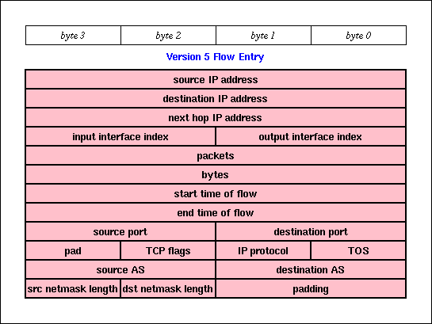
Flow data Netflow v5 protocol
Source: caida.org/tools/utilities/flowscan/arch.xml
Notes:
Source: Plonka, Flowscan: A network traffic flow reporting and visualization tool. Note, this does not include header.

Slide 56
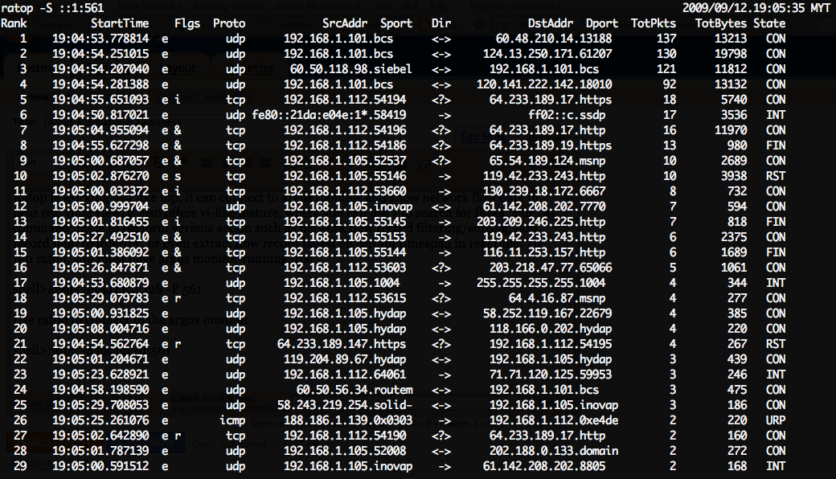
Flow data Command line output

Slide 57
Flow data Directionality
Some types of flow records are unidirectional (SiLK, rw tools), and others are bidirectional (argus, ratools, original flow data).
Unidirectional flow data has a separate record for both sides of the conversation. This is how Cisco NetFlow v5, v9, and IPFIX records are specified.
Bidirectional flow data combines both sides into one record, usually having extra fields for “# of sender packets”, “# of destination bytes”, and other things that would get muddled by combining two unidirectional flows.

Slide 58
Flow data Directionality
Depending on what you need, you can convert between bidirectional and unidirectional using whatever tool is appropriate to your data set.

Slide 59
Flow data Cutoff and Aging
Until conversations end, their flow data sits in the router/switch/etc. memory, taking up space (DOS?). So if we’ve got lots of very long lived flows or flows that didn’t end well (FIN ACK) we need to free up that memory and write the flows.
For long flows, we have a configurable time (say 30 minutes) after which we write a record and start a new one. Figuring out how long the flow actually was will require massaging your data.
For broken flows, another cutoff time (maybe 15 seconds?) will clear them out.

Slide 60
Flow data Sampling
When there’s too much traffic for your switch, NIC, or whatever to handle, sampling is used to throttle the workload.
Instead of every packet being recorded in a flow (sample rate = 1 out of 1), we take 1 out of N packets, make flow records, and then scale the appropriate values by N.
We will miss flows due to this ☹ but for very large throughputs it’s necessary. Also, N is not always constant over time.

Slide 61
Flow data Formats
And then there are different formats…
Cisco NetFlow v5 and v9 are very common. V5 will only do IPv4, though.
IPFIX is a lot like v9 plus some interesting fields. Open protocol put out by IETF.
sFlow hardware accelerated, forced sampling, mainly an HP thing.
And there are others, but we’ll focus on v5/v9 and IPFIX.

Slide 62
Flow data Formats
There isn’t a current standard for how to store flow data on disk, so different software suites will store it differently to suit their search and compression capabilities. Choose your software suite based on what formats it can consume, and be prepared to perform a conversion if you switch.

Slide 63
Flow data Capturing
Switches and routers
Flow data is gathered by the network hardware, and then sent over the network to one or more listeners.
To set up collection and forwarding, look up instructions particular to your device and the revision of its OS (typically Cisco IOS).
Remember, this is going over the network, so it can be intercepted, falsified, or blocked by attackers, outages, and misconfigurations!

Slide 64
Flow data Capturing
Machines on the network
Creates flow data based on what network traffic that machine can see.
Can either generate flow data and forward it to another collector, store it locally, or both.
Also possible to collect flow data from other machines or network hardware.
Eventually your flow data will have to end up somewhere. You want that somewhere to be handy to your analysts.

Slide 65
Flow data Analyzing with argus
Argus is another popular tool which is much easier to deploy, so we’ll be using it to do some sleuthing.
Become familiar with a few of the tools
Locate a scanning machine
Detect beaconing
Find activities by a compromised machine
Find routing misconfigurations

Slide 66
Flow data Capturing with SiLK
YAF – yet another flowmeter
Produces IPFIX data from files or network traffic
Can write to disk or push out over network
Lightweight, easy to install
Works well with SiLK tools

Slide 67
Flow data Capturing – consolidating in SiLK
rwflowpack
Part of the SiLK toolset
Designed to receive input from multiple sensors and build a consolidated repository for analysis
Just one of the pieces of a full sensor network.

Slide 68
Flow data Analyzing with SiLK
SiLK tools
Produced by CERT NetSA
Relatively easy to use
We’ve already been using them and have done a decent amount of writing on how to use them (check my transfer folder)

Slide 69
Flow data SiLK tools - conclusion
Free, very powerful, extensible, pretty easy to use.
Command line tools are great for things that we have running as daemons, but for visualizing flow data we can find a better interface. With the right tools, we can add better visualization.

Slide 70
Flow data Visualizing
Open source
Afterglow + graphviz: cheap, but too much work to set up
Free/commercial
Scrutinizer: quick and easy, consumes pretty much any flow data, free version is limited to 24 hours of data
Lynxeon: belongs in the SIEM category, visualization tool is worth a mention though, 60 day trial
Notes:
http://www.cisco.com/en/US/prod/iosswrel/ps6537/ps6555/ps6601/networking_solutions_products_genericcontent0900aecd805ff72b.html

Slide 71
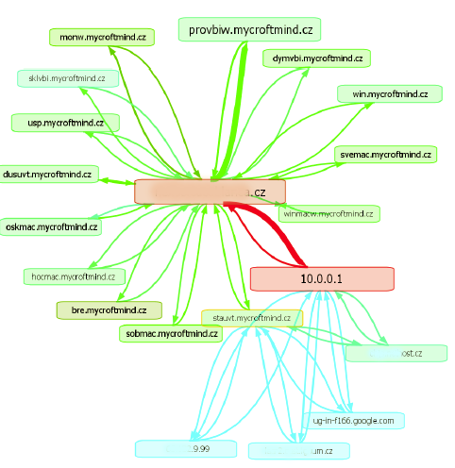
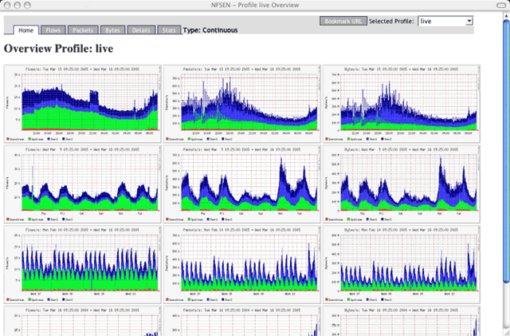
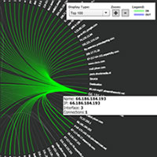
Flow data Visualization
http://www.networkuptime.com/tools/netflow/
http://freshmeat.net/search/?q=netflow&section=projects
TONS more
Source: plixer.com, vizworld.com, networkuptime.com
Notes:
Source: plixer.com, vizworld.com, networkuptime.com

Slide 72
Flow data Continuing research
Flowcon, Centaur Jam, etc.
Come join us!
Share your tools!
Statistical anomaly/group detection
Complicated math
New-ish technology, but worth a look if you’ve got a pile of netflow data that you’re sitting on.

Slide 73
Agenda
Day 1
Agenda and motivation
Intro to forensic data types
Working with PCAP data
What it looks like
How to interpret it
How to get it
Working with flow data
What it looks like
How to interpret it
How to get it
Day 2
PCAP and flow recap
Working with logs and alerts
What they look like
How to interpret them
Getting them all in one place
SIEM’s and their familiars
Fielding a monitoring solution

Slide 74
PCAP reCAP
Most granular data we can collect
Takes a lot of resources to gather
Great for finding out how machines got pwned
Bad for figuring out what’s going on quickly
Can be converted into flow and alert data with the right tools

Slide 75
FLOW reFLOW
Info about conversations on the network
Cheap and easy to collect
Quick to analyze with the right tools
Different analysis suites, formats

Slide 76
Learning styles to use
More tool use?
More theory?
More collaboration!
You’ve got threats. I’ve got solutions.

Slide 77
Questions about anything up to now?

Slide 78
Agenda
Day 1
Agenda and motivation
Intro to forensic data types
Working with PCAP data
What it looks like
How to interpret it
How to get it
Working with flow data
What it looks like
How to interpret it
How to get it
Day 2
PCAP and flow recap
Working with logs and alerts
What they look like
How to interpret them
Getting them all in one place
SIEM’s and their familiars
Fielding a monitoring solution

Slide 79
Log/Alert data What are we dealing with?
Logs are any continual text output stored by applications or devices in the process of their functioning.
Alerts are specialized logs produced by something when certain conditions occur that we had the foresight to set an alarm for. If a log is created saying that something we’ve set up a trigger for has happened, then we’ll get an alert.

Slide 80
Log data Typical sources
Web server
Web proxy
DNS
Operating system (/var/log/*)
SMTP
Whatever you’re using to manage logons
Building access controls
HVAC/ICS/SCADA/Power

Slide 81
Alert data Typical sources
IDS
Firewall
Host based IDS
SIEM (Security Information & Event Manager)
Your server uptime and HA (high availability) stuff
What else?
Typically alerts are being produced because triggers that we’ve written are being tripped. If you’re not getting useful alerts, then you’ve configured something wrong!

Slide 82
Alert data Redundant IDS, etc?
Extra configuration
Add personnel
When one dies- “Multiple TippingPoint IPS Malformed Packet Detection Bypass Vulnerability”
Increased attack surface
More filtration, more rules, etc.
Notes:
Tipping point exploit example, http://www.securityfocus.com/bid/19125

Slide 83
Alert data Let’s go set up some triggers
Here’s how you go about getting good alerts
Find an incident that you want to be alerted about
Research what went over the network or got written to a log when that incident was occurring
Write a rule in your IDS or whatever to create an alert when that traffic is seen
Test your rule
Continue testing…

Slide 84
Alert data What will we use as a trigger?
Snort!
Open source, support packages available
Basis for Sourcefire appliances
Very popular, good support among SIMs
Very robust community providing rules, extensions, add ons, and anything else you can think of
Rule set subscriptions can be had from Sourcefire, and rules become free 30 days after they’re made available to subscribers

Slide 85
Alert data How Snort works
Reads traffic from network
Decodes packets
Performs stream reassembly
Applies filters
Upon the first filter match, an alert is generated

Slide 86
Alert data Writing Snort rules
Fire up your VM’s. Time to go to work.
We’re going to look at how snort rules are written, what alerts look like, and how to write our own rules.

Slide 87
Alert data Writing better rules
Write to the vulnerability, not the exploit
Understand the base rate fallacy
Inspection chain
Test and tune your alerts
Dumbpig, external checking tools, profiling

Slide 88
Log/Alert data Priority of sources
Obviously not all data is equal, so here’s the basic order of which ones you should concentrate on first.
Alerts from security products (e.g. IDS, SIEM)
Netflow data, so you can track what those alerts are related to
OS event logs, so you can see what happened when those alerts were caused
What else?
Notes:
Network device logs, vpn, all apps, proxies, dns, http, doors, hvac

Slide 89
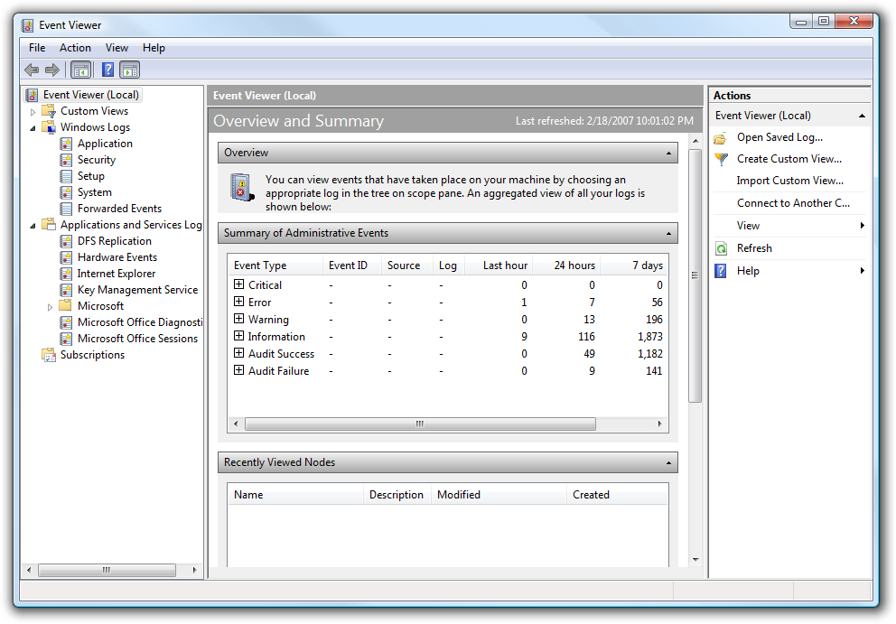
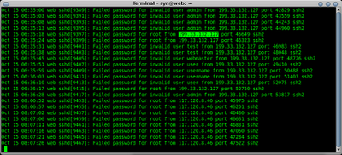
Log/Alert data What does it look like?
Tons of formats, most of them customizable and flexible, some standards
Often application specific
Hard to read straight through, even using search…
Source: screenshot from Windows Event Viewer

Slide 90
Alert data Event formats
CEE – Common Event Expression
CVE – Vulnerability
CCE – Configuration
CWE – Weakness
CPE – Platform
CAPEC – Attack Patterns
…

Slide 91
Log/Alert data Dealing with disparate data
There’s too much text and not enough context. We need a way to get to the important logs and alerts quickly.
That’s why we use log managers and SIEM’s. They import the logs into one place, give us some pretty graphs, and (hopefully) make sure that the important entries catch our attention quickly.

Slide 92
Log/Alert data SIM, SEM, SIEM…
SIM = Security Information Management
SEM = Security Event Management
SIEM = Security Information and Event Management
SIM is for bookkeeping, SEM is for correlating data into events, and SIEM is a combo of the two.
Notes:
Sim is normalized, log managers are not

Slide 93
Log/Alert data SIEMs
Perform event correlation, reduce false positives
Help filter logs and alerts to bring us the important data quickly under one monitor
Typically have a method for reading lots of log types
This is what you have running on a dedicated monitor in your lab for a technician to keep an eye on and call you when it turns red

Slide 94
Log/Alert data Some common managers/SIEMs
Splunk: free version will read 500MB/day of logs, has a decent interface to set up log parsing, technically just a log manager
ArcSight: popular SIEM suite, has its own log manager, could have a class just on Arcsight alone (and there are). BIG player in government and commercial sector, owing greatly to pushbutton compliance auditing.
RSA enVision: another big player, focused on appliances
Disclaimer: the information expressed here is meant only to be informative and does not imply a recommendation
Notes:
http://www.gartner.com/technology/media-products/reprints/nitrosecurity/article1/article1.html

Slide 95
Log/Alert data Using Splunk
Splunk is common enough that it’s worth your time to get to know. So for that reason, we’ll now take a quick look through its capabilities and the resources available for learning Splunk 4.0.
Notes:
http://www.gartner.com/technology/media-products/reprints/nitrosecurity/article1/article1.html

Slide 96
Log/Alert data Some common managers/SIEMs
http://www.gartner.com/technology/media-products/reprints/nitrosecurity/article1/article1.html
Source: Gartner (May 2010)
Notes:
http://www.gartner.com/technology/media-products/reprints/nitrosecurity/article1/article1.html
Source: Gartner (May 2010)

Slide 97
Log/Alert data Arcsight event priority
Recalculated by ESM
Factors in:
Normalized Severity S [0—10]
Model of Confidence MCR [0—1] & Relevance
Security History H [1—1.3]
Asset Criticality C [0.8—1.3]
Priority = S * MCR * H * C
Notes:
http://www.gartner.com/technology/media-products/reprints/nitrosecurity/article1/article1.html

Slide 98
Log/Alert data Arcsight event priority
Priority = S * MCR * H * C
MCR is the only factor that can drop P to 0
Fully modeled asset, zero ports, zero vulnerabilities
MCR = 0 → Priority = 0
False positives fed into SIEM force H > 1
Avalanche multiplication of false positives
Worst case: False positives + no asset modeling
Source: arcsight console interface
Notes:
http://www.gartner.com/technology/media-products/reprints/nitrosecurity/article1/article1.html

Slide 99
Log/Alert data Using SIEMs effectively
Understand the complexity of the tools you are using and allocate personnel appropriately.
Standardize what information your organization collects. Prioritize which information you set up collection for.
Regularly look at your flow data. Don’t depend on the SIEM to see everything.
Write new alert rules to handle your own particular threats.
Notes:
http://www.gartner.com/technology/media-products/reprints/nitrosecurity/article1/article1.html
Siems need to be taught about your organization sql xpcmdshell example in dmz vs internal

Slide 100
Deploying a monitoring solution
What you need to monitor a network will vary greatly depending on the size of the network, its purpose, the threats it will face, the technology used to build it, and countless other things.
Now go to www.ratemynetworkdiagram.com and let’s play pin the sensor on the network.
Notes:
http://www.gartner.com/technology/media-products/reprints/nitrosecurity/article1/article1.html

Slide 101
Extended topics (if we have time)
Privacy/confidentiality laws
Attacking network monitoring devices
Evading network monitoring
Wireless monitoring
What products have you used and which ones did you like?
What else?

Slide 102
The End!
Please give feedback!
Tell your friends!

